Slide 1


Supply Chain Management
Prepared by Dr. Tarek Mohamed
MGM 660
Lecture 4

Slide 2


Designing distribution networks in the Supply Chain
Lecture 4
MGM 660
Prepared by
Dr. Tarek Mohamed
www.midocean.km

Slide 3

Course Agenda
Chapter
01
1- Identify the key factors to be considered when designing
a distribution network.
2- Discuss the strengths and weaknesses of various
distribution options.
3- Understand how e-business have affected the design of
distribution networks in different industries.
www.midocean.km

Slide 4
The Role of Distribution in the Supply Chain
Distribution – the steps taken to move and store a product from the supplier stage to the customer stage in a supply chain
Distribution- is a key driver of the overall profitability of a firm because it affects both the supply chain cost and the customer value directly
Choice of distribution network can achieve supply chain objectives from low cost to high responsiveness
In the apparel retail industry, for example, distribution affects about 35 percent of the revenue (including its influence on markdowns and lost sales).
www.midocean.km

Slide 5
The Role of Distribution in the Supply Chain
Until 2007, Dell distributed its PCs directly to end consumers, whereas companies such as HP distributed through resellers.
Dell customers waited several days to get a PC, whereas customers could walk away with an HP computer from a reseller.
Starting in June 2007, Dell also started selling its PCs through retailers such as Walmart.
In the late 1990s, Gateway opened Gateway Country stores, wherein customers could examine the products and have salespeople help them configure a PC that suited their needs. Gateway, however, chose to sell no products at the stores; all PCs were shipped directly from the factory to the customer.
www.midocean.km

Slide 6
Factors influencing distribution network Design
Distribution network performance evaluated along two dimensions
  Customer needs that are met
  Cost of meeting customer needs
Evaluate the impact on customer service and cost for different distribution network options
Profitability of the delivery network is determined by revenue from meeting customer needs and network costs
Inbound transportation costs are costs incurred in bringing material into a facility
Outbound transportation costs are costs incurred in sending material out of a facility
www.midocean.km

Slide 7
Factors influencing distribution network design
Elements of customer service influenced by network structure:
Response time
Product variety
Product availability
Customer experience
Order visibility
Returnability
www.midocean.km

Slide 8
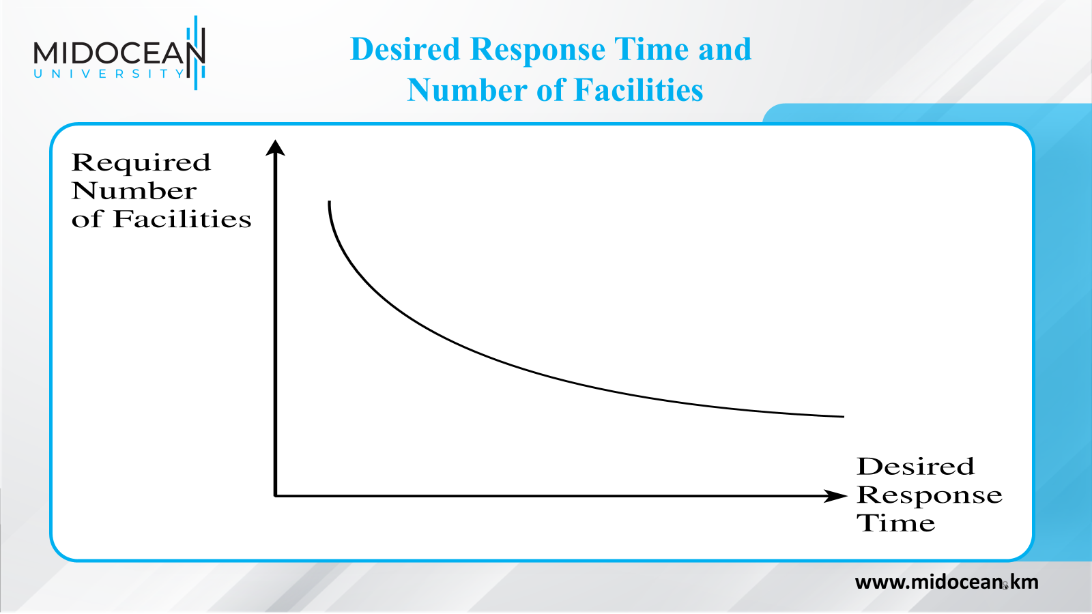

Slide 9
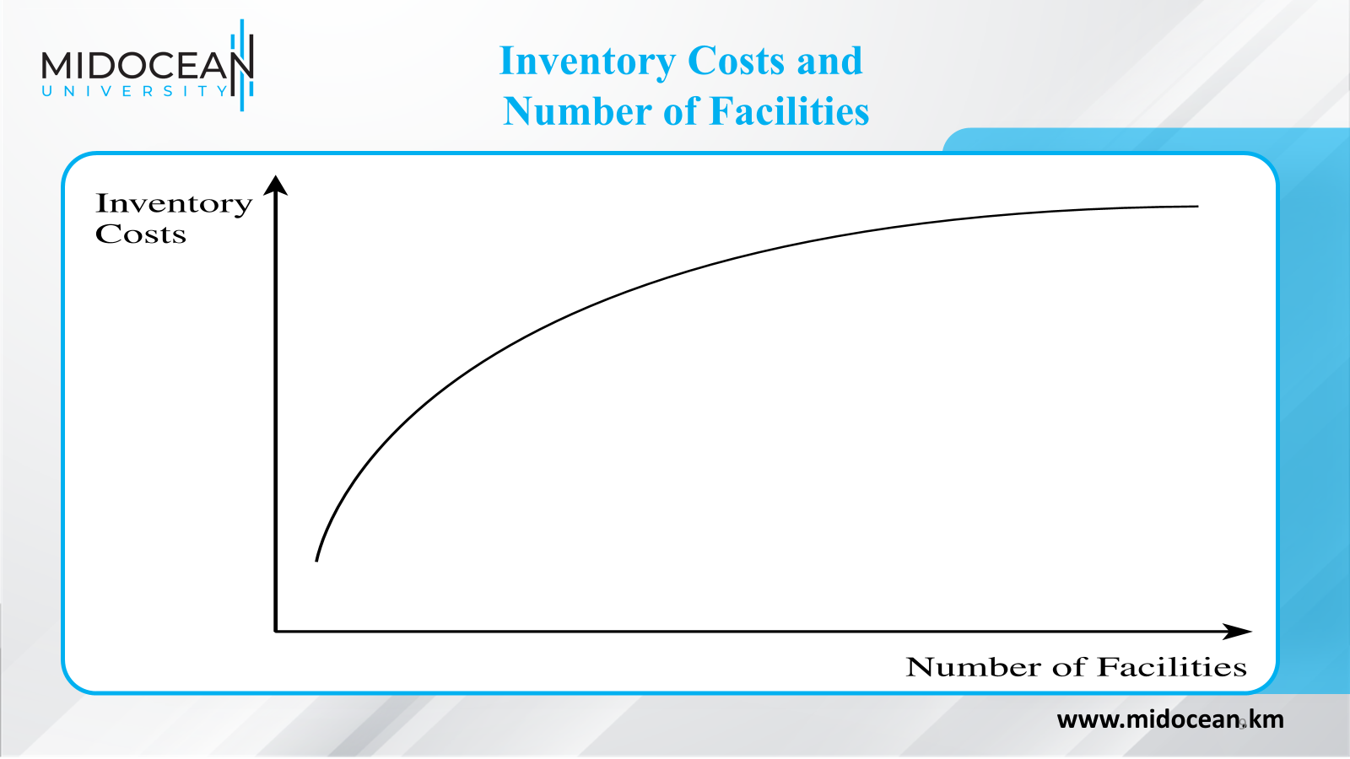

Slide 10
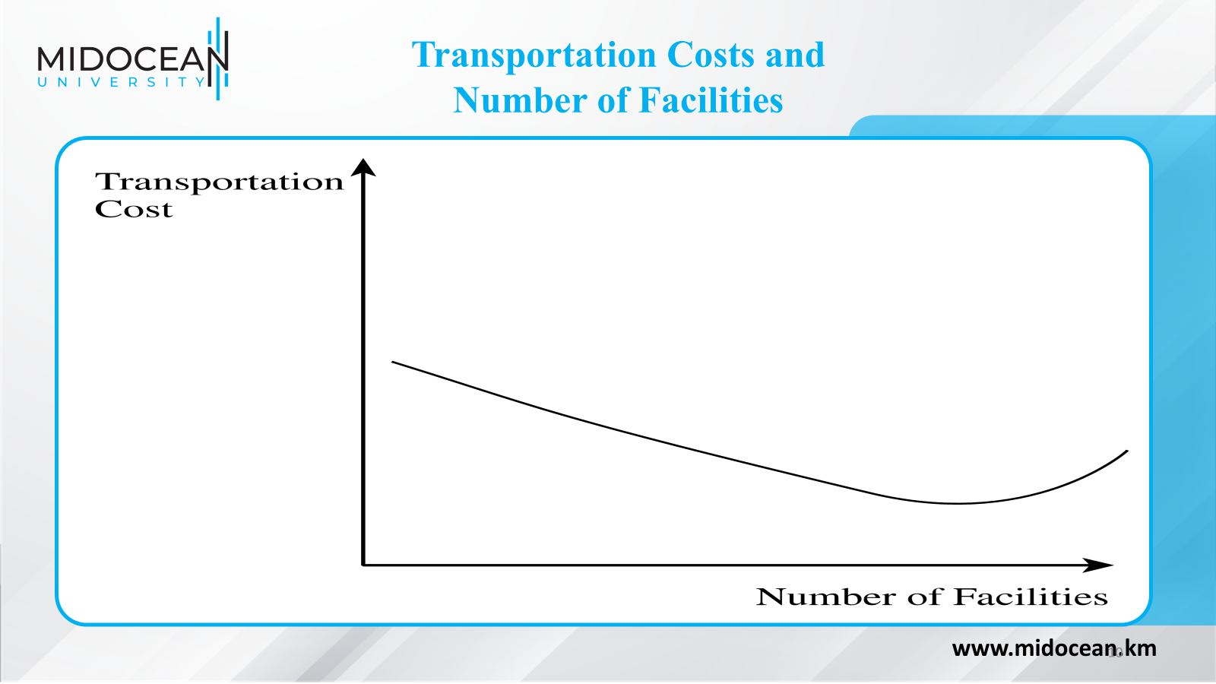

Slide 11
Factors Influencing
Distribution Network Design
Supply chain costs affected by network structure:
  Inventories
  Transportation
  Facilities and handling
  Information
  The choice of the distribution network can be used to achieve supply chain objectives such as low cost and high responsiveness
  Total logistics costs for a supply chain network are a sum of inventory, transportation, and facility costs
www.midocean.km

Slide 12
Design Options for a Distribution Network
Distribution network choices from the manufacturer to the end consumer
Two key decisions
  Will product be delivered to the customer location or picked up from a prearranged site?
  Will product flow through an intermediary (or intermediate location)?
www.midocean.km

Slide 13
Design Options for a Distribution Network
One of six designs may be used
  Manufacturer storage with direct shipping
  Manufacturer storage with direct shipping and in-transit merge
  Distributor storage with carrier delivery
  Distributor storage with last-mile delivery
  Manufacturer/distributor storage with customer pickup
  Retail storage with customer pickup
www.midocean.km

Slide 14
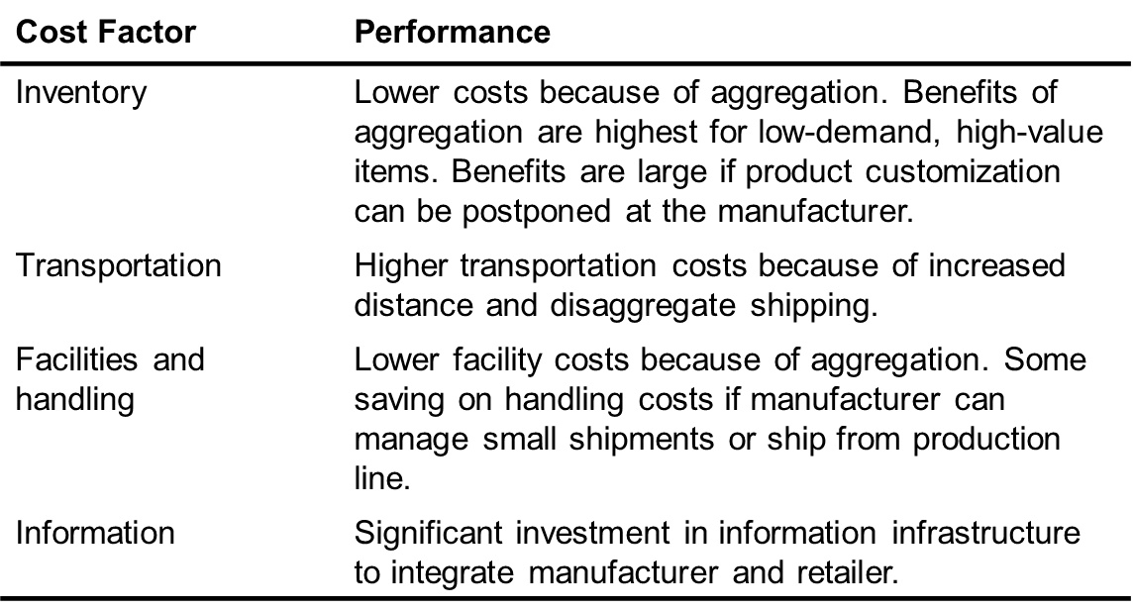
Manufacturer Storage with Direct Shipping Network
www.midocean.km

Slide 15
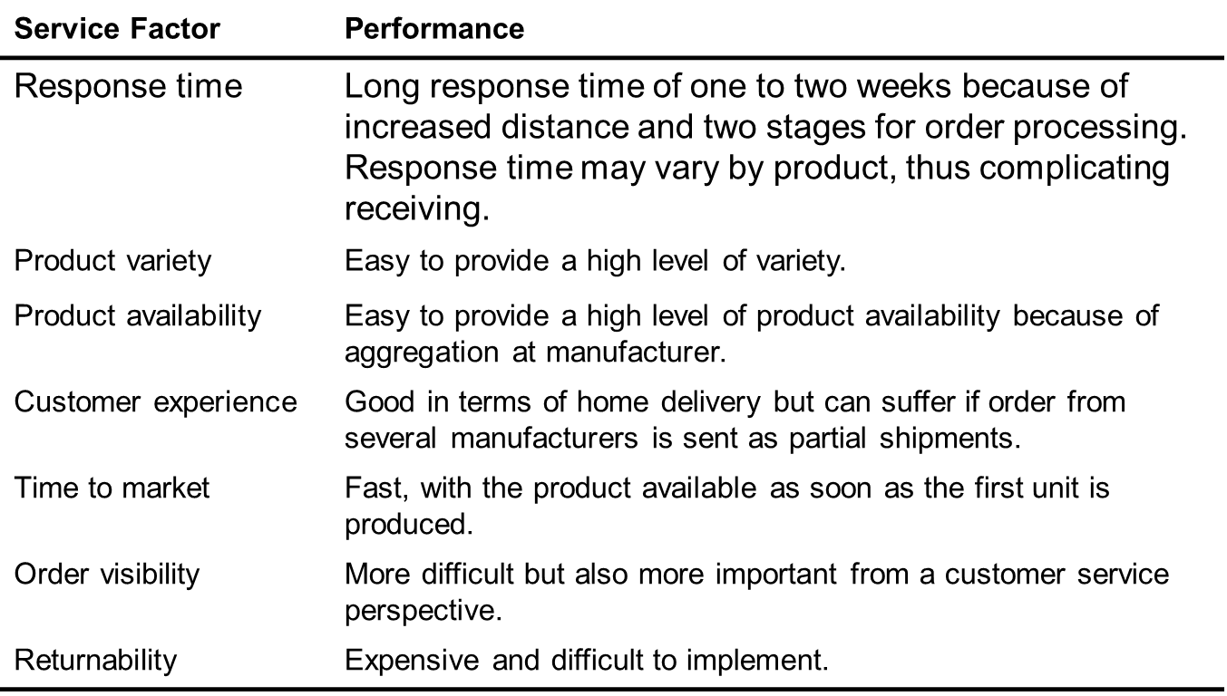
Manufacturer Storage with Direct Shipping Network
www.midocean.km

Slide 16
In-Transit Merge
Cost Factor | Performance
Inventory | Similar to drop-shipping.
Transportation | Somewhat lower transportation costs than drop-shipping.
Facilities and handling | Handling costs higher than drop-shipping at carrier; receiving costs lower at customer.
Information | Investment is somewhat higher than for drop-shipping.
www.midocean.km

Slide 17
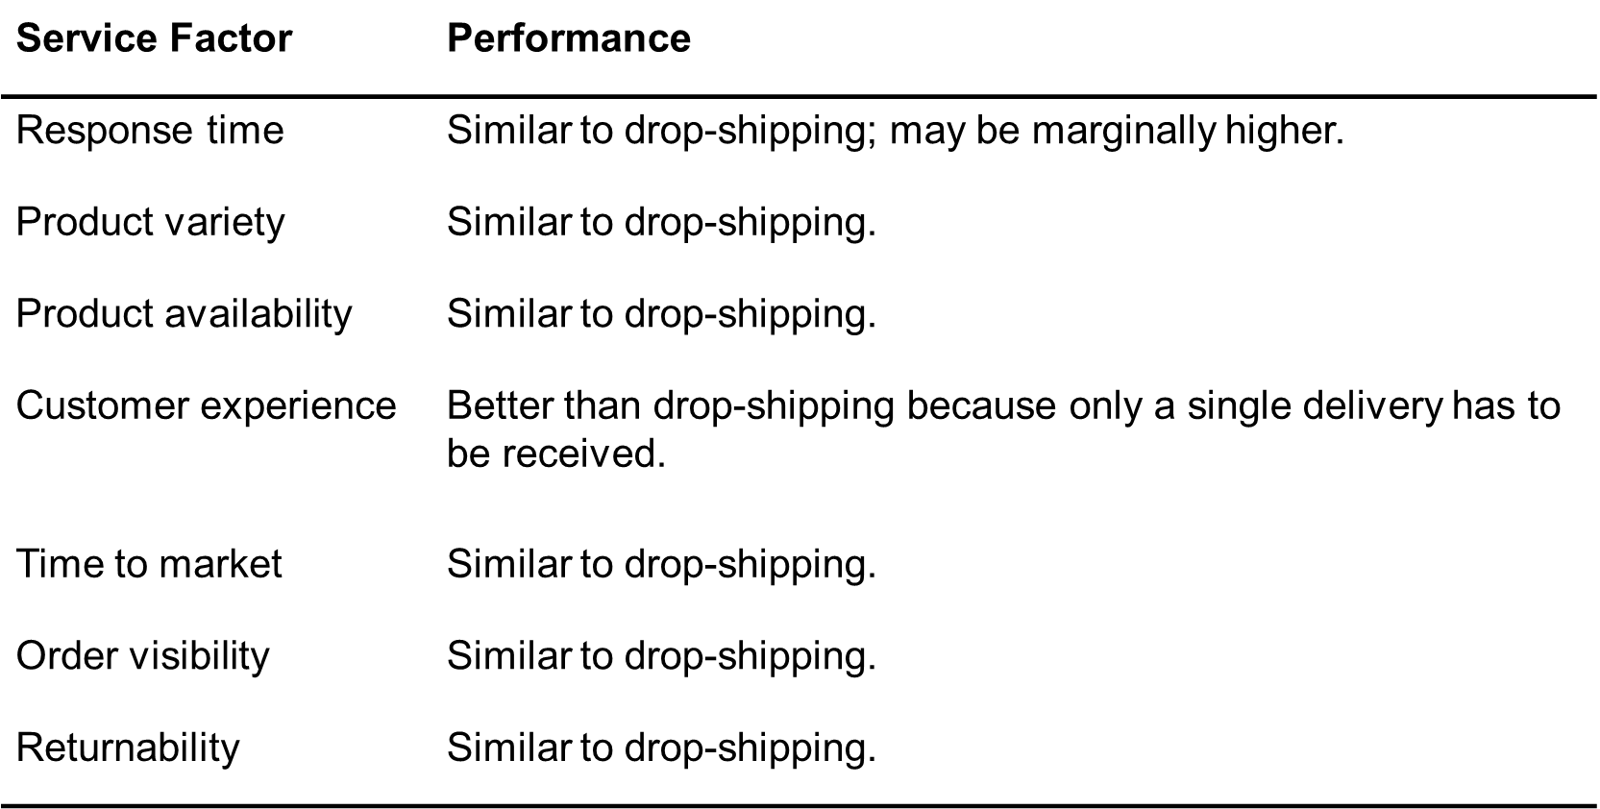
In-Transit Merge
www.midocean.km

Slide 18
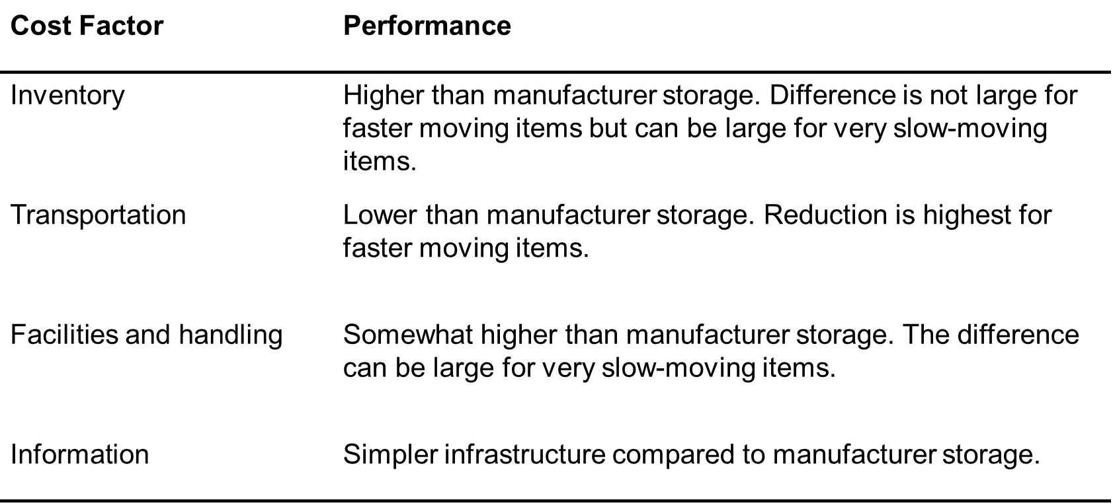
Distributor Storage with Carrier Delivery
www.midocean.km

Slide 19
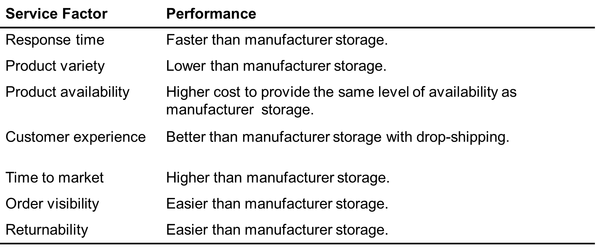
Distributor Storage with Carrier Delivery
www.midocean.km

Slide 20
Distributor Storage with Last Mile Delivery
Cost Factor | Performance
Inventory | Higher than distributor storage with package carrier delivery.
Transportation | Very high cost given minimal scale economies. Higher than any other distribution option.
Facilities and handling | Facility costs higher than manufacturer storage or distributor storage with package carrier delivery, but lower than a chain of retail stores.
Information | Similar to distributor storage with package carrier delivery.
www.midocean.km

Slide 21
Distributor Storage with Last Mile Delivery
Service Factor | Performance
Response time | Very quick. Same day to next-day delivery.
Product variety | Somewhat less than distributor storage with package carrier delivery but larger than retail stores.
Product availability | More expensive to provide availability than any other option except retail stores.
Customer experience | Very good, particularly for bulky items. Slightly higher than distributor storage with package carrier delivery.
Time to market | Less of an issue and easier to implement than manufacturer storage or distributor storage with package carrier delivery.
Order visibility | Easier to implement than other previous options.
Returnability | Harder and more expensive than a retail network.
www.midocean.km

Slide 22
Manufacturer or Distributor Storage with Customer Pickup
Manufacturer or Distributor Storage with Customer Pickup
Cost Factor | Performance
Inventory | Can match any other option, depending on the location of inventory.
Transportation | Lower than the use of package carriers, especially if using an existing delivery network.
Facilities and handling | Facility costs can be high if new facilities have to be built. Costs are lower if existing facilities are used. The increase in handling cost at the pickup site can be significant.
Information | Significant investment in infrastructure required.
www.midocean.km

Slide 23
Manufacturer or Distributor Storage with Customer Pickup
Service Factor | Performance
Response time | Similar to package carrier delivery with manufacturer or distributor storage. Same-day delivery possible for items stored locally at pickup site.
Product variety | Similar to other manufacturer or distributor storage options.
Product availability | Similar to other manufacturer or distributor storage options.
Customer experience | Lower than other options because of the lack of home delivery. Experience is sensitive to capability of pickup location.
Time to market | Similar to manufacturer storage options.
Order visibility | Difficult but essential.
Returnability | Somewhat easier given that pickup location can handle returns.
www.midocean.km

Slide 24
Retail Storage with Customer Pickup
Cost Factor | Performance
Inventory | Higher than all other options.
Transportation | Lower than all other options.
Facilities and handling | Higher than other options. The increase in handling cost at the pickup site can be significant for online and phone orders.
Information | Some investment in infrastructure required for online and phone orders.
www.midocean.km

Slide 25
Retail Storage with Customer Pickup
Service Factor | Performance
Response time | Same-day (immediate) pickup possible for items stored locally at pickup site.
Product variety | Lower than all other options.
Product availability | More expensive to provide than all other options.
Customer experience | Related to whether shopping is viewed as a positive or negative experience by customer.
Time to market | Highest among distribution options.
Order visibility | Trivial for in-store orders. Difficult, but essential, for online and phone orders.
Returnability | Easier than other options because retail store can provide a substitute.
www.midocean.km

Slide 26
Impact of Online Sales on Customer Service
Response time to customers
  Physical products take longer to fulfill than retail store
  No delay for information goods
Product variety
  Easier to offer larger selection
Product availability
  Aggregating inventory and better information on customer preferences improves product availability
www.midocean.km

Slide 27
Impact of Online Sales on Customer Service
Customer experience
  Improved access, customization, and convenience
Faster time to market
Order Visibility
Returnability
  Harder with online orders
  Proportion of returns likely to be much higher
www.midocean.km

Slide 28
Impact of Online Sales on Customer Service
Direct Sales to Customers
  Social networking channels allow firms to directly pitch products and promotion
Flexible Pricing, Product Portfolio, and Promotions
  Manage revenues from product portfolio more effectively than traditional channels
  Promotion information can be conveyed to customers quickly and inexpensively
Efficient Funds Transfer
www.midocean.km

Slide 29
Impact of Online Sales on Cost
Inventory
  Lower inventory levels if customers will wait
  Postpone variety until after the customer order is received
Facilities
  Costs related to the number and location of facilities in a network
  Costs associated with the operations in these facilities
Transportation
  Lower cost of “transporting” information goods in digital form
  For nondigital, aggregating inventories increases outbound transportation
Information
  Share demand, planning, and forecasting information throughout its supply chain
  Additional costs to build and maintain the information infrastructure
www.midocean.km

Slide 30
Using Online Sales to Sell Computer Hardware: Dell
Impact of online sales on customer service
Delay in fulfilling customer request
Impact of online sales on cost
Reduced inventory costs
Lower facility costs
Higher total transportation costs
Incremental increase in information costs
www.midocean.km

Slide 31
Using Online Sales to Sell Computer Hardware: Dell
A tailored supply chain network to sell computer hardware for Dell includes :
A hybrid model can be very effective
More significant as hardware becomes more of a commodity
Take advantage of the strengths of both online sales and traditional retail and distribution channels
www.midocean.km

Slide 32
Using Online Sales to Sell Books: Amazon
Impact of online sales on customer service
  Internet has not shortened supply chains
  Increased selection, convenience
Impact of online sales on cost
  Reduced inventory costs
  Lower facility costs
  Higher total transportation costs
  Increase in information costs
A supply chain network for books
  Traditional bookstores pressured from both ends
  Amazon more efficient
www.midocean.km

Slide 33
Using the Internet to Sell Groceries: Peapod
Impact of online sales on customer service
  Sell convenience and the time savings
  Offers less variety
  Creating a personalized shopping experience and customized advertising and promotions
Impact of online sales on cost
  Reduced inventory costs
  Higher facility costs due to picking operation
  Significantly higher total transportation costs
  Increase in information costs
www.midocean.km

Slide 34
Using the Internet to Sell Groceries: Peapod
Value of online sales to a traditional grocery chain
  Complement the strengths of their existing network
  Offer an entire array of services at differing prices based on the amount of work the customer does
www.midocean.km

Slide 35
Using the Internet to Rent Movies: Netflix
Impact of online sales on customer service
  Staggering selection and an excellent recommendation engine
  Video streaming through a variety of devices
  Customers received their DVDs within 24 hours of being shipped
Impact of online sales on cost
  Reduced inventory costs
  Lower facility costs
  Considerably higher total transportation costs, increased streaming will reduce transportation costs
  Increase in information costs
www.midocean.km

Slide 36
Distribution Networks in Practice
The ownership structure of the distribution network can have as big as an impact as the type of distribution network
It is important to have adaptable distribution networks
Product price, commoditization, and criticality affect the type of distribution system preferred by customers
www.midocean.km

Slide 37
Distribution Networks in Practice
Integrate the Internet with the existing physical network
Consider whether an exclusive distribution strategy is advantageous
www.midocean.km

Slide 38
Summary of Learning Objectives
Chapter
01
1- Identify the key factors to be considered when designing
a distribution network.
2- Discuss the strengths and weaknesses of various
distribution options.
3- Understand how e-business have affected the design of
distribution networks in different industries.
www.midocean.km

Slide 39
Essential Reference
Chopra, S., & Meindl, P. (2016). Global Edition. Pearson Education Limited Chapter 4.
Lysons, K., & Farrington, B. (2020). Procurement and supply chain management. Pearson UK.
Morris, P. W., & Pinto, J. K. (Eds.). (2007). The Wiley guide to project technology, supply chain, and procurement management (Vol. 4). John Wiley & Sons.
Schwalbe, K. (2015). Information technology project management. Cengage Learning.
Supply Chain Council
www.midocean.km

Slide 40


Thank You

