Slide 1




AWS Cloud Security Foundations– AWS-CSF
Dr. Ibrahim Gomaa
Lecture 5 – Automatic Scaling, Logging and Monitoring

Slide 2


Lecture
Course Outline
5
Lecture 5: Automatic Scaling, Logging and Monitoring
Topics
Elastic Load Balancing
Amazon CloudWatch
Amazon EC2 Auto Scaling
Importance of logging and monitoring
Capture and collect
AWS services with built-in logs
Monitor and report
Activities
Elastic Load Balancing activity
Amazon CloudWatch
Lab
Scale and Load Balance Your Architecture
Monitoring and Alerting with CloudTrail and CloudWatch
AWS Cloud Security Foundations– AWS-CSF
Lecture 5 – Automatic Scaling, Logging and Monitoring
Dr. Ibrahim Gomaa

Slide 3
Lecture
Automatic Scaling, Logging and Monitoring
5
Elastic Load Balancing
AWS Cloud Security Foundations– AWS-CSF
Lecture 5 – Automatic Scaling, Logging and Monitoring
Dr. Ibrahim Gomaa

Slide 4





Lecture
5
Elastic Load Balancing
Elastic Load Balancing (ELB)
  Distributes incoming application or network traffic across multiple targets in a single Availability Zone or across multiple Availability Zones.
  Scales your load balancer as traffic to your application changes over time.
Elastic Load
Balancing
IP addresses
Containers
Lambda functions
EC2 instances
AWS Cloud Security Foundations– AWS-CSF
Lecture 5 – Automatic Scaling, Logging and Monitoring
Dr. Ibrahim Gomaa

Slide 5
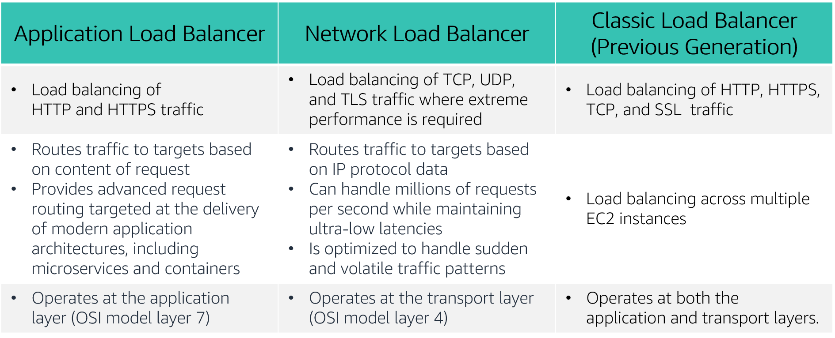
Lecture
5
Elastic Load Balancing
Types of load balancers
AWS Cloud Security Foundations– AWS-CSF
Lecture 5 – Automatic Scaling, Logging and Monitoring
Dr. Ibrahim Gomaa

Slide 6


Lecture
5
Elastic Load Balancing
How Elastic Load Balancing works
With Application Load Balancers and Network Load Balancers, you register targets in target groups, and route traffic to the target groups.
With Classic Load Balancers, you register instances with the load balancer.
AWS Cloud
Load balancer accepts
incoming traffic
from clients.
Availability Zone A
Availability Zone B
Listener
Listener checks for
connection requests.
Listener
Load balancer routes
traffic only to
healthy targets.
Load balancer performs health checks to monitor health of registered targets.
.
X
.
.
.
Target
Target
Target
Target
Target
AWS Cloud Security Foundations– AWS-CSF
Lecture 5 – Automatic Scaling, Logging and Monitoring
Dr. Ibrahim Gomaa

Slide 7



Lecture
5
Elastic Load Balancing
Elastic Load Balancing use cases
Highly available and
fault-tolerant
applications
Containerized
applications
Elasticity
and scalability
Virtual private
cloud (VPC)
Hybrid environments
Invoke Lambda
functions over HTTP(S)
AWS Cloud Security Foundations– AWS-CSF
Lecture 5 – Automatic Scaling, Logging and Monitoring
Dr. Ibrahim Gomaa

Slide 8
Activity: Elastic Load Balancing
Lecture
Automatic Scaling, Logging and Monitoring
5
You must support traffic to a containerized application.
Application Load Balancer
You have extremely spiky and unpredictable TCP traffic.
Network Load Balancer
You need simple load balancing with multiple protocols.
Classic Load Balancer
You need to support a static or Elastic IP address, or an IP target outside a VPC.
Network Load Balancer
You need a load balancer that can handle millions of requests per second while maintaining low latencies.
Network Load Balancer
You must support HTTPS requests.
Application Load Balancer
AWS Cloud Security Foundations– AWS-CSF
Lecture 5 – Automatic Scaling, Logging and Monitoring
Dr. Ibrahim Gomaa

Slide 9

Lecture
5
Elastic Load Balancing
Load balancer monitoring
Amazon CloudWatch metrics – Used to verify that the system is performing as expected and creates an alarm to initiate an action if a metric goes outside an acceptable range.
Access logs – Capture detailed information about requests sent to your load balancer.
AWS CloudTrail logs – Capture the who, what, when, and where of API interactions in AWS services.
AWS Cloud Security Foundations– AWS-CSF
Lecture 5 – Automatic Scaling, Logging and Monitoring
Dr. Ibrahim Gomaa

Slide 10
Lecture
Automatic Scaling, Logging and Monitoring
5
Amazon CloudWatch
AWS Cloud Security Foundations– AWS-CSF
Lecture 5 – Automatic Scaling, Logging and Monitoring
Dr. Ibrahim Gomaa

Slide 11
Lecture
5
Amazon CloudWatch
Monitoring AWS resources
To use AWS efficiently, you need insight into your AWS resources:
How do you know when you should launch more Amazon EC2 instances?
Is your application's performance or availability being affected by a lack of sufficient capacity?
How much of your infrastructure is actually being used?
AWS Cloud Security Foundations– AWS-CSF
Lecture 5 – Automatic Scaling, Logging and Monitoring
Dr. Ibrahim Gomaa

Slide 12



Lecture
5
Amazon CloudWatch
Amazon CloudWatch
Monitors –
  AWS resources
  Applications that run on AWS
Collects and tracks –
  Standard metrics
  Custom metrics
Alarms –
  Send notifications to an Amazon SNS topic
  Perform Amazon EC2 Auto Scaling or Amazon EC2 actions
Events –
  Define rules to match changes in AWS environment and route these events to one or more target functions or streams for processing
Amazon
CloudWatch
AWS Cloud Security Foundations– AWS-CSF
Lecture 5 – Automatic Scaling, Logging and Monitoring
Dr. Ibrahim Gomaa

Slide 13
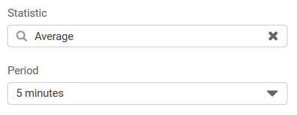
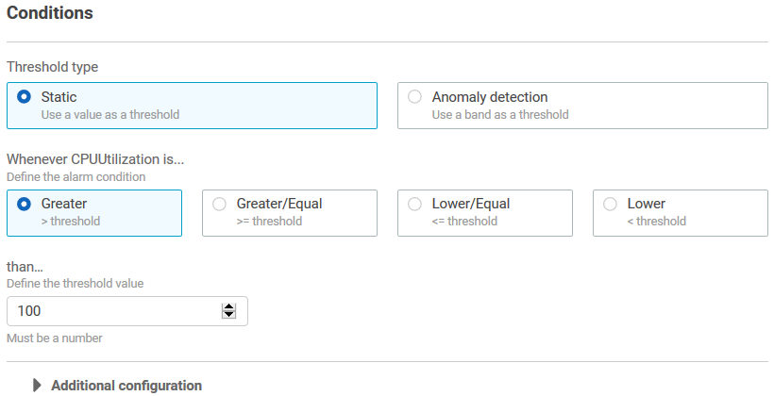
Lecture
5
Amazon CloudWatch
CloudWatch alarms
Create alarms based on –
  Static threshold
  Anomaly detection
  Metric math expression
Specify –
  Namespace
  Metric
  Statistic
  Period
  Conditions
  Additional configuration
  Actions
AWS Cloud Security Foundations– AWS-CSF
Lecture 5 – Automatic Scaling, Logging and Monitoring
Dr. Ibrahim Gomaa

Slide 14
Lecture
5
Amazon CloudWatch
CloudWatch alarms
Create alarms based on –
  Static threshold
  Anomaly detection
  Metric math expression
Specify –
  Namespace
  Metric
  Statistic
  Period
  Conditions
  Additional configuration
  Actions
AWS Cloud Security Foundations– AWS-CSF
Lecture 5 – Automatic Scaling, Logging and Monitoring
Dr. Ibrahim Gomaa

Slide 15




Activity: Amazon CloudWatch
Lecture
Automatic Scaling, Logging and Monitoring
5
If average CPU utilization is > 60% for 5 minutes…
Correct!
Amazon EC2
If the number of simultaneous connections is > 10 for 1 minute…
Correct!
Amazon RDS
If the maximum bucket size in bytes is around 3 for 1 day…
Incorrect. Around is not a threshold option. You must specify a threshold of >, >=, <=, or <.
Amazon S3
If the number of healthy hosts is < 5 for 10 minutes…
Correct!
Elastic Load Balancing
If the volume of read operations is > 1,000 for 10 seconds…
Incorrect. You must specify a statistic (for example, average volume).
Amazon Elastic Block Store
AWS Cloud Security Foundations– AWS-CSF
Lecture 5 – Automatic Scaling, Logging and Monitoring
Dr. Ibrahim Gomaa

Slide 16
Lecture
Automatic Scaling, Logging and Monitoring
5
Amazon EC2 Auto Scaling
AWS Cloud Security Foundations– AWS-CSF
Lecture 5 – Automatic Scaling, Logging and Monitoring
Dr. Ibrahim Gomaa

Slide 17
Lecture
5
Amazon EC2 Auto Scaling
Why is scaling important?
Unused
capacity
Over
capacity
Su M T W Th F Sa
Su M T W Th F Sa
Used capacity
(demand)
Provisioned capacity
AWS Cloud Security Foundations– AWS-CSF
Lecture 5 – Automatic Scaling, Logging and Monitoring
Dr. Ibrahim Gomaa

Slide 18
Lecture
5
Amazon EC2 Auto Scaling
Amazon EC2 Auto Scaling
Helps you maintain application availability
Enables you to automatically add or remove EC2 instances according to conditions that you define
Detects impaired EC2 instances and unhealthy applications, and replaces the instances without your intervention
Provides several scaling options – Manual, scheduled, dynamic or on-demand, and predictive
Su M T W Th F Sa
Used capacity
(demand)
Provisioned capacity
AWS Cloud Security Foundations– AWS-CSF
Lecture 5 – Automatic Scaling, Logging and Monitoring
Dr. Ibrahim Gomaa

Slide 19


Lecture
5
Amazon EC2 Auto Scaling
Auto Scaling groups
Auto Scaling group
An Auto Scaling group is a collection of EC2 instances that are treated as a logical grouping for the purposes of automatic scaling and management.
Minimum size
Launch or terminate
instances as needed
Desired capacity
Maximum size
AWS Cloud Security Foundations– AWS-CSF
Lecture 5 – Automatic Scaling, Logging and Monitoring
Dr. Ibrahim Gomaa

Slide 20
Lecture
5
Amazon EC2 Auto Scaling
Scaling out versus scaling in
Elastic Load
Balancing
Auto Scaling group
Auto Scaling group
Auto Scaling group
Base configuration
Scale out
(launch instances)
Scale in
(terminate instances)
AWS Cloud Security Foundations– AWS-CSF
Lecture 5 – Automatic Scaling, Logging and Monitoring
Dr. Ibrahim Gomaa

Slide 21



Lecture
5
Amazon EC2 Auto Scaling
Implementing dynamic scaling
Elastic Load Balancing
Auto Scaling group
CPU
utilization
If average CPU
utilization is
> 60% for 5
minutes…
Run Amazon EC2 Auto Scaling policy
Amazon EC2 Auto Scaling
Amazon CloudWatch
AWS Cloud Security Foundations– AWS-CSF
Lecture 5 – Automatic Scaling, Logging and Monitoring
Dr. Ibrahim Gomaa

Slide 22

Lecture
5
Amazon EC2 Auto Scaling
AWS Auto Scaling
Monitors your applications and automatically adjusts capacity to maintain steady, predictable performance at the lowest possible cost
Provides a simple, powerful user interface that enables you to build scaling plans for resources, including –
  Amazon EC2 instances and Spot Fleets
  Amazon Elastic Container Service (Amazon ECS) Tasks
  Amazon DynamoDB tables and indexes
  Amazon Aurora Replicas
AWS Auto Scaling
AWS Cloud Security Foundations– AWS-CSF
Lecture 5 – Automatic Scaling, Logging and Monitoring
Dr. Ibrahim Gomaa

Slide 23
Lecture
Automatic Scaling, Logging and Monitoring
5
Importance of logging and monitoring
AWS Cloud Security Foundations– AWS-CSF
Lecture 5 – Automatic Scaling, Logging and Monitoring
Dr. Ibrahim Gomaa

Slide 24

Lecture
5
Importance of logging and monitoring
What is logging?
Logging is the collection and recording of activity and event data.
  Provided by the service itself (Amazon VPC Flow Logs and Amazon S3 server access logs)
  Provided by a secondary service (AWS CloudTrail)
Information logged will vary based on the service conducting the logging.
  Common log elements:
      Date and time of event
      Origin of event
      Identity of resources accessed
AWS Cloud Security Foundations– AWS-CSF
Lecture 5 – Automatic Scaling, Logging and Monitoring
Dr. Ibrahim Gomaa

Slide 25


Lecture
5
Importance of logging and monitoring
Why is logging important?
Logging provides a record of events, which is useful for the following:
  Troubleshooting
  Auditing
  Recordkeeping
  Incident response and remediation
Logs are a requirement for demonstrating compliance with regulations, such as the following:
  HIPAA (US Health Insurance Portability and Accountability Act )
  GDPR (European Union General Data Protection Regulation )
  LGPD (Brazil's General Data Protection Law )
AWS Cloud Security Foundations– AWS-CSF
Lecture 5 – Automatic Scaling, Logging and Monitoring
Dr. Ibrahim Gomaa

Slide 26

Lecture
5
Importance of logging and monitoring
What is monitoring?
Monitoring is the continuous verification of the security and performance of your resources, applications, and data.
AWS provides several services that give you the visibility to spot issues before they impact operations:
  AWS CloudTrail
  Amazon CloudWatch
  Amazon EventBridge
  AWS X-Ray
AWS Cloud Security Foundations– AWS-CSF
Lecture 5 – Automatic Scaling, Logging and Monitoring
Dr. Ibrahim Gomaa

Slide 27
Lecture
Automatic Scaling, Logging and Monitoring
5
Capture and collect
AWS Cloud Security Foundations– AWS-CSF
Lecture 5 – Automatic Scaling, Logging and Monitoring
Dr. Ibrahim Gomaa

Slide 28
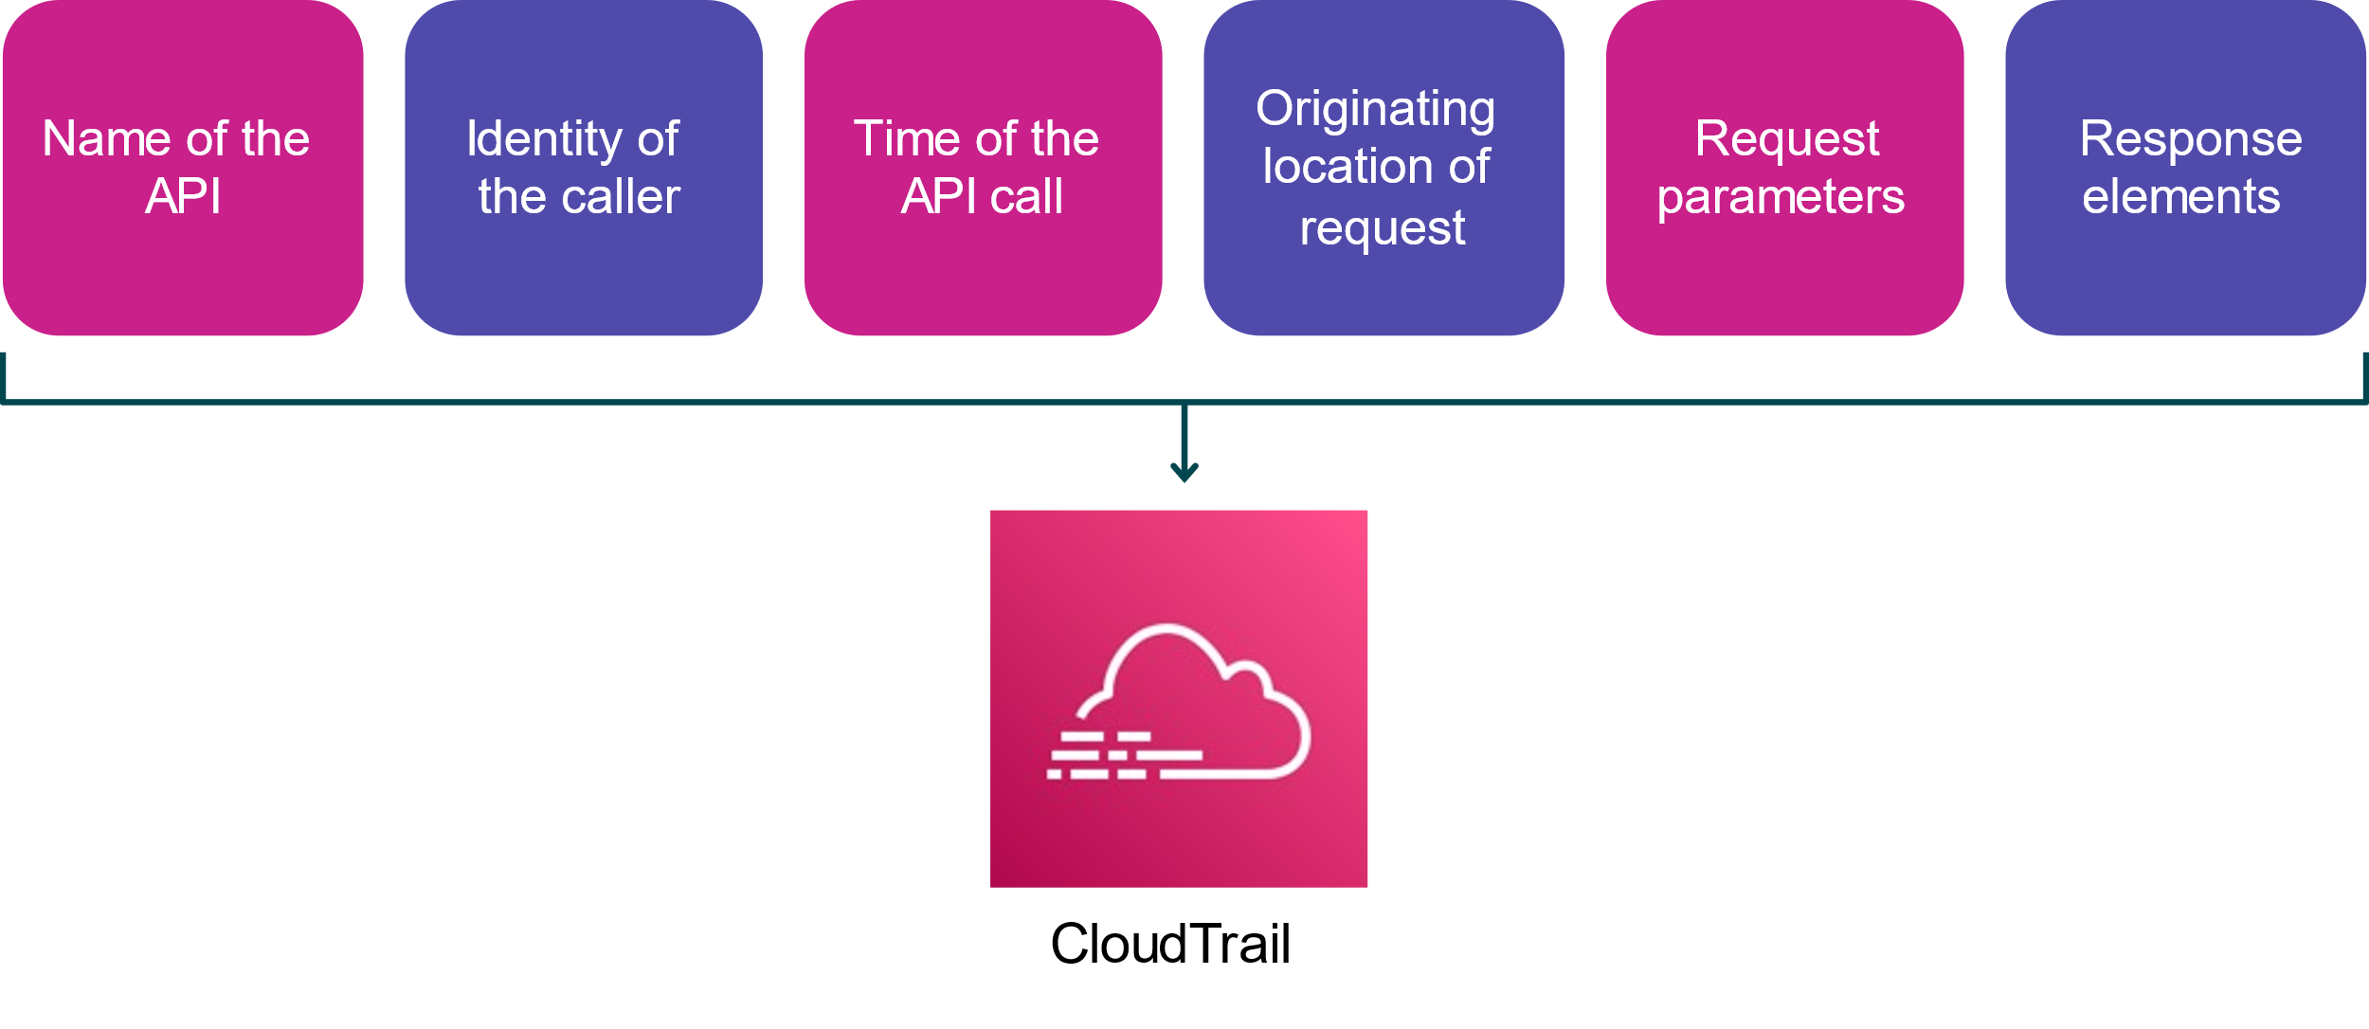
Lecture
5
Capture and collect
API security-relevant information
CloudTrail records important information about each API call, this information helps you to track changes made to your AWS resources, troubleshoot operational issues, and ensure compliance with internal policies and regulatory standards.
AWS Cloud Security Foundations– AWS-CSF
Lecture 5 – Automatic Scaling, Logging and Monitoring
Dr. Ibrahim Gomaa

Slide 29

Lecture
5
Capture and collect
AWS CloudTrail
Assists you to enable governance and compliance, as well as operational and risk auditing of your AWS account
Records actions taken by a user, role, or AWS service as events
Provides visibility of events in the CloudTrail console
Can be used to view, search, download, archive, analyze, and respond to account activity across your AWS infrastructure
AWS Cloud Security Foundations– AWS-CSF
Lecture 5 – Automatic Scaling, Logging and Monitoring
Dr. Ibrahim Gomaa

Slide 30
Activity: Reading a Log File
Lecture
Automatic Scaling, Logging and Monitoring
5
Reading a log: Identity of the caller
{
"Records": [{
"eventVersion": "1.0",
"userIdentity": {
"type": "IAMUser",
"principalId": "AIDACKCEVSQ6C2EXAMPLE",
"arn": "arn:aws:iam::111122223333:user/Jane",
"accountId": "111122223333",
"accessKeyId": "AKIAIOSFODNN7EXAMPLE",
"userName": "Jane"
},
AWS Cloud Security Foundations– AWS-CSF
Lecture 5 – Automatic Scaling, Logging and Monitoring
Dr. Ibrahim Gomaa

Slide 31
Activity: Reading a Log File
Lecture
Automatic Scaling, Logging and Monitoring
5
Reading a log: Time and origin of the request
"eventTime": "2021-07-06T21:01:59Z",
"eventSource": "ec2.amazonaws.com",
"eventName": "StopInstances",
"awsRegion": "us-east-2",
"sourceIPAddress": "203.0.113.176",
"userAgent": "ec2-api-tools 1.6.12.2",
AWS Cloud Security Foundations– AWS-CSF
Lecture 5 – Automatic Scaling, Logging and Monitoring
Dr. Ibrahim Gomaa

Slide 32
Activity: Reading a Log File
Lecture
Automatic Scaling, Logging and Monitoring
5
Reading a log: Request parameters and response elements
"requestParameters": {
"instancesSet": {
"items": [{
"instanceId": "i-ebeaf9e2" } ] },
"force": false },
"responseElements": {
"instancesSet": {
"items": [{
"instanceId": "i-ebeaf9e2",
"currentState": {
"code": 64,
"name": "stopping" },
"previousState": {
"code": 16,
"name": "running" } } ] },
AWS Cloud Security Foundations– AWS-CSF
Lecture 5 – Automatic Scaling, Logging and Monitoring
Dr. Ibrahim Gomaa

Slide 33
Activity: Reading a Log File
Lecture
Automatic Scaling, Logging and Monitoring
5
Reading a log: Answer
AWS Identity and Access Management (IAM) user named Jane. Jane used the ec2-stop-instances command in the AWS CLI to call the Amazon EC2 StopInstances action.
AWS Cloud Security Foundations– AWS-CSF
Lecture 5 – Automatic Scaling, Logging and Monitoring
Dr. Ibrahim Gomaa

Slide 34
Lecture
Automatic Scaling, Logging and Monitoring
5
AWS services with built-in logs
AWS Cloud Security Foundations– AWS-CSF
Lecture 5 – Automatic Scaling, Logging and Monitoring
Dr. Ibrahim Gomaa

Slide 35

Lecture
5
AWS services with built-in logs
Services with built-in logs: Amazon S3
Server access logging is a built-in feature of Amazon S3. Enable the feature for detailed records of requests that are made to an S3 bucket
Amazon S3 provides detailed access request records through Amazon S3 server access logging.
Server access logs provide useful information for security and access audits.
Server access logs can provide insight into your customer base and assist you to understand your Amazon S3 bill.
Amazon Simple Storage Service (Amazon S3)
AWS Cloud Security Foundations– AWS-CSF
Lecture 5 – Automatic Scaling, Logging and Monitoring
Dr. Ibrahim Gomaa

Slide 36

Lecture
5
AWS services with built-in logs
Services with built-in logs: Amazon VPC
With VPC Flow Logs, you can capture information about inbound and outbound IP traffic from the following:
  VPC
  Subnets
  Individual network interfaces
Publish flow log data to CloudWatch or Amazon S3.
Flow log data is collected outside of the path of your network traffic, with no impact on throughput or latency.
Amazon Virtual Private Cloud (Amazon VPC)
AWS Cloud Security Foundations– AWS-CSF
Lecture 5 – Automatic Scaling, Logging and Monitoring
Dr. Ibrahim Gomaa

Slide 37

Lecture
5
AWS services with built-in logs
Services with built-in logs: ELB
ELB access logs capture detailed information about requests sent to your load balancer.
Use access logs to analyze traffic patterns and for troubleshooting.
ELB captures, compresses, and stores logs in a specified S3 bucket.
Elastic Load Balancing (ELB)
AWS Cloud Security Foundations– AWS-CSF
Lecture 5 – Automatic Scaling, Logging and Monitoring
Dr. Ibrahim Gomaa

Slide 38
Lecture
Automatic Scaling, Logging and Monitoring
5
Monitor and Report
AWS Cloud Security Foundations– AWS-CSF
Lecture 5 – Automatic Scaling, Logging and Monitoring
Dr. Ibrahim Gomaa

Slide 39

Lecture
5
Monitor and Report
Amazon CloudWatch
Is a monitoring and observability service
Provides a unified view of the operational health of your AWS resources, applications, and services
Collects metrics in the AWS Cloud and on premises
Can be used for infrastructure monitoring and troubleshooting
Provides the ability to customize logs and events
Amazon CloudWatch
AWS Cloud Security Foundations– AWS-CSF
Lecture 5 – Automatic Scaling, Logging and Monitoring
Dr. Ibrahim Gomaa

Slide 40
Lecture
5
Monitor and Report
Comparing CloudTrail and CloudWatch
AWS CloudTrail | Amazon CloudWatch
Continuously monitors and logs user activities | Continuously monitors resource and application performance
Useful for compliance auditing, security analysis, and troubleshooting | Useful for detecting anomalous service behavior, setting alarms, and discovering insights
Helps you determine WHO performed WHAT unauthorized action and WHEN they did it | Alerts you that an issue has occurred due to an unauthorized action
When used together, you can create custom CloudWatch dashboards, alarms, and notifications for key metrics and specific CloudTrail events.
AWS Cloud Security Foundations– AWS-CSF
Lecture 5 – Automatic Scaling, Logging and Monitoring
Dr. Ibrahim Gomaa

Slide 41

Lecture
5
Monitor and Report
AWS Trusted Advisor
Provides recommendations based on five categories of AWS best practices: cost optimization, security, fault tolerance, service limits, and performance improvement
Evaluates your account to suggest improvements and optimizations for your resources
Is accessible through the AWS Management Console and available to all support tiers
AWS Trusted Advisor
AWS Cloud Security Foundations– AWS-CSF
Lecture 5 – Automatic Scaling, Logging and Monitoring
Dr. Ibrahim Gomaa

Slide 42

Lecture
5
Monitor and Report
Amazon EventBridge
Is a serverless event bus service that is used to connect your applications with data from a variety of sources
Provides a stream of real-time data from applications and services to targets, such as AWS Lambda or event buses
Was formerly called Amazon CloudWatch Events
Amazon EventBridge
AWS Cloud Security Foundations– AWS-CSF
Lecture 5 – Automatic Scaling, Logging and Monitoring
Dr. Ibrahim Gomaa

Slide 43

Lecture
5
Monitor and Report
AWS Security Hub
Aggregates security alerts from various AWS services and partner products in a standardized format
Collects data across accounts and checks cloud security posture against AWS security best practices
Helps you to understand your overall security posture by using a consolidated security score across all of your AWS accounts
AWS Security Hub
AWS Cloud Security Foundations– AWS-CSF
Lecture 5 – Automatic Scaling, Logging and Monitoring
Dr. Ibrahim Gomaa

Slide 44

Lecture
5
Monitor and Report
AWS Config
Helps to assess, audit, and evaluate the configurations of your AWS resources
Continuously monitors and records AWS resource configurations
Provides automated evaluation of recorded configurations against desired configurations
AWS Config
AWS Cloud Security Foundations– AWS-CSF
Lecture 5 – Automatic Scaling, Logging and Monitoring
Dr. Ibrahim Gomaa

Slide 45
Lecture
Automatic Scaling, Logging and Monitoring
5
Thanks
AWS Cloud Security Foundations– AWS-CSF
Lecture 5 – Automatic Scaling, Logging and Monitoring
Dr. Ibrahim Gomaa

