Slide 1

CCNA (200-301) Cisco Certified Network Associate
Prepared by Eng. Taghreed Elsayed
Lecture 5
Static Routing & Router Basic Configuration

Slide 2
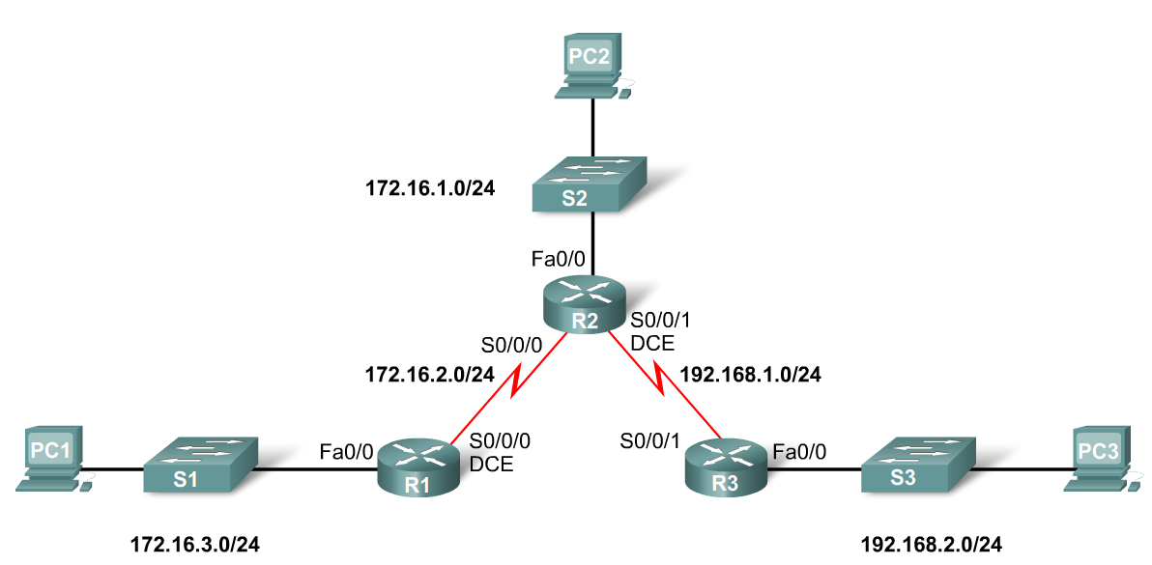

Chapter
03
Static Routing
General Role of the Router
Functions of a Router
  Best Path Selections
  Forwarding packets to destination
Introducing the Topology
  3 1800 series routers connected via WAN links
  Each router connected to a LAN represented by a switch and a PC

Slide 3
Chapter
03
Static Routing
General Role of the Router
Connections of a Router for WAN
  -A router has a DB-60 port that can support 5 different cabling standards
Connections of a Router for Ethernet
  -2 types of connectors can be used: Straight through and Cross-over
  Straight through used to connect:
    -Switch-to-Router, Switch-to-PC, Router-to-Server, Hub-to-PC, Hub-to-Server
  Cross-over used to connect:
    -Switch-to-Switch, PC-to-PC, Switch-to-Hub, Hub-to-Hub, Router-to-Router

Slide 4
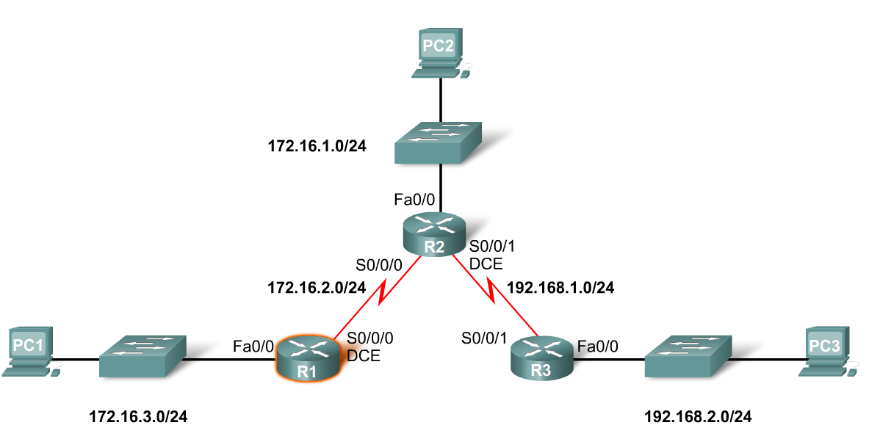
Chapter
03
Static Routing
Interfaces
Examining Router Interfaces
  -Show IP router command – used to view routing table
  -Show Interfaces command – used to show status of an interface
  -Show IP Interface brief command – used to show a portion of the interface information
  -Show running-configuration command – used to show configuration file in RAM

Slide 5
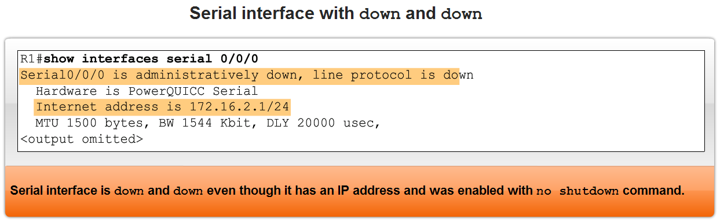
Chapter
03
Static Routing
Interfaces
Configuring a Serial interface
  -Enter interface configuration mode
  -Enter in the ip address and subnet mask
  -Enter in the no shutdown command
Example:
  -R1(config)#interface serial 0/0
  -R1(config-if)#ip address 172.16.2.1 255.255.255.0
  -R1(config-if)#no shutdown

Slide 6
Chapter
03
Static Routing
Interfaces
Examining Router Interfaces
  -Physically connecting a WAN Interface.
  -A WAN Physical Layer connection has sides:
    Data Circuit-terminating Equipment (DCE) – This is the service provider. CSU/DSU is a DCE device.
    Data Terminal Equipment (DTE) – Typically the router is the DTE device.
    #show controller s0/0/1

Slide 7
Chapter
03
Static Routing
Interfaces
Configuring serial links in a lab environment
  One side of a serial connection must be considered a DCE
  This requires placing a clocking signal – use the clock rate command.
  Example:
    -R1(config)#interface serial 0/0
    -R1(config-if)#clock rate 64000
  Serial Interfaces require a clock signal to control the timing of the communcations.

Slide 8
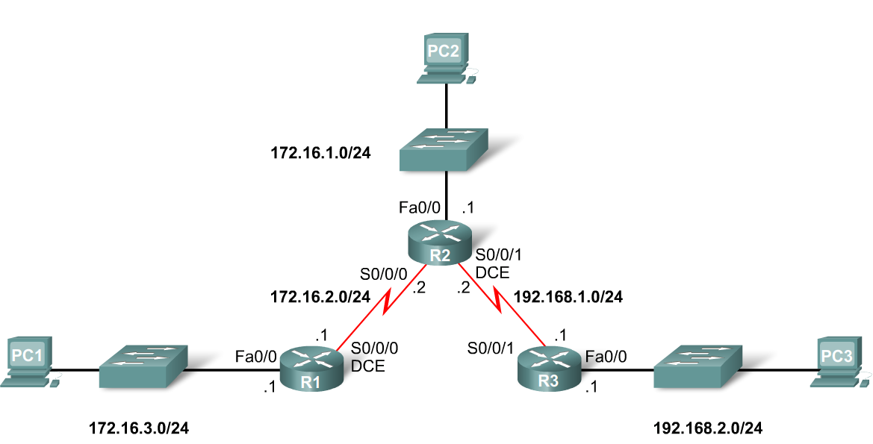
Chapter
03
Static Routing
Routing Table and CDP Protocol
When a router only has its interfaces configured & no other routing protocols are configured then:
  -The routing table contains only the directly connected networks
  -Only devices on the directly connected networks are reachable

Slide 9
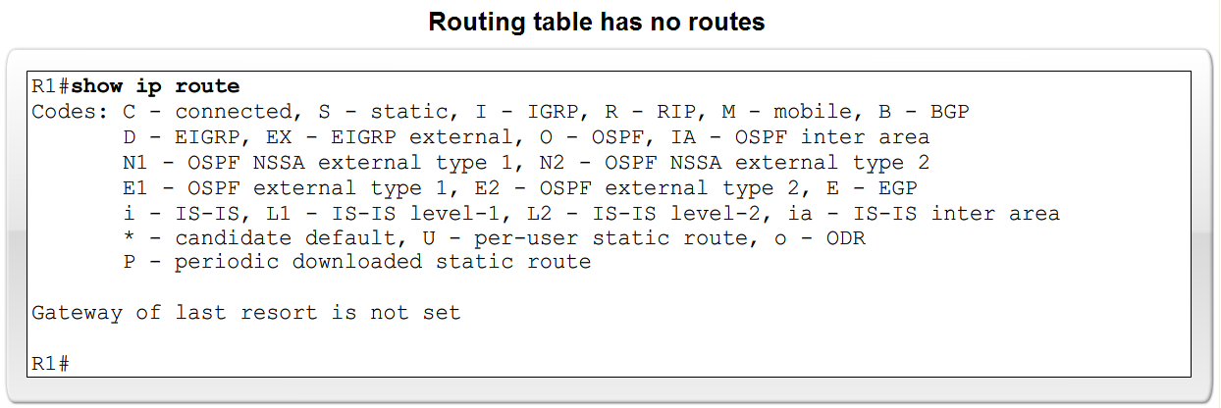
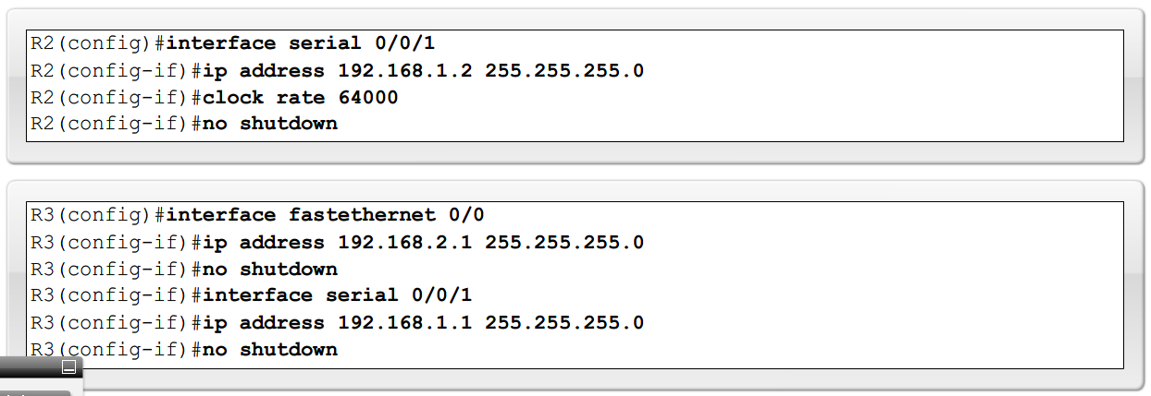
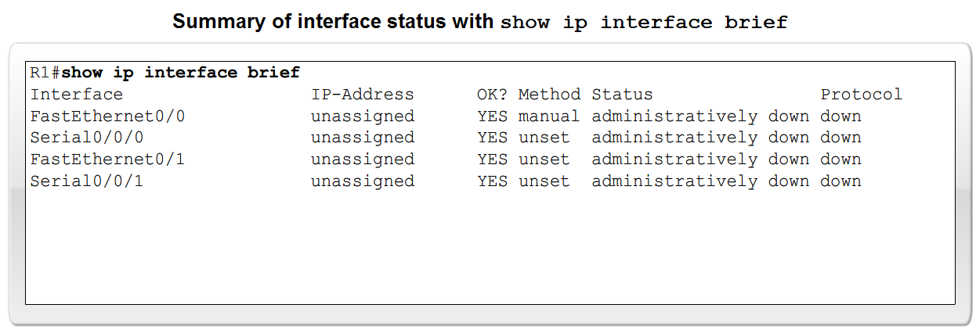
Chapter
03
Static Routing
Routing Table and CDP Protocol

Slide 10
Chapter
03
Static Routing
Routing Table and CDP Protocol
Purpose of CDP
  A layer 2 cisco proprietary tool used to gather information about other directly connected Cisco devices.
Concept of neighbors
  -2 types of neighbors
    Layer 3 neighbors
    Layer 2 neighbors

Slide 11
Chapter
03
Static Routing
Routing Table and CDP Protocol
CDP(cisco discovery protocol) show commands
  Show cdp neighbors command
    -Displays the following information:
      Neighbor device ID
      Local interface
      Hold time value, in seconds
      Neighbor device capability code
      Neighbor hardware platform
      Neighbor remote port ID
  Show cdp neighbors detail command
    -Useful in determining if an IP address configuration error

Slide 12
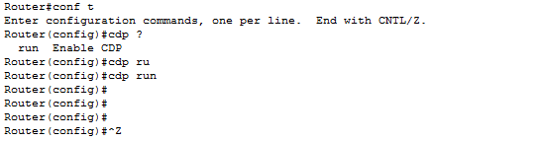
Chapter
03
Static Routing
Routing Table and CDP Protocol
Disabling CDP
  To disable CDP globally use the following command
    Router(config)#no cdp run

Slide 13
Chapter
03
Static Routing
Routing : the process of selecting best path to forward the packets
Routing Types
Static Routing
Dynamic Routing
Purpose of a static route
  A manually configured route used when routing from a network to a stub network

Slide 14
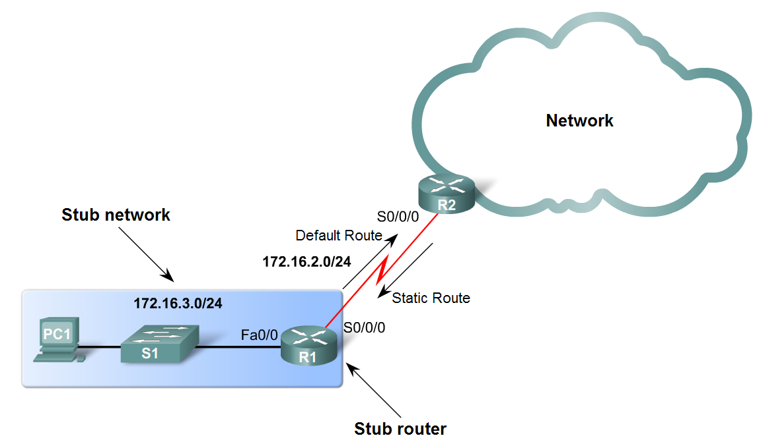
Chapter
03
Static Routing
Static Routes with Exit Interfaces
Purpose of a static route
  A manually configured route used when routing from a network to a stub network

Slide 15
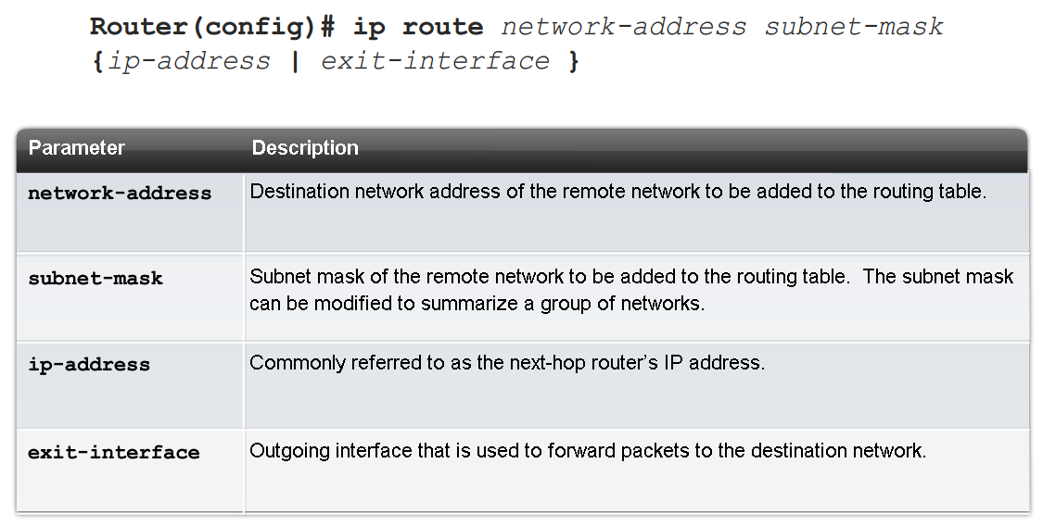
Chapter
03
Static Routing
Static Routes with Exit Interfaces
IP route command
  To configure a static route use the following command: ip route
  Example:
    -Router(config)# ip route network-address subnet-mask {ip-address of next hop | exit-interface }

Slide 16
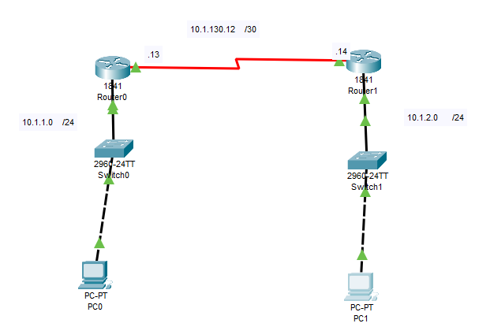
Chapter
03
Static Routing

Slide 17
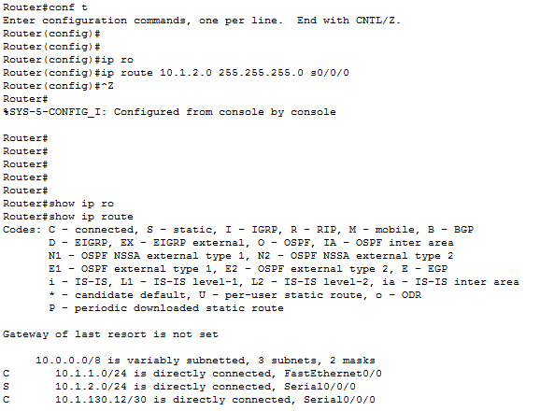
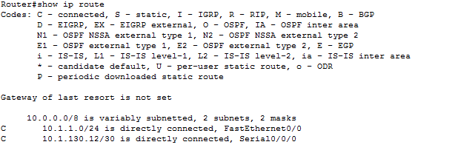
Chapter
03
Static Routing

Slide 18
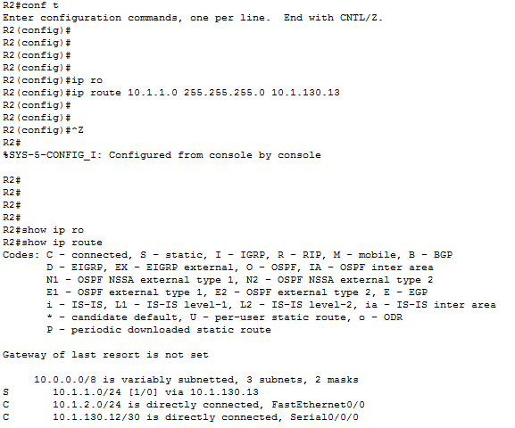
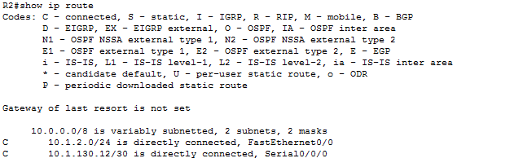
Chapter
03
Static Routing

