Slide 1



Organizational Structure and Design
lecture-7
Principle of Management
MGM111
Dr. Magdy Al-haj

Slide 2
Organizational Structure and Design

Slide 3

OUTLINE
Defining Organizational Structure
  Work specialization
  Departmentalization
  Chain of Command
  Span of Control
  Centralize vs. Decentralize
  Formalization
Organization Design Decisions
  Mechanistic and Organic
  Contingency Factors
  Common Designs

Slide 4
Defining Organizational Structure
Organizational Structure
  The formal arrangement of jobs within an organization
Organizational Design
  A process involving decisions about six key elements:
    Work specialization
    Departmentalization
    Chain of command
    Span of control
    Centralization and decentralization
    Formalization

Slide 5
Grouping Jobs into Functions
Functional Structure
  An organizational structure composed of all the departments that an organization requires to produce its goods or services.
Notes:
5

Slide 6
Purposes of Organizing
Divides work to be done into specific jobs and departments
Assigns tasks and responsibilities associated with individual jobs
Coordinates diverse organizational tasks
Clusters jobs into units
Establishes relationships among individuals, groups, and departments
Establishes formal lines of authority
Allocates and deploys organizational resources

Slide 7

Organizational Structure
Work Specialization
  The degree to which tasks in the organization are divided into separate jobs with each step completed by a different person
    Overspecialization can result in human diseconomies from boredom, fatigue, stress, poor quality, increased absenteeism, and higher turnover

Slide 8
Departmentalization by Type
1- Functional
  Grouping jobs by functions performed
2- Product
  Grouping jobs by product line
3- Geographical
  Grouping jobs on the basis of territory or geography
4- Process
  Grouping jobs on the basis of product or customer flow
5- Customer
  Grouping jobs by type of customer and needs

Slide 9
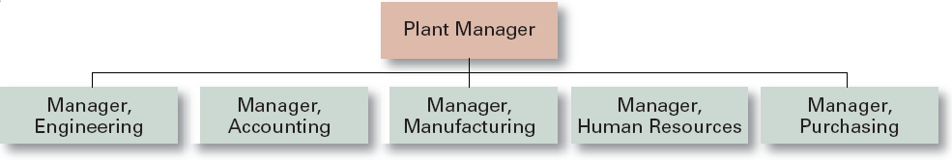
1- Functional Departmentalization
+ Efficiencies from putting together similar specialties and people with common skills, knowledge, and orientations
+ Coordination within functional area
+ In-depth specialization
– Poor communication across functional areas
– Limited view of organizational goals

Slide 10
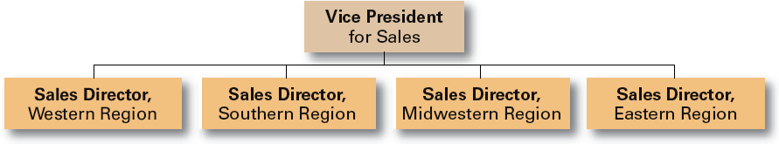
2- Geographical Departmentalization
+ More effective and efficient handling of specific regional issues that arise
+ Serve needs of unique geographic markets better
– Duplication of functions
– Can feel isolated from other organizational areas

Slide 11
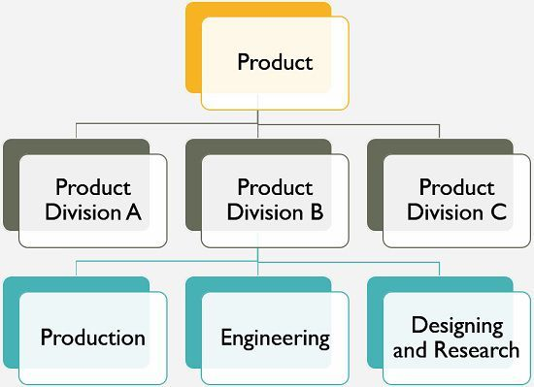
3- Product Departmentalization
+ Allows specialization in particular products and services
+ Managers can become experts in their industry
+ Closer to customers
– Duplication of functions
– Limited view of organizational goals

Slide 12
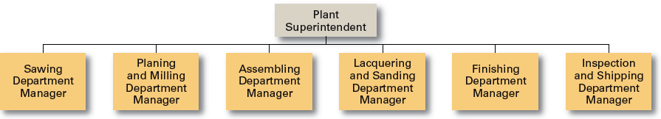
4- Process Departmentalization
+ More efficient flow of work activities
– Can only be used with certain types of products

Slide 13
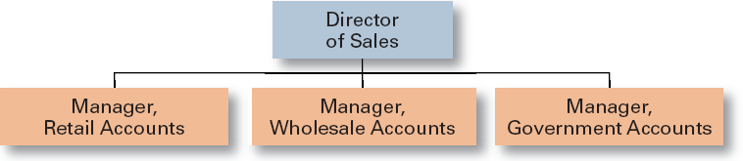
5- Customer Departmentalization
+ Customers’ needs and problems can be met by specialists
– Duplication of functions
– Limited view of organizational goals

Slide 14
Chain of Command
Chain of Command
  The continuous line of authority that extends from upper levels of an organization to the lowest levels of the organization and clarifies who reports to whom

Slide 15
Organizational Structure (cont’d)
Authority
  The rights inherent in a managerial position to tell people what to do and to expect them to do it
Responsibility
  The obligation or expectation to perform. Responsibility brings with it accountability (the need to report and justify work to manager’s superiors)
Unity of Command
  The concept that a person should have one boss and should report only to that person
Delegation
  The assignment of authority to another person to carry out specific duties

Slide 16
Organizational Structure (cont’d)
Line and Staff Authority
  Line managers are responsible for the essential activities of the organization, including production and sales. Line managers have the authority to issue orders to those in the chain of command
    The president, the production manager, and the sales manager are examples of line managers
  Staff managers have advisory authority, and cannot issue orders to those in the chain of command (except those in their own department)

Slide 17
  Span of Control
Span of Control
  The number of employees who can be effectively and efficiently supervised by a manager
  Width of span is affected by:
    Skills and abilities of the manager and the employees
    Characteristics of the work being done
    Similarity of tasks
    Complexity of tasks
    Physical proximity of subordinates
    Standardization of tasks
    Sophistication of the organization’s information system
    Strength of the organization’s culture
    Preferred style of the manager

Slide 18
  Centralize vs. Decentralize
Centralization
  The degree to which decision making is concentrated at a single point in the organization
    Organizations in which top managers make all the decisions and lower-level employees simply carry out those orders
Decentralization
  The degree to which lower-level employees provide input or actually make decisions
  Employee Empowerment
    Increasing the decision-making discretion of employees

Slide 19
Factors that Influence the Amount of Centralization
More Centralization
  Environment is stable
  Lower-level managers are not as capable or experienced at making decisions as upper-level managers
  Lower-level managers do not want to have a say in decisions
  Decisions are significant
  Organization is facing a crisis or the risk of company failure
  Company is large
  Effective implementation of company strategies depends on managers retaining say over what happens

Slide 20
Factors that Influence the Amount of Decentralization
More Decentralization
  Environment is complex, uncertain
  Lower-level managers are capable and experienced at making decisions
  Lower-level managers want a voice in decisions
  Decisions are relatively minor
  Corporate culture is open to allowing managers to have a say in what happens
  Company is geographically dispersed
  Effective implementation of company strategies depends on managers having involvement and flexibility to make decisions

Slide 21

  Formalization
Formalization
  The degree to which jobs within the organization are standardized and the extent to which employee behavior is guided by rules and procedures.

Slide 22
Organizational Design Decisions
Mechanistic Organization
  A rigid and tightly controlled structure
Organic Organization
  Highly flexible and adaptable structure
Mechanistic
Organic
•
High Specialization
•
Cross-Functional Teams
•
Rigid Departmentalization
•
Cross-Hierarchical Teams
•
Clear Chain of Command
•
Free Flow of Information
•
Narrow Spans of Control
•
Wide Spans of Control
•
Centralization
•
Decentralization
•
High Formalization
•
Low Formalization

Slide 23
Structural Contingency Factors
Structural decisions are influenced by:
  Overall strategy of the organization
    Organizational structure follows strategy
  Size of the organization
    Firms change from organic to mechanistic organizations as they grow in size
  Technology use by the organization
    Firms adapt their structure to the technology they use
  Degree of environmental uncertainty
    Dynamic environments require organic structures; mechanistic structures need stable environments

Slide 24
Structural Contingency Factors (cont’d)
Strategy Frameworks:
  Innovation
    Pursuing competitive advantage through meaningful and unique innovations favors an organic structuring
  Cost minimization
    Focusing on tightly controlling costs requires a mechanistic structure for the organization
  Imitation
    Minimizing risks and maximizing profitability by copying market leaders requires both organic and mechanistic elements in the organization’s structure

Slide 25

Structural Contingency Factors (cont’d)
Strategy and Structure
  Achievement of strategic goals is facilitated by changes in organizational structure that accommodate and support change
Size and Structure
  As an organization grows larger, its structure tends to change from organic to mechanistic with increased specialization, departmentalization, centralization, and rules and regulations

Slide 26

Structural Contingency Factors (cont’d)
Technology and Structure
  Organizations adapt their structures to their technology
  Routine technology = mechanistic organizations
  Non–routine technology = organic organizations

Slide 27
Common Organizational Designs
1- Traditional Designs
2- Contemporary Organizational Designs

Slide 28
1-Traditional Designs
Traditional Designs
  Simple Structure
    Low departmentalization, wide spans of control, centralized authority, little formalization
  Functional Structure
    Departmentalization by function
      Operations, finance, human resources, and product research and development
  Divisional Structure
    Composed of separate business units or divisions with limited autonomy under the coordination and control of the parent corporation

Slide 29
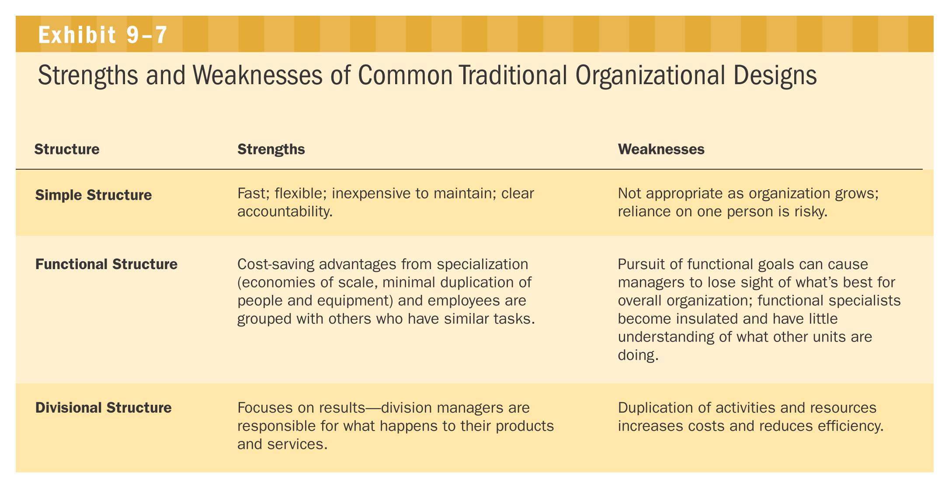
Strengths and Weaknesses of Common Traditional Organizational Designs

Slide 30
2- Contemporary Organizational Designs
Contemporary Organizational Designs
  Team Structures
    The entire organization is made up of work groups or self-managed teams of empowered employees
  Matrix Structures
    Specialists for different functional departments are assigned to work on projects led by project managers
    Matrix participants have two managers
  Project Structures
    Employees work continuously on projects, moving on to another project as each project is completed

Slide 31
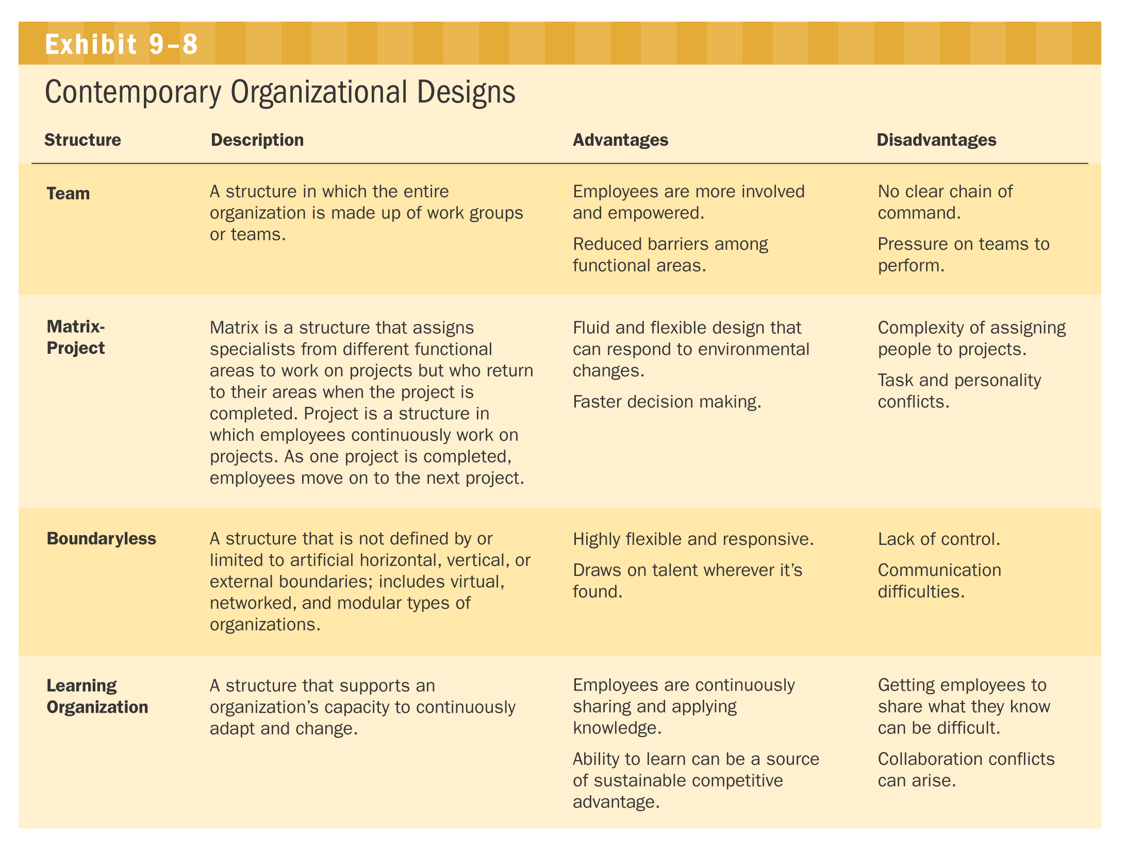
Contemporary Organizational Designs

Slide 32
Contemporary Organizational Designs (cont’d)
Contemporary Organizational Designs (cont’d)
  Boundary less Organization
    A flexible and an unstructured organizational design that is intended to break down external barriers between the organization and its customers and suppliers
    Removes internal (horizontal) boundaries:
      Eliminates the chain of command
      Has limitless spans of control
      Uses empowered teams rather than departments
    Eliminates external boundaries:
      Uses virtual, network, and modular organizational structures to get closer to stakeholders

Slide 33

Removing Boundaries
Virtual Organization
  An organization that consists of a small core of full-time employees and that temporarily hires specialists to work on opportunities that arise
Network Organization
  A small core organization that outsources its major business functions (e.g., manufacturing) in order to concentrate on what it does best
Modular Organization
  A manufacturing organization that uses outside suppliers to provide product components for its final assembly operations

Slide 34
Learning Organization
Learning Organization
  An organization that has developed the capacity to continuously learn, adapt, and change through the practice of knowledge management by employees
Organizational Design
•
Boundaryless
•
Teams
•
Empowerment
Organizational Culture
Information Sharing
•
Strong Mutual Relationships
THE LEARNING
•
Open
•
Sense of Community
ORGANIZATION
•
Timely
•
Caring
•
Accurate
•
Trust
Leadership
•
Shared Vision
•
Collaboration

Slide 35
Thanks!

