Slide 1


Entrepreneurial
New Ventures
Prepared by Dr. Sarah Chahine
ENT634
Industry and Competitor Analysis
Lecture 5

Slide 2



Entrepreneurial
New Ventures
Lecture 5
ENT634
Industry and Competitor Analysis
Prepared by
Dr. Sarah Chahine
www.midocean.ae

Slide 3

Chapter
Introduction
05
In this chapter, we’ll look at industry analysis and competitor analysis.
www.midocean.ae

Slide 4

Chapter
Introduction
05
The first section considers industry analysis, which is business research that focuses on the potential of an industry. An industry is a group of firms producing a similar product or service, such as music. Once it is determined that a new venture is feasible in regard to the industry and the target market in which it intends to compete, a more in-depth analysis is needed to learn the operational realities associated with the chosen industry.
www.midocean.ae

Slide 5
Chapter
Introduction
05
We focus on competitor analysis in the second section. A competitor analysis is a detailed evaluation of a firm’s competitors. Once a firm decides to enter an industry and chooses a market in which to compete, it must gain an understanding of its competitive environment.
www.midocean.ae

Slide 6
Chapter
Industry Analysis
05
When studying an industry, an entrepreneur must answer three questions before pursuing the idea of starting a firm:
Is the industry accessible—in other words, is it a realistic place for a new venture to enter?
Does the industry contain markets that are ripe for innovation or are underserved?
Are there positions in the industry that will avoid some of the negative attributes of the industry as a whole?
www.midocean.ae

Slide 7
Chapter
Industry Analysis
05
Some industries are simply more attractive than others in terms of their annual growth rate and other factors.
  For example, the industry for e-book publishing is expected to grow at an annual rate of 3.7 percent over the next five years.
  For the same period, the industry for traditional book publishing is expected to decline at an annual rate of −0.8 percent per year.
Studying industry trends and using the five forces model are two techniques entrepreneurs have available for assessing industry attractiveness.
www.midocean.ae

Slide 8
Chapter
Industry Analysis
05
Studying Industry Trends
The first technique an entrepreneur has available to discern the attractiveness of an industry is to study industry trends. Two most important trends to focus on are:
Environmental Trends
Business Trends
www.midocean.ae

Slide 9
Chapter
Industry Analysis
05
Environmental Trends
Economic trends, social trends, technological advances, and political and regulatory changes are the most important environmental trends for entrepreneurs to study.
For example, companies in industries selling products to seniors, such as the eyeglasses industry and the hearing aid industry, benefit from the social trend of the aging of the population.
In contrast, industries selling food products that are high in sugar, such as the candy industry and the sugared soft-drink industry, suffer as the result of a renewed emphasis on health and fitness.
www.midocean.ae

Slide 10
Chapter
Industry Analysis
05
Business Trends:
For example, the firms in some industries benefit from an increasing ability to outsource manufacturing or service functions to lower-cost foreign labor markets, while firms in other industries don’t share this advantage.
For example, the firms in some industries are able to move customer procurement and service functions online, at considerable cost savings, while the firms in other industries aren’t able to capture this advantage. Trends such as these favor some industries over others.
www.midocean.ae

Slide 11
Chapter
The Five Forces Model
05
The five forces model is a framework entrepreneurs use to understand an industry’s structure. Professor Michael Porter developed this important tool.
The framework is comprised of the following forces that determine industry profitability:
  The threat of substitutes
  The threat of new entrants (that is, new competitors)
  Rivalry among existing firms
  The bargaining power of suppliers
  The bargaining power of buyers
www.midocean.ae

Slide 12
Chapter
The Five Forces Model
05
Threat of Substitutes:
In general, industries are more attractive when the threat of substitutes is low. This means that products or services from other industries can’t easily serve as substitutes for the products or services being made and sold.
The extent to which substitutes suppress the profitability of an industry depends on the propensity of buyers to substitute alternatives. This is why the firms in an industry often offer their customers amenities to reduce the likelihood they’ll switch to a substitute product, even in light of a price increase.
www.midocean.ae

Slide 13
Chapter
The Five Forces Model
05
Threat of New Entrants:
In general, industries are more attractive when the threat of entry is low. This means that competitors cannot easily enter the industry and successfully copy what the industry incumbents are doing to earn profits.
A barrier to entry is a condition that creates a disincentive for a new firm to enter an industry. For example:
  Economies of Scale: occur when mass-producing a product results in lower average costs.
www.midocean.ae

Slide 14
Chapter
The Five Forces Model
05
Threat of New Entrants:
  Product Differentiation: Industries such as the soft-drink industry that are characterized by firms with strong brands are difficult to break into without spending heavily on advertising.
  Capital Requirements: The need to invest large amounts of money to gain entrance to an industry is another barrier to entry.
www.midocean.ae

Slide 15
Chapter
The Five Forces Model
05
Threat of New Entrants:
When start-ups create their own industries or create new niche markets within existing industries, they must create barriers to entry of their own to reduce the threat of new entrants.
The ideal barrier to entry is a patent, trademark, or copyright, which prevents another firm from duplicating what the start-up is doing.
There is a category of barriers to entry called nontraditional barriers to entry, which are barriers particularly suited to start-up firms. These barriers include factors such as the strength of a company’s management team, a first-mover advantage, a unique business model, or inventing a new approach to an industry.
www.midocean.ae

Slide 16
Chapter
The Five Forces Model
05
Rivalry among Existing Firms:
In most industries, the major determinant of industry profitability is the level of competition among the firms already competing in the industry.
Some industries are fiercely competitive to the point where prices are pushed below the level of costs. When this happens, industry-wide losses occur. In other industries, competition is much less intense and price competition is subdued.
www.midocean.ae

Slide 17
Chapter
The Five Forces Model
05
Rivalry among Existing Firms:
There are four primary factors that determine the nature and intensity of the rivalry among existing firms in an industry.
Number and balance of competitors: With a larger number of competitors, it is more likely that one or more will try to gain customers by cutting prices.
Degree of differentiation between products: The degree to which products differ from one producer to another affects industry rivalry. For example, commodity industries such as paper product producers tend to compete on price because there is no meaningful difference between one manufacturer’s products and another’s.
www.midocean.ae

Slide 18
Chapter
The Five Forces Model
05
Rivalry among Existing Firms:
Growth rate of an industry: The competition among firms in a slow-growth industry is stronger than among those in fast-growth industries. Slow-growth industry firms, such as insurance, must fight for market share, which may tempt them to lower prices or increase quality to obtain customers. In fast-growth industries, such as e-book publishing, there are enough customers to satisfy most firms’ production capacity, making price-cutting less likely.
Level of fixed costs: Firms that have high fixed costs must sell a higher volume of their product to reach the break-even point than firms with low fixed costs.
www.midocean.ae

Slide 19
Chapter
The Five Forces Model
05
Bargaining Power of Suppliers:
In general, industries are more attractive when the bargaining power of suppliers is low.
Several factors have an impact on the ability of suppliers to exert pressure on buyers and suppress the profitability of the industries they serve. These include the following:
Supplier Concentration: When there are only a few suppliers to provide a critical product to a large number of buyers, the supplier has an advantage.
www.midocean.ae

Slide 20
Chapter
The Five Forces Model
05
Bargaining Power of Suppliers:
Switching Costs: Switching costs are the fixed costs that buyers encounter when switching or changing from one supplier to another. If switching costs are high, a buyer will be less likely to switch suppliers.
Attractiveness of substitutes: Supplier power is enhanced if there are no attractive substitutes for the products or services the supplier offers.
www.midocean.ae

Slide 21
Chapter
The Five Forces Model
05
Bargaining Power of Buyers:
In general, industries are more attractive when the bargaining power of buyers (a start-up’s customers) is low.
Buyers can suppress the profitability of the industries from which they purchase by demanding price concessions or increases in quality.
Several factors affect buyers’ ability to exert pressure on suppliers and suppress the profitability of the industries from which they buy. These include the following:
www.midocean.ae

Slide 22
Chapter
The Five Forces Model
05
Bargaining Power of Buyers:
Buyer’s costs: The greater the importance of an item is to a buyer, the more sensitive the buyer will be to the price it pays.
Degree of standardization of a supplier’s products: The degree to which a supplier’s product differs from its competitors’ offering affects the buyer’s bargaining power.
www.midocean.ae

Slide 23
Chapter
The Value of the Five Forces Model
05
Along with helping a firm understand the dynamics of the industry it plans to enter, the five forces model can be used in two ways—to help a firm determine (1) whether it should enter a particular industry and (2) whether it can carve out an attractive position in that industry.
First, the five forces model can be used to assess the attractiveness of an industry or a specific position within an industry by determining the level of threat to industry profitability for each of the forces.
www.midocean.ae

Slide 24
Chapter
The Value of the Five Forces Model
05
The second way a new firm can apply the five forces model to help determine whether it should enter an industry is by using the model pictured in Figure 5.2 to answer several key questions. By doing so, a new venture can assess the thresholds it may have to meet to be successful in a particular industry:
www.midocean.ae

Slide 25
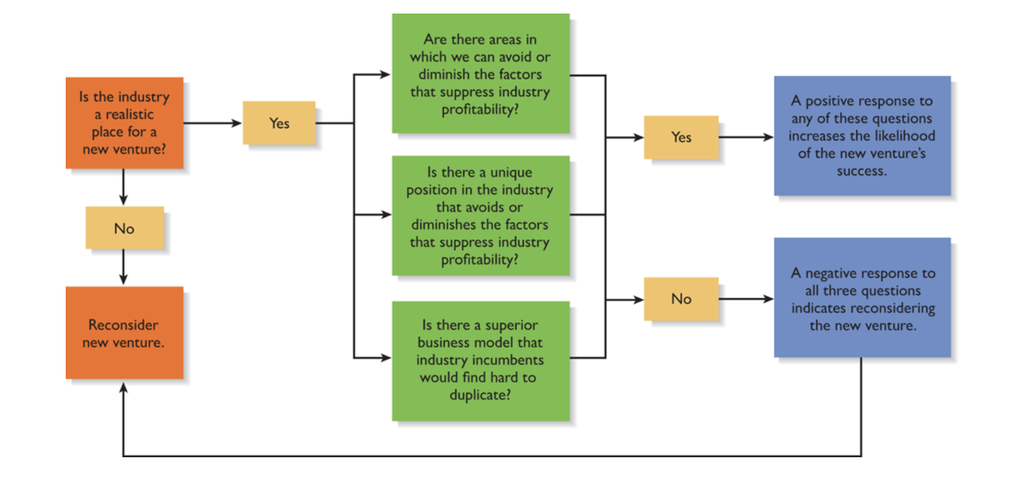
Chapter
The Value of the Five Forces Model
05
www.midocean.ae

Slide 26
Chapter
Industry Types and the Opportunities They Offer
05
An emerging industry is a new industry in which standard operating procedures have yet to be developed. The firm that pioneers or takes the leadership of an emerging industry often captures a first-mover advantage.
A first-mover advantage is a sometimes insurmountable advantage gained by the first company to establish a significant position in a new market.
A fragmented industry is one that is characterized by a large number of firms of approximately equal size. The primary opportunity for start-ups in fragmented industries is to consolidate the industry and establish industry leadership as a result of doing so.
www.midocean.ae

Slide 27
Chapter
Industry Types and the Opportunities They Offer
05
A mature industry is an industry that is experiencing slow or no increase in demand, has numerous repeat (rather than new) customers, and has limited product innovation. Occasionally, entrepreneurs introduce new product innovations to mature industries, surprising incumbents who thought nothing new was possible in their industries.
A declining industry is an industry or a part of an industry that is experiencing a reduction in demand. The renting of DVDs and video games by mail and producing and distributing hard copy textbooks are examples of products associated with industries or segments of an industry that are in some state of decline.
www.midocean.ae

Slide 28
Chapter
Industry Types and the Opportunities They Offer
05
A global industry is an industry that is experiencing significant international sales. The two most common strategies pursued by firms in global industries are the multidomestic strategy and the global strategy.
Firms that pursue a multidomestic strategy compete for market share on a country-by-country basis and vary their product or service offerings to meet the demands of the local market.
In contrast, firms pursuing a global strategy use the same basic approach in all foreign markets. The choice between these two strategies depends on how similar consumers’ tastes are from market to market (example: Adidas).
www.midocean.ae

Slide 29
Chapter
Competitor Analysis
05
After a firm has gained an understanding of the industry and the target market in which it plans to compete, the next step is to complete a competitor analysis. A competitor analysis is a detailed analysis of a firm’s competition. It helps a firm understand the positions of its major competitors and the opportunities that are available to obtain a competitive advantage in one or more areas.
www.midocean.ae

Slide 30
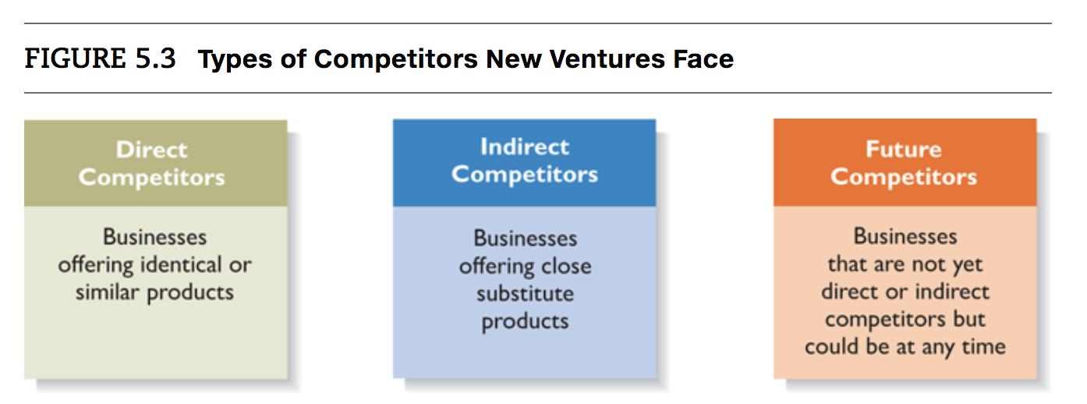
Chapter
Competitor Analysis
05
Identifying Competitors:
The first step in a competitive analysis is to determine who the competition is.
www.midocean.ae

Slide 31
Chapter
Competitor Analysis
05
Identifying Competitors:
It is impossible for a firm to identify all its direct and indirect competitors, let alone its future competitors. However, identifying its top 5 to 10 direct competitors and its top 5 to 10 indirect and future competitors makes it easier for the firm to complete its competitive analysis grid.
Creating meaningful value and sharp differentiation from competitors are actions small firms in crowded industries can take to remain competitive and gain market share.
www.midocean.ae

Slide 32
Chapter
Competitor Analysis
05
Sources of Competitive Intelligence:
To complete a meaningful competitive analysis grid, a firm must first understand its competitors’ strategies and behaviors. The information that is gathered by a firm to learn about its competitors is called competitive intelligence.
There are a number of ways that a firm can ethically obtain information about its competitors. For example: attend conferences and trade shows, purchase competitors’ products, study competitors’ websites and social media pages and talk to customers about what motivated them to buy your product as opposed to your competitor’s product.
www.midocean.ae

Slide 33
Chapter
Competitor Analysis
05
Completing a Competitive Analysis Grid:
As we mentioned previously, a competitive analysis grid is a tool for organizing the information a firm collects about its competitors. It can help a firm see how it stacks up against its competitors, provide ideas for markets to pursue, and, perhaps most importantly, identify its primary sources of competitive advantage. To be a viable company, a new venture must have at least one clear competitive advantage over its major competitors.
www.midocean.ae

Slide 34
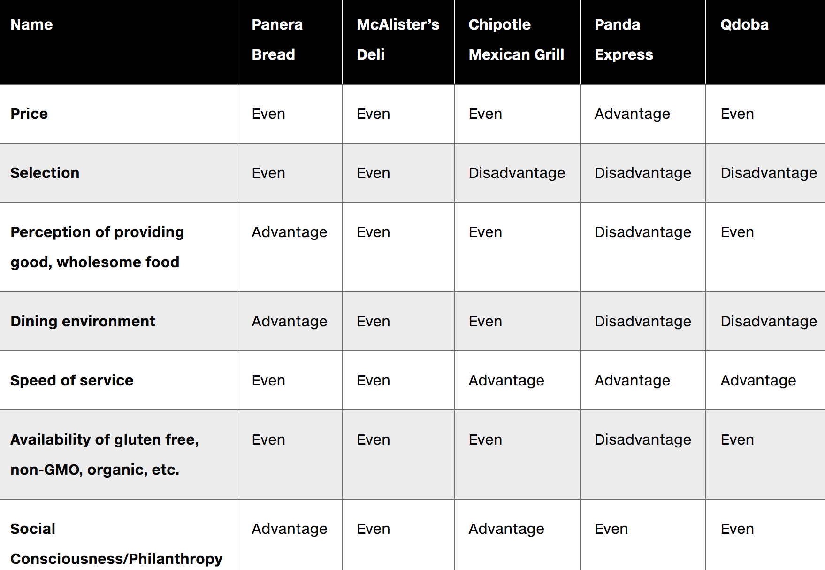
Chapter
Competitor Analysis
05
An example of a competitive analysis grid is provided in this table.
www.midocean.ae

Slide 35


Thank You

