Slide 1


Health Law and Ethics
Prepared by Dr. Aya Mohamed
MHA 633
Duties and Responsibilities of Physician and Patient
Lecture 3

Slide 2

In the previous Lecture: A practical approach to ethics
Chapter
01
Key concepts in medical ethics
Medical Ethics Vs Bioethics
What Are Ethical Principles?
The Principle of Non-Maleficence
The Principle of Beneficence
The Principle of Autonomy
The Principle of Veracity
The Principle of Confidentiality
The Principle of Justice
The Principle of Privacy

Slide 3
Duties and Responsibilities of Physician and Patient
Chapter
02
Duties and responsibilities of physician
Patients Bill of Rights
Patients Rights
Patients Responsibilities
Unethical Acts
Punishment & Disciplinary Action

Slide 4

Duties and responsibilities of physician in general
Character of Physician
  Uphold dignity and honour of his profession.
  Render service to humanity.
  Person with recognized qualification can only practice modern system of medicine.
Maintaining good medical practice.
  Render service to humanity with full respect for the dignity of profession and man.

Slide 5

Duties and responsibilities of physician in general
Maintenance of Medical records
  Maintain the medical records pertaining to his / her indoor patients for a period of 3 years.
  Records to be given within 72 hrs (if requested by patients/legal authorities).
  Maintain a Register of Medical Certificates giving full details of certificates issued.
Display of registration numbers.
Use of Generic names of drugs.

Slide 6

Duties and responsibilities of physician in general
Highest Quality Assurance in patient care
Exposure of Unethical Conduct
Payment of Professional Services
  Personal financial interests of a physician should not conflict with the medical interests of patients.
Evasion of Legal Restrictions
  Physician shall observe the laws of the country in regulating the practice of medicine.

Slide 7
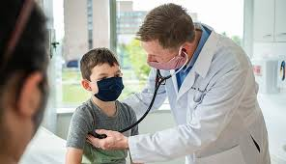
Duties of Physician to their patients
Obligations to the sick
    Always respond to the calls of the sick.
    Ailment not within range of experience he can refuse treatment and refer.
Patience, delicacy & secrecy
    Patience and delicacy should characterize the physician.
    Secrecy of patients to be maintained except when required by laws of the state and to protect healthy individuals.

Slide 8

Duties of Physician to their patients
Prognosis
    Neither exaggerate or minimize gravity of patient’s condition
Do not neglect the patient
    Physician free to choose.
    Once undertaken should not neglect the case.
    Respond to request in emergency.

Slide 9
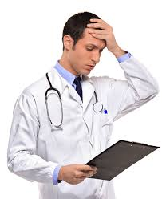
Duties Of Physician in consultation
Avoid un-necessary consultation
  Consulting pathologist, radiologist or asking for lab investigation should be done judiciously .
Consultation for patient benefit.
Punctuality in consultation.
Statement to patient after consultation.
Treatment after consultation.
Patient referred to specialist.
Fees and other charges.

Slide 10
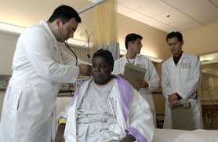
Responsibilities
To Each Other
Dependence of Physicians on each other
  Should consider it as a pleasure and privilege to render gratuitous service to all physicians and their immediate family dependants.
Conduct in consultation
  Respect should be observed towards the physician in-charge of the case and no statement or remark be made.

Slide 11

Responsibilities
To Each Other
Consultant not to take the charge of the case.
Appointment of the substitute
  only when he has the capacity to discharge the additional responsibility along with his / her other duties
Visiting another Physician's case-
  Avoid remarks upon the diagnosis or the treatment that has been adopted.

Slide 12

Duties Of Physician To
Public And Paramedical Staff
Physicians as citizens
    Should particularly co-operate with the authorities in the administration of sanitary/public health laws and regulations.
Public and community health
    Should enlighten the public concerning quarantine regulations and measures for the prevention of epidemic and communicable diseases.
Pharmacists/nurses
    Should promote and recognize their services and seek their cooperation.

Slide 13

The duties of a doctor registered with the General Medical Council GMC
Patients must be able to trust doctors with their lives and well-being. To justify that trust, we as a profession have a duty to maintain a good standard of practice and care and to show respect for human life. In particular as a doctor you must:
  make the care of your patient your first concern;
  treat every patient politely and considerately;
  respect patients' dignity and privacy;
  listen to patients and respect their views;
  give patients information in a way they can understand;
  respect the rights of patients to be fully involved in decisions about their care;
  keep your professional knowledge and skills up to date;
  recognise the limits of your professional competence;
  be honest and trustworthy;
  respect and protect confidential information;
  make sure that your personal beliefs do not prejudice your patients' care;
  act quickly to protect patients from risk if you have good reason to believe that you or a colleague may not be fit to practise;
  avoid abusing your position as a doctor; and
  work with colleagues in the ways that best serve patients' interests.
In all these matters you must never discriminate unfairly against your patients or colleagues. And you must always be prepared to justify your actions to them.

Slide 14

Patients Bill of Rights

Slide 15
What is Patient Bill of Rights?
It is a list of patient's rights. It offers guidance and protection to patients by stating the responsibilities that a hospital and its staff have toward them and their families during hospitalization, but it is not legally obligatory document.

Slide 16
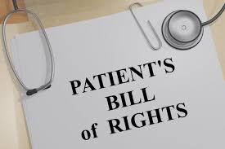
Importance of patient’s bill of rights
To protect both a patient and a hospital.
To help patients feel more confident in the health care system.

Slide 17
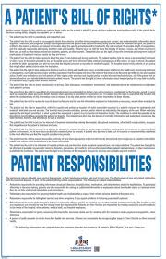
Importance of patient’s bill of rights
3. To stress the importance of a strong relationship between patients and their health care providers.
4. To arrange the rights and responsibilities for all patients and health care providers.

Slide 18

Patients Rights:
The right to receive information from physicians and to discuss the benefits, risks and costs of appropriate treatments
The right to make decision regarding the health care that is recommended by physician.
Be treated with respect and dignity

Slide 19
Cont. Patients Rights
Privacy and confidentiality, which includes access to medical records upon request.
The right to continue health care
Right to review records about his/her care and to have the information explained or interpreted as necessary, except when restricted by law.
Participate in the development and implementation of care

Slide 20
Cont. Patients Rights
Refuse treatment in accordance with the law, and receive information about the refusal of treatment.
Quality health care without discrimination because of race, creed, gender, religion or source of payment
Consultation and communication

Slide 21

Cont. Patients Rights
The patient has a right to expect all their communications and records related to their care will be treated das confidential by the hospital.
The patient has a right to be informed of hospital policies and practices that relate to patent care, treatment and responsibilities.

Slide 22
Cont. Patients Rights
Personal safety.
Know the identity of the person treating the patient
Informed consent for all procedures
Complain or compliment without the fear of retaliation or compromise of access or quality of care

Slide 23
Patients Responsibilities:
A patient is responsible for keeping his/her appointments and if not able to make it to their appointment, a need to notify their office.
A patient is responsible for reporting any changes.
A patient is responsible to follow a treatment recommended by their doctor. ( If a patient agreed to doctors' recommendation)
A patient is responsible for following health care rules and regulations.
Respect the autonomy of the doctors and nurses

Slide 24
Patients Responsibilities:
A patient is responsible for following health care rules and regulations.
Treat doctors and nurses with respect
Be punctual to attend the clinics / hospital for the treatment at the given time and if not able to attend, a need to notify their office.
To respect the privacy of others. NOTE: No photography is permitted at JHAH without prior written permission
To respect that patients will be treated based on the urgency of their medical needs
To safeguard all valuables you bring to the hospital
To understand that some services are not available at Hospital. As a result, you may be referred to another hospital
To follow all hospital policies and procedures (e.g. visiting hours, smoking policy, use of electrical equipment and safety of belongings)
To use hospital facilities and equipment safely

Slide 25
Unethical Acts
Advertising
Printing of self-photograph, or any such material of publicity in the letter head or on sign board of the consulting room or any such clinical establishment shall be regarded as acts of self-advertisement and unethical conduct on the part of the physician
Not endorse any items

Slide 26
Unethical Acts
Advertising
Formal announcement in press
On starting practice.
(2) On change of type of practice.
(3) On changing address.
(4) On temporary absence from duty.
(5) On resumption of another practice.
(6) On succeeding to another practice.
(7) Public declaration of charges

Slide 27
Unethical Acts
Advertising
Patent and Copy rights:
Running an open shop (Dispensing of Drugs and Appliances by Physicians)
May patent the items, methods & procedures
But it shall be unethical if benefits are not made available in interest of society

Slide 28
Unethical Acts
Advertising
Patent and Copy rights:
Running an open shop (Dispensing of Drugs and Appliances by Physicians)
Rebates and Commission
A physician shall not give, or receive, any gift, gratuity, commission or bonus in consideration of or return for the referring, recommending or procuring of any patient for medical, surgical or other treatment

Slide 29
Unethical Acts
Advertising
Patent and Copy rights:
Running an open shop (Dispensing of Drugs and Appliances by Physicians)
Rebates and Commission
Secret Remedies
Should not prescribe or dispense secret remedial agents of which he does not know (composition, manufacture, use, etc.

Slide 30
Unethical Acts
Advertising
Patent and Copy rights:
Running an open shop (Dispensing of Drugs and Appliances by Physicians)
Rebates and Commission
Secret Remedies
Human Rights
Should not assist nor be a party to either infliction of mental or physical trauma or concealment of torture by another person

Slide 31
Unethical Acts
Advertising
Patent and Copy rights:
Running an open shop (Dispensing of Drugs and Appliances by Physicians)
Rebates and Commission
Secret Remedies
Human Rights
Euthanasia
Practicing euthanasia shall constitute unethical conduct.
However on specific occasion, the question of withdrawing supporting devices to sustain cardio-pulmonary function even after brain death, shall be decided only by a team of doctors and not merely by the treating physician alone

Slide 32

Misconduct
Violation of regulations
improper conduct
Conviction in court of law
Sex determination test
Signing false professional certificates, reports & other documents
Any registered practitioner who is shown to have signed or given under his name and authority any certificate, notification, report or document which is untrue, misleading or improper, is liable to have his name deleted from the Register

Slide 33
Punishment & Disciplinary
Action
Complaint is first heard by appropriate medical council .
During the enquiry the full opportunity is given to registered medical practitioner to be heard in person or by pleader.
The decision has to be taken within 6 months.
Appropriate medical council gives decision according to the case.
During the pendency of the complaint the appropriate council may restrain the physician from performing the procedure or practice which is under scrutiny.

Slide 34
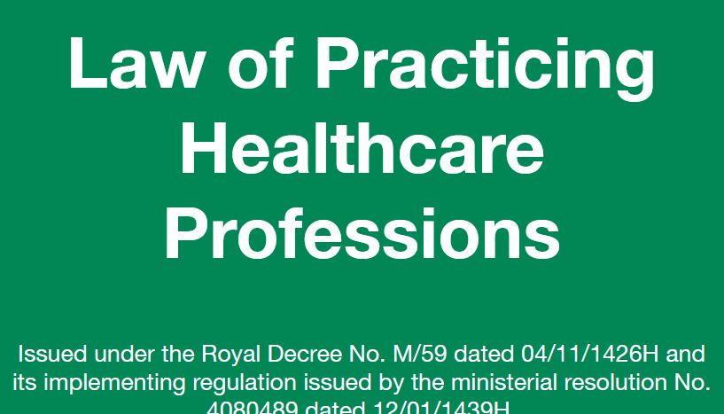
Punishment & Disciplinary
Action
Disciplinary Liability
Article (31)
Without prejudice to provisions of criminal or civil liability, a health practitioner who defaults in
performing any duty provided for in this Law, violates relevant codes of practice or acts contrary
to professional conduct or ethics, shall be accountable and subject to disciplinary measures.
Article (32):
Disciplinary penalties for professional violations shall be as follows:
1- Warning
2- A fine not exceeding ten thousand riyals.
3- Health profession license practicing cancellation, strike him off the roll of licensees. In
case of license cancellation, reapplication for a new license may not be filed before the
lapse of two years from the date of cancellation.

Slide 35

Punishment & Disciplinary
Action
The punishment given by the appropriate medical council or MCI includes:
  Warning
  Reprimand – official action
  Cancellation of registration
    Temporary – for specific period of time.
    Permanent

Slide 36
Ethical Dilemma:
Value conflicts, no clear
consensus as to the “right” thing to do. A conflict between moral obligations that are difficult to reconcile and require moral reasoning.
Situations necessitating a choice between two equal (usually undesirable) alternatives.

Slide 37
Ethical Issues in
Modern Healthcare
In modern healthcare and research, value conflicts arise where often there appears to be no clear consensus as to the “Right thing to do.” These conflicts present problems requiring moral decisions and necessitates a choice between two or more alternatives.
Examples:
Should a parent have a right to refuse immunizations for his or her child?
Does public safety supersede an individual’s, right?

Slide 38

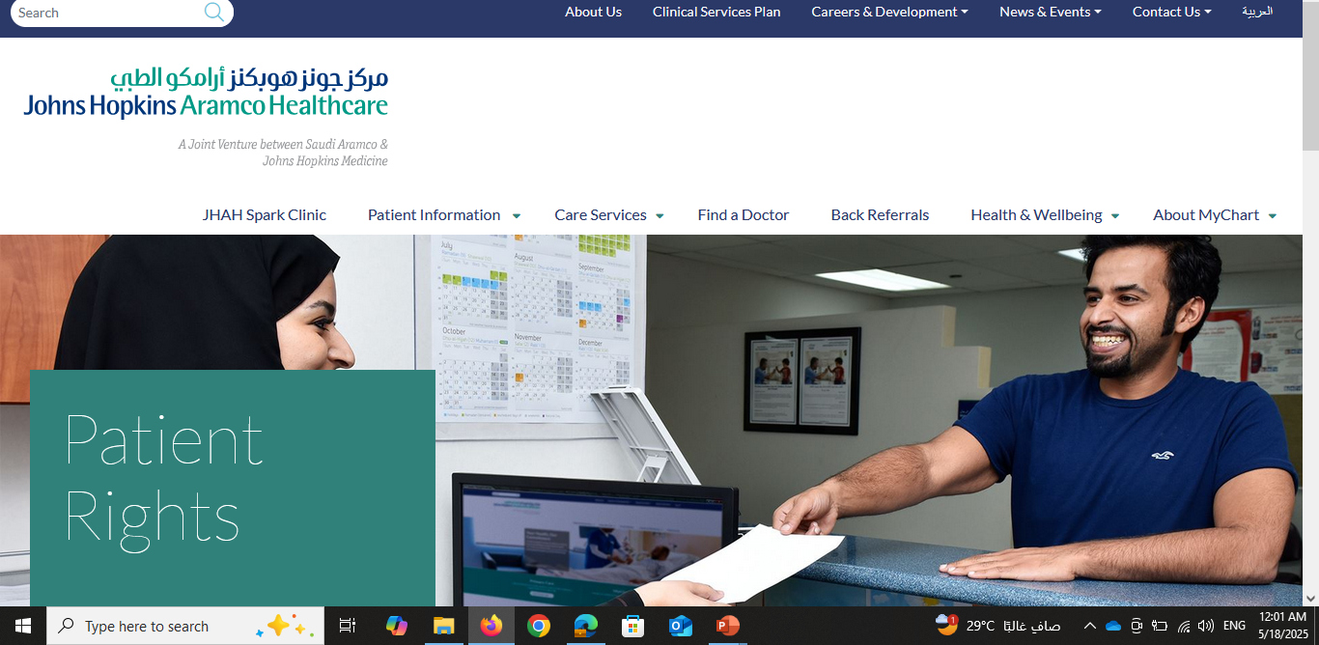
Conclusion

Slide 39
Chapter
Duties and Responsibilities of Physician and Patient
02
Duties and responsibilities of physician
Patients Bill of Rights
Patients Rights
Patients Responsibilities
Unethical Acts
Punishment & Disciplinary Action

Slide 40



Thank You

