Slide 1




Organizational Behavior and Projects
PMG421
Prepared by Mrs. Deena Ibrahim
Introduction

Slide 2



2nd term, 2023

Slide 3

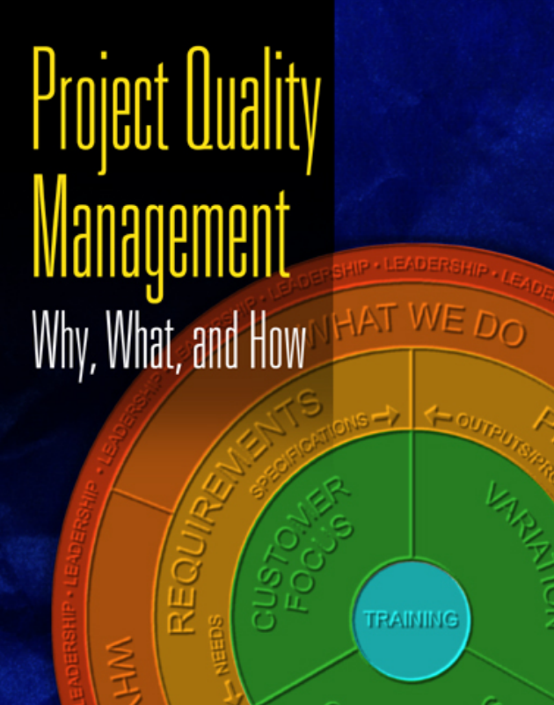

Slide 4

Lecture 2: Evolution of Quality and Its Contemporary Application to Projects. | Lecture 1: Quality Foundations.
Lecture 4: Project Quality Assurance | Lecture 3:- Pioneers and Paradigms. Project Quality Planning.
Lecture 6: Tools for Managing Project Quality. | Lecture 5: Project Quality Control and Quality Improvement.
Lecture 8: Analyzing Project Processes. | Lecture 7: Understanding Project Processes.
Lecture 10: Common Project Practices. | Lecture 9: Solving Project Problems.

Slide 5
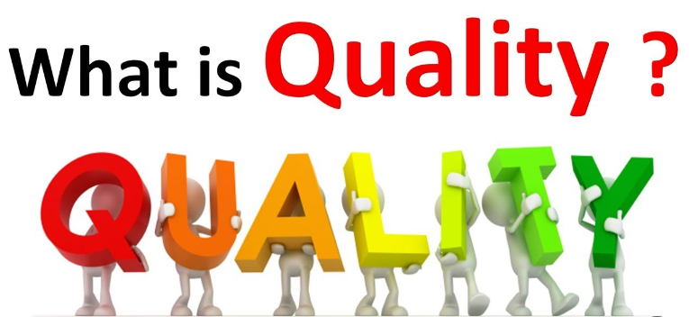

Slide 6

Quality means “Performance upon expectations” and “fit for functions.”
A product is said to be of good quality if it satisfies the customer requirements in terms of performance, grade, durability, appearance and intended use/purpose, etc.

Slide 7

Quality Definitions:
The word “Quality” has a variety of meanings and definitions which are mentioned below:
1- Fitness for use/purpose: The component is said to possess good quality if it works well in the equipment for which it is meant. In other words, the product should be suitable for the intended use/purpose. Thus it is defined as fitness for purpose.
2- Conformance to requirements: It is the ability of the material/component to perform satisfactorily in the application for which it is intended by the user. Quality of a product, thus, means conformance to customer’s requirements. This is a Manufacturing-based definition.

Slide 8

3- Grade: It is a distinguishing feature or grade of the product in appearance, performance, life, taste, and maintainability, etc. This is generally called quality characteristics.
Degree of Excellence: It is a measure of a degree of excellence at a suitable price and control of variability at a suitable cost. this is often a Value-based definition.
Degree of preference: It is the degree to which a particular product is preferred over competing products of similar grade, supported comparative test by customers, normally called as customer’s preference.

Slide 9

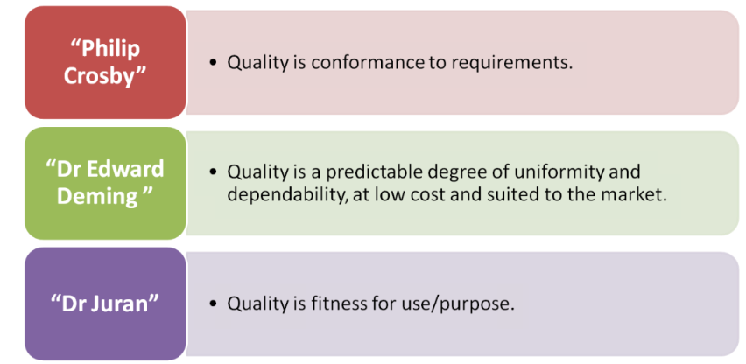

Slide 10
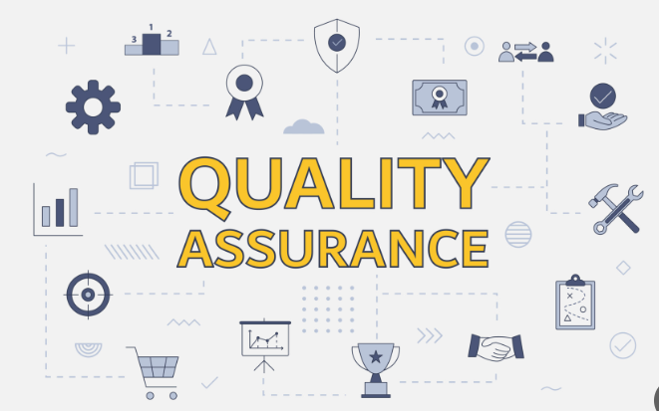
Quality Assurance,
QA contains all those planned and systematic actions necessary to supply adequate confidence that a product or service will satisfy/fulfill given requirements for Quality.
QA includes QC, but it emphasizes quality in the design of products and processes.

Slide 11
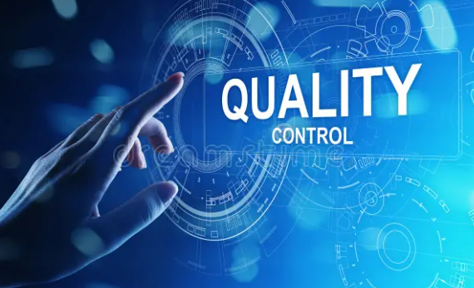
Quality Control,
QC is the process through which we measure the actual quality performance and compare it with the set standards.
And if there is a deviation then we take corrective actions.
The typically quality control program is based on the periodic inspection, followed by feedback of the results and change or adjustment whenever required.

Slide 12

Total Quality Management – TQM
It basically aims to involve every person from every function or department of an organization working together to eliminate defects/errors and prevent Waste from the manufacturing process.

Slide 13
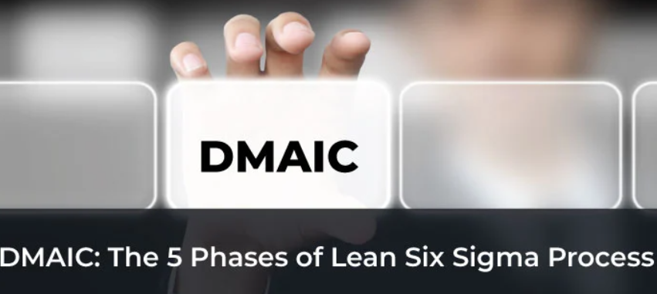
The 5 Phases of Lean Six Sigma Process

Slide 14
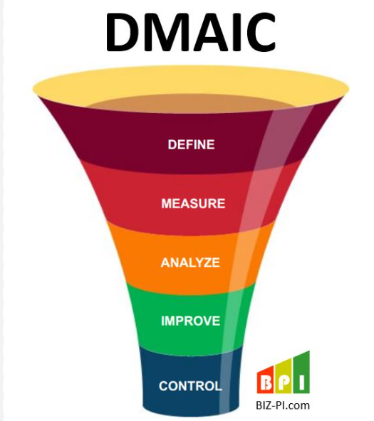
DMAIC: (Define, Measure, Analyze, Identify, and Control) is an approach used to refine projects and deliver tangible results. DMAIC is one of the best Six Sigma problem-solving processes that has found widespread acceptance around the world.
The DMAIC rests on fundamental principles that are:
- Driven by data, facts, results-oriented, and metrics.
- It is a project-based work which is short-term in nature.

Slide 15
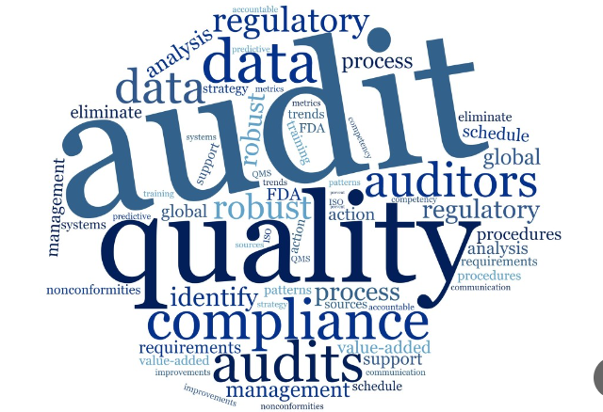
Quality Audit
A systematic and independent examination to determine whether quality activities and related results comply with planned arrangements or defined standard operating procedures.

Slide 16
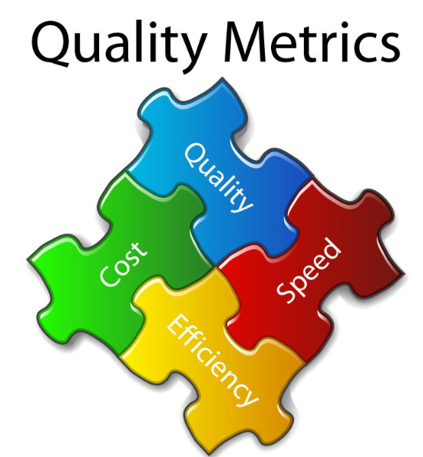
What is Quality Metrics
Quality Metrics are a vital part of project management. By tracking and measuring the quality of your projects, by tracking quality metrics, you can make sure that your project is always moving in the right direction and that any problems are quickly addressed.

Slide 17


