Slide 1


Machine Learning
for Finance
Prepared by Dr. Diaa Salama
FNT633
Orientation Week
Lecture 0

Slide 2




Machine Learning
for Finance
Lecture 0
FNT633
Orientation Week
Prepared by
Dr. Diaa Salama
www.midocean.ae

Slide 3

www.midocean.ae
Associate Professor, Data Science Department, Faculty of Computers Science , Misr International University, On Leave from Faculty of Computers & Artificial Intelligence, Banha University, Banha, Egypt.
Member, National Committee of Communications and Information Technology, Academy of Scientific Research & Technology, CAIRO, Egypt.
Member, International Telecommunication Union (ITU), United Nations (UN)
Member, International Federation for Information Processing - IFIP
Winner of the Arab Republic of Egypt Encouragement Award for Advanced Science and Technology in the Field of Engineering Sciences 2021
Winner of the Benha University Encouragement Award for Advanced Science and Technology in the Field of Engineering Sciences 2019
Winner of the DELL EMC AWARD for the academic year 2015/2016, 2016/2017, and 2017/2018
Dr.Diaa Salama Ph.D
One of the top 2% Scientists worldwide 2023 by Stanford university ranking.
Email: diaasalama@midocean.edu.km

Slide 4
Week
Master of Financial Technology
01
After completion of the program, the graduate becomes eligible to
The Master of Financial Technology focuses on developing FinTech services.
  The program emphasizes the systematic understanding of new digital business models in financial services,
  how innovation through technology is changing business practices,
  quantitative finance skills, and the application of emerging technologies to financial services.
www.midocean.ae

Slide 5
Week
Degree Requirements
01
To earn a master’s degree in Financial Technology (FinTech), the student must complete a minimum of 30 credit hours of credit upon graduation and successfully complete the required scientific seminars of the programs.
Period of study
    3 terms
www.midocean.ae

Slide 6
Week
Careers
01
After completion of the program, the graduate becomes eligible to work in several jobs, including:
    Data Specialist
    Quantitative Analyst
    Application Developer
    Machine Learning Engineer/Analyst
    Blockchain Developer
www.midocean.ae

Slide 7
Week
Course Basics data
01
Instructor: | Associate Professor : Diaa Salama
Subject Name: | Machine Learning in Finance
Subject Code: | FNT633
Program name: | Master of Financial Technology
University Name: | Midocean
Faculty | Faculty of Humanities
Department | Financial Technology
Academic Year | 2024
Teaching Language | Course are in English, with explanations provided in Arabic.
Date of establishment of the curriculum plan/Date of review of the curriculum plan. | 2024
www.midocean.ae

Slide 8
Week
Course Objectives
01
After finishing this course, students are expected to learn the following objectives :
    Understand the fundamental concepts of machine learning.
    Explore the application of machine learning techniques in the financial industry.
    Develop practical skills to implement machine learning solutions in finance.
    Analyze the impact and future trends of machine learning in finance.
www.midocean.ae

Slide 9
Week
Course Description
01
This course provides a comprehensive introduction to machine learning and its applications in the financial sector.
  Students will learn about various machine learning techniques, from fundamental concepts to advanced algorithms, and how these can be applied to solve real-world economic problems.
  The course covers data processing, feature engineering, supervised and unsupervised learning, and natural language processing, focusing on their relevance to financial forecasting, credit scoring, risk management, algorithmic trading, and regulatory compliance.
  Through lectures and case studies, participants will gain practical experience implementing machine learning models using economic data.
www.midocean.ae

Slide 10
Week
Course Information
01
English/Arabic
80–90-minute videos
Practice Questions by the end of each domain
Extra study resources (if needed)
YOU MUST KNOW THE BASICS FIRST
www.midocean.ae

Slide 11
Week
Course Information
01
Work and Grading:
  10 Weeks and Weekly Exam (each Week 8 marks , Final Exam 20 marks)
  homework assignments:
    Part 1: interactive, solve together
    Part 2: written, solve together, write up alone, electronic submission through Moodle
  Fixed scale
Contests!
www.midocean.ae

Slide 12
Week
Course Information
01
Communication:
During Discussion panels
SIS tickets
Course technology:
New infrastructure
Help us make it awesome!
www.midocean.ae

Slide 13
Week
Prerequisites
01
Prerequisites:
No specific prerequisites
No work experience in cybersecurity.
Only
  Basic information technology (IT) knowledge & Network basics) & Math courses.
  Basic English understanding
www.midocean.ae

Slide 14

Week
This could be achieved through the following:
01
- Class Lectures
- Tutorials
– Weekly Exam.
– In-Class activities and attendance.
– Final examination.
Problem Solving
www.midocean.ae

Slide 15
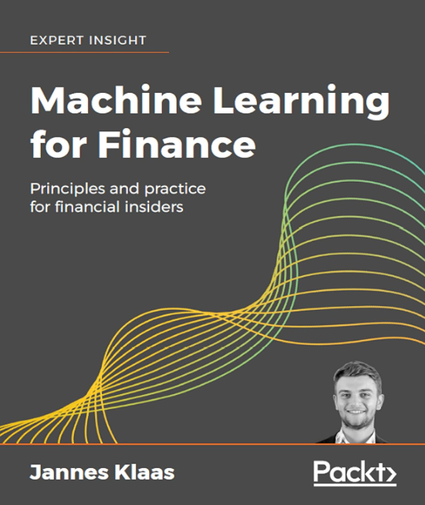
Week
Text Book
01
Not required, but for students who want to read more we recommend
  Machine Learning for Finance: Principles and practice for financial insiders
  Warning: Not a course textbook, so our presentation does not necessarily follow the presentation in the book.
www.midocean.ae

Slide 16
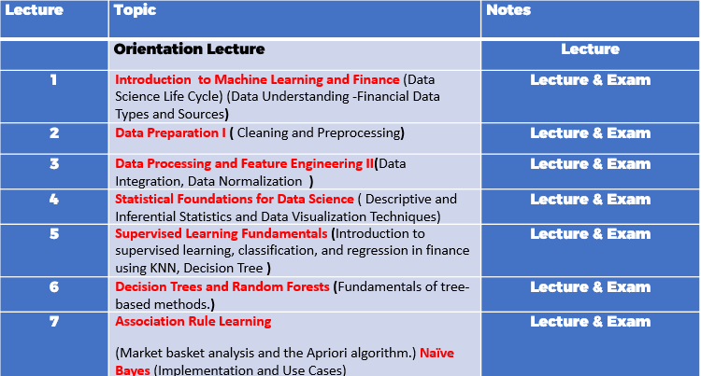
Week
Course content and Weekly plan
01
8 | Time Series Analysis I- Models and Forecasting | Lecture & Exam
9 | Unsupervised Learning in Finance (Clustering algorithms and their applications.) | Lecture & Exam
10 | Natural Language Processing for Financial News NLP techniques for sentiment analysis. Impact of news on market movements. Dimensionality Reduction Techniques - PCA and t-SNE | Lecture & Exam
11 | Revision
12 | Final Exams
13 | Final Exams
 | Final Exams
www.midocean.ae

Slide 17
Week
01
Course Structure (five Modules)
Module 1: Introduction to Machine Learning
  Overview of machine learning and its history.
  Types of machine learning: supervised, unsupervised, and reinforcement learning.
  Key algorithms and techniques.
Module 2: Data Handling and Preprocessing
  Financial data sources and formats.
  Data cleaning and preprocessing techniques.
  Feature engineering and selection.
Module 3: Data Analysis
    Data Visualization
    BoxPlot , Five number summery
www.midocean.ae

Slide 18
Week
01
Course Structure (five Modules)
Module 4: Predictive Modeling in Finance
  Supervised Learning
      Regression models for financial prediction.
      Classification models for credit scoring and risk assessment.
  Unsupervised Learning
      K means Clustering
  Forecasting Methods
      Time series analysis and forecasting.
      Moving Average , Weight Moving Average , ARIMA , Forecasting Including Trend
  Association Rule
      Apriori Algorithm
  Natural Language Processing for Financial News
      NLP techniques for sentiment analysis.
      Impact of news on market movements.
      Dimensionality Reduction Techniques - PCA and t-SNE
www.midocean.ae

Slide 19
Week
01
Course Structure (five Modules)
Module 5: Practical Implementation and Case Studies
  Hands-on projects
  Case studies from industry leaders.
  Ethical considerations and regulatory environment.
www.midocean.ae

Slide 20
Week
Exam Overview
01
10 Weekly Exams MCQs / each Exam 8 Questions
Exam Availability: English
Final Exam MCQs / 20 Questions
www.midocean.ae

Slide 21
Week
01
Recommended Textbooks and Main References
"Machine Learning for Finance: Principles and Practice for Financial Insiders" by Jannes Klaas
Machine Learning for Asset Managers" by Marcos López de Prado
  ISBN: 978-1108792891
"Advances in Financial Machine Learning" by Marcos López de Prado
  ISBN: 978-1119482086
"Hands-On Machine Learning for Algorithmic Trading: Design and Implement Algorithmic Trading Systems Using Python and Advanced Data Analysis" by Stefan Jansen
  ISBN: 978-1839217715
"Python for Data Analysis: Data Wrangling with Pandas, NumPy, and IPython" by Wes McKinney
  ISBN: 978-1491957660
"Introduction to Machine Learning with Python: A Guide for Data Scientists" by Andreas C. Müller and Sarah Guido
  ISBN: 978-1449369415
"Artificial Intelligence in Finance" by Yves Hilpisch
  ISBN: 978-1492055433
Textbooks:
www.midocean.ae

Slide 22



Thank You

