Slide 1



Corporate Entrepreneurship and Innovation
Prepared by Dr. Ibrahim Siam
ENT628
Entrepreneurship
Lecture 8

Slide 2



Chapter
Strategy and business model development
12
CONTENTS
  Levels of strategic planning
  Identifying core competencies
  Developing strategy
  Business model development
  The New Venture Creation Framework
  The Business Model Canvas
  The Lean Canvas
  Generic business models
  Business models for virtual products
  Project-level review - pivoting
  Corporate-level strategic review
ENT628
Entrepreneurship

Slide 3
Strategy and business model development
Chapter
08
LEARNING OUTCOMES
Understand and explain what makes an organization's core competencies and capabilities;
Understand and explain how business strategy is developed and how business model frameworks can facilitate this;
Critically analyze a business model using the New Venture Creation Framework;
Understand and explain the importance of differentiation and customer focus or intimacy in developing a business model and its impact on the price a company is able to charge;
Understand and explain the different sorts of business models that have been developed for Internet businesses
ENT628
Entrepreneurship

Slide 4
Chapter
Levels Of Strategic Planning
11
A business model is the plan for how a business competes, uses its resources, structures its relationships, communicates with customers, creates value and generates profits.
For a company operating within a single product /market, it constitutes the central part of their strategic plan.
For a company operating in a number of different product /markets, each product /market will have its own business model and plan. There may even be variations for different market segments. These must link and be consistent with the overall strategic plan of the organization.
ENT628
Entrepreneurship

Slide 5
Chapter
11
Levels Of Strategic Planning
  for example by taking the firm into new markets. The two plans are symbiotic.
  The first is 'business' or 'competitive strategy; which is how the organization competes. The business plans for individual product /market developments feed into this.
  The second form is 'corporate strategy; which also includes the scope of the organization (i.e. the sec­ tors within which it operates) and structure of the organization, including its overall archi­texture.
ENT628
Entrepreneurship

Slide 6
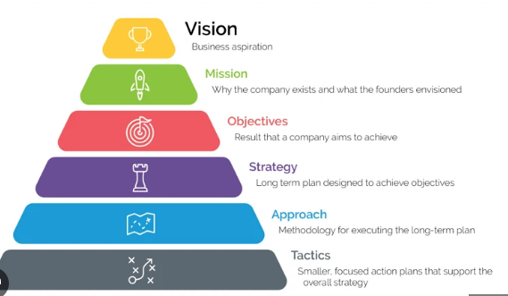
Chapter
Levels Of Strategic Planning
11
New product /market developments can shift the scope of an organization, intentionally or unintentionally. In a multi-product /market organization, business or com­petitive strategy is usually determined at the divisional or subsidiary level whilst corporate strategy is decided on at the head office or holding company level
ENT628
Entrepreneurship

Slide 7
Chapter
Identifying Core Competencies
11
The secret to successful strategy development for any organization starts with identifying its unique set of core competencies and capabilities - the things it does best, its strengths. These might include skills, technical capabilities, pooled knowledge or market leverage such as branding or distribution.
This is a portfolio of resources that can be combined in various ways to meet the opportunities or threats that the organization faces and give it a competitive advantage.
Identifying the core competencies of an organization underpins the process of strategic review and the SWOT (strengths, weaknesses, opportunities and threats) analysis used to aid it
ENT628
Entrepreneurship

Slide 8
Chapter
Identifying Core Competencies
11
Competencies are the glue that binds existing businesses. They are also the engine for new business development: They suggested that there were three tests that can be applied to identify core competencies:
They should provide potential access to a wide variety of markets rather than generating competitive advantage only in one.
They should make 'a significant contribution to the perceived customer benefits of the end-product' -they add value.3
They should be difficult for competitors to copy. Products are easier to copy than pro­cesses and, as this book outlines, an entrepreneurial architecture should be particularly difficult to copy.
ENT628
Entrepreneurship

Slide 9

Chapter
Developing Strategy
11
Once the core competencies of an organization are identified, it can start to plan how to respond to the opportunities and threats that it faces. A strategy is simply a plan as to how to achieve a longer-term goal.
It comprises a series of interlinked actions or tactics. The specific goal in any time period should be quantifiable and measurable. It should help the organization towards achieving its long-term vision -what it might become. This is framed by the organization's mission -what it aims to achieve and how it will achieve it. The mis­sion usually identifies the areas of activity of the business (its scope) and even the basis of its competitive advantage
ENT628
Entrepreneurship

Slide 10
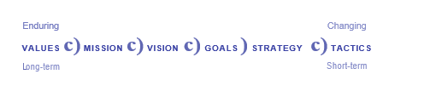
Chapter
Developing Strategy
11
These actions and tactics can themselves be made up from any number of other plans. This process was shown in Figure 6.1, which is reproduced in this chapter as Figure .
In many ways how strategy is developed is the most distinctive feature of an entrepreneurial organization
ENT628
Entrepreneurship

Slide 11
Chapter
Developing Strategy
11
In Chapter 6, we characterized the entrepreneurial leader as develop­ing a strong vision that helps build a strategic intent within the organization; as someone who is continually strategizing, meaning that strategy will often be seen externally as emer­gent; and as someone who always has a number of strategic options that give the organiza­tion flexibility should circumstances change.
They were also characterized as exercising dispersed or distributed leadership, which ensures that the process of strategy develop­ment is also dispersed rather than centralized and coordinated rather than controlled, and that information and knowledge flow freely within the organization so as to encourage flexibility and adaptability.
ENT628
Entrepreneurship

Slide 12
Chapter
Developing Strategy
11
Leading -This scale gauges the degree of respect and deference shown to authority figures (power distance}. (China, Russia)
Deciding -This scale measures how group decision-making is consensually compared to relying on one person (the boss). (Japanese)
Trusting -This scale balances task-based trust (from the head} with relationship ­based trust (from the heart). In task-based cultures (e.g., the USA, the UK, Germany) trust is built through work. In relationship -based societies (e.g., Brazil, China, India} trust is built by personal networks
The 'Entrepreneurial School' :
of strategy is focused 'exclusively on the single leader' - the entrepreneur: 'Under entrepreneurship, key decisions concern­ing strategy and operations are centralized in the office of the chief executive. Such central­ization can ensure that strategic response reflects full knowledge of the operations. It also encourages flexibility and adaptability: only one person needs to take the initiative: For them, the entrepreneurial school 'stresses the most innate of mental states and processes -intuition, judgment, wisdom, experience, and insight.
It is also to ensure that 'intuition, judgment, wisdom, experience, insight' - which are all part of a learning organization -are captured as part of the culture of the organization.
ENT628
Entrepreneurship

Slide 13
Chapter
Developing Strategy
11
The 'Positioning School' treats strategy development as a rational, deductive, more deliberate process that can be depicted as a logical sequence of operations. By way of con­trast, academics in what is called the 'Process School' would argue that the strategic process is so inextricably interlinked that what you need to do to understand strategy is to look at how it is actually developed, rather than how it ought to be developed.
ENT628
Entrepreneurship

Slide 14
Chapter
Developing Strategy
11
Leading -This scale gauges the degree of respect and deference shown to authority figures (power distance}. (China, Russia)
Deciding -This scale measures how group decision-making is consensually compared to relying on one person (the boss). (Japanese)
Trusting -This scale balances task-based trust (from the head} with relationship ­based trust (from the heart). In task-based cultures (e.g., the USA, the UK, Germany) trust is built through work. In relationship -based societies (e.g., Brazil, China, India} trust is built by personal networks
The development of strategy can be both deliberate and emergent, but at different times and in different circumstances. As we observed in Chapter 1, whilst executives tend to set goals and seek to achieve them sequen­tially and logically, entrepreneurs' goals are broad and evolved over time based on whatever personal strengths and resources they had, creatively reacting to contingencies as they occur - an approach which Sarasvathy (2001) calls 'effectual reasoning' or 'effectuation: However, these strategies and goals must always be underpinned by a strong vision or direction -again one that is deliberate but also adaptable.
Timely emergent strategy neces­sitates continuous strategizing, informed by good information flows which should lead to the development of strategic options for evaluation. This process is needed at both the organization and project level.
Continuous strategizing encourages the development of a consensus strategy' -important for a project team developing a new product.
ENT628
Entrepreneurship

Slide 15
Chapter
Developing Strategy
11
Leading -This scale gauges the degree of respect and deference shown to authority figures (power distance}. (China, Russia)
Deciding -This scale measures how group decision-making is consensually compared to relying on one person (the boss). (Japanese)
Trusting -This scale balances task-based trust (from the head} with relationship ­based trust (from the heart). In task-based cultures (e.g., the USA, the UK, Germany) trust is built through work. In relationship -based societies (e.g., Brazil, China, India} trust is built by personal networks
It informs, involves, and motivates a team. To quote Mintzberg et al. (1998): 'A successful strategy is one that committed people to infuse with energy: they make it good by making it real - and perhaps making it themselves: Continuous strategizing evolves from the process of learning (and making mistakes) but is focused by agreement to a common vision and mission.
In that sense, entrepreneurial strat­ egy can also be both deliberate in overall vision and emergent in how the details of the vision unfold. Furthermore, strategy development and action can proceed side by side, rec­ognizing that the future is not predictable and planning cannot, therefore, be a simple, linear process. It is non-linear and adaptive, even sometimes opportunistic.
ENT628
Entrepreneurship

Slide 16
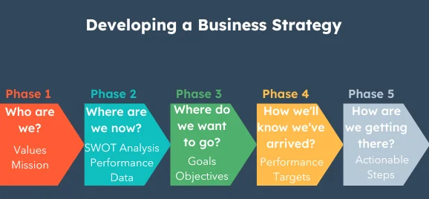
Chapter
Developing Strategy
11
Actions (both successful and unsuccessful) feed into strategy development. Decision-making can be incremental and adaptive so as to maintain the maximum flexibility and adaptability needed to capitalize on change and make the most of any commercial opportunities that appear. Complexity theory shows how direction can be given to these individual decisions through the capacity to self-organize (through identity, information, and relationships).
ENT628
Entrepreneurship

Slide 17
Chapter
Business Model Development
11
The business model is the route to taking a business idea to market and it will have a very large impact on whether or not the idea is successful.
A good business idea can fail because of a bad model and a poor idea can survive because it has a good one. Some might say it is actually more important than the product or service idea itself. A business model is a stra­tegic framework that gives the business idea direction and generates its competitive advan­tage. It is a commercial framework that creates a common language for the project team and a mechanism for communication as the commercial potential of the idea is developed.
ENT628
Entrepreneurship

Slide 18
Chapter
Business Model Development
11
It helps with distributed strategizing. It allows the team to identify patterns and ask the impor­tant 'What-if?' questions and work through the likely consequences. These questions help identify strategic options, each option contingent upon different circumstances, using infor­mation to modify strategies to reflect the reality of these uncertain situations.
The more options that can be identified, the more flexibility there is in formulating or indeed pivoting and changing the strategy. Not all options should be constrained by current resources or the current competitive position. These constraints might change over time and sometimes the vision for the project might generate options that transcend these constraints anyway.
ENT628
Entrepreneurship

Slide 19
Chapter
Business Model Development
11
Developing a business model involves producing plans about how the product or service will be produced and marketed, the resources (both human and financial} needed to do this, and the resulting costs and revenues.
Developing the model involves iterations -going back over the building blocks to ensure consistency and coherence in the model. Alter how a product or service is produced or delivered and price may have to be altered, which in turn affects how it is marketed. This is a continuous process of refinement. What is important is that all of the elements of the business model are consistent and deliver the all-important value proposition to the target customers. The challenge is to develop a model that is attractive to customers as well as sponsors within the company. It is worth remembering that the two may not be mutually consistent.
ENT628
Entrepreneurship

Slide 20
Chapter
Business Model Development
11
There are a number of generic business model frameworks that provide pictorial and/or verbal structures to aid the understanding and development of a business model. The best are minimalist and simple - they force focused thinking and succinct communication.
Nevertheless, the structure they use provides a coherent but flexible framework that helps the team develop their ideas. A framework needs to be flexible as it will probably change as feedback and market information becomes available. However, it also needs to ensure con­sistency, so that if one element of the model is altered another can be adjusted appropri­ately.
ENT628
Entrepreneurship

Slide 21
Chapter
Business Model Development
11
his chapter will outline three business model frameworks: the New Venture Creation Framework; the Business Model Canvas; and the Lean Canvas. All three models cover simi­lar ground and are consistent, although they do use slightly different terminologies.
However, the New Venture Creation Framework develops the elements of a business model in a sequential manner consistent with developing a new business or product/service, whereas the others work best with existing products/services. The advantage of developing any of these business models in this way is that they are (relatively) quick to develop and easy to change.
ENT628
Entrepreneurship

Slide 22
Chapter
Business Model Development
11
The general rule of prudent financing is to match the term duration of the loan with the term duration of the use to which it is put. Hence long-term loans should be used to finance long-term projects or the purchase of fixed assets. However, lenders are usually unwilling to lend for the development of more innovative longer-term projects, where the return is uncertain and does not materialize until some way into the future. For these reasons, they see such projects as too risky.
However, whilst financiers may be unwilling to lend against a specific project, they may be willing to lend to an established business that has a track record of successful trading on the basis that its portfolio of products or services generates sufficient income to cover the interest and loan repayments.
ENT628
Entrepreneurship

Slide 23
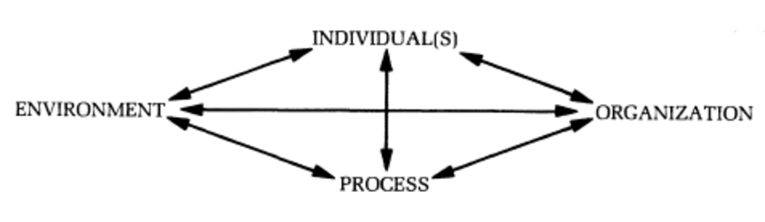
Chapter
The New Venture Creation Framework
11
The New Venture Creation Framework comprises the five sequential
1. Market segments and the value proposition - This stage involves identifying keycus­ timers or groups of customers (target market segments) and their specific needs so as to tailor the value proposition for each group. The value proposition is the bundle of prod­ucts or services that satisfies customers' needs or solves their problems. This includes emotional as well as physical needs and therefore how customer relationships might be cemented through the values embedded in the product or service and its branding.
ENT628
Entrepreneurship

Slide 24
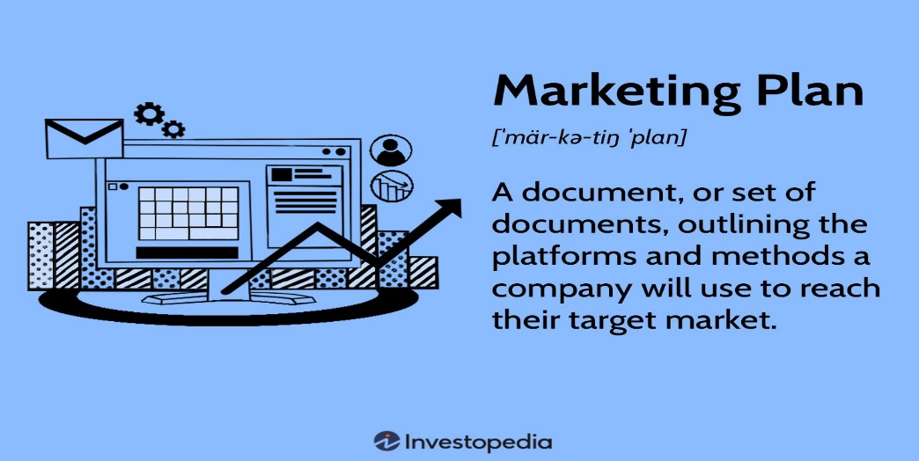
Chapter
The New Venture Creation Framework
11
2. Marketing plan - The marketing plan describes how to target these customers and deliver the value proposition to them through a consistent marketing mix (product/ service, price, promotion, channels of distribution, etc.), persuading them to purchase the product or service and then become loyal, repeat customers, and how the venture might be scaled-up beyond launch.
ENT628
Entrepreneurship

Slide 25
Chapter
The New Venture Creation Framework
11
3. Operations plan - The operations plan highlights the practical things that need to be done to launch a new venture: the key activities, critical success factors and the strategic options, available if plans change. This involves identifying the risks facing the venture and how they will be monitored and mitigated, for example through partnerships.
4. Resources -This stage identifies the resources or capital available as well as needed for the venture: human, social and financial. The capital available and the capital needed influence and are influenced by the business model.
5. Financial plan -This stage involves pulling the plan together to show the financial con­ sequences of the decisions made in developing the business model: sales, costs, profit­ ability, breakeven and cash flow
ENT628
Entrepreneurship

Slide 26
Chapter
The Business Model Canvas
11
Whilst the New Venture Creation Framework was designed to facilitate the development of a business model for a new product /service, the Business Model Canvas, developed by Osterwalder and Pigneur (2010) and shown in Figure 12.4, has a more general application and is widely used for established product /services.
Whilst Business Model Canvas covers the same ground as the New Venture Creation Framework, there is no sequential process and differ­ ent elements of a business model are emphasized. It comprises nine interlinked building blocks, each influencing the other
ENT628
Entrepreneurship

Slide 27
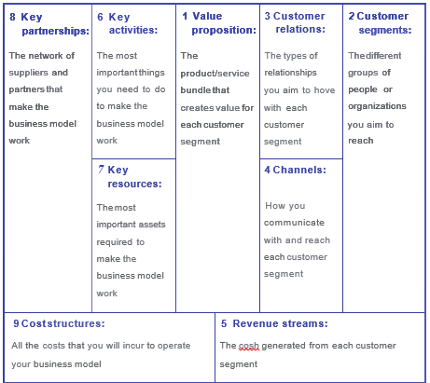
Chapter
The Business Model Canvas
11
ENT628
Entrepreneurship

Slide 28
Chapter
THE LEAN CANVAS
11
Osterwalder and Pigneur encouraged the challenging of conventional business models using six techniques in conjunction with their Canvas:
Generating new ideas -encouraging you not always to accept the 'dominant logic' of how to do things in a particular industry;
Prototype development - encouraging you to explore alternative business models that might add value for customers;
Storytelling - encouraging you to be able to articulate the concept behind the prod­uct/service and how it creates value for customers;
ENT628
Entrepreneurship

Slide 29
Chapter
THE LEAN CANVAS
11
The generic Business Model Canvas was developed for larger, established businesses. Rather than developing a new model, Maurya (2010, 2012) modified it to better suit web­ based start-ups and similar small-scale projects. He acknowledged that 'it may have been easier to lay out a new canvas differently: Shown in Figure 12.5, he called this the Lean Canvas. He modified four of the original nine blocks in the Business Model Canvas
ENT628
Entrepreneurship

Slide 30
Chapter
THE LEAN CANVAS
11
Box 3 Customer relations became 'Unfair advantage'. This was just another name for 'com­ positive advantage; which is what any marketing plan should seek to gain. Despite its importance, he justified the exclusion of 'customer relations' on the grounds that it was included in 'channels' [original box 4].
Box 6 Key activities became 'Solutions: These were the solutions to the problems that Mauyer added to the canvas [new box 8]. He justified the exclusion of 'key activities' [original box 6] on the grounds that it was too 'outside-in' -'helping outsiders look­ing in to understand what the start-up did:
ENT628
Entrepreneurship

Slide 31
Chapter
THE LEAN CANVAS
11
Box 7 Key resources became 'Key metrid He defined this as 'the few actions that matter‘ what we have called 'critical success factors: He justified the exclusion of 'key resources' on the grounds that 'we need fewer resources than ever to get a product to market' - a claim that might be questioned.
Box 8 Key partnerships became 'Problems' . These were the key problems that the value proposition seeks to solve for customers. Meyer admitted that 'key partnerships' was the hardest block to remove and, for me, partnerships remain an important way of identifying an approach to solving the problems of risk and resources faced by any start-up as well as signalling a way of working in the future.
ENT628
Entrepreneurship

Slide 32
Chapter
THE LEAN CANVAS
11
Maurya highlighted the feedback loops needed to monitor customer feedback on an MVP - a learning cycle that turned ideas into products, measured customers' reactions for and against these products, and then decided whether or not to persevere or pivot the idea. The now-familiar process could be repeated as many times as necessary:
Idea Build Product Measure Data Learn
ENT628
Entrepreneurship

Slide 33
Chapter
Generic Business Models
11
There are two strategic dimensions to any business model that combine to affect the price a company is able to charge (and therefore the profit it is likely to make) and have implica­tions for how operations should be organized:
Differentiation -where customers value the other elements of the marketing mix more than price and are therefore willing to pay a premium. Differentiation means setting out to be unique in the industry with regard to some dimensions that are widely valued by customers. These can be based upon the product or service and can be tangible (observable product/service characteristics such as function, quality, performance, or technology etc.) and/or intangible (customer needs such as status, exclusivity etc.).
ENT628
Entrepreneurship

Slide 34
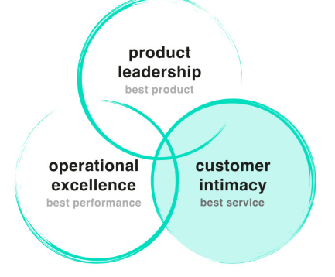
Chapter
Generic Business Models
11
Customer focus or intimacy
-where knowledge of customer needs to be the greatest, allowing the product or service to be more closely tailored to their specific needs. The key to this is close customer relations and this approach goes hand in hand with effective market segmentation. It is often based on good customer service, but it can also be the result of effective marketing appealing particularly to the emotions of buyers.
ENT628
Entrepreneurship

Slide 35
Chapter
Creative Environments
11
The more a product or service is different to competitors and the closer and more focused the company is on the needs of customers, the higher the price it is likely to be able to command.
These dimensions are important and can be applied to a wide range of businesses to produce fundamental ways of creating sustainable competitive advantage. Clear differentiation often goes with well-aimed market segmentation as it is easier to differentiate in a small, clearly identified market. The key to segmentation is the ability to identify the unique benefits that a product or service offers to potential customers.
ENT628
Entrepreneurship

Slide 36
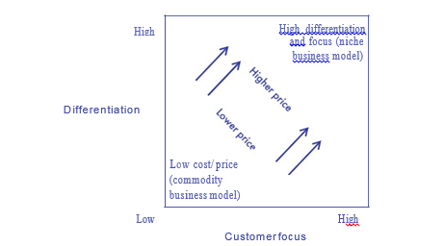
Chapter
Knowledge And Learning
11
, what proportion of customers focus on it as their primary or dominant decision criterion
Which competitors provide the best value in each of these value dimensions.
How does the product /service compare to the competition on each dimension
ENT628
Entrepreneurship

Slide 37
Chapter
Business Models For Virtual Products
11
New business models are emerging all the time, particularly for businesses that produce virtual products such as computer programmes, apps, videos, etc. -often called 'knowledge products: They face a particular set of challenges because, once developed, the product is available for downloading again and again at virtually zero cost to the producer - raising the issue of how to price this sort of 'product' since in theory, under competitive conditions, it should tend to be driven down to that marginal cost.
it can take time to 'monetize' a new internet-based business idea - longer than it does to design the product or service itself. Nevertheless, it is often the case that users have to be found first in order to prove the concept and only afterwards can ways of monetizing it be found - underlining the attractiveness of the 'lean start-up: Some companies generate revues directly from product /services sales
ENT628
Entrepreneurship

Slide 38
Chapter
Business Models For Virtual Products
11
Here are just some of the better-known and more established business models that can generate income for Internet companies. They are not mutually exclusive. Often more than one model is used alongside another, bringing together different market segments that derive value from the presence of the other. This is called a multi-sided market or platform.
Direct sales model - where products or services are sold directly online and delivered by post (e.g., Amazon);
Bricks-and-clicks model -where traditional retail is combined with the direct internet sales model, either with postal delivery or customer collection (e.g., most large retailers such as John Lewis);
Affiliate model -where a company helps sell a product or service, without necessarily taking ownership, in return for commission (e.g., Amazon);
ENT628
Entrepreneurship

Slide 39
Chapter
Corporate-level Strategic Review
11
The success or failure of individual projects (and their business models) can affect the overall strategy of an organization, The process is similar to the one outlined earlier, but at the corporate level. This is the distinction between 'business' and 'corporate' strategy, .The process is given direction by the vision for the organization overall and underpinned by its core values and beliefs.
At the corporate level, the SWOT analysis can use the same tools. It seeks to identify an overlap between the business environment and the firm's resources -a match between the organization's core competencies, capabilities and resources and market opportunities. Again , this gives the whole organization a strategic direction that can then be translated into detailed tactical and operating plans.
ENT628
Entrepreneurship

Slide 40
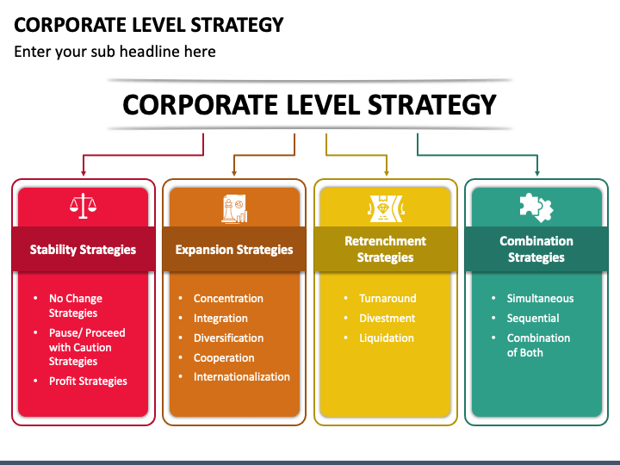
Chapter
Corporate-level Strategic Review
11
ENT628
Entrepreneurship

Slide 41



Thank You

