Slide 1

Supply chain Management
Prepared by Dr. Badur elgasim
Lecture 9
PMG 660
Managing Economies of Scale in a Supply Chain: Cycle Inventory

Slide 2

Learning Objectives
After reading this chapter, you will be able to:
1. Balance the appropriate costs to choose the optimal amount of cycle inventory in a supply chain.
2. Understand the impact of quantity discounts on lot size and cycle inventory.
3. Devise appropriate discounting schemes for a supply chain.
4. Understand the impact of trade promotions on lot size and cycle inventory.
5. Identify managerial levers that reduce lot size and cycle inventory in a supply chain without increasing cost.

Slide 3

The role of cycle inventory in a supply chain
A lot or batch size is the quantity that a stage of a supply chain either produces or purchases at a time. Consider, for example, a computer store that sells an average of four printers a day. The store manager, however, orders 80 printers from the manufacturer each time he places an order. The lot or batch size in this case is 80 printers. Given daily sales of four printers, it takes an average of 20 days before the store sells the entire lot and purchases a replenishment lot.

Slide 4

Cont.
The computer store holds an inventory of printers because the manager purchases a lot size larger than the store's daily sales. Cycle inventory is the average inventory in a supply chain due to either production or purchases in lot sizes that are larger than those demanded by the customer. In the rest of this chapter we use the following notation:
Q: Quantity in a lot or batch size
D: Demand per unit time

Slide 5

Cont.
In this chapter, we ignore the impact of demand variability and assume that demand is stable . Let us consider the cycle inventory of jeans at Jean-Mart, a department store. The demand for jeans is relatively stable at D = 100 pairs of jeans per day.
The store manager at Jean-Mart currently purchases in lots of Q = 1,000 pairs. The inventory profile of jeans at Jean-Mart is a plot depicting the level of inventory over time, as shown in Figure 10-1. below

Slide 6
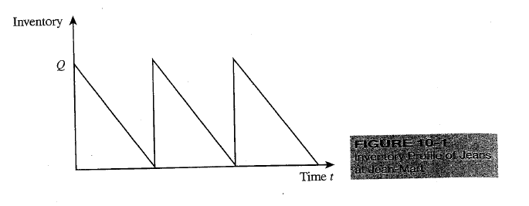
Cont.

Slide 7

Cont.
Because purchases are in lots of Q = 1,000 units, whereas demand is only D = 100 units per day, it takes 10 days for an entire lot to be sold. Over these 10 days, the inventory of jeans at Jean-Mart declines steadily from 1,000 units (when the lot arrives) to 0 (when the last pair is sold).
This sequence of a lot arriving and demand depleting inventory until another lot arrives repeats itself every 10 days, as shown in the inventory profile in Figure 10-1. When demand is steady, cycle inventory and lot size are related as follows: . Cycle inventory/2 = Q/2

Slide 8

Cont.
For a lot size of 1,000 units, Jean-Mart carries a cycle inventory of Q/2 = 500 pairs of jeans. From Equation, we see that cycle inventory is proportional to the lot size.
A supply chain in which stages produce or purchase in larger lots has more cycle inventory than a supply chain in which stages purchase in smaller lots. For example, if a competing department store with the same demand purchases in lot sizes of 200 pairs of jeans, it will carry a cycle inventory of only 100 pairs of jeans

Slide 9
Cont.
Lot sizes and cycle inventory also influence the flow time of material within the supply chain.
Average flow time = average inventory / average flow rate
For any supply chain, average flow rate equals demand. We thus have
Average flow time resulting from cycle inventory =
cycle inventory / demand= Q/2D.
For lot sizes of 1,000 pairs of jeans and daily demand of 100 pairs of jeans, we obtain Average flow time resulting from cycle inventory = Q/ 2D = 1000/ 200 = 5 days

Slide 10
Cont.
Cycle inventory at the Jean-Mart store thus adds five days to the average amount of time that jeans spend in the supply chain. The larger the cycle inventory, the longer is the lag time between when a product is produced and when it is sold. A lower level of cycle inventory is always desirable, because long time lags leave a firm vulnerable to demand changes in the marketplace. A lower cycle inventory also decreases a firm's working capital requirement. Toyota, for example, keeps a cycle inventory of only a few hours of production between the factory and most suppliers. As a result, Toyota is never left with unneeded parts and its working capital requirements are less than those of its competitors. Toyota also allocates very little space in the factory to inventory.

Slide 11
Cont.
Before we suggest actions that a manager can take to reduce cycle inventory, it is important to understand why stages of a supply chain produce or purchase in large lots and how lot size reduction affects supply chain performance. Cycle inventory is held to take advantage of economies of scale and reduce cost within a supply chain. To understand how the supply chain achieves these economies of scale, we first identify supply chain costs that are influenced by lot size. The average price paid per unit purchased is a key cost in the lot sizing decision. A buyer may increase the lot size if this action results in a reduction in the price paid per unit purchased.

Slide 12
Cont.
For example,
if the jeans manufacturer charges $20 per pair for orders under 500 pairs of jeans and $18 per pair for larger orders, the store manager at Jean Mart gets the lower price by ordering in lots of at least 500 pairs of jeans.
The price paid per unit is referred to as the material cost and is denoted by C. It is measured in $/unit.
In many practical situations, material cost displays economies of scale and increasing lot size decreases material cost.

Slide 13
Cont.
The fixed ordering cost includes all costs that do not vary with the size of the order but are incurred each time an order is placed. For example, there may be a fixed administrative cost to place an order, a trucking cost to transport the order, and a labor cost to receive the order. Jean-Mart, for example, incurs a cost of $400 for the truck regardless of the number of pairs of jeans shipped.
If the truck can hold up to 2,000 pairs of jeans, a lot size of 100 pairs results in a transportation cost of $4/pair, whereas a lot size of 1,000 pairs results in a transportation cost of $0.40/pair. Given the fixed transportation cost per batch, the store manager can reduce transportation cost per unit by increasing the lot size.

Slide 14

Cont.
The fixed ordering cost per lot or batch is denoted by S (commonly thought of as a setup cost) and is measured in $/lot. The ordering cost also displays economies of scale, and increasing the lot size decreases the fixed ordering cost per unit purchased. Holding cost is the cost of carrying one unit in inventory for a specified period of time, usually one year. It is a combination of the cost of capital, the cost of physically storing the inventory, and the cost that results from the product becoming obsolete. The holding cost is denoted by H and is measured in $/unit/year. It may also be obtained as a fraction, h, of the unit cost of the product. Given a unit cost of C, the holding cost H is given by H = h/c

Slide 15
Cont.
The total holding cost increases with an increase in lot size and cycle inventory. To summarize, the costs that must be considered in any lot sizing decision are
• Average price per unit purchased, $C/unit
• Fixed ordering cost incurred per lot, $S/lot
• Holding cost incurred per unit per year, $H/unit/year = h C.
The primary role of cycle inventory is to allow different stages in a supply chain to purchase product in lot sizes that minimize the sum of the material, ordering, and holding costs. If a manager considers the holding cost alone, he or she will reduce the lot size and cycle inventory. Economies of scale in purchasing and ordering, however, motivate a manager to increase the lot size and cycle inventory. A manager must make the trade-off that minimizes total cost when making lot sizing decisions.

Slide 16
Economies of scale to exploit fixed costs
To better understand the trade-offs, consider a situation that often arises in daily life-the purchase of groceries and other household products. These may be purchased at a nearby convenience store , which is generally located much farther away. The fixed cost of going shopping is the time it takes to go to either location. This fixed cost is much lower for the nearby convenience store.

Slide 17
Cont.
Prices, however, are higher at the local convenience store. Taking the fixed cost into account, we tend to tailor our lot size decision accordingly. When we need only a small quantity, we go to the nearby convenience store because the benefit of a low fixed cost outweighs the cost of the convenience store's higher prices. When we are buying a large quantity, however, we go to X -shop, where the lower prices over the larger quantity purchased more than make up for the increase in fixed cost.

Slide 18
Lot sizing for a single product (economic order quantity)
As Best Buy sells its current inventory of HP computers, the purchasing manager places a replenishment order for a new lot of Q computers. Including the cost of transportation, Best Buy incurs a fixed cost of $S per order. The purchasing manager must decide on the number of computers to order from HP in a lot. For this decision, we assume the following inputs:
D = Annual demand of the product
S = Fixed cost incurred per order
C = Cost per unit
h = Holding cost per year as a fraction of product cost

Slide 19
Cont.
Assume that HP does not offer any discounts and each unit costs $C no matter how large an order is. The holding cost is thus given by H = hC . The purchasing manager makes the lot sizing decision to minimize the total cost the store incurs. He must consider three costs when deciding on the lot size:
• Annual material cost=CD
• Annual order cost = D/Q*S
• Annual holding cost =Q/S*h

Slide 20
Aggregating multiple products in a single order
To reduce the lot size effectively, the store manager must understand the source of the fixed cost. As pointed out earlier, one major source of fixed costs is transportation.
In several companies the array of products sold is divided into families or groups, with each group managed independently by a separate product manager.
This results in separate orders and deliveries for each product family, thus increasing the overall cycle inventory. Aggregating orders and deliveries across product families is an effective mechanism to lower cycle inventories.

Slide 21
Lot sizing with multiple products or customers
In general, the ordering, transportation, and receiving cost of an order grows with the variety of products or pickup points. For example, it is cheaper for Wal-Mart to receive a truck containing a single product than it is to receive a truck containing many different products, because the inventory update and restocking effort is much less for a single product.
A portion of the fixed cost of an order can be related to transportation (this depends only on the load and is independent of product variety on the truck). A portion of the fixed cost is related to loading and receiving (this cost increases with variety on the truck). We now discuss how optimal lot sizes may be determined in such a setting.

Slide 22
Economies of scale to exploit quantity discounts
There are many instances where the pricing schedule displays economies of scale, with prices decreasing as lot size increases. This form of pricing is very common in business to- business transactions.
A discount is lot size based if the pricing schedule offers discounts based on the quantity ordered in a single lot.
A discount is volume based if the discount is based on the total quantity purchased over a given period, regardless of the number of lots purchased over that period. Two commonly used lot size-based discount schemes are
• All unit quantity discounts
• Marginal unit quantity discount or multiblock tariffs

Slide 23
Cont.
In this section we investigate the impact of such quantity discounts on the supply chain. We must answer the following two basic questions in this context:
Given a pricing schedule with quantity discounts, what is the optimal purchasing decision for a buyer seeking to maximize profits? How does this decision affect the supply chain in terms of lot sizes, cycle inventories, and flow times?

Slide 24
Cont.
2. Under what conditions should a supplier offer quantity discounts? What are appropriate pricing schedules that a supplier, seeking to maximize profits, should offer?
We start by studying the optimal response of a retailer (the buyer) when faced with either of the two lot size-based discount schemes offered by a manufacturer (the supplier). The retailer's objective is to select lot sizes to minimize the total annual material, order, and holding cost. Next we evaluate the optimal lot size in the case of all unit quantity discounts.

Slide 25

Cont.
Pricing schedules with all unit quantity discounts encourage retailers to order in larger lots to take advantage of price discounts.
This adds to the average inventory and flow time in a supply chain. This increase in inventory raises a question about the value that all unit quantity discounts offer in a supply

Slide 26
All unit quantity discounts
In all unit quantity discounts, the pricing schedule contains specified break points q0, q1 ... , qr, where q 0 = 0. If an order placed is at least as large as qi but smaller than qi+ 1, each unit is obtained at a cost of Ci. In general, the unit cost decreases as the quantity ordered increases; that is,
Co ≥ C1 ≥…. ≥ Cr,. The retailer's objective is to decide on lot sizes to maximize profits or, equivalently, to minimize the sum of material, order, and holding costs.

Slide 27

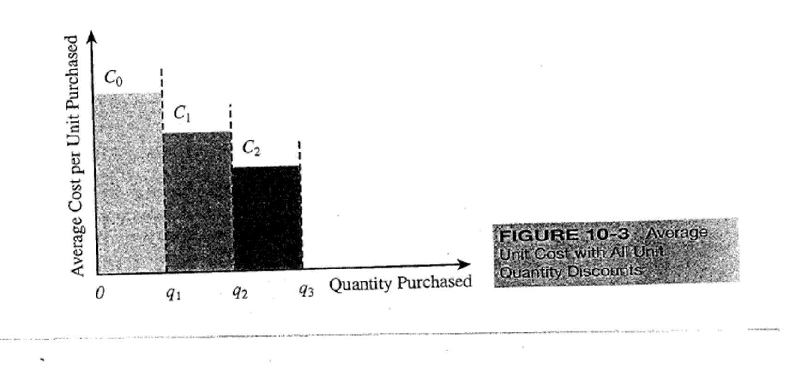
Cont.
For all unit discounts, the average unit cost varies with the quantity ordered, as shown in Figure 10-3.
Observe that under this discount scheme, ordering q 1 + 1 units may be less expensive (in terms of material cost) than ordering
q 1 - 1 units.

Slide 28
Marginal unit quantity discount
Marginal unit quantity discounts are also referred to as multiblock tariffs. In this case, the pricing schedule contains specified break points q 0 , q 1, ... , qr- It is not the average cost of a unit but the marginal cost of a unit that decreases at a breakpoint (in contrast to the all unit discount scheme). If an order of size q is placed, the first q 1 - q0 units are priced at Co, the next q2 - q1 are priced at C1 and so on. The marginal cost per unit varies with the quantity purchased, as shown in Figure 10-4.

Slide 29
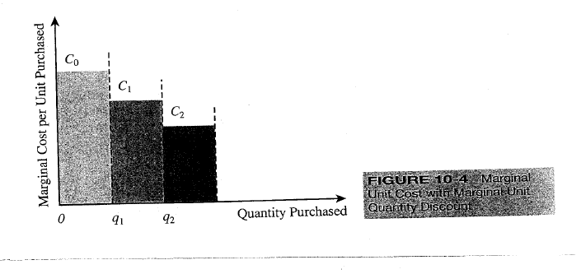
Marginal unit quantity discount

Slide 30
Why quantity discounts?
In this section we develop arguments supporting the presence of quantity discounts in a supply chain. Quantity discounts are valuable in a supply chain for the following two reasons:
1. Improved coordination to increase total supply chain profits
2. Extraction of surplus through price discrimination

Slide 31
Coordination to Increase Total Supply Chain Profits
A supply chain is coordinated if the decisions the retailer and supplier make maximize total supply chain profits. In reality, each stage in a supply chain may have a separate owner and thus attempt to maximize that stage's own profits. The result of this independent decision making can be a lack of coordination in a supply chain because actions that maximize retailer profits may not maximize supply chain profits. In this section we discuss how a manufacturer may use appropriate quantity discounts to ensure that total supply chain profits are maximized even if the retailer is acting to maximize its own profits.

Slide 32
Price Discrimination to Maximize Supplier Profits
Price discrimination is the practice whereby a firm charges differential prices to maximize profits. An example of price discrimination is airlines:
Passengers traveling on the same plane often pay different prices for their seats. setting a fixed price for all units does not maximize profits for the manufacturer. In principle, the manufacturer can obtain the entire area under the demand curve above its marginal cost by pricing each unit differently based on customers' marginal evaluation at each quantity. Quantity discounts are one mechanism for price discrimination because customers pay different prices based on the quantity purchased.

Slide 33
Short-term discounting: trade promotions
Manufacturers use trade promotions to offer a discounted price and a time period over which the discount is effective. For example, a manufacturer of canned soup may offer a price discount of 10 percent for the shipping period December 15 to January 25. For all purchases within the specified time horizon, retailers get a 10 percent discount. In some cases, the manufacturer may require specific actions from the retailer, such as displays, advertising, promotion, and so on, to qualify for the trade promotion. Trade promotions are quite common in the consumer packaged-goods industry, with manufacturers promoting different products at different times of the year.

Slide 34
Cont.
The goal of trade promotions is to influence retailers to act in a way that helps the manufacturer achieve its objectives. A few of the key goals (from the manufacturer's perspective) of a trade promotion are as follows:
1. Induce retailers to use price discounts, displays, or advertising to spur sales.
2. Shift inventory from the manufacturer to the retailer and the customer.
3. Defend a brand against competition.

Slide 35
Cont.
Although these may be the manufacturer's objectives, it is not clear that they are always achieved as the result of a trade promotion.
Our goal in this section is to investigate the impact of a trade promotion on the behavior of the retailer and the performance of the entire supply chain. The key to understanding this impact is to focus on how a retailer reacts to a trade promotion that a manufacturer offers.

Slide 36
Cont.
In response to a trade promotion, the retailer has the following options:
1. Pass through some or all of the promotion to customers to spur sales.
2. Pass through very little of the promotion to customers but purchase in greater quantity during the promotion period to exploit the temporary reduction in price.

Slide 37

Cont.
The first action lowers the price of the product for the end customer, leading to increased purchases and thus increased sales for the entire supply chain.
The second action does not increase purchases by the customer but increases the amount of inventory held at the retailer. As a result, the cycle inventory and flow time within the supply chain increase.

Slide 38
Managing multiechelon cycle inventory
A multiechelon supply chain has multiple stages and possibly many players at each stage.
The lack of coordination in lot sizing decisions across the supply chain results in high costs and more cycle inventory than required.
The goal in a multiechelon system is to decrease total costs by coordinating orders across the supply chain.

Slide 39
Estimating cycle inventory-related costs in practice
When setting cycle inventory levels in practice, a common hurdle is estimating the ordering and holding costs. Given the robustness of cycle inventory models, it is better to get a good approximation quickly rather than spend a lot of time trying to estimate costs exactly. Our goal is to identify incremental costs that change with the lot sizing decision. We can ignore costs that are unchanged with a change in lot size. For example, if a factory is running at 50 percent of capacity and all labor is full-time and not earning overtime, it can be argued that the incremental setup cost for labor is zero. Reducing the lot size in this case will not have any impact on setup cost until either labor is fully utilized (and earning overtime) or machines are fully utilized (with a resulting loss in production capacity).

Slide 40

Inventory holding cost
Holding cost is estimated as a percentage of the cost of a product and is the sum of the following major components.
• Cost of capital: This is the dominant component of holding cost for products that do not become obsolete quickly. The appropriate approach is to evaluate the weighted average cost of capital (WACC), 5 which takes into account the required return on the firm's equity and the cost of its debt. These are weighted by the amount of equity and debt financing that the firm has. The formula for the WACC is

Slide 41
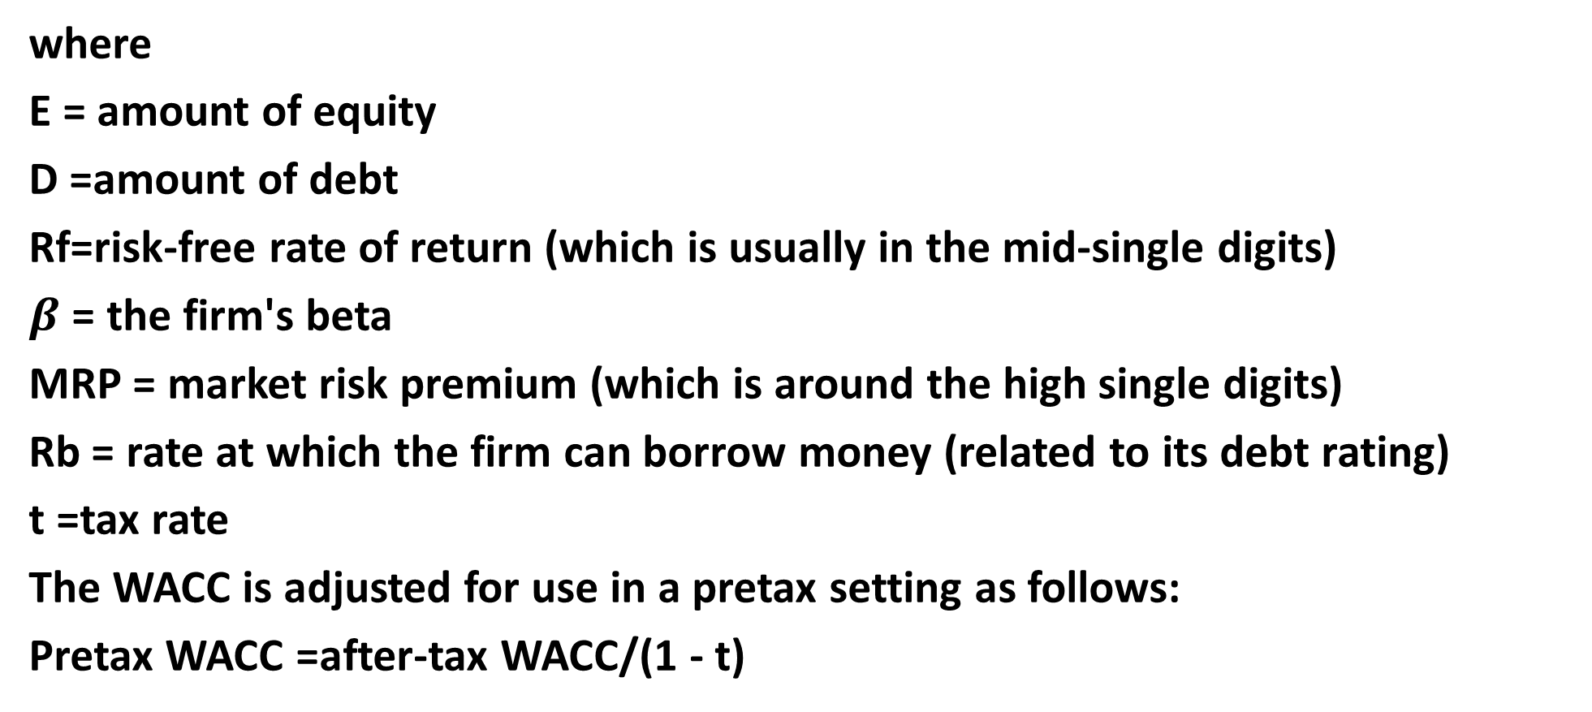
Cont.
where
E = amount of equity
D =amount of debt
Rf=risk-free rate of return (which is usually in the mid-single digits)
$β$ = the firm's beta
MRP = market risk premium (which is around the high single digits)
Rb = rate at which the firm can borrow money (related to its debt rating)
t =tax rate
The WACC is adjusted for use in a pretax setting as follows:
Pretax WACC =after-tax WACC/(1 - t)

Slide 42
Cont.
• Obsolescence (or spoilage) cost:
The obsolescence cost estimates the rate at which the value of the stored product drops because its market value or quality falls. This cost can range dramatically, from rates of many thousands percent to virtually zero, depending on the type of product. Perishable products have high obsolescence rates. Even nonperishables can have high obsolescence rates if they have short life cycles.
A product with a life cycle of six months has an effective obsolescence cost of 200 percent. At the other end of the spectrum are products such as crude oil that take a long time to become obsolete or spoil. For such products a very low obsolescence rate may be applied

Slide 43
Cont.
• Handling cost:
Handling cost should include only incremental receiving and storage costs that vary with the quantity of product received. Quantity-independent handling costs that vary with the number of orders should be included in the order cost. The quantity-dependent handling cost often does not change if quantity varies within a range. If the quantity is within this range (e.g., the range of inventory a crew of four people can unload per period of time), incremental handling cost added to the holding cost is zero.
If the quantity handled requires more people, an incremental handling cost is added to the holding cost.

Slide 44
Cont.
• Occupancy cost:
The occupancy cost reflects the incremental change in space cost due to changing cycle inventory. If the firm is being charged based on the actual number of units held in storage, we have the direct occupancy cost. Firms often lease or purchase a fixed amount of space. As long as a marginal change in cycle inventory does not change the space requirements, the incremental occupancy cost is zero. Occupancy costs often take the form of a step function, with a sudden increase in cost when capacity is fully utilized and new space must be acquired.

Slide 45
Cont.
• Miscellaneous costs:
The final component of holding cost deals with a number of other relatively small costs. These costs include theft, security, damage, tax, and additional insurance charges that are incurred. Once again, it is important to estimate the incremental change in these costs on changing cycle inventory.

Slide 46

Reference
Supply chain management
Strategy, Planning, and Operation
By: Sunil Chopra,
>eter Meind!.-3rd ed.
Chapter 10

