Slide 1


Slide 2


Slide 3
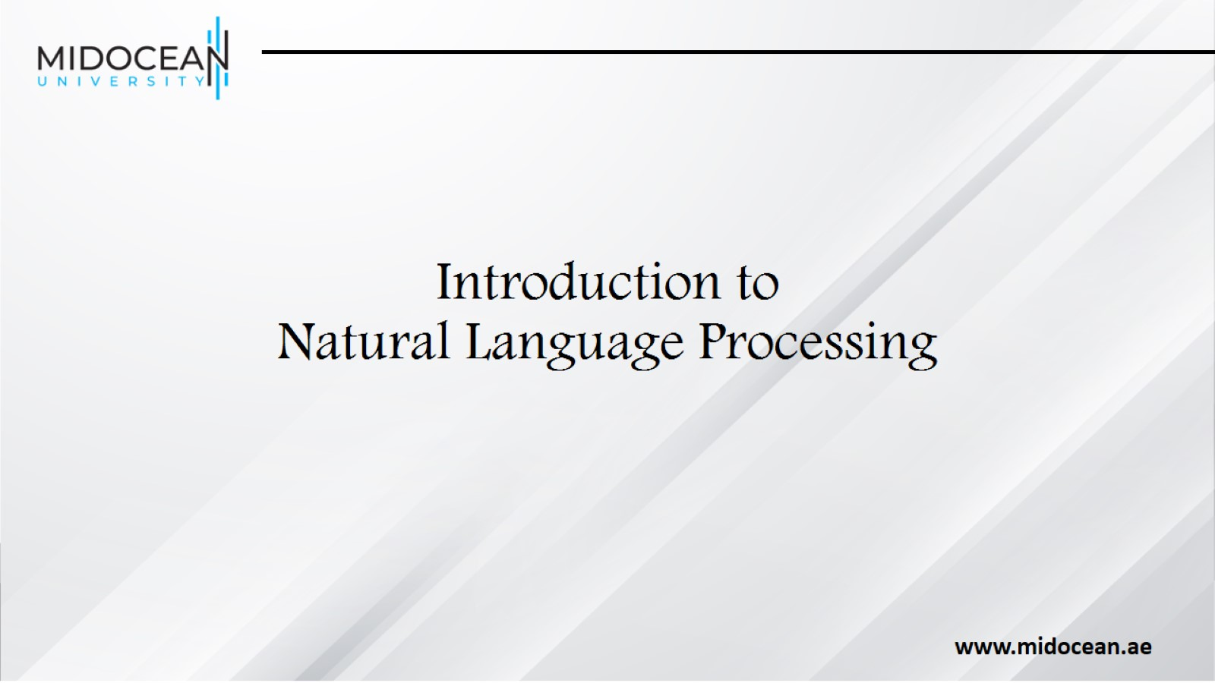
Introduction to
Natural Language Processing

Slide 4
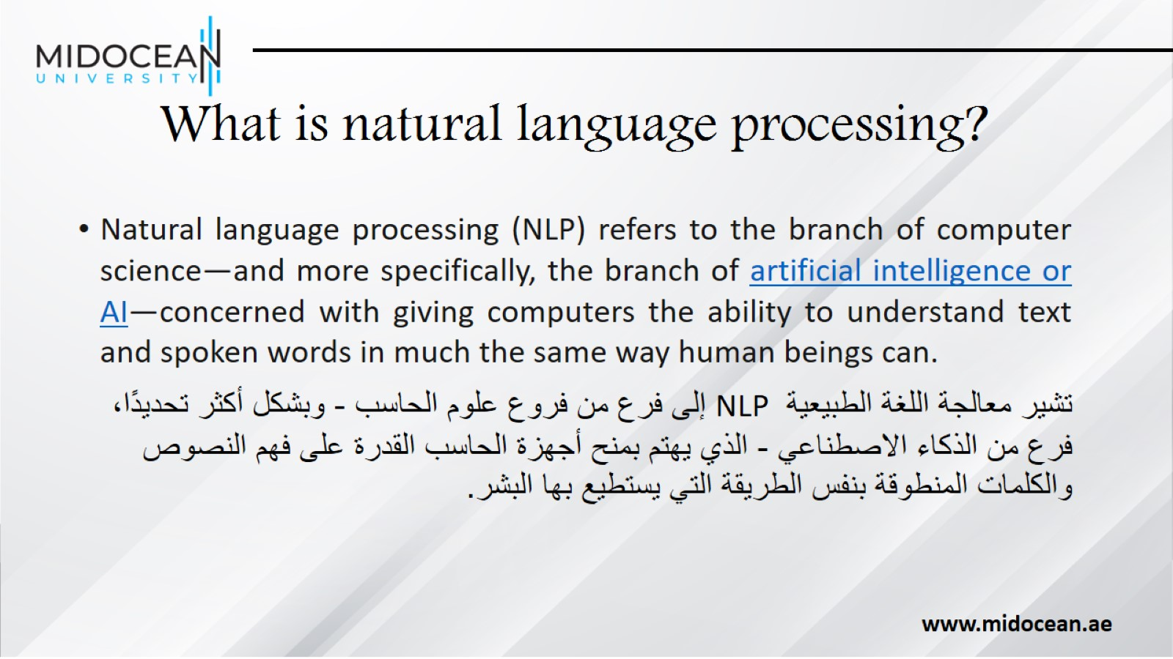
What is natural language processing?

Slide 5
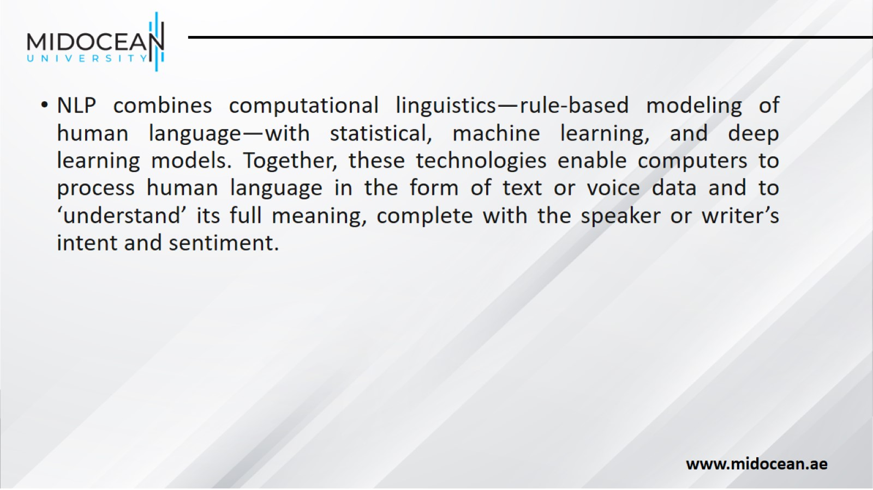

Slide 6
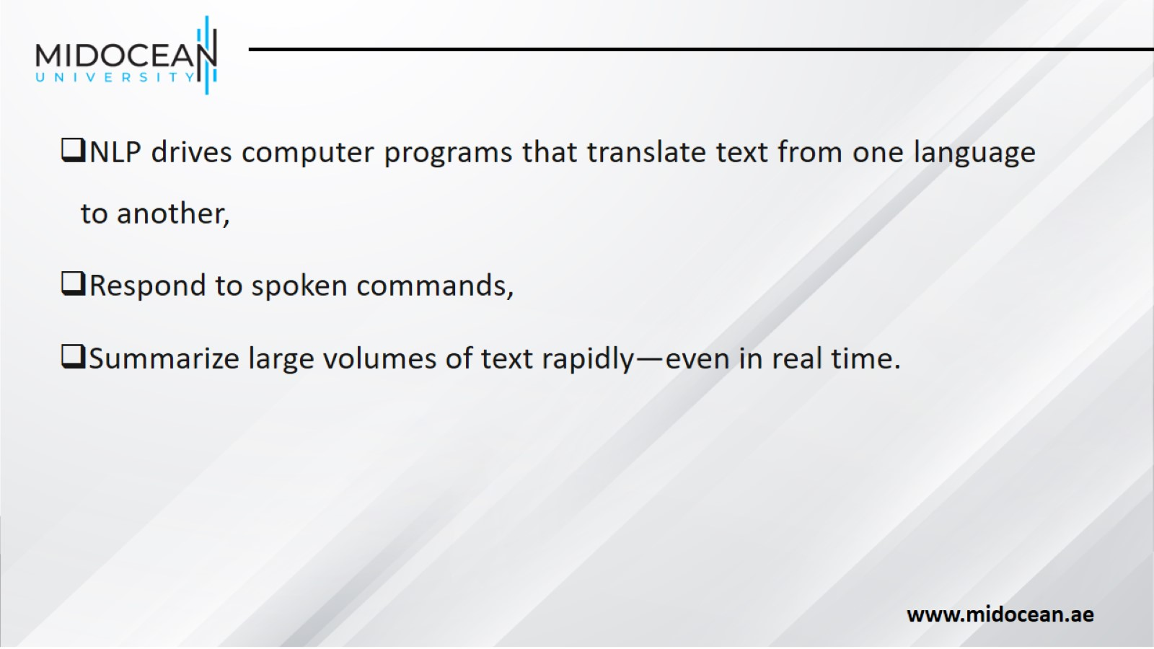

Slide 7
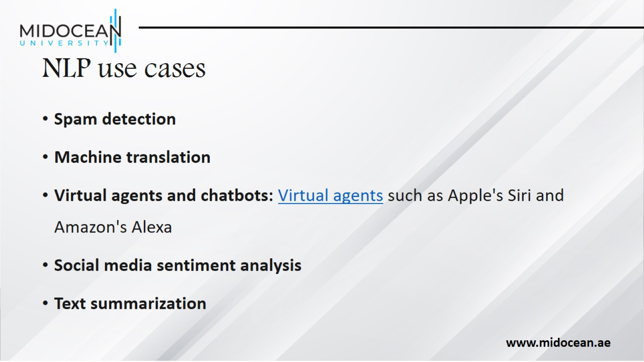
NLP use cases

Slide 8
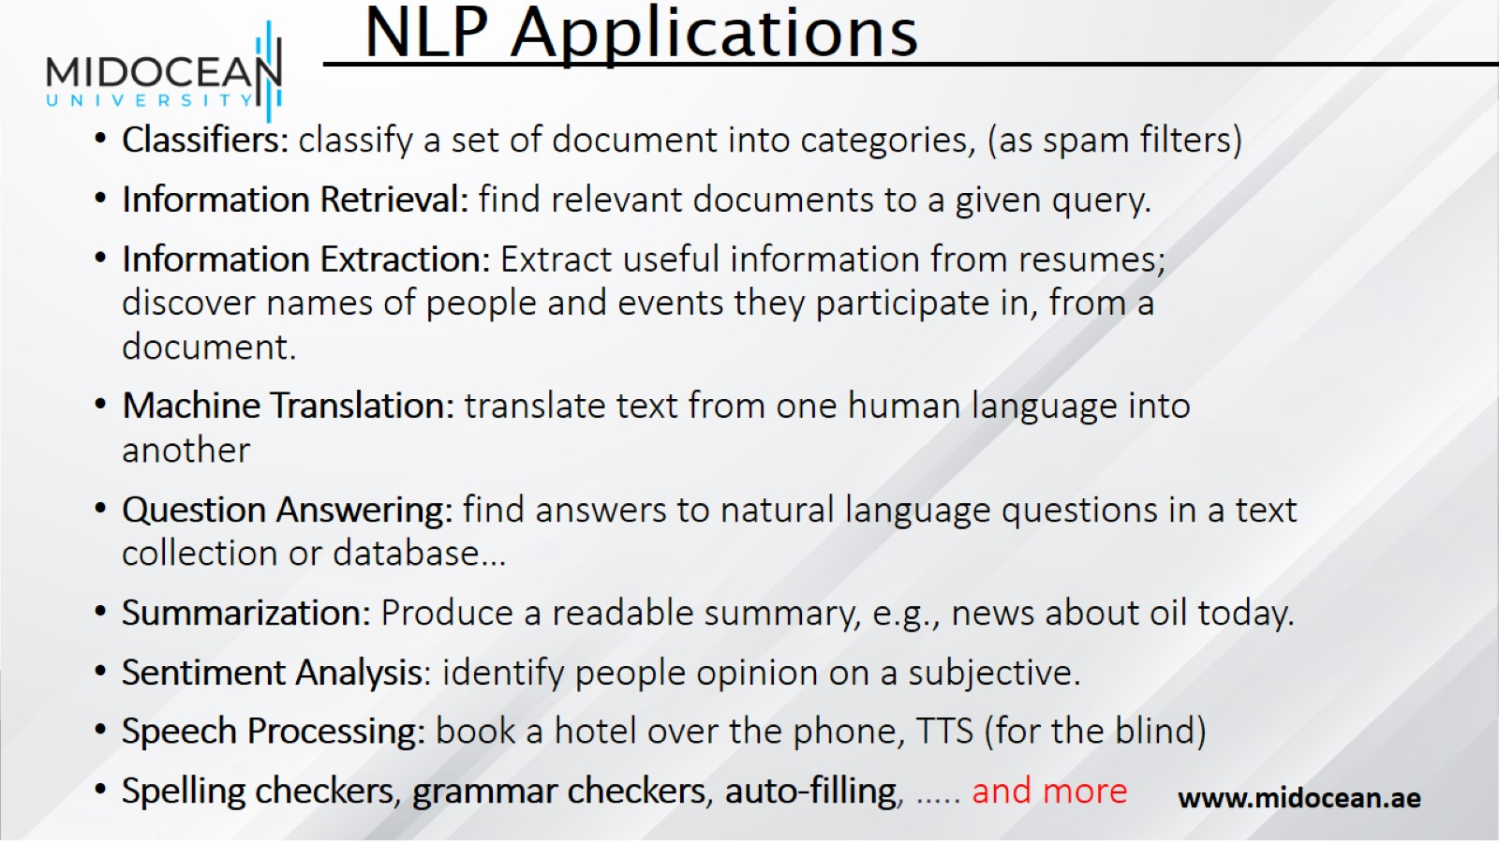

Slide 9
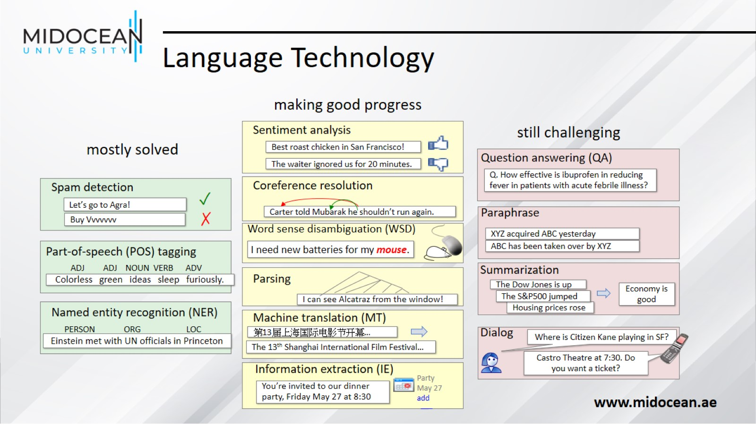
Language Technology

Slide 10
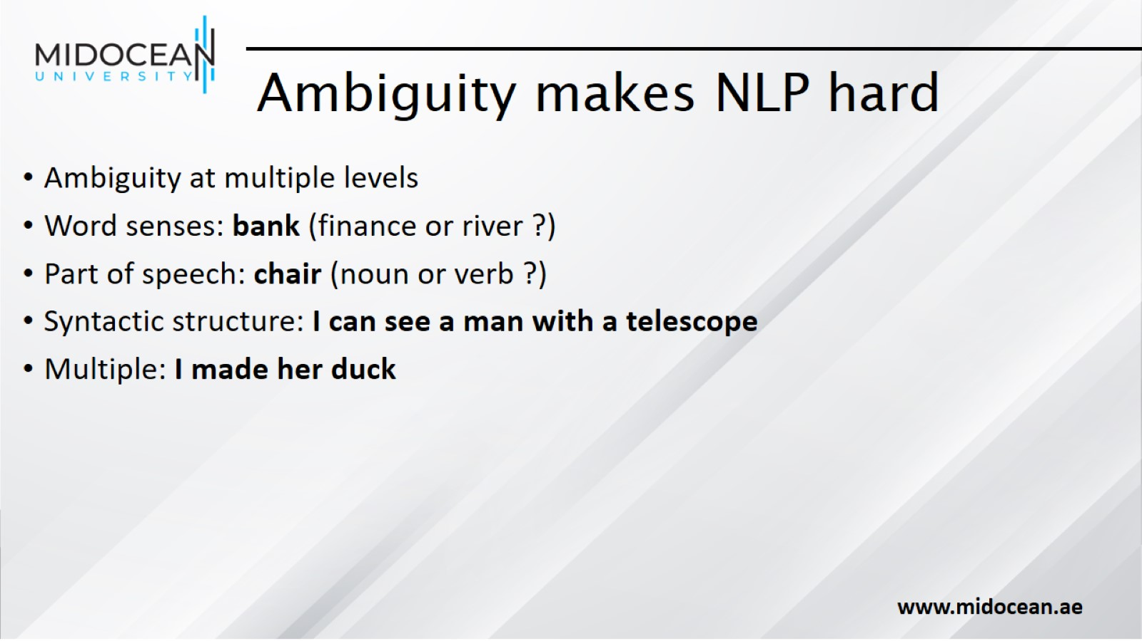
Ambiguity makes NLP hard

Slide 11
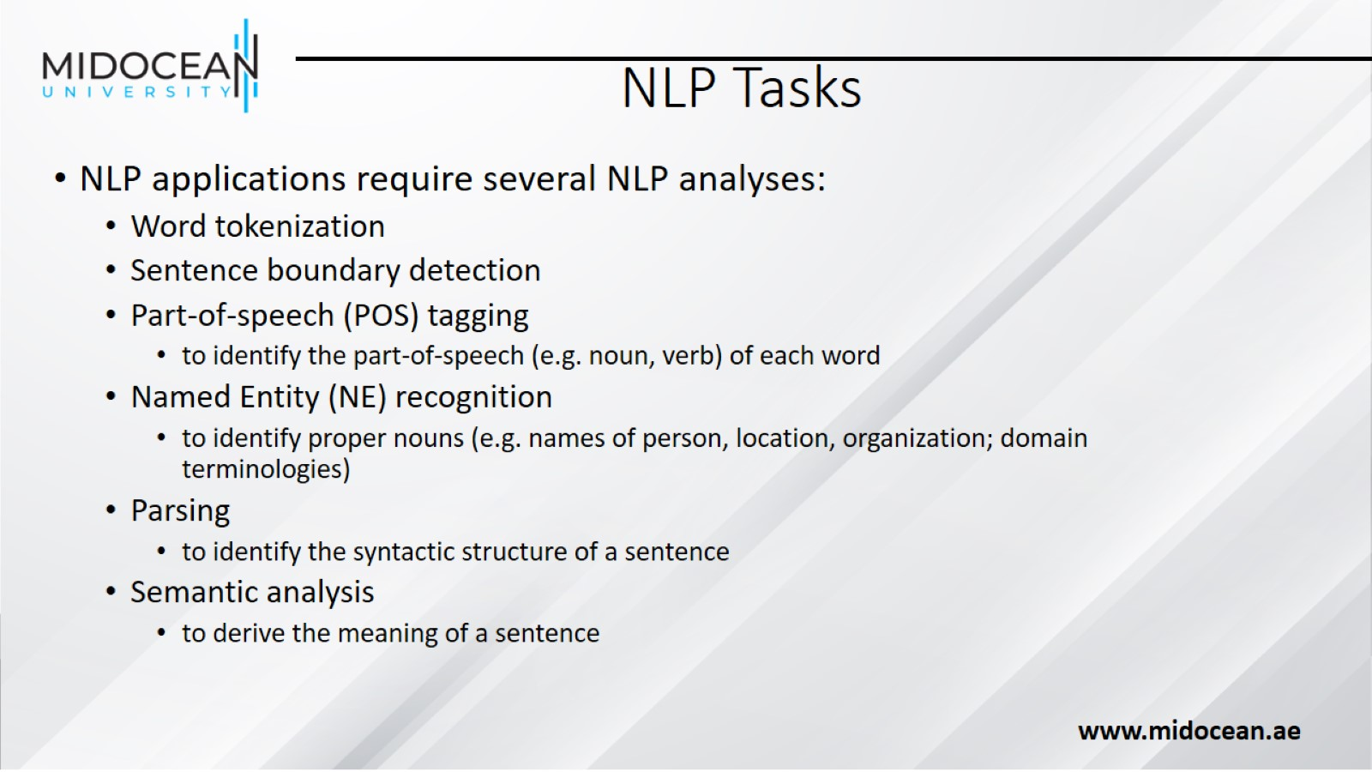
NLP Tasks

Slide 12
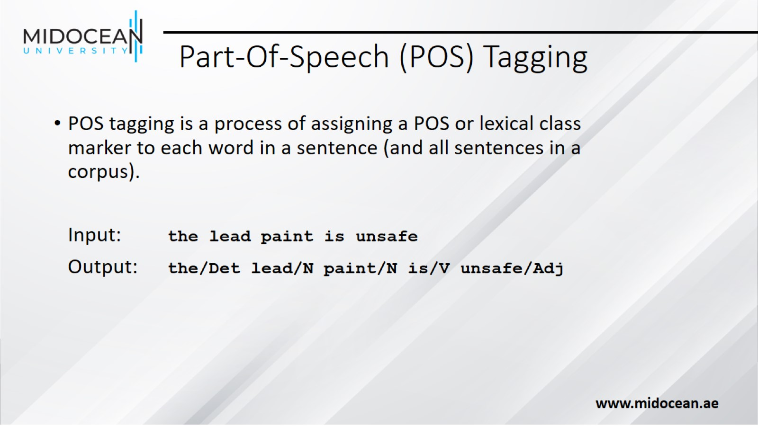
Part-Of-Speech (POS) Tagging

Slide 13
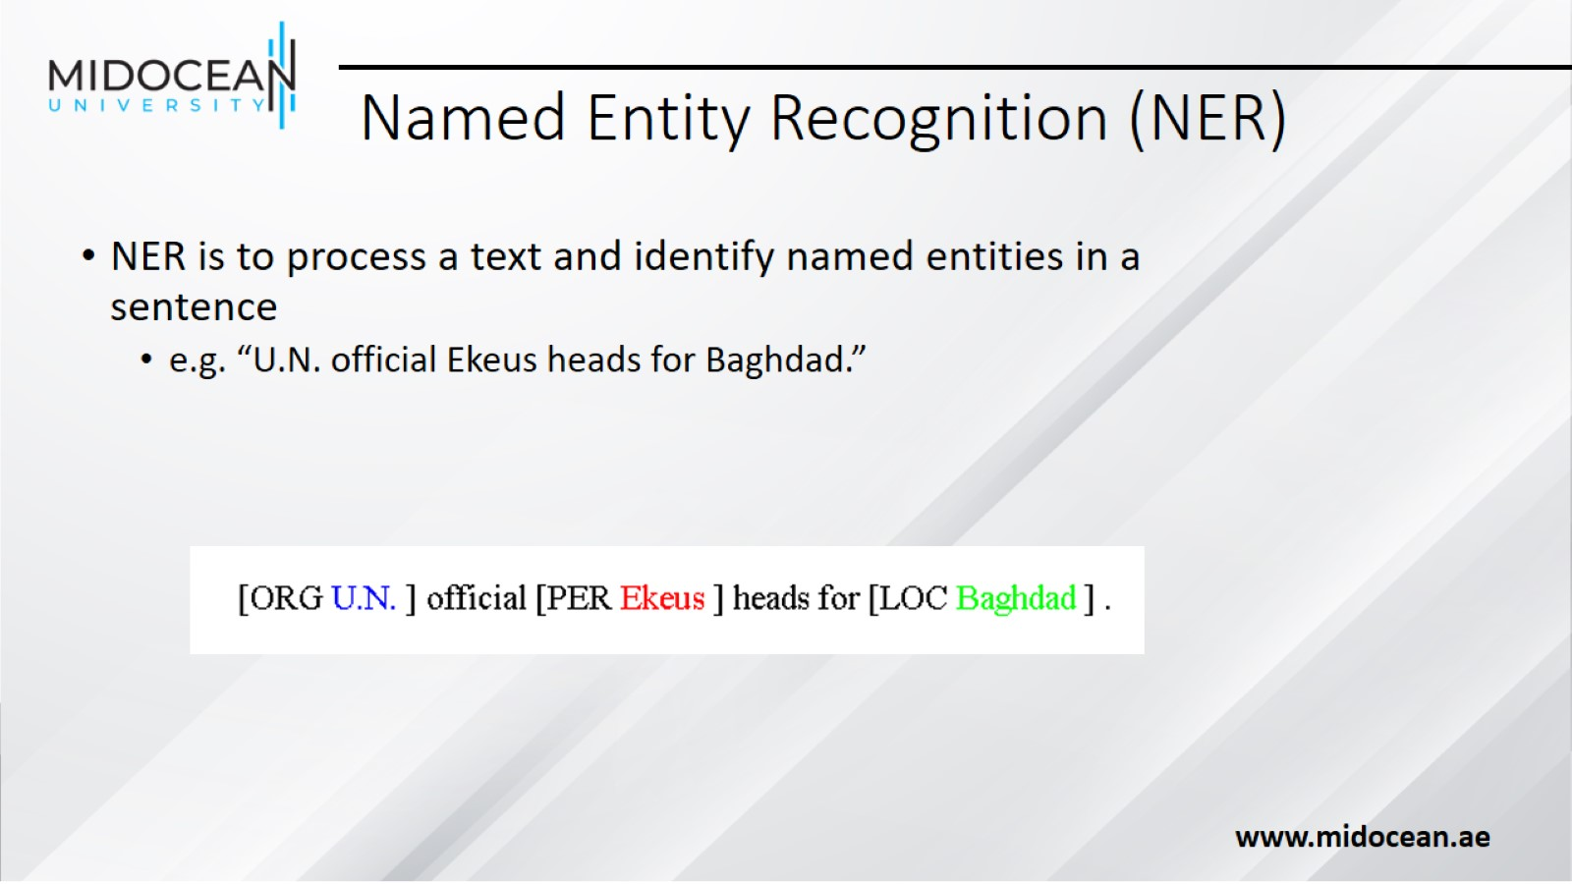
Named Entity Recognition (NER)

Slide 14
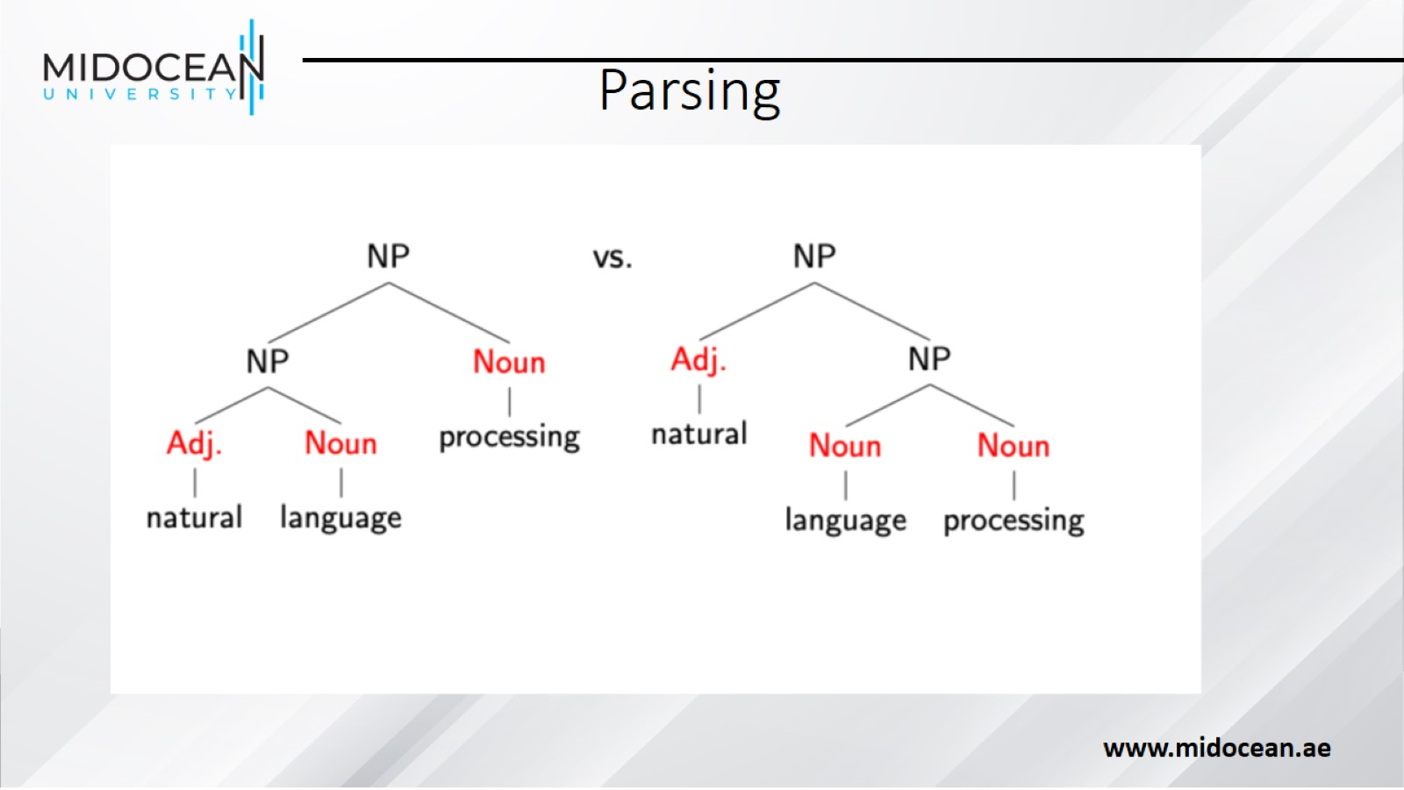
Parsing

Slide 15
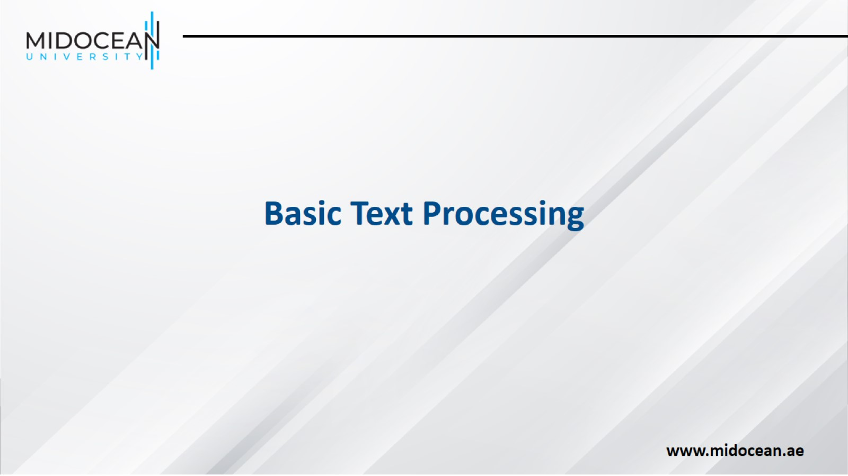

Slide 16
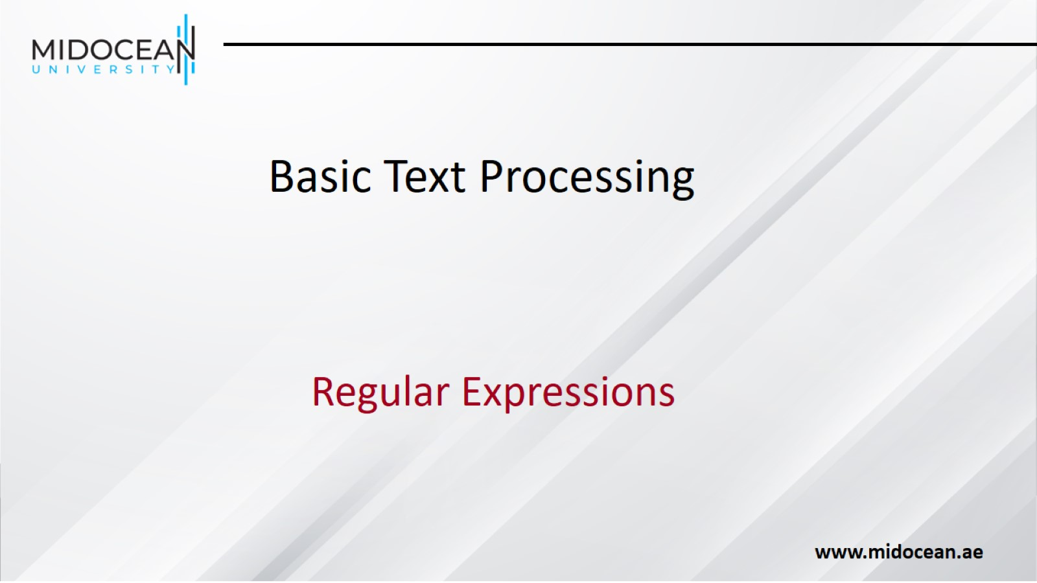

Slide 17
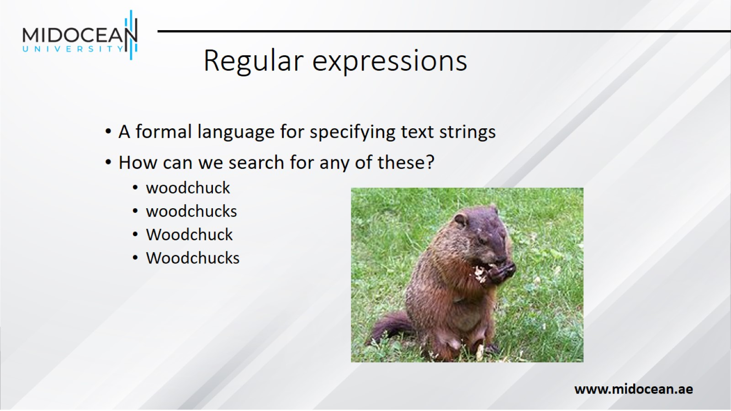
Regular expressions

Slide 18
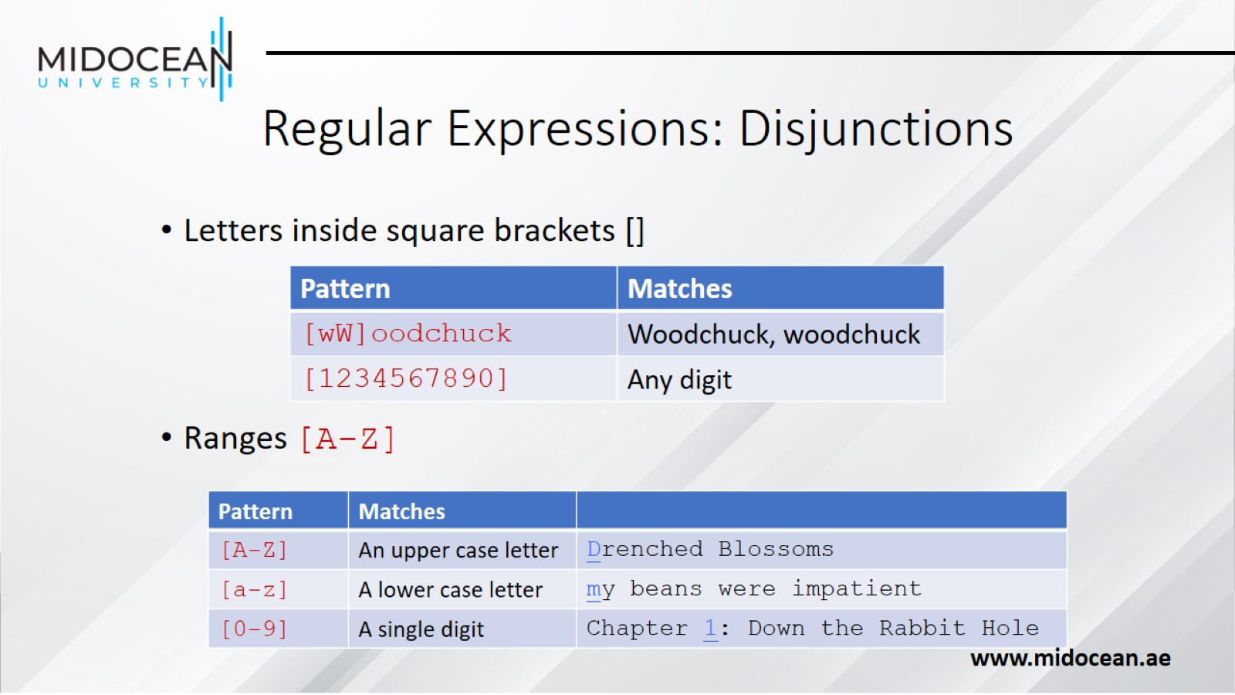
Regular Expressions: Disjunctions

Slide 19
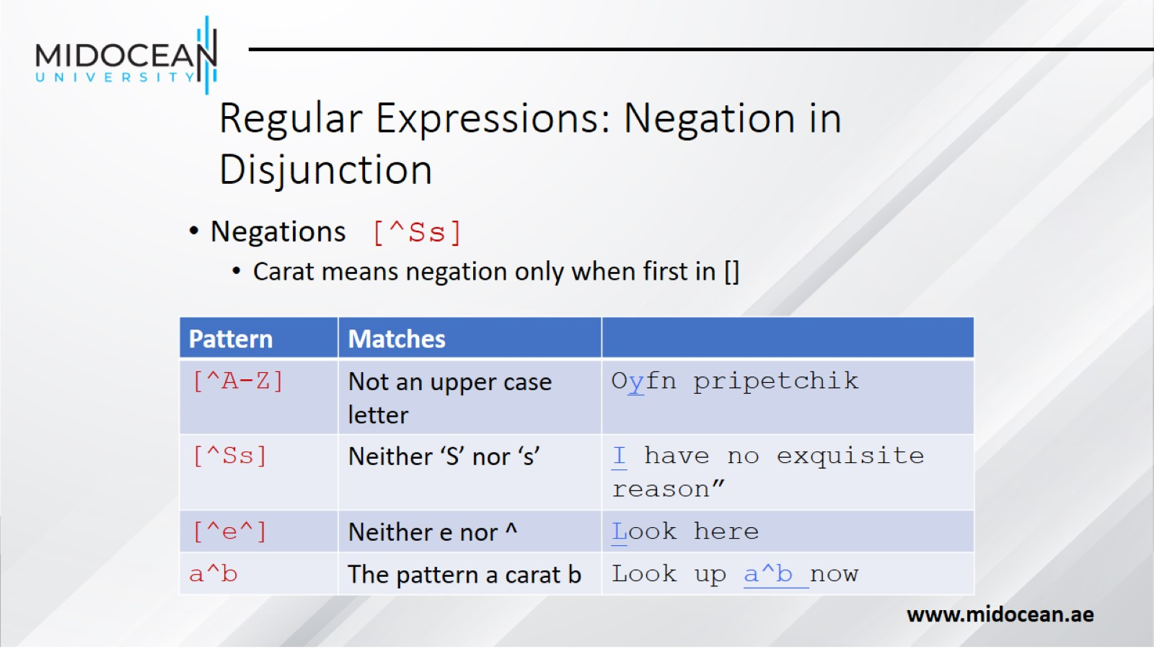
Regular Expressions: Negation in Disjunction

Slide 20
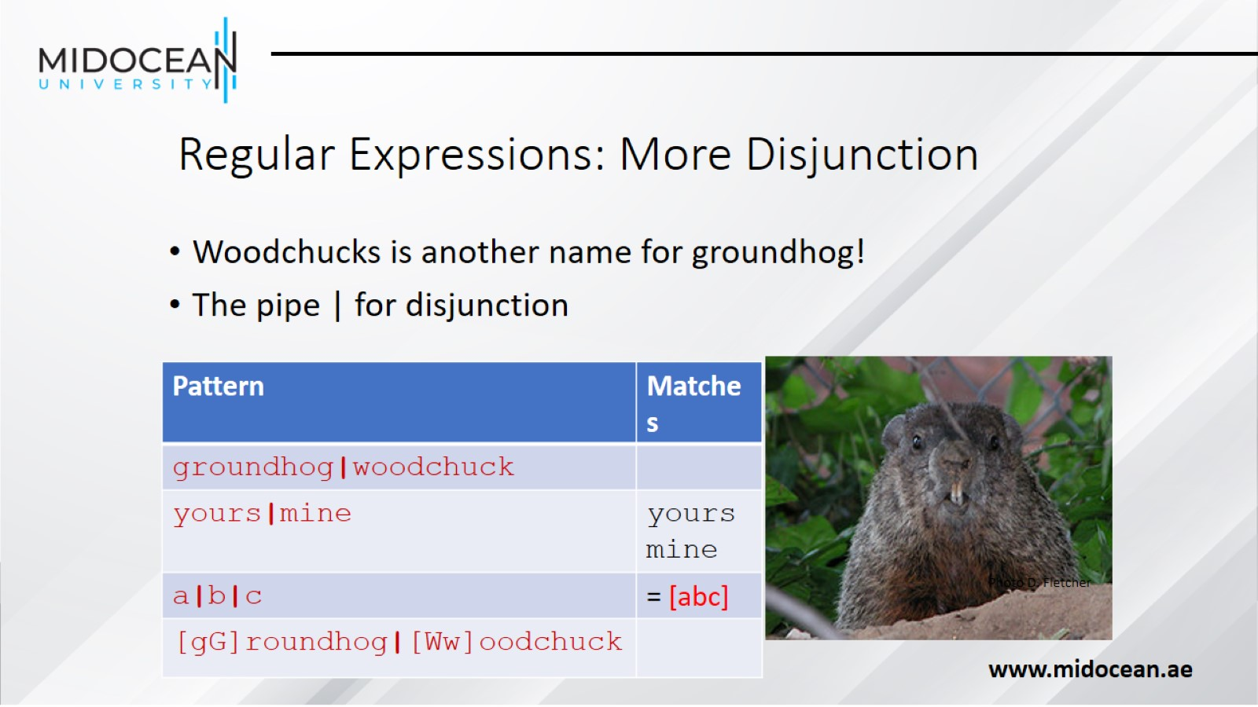
Regular Expressions: More Disjunction

Slide 21
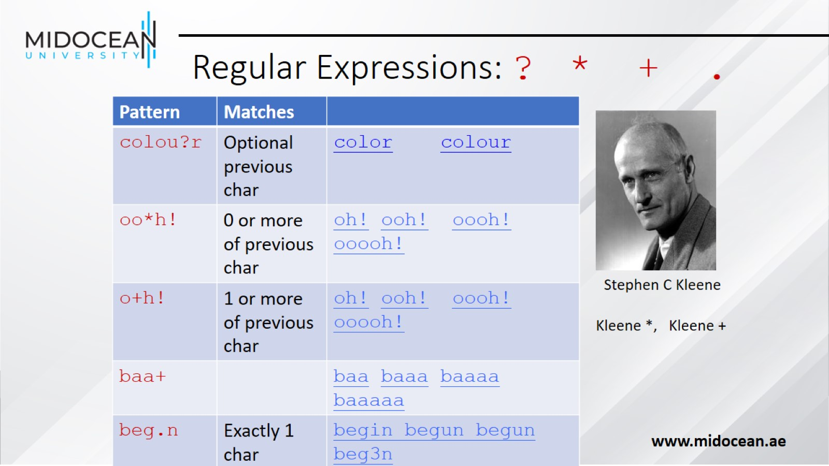
Regular Expressions: ? * + .

Slide 22
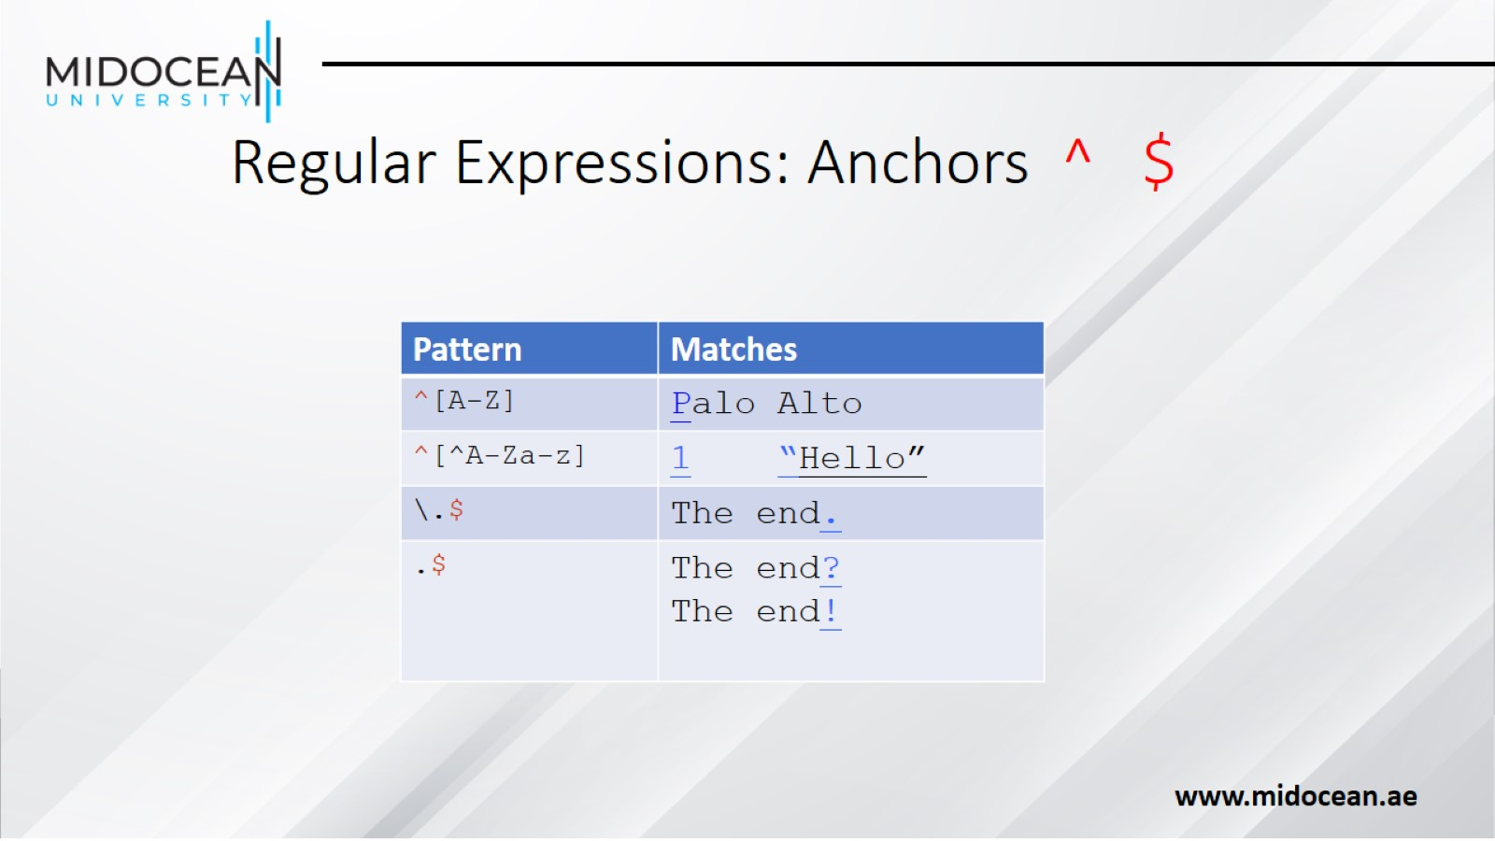
Regular Expressions: Anchors ^ $

Slide 23
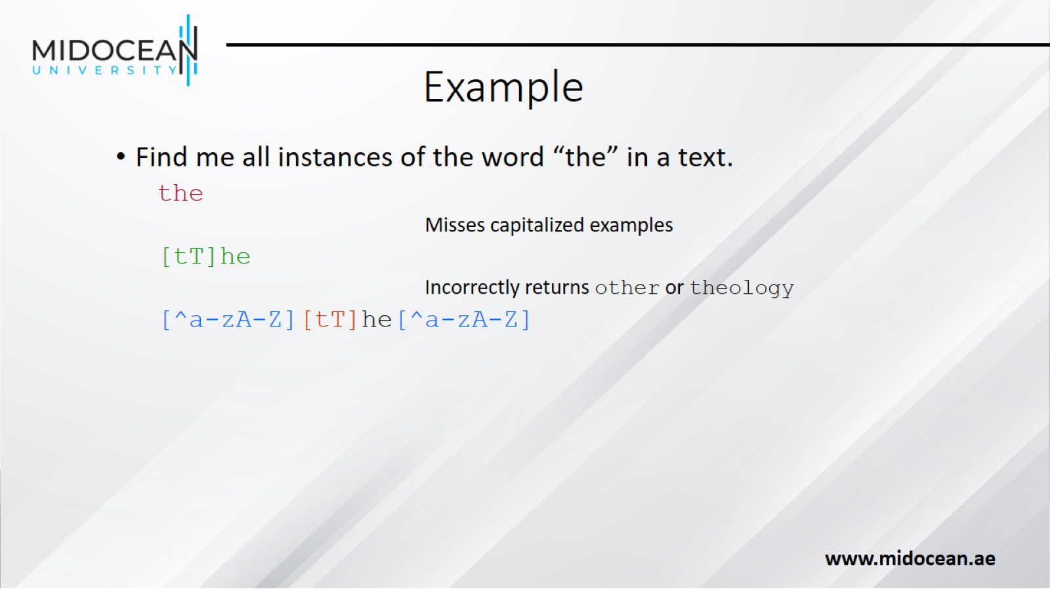
Example

Slide 24
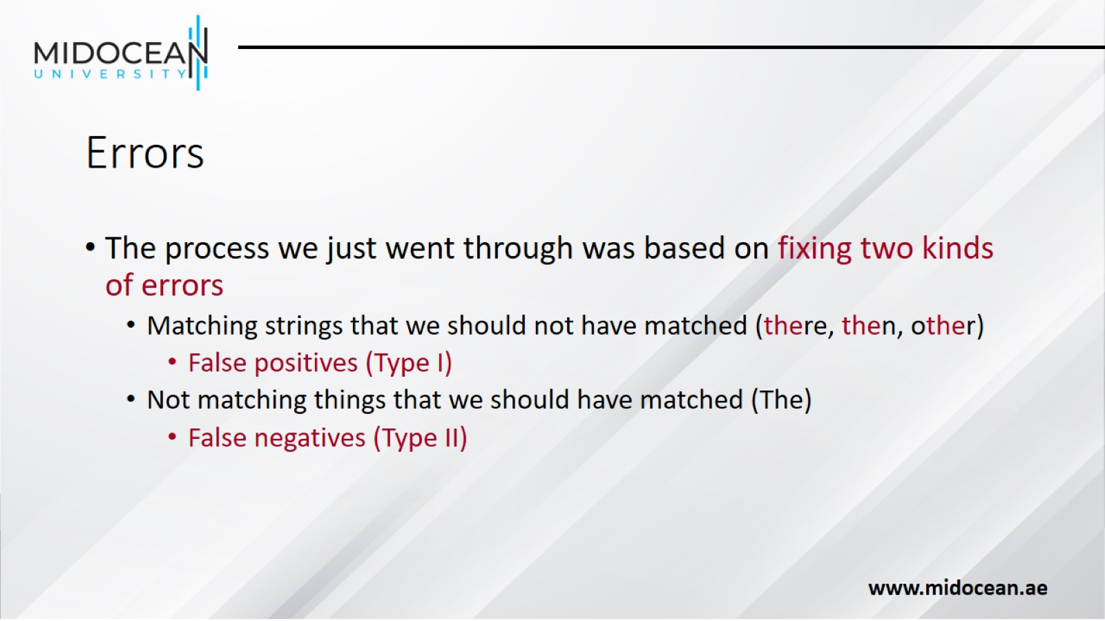
Errors

Slide 25
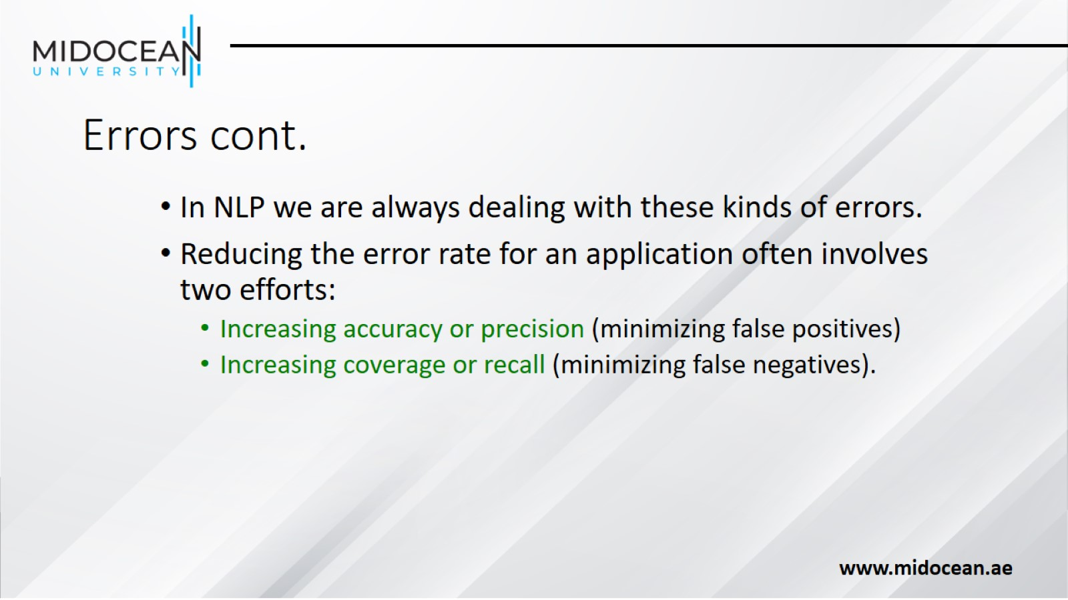
Errors cont.

Slide 26
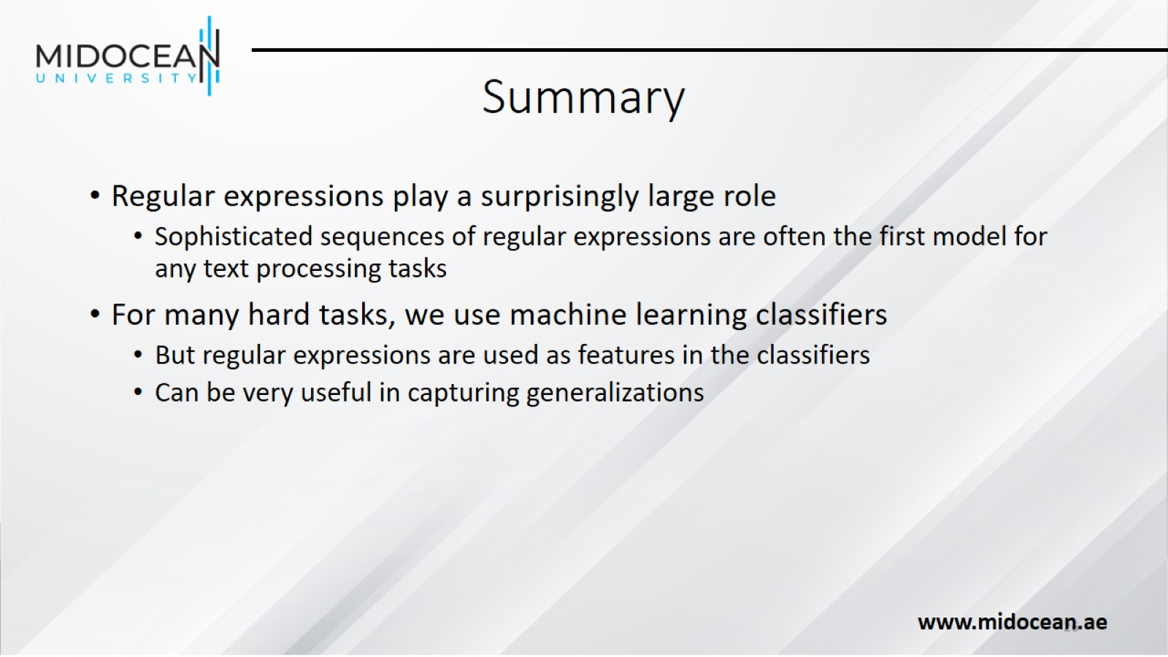
Summary

Slide 27
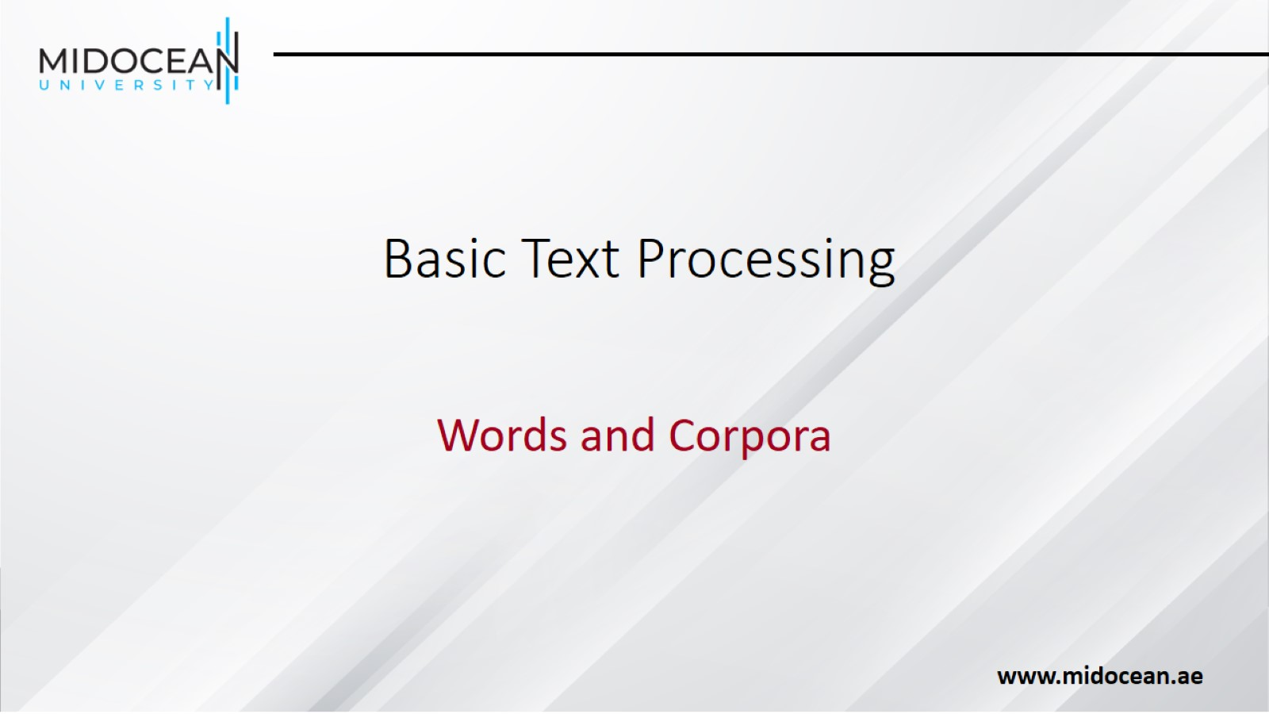
Basic Text Processing

Slide 28
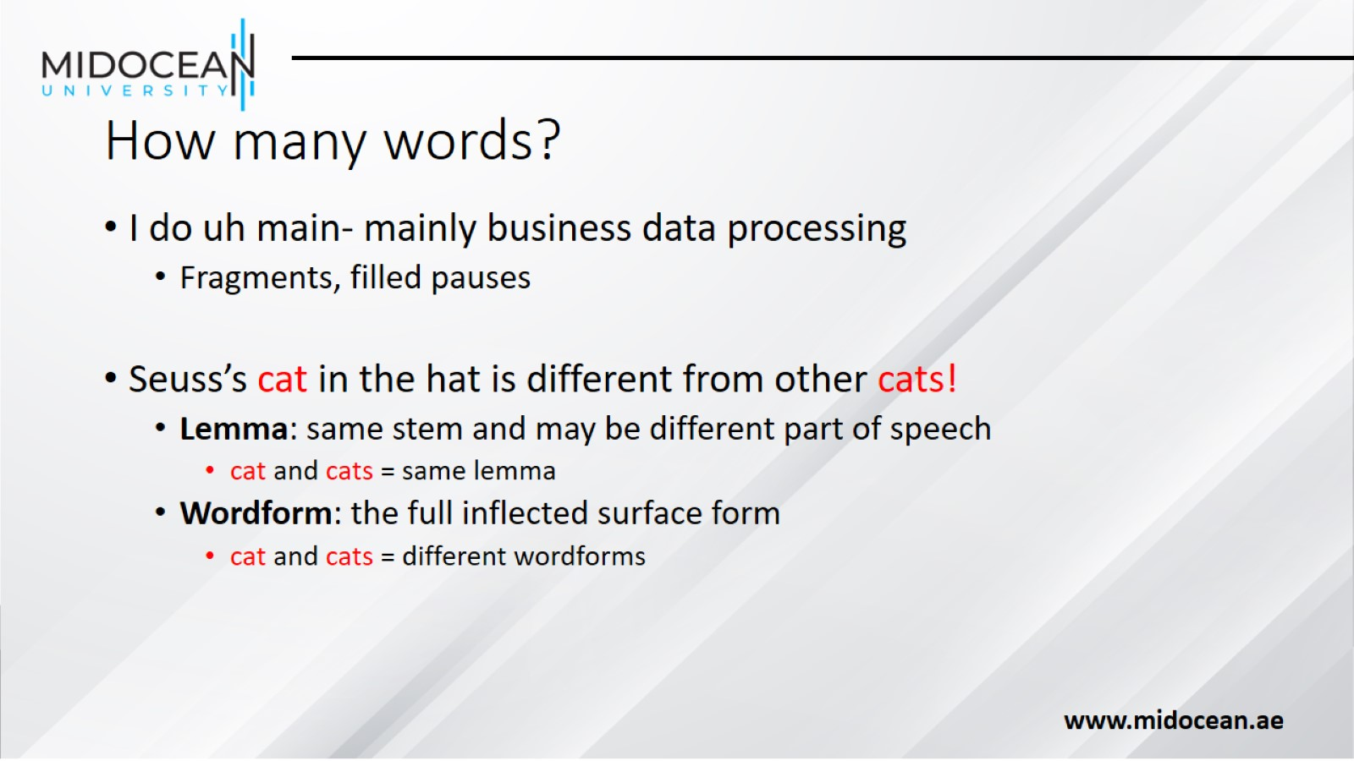
How many words?

Slide 29
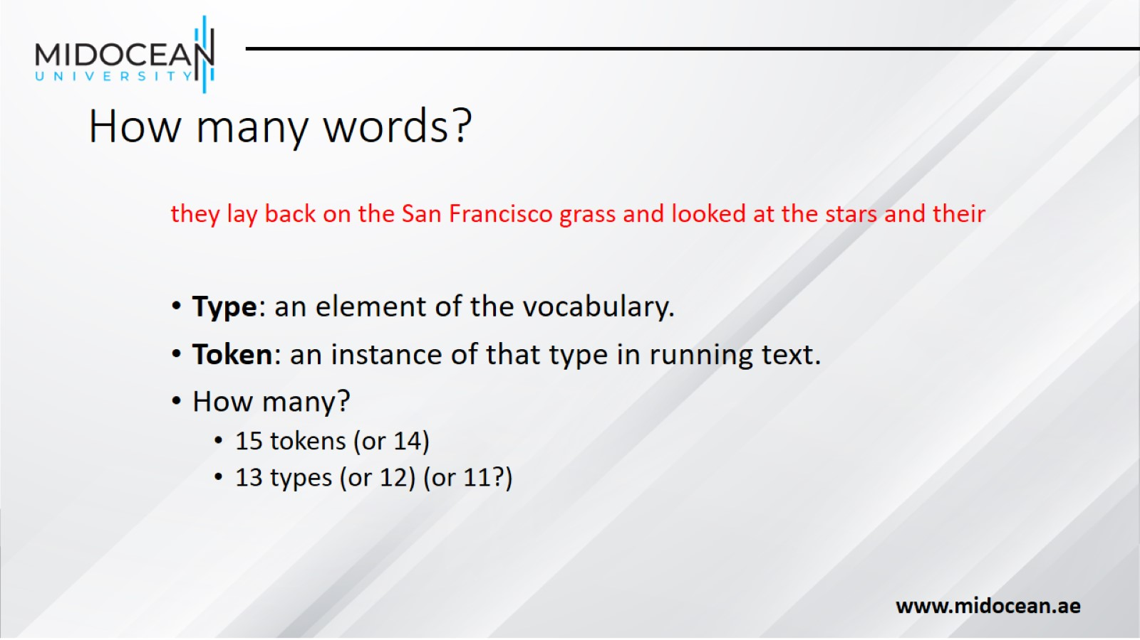
How many words?

Slide 30
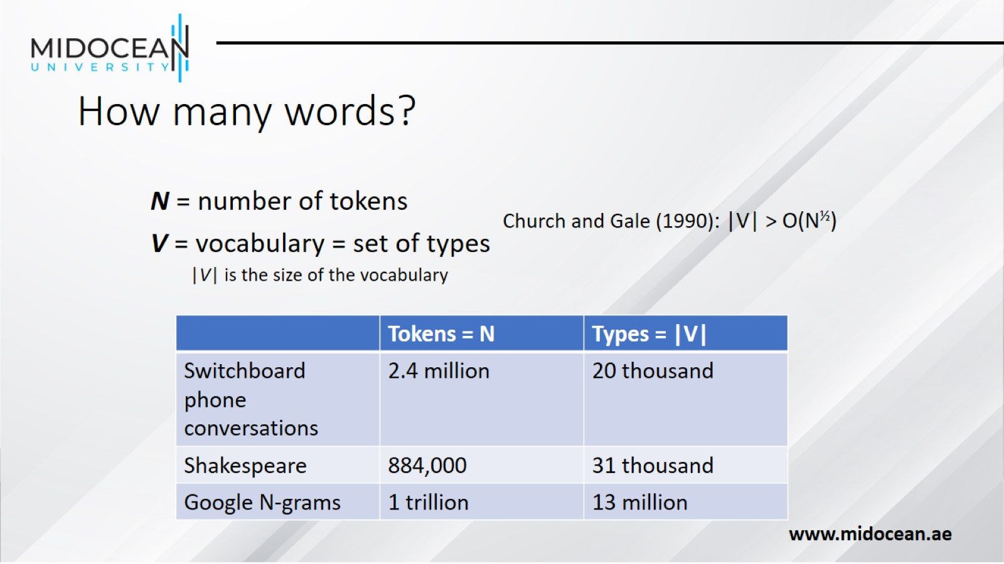
How many words?

Slide 31
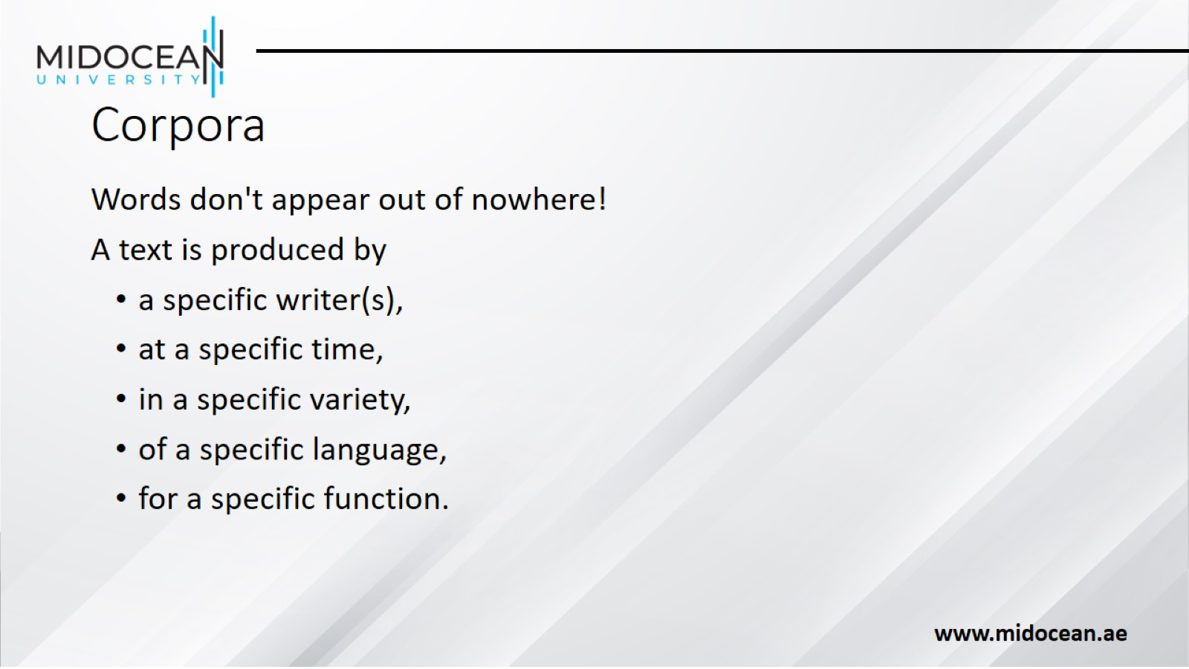
Corpora

Slide 32
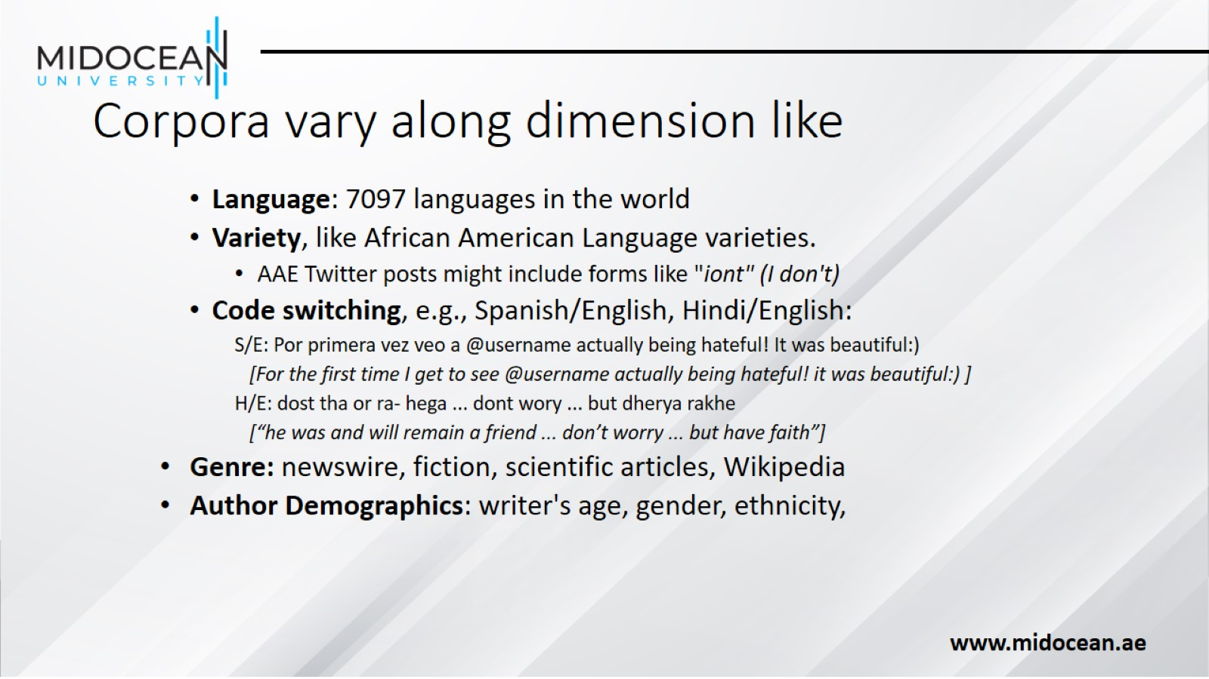
Corpora vary along dimension like

Slide 33
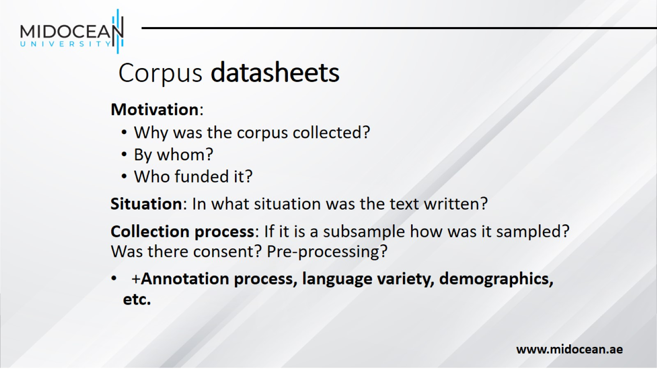
Corpus datasheets

Slide 34


