Slide 1


Marketing Management
MGM612
Dr. Ayman Hassan
  Lecture - 10 -
Marketing Channels Management

Slide 2

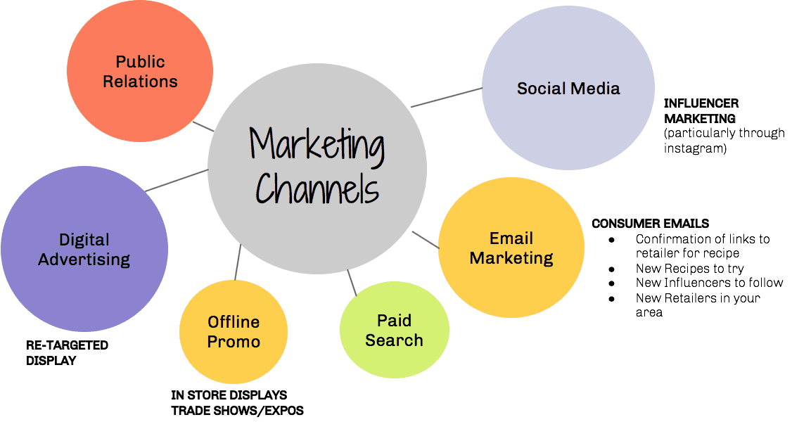
Chapter
10
Marketing Channels Management
Lecture : 10
Dr. Ayman Hassan

Slide 3
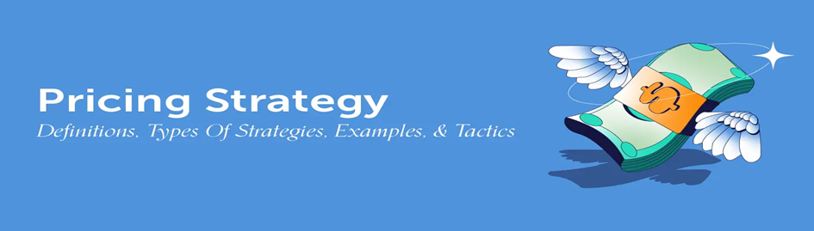
In the previous lecture,
We have discussed
In the previous lecture, we presented the topic of the Branding, We explained a set of topics, which are as follows:
Major Pricing Strategies
New-Product Pricing Strategies
Product Mix Pricing Strategies
Price Adjustment Strategies
Price Changes

Slide 4

Learning Outcomes
Chapter
10
After studying this chapter you will be able to know all of the following:
The Marketing Channel Define and Importance of Marketing Channels
Distribution Channel
Types of Marketing Channels
Explain the functions and key activities of marketing channels.
Marketing Channels and Marketing Management Strategy
Channel Conflict
Physical Distribution Management

Slide 5

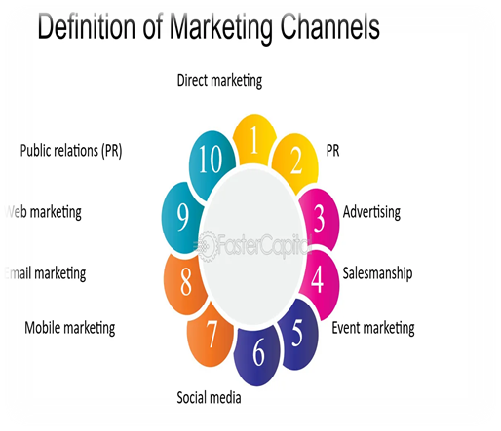
Chapter
10
The Marketing Channel Define
A marketing channel consists of individuals and firms involved in the process of making a product or service available for consumption or use by consumers and industrial users.
The route taken by a product as it moves from producer to the customer or other ultimate user.
The path taken by the title to goods as it moves through various agencies.
A loose coalition of business firms that have banded together for purposes of trade.

Slide 6
Chapter
10
The Marketing Channel Define
The most common marketing channels are:
Direct marketing: Email or postal mail.
Advertising: They use advertising to spread awareness about their products and services.
Salesmanship: Salesmanship is a combination of advertising, public relations, and direct marketing.
Event marketing: Using events (such as trade shows or conferences) to attract new customers.
Social media: Social media platforms such as Facebook, Twitter, and LinkedIn.
Mobile marketing: Using mobile devices (such as smartphones and tablets) to reach your target market.
Email marketing: A great way to stay in touch with your customers and promote your brand or product.
Web marketing: Using websites to promote your brand and sell your products or services online.
Public relations (PR): The practice of creating positive media coverage for your company or product in order to attract new customers and enhance your brand reputation.

Slide 7
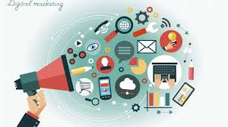
Chapter
10
Chapter
What is a Marketing Channel?
A marketing channel system is the particular set of interdependent organizations involved in the process of making a product or service available for use or consumption.
Marketing channels determine how and where customers buy.

Slide 8
Chapter
10
Importance of Channel Component
Selecting the channel design mix is challenging
  The alternatives are numerous
  Marketing goals differ between channel members
  Business markets segments vary, thus it may require numerous channels concurrently
  Business market environment constantly changes
  Competition is stiff
  Customer requirements change
  Internet technology is changing the landscape
All of this creates new opportunities and the need for fresh channel strategies

Slide 9
Chapter
10
Growing Importance of Marketing Channels
Explosion of information technology and E-commerce
Greater difficulty of gaining a sustainable competitive advantage
Growing power of distributors, especially retailers in marketing channels
The need to reduce distribution costs

Slide 10
Chapter
10
Managing the Channel
Once a channel structure is specified and goals set, marketing managers need to:
  Develop procedures for selecting intermediaries
  Motivate them to meet goals
  Resolve conflict between them
  Evaluate performance
The following discussion centers around designing and administering the business marketing channel.

Slide 11
Chapter
10
Distribution Channel
The link between the manufacturer and the customer is called the Channel of Distribution
The channel accomplishes all the tasks necessary to get the product/service to market
Tasks can be performed by the manufacturer or be delegated throughout the channel
The question is: “What is the best way to execute the tasks?”

Slide 12
Chapter
10
Channel Tasks Include:
Contacting potential buyers
Negotiating
Selling
Contracting
Transferring title
Training
Financing
Servicing the product
Inventorying
Transporting
Storage

Slide 13
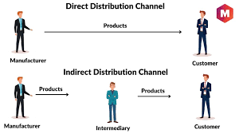
Chapter
10
Direct and Indirect Channels
Who performs the Tasks ?
Direct : is when the manufacturer performs all the marketing functions
Indirect : is when some type of intermediary sells or handles the product

Slide 14
Chapter
10
Types of Marketing Channels 4 Consumer Products

Slide 15
Chapter
10
Types of Marketing Channels 4 Industrial Products

Slide 16
Chapter
10
The importance of marketing channels
Why do we need
marketing channels?
Specialization and
division of labor
Overcoming
discrepancies
Providing contact
efficiency
So, we need marketing channels for specialization and division of labor, thus efficiency and effectiveness, and thus overcoming problems.

Slide 17
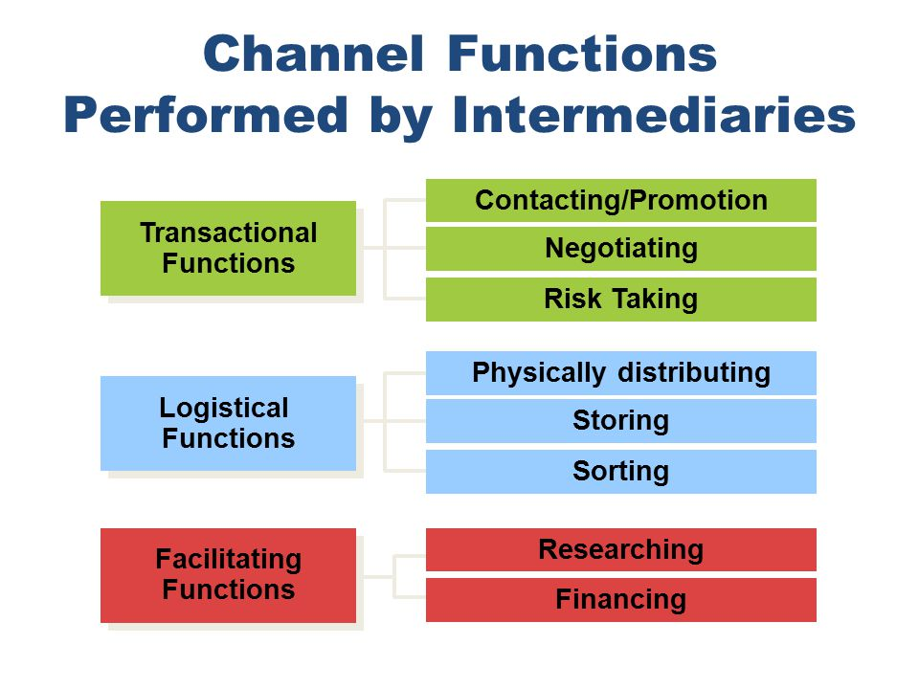
Chapter
10
Channel Functions
Transactional Functions
Contacting & Promotion
Negotiation
Risk taking
Logistical Functions
physical distribution
Sorting and Regrouping Products
Storing and Managing Inventory
Facilitating Functions
Researching & Information
Financing

Slide 18
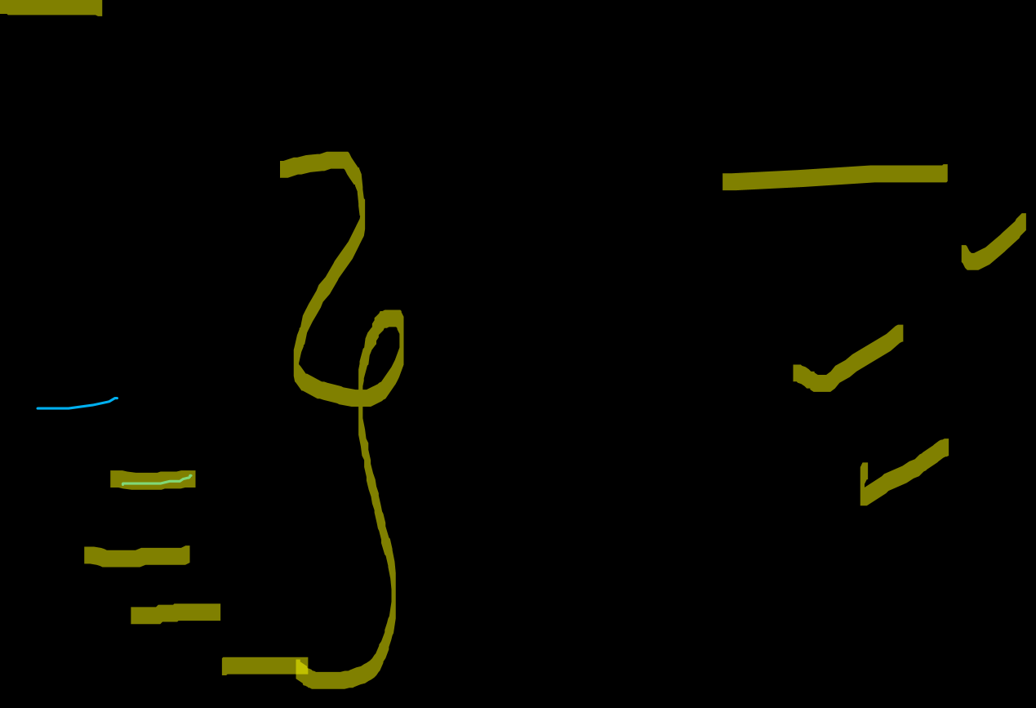
Chapter
10
Determinants of Channel Structure and Relationships
INTERNAL
  Company objectives
  Character
  Capital
  Cost
  Coverage
  Control
  Continuity
  Communication
EXTERNAL
  Customer characteristics
  Culture
  Competition

Slide 19

Chapter
10
Explain how channel members add value
Right PLACE
Right TIME
Place Utility
  Location – having the product where customers can buy it
Time Utility
  Having the product available when the customer wants/needs it

Slide 20





Chapter
10
Channel Member Functions
Gather information
Develop and disseminate persuasive communications
Reach agreements on price and terms
Acquire funds to finance inventories
Assume risks
Provide for storage
Provide for buyers’ payment of their bills
Oversee actual transfer of ownership

Slide 21

Chapter
10
Key Functions Performed in Marketing Channels
Marketing Communications
Advertising the Product
Providing a salesforce that offers information & service to customers
Inventory Management
Ordering appropriate merchandise assortment
Maintaining adequate stock to meet customer demand
Storing merchandise in an appropriate facility
Physical Distribution
Delivering products
Coordinating delivery schedules to meet customer expectations
Arranging for the return of defective merchandise
Philip Kotler: “Modern marketing channels are value networks designed to maximize customer satisfaction with minimum cost and maximum convenience.”

Slide 22

Chapter
10
Key Functions Performed in Marketing Channels
Market Feedback
Serving on manufacturer advisory boards
Informing other channel members of competitive activity
Participating in test market evaluations
Financial Risk
Offering credit
Managing risks related to product loss or deterioration
Managing risks related to product safety and liability

Slide 23

Chapter
10
Contributions of Intermediaries
Provide Economic Value
Provide Social Value
Provide Marketing Support
Impact Supply-chain Management
Add Value to the Market Offering

Slide 24

Chapter
10
Types of Marketing Channels
1- Direct Channels
2- Indirect Channels
3- Single Marketing Channels
4- Multiple Marketing Channels
5- Vertical Marketing Systems
"Marketing channels are not just pathways to deliver products — they are strategic systems that shape customer experience, operational efficiency, and competitive advantage."
(Kotler & Keller, 2024)

Slide 25

Chapter
10
Evaluating Channel Alternatives
Evaluation of Capabilities and Costs
Evaluation of Channel Compatibility:
  Product Considerations
  Pricing Considerations
  Marketing Communications Considerations
Evaluation of Availability

Slide 26

Chapter
10
Evaluating Channel Performance
1- Financial Evaluation
2- Evaluate Working Relationships
3- Evaluate Legal and Ethical Issues

Slide 27

Chapter
10
Designing a Marketing Channel System
Analyze customer needs
Establish channel objectives
Identify major channel alternatives
Evaluate major channel alternatives

Slide 28

Chapter
10
Channel Service Outputs
Lost size
Waiting/delivery time
Spatial convenience
Product variety
Service backup

Slide 29

Chapter
10
Identifying Channel Alternatives
Types of intermediaries
Number of intermediaries
Terms and responsibilities

Slide 30
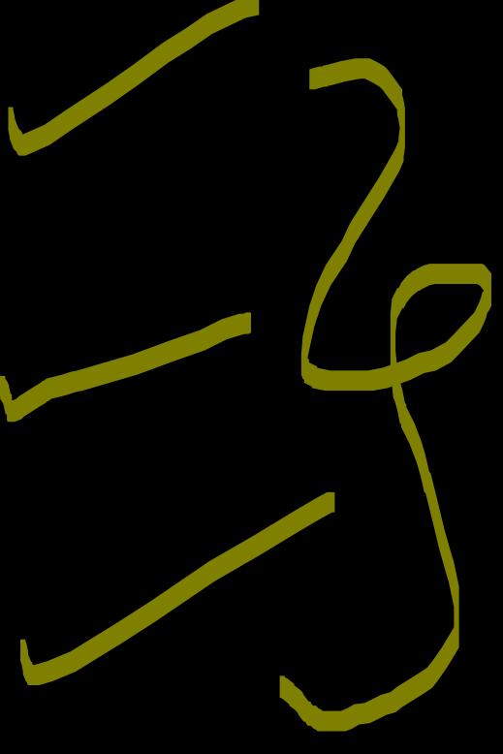
Chapter
10
Number of Intermediaries
Exclusive
Selective
Intensive

Slide 31

Chapter
10
Terms and Responsibilities of Channel Members
Price policy
Condition of sale
Distributors’ territorial rights
Mutual services and responsibilities

Slide 32
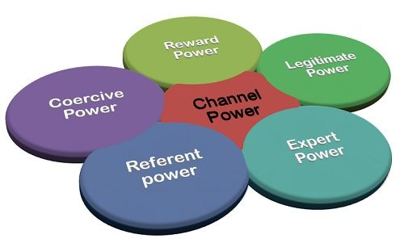

Chapter
10
Channel Power
Coercive
Reward
Legitimate
Expert
Referent

Slide 33
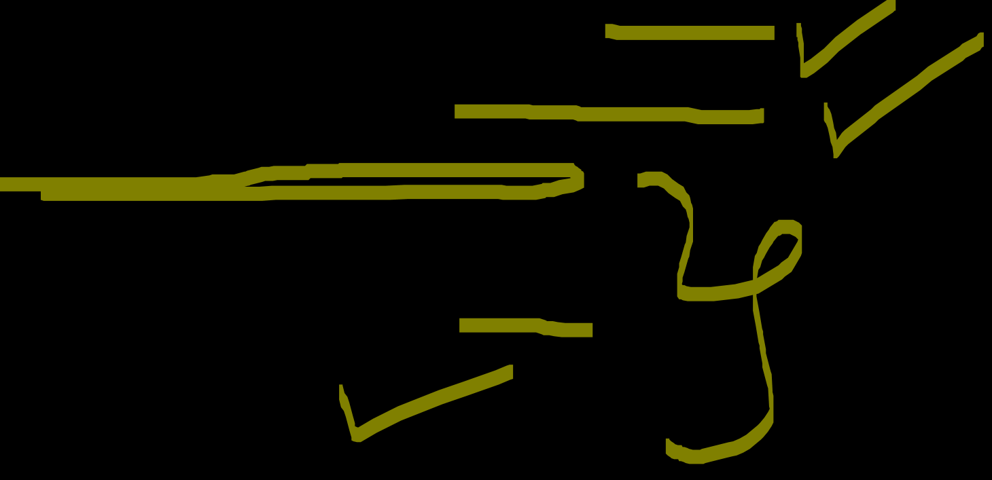
Chapter
10
Channel Management
Coordinating two independent entities with shared goals.
The relationship needs to be managed for the long term.
Factors complicating channel management
  Ownership
  Geographic, cultural, and economic distance
  Different rules of law

Slide 34
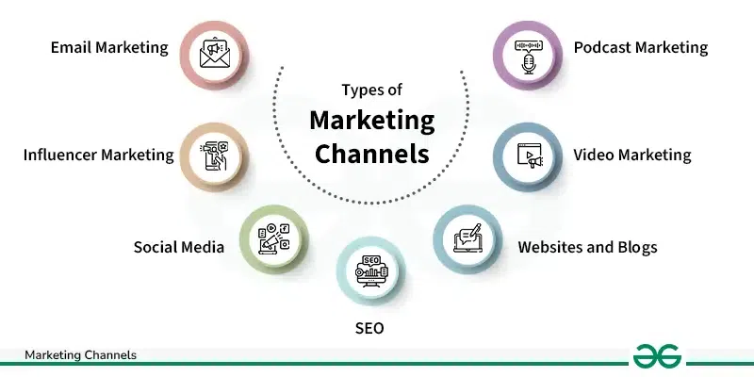
Chapter
10
Marketing Channels and Marketing Management Strategy
Marketing channel strategy: One of the major strategic areas of marketing management.
  Management must develop and operate its marketing channels in such way as to support and enhance the other strategic variables of the marketing mix in order to meet the demand of the firm’s target markets.

Slide 35

Chapter
10
Channel Strategy versus Logistics Management
Marketing mix
Product strategy
Pricing strategy
Promotion strategy
Distribution strategy
Channel strategy component
Logistics management component

Slide 36
Chapter
10
Channel Strategy versus Logistics Management
Channel strategy
is much broader and more basic component than logistics management.
is concerned with the entire process of setting up and operating the contractual organization that is responsible for meeting the firm’s distribution objectives.
Logistics management
is more narrowly focused on providing product availability at the appropriate times and places in the marketing channel.
Distribution strategy
Channel strategy component
Logistics management component
Usually, channel strategy must already be formulated before logistics management can even be considered.

Slide 37
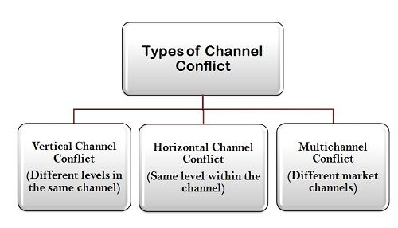

Chapter
10
What is Channel Conflict?
Channel conflict
Occurs when one member’s actions prevent another channel from achieving its goal.
Types of channel conflict
  Vertical
  Horizontal
  Multichannel

Slide 38

Chapter
10
Causes of Channel Conflict
Goal incompatibility
Unclear roles and rights
Differences in perception
Intermediaries’ dependence on the manufacturer

Slide 39

Chapter
10
Strategies for Managing Channel Conflict
Adoption of superordinate goals
Exchange of employees
Joint membership in trade associations
Cooptation
Diplomacy
Mediation
Arbitration
Legal recourse

Slide 40
Chapter
10
Key Terms
Channel: Different options for getting products to consumers and businesses that want to buy them.
Channel Density: To achieve optimal market exposure.
Channel Length: The total number of channel members.
Distribution Patterns: These are determined by considering the needs of consumers as well as the nature of the product itself.
Exclusive Distribution: This means selling the product through only one intermediary in a geographic area. Marketers use this method when they need to maintain tight control over the product.
Selective Distribution: This means selling the product through a limited number of wholesalers and retailers in a geographic area. Marketers use this method when they want to deal with intermediaries that they feel will do the best job of promoting and selling their products.
Intensive Distribution: This means selling the product through every available wholesaler and retailer in a geographic area where consumers might be looking for it. Marketers use this method when they are trying to reach as many consumers as possible

Slide 41

The last lecture of this course
Dr. Ayman Hassan

Slide 42
Resources and References
What is Channel Power? definition and meaning - Business Jargons
Direct Channel - Definition, Importance, Types and Benefits Information | Marketing91
What is Channel Conflict Management? definition and meaning - Business Jargons
Marketing Channels: Concept, Importance, Levels and Types - GeeksforGeeks
What are Marketing Channels? Definition, Factors, Functions - The Investors Book

Slide 43

01
Best wishes
Dr. Ayman Hassan

