Slide 1



Time Management & Decision Making
Lecture 5
MGM111
Principle of Management
Prepared by
Dr. Bothaina Mahmoud Fouad

Slide 2

www.midocean.ae
Time Management Concept
Decision Making Process
Learning Outcomes of the Lecture

Slide 3

www.midocean.ae
the ability to use one's time effectively or productively, especially at work.
is a technique for using your time more effectively.
Organize your professional and personal tasks based on how urgent and important they are, and take care of the most urgent and important first, followed by activities that are not urgent but still important
Time Management

Slide 4
www.midocean.ae
Time management is the key to efficient working

Slide 5
Choose Goals Priorities
Short-term goals
Long-term goals
why it is important?
The benefits of good time management include greater productivity, less stress, and more opportunities to do the things that matter.
Good time management enables an individual to complete more in a shorter period of time, lowers stress, and leads to career success.

Slide 6
www.midocean.ae
Its Importance for the Management
Effective time management increases your focus and improves your productivity. Greater focus allows you to capture bigger opportunities. It also allows you to spend more time on the projects, goals, and people that matter. Time management is important in helping you achieve greater focus and prioritisation.

Slide 7
www.midocean.ae
The 4 Ds of Time Management
the 4 Ds of productivity
A popular strategy for discerning whether or not a task or project is worth your time.
It involves making a quick decision about what to act on now either by doing it yourself or delegating to someone else, what to act on in the future, or what to drop from your to-do list

Slide 8
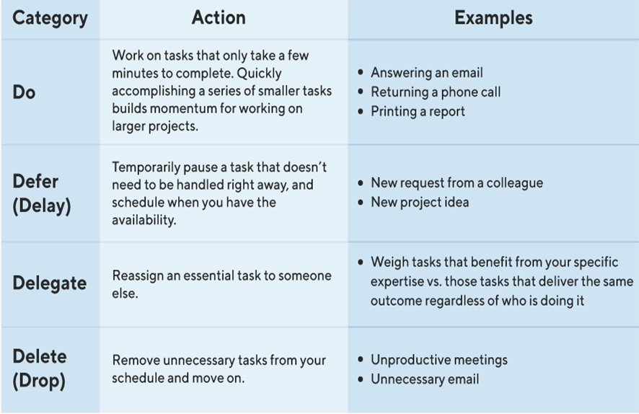
www.midocean.ae
The 4 Ds of Time Management

Slide 9
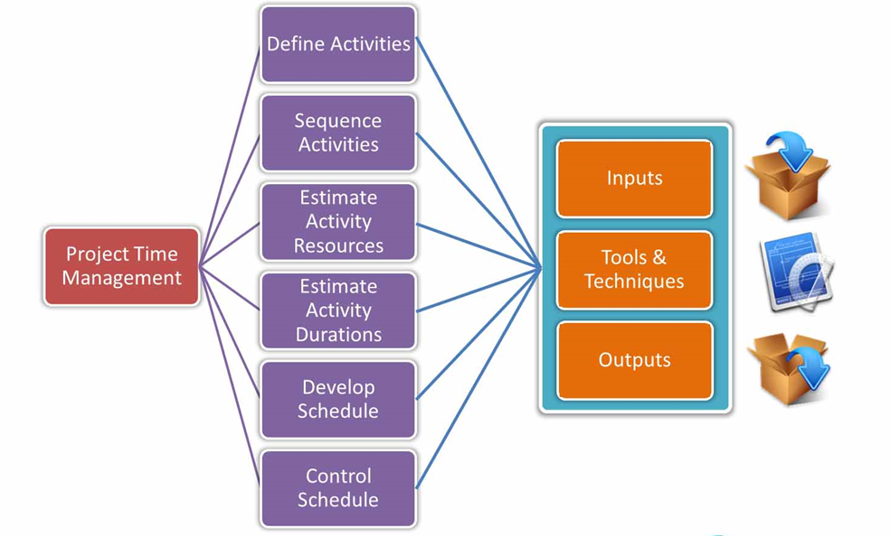
www.midocean.ae
Project Time Management

Slide 10
www.midocean.ae
Time-management challenges
How to fix it | Challenge
You might also identify ways your task will help you reach a different, yet related, goal that is important to you | The effort may seem to exceed your energy level on a given day, perhaps, or it might have to do with your enthusiasm level for a specific task. | Low motivation
try concentrating on one objective at a time. You may find that this makes your work more effective and efficient, as well as higher quality | Multitasking involves switching between tasks rapidly, which can overwhelm a person's decision-making processes. And affect work quality | Attempted multitasking
Consider reorganizing your physical space to streamline your workflow and Try keeping a to-do list | Many people also find that messiness can impede their time management and productivity | Lack of organization

Slide 11
www.midocean.ae
Time-management challenges
You might also try to collaborate with a colleague or even refer to a trusted mentor to help decide which tasks are most important for a given period of time. | Different stakeholders may have expectations that differ from your own understanding of how to prioritize tasks at work | Trouble prioritizing
try integrating success measures into your to-do list. | Attention to detail can be a valuable asset in the workplace. When prioritized out of the bounds of moderation | Perfectionism

Slide 12

Decision Making In Management

Slide 13
Managers are faced with decisions when a problem occurs or when an opportunity arises.

Slide 14
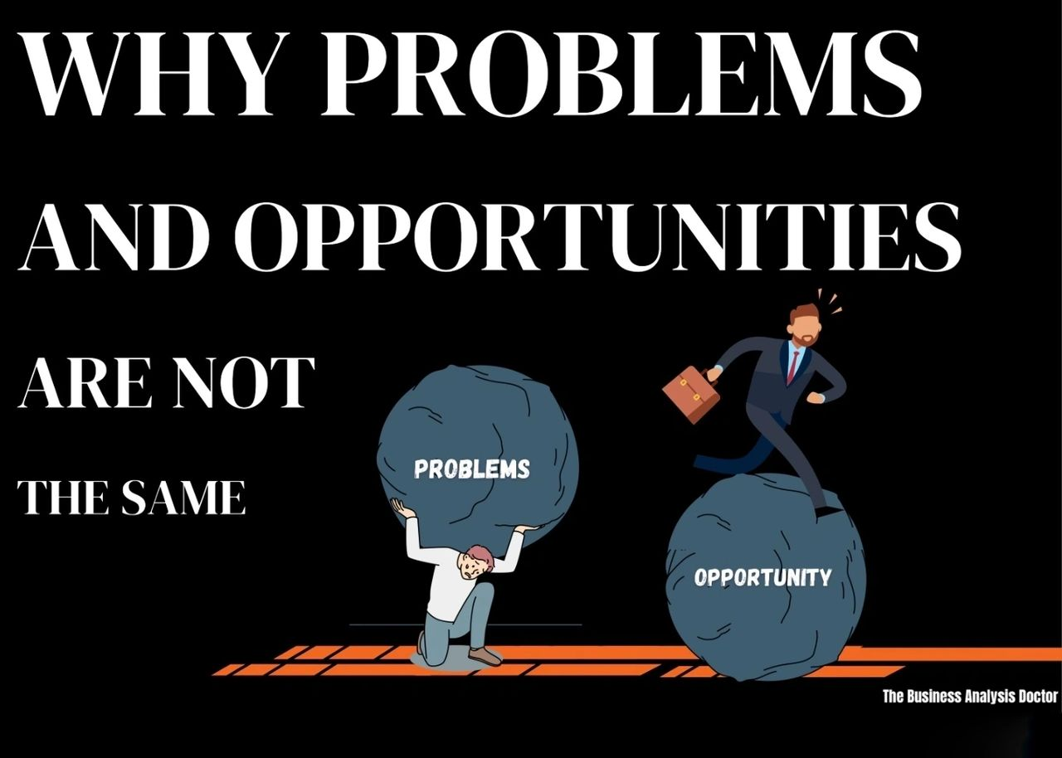

Slide 15
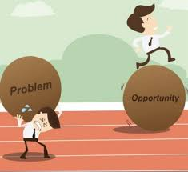
Making Decisions
Problem – A situation in which some aspect of organizational performance is less than desirable.
Opportunity – A situation that has the potential to provide additional beneficial outcomes.

Slide 16
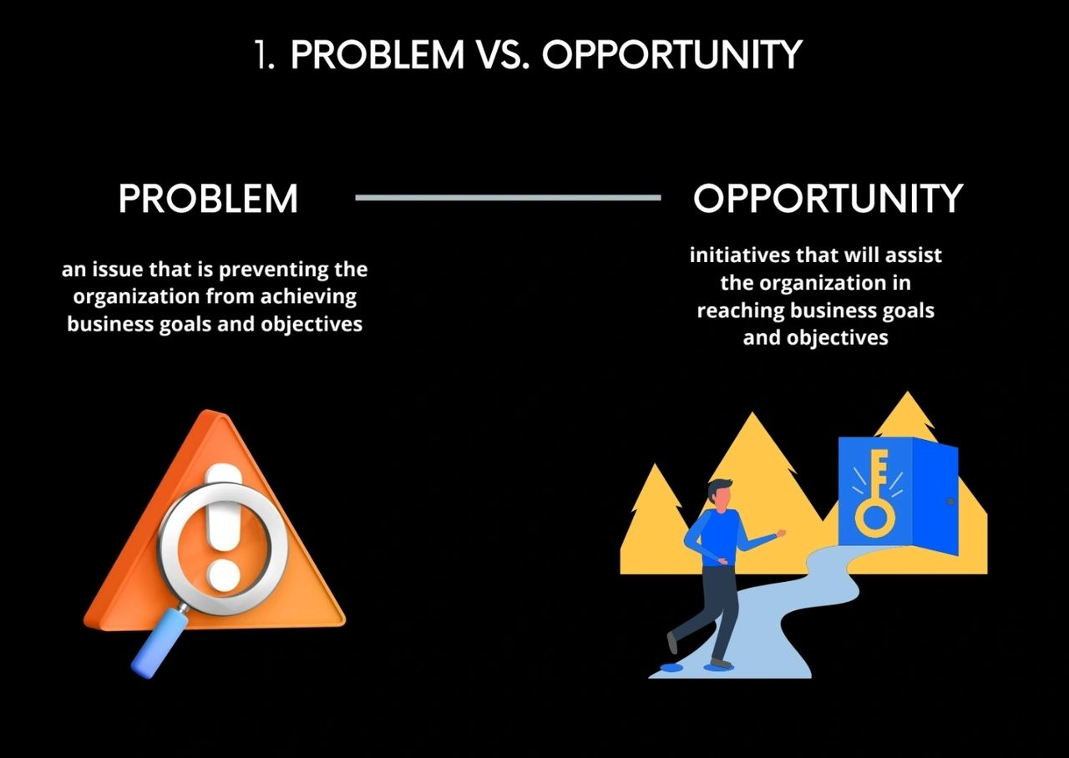

Slide 17
Making Decision definition
a process of choosing among alternative courses of action for the purpose of attaining a goal or goals
Making Decision is at the heart of organizational effectiveness.

Slide 18
Making Decision definition
Two dominant issues affect how decisions are made in organizations:
  Stability (application of existing practices and maintenance of existing performance levels)
  Change (environmental demands for quick response and emerging problems that are ambiguous)

Slide 19
Making Decision definition
Participative making decision structures are required to effectively manage change.
Empowering people to participate in important decisions is highly motivating to them.
Broad participation infuses the making decision process with the full spectrum of knowledge and good ideas that people throughout the organization have to contribute

Slide 20
Making Decision Theory
Daniel Griffith’s Theory of Leadership is About Decision Making:
  Administration is making decision.
  Organization’s structure is determined by the nature of its making decision process.
  An individual's rank equals his or her degree of control of the making decision process.
  Effectiveness of the leader is inversely proportional to the number of decisions made personally.
  The major differences between types of organizations are related to differences in the making decision process.

Slide 21
Making Decision versus Problem Solving
Herbert Simon’s 4 Phases of Decision Making
Intelligence
Design
Choice
Implementation
making Decision and problem solving
are interchangeable

Slide 22
Phases of Decision Making
  Intelligence activity - gathering information regarding the need for a decision to be made
  Design activity - alternatives are envisioned, developed and analyzed
  Choice activity - selecting a course of action
  Implementation – implement the best action

Slide 23
Phases of Decision Making
Intelligence phase
  Reality is examined
  The problem is identified and defined
Design phase
  Representative model is constructed
  The model is validated and evaluation criteria are set
Choice phase
  Includes a proposed solution to the model
  If reasonable, move on to the
Implementation phase
  Solution to the original problem
  Failure: Return to the modeling process

Slide 24
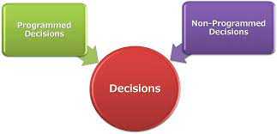
Making Decision versus Problem Solving
Programmed decisions – Decisions made in response to routine situations that have occurred in the past.
Non programmed decisions – Decisions made in response to situations that are unique, unstructured, or poorly defined.

Slide 25
Making Decision versus Problem Solving
Programmed decisions
Non Programmed decisions
Alternatives are familiar to decision makers
Responses are routine
Alternatives are not familiar to decision makers
Responses require creativity

Slide 26
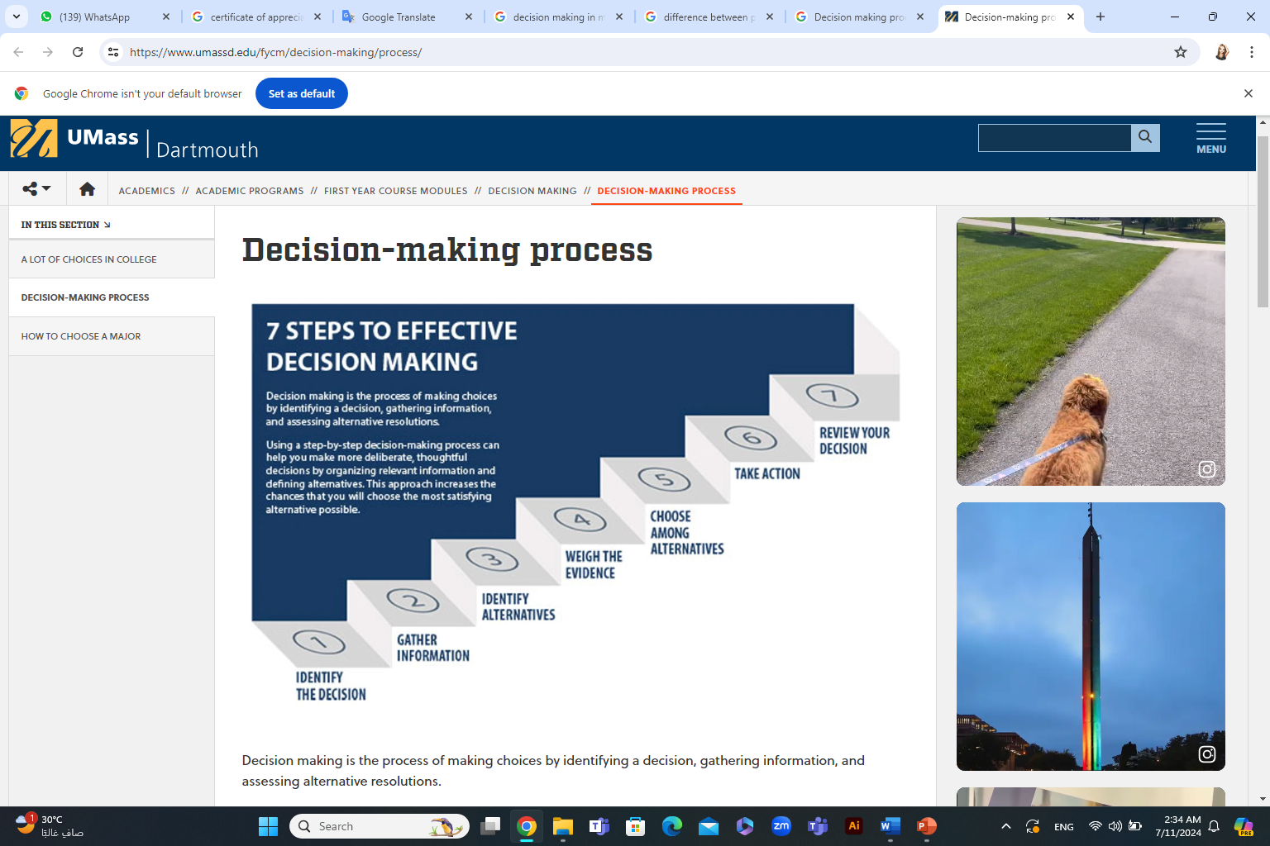
Decision Making Process

Slide 27
Decision Making Process
Step 1: Identify the decision
You realize that you need to make a decision. Try to clearly define the nature of the decision you must make. This first step is very important.
Step 2: Gather relevant information
Collect some pertinent information before you make your decision: what information is needed, the best sources of information, and how to get it. This step involves both internal and external “work.” Some information is internal: you’ll seek it through a process of self-assessment. Other information is external: you’ll find it online, in books, from other people, and from other sources.

Slide 28
Decision Making Process
Step 3: Identify the alternatives
As you collect information, you will probably identify several possible paths of action, or alternatives. You can also use your imagination and additional information to construct new alternatives. In this step, you will list all possible and desirable alternatives.
Step 4: Weigh the evidence
Draw on your information and emotions to imagine what it would be like if you carried out each of the alternatives to the end. Evaluate whether the need identified in Step 1 would be met or resolved through the use of each alternative. As you go through this difficult internal process, you’ll begin to favor certain alternatives: those that seem to have a higher potential for reaching your goal. Finally, place the alternatives in a priority order, based upon your own value system.

Slide 29
Decision Making Process
Step 5: Choose among alternatives
Once you have weighed all the evidence, you are ready to select the alternative that seems to be best one for you. You may even choose a combination of alternatives. Your choice in Step 5 may very likely be the same or similar to the alternative you placed at the top of your list at the end of Step 4.
Step 6: Take action
You’re now ready to take some positive action by beginning to implement the alternative you chose in Step 5.

Slide 30
Decision Making Process
Step 7: Review your decision & its consequences
In this final step, consider the results of your decision and evaluate whether or not it has resolved the need you identified in Step 1. If the decision has not met the identified need, you may want to repeat certain steps of the process to make a new decision. For example, you might want to gather more detailed or somewhat different information or explore additional alternatives.

Slide 31
Other Steps in making decision
Peter Drucker’s rational steps in making decision :
  Define the Problem
  Analyze the Problem
  Develop Alternative Solutions
  Decide on the Best Solution
  Convert decisions into Effective Actions

Slide 32
Models of Decision-Making
Rational Model
Effective decision
a timely decision
that meets a desired objective and is acceptable to those individuals affected
by it
Bounded Rationality Model
Garbage Can Model

Slide 33
Models of Decision-Making
Rationality - a logical, step-by-step approach to decision making, with a
thorough analysis of alternatives and their consequences.
1. The outcome will be completely rational
2. The decision maker uses a consistent system of preferences to choose the best alternative
3. The decision maker is aware of all alternatives
4. The decision maker can calculate the probability of success for each alternative
Rational Model
Bounded Rationality Model
Garbage Can Model

Slide 34
Models of Decision-Making
Bounded Rationality – a theory that suggests that there are limits upon how rational a decision maker can actually be
1. Managers suggest the first satisfactory alternative
2. Managers recognize that their conception of the world is simple
3. Managers are comforable making decisions without determining all the alternatives
4. Managers make decisions by rules of thumb or heuristics
Rational Model
Bounded Rationality Model
Garbage Can Model

Slide 35
Models of Decision-Making
Garbage Can Model - a theory that contends
that decisions in organizations are random and unsystematic
Rational Model
Solutions
Bounded Rationality Model
Problems
Choice
opportunities
Participants
Garbage Can Model

Slide 36
Techniques that Enhance Quality in Making Decision
Three different making decision environments are generally identified depending on the amount of knowledge that exists about future conditions that might occur.
making Decision under certainty
making Decision under uncertainty
making Decision under risk

Slide 37
Making decision environments
making Decision under certainty: the decision maker knows with certainty what conditions will subsequently occur and affect the decision outcomes.
making Decision under risk: the probabilities are used to obtain expected values of outcomes for each decision alternative.
making Decision under uncertainty: In some cases a decision maker cannot assess the probability of occurrence for the various states of nature.

Slide 38
Making decision environments
making Decision under uncertainty:
Several outcomes possible for each course of action
but the decision maker does not know, or cannot estimate the probability of occurrence
More difficult - insufficient information

Slide 39
Ethical and Social Implications in
Making Decision
What are the ethical and social implications of my decision?
How will the decision affect the personal lives of my employees?
How do I balance economic and social considerations?

Slide 40
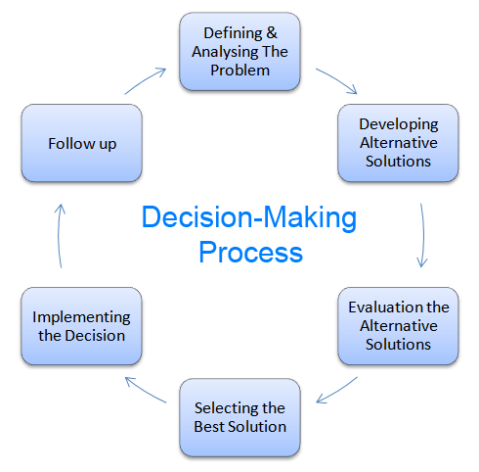
Remember, Making Decision Process

Slide 41
Measuring Outcomes
Goal attainment
Maximize profit
Minimize cost
Customer satisfaction level (minimize number of complaints)
Maximize quality or satisfaction ratings (surveys)

Slide 42



Thank You

