Slide 1


Introduction to the Financial System
Prepared by Dr. Yara Ibrahim
FIN 615
Finance Concepts
Lecture 1
www.midocean.ae

Slide 2

Chapter
Intended Learning Outcomes
01
Understand the financial system and markets.
Describe financial markets and their functions.
Distinguish between Primary and Secondary Market.
Describe the types of securities traded within financial markets.
Understand why the financial markets exists.

Slide 3

What is a Market?
A market is a place where two parties can gather to facilitate the exchange of goods and services. The parties involved are usually buyers and sellers.
The market may be physical like a retail outlet, where people meet face-to-face, or virtual like an online market, where there is no direct physical contact between buyers and sellers.

Slide 4
Types of Markets
Market
Trading Physical Assets
Trading Financial Asset
Notes:
Assets are commonly known as anything with a value that represent economic resources or ownership that can be converted into something of value such as cash.
Financial assets and physical assets, both represent such ownerships of value, even though they are very different to each other based on their features and characteristics. Since many easily confuse the two types of assets to be of similar meaning, the following article provides a solid explanation of the difference between the two, and explore a few points that may help readers understand the difference between these two types of assets.
Financial Assets
Financial assets are intangible, meaning that they cannot be seen or felt and may not have a physical presence except for the existence of a document that represents the ownership interest held in the asset. It is important to note that the papers and certificates that represent these financial assets do not have any intrinsic value (the paper held is only a document certifying ownership and is of no value). The paper derives its value from the value of the asset that is represented. Examples of such financial assets include stocks, bonds, funds held in a bank, investments, accounts receivable, company goodwill, copyrights, patents, etc. Regardless of the fact that financial assets do not exist in physical form, they are still recorded in a firm’s balance sheet, to represent the value that is held by them.
Physical Assets
Physical assets are tangible assets and can be seen and touched, with a very identifiable physical presence. Examples of such physical assets include land, buildings, machinery, plant, tools, equipment, vehicles, gold, silver, or any other form of tangible economic resource. From an accounting point of view, physical assets refer to the things that may be liquidated when the entity wound up its interest. Physical assets have a useful economic life, when it ascertains its age it may be disposed off. They usually experience a reduction in value due to wear and tear of the asset through continuous use known as depreciation, or may lose their value in becoming obsolete, or too old for use. Certain tangible assets are also perishable, such as a container of apples, or flowers that need to be sold soon in order to ensure that they do not perish and lose their value.
What is the difference between Financial Assets and Physical Assets?
The main similarity between tangible and physical assets is that they both represent an economic resource that can be converted into value, and both assets are recorded in a firm’s balance sheet. The main difference between the two is that physical assets are tangible and financial assets are not. Physical assets usually depreciate or lose value due to wear and tear, whereas financial assets do not experience such reduction in value due to depreciation. However, financial assets may lose value to changes in market interest rates, fall in investment returns or fall in the stock market prices. Physical assets also require maintenance, upgrades and repairs, whereas financial assets do not incur such expenses.

Slide 5
What is a Financial Market?
A financial market is a market in which financial assets (securities) such as stocks and bonds can be purchased or sold.
Funds are transferred in financial markets when one party purchases financial assets previously held by another party.
Financial markets facilitate the flow of funds and thereby allow financing and investing by households, firms, and government agencies.

Slide 6
Types of Financial Markets
Money Markets - Typically the money markets trade in products with highly liquid short-term maturities (of less than one year) and are characterized by a high degree of safety and a relatively low return in interest.

Slide 7
Types of Financial Markets
2. Capital Markets - venues where savings and investments are channeled between the suppliers who have capital and those who need capital. The entities that have capital include retail and institutional investors while those who seek capital are businesses, governments, and people. Capital markets are composed of primary and secondary markets. The most common capital markets are the equity market and the bond market.

Slide 8
Types of Financial Markets
3. Foreign Exchange Market - In such type of market, parties are involved in trading of currency. In a foreign exchange market (also called currency market), one party exchanges one country’s currency with equivalent quantity of another currency.

Slide 9
Types of Financial Markets
4.Derivatives Markets - Predictive market is a set up where exchange of good or service takes place for future. The buyer benefits when the market goes up and is at a loss when the market crashes.

Slide 10
1- Role of Financial Markets

Slide 11
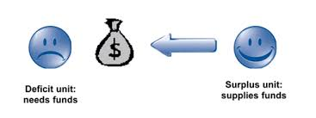
Role of Financial Markets
Financial markets transfer funds from those who have excess funds to those who need funds.
If funds were not supplied, the financial markets would not be able to transfer funds to those who need them.
Those participants who receive more money than they spend are referred to as surplus units (or investors). They provide their net savings to the financial markets.
Those participants who spend more money than they receive are referred to as deficit units. They access funds from financial markets so that they can spend more money than they receive.

Slide 12
Role of Financial Markets
A key role of financial markets is to
  Accommodate corporate finance needs, and
  Accommodate Investment needs.
  through the primary and secondary market.

Slide 13

Accommodating Corporate Finance Need
A key role of financial markets is to accommodate corporate finance activity.
Corporate finance (also called financial management) involves corporate decisions such as how much funding to obtain and what types of securities to issue when financing operations.
The financial markets serve as the mechanism whereby corporations (acting as deficit units) can obtain funds from investors (acting as surplus units).

Slide 14

Accommodating Investment Needs
Another key role of financial markets is accommodating surplus units who want to invest in either debt or equity securities.
Investment management involves decisions by investors regarding how to invest their funds.
The financial markets offer investors access to a wide variety of investment opportunities.
Financial institutions serve as intermediaries within the financial markets.
  They channel funds from surplus units to deficit units. For example, they channel funds received from individuals to corporations.
  They connect the investment management activity with the corporate finance activity, as shown in Exhibit 1.1.
  They also commonly serve as investors and channel their own funds to corporations.

Slide 15
How Financial Markets Facilitate Corporate Finance and Investment Management
Corporations
Needs Financing
Financial Markets
Investors
Surplus funds
Funds
Funds
Securities
Investment

Slide 16
Role of Financial Markets
Many deficit units such as firms and government agencies access funds from financial markets by issuing securities, which represent a claim on the issuer.
  Debt securities represent debt (also called credit or borrowed funds) incurred by the issuer. Deficit units that issue the debt securities are borrowers. The surplus units that purchase debt securities are creditors, and they receive interest on a periodic basis (such as every six months). Debt securities have a maturity date, at which time the surplus units can redeem the securities in order to receive the principal (face value) from the deficit units that issued them.
  Equity securities (also called stocks) represent equity or ownership in the firm. Some large businesses prefer to issue equity securities rather than debt securities when they need funds but might not be financially capable of making the periodic interest payments required for debt securities.

Slide 17
Primary versus Secondary Markets
Primary markets facilitate the issuance of new securities.
Secondary markets facilitate the trading of existing securities, which allows for a change in the ownership of the securities.
Many types of debt securities have a secondary market, so that investors who initially purchased them in the primary market do not have to hold them until maturity.
Primary market transactions provide funds to the initial issuer of securities; secondary market transactions do not.
An important characteristic of securities that are traded in secondary markets is liquidity, which is the degree to which securities can easily be liquidated (sold) without a loss of value.
Some securities have an active secondary market, meaning that there are many willing buyers and sellers of the security at a given moment in time.
Investors prefer liquid securities so that they can easily sell the securities whenever they want (without a loss in value).
If a security is illiquid, investors may not be able to find a willing buyer for it in the secondary market and may have to sell the security at a large discount just to attract a buyer.

Slide 18
2- Financial System

Slide 19

Financial System
A financial system is a network of financial institutions – such as insurance companies, stock exchanges, and investment banks– that work together in the financial markets to exchange and transfer capital from one place to another.
Through the financial system, investors receive capital to fund projects and receive a return on their investments.
Notes:
One of the biggest problems for any economy is to figure out is how to get money from people who want to save to people who want to borrow. Finance is the answer to that problem. If you think of the economy as a body, finance would be the heart, pumping money from pension funds in Iowa to construction sites in Madrid. In economic terms, the financial system is responsible for a lot of the world’s resource allocation. It decides which investments get funded and which ones do not. This makes it quite important and quite powerful.

Slide 20
Understanding Financial Systems
Financial markets involve various players, including borrowers, lenders, and investors.
The borrowers and lenders tend to trade money in exchange for a return on the investment at some future date.
When determining the guidelines of raising capital within a financial system, the project being funded and who funds them are decided upon by the planner, who can be a business manager. Thus, the financial system is typically organized through central planning, a market economy, or a combination of both.

Slide 21
Understanding Financial Systems
A centrally planned economy is structured around a central authority, such as a government, which makes economic decisions regarding the manufacturing and distribution of products for a specific country.
A market economy is when the pricing of goods and services is resulting from the effects of supply and demand.
An efficient markets is when all security prices fully reflect all available information.
Financial systems are heavily regulated due to their influence and facilitation capabilities to contribute to the growth of real assets.

Slide 22
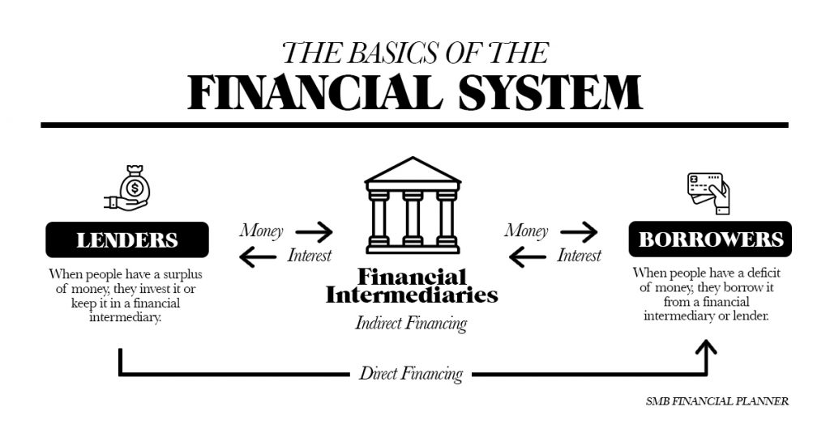

Slide 23
3- Securities Traded in Financial Markets

Slide 24

Securities Traded in Financial Markets
Securities can be classified as
  Money market securities,
  Capital market securities, or
  Derivative securities.

Slide 25
Money Market Securities
Money markets facilitate the sale of short-term debt securities by deficit units to surplus units.
The securities traded in this market are referred to as money market securities, which are debt securities that have a maturity of one year or less.
These generally have a relatively high degree of liquidity, not only because of their short-term maturity but also because they are desirable to many investors and therefore commonly have an active secondary market.
Money market securities tend to have a low expected return but also a low degree of credit (default) risk.
Common types of money market securities include
  Treasury bills (issued by the U.S. Treasury and governments),
  Commercial paper (issued by corporations), and
  Negotiable certificates of deposit (issued by depository institutions).

Slide 26
Capital Market Securities
Capital markets facilitate the sale of long-term securities by deficit units to surplus units.
The securities traded in this market are referred to as capital market securities.
Capital market securities are commonly issued to finance the purchase of capital assets, such as buildings, equipment, or machinery.
Three common types of capital market securities are
  Bonds are long-term debt securities issued by the Treasury, government agencies, and corporations to finance their operations. They provide a return to investors in the form of interest income (coupon payments) every six months. Bonds commonly have maturities of between 10 and 20 years.
  Stocks (or equity securities) represent partial ownership in the corporations that issue them. They are classified as capital market securities because they have no maturity and therefore serve as a long-term source of funds. Investors who purchase stocks (referred to as stockholders) issued by a corporation in the primary market can sell the stocks to other investors at any time in the secondary market.
  Mortgages are long-term debt obligations created to finance the purchase of real estate. Residential mortgages are obtained by individuals and families to purchase homes. Financial institutions serve as lenders by providing residential mortgages in their role as a financial intermediary. They can pool deposits received from surplus units and lend those funds to an individual who wants to purchase a home.

Slide 27
Derivative Securities
In addition to money market and capital market securities, derivative securities are also traded in financial markets.
Derivative securities are financial contracts whose values are derived from the values of underlying assets (such as debt securities or equity securities).
Many derivative securities enable investors to engage in speculation and risk management.
Speculation
  Derivative securities allow an investor to speculate on movements in the value of the underlying assets.
  Investors who speculate in derivative contracts can achieve higher returns than if they had speculated in the underlying assets, but they are also exposed to higher risk.
Risk Management
  Derivative securities can be used to reduce the risk by locking the price of the financial asset.

Slide 28
4- Functions of Financial Markets

Slide 29
What are the functions of markets?
Financial markets take many different forms and operate in diverse ways. But all of them, whether highly organized, like the London Stock Exchange, or highly informal, like the money changers on the street corners, serve the same basic functions.
  Price Setting,
  Asset Valuation,
  Arbitrage,
  Raising Capital,
  Commercial Transaction,
  Investment, and
  Risk Management

Slide 30

1. Price setting
The value of an ounce of gold or a share of stock is no more, and no less, than what someone is willing to pay to own it.
Markets provide price discovery, a way to determine the relative values of different items, based upon the prices at which individuals are willing to buy and sell them.

Slide 31

2. Asset valuation
Market prices offer the best way to determine the value of a firm or of the firm’s assets, or property.
This is important not only to those buying and selling businesses, but also to regulators.
An insurer, for example, may appear strong if it values the securities it owns at the prices it paid for them years ago, but the relevant question for judging its solvency is what prices those securities could be sold for if it needed cash to pay claims today.

Slide 32

3.Arbitrage
In countries with poorly developed financial markets, commodities and currencies may trade at very different prices in different locations.
As traders in financial markets attempt to profit from these divergences, prices move towards a uniform level, making the entire economy more efficient.

Slide 33

4. Raising capital
Firms often require funds to build new facilities, replace machinery or expand their business in other ways.
Shares, bonds and other types of financial instruments make this possible.
Increasingly, the financial markets are also the source of capital for individuals who wish to buy homes or cars, or even to make credit-card purchases.

Slide 34
5. Commercial Transaction
As well as long-term capital, the financial markets that makes many commercial transactions possible.
This includes such things as arranging payment for the sale of a product abroad and providing working capital so that a firm can pay employees if payments from customers run late.

Slide 35

6. Investment
The stock, bond and money markets provide an opportunity to earn a return on funds that are not needed immediately, and to accumulate assets that will provide an income in future.

Slide 36

7. Risk management
Futures, options and other derivatives contracts can provide protection against many types of risk, such as the possibility that a foreign currency will lose value against the domestic currency before an export payment is received.

Slide 37



Thank You

