Slide 1

CCNA - Introduction to Networks v7.0 (ITN)
Prepared by Dr. Abdelrhman Ahmed
Lecture 3
Module 6: Data Link Layer

Slide 2
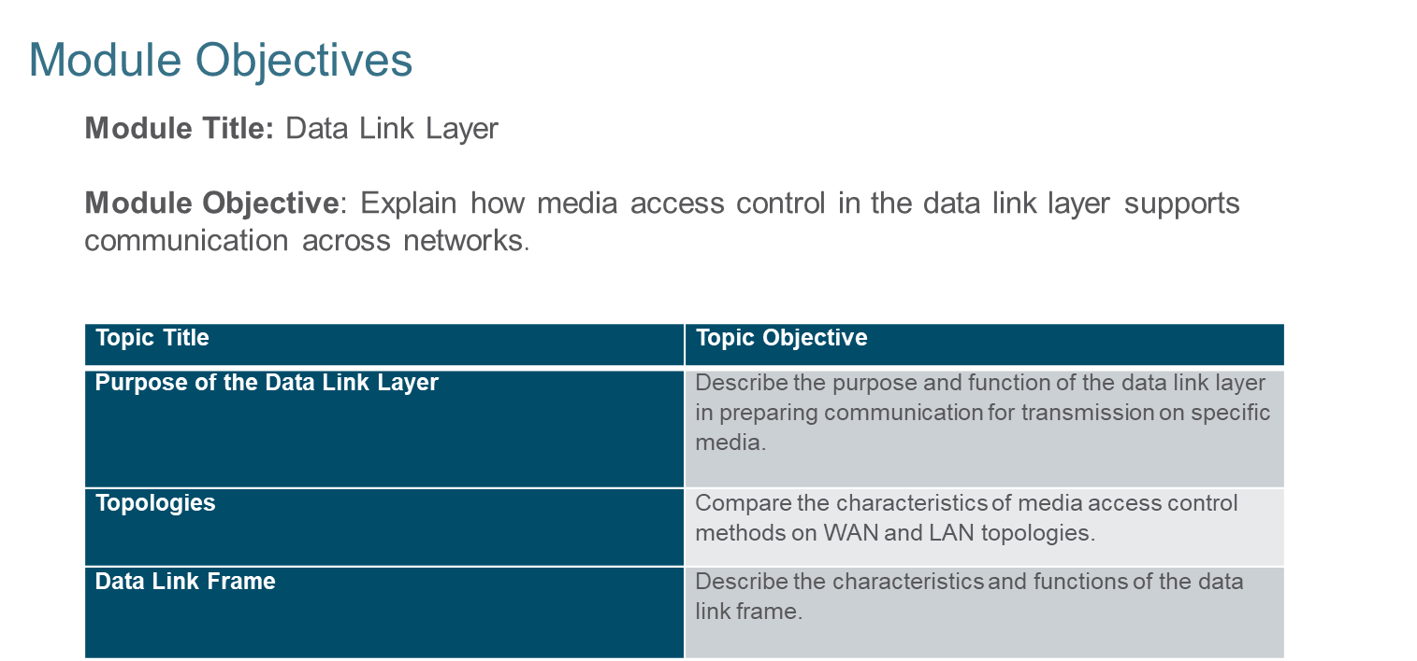

Chapter 3
Data Link Layer

Slide 3
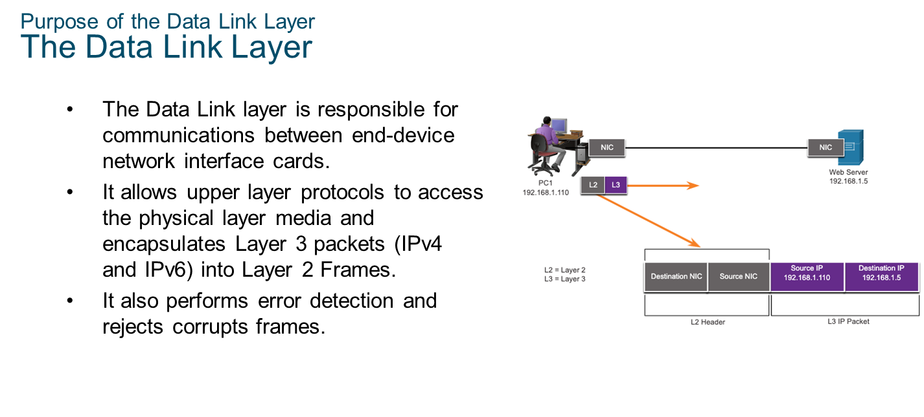
Chapter 3
Purpose of the Data Link Layer

Slide 4
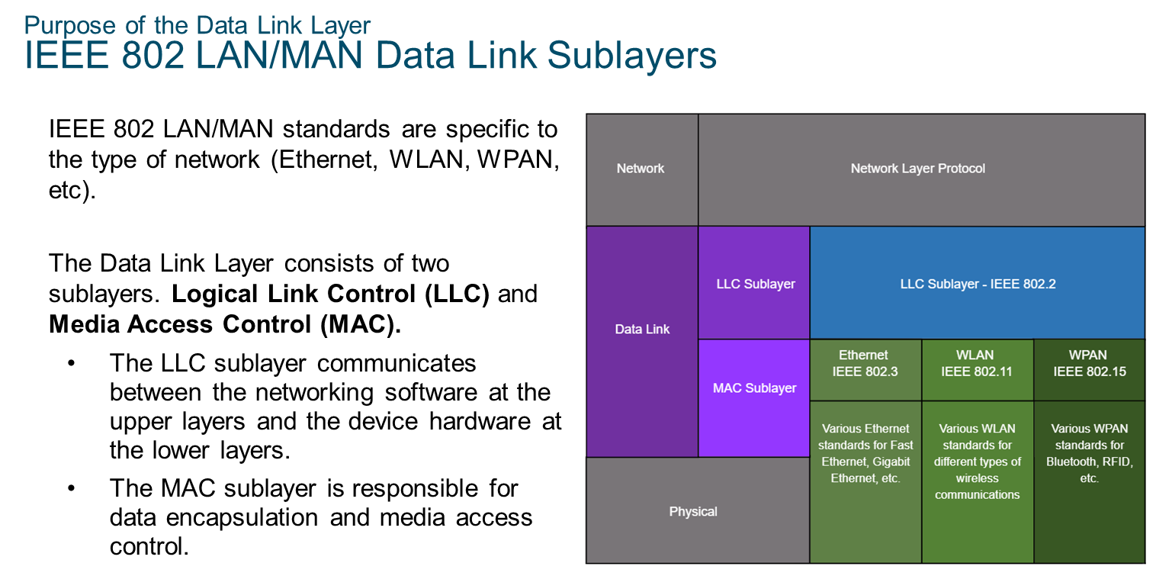
Chapter 3
Purpose of the Data Link Layer

Slide 5
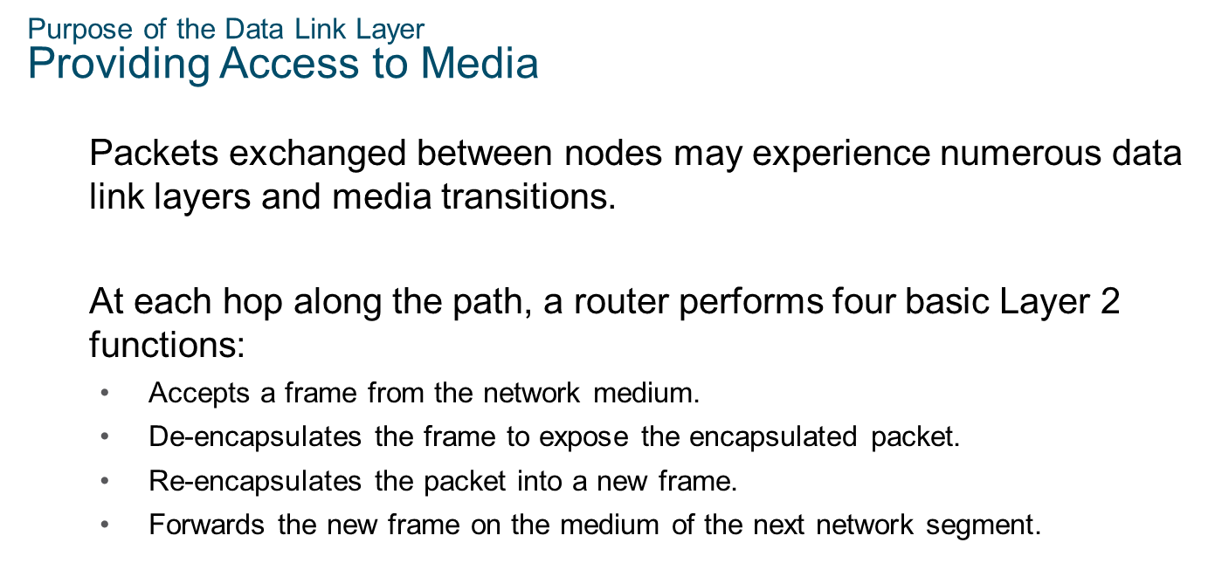
Chapter 3
Purpose of the Data Link Layer

Slide 6
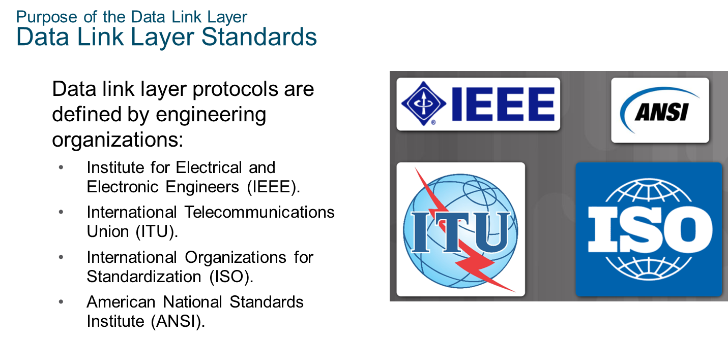
Chapter 3
Purpose of the Data Link Layer

Slide 7
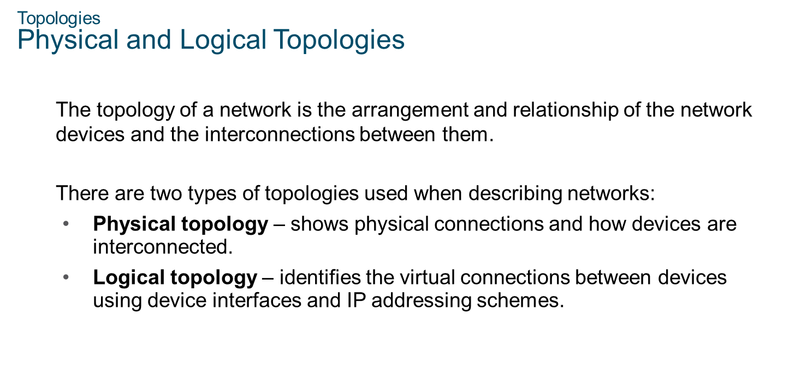
Chapter 3
Topologies

Slide 8
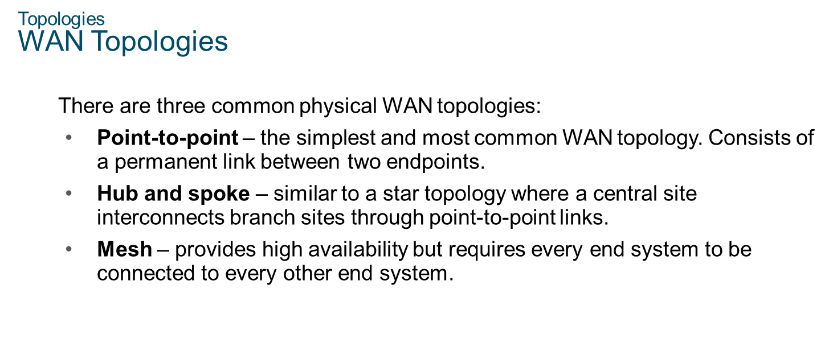
Chapter 3
Topologies

Slide 9
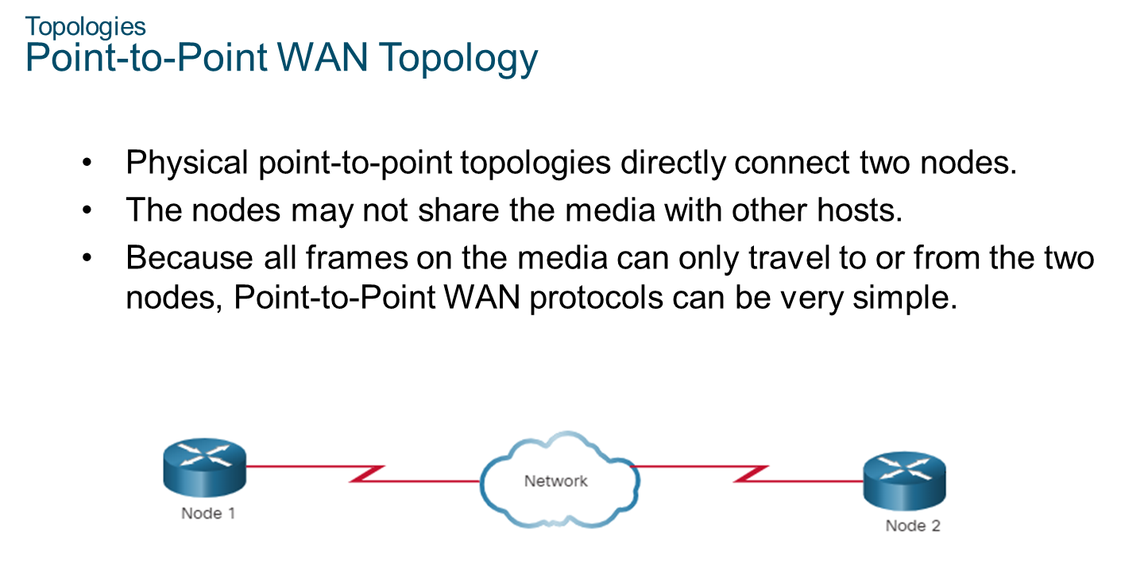
Chapter 3
Topologies

Slide 10
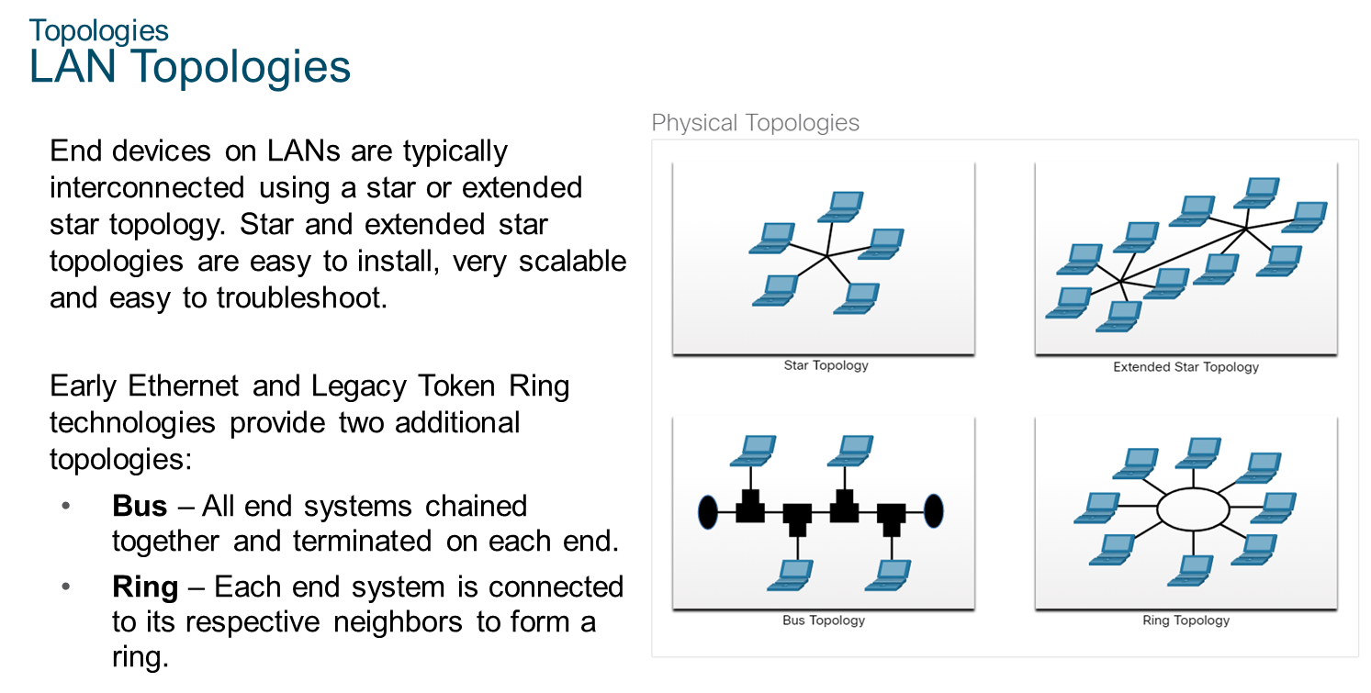
Chapter 3
Topologies

Slide 11
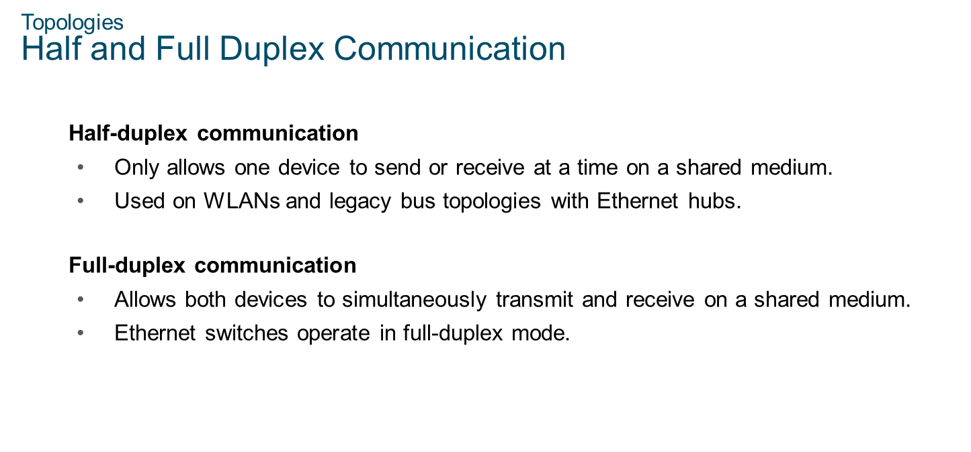
Chapter 3
Topologies

Slide 12
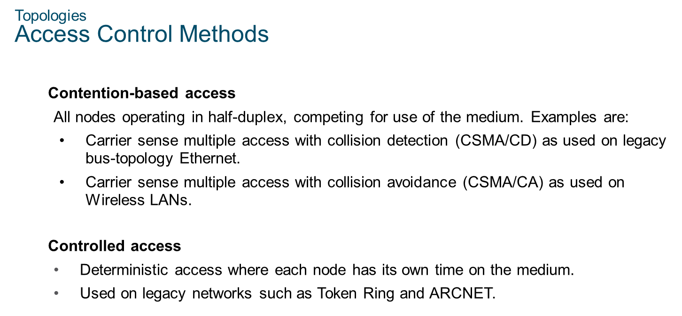
Chapter 3
Topologies

Slide 13
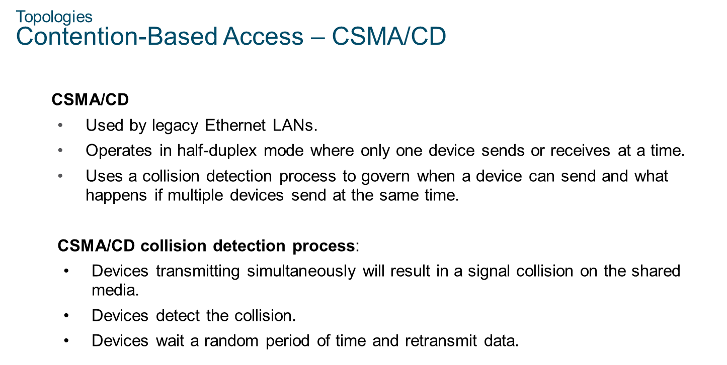
Chapter 3
Topologies

Slide 14
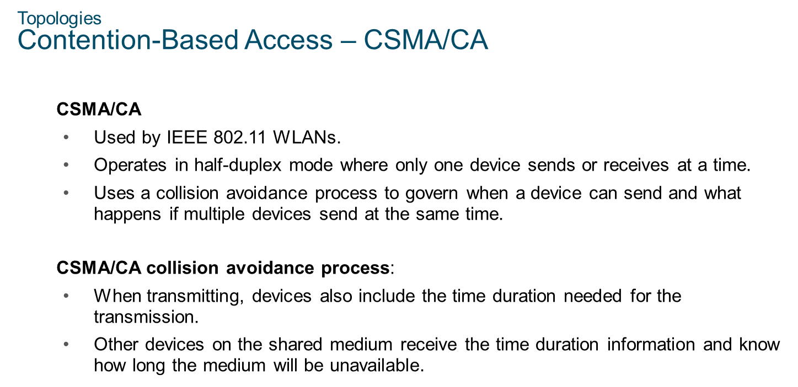
Chapter 3
Topologies

Slide 15
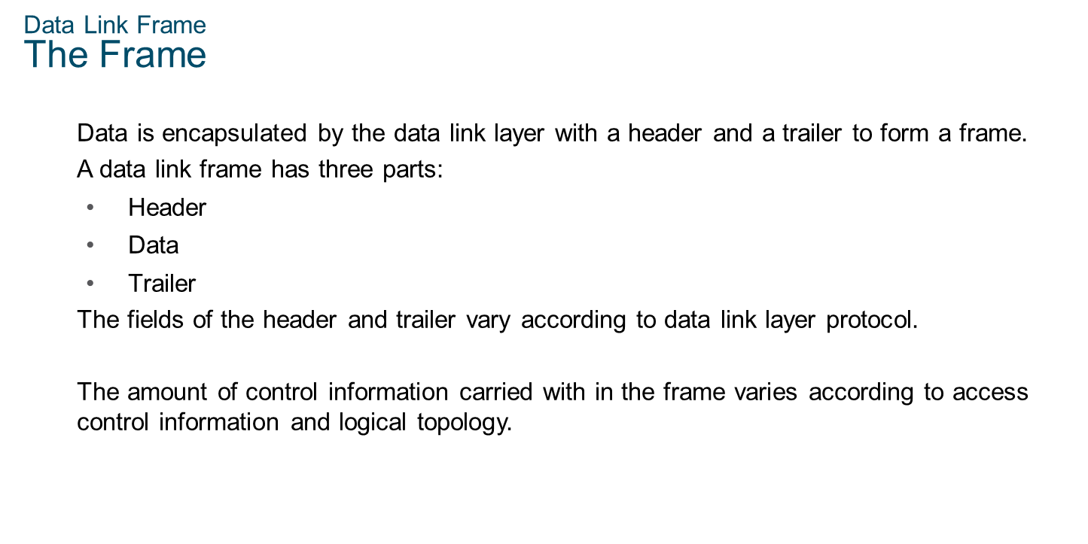
Chapter 3
Data Link Frame

Slide 16
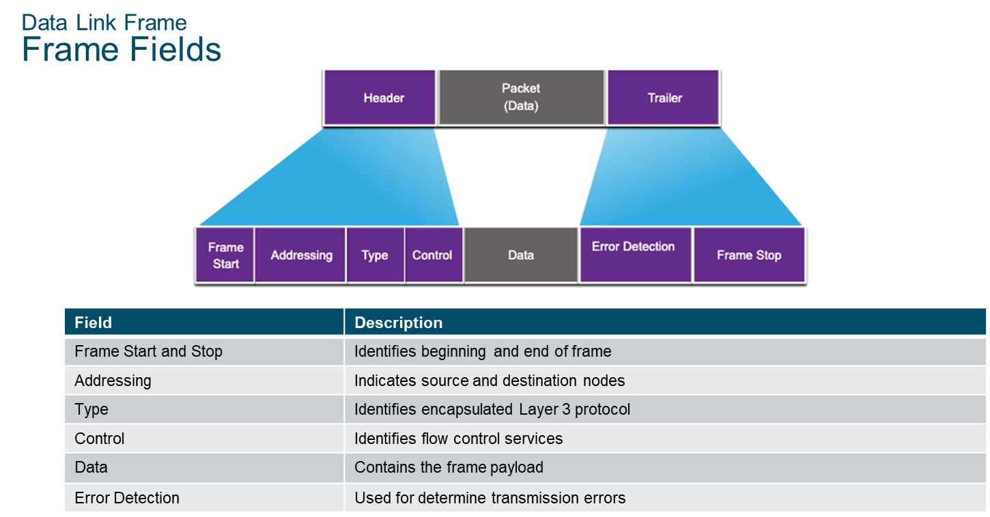
Chapter 3
Data Link Frame

Slide 17
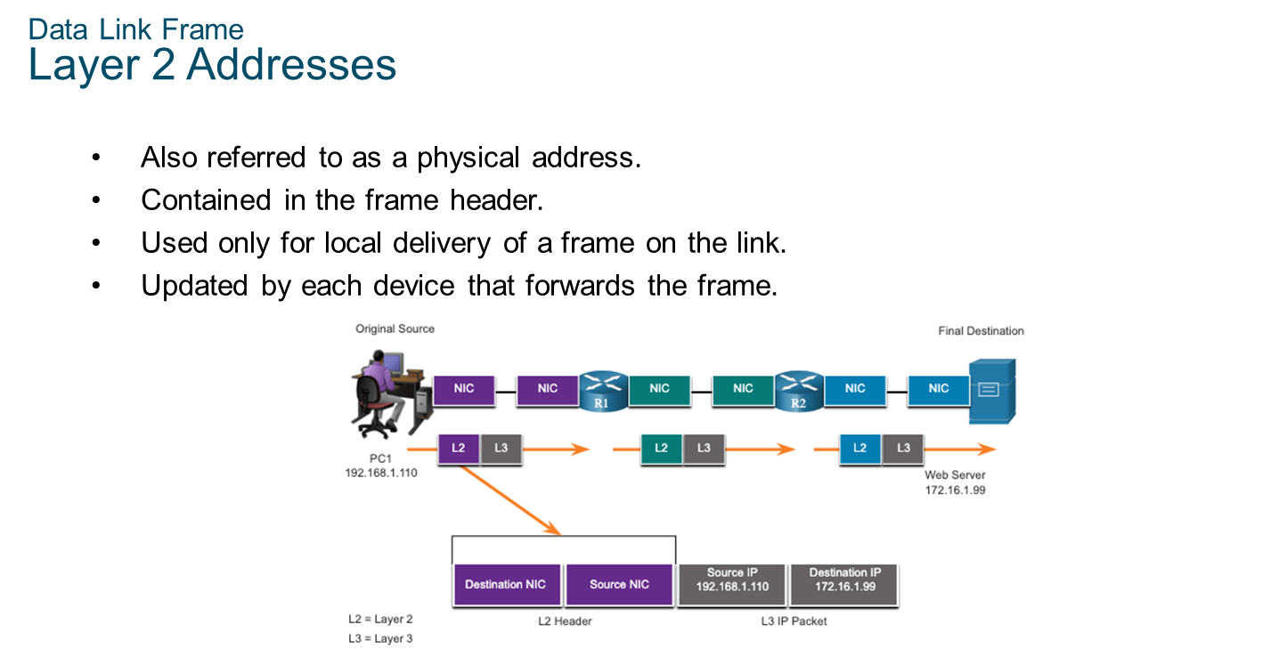
Chapter 3
Data Link Frame

Slide 18
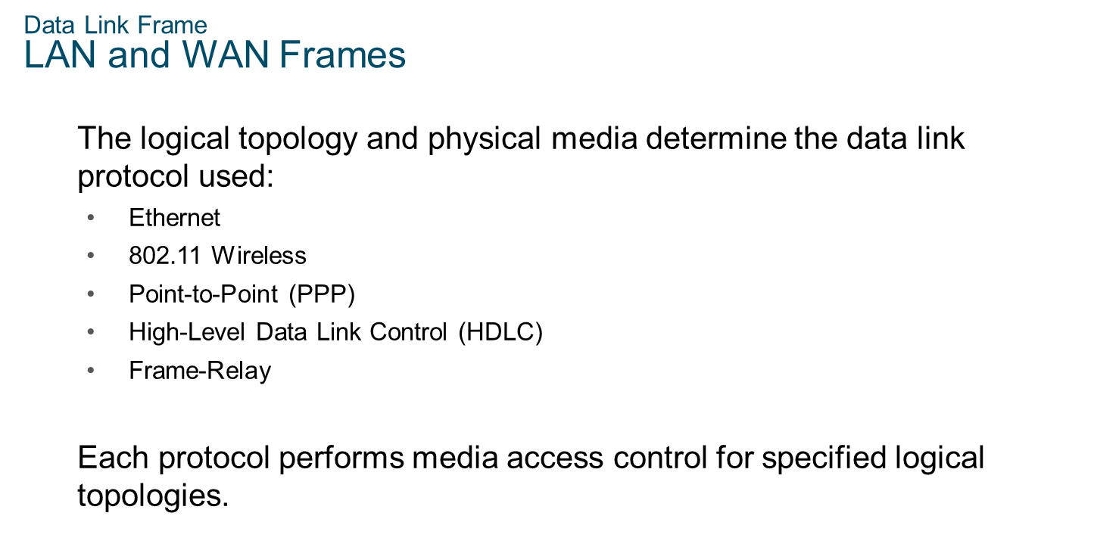
Chapter 3
Data Link Frame

Slide 19


