Slide 1



Influence and Negotiation Skills
Negotiation Barriers
Lecture 9
College of Entrepreneurship and Innovation
Code ENT623
Prepared by
Dr. Bothaina Mahmoud Fouad

Slide 2

Our Learning Outcomes
The main points:
Identify the negotiation barriers and challenges
How to overcome these barriers and challenges

Slide 3
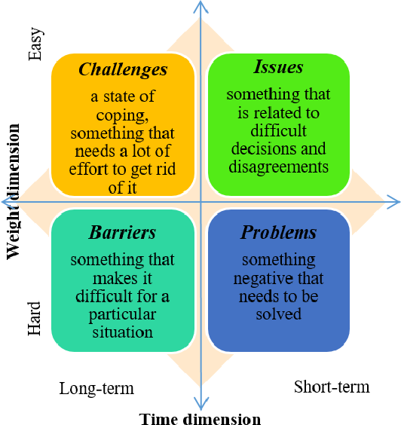
Problem: A broad, overarching difficulty or matter requiring a solution. Examples include poverty, climate change, or a malfunctioning machine.
Issue: A specific point or matter in question, often arising from or related to a problem. For instance, in the context of a malfunctioning machine, an issue could be a faulty sensor or a loose wire.
Challenge: A stimulating task or situation that requires effort and skill to overcome, often seen as an opportunity for growth or improvement. Examples include learning a new skill, completing a difficult project, or adapting to a new environment.
Barrier: An obstacle that prevents or hinders progress or movement. Barriers can be physical (e.g., a locked door), social (e.g., prejudice), or psychological (e.g., fear of failure).
Difference between challenge, barrier, issue and problem

Slide 4
Examples:
Problem: Poor public transportation in a city.
Issue: A specific route on the public transportation system is frequently delayed.
Challenge: Developing a new, eco-friendly public transportation system to replace the existing one.
Barrier: The lack of funding for the new transportation system.
Difference between challenge, barrier, issue and problem

Slide 5

Negotiation barriers and challenges encompass a wide range of obstacles that can hinder successful outcomes. These can include conflicting objectives, emotional barriers, lack of preparation, power imbalances, communication issues, and cultural differences. Understanding and addressing these challenges is crucial for effective negotiation.
Here are some common negotiation barriers:
Negotiation Barriers & Challenges

Slide 6
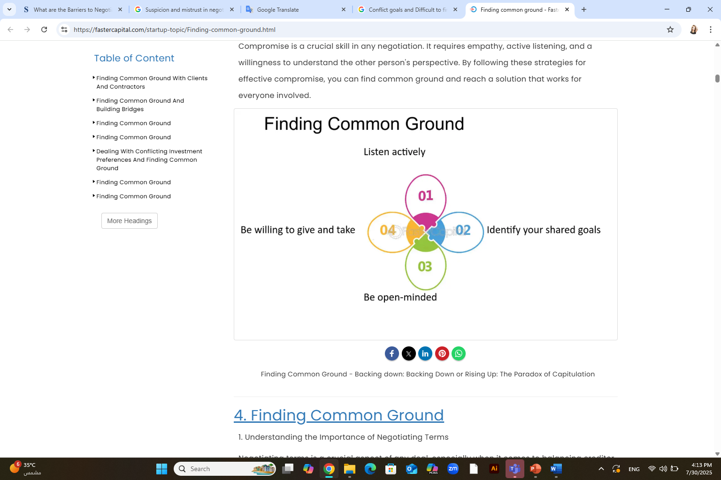
1. Conflict goals and Difficult to find Common Ground
Conflicting Objectives: Parties may have fundamentally different goals or priorities, making it difficult to find common ground.
Difficulty finding Common Ground: Disagreements on fundamental issues or an inability to identify shared interests can make it difficult to reach an agreement.

Slide 7

2. Lack of Information
Negotiations can be impeded when one or both parties lack essential information about the subject matter, market conditions, or the other party's interests and constraints. Insufficient information can lead to misunderstandings and an inability to find mutually beneficial solutions.

Slide 8
2. Lack of Information
Other or both sides fail to provide necessary information about issues, criteria, desired outcomes, or interests
Failure to provide necessary information can be unintentional or intentional ( for example in the form of selective disclosure).
EX: For instance, during the sale of aircrafts, a mandate agreement and an NCND ( Non- Circumvent non- Disclosure Agreement ) is required. Without these documents, the buyer and seller will not trust each other and will doubt each other’s ability to sign the contract successfully. And not having these documents will lead to the deal falling apart.

Slide 9
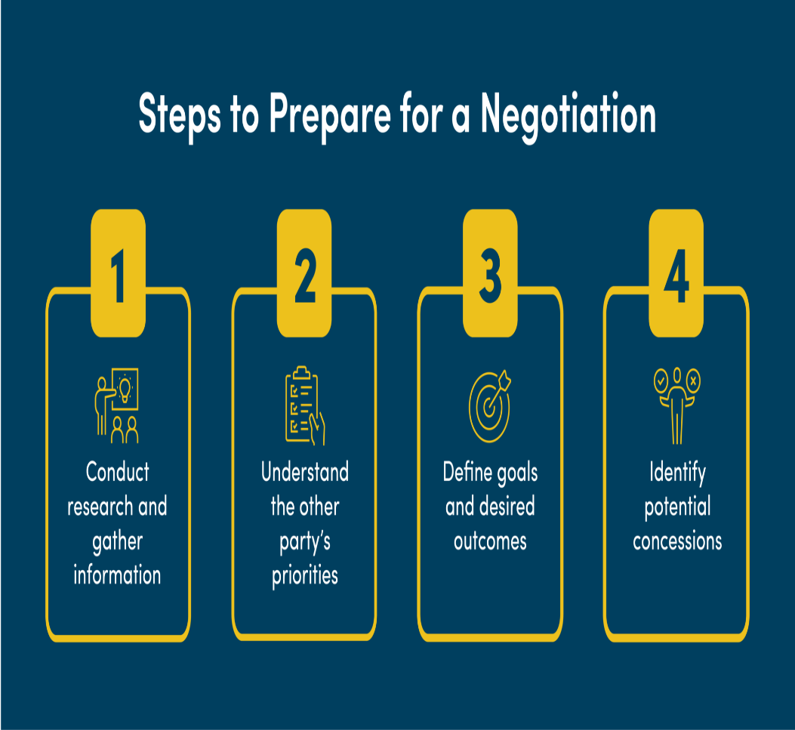
3. Poor preparation for a negotiation
Inadequate research, lack of information, or an inability to anticipate the other party's needs can weaken a negotiator's position.
is unacceptable. Don’t underestimate the second party. Check out even the smallest details before going for a negotiation.
Don’t think that the other person is not as smart as you, he can ask you anything and remember even he will try his level best to convince you.
You need to have valid answers for his questions.

Slide 10
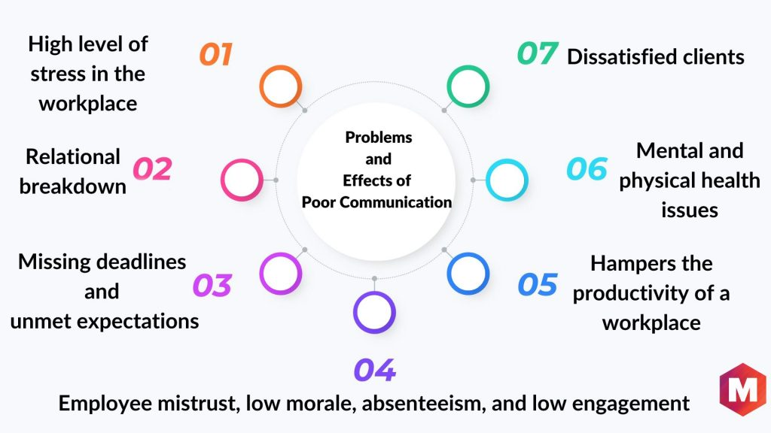
4. Poor and impaired communication
Effective communication is crucial for successful negotiations. Barriers such as language barriers, misinterpretation of messages, Poor listening skills, ambiguous language, or cultural differences in communication styles can lead to misunderstandings and breakdowns in dialogue and prevent parties from reaching a satisfactory agreement.

Slide 11
Communication is considered the first step towards the ladder of success. Poor communication in negotiation results in actions that have some serious consequences. For instance, we are trying to make a deal with a party that is not native.
When negotiating our agenda we will face problems in understandably delivering our message, the party will fall prey to lingual and cultural biases as this party does not have any idea how systems operate in the respected area so the level of effective negotiation drops here.

Slide 12

5. Power imbalances
When one party has significantly more power or leverage than the other, it can create an imbalance that affects the negotiation process. The stronger party may exploit their power, making it challenging for the weaker party to assert their interests or secure a fair outcome.
Disparities in power can lead to one party dominating the negotiation or the other feeling pressured to concede.

Slide 13

6. Cultural differences
Negotiating across different cultures can present additional barriers. Varying communication styles, norms, values, and decision-making processes can lead to misunderstandings and hinder effective negotiation.

Slide 14

7. Lack of alternatives
When parties feel that they have no viable alternatives or options outside of the negotiation, they may be less willing to make concessions or reach a mutually beneficial agreement. This can lead to a stalemate or unsatisfactory outcomes.

Slide 15

8. Suspicion and Mistrust or Distrust
Building trust is crucial for successful negotiations.
Mistrust between parties can make it difficult to build rapport and reach mutually beneficial agreements.
If the parties have a history of conflict, lack confidence in each other's integrity, or feel that their interests are not being respected, it can impede open and collaborative negotiation.

Slide 16
A lack of trust in negotiation can manifest as excessive questioning of information, delayed responses, or even outright deception, all of which can lead to an impasse.
For example, one party might fabricate information or exaggerate claims to gain an advantage, or they might delay sharing crucial information, leading the other party to question their motives and sincerity

Slide 17
There is the Dilemma Honesty
  On one hand, telling the other party everything about your situation may give that person an opportunity to take advantage of you.
  However, not telling the other person anything may lead to a stalemate
The Dilemma of trust concerns how much you should believe of what the other party tells you.
  Believing everything, the person could take advantages of you.
  Believing nothing, then reaching an agreement will be very difficult.

Slide 18
Ex: party A and party B are negotiating for a deal consisting of large number of barrels of petroleum.
  Party A ( the buyer ) is suspicious about the quality of petroleum that party B is supplying because of a recent conflict of part B with another customer over quality control.
  Party B did not disclose the reasons of this conflict during the negotiation with party A. as party B is not being fully honest and is unable to eliminate these suspicious of party a, the deal falls apart.

Slide 19
To overcome this barrier, they should build trust with each other through:
  Gain the trust of the other part before negotiating
  Treat your negotiators fairly
Repairing breach of trust
  Arrange a personal meeting to discuss the conflict and any surrounding issues.
  Taking responsibility for all or some aspects of underlying relationship tension is important to disarm conflict.

Slide 20
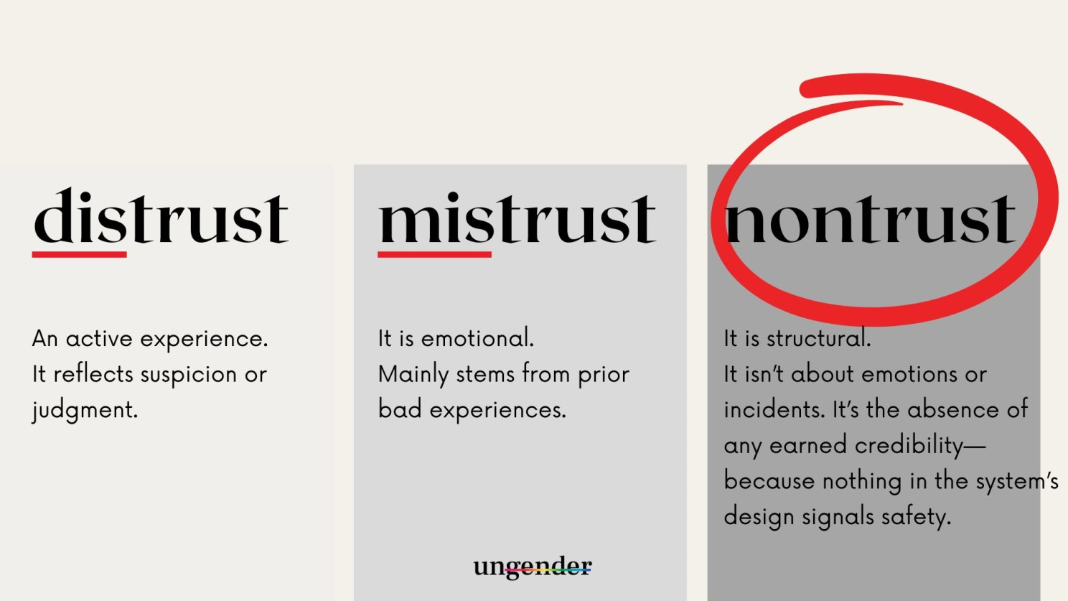
Difference between Mistrust, Distrust and Nontrust
Understanding these terms' differences can help you use them correctly in your conversations and writing. Use 'distrust' when expressing a definitive lack of trust based on evidence or experience. Use 'mistrust' when you want to convey suspicion or doubt without any concrete reason. Use ‘non-trust’ is different. It doesn’t announce itself with disappointment or doubt.

Slide 21
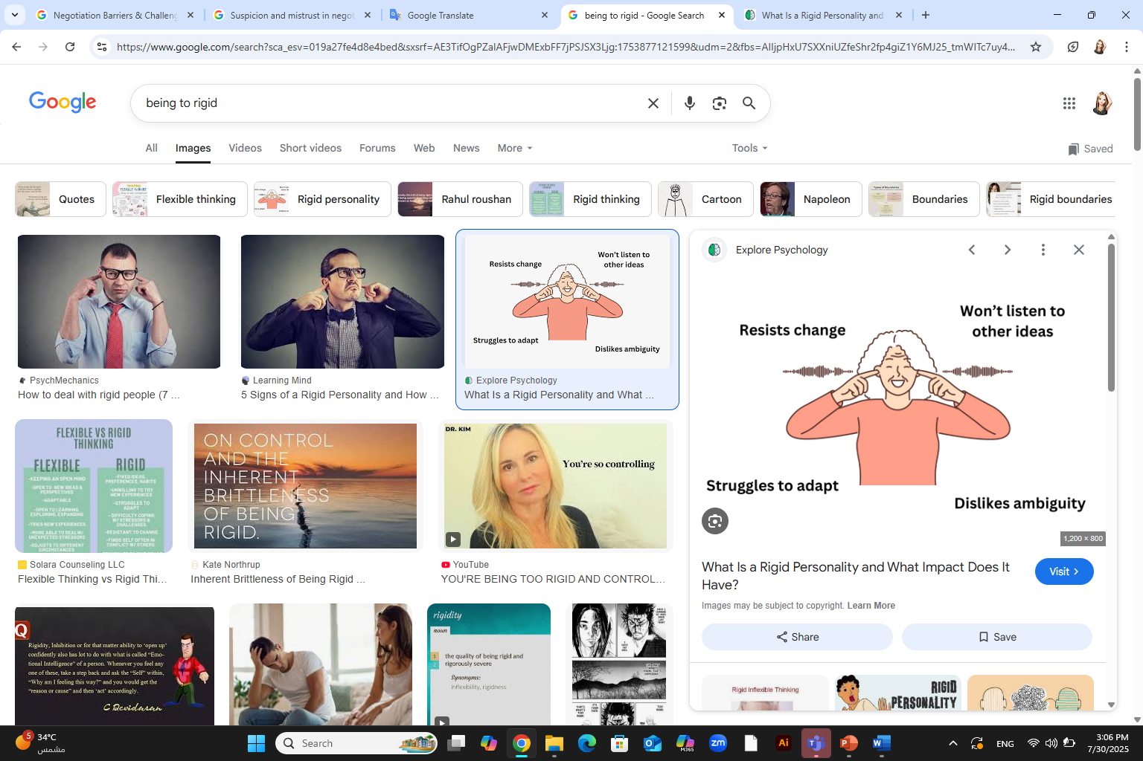
9. Being too rigid
If both parties approach negotiations with fixed positions and have a rigid mindset, it becomes challenging to explore creative solutions or make concessions. Inflexibility can lead to a stalemate or an unsatisfactory compromise.
Refusing to compromise or consider alternative solutions can stall negotiations and prevent progress.
Negotiations will fail if you are too rigid about your opinions rather than simply being clear about your end purpose, and open to how to design the deal and where flexibility can be practiced.

Slide 22
EX: if a shopkeeper is selling an antique glass vase but he is being too rigid and is not willing to lower the price a bit so as to make it more affordable, not only he is losing customers but also the potential customer will be deprived of the product he liked and wanted to purchase.
In this case, it will be a lose – lose situation.
To Overcome this barrier,
  Be a little flexible, compromise to your best extent possible and don’t crib always.
  One should adopt a positive attitude and try his level best to adjust with each other and find out a solution which will satisfy all.

Slide 23
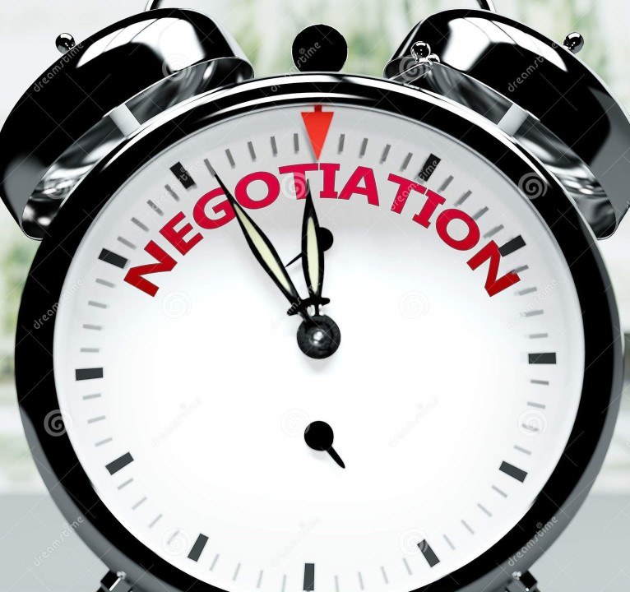
10. Time Constraints
Negotiations that are rushed or subject to tight deadlines can create pressure and limit the ability to thoroughly explore options and find mutually beneficial agreements. Time constraints can increase tension and hinder the development of trust and rapport between the parties and potentially leading to unfavorable outcomes
It is a major challenge to effective negotiation. One should never be in a hurry.
  You need time to convince others
  Never be in rush to purchase things or close a deal.
  Analyze things carefully and then only come to conclusions.

Slide 24

11. Blame Game
While negotiating, favoring the statement of one party over another without listening to the point of view of the other results in bad negotiation due to lack of empathy towards the other party.
Playing the blame game complicates the negotiation situation. Each party contributes for better or worse to any conflict or negotiation
Problem/ arguments will result if you blame the other person for the difficulty
If you accept responsibility for the problem, you will foster a cooperative spirit

Slide 25
EX: in any conflict, or negotiation, both parties are striving to get their desirable outcomes without listening to the queries of the other party.
To overcome this barrier:
  We should be gentle and assertive in our negotiation
  We should show sense of empathy for the second party’s argument
  We should try to build a rapport with the other party

Slide 26

12. Failure to understand
The biggest challenge to negotiation is when individuals are not ready to understand the second party at all. There are individuals who only think about their interests and tend to ignore the interest and needs of the other.
EX: Jim wanted to buy a shirt for himself, he was only concerned with his pocket and never bothered about the store owner. He quoted an unusually low price and the store owner refused to sell the shirt.
The outcome was a big zero, nobody could get what they wanted.
Jim failed to understand the fact that the store owner is not sitting for charity. He also has a family to look after and thus even his profits are important.
Why would he sell something at a less rate which would not earn him his profits?

Slide 27
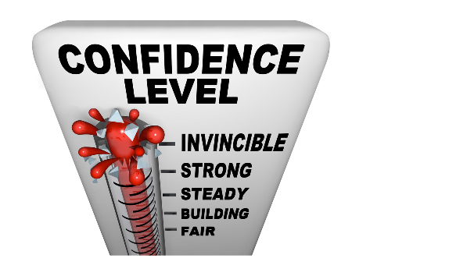
13. Lack of confidence Or Overconfidence
If you lack confidence, chances are that you will make an ineffective negotiator. Confidence has a huge impact on negotiator’s behavior and what they ultimately achieve.
EX: negotiating with someone more powerful than you, can feel intimidating, especially when you are just starting with our career. The common reason so is because of what’s at stake.

Slide 28
To overcome this barrier:
  Don’t forget to make an eye contact with the person sitting on the other side of the table.
  Prepare and practice it is natural to feel nervous and anxious ahead of time.
  Preparing ahead of time can help calm your nerves.
  It’s important to be serious but that does not mean you will not even greet the other person.
  Be straight forward and crisp in your communication.
  Take care of your dressing and appearance as well

Slide 29

14. Criticism, sarcasm, derogatory remarks
Never ever say anything which might hurt others.
Remember everyone is here to do business and make profits, so be logical and justified.
Don’t get too involved and over emotional.
One should be a little diplomatic and intelligent for an effective negotiation

Slide 30

15. Lack of patience
Every individual has the right to express his views and one should not interfere in his speech.
You might not agree to him but at least listen to him first.
Sit with the second party and make him realize how the deal would benefit you as well as him.
If possible, take a note pad and a pen with you to explain things in a better way.
Carry all the necessary documents which you might require at the time of negotiation.

Slide 31
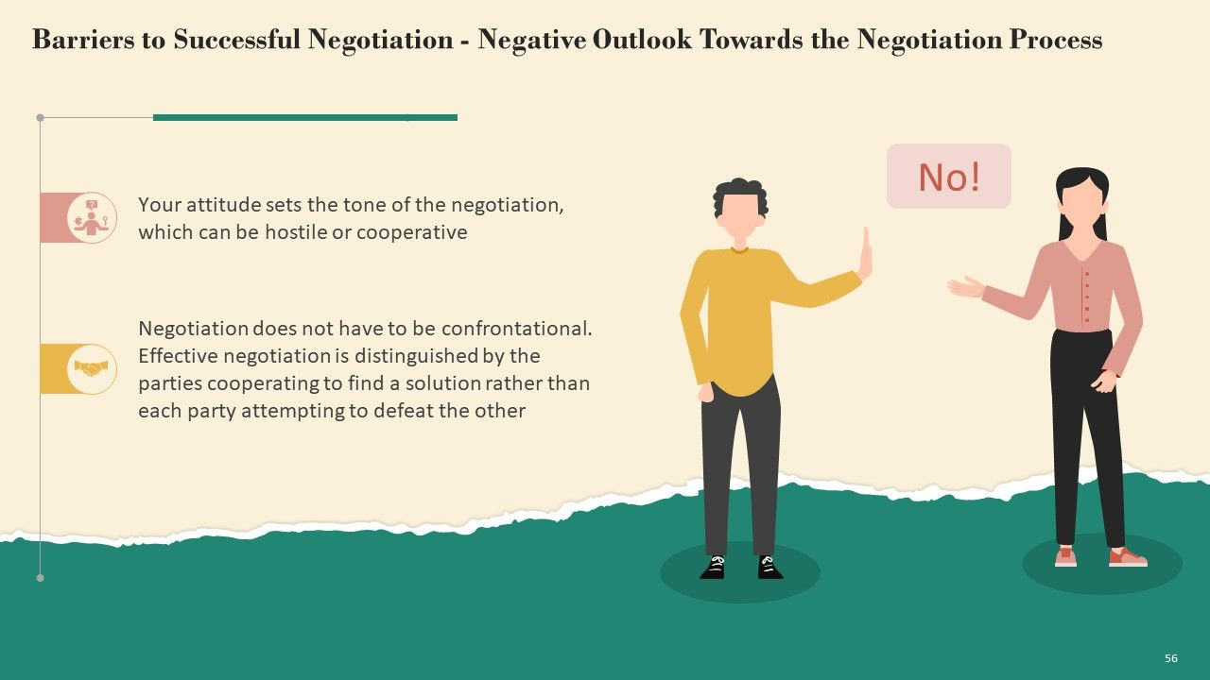
16. Negative Outlook Towards the Negotiation Process
Your attitude sets the tone of the negotiation, which can be hostile or cooperative.
Negotiation does not have to be confrontational, effective negotiation is distinguished by the parties cooperating to find a solution rather than each party attempting to defeat the other

Slide 32
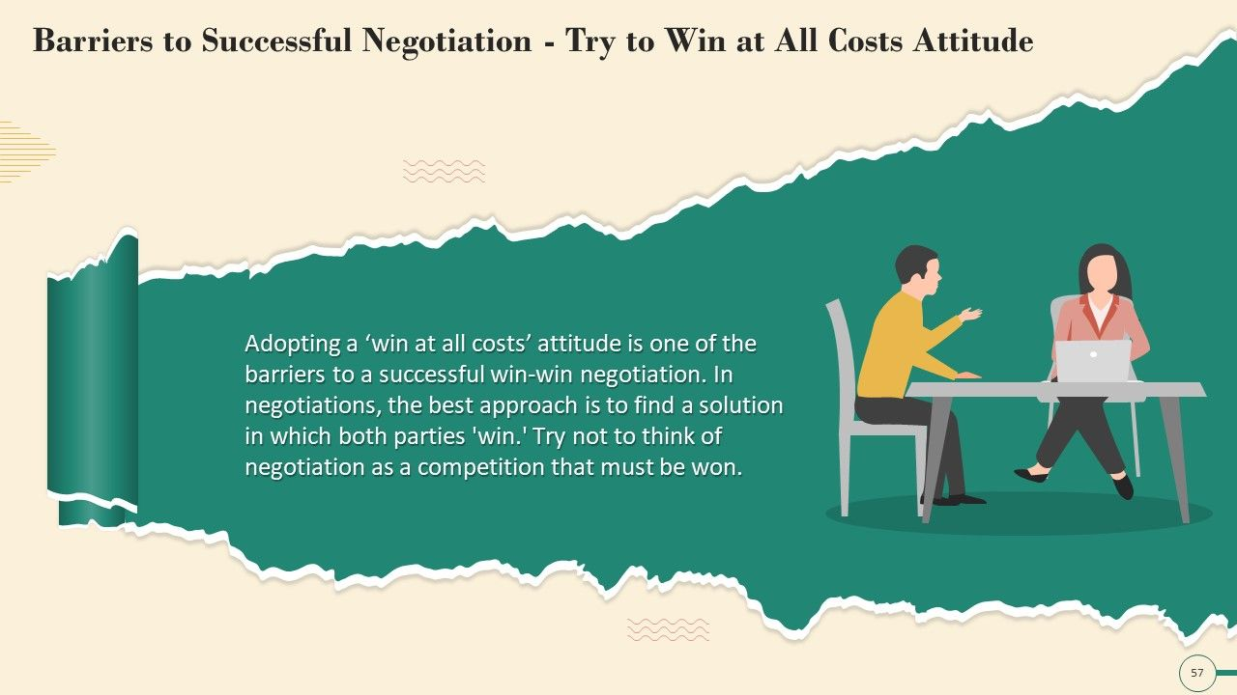
17. Try to win at all costs attitude
Viewing negotiations as a zero-sum game where one party's gain is another's loss and Adopting a ‘ win at all costs ‘ attitude is one of the barriers to a successful win – win negotiation which can hinder collaboration
The best approach is to find a solution in which both parties
“ Win- Win “ , Try not to think of negotiation as a competition that must be won.

Slide 33
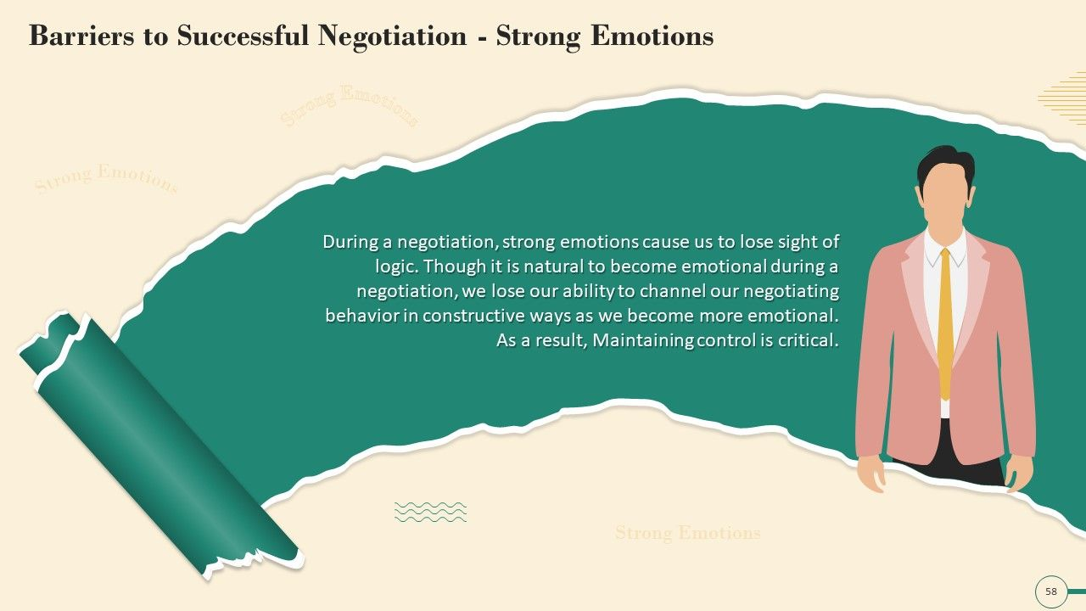
18. Strong Emotions factors
Emotions can play a significant role in negotiations. Strong emotions like anger, fear, ego, frustration or personal biases can cloud judgment and lead to irrational decision-making. Emotional barriers can escalate conflicts and make it difficult to find common ground.
During a negotiation, strong emotions cause us to lose sight of logic. Through it is natural to become emotional during a negotiation.
We lose our ability to channel our negotiating behavior in constructive ways as we become more emotional.

Slide 34
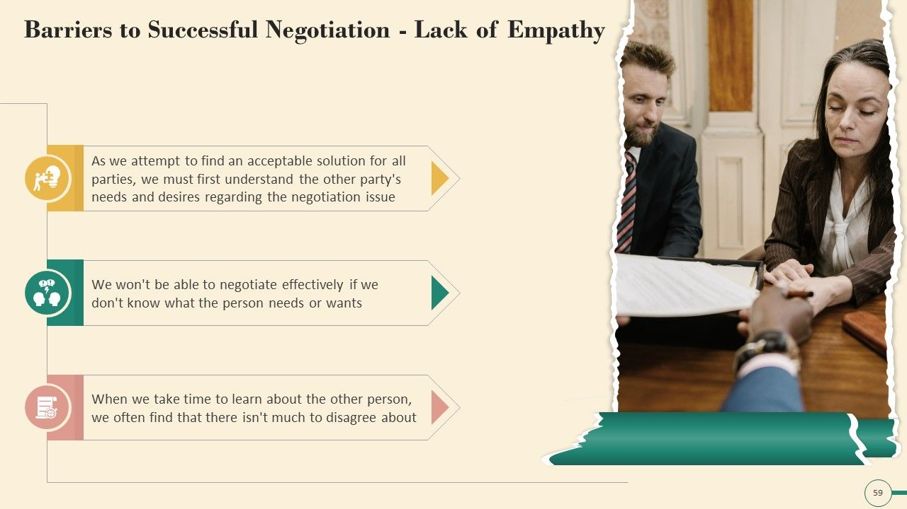
19. Lack of Empathy
As we attempt to find an acceptable solution for all parties, we must first understand the other party’s needs and desires regarding the negotiation issue
We won’t be able to negotiate effectively if we don’t know what the person needs or wants
When we take time to learn about the other person, we often find that there isn’t much to disagree about

Slide 35
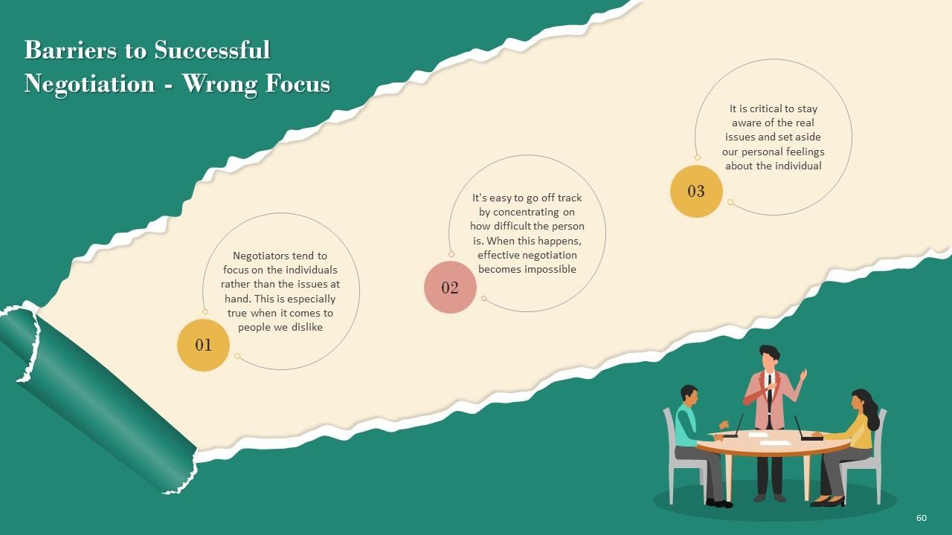
20. Wrong Focus
Negotiators tend to focus on the individuals rather than the issues at hand. This is especially true when it comes to people we dislike.
It’s easy to go off track by concentrating on how difficult the person is. When this happens, effective negotiation become impossible.
It is critical to stay aware of the real issues and set aside our personal feelings about the individual.

Slide 36
21. Ethical Concerns & Psychological Factors:
Unethical behavior or lack of transparency can erode trust and damage long-term relationships.
Individual biases, personal preferences, and psychological needs can influence how a negotiation unfolds

Slide 37
Overcoming negotiation barriers requires awareness, effective communication, empathy, creativity, and a willingness to explore win-win solutions. Skilled negotiators understand these barriers and employ strategies to address them, fostering a collaborative and constructive negotiation process.

Slide 38
To Overcome these Barriers
Preparation: Thoroughly research the other party, understand their interests, and develop alternative solutions.
Emotional Intelligence: Develop self-awareness and empathy to manage emotions and understand the other party's perspective.
Effective Communication: Practice active listening, ask clarifying questions, and use clear and concise language.
Building Trust: Be transparent, reliable, and demonstrate a willingness to collaborate.
Flexibility: Be open to compromise and explore alternative solutions that meet the needs of all parties.
Cultural Sensitivity: Be aware of cultural differences and adapt your communication style accordingly.
Seek Professional Help: If necessary, consider involving a skilled negotiator or mediator to guide the process

Slide 39
Practical Negotiation Scenario: International Business Deal for Medical Equipment
Situation:
A Middle Eastern hospital (Buyer – Party A) is negotiating a large-scale purchase of high-end medical imaging equipment with a European supplier (Seller – Party B). The meeting is being held via video conference, and tensions rise quickly.

Slide 40
Challenges & Barriers Encountered
Conflicting Goals
  Barrier: Party A is focused on getting the best price; Party B is focused on maximizing profit and only offering a package deal.
  Solution: Use interest-based negotiation to find shared goals—e.g., patient care improvement—and create value through service warranties instead of reducing price.
Lack of Information
  Barrier: The buyer does not know the technical details of the latest model, while the seller is unaware of the hospital’s budget restrictions.
  Solution: Share non-confidential financial and technical documents early; conduct a pre-negotiation briefing to align expectations.
Poor Preparation
  Barrier: Party A’s lead negotiator is unfamiliar with the legalities of import duties and doesn’t bring the procurement officer.
  Solution: Improve internal coordination and involve key stakeholders. Prepare a checklist of negotiation areas in advance.

Slide 41
Challenges & Barriers Encountered
Cultural Differences
  Barrier: Party B’s direct communication style is perceived as rude by Party A, leading to defensiveness.
  Solution: Assign cultural liaison officers and offer cultural sensitivity training. Use interpreters if necessary.
Power Imbalance
  Barrier: Party B is the only distributor in the region. They use this to pressure a quick agreement.
  Solution: Party A should explore alternatives (BATNA) by researching other suppliers, even if international.
Mistrust
  Barrier: Party A doubts the after-sales support and transparency of the supplier due to negative online reviews.
  Solution: Build trust through testimonials, offering pilot programs, and arranging site visits to existing clients.
Time Constraints
  Barrier: Party A’s purchasing window closes in 3 days, forcing a rushed negotiation.
  Solution: Negotiate a conditional agreement now and finalize details post-deadline, or request a formal extension.

Slide 42
Challenges & Barriers Encountered
Rigidity
  Barrier: Party B refuses to change any delivery terms or pricing structures.
  Solution: Emphasize mutual loss if deal fails. Introduce phased delivery or volume discounts to create flexibility.
Strong Emotions
  Barrier: Frustration builds due to slow progress. One party raises their voice.
  Solution: Pause the meeting briefly. Appoint a neutral facilitator or mediator to keep the dialogue productive.
Lack of Empathy
  Barrier: Neither side acknowledges the other’s constraints—technical, financial, or emotional.
  Solution: Start the meeting with rapport-building conversation. Use reflective listening to show understanding.

Slide 43



Thank You

