Slide 1






The Earned Benefits Methods for Controlling Program Performance
Prepared by Dr. Sami Alzahrani
Lecture 6
PMG 665
Program and Portfolio Management

Slide 2


Introduction
Chapter
06
Introduction
PMI®’s Standard for Program Management refers to benefits management and provides a diagram of the benefits management life cycle. However it does not provide a coherent view of how to apply benefits management in an integrated way across the life cycle for managing programs. This chapter addresses this lack. It describes how the life cycles should correspond to each other and proposes a new technique—Earned Benefit Management—for planning and tracking the realization of program benefits.

Slide 3
Introduction
Chapter
06
Introduction
In the same way as for Earned Value (Fleming and Koppelman, 2000) there is the need for an organizational approach to make the Earned Benefit technique effective (PMGS, 2011). This chapter addressed the (Current Life Cycles and Modified Benefits Realization Life Cycle).

Slide 4
The benefits management life cycle
Chapter
06
The benefits management life cycle
As can be seen in Figure 7.2, adapted from the PMI® Standard for Program Management—Second Edition, the “benefits management life cycle” as shown only caters for the realization of the benefits and not the long-term operational delivery. The term “benefits realization management” would be a better description of this life cycle.

Slide 5
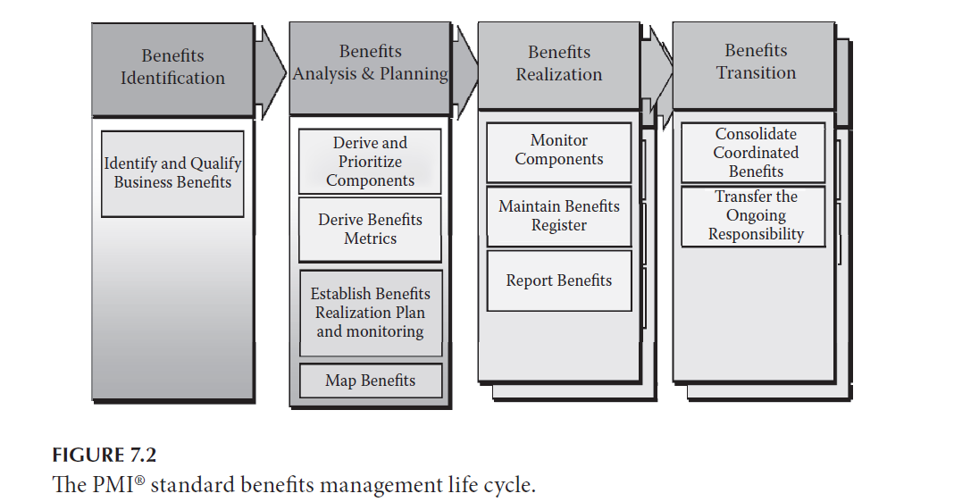
The benefits management life cycle
Chapter
06
The benefits management life cycle

Slide 6
Modified benefits realization life cycle
Chapter
06
The benefits management life cycle
Defining the Modified Life Cycle
Approach and Scope
The approach taken here is the opposite to that taken in the PMI® Standard: we will start with the Benefits Realization Management life cycle: benefits should drive programs not vice versa, since programs are run in order to deliver benefits. This is therefore a bottom-up approach starting with the definition of the sequential benefits realization processes and then grouping them into phases aligned as closely as possible to those defined in the PMI® Standard.

Slide 7
Modified benefits realization life cycle
Chapter
06
The benefits management life cycle
Note also that the goal is not to define the entire life cycle of managing benefits, but only the part that the program is concerned with—i.e., the realization of the benefits: their creation and transition into the operational environment. The longer-term delivery and exploiting of these benefits is the operational responsibility of the organization and is outside the scope of a program. Within the program, it is important to define a clear set of steps for achieving the benefits-related objectives. The key steps are described next.

Slide 8
Modified benefits realization life cycle
Chapter
06
The benefits management life cycle
Benefits Focus Steps
A program has to take into account the following five levels of focus:
1. Strategic focus: Providing vision
2. Business focus: Ensuring viability
3. Benefits focus: Achieving value
4. Program focus: Creating benefits
5. Project focus: Delivering capabilities

Slide 9
Benefits assessment
Chapter
06
Benefits assessment
This is adapted from the PMI® Standard “Benefits Identification” phase. It is launched when a vision has been elaborated. It is then up to the business change manager to help translate the vision into a set of benefits to be achieved in order to achieve the vision. There are three main steps:

Slide 10
Benefits assessment
Chapter
06
Benefits assessment
• Develop Mission Statement: The first step, however, which is not mentioned in the PMI® life cycle, is to translate the vision into a more concrete description of the organizational change required in order to achieve the vision. This is the responsibility of the business change manager and will take the form of a mission statement.

Slide 11
Benefits assessment
Chapter
06
Benefits assessment
• Identify Benefits: The goal of this step is to determine the relevant benefits that contribute to the overall goal, as well as their interdependencies and any “dis-benefits” that could occur as side-effects. This step can be developed in the form of a “benefits map”: a network diagram showing how outputs, capabilities, outcomes and benefits are interrelated.

Slide 12
Benefits assessment
Chapter
06
Benefits assessment
• Assess Benefits Qualitatively: At this point there is not enough hard data for the viability (i.e. the business case) to be assessed numerically. However a qualitative analysis can be carried out in order to decide whether the idea is sufficiently promising to pursue. This is the draft business case and is used as an input to the Initiate Program process. If it is decided to pursue it further, the qualitative analysis is accepted, and the subsequent phase is launched.

Slide 13
Business case development
Chapter
06
Business case development
The goal of this phase is to develop the first part of a business model: a numerical estimate of the benefits.
This requires the following steps to be carried out:
• Derive components: Decide on the projects and non-project work that is needed in order to achieve the organizational change described in the mission statement
• Map benefits: Provide the interdependency diagram between components and benefits: the component-benefit matrix described later in this chapter

Slide 14
Business case development
Chapter
06
Business case development
• Define units: Benefits can only be measured if the criteria and the corresponding metrics are defined (e.g. a balanced scorecard).
• Derive metrics: Define completion criteria and the value of completion with respect to the relevant units.
• Estimate component costs
• Quantify the business case: At this point the quantified benefits can be added to the draft business case to provide a financial feasibility analysis.

Slide 15
Benefits realization planning
Chapter
06
Benefits realization planning
The goal of this phase is to produce the benefits realization plan. This is built as follows:
• Determine component interdependencies
• Prioritize components: Based on a chosen set of criteria such as time, value, etc.
• Derive initial roadmap: This roadmap sequences the components and the benefits milestones.

Slide 16
Benefits realization planning
Chapter
06
Benefits realization planning
• Create benefits realization plan:
• Link the roadmap to the component duration, cost and value estimates
• This plan allows the cumulative Benefit curve to be developed.
• This defines how Earned Value, Earned Benefit and the cumulative Benefit curve are applied for the specific program.
• This benefits realization plan is the basis for the go/no-go decision to start to create the capabilities and realize the benefits, so it first needs to be approved.

Slide 17
Benefits Realization Plan Review
Chapter
06
Benefits realization review
PMI® does not mention any benefits-specific phase gates. However, once the life cycles have been aligned, the review of the benefits realization plan should form part of the gate review prior to the Program Setup Phase, to ensure an on-going and effective link between the management of the program and the management of the business.

Slide 18
Benefits realization
Chapter
06
Benefits realization
This phase is composed of one or several, serial, overlapping stages, each of which delivers incremental benefits.
The steps in any stage are as follows, in overlapping cycles. Once these are complete, only the final tidying-up will then remain.

Slide 19
Benefits realization completion
Chapter
06
Benefits realization completion
In theory, once the final stage reaches completion, all of the integration and transitioning actions will have been executed. However, since programs can be large and complex, they need a specific focus to ensure the final result has reached a stable operating state and no longer needs support from the program team.

Slide 20
Benefits realization completion
Chapter
06
Benefits realization completion
This phase completes with the official approval for program closure.
Now that a clear and consistent benefits realization life cycle has been developed, it is important to ensure that tools are available in order that it provides the required level of control. The way in which this control is set up and managed across this life cycle will now be described. This is where the Earned Benefit technique is used.

Slide 21
Toward the earned benefit method
Chapter
06
Toward the earned benefits method
This section uses the newly-developed life cycle to show how the Earned Benefit concepts are developed, planned for, and applied within programs.
Benefits assessment
The key output of this phase is a clear definition of each of the benefits required from the program. The first step (see Figure 7.4) below is to clarify and agree upon the mission.

Slide 22
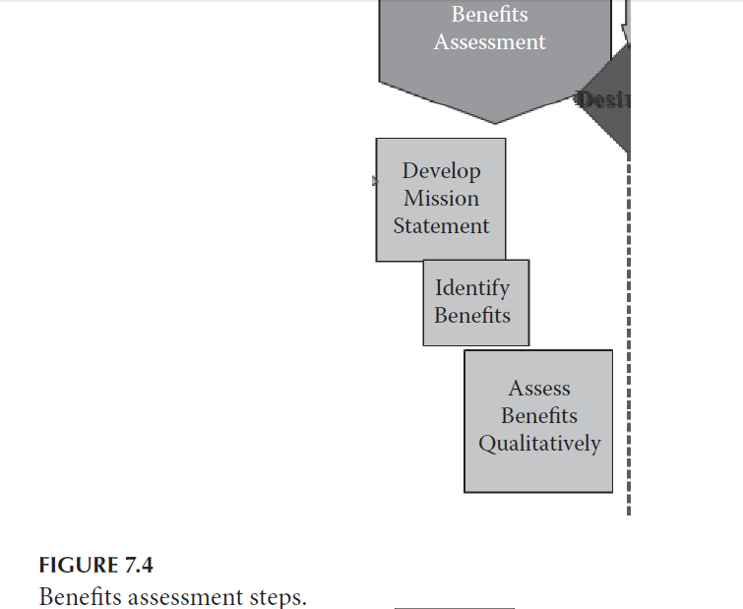
Benefits assessment
Chapter
06
Benefits assessment

Slide 23
Chapter
06
Benefits assessment
provides a high-level definition of the capabilities that need to be created, as well as the realization strategy to be defined—i.e., what approach should be taken for realizing the benefits (e.g. quick wins, minimal cost exposure, high-risk first, etc.). The corresponding benefits can then be determined.
Identify the Benefits
The benefits description is based on an analysis of what will have changed (for the better) from the current state to the state described in the vision. Once the benefits have been identified, they need to be assessed.

Slide 24
Chapter
06
Benefits assessment
Assess the Benefits
These benefits should be described in purely qualitative terms: the benefits criteria should be defined along with a definition of the meaning of qualitative assessment terms (such as “high,” “medium” and “low”).
Once the benefits have been identified and assessed in line with the vision and mission, they provide the basic building blocks for the Earned Benefit technique in parallel with developing the business case.

Slide 25
Business case development
Chapter
06
Benefits case development
Derive Components
Once the set of required capabilities has been defined, these have to be investigated in order to determine the set of projects (and non-project work)—i.e., components—required in order to deliver these capabilities. Prioritization will depend on the contribution of the component to achieving the strategy. This requires the component-benefit matrix to be developed . See Figure 7.5.

Slide 26
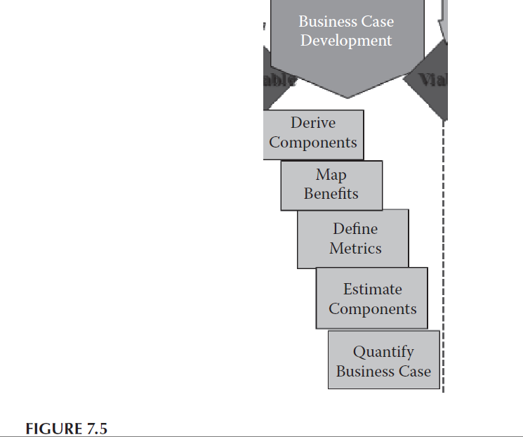
Chapter
06
Benefits case development

Slide 27
Chapter
06
Benefits case development
Map Benefits
It is unlikely that each component contributes to a single benefit, so a “component-benefit matrix” needs to be developed at the same time.
Each cell of the matrix indicates the relative contribution of a component (row) to a benefit (column); a value of zero indicates that the component does not contribute to that benefit; ideally, the values are then normalized so that each column sums to 1, as shown below (Figure 7.6).

Slide 28
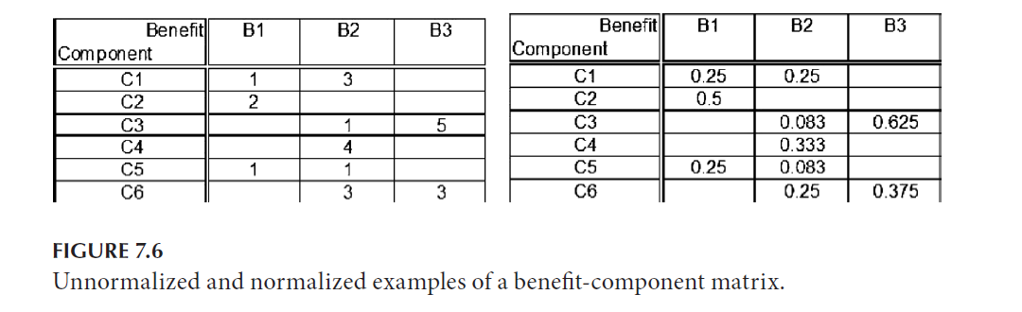
Chapter
06
Benefits case development

Slide 29
Chapter
06
Benefits case development
Define Benefits Metrics—Part 1: Units
In order to allow tracking and consolidation, the qualitative analysis in the previous phase needs to be transformed into a quantitative forecast; this entails defining the units in which the Benefit will be measured as explained in Business Case Development.

Slide 30
Chapter
06
Benefits case development
Define Benefits Metrics—Part 2: Quantities
For each benefit, the following must be defined:
• Benefit capability completion criteria: i.e., how to determine if all of the capabilities required to achieve the benefit are in place
• Benefit value measured in the predefined units.

Slide 31
Chapter
06
Benefits case development
Estimate Components
This step implies estimating the cost and duration of each component using standard project management estimation tools.
Quantify the Business Case
Developing a quantified business case is beyond the scope of this document (but see for example The International Institute of Business Analysis, 2009), but is required in order to obtain approval to start planning on how to achieve it.

Slide 32
Benefits realization planning
Chapter
06
Benefits realization planning
Although the overall business case has been developed, we do not yet have a clear idea of how to achieve it. That is carried out in this phase.
Determine Dependencies
The way in which the components work together (e.g. the output of one is the input for another) defines constraints on the order in which the components can be implemented. Given these constraints, the overall plan will need to apply a priority order for the components. There are a number of options as shown as follows.

Slide 33
Benefits realization planning
Chapter
06
Benefits realization planning
Establish Priorities
The Benefit-Component matrix (Figure 7.6) above is a useful basis for component prioritization: the question to be answered is: how much does each component contribute individually to the total program Benefit?”

Slide 34
Chapter
06
reference
Reference
Program Management: A Life Cycle Approach
by Ginger Levin, PMP, PgMP
Chapter 7

