Slide 1


PMG 671
Leadership& Organizational
Behavior
Prepared by
Dr. Walid El Leithy
Chapter 3

Slide 2



Chapter 3
www.midocean.ae

Slide 3

Chapter
Personality and Values
3
This chapter will enable you to:
1. Contrast the two types of ability: intellectual and physical.
2. Identify the key biographical characteristics and describe how they are relevant to OB.
3. Define learning and outline the principles of the three major theories of learning.
www.midocean.ae

Slide 4
Chapter
Personality and Values
3
This chapter will enable you to:
4. Define shaping and show how it can be used in OB.
5. Define personality, describe how it is measured, and explain the factors that determine an individual’s personality.
www.midocean.ae

Slide 5
Chapter
Personality and Values
3
This chapter will enable you to:
Describe the Myers-Briggs Type Indicator personality framework and assess its strengths and weaknesses.
Identify the key traits in the Big Five personality model and demonstrate how the Big Five traits predict behavior at work.
.
www.midocean.ae

Slide 6
Chapter
Personality and Values
3
This chapter will enable you to:
8. Identify other personality traits relevant to OB.
9. Define values, demonstrate the importance of values, and contrast terminal and instrumental values.
10. Show the relationship between individual personality and the workplace.
11. Identify Hofstede’s five value dimensions of national culture.
www.midocean.ae

Slide 7
Chapter
Ability
3
Ability is an individual’s capacity to perform the various tasks in a job. It is made up of two sets of factors:
Intellectual Abilities
  The abilities needed to perform mental activities like thinking and reasoning.
Physical Abilities
  The capacity to do tasks demanding stamina, strength, and similar characteristics.
.
www.midocean.ae

Slide 8
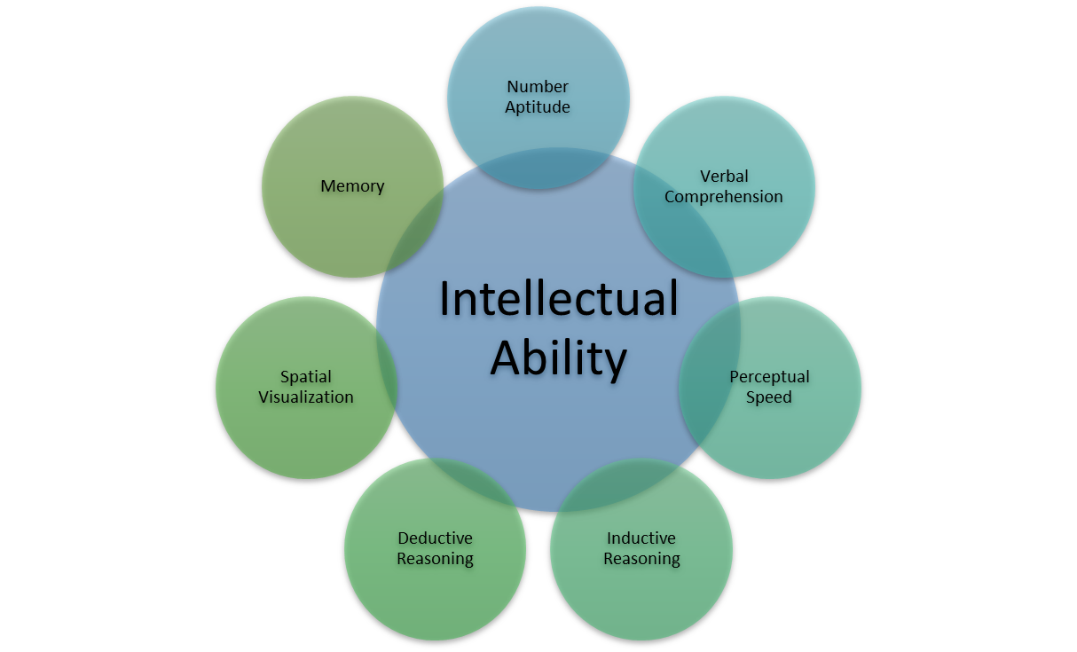
Chapter
Dimensions of Intellectual Abilities
3
www.midocean.ae

Slide 9
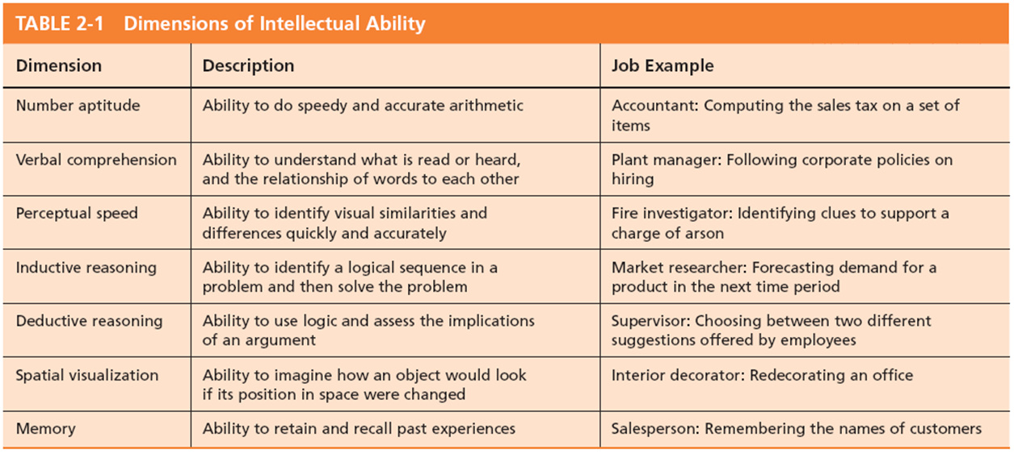
Chapter
Dimensions of Intellectual Abilities
3
www.midocean.ae

Slide 10
Chapter
Nine Basic Physical Abilities
3
Strength Factors
  Dynamic strength
  Trunk strength
  Static strength
  Explosive strength
Flexibility Factors
  Extent flexibility
  Dynamic flexibility
Other Factors
  Body coordination
  Balance
  Stamina
www.midocean.ae

Slide 11
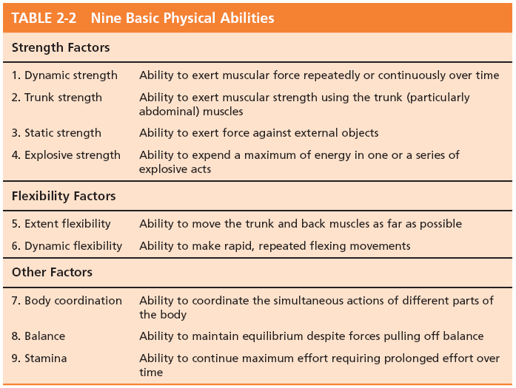
Chapter
Nine Basic Physical Abilities
3
www.midocean.ae

Slide 12
Chapter
Biographical Characteristics
3
Objective and easily obtained personal characteristics:
Age
Older workers bring experience, judgment, a strong work ethic, and commitment to quality.
Gender
Very few differences exist between men and women that affect job performance.
Race
The biological heritage used to identify oneself.
Contentious issue: differences exist, but could be more culture-based than race-based.
www.midocean.ae

Slide 13

Chapter
Biographical Characteristics
3
Gender:
The Qatari Business Women’s Forum (QBWF) was set up to raise awareness of the role that women play in business in Qatar.
www.midocean.ae

Slide 14
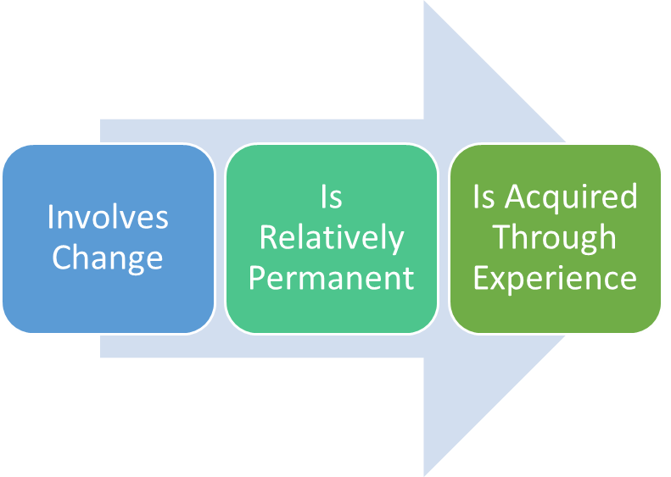
Chapter
Learning
3
Learning is any relatively permanent change in behavior that occurs as a result of experience
Learning components:
www.midocean.ae

Slide 15
Chapter
Theories of Learning
3
Classical Conditioning
A type of conditioning in which an individual responds to some stimulus that would not ordinarily produce such a response.
Operant Conditioning
A type of conditioning in which desired voluntary behavior leads to a reward or prevents a punishment.
Social-Learning Theory
People can learn through observation and direct experience.
www.midocean.ae

Slide 16
Chapter
Classical Conditioning
Pavlov’s Dog Drool
3
Key Concepts:
  Unconditioned stimulus
    A naturally occurring phenomenon.
  Unconditioned response
    The naturally occurring response to a natural stimulus.
  Conditioned stimulus
    An artificial stimulus introduced into the situation.
  Conditioned response
    The response to the artificial stimulus.
This is a passive form of learning. It is reflexive and not voluntary—not the best theory for OB learning.
www.midocean.ae

Slide 17
Chapter
Classical Conditioning
Pavlov’s Dog Drool
3
Watson’s controversial experiment involving Little Albert is also an example of classical conditioning (Powell, Digdon, Harris, & Smithson, 2014). Little Albert was a young boy who was introduced to a white rat. At first, he enjoyed playing with and petting the rat; however, Watson began pairing the furry rat with a loud sound. Soon, Little Albert associated the rat with the loud noise, which made him cry.
Watson could eventually present the white rat without the loud noise and elicit a cry from Little Albert. It was theorized that Little Albert would develop a phobia of furry animals.
www.midocean.ae

Slide 18
Chapter
Operant Conditioning Skinner’s Behaviorism
3
B. F. Skinner’s concept of Behaviorism: behavior follows stimuli in a relatively unthinking manner.
Key Concepts:
  Conditioned behavior: voluntary behavior that is learned, not reflexive.
  Reinforcement: the consequences of behavior which can increase or decrease the likelihood of behavior repetition.
  Pleasing consequences increase likelihood of repetition.
  Rewards are most effective immediately after performance.
  Unrewarded/punished behavior is unlikely to be repeated.
www.midocean.ae
Notes:
kinner

Slide 19
Chapter
Social Learning Theory
3
Based on the idea that people can also learn indirectly: by observation, reading, or just hearing about someone else’s—a model’s—experiences.
Key Concepts:
  Attentional processes
    Must recognize and pay attention to critical features to learn.
  Retention processes
    Model’s actions must be remembered to be learned.
  Motor reproduction processes
    Watching the model’s behavior must be converted to doing.
  Reinforcement processes
    Positive incentives motivate learners.
www.midocean.ae

Slide 20
Chapter
Shaping: A Managerial Tool
3
Systematically reinforcing each successive step that moves an individual closer to the desired response
Four Methods of Shaping Behavior:
  Positive reinforcement
    Providing a reward for a desired behavior (learning).
  Negative reinforcement
    Removing an unpleasant consequence when the desired behavior occurs (learning).
www.midocean.ae

Slide 21
Chapter
3
Shaping: A Managerial Tool
  Punishment
    Applying an undesirable condition to eliminate an undesirable behavior (“unlearning”).
  Extinction
    Withholding (hagb) reinforcement of a behavior to cause its cessation (“unlearning”).
www.midocean.ae

Slide 22
Chapter
3
في المرة الأولى التي تذهب فيها إلى محل البقالة مع طفلك يطلب منك شراء الحلوى في البداية فإنك ترفض ، ولكن عندما يبدأ في البكاء تشتري له الحلوى ، وهذا يعزز الفكرة في ذهنه أنه في كل مرة يلقي فيها نوبة غضب في سيحصل على شوكولاتة من محل بقالة ، ويواصل القيام بذلك ، وتستمر في مكافأة سلوكه عن غير قصد ، ثم يومًا ما تقول ببساطة “لا” لطلبه على الرغم من نوبات الغضب التي يمر بها ، ويبكي ولكنك تجاهلت هذا في المناسبتين التاليتين وفي النهاية عندما تذهب إلى المتجر للمرة الثالثة تدرك أنه لم يعد يلقي بنوبات الغضب.
www.midocean.ae

Slide 23
Chapter
Schedules of Reinforcement : A Critical Issue
3
There are two major types:
Continuous Reinforcement
  A desired behavior is reinforced each time it is demonstrated.
Intermittent Reinforcement
  A desired behavior is reinforced often enough to make the behavior worth repeating but not every time it is demonstrated.
  Multiple frequencies.
www.midocean.ae

Slide 24
Chapter
Types of Intermittent Reinforcement
3
Ratio
  Depends on the number of responses made.
Interval
  Depends on the time between reinforcements.
Fixed
  Rewards are spaced at uniform time intervals or after a set number of responses.
Variable
  Rewards that are unpredictable or that vary relative to the behavior.
www.midocean.ae

Slide 25
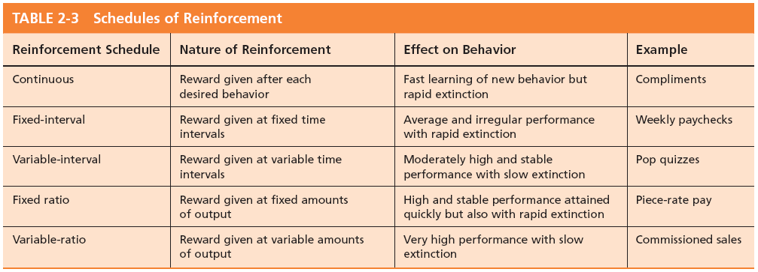
Chapter
Schedule of Reinforcement
3
www.midocean.ae

Slide 26
Chapter
What is Personality?
3
The dynamic organization within the individual of those psychophysical systems that determine his unique adjustments to his environment.
Gordon Allport.
Personality is the sum total of ways in which an individual reacts and interacts with others, the measurable traits a person exhibits.
www.midocean.ae

Slide 27
Chapter
What is Personality?
3
Measuring Personality
  Helpful in hiring decisions.
  Most common method: self-reporting surveys.
  Observer-ratings surveys provide an independent assessment of personality—often better predictors.
.
www.midocean.ae

Slide 28
Chapter
Personality Determinants
3
Heredity
  Factors determined at conception: physical stature, facial attractiveness, gender, temperament, muscle composition and reflexes, energy level.
  This ‘Heredity Approach’ argues that genes are the source of personality.
  Twin studies: raised apart but very similar personalities.
  Parents don’t add much to personality development.
  There is some personality change over long
  time periods.
www.midocean.ae

Slide 29
Chapter
Personality Traits
3
Traits are enduring مستمر characteristics that describe an individual’s behavior.
  The more consistent the characteristic and the more frequently it occurs in diverse situations, the more important the trait.
Two dominant frameworks are used to describe personality:
  Myers-Briggs Type Indicator (MBTI)
  Big Five Model
www.midocean.ae

Slide 30
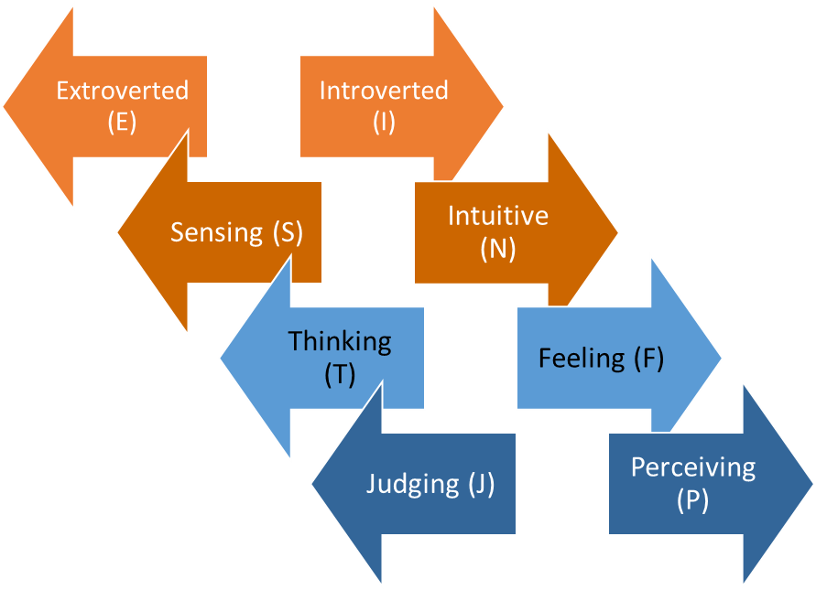
Chapter
The Myers-Briggs Type Indicator
3
Most widely used instrument in the world.
Participants are classified on four axes to determine one of 16 possible personality types, such as ENTJ.
Sociable and Assertive
Quiet and
Shy
Unconscious
Processes
Practical and
Orderly
Uses Values & Emotions
Use Reason
and Logic
Flexible and Spontaneous
Want Order
& Structure
www.midocean.ae

Slide 31
Chapter
Myers-Briggs Types and their Uses
3
Each of the sixteen possible combinations has a name, for instance:
Visionaries (INTJ) – original, stubborn, and driven.
Organizers (ESTJ) – realistic, logical, analytical, and business-like.
Conceptualizer (ENTP) – entrepreneurial, innovative, individualistic, and resourceful.
Research results on the validity of MBTI are mixed.
MBTI is a good tool for self-awareness and counseling.
Should not be used as a selection test for job candidates.
www.midocean.ae

Slide 32
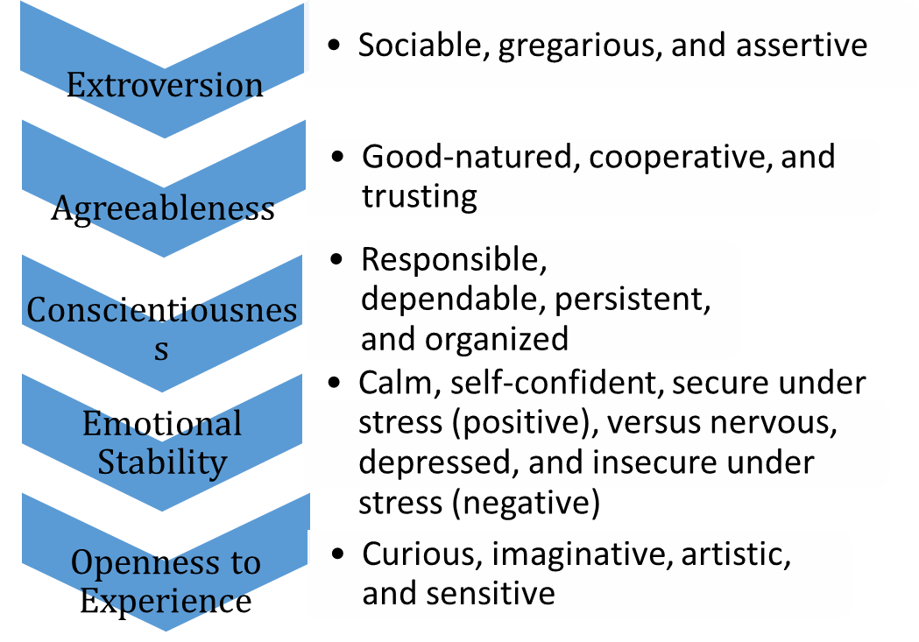
Chapter
The big Five Model of Personality Dimensions
3
www.midocean.ae

Slide 33
Chapter
How do Big Five Traits Predict Behavior?
3
s
Research has shown this to be a better framework.
Certain traits have been shown to strongly relate to higher job performance:
  Highly conscientious people develop more job knowledge, exert greater effort, and have better performance.
  Other Big Five Traits also have implications for work.
    Emotional stability is related to job satisfaction.
    Extroverts tend to be happier in their jobs and have good social skills.
    Open people are more creative and can be good leaders.
    Agreeable people are good in social settings.
www.midocean.ae

Slide 34

Chapter
3
The Big Five Traits
www.midocean.ae

Slide 35
Chapter
Other Personality Traits Relevant to OB
3
Core Self-Evaluation
  Represent a stable personality trait which includes an individual's subconscious, fundamental evaluations about themselves, their own abilities and their own control. People who have high core self-evaluations will think positively of themselves and be confident in their own abilities.
Machiavellianism
  A pragmatic, emotionally distant power-player who believes that ends justify the means.
  High Machs are manipulative, win more often, and persuade more than they are persuaded. Flourish when:
    they have direct interaction;
    they work with minimal rules and regulations;
    their emotions distract others.
www.midocean.ae

Slide 36
Chapter
Other Personality Traits Relevant to OB
3
Narcissism
  A narcissist is an arrogant, entitled, self-important person who needs excessive admiration.
  Less effective in their jobs.
Self-Monitoring
  The ability to adjust behavior to meet external, situational factors.
  High self-monitors conform more and are more likely to become leaders.
www.midocean.ae

Slide 37
Chapter
Other Personality Traits Relevant to OB
3
Risk Taking
  The willingness to take chances.
  May be best to align propensities النزعات with job requirements.
  Risk takers make faster decisions with less information.
  Creates positive change in the environment.
www.midocean.ae

Slide 38
Chapter
Values
3
Values are basic convictions قناعات on how to conduct yourself or how to live your life that are personally or socially preferable— “How To” live life properly.
Attributes of Values:
Content Attribute—that the mode of conduct or end-state is important.
  Intensity Attribute—just how important that content is.
Value System:
  A person’s values rank-ordered by intensity.
  Tends to be relatively constant and consistent.
www.midocean.ae

Slide 39
Chapter
Classifying Values-Rokeach Value Survey
3
Terminal Values
  Desirable end-states of existence; the goals that a person would like to achieve during his or her lifetime.
Instrumental Values
  Preferable modes of behavior or means of achieving one’s terminal values.
People in same occupations or categories tend to hold similar values, but:
  values vary between groups
  value differences make it difficult for groups to negotiate and may create conflict.
www.midocean.ae

Slide 40

Chapter
Value Different Between Groups
3
www.midocean.ae

Slide 41
Chapter
Linking Personality and Values to Workplace
3
Managers are less interested in someone’s ability to do a specific job than in that person’s flexibility.
John Holland’s Personality-Job Fit Theory
  Six personality types.
  Vocational Preference Inventory (VPI).
Key Points of the Model:
  There appear to be intrinsic حقيقي differences in personality between people.
  There are different types of jobs.
  People in jobs congruent with their personality should be more satisfied and therefore turnover should reduce.
www.midocean.ae

Slide 42

Chapter
Holland’s Personality Typology & Occupations
3
www.midocean.ae

Slide 43
Chapter
Still Linking Personality to the Workplace
3
In addition to matching the individual’s personality to the job, managers are also concerned with Person-Organization Fit.
  The employee’s personality must fit with the organizational culture.
  People are attracted to organizations that match their values.
  Those who match are most likely to be selected.
  Mismatches will result in turnover.
  Can use the Big Five personality types to match to the organizational culture.
www.midocean.ae

Slide 44
Chapter
Linking Cultures & Behaviors- Hofstade’s Framework: Power Distance
3
Power Distance is the extent to which a society accepts that power in institutions and organizations is distributed unequally.
  Low distance
    Relatively equal power between those with status/wealth and those without status/wealth
  High distance
    Extremely unequal power distribution between those with status/wealth and those without status/wealth
www.midocean.ae

Slide 45
Chapter
Linking Cultures & Behaviors- Hofstade’s Framework:
3
Individualism vs. Collectivism:
Collectivist cultures emphasize the needs and goals of the group as a whole over the needs and desires of each individual. In such cultures, relationships with other members of the group and the interconnectedness between people play a central role in each person's identity.
Collectivism contrasts with individualism, in which personal needs take precedence.
www.midocean.ae

Slide 46
Chapter
Linking Cultures & Behaviors- Hofstade’s Framework:
3
Individualism vs. Collectivism:
Common traits of collectivist cultures include:
Individuals define themselves in relation to others (for example, “I am a member of…”).
Communication is often more indirect to avoid potential conflict or embarrassment.1
Group loyalty is encouraged.
Decisions are based on what is best for the group.
Compromise is favored when a decision needs to be made to achieve greater levels of peace.2
Working as a group and supporting others is essential.
Greater emphasis is placed on common goals than on individual pursuits.
The rights of families and communities come before those of the individual.
Asian countries—such as China, Japan, and South Korea—as well as countries in South America tend to be more collectivist
www.midocean.ae

Slide 47
Chapter
Individualism Vs Collectivism
3
Collectivist cultures are usually contrasted with individualistic cultures. Collectivism stresses the importance of the community, while individualism is focused on the rights and concerns of each person. Where unity and selflessness or altruism are valued traits in collectivist cultures, independence and personal identity are promoted in individualistic cultures.
These cultural differences are pervasive and can influence many aspects of how society functions. How people shop, dress, learn, and conduct business can all be influenced by whether they are from a collectivist or individualist culture.
For example, workers who live in a collectivist culture might strive to sacrifice their own happiness for the greater good of the group. Those from individualistic cultures, on the other hand, may feel that their own well-being and goals carry greater weight
www.midocean.ae

Slide 48
Chapter
Linking Cultures & Behaviors- Hofstade’s Framework:
3
Masculinity
The extent to which society values the work roles of achievement, power, and control, and where assertiveness and materialism are also valued. Masculinity describes the degree to which society focus on assertiveness and achievement.
Femininity
When in contrary, femininity describes the focus of society to quality-of-life issues, such as caring for others, group solidarity and helping the less fortunate are valued. In other words, society still recognizes a gap between male and female values. This dimension is frequently viewed as taboo in highly masculine societies.
Masculinity: Strong egos – feelings of pride and importance are attributed to status. Money and achievement are important. Examples of masculinity cultures are Slovakia, Japan, Hungary, Austria, Venezuela.
Femininity: Relationship oriented, more focus on quality of life. Examples of femininity culture are Sweden, Norway, Netherlands and Denmark.
www.midocean.ae

Slide 49
Chapter
Linking Cultures and Behaviors
3
Uncertainty avoidance is the extent to which a society feels threatened by uncertain and ambiguous situations and tries to avoid them.
High Uncertainty Avoidance:
Society does not like ambiguous situations and tries to avoid them.
Low Uncertainty Avoidance:
Society does not mind ambiguous situations and embraces them.
www.midocean.ae

Slide 50
Chapter
Linking Cultures & Behaviors- Hofstade’s Framework:
3
Long-term Orientation
  A national culture attribute that emphasizes the future, thrift, and persistence.
Short-term Orientation
  A national culture attribute that emphasizes the present and the here and now.
www.midocean.ae

Slide 51
Chapter
Linking Cultures & Behaviors- Hofstade’s Framework:
3
There are regional differences within countries.
The original data is old and based on only one company.
Hofstede had to make many judgment calls while doing the research.
Some results don’t match what is believed to be true about given countries.
Despite these problems it remains a very popular framework.
www.midocean.ae

Slide 52
Chapter
Globe Framework for Assessing Cultures
3
Identifies nine dimensions of national culture.
Similar to Hofstede’s framework with these additional dimensions:
  Humane Orientation: how much society rewards people for being generous, and kind.
  Performance Orientation: how much society encourages and rewards performance improvement and excellence.
www.midocean.ae

Slide 53
Chapter
Summary & Managerial Implications
3
Ability
    Directly influences employees’ level of performance.
    Managers need to focus on ability in selection, promotion, and transfer.
    Fine-tune job to fit incumbent’s abilities.
  Biographical Characteristics
    Should not be used in management decisions: possible source of bias.
  Learning
    Observable change in behavior = learning.
    Reinforcement works better than punishment.
www.midocean.ae

Slide 54
Chapter
Summary & Managerial Implications
3
Personality
  Screen for the Big Five trait of conscientiousness.
  Take into account the situational factors as well.
  MBTI can help with training and development.
Values
  Often explain attitudes, behaviors, and perceptions.
  Higher performance and satisfaction achieved when the individual’s values match those of the organization
www.midocean.ae

Slide 55




Thank You

