Slide 1
A Saudi Sign Language Recognition System based on Convolutional Neural Networks

Slide 2
Authors: Al-Obodi, Al-Hanine, Al-Harbi, Al-Dawas, & Al-Shargabi
Institution: Qassim University, Saudi Arabia

Slide 3
Overview:
Aim to bridge the communication gap between Saudi deaf and hearing communities
Use of deep learning—in particular, Convolutional Neural Networks (CNNs)—to recognize Saudi Sign Language gestures

Slide 4
Motivation & Background
Need for Sign Language Recognition:
Deaf people often face social and communication challenges
Most non-deaf individuals have limited understanding of sign language
Saudi Context:
Saudi Sign Language differs from standard Arabic sign language
A specialized system is required to cater to local dialect and gestures

Slide 5
Dataset & Preprocessing
Source: Based on the Saudi Sign Language dictionary (published in 2018 by the Saudi Association for Hearing Disability)
40 different Saudi signs
Approximately 700 images per sign, totaling 27,301 images
Captured using a mobile camera
Includes variations in hand sizes, skin colors, lighting, backgrounds
The constructed dataset images were preprocessed to have a unified size.

Slide 6
CNN Model
multiple convolutional layers, max pooling layers, dropout layers, and ended with flatten and dense layers
Training
Training on 21,840 images; testing on 5,461 images
Methodologies

Slide 7
Performance
High accuracy in both training accuracy of 97.69% and testing accuracy of 99.47%.
Model Evaluation & Results

Slide 8
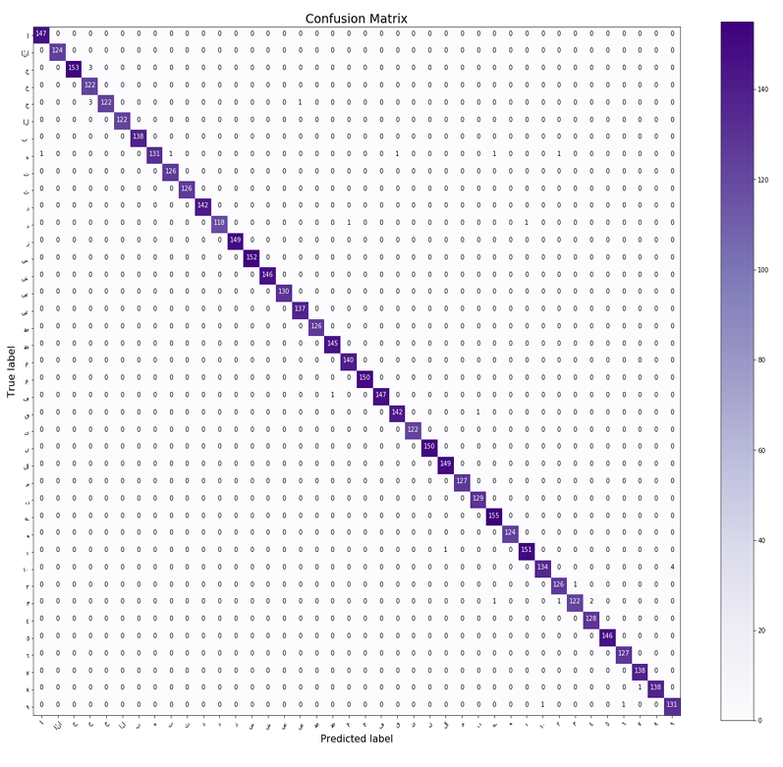

Slide 9
System Prototype
Mobile Application:
Developed using Flutter and TensorFlow Lite
Enables users to capture signs via a mobile camera and translate them into text
Desktop Application:
Built using Python's Tkinter framework
Allows similar functionality on desktop systems

Slide 10
Limitations
Static Gestures Only
Limited Vocabulary with only 40 different signs

