Slide 1


Project Time Management
مقرر: إداره وقت المشروع
Prepared by Dr. Amira Elfekky
PMG 212
Lecture 1

Slide 2
Agenda
The Concept of Project Management Understanding Project Management
Meaning of “ Project “
Meaning of “ Project time management“
History of Project Management
Benefits of project management
Benefits of project time management
Benefits of Proper Planning
Approaches to Project Management “Project Management Life Cycle”
The Initiating Process
The Planning Process
The Executing Process
The Monitoring and Controlling Process
The Closing Process
Successful project management
Obstacles of project management
Project Management
Role of the Project Manager
Role of the Functional Manager
Goals of the Project

Slide 3


Chapter
8 steps to effective project time management
1
  1. Plan your project
  2. Define your deliverables
  3. Organize project tasks
  4. Create a timeline
  5. Assign jobs
  6. Use project planning tools
  7. Communicate regularly
  8. Minimize distractions

Slide 4
Agenda
The Concept of Project Management Understanding Project Management
Meaning of “ Project “
Meaning of “ Project time management“
History of Project Management
Benefits of project management
Benefits of project time management
Benefits of Proper Planning
Approaches to Project Management “Project Management Life Cycle”
The Initiating Process
The Planning Process
The Executing Process
The Monitoring and Controlling Process
The Closing Process
Successful project management
Obstacles of project management
Project Management
Role of the Project Manager
Role of the Functional Manager
Goals of the Project

Slide 5


Chapter
The Concept of Project Management Understanding Project Management
1
In order to understand project management, one must begin with the definition of a project.
A project can be any series of activities and tasks.

Slide 6
Chapter
Meaning of “ Project “
1
A project: is a temporary endeavor undertaken to create a unique product, service, or result.
Project characteristic:
  Projects are temporary.
  Has definite beginning and end, the end is reached when the project’s objective have been achieved.
  Projects are unique.
  Every project creates a unique product, service, or results.
  Progressively elaborated.
  Progressively: proceeding in steps.
  Elaborated: worked with care and detail.

Slide 7
Chapter
Meaning of “ Project “
1
The temporary nature of projects indicates that a project has a definite beginning and end.
Temporary does not necessarily mean a project has a short duration.
The end of the project is reached when one or more of the following is true:
  The project’s objectives have been achieved;
  The objectives will not or cannot be met;

Slide 8
Chapter
Project Ending
1
  Funding is exhausted or no longer available for allocation to the project;
  The need for the project no longer exists (e.g., the customer no longer wants the project completed, a change in strategy or priority ends the project, the organizational management provides direction to end the project);
  The human or physical resources are no longer available; or The project is terminated for legal cause or convenience.

Slide 9
Chapter
Meaning of “ Project time management“
1
  Project time management is the process of planning, scheduling and overseeing activities required to complete a project. Organizations use it to define milestones, meet deadlines, stay within budget and work toward project goals. It’s typically handled by a designated project manager, but also involves team managers responsible for helping employees with their own time management skills.

Slide 10
Agenda
The Concept of Project Management Understanding Project Management
Meaning of “ Project “
Meaning of “ Project time management“
History of Project Management
Benefits of project management
Benefits of project time management
Benefits of Proper Planning
Approaches to Project Management “Project Management Life Cycle”
The Initiating Process
The Planning Process
The Executing Process
The Monitoring and Controlling Process
The Closing Process
Successful project management
Obstacles of project management
Project Management
Role of the Project Manager
Role of the Functional Manager
Goals of the Project

Slide 11
Chapter
History of Project Management
1
  Practiced since ancient times (Great Pyramids).
  Emerged as a formal discipline with complex projects.
  Early pioneers: Henry L. Gantt and Henri Fayol.
  Developed principles still used today.

Slide 12
Agenda
The Concept of Project Management Understanding Project Management
Meaning of “ Project “
Meaning of “ Project time management“
History of Project Management
Benefits of project management
Benefits of project time management
Benefits of Proper Planning
Approaches to Project Management “Project Management Life Cycle”
The Initiating Process
The Planning Process
The Executing Process
The Monitoring and Controlling Process
The Closing Process
Successful project management
Obstacles of project management
Project Management
Role of the Project Manager
Role of the Functional Manager
Goals of the Project

Slide 13
Chapter
Benefits of project management
1
● Identification of functional responsibilities to ensure that all activities are accounted for, regardless of personnel turnover
● Minimizing the need for continuous reporting
● Identification of time limits for scheduling

Slide 14
Chapter
Benefits of project management
1
● Identification of a methodology for trade-off analysis
● Measurement of accomplishment against plans
● Early identification of problems so that corrective action may follow
● Improved estimating capability for future planning
● Knowing when objectives cannot be met or will be exceeded

Slide 15
Chapter
Benefits of project time management
1
Effective task management doesn’t just lead to more productive employees. With the right strategies in place, you’ll also experience:
Shorter deadlines: Proper time management makes it easier to complete tasks on time, ensuring customer satisfaction and helping you maintain a competitive edge in your market.
Better use of resources: Managing project timelines also helps improve employee efficiency as you redistribute unbalanced workloads. By keeping your finger on the pulse of all activities, you’ll see if someone’s carrying more than their fair share of the burden

Slide 16
Chapter
1
Benefits of project time management
Effective task management doesn’t just lead to more productive employees. With the right strategies in place, you’ll also experience:
Controlled budgets: Time management helps control project costs by ensuring timely completion of activities and preventing delays that would otherwise lead to additional expenses.
Improved communication: By adhering to project schedules, project managers have the details they need to update stakeholders and set clear expectations.

Slide 17
Chapter
1
Benefits of Proper Planning
• Provides waterfall structure.
• Reduces risks and unforeseen issues.
• Improves team buy-in.
• Establishes performance baseline.

Slide 18
Agenda
The Concept of Project Management Understanding Project Management
Meaning of “ Project “
Meaning of “ Project time management“
History of Project Management
Benefits of project management
Benefits of project time management
Benefits of Proper Planning
Approaches to Project Management “Project Management Life Cycle”
The Initiating Process
The Planning Process
The Executing Process
The Monitoring and Controlling Process
The Closing Process
Successful project management
Obstacles of project management
Project Management
Role of the Project Manager
Role of the Functional Manager
Goals of the Project

Slide 19
Approaches to Project Management “Project Management Life Cycle”
Chapter
1
Initiation
Planning
Execution
Controlling
Closeout

Slide 20
Chapter
1st Project initiation
1
● Selection of the best project given resource limits
● Recognizing the benefits of the project
● Preparation of the documents to sanction the project
● Assigning of the project manager

Slide 21
Chapter
2nd Project planning
1
● Definition of the work requirements
● Definition of the quality and quantity of work
● Definition of the resources needed
● Scheduling the activities
● Evaluation of the various risks

Slide 22
Chapter
3rd Project execution
1
● Negotiating for the project team members
● Directing and managing the work
● Working with the team members to help them improve

Slide 23
Chapter
4th Project monitoring and control
1
● Tracking progress
● Comparing actual outcome to predicted outcome
● Analyzing variances and impacts
● Making adjustments

Slide 24
Chapter
5th Project closure
1
● Verifying that all of the work has been accomplished
● Contractual closure of the contract
● Financial closure of the charge numbers
● Administrative closure of the paper work

Slide 25
Agenda
The Concept of Project Management Understanding Project Management
Meaning of “ Project “
Meaning of “ Project time management“
History of Project Management
Benefits of project management
Benefits of project time management
Benefits of Proper Planning
Approaches to Project Management “Project Management Life Cycle”
The Initiating Process
The Planning Process
The Executing Process
The Monitoring and Controlling Process
The Closing Process
Successful project management
Obstacles of project management
Project Management
Role of the Project Manager
Role of the Functional Manager
Goals of the Project

Slide 26
Chapter
Successful project management
1
Successful project management can then be defined as having achieved the project objectives:
● Within time
● Within cost
● At the desired performance/technology level
● While utilizing the assigned resources effectively and efficiently
● Accepted by the customer

Slide 27
Agenda
The Concept of Project Management Understanding Project Management
Meaning of “ Project “
Meaning of “ Project time management“
History of Project Management
Benefits of project management
Benefits of project time management
Benefits of Proper Planning
Approaches to Project Management “Project Management Life Cycle”
The Initiating Process
The Planning Process
The Executing Process
The Monitoring and Controlling Process
The Closing Process
Successful project management
Obstacles of project management
Project Management
Role of the Project Manager
Role of the Functional Manager
Goals of the Project

Slide 28
Chapter
Obstacles of project management
1
● Project complexity
● Customer’s special requirements and scope changes
● Organizational restructuring
● Project risks
● Changes in technology
● Forward planning and pricing

Slide 29
Agenda
The Concept of Project Management Understanding Project Management
Meaning of “ Project “
Meaning of “ Project time management“
History of Project Management
Benefits of project management
Benefits of project time management
Benefits of Proper Planning
Approaches to Project Management “Project Management Life Cycle”
The Initiating Process
The Planning Process
The Executing Process
The Monitoring and Controlling Process
The Closing Process
Successful project management
Obstacles of project management
Project Management
Role of the Project Manager
Role of the Functional Manager
Goals of the Project

Slide 30
Chapter
Project Management
1
Project management can mean different things to different people.
Quite often, people misunderstand the concept because they have ongoing projects within their company and feel that they are using project management to control these activities.

Slide 31
Chapter
Project Management
1
In such a case, the following might be considered an appropriate definition:
Project management is the art of creating the illusion that any outcome is the result of a series of predetermined, deliberate acts when, in fact, it was dumb luck.

Slide 32
Chapter
Project Management
1
Project management is designed to make better use of existing resources by getting work to flow horizontally as well as vertically within the company.

Slide 33
Chapter
Project Management
1
Project management is the planning, organizing, directing, and controlling of company resources for a relatively short-term objective that has been established to complete specific goals and objectives.

Slide 34
Chapter
Project Management
1
Classical management is usually considered to have five functions or principles:
● Planning
● Organizing
● Staffing
● Controlling
● Directing

Slide 35
Chapter
Project Management
1
Today, the definition of project success has been modified to include completion:
● Within the allocated time period
● Within the budgeted cost
● At the proper performance or specification level
● With acceptance by the customer/user

Slide 36
Agenda
The Concept of Project Management Understanding Project Management
Meaning of “ Project “
Meaning of “ Project time management“
History of Project Management
Benefits of project management
Benefits of project time management
Benefits of Proper Planning
Approaches to Project Management “Project Management Life Cycle”
The Initiating Process
The Planning Process
The Executing Process
The Monitoring and Controlling Process
The Closing Process
Successful project management
Obstacles of project management
Project Management
Role of the Project Manager
Role of the Functional Manager
Goals of the Project

Slide 37
Chapter
PROJECT MANAGER’S ROLE
1
The project manager is responsible for coordinating and integrating activities across multiple, functional lines.
The integration activities performed by the project manager include:
● Integrating the activities necessary to develop a project plan

Slide 38
Chapter
PROJECT MANAGER’S ROLE
1
The integration activities performed by the project manager include:
● Integrating the activities necessary to execute the plan
● Integrating the activities necessary to make changes to the plan

Slide 39
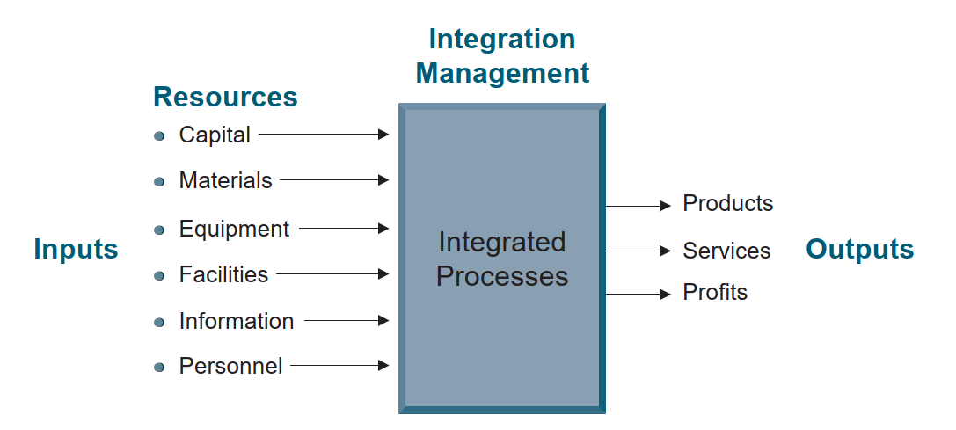
Chapter
Integration management.
1

Slide 40
Agenda
The Concept of Project Management Understanding Project Management
Meaning of “ Project “
Meaning of “ Project time management“
History of Project Management
Benefits of project management
Benefits of project time management
Benefits of Proper Planning
Approaches to Project Management “Project Management Life Cycle”
The Initiating Process
The Planning Process
The Executing Process
The Monitoring and Controlling Process
The Closing Process
Successful project management
Obstacles of project management
Project Management
Role of the Project Manager
Role of the Functional Manager
Goals of the Project

Slide 41
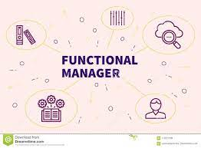
Chapter
FUNCTIONAL MANAGER’S ROLE
1
● The functional manager has the responsibility to define how the task will be done and where the task will be done (i.e., the technical criteria).

Slide 42
Chapter
FUNCTIONAL MANAGER’S ROLE
1
● The functional manager has the responsibility to provide sufficient resources to accomplish the objective within the project’s constraints (i.e., who will get the job done).

Slide 43


Chapter
FUNCTIONAL MANAGER’S ROLE
1
● The functional manager has the responsibility for the deliverable.

Slide 44
Agenda
The Concept of Project Management Understanding Project Management
Meaning of “ Project “
Meaning of “ Project time management“
History of Project Management
Benefits of project management
Benefits of project time management
Benefits of Proper Planning
Approaches to Project Management “Project Management Life Cycle”
The Initiating Process
The Planning Process
The Executing Process
The Monitoring and Controlling Process
The Closing Process
Successful project management
Obstacles of project management
Project Management
Role of the Project Manager
Role of the Functional Manager
Goals of the Project

Slide 45

Chapter
Project Goals
1
Contractual performance obligations.
Financial objectives: profit and cost control.
Prevent delays and claims.
Maintain team focus on objectives.

Slide 46



Thank You

