Slide 1

Prioritization:
The Core of Project Leadership
Putting ‘this’ before ‘that,’ and deciding what is more important.
Chapter 5
Everyone’s Smart
University
PMG511
Project Leadership
Dr.Sara Adel

Slide 2

Learning Outcomes:
    5.1 Why is Prioritization So Essential?
    5.2 Estimation Methods
    5.3 Estimates vs. Commitments
    5.4 Accuracy and Precision
    5.5 Project Scheduling
    5.6 Project Tracking
    5.7 Prioritizing Stakeholders
    5.8 Summary and Conclusion
    5.9 Self Assesment.
Dr.Sara Adel

Slide 3
5.1 Planning and Prioritizing Project Work
Dr.Sara Adel

Slide 4

What is a Project Prioritization?
Project prioritization is the foundation for successfully implementing projects. It's where you align your projects to strategy. It's where you win executive sponsorship and support. It's where you identify and eliminate waste.
Poor prioritization leads to project failure and, ultimately, missed business goals.
Done well, a good project prioritization process will allow the leader to strategically align your resource allocation and decisions while delivering more successful projects.
Dr.Sara Adel

Slide 5

What is Prioritization?
prioritization is a process where you work out which projects are the most important so that you can focus your resources on successfully delivering those value-added projects.
Dr.Sara Adel

Slide 6
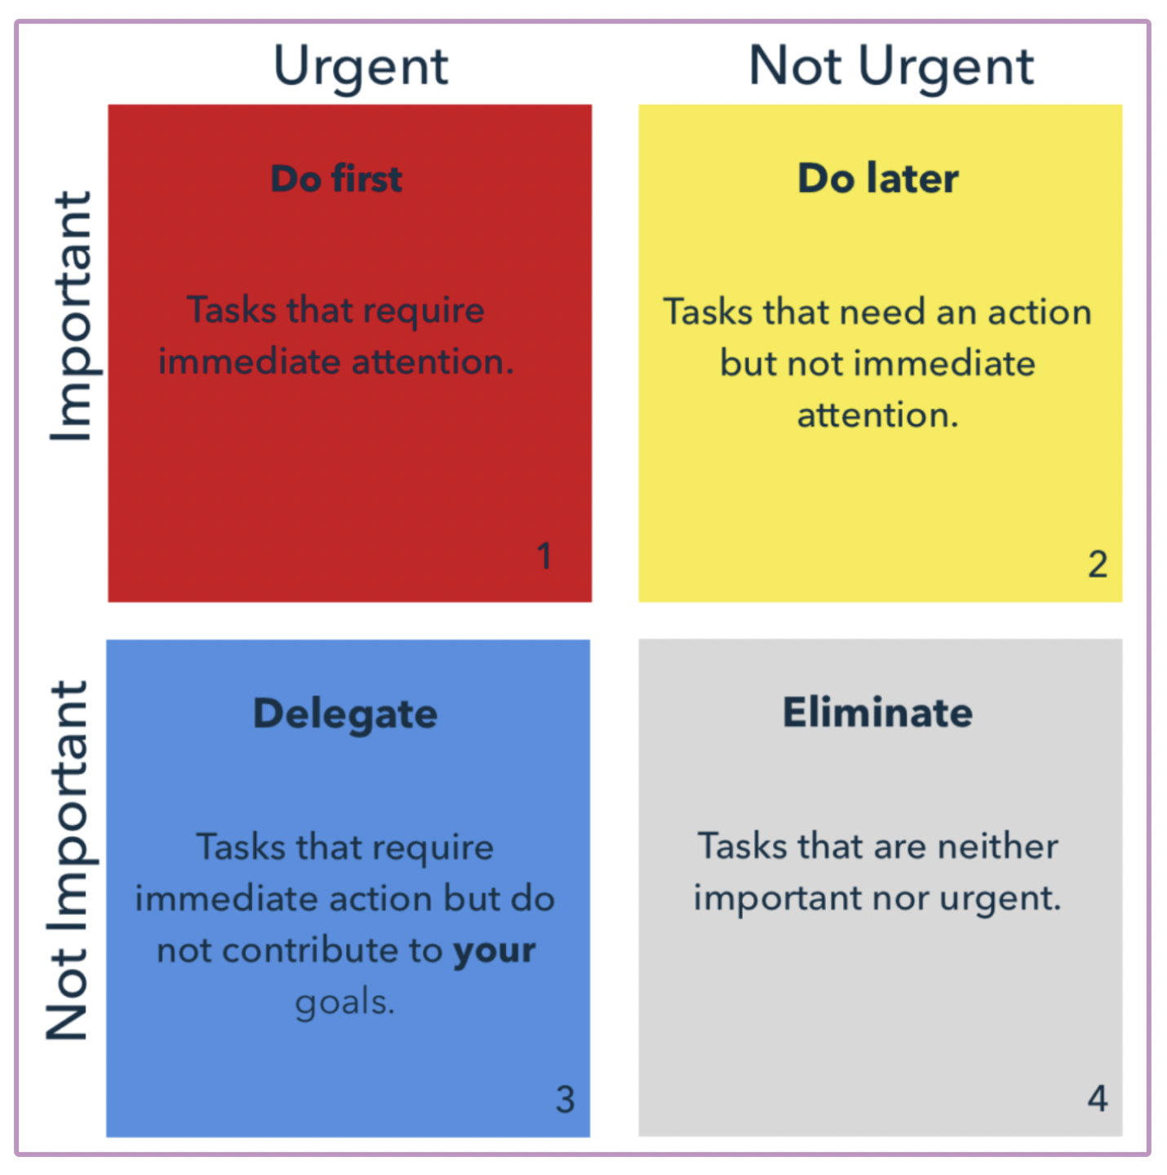
The Eisenhower Matrix:
Dr.Sara Adel

Slide 7

When thinking about prioritization it is important to address these six aspects...
1. Who wants the work done?
3. When do they want delivery of the work?
5. Why does it fit there?
2. What do they want done?
4. Where does the work fit in the schedule?
6. How will this work impact deadlines for other work?
Dr.Sara Adel

Slide 8

Think about that (to Prioritize your project work):
Grab your pen and paper and think about projects you need to prioritize their work.
Dr.Sara Adel

Slide 9
Reasons to Prioritize Project:
Effort concentration:
Focus on time and resource.
Costs:
- The right investment in the adequate product/service.
- Better financial management.
Strategy:
- Direct link to the strategic plan.
- Increase in strategic alignment (business objective).
Dr.Sara Adel

Slide 10
Leadership priorities
- What are the strategic initiatives today, this year and next year?
- Smart leaders understand that their job requires, choosing what not to do as much as what to do.
- leaders often turn to rank ordering their priorities; it is natural and easy to make a list.
Dr.Sara Adel

Slide 11
Three interdependent variables that are essential for priorities starting from initiative process:
.
Timing
Cost
Resources
Dr.Sara Adel

Slide 12

- Once a leader decides what resources will be allocated to achieve which objectives over what periods of time, he has no more need for ranking. he will be forced to acknowledging three kinds of priorities: critical, important, and desirable..
Dr.Sara Adel

Slide 13
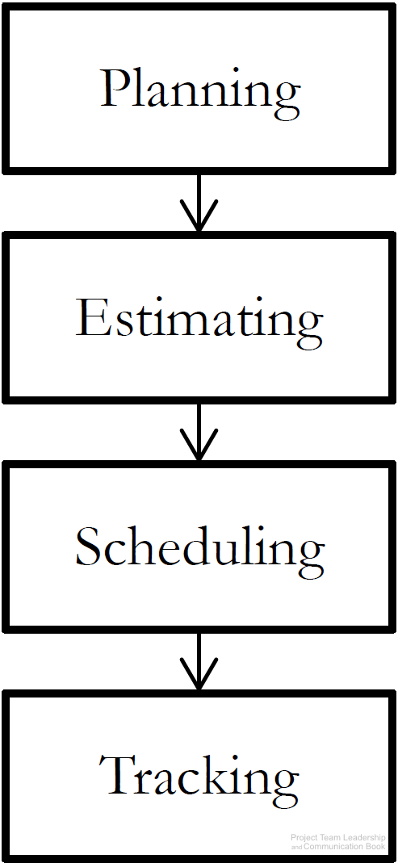
Planning and Prioritizing Project Work
Before work can be completed, three basic steps must take place:
  Planning takes place early in the project, and determines objectives to be completed, resources available, etc.
  Estimating is the process of determining how long or how many resources each planned element will take
  Scheduling is the ‘calendarization’ of estimated work
Once the work begins (execution of plans):
  Tracking must occur, comparing actual results with plans, estimates, and schedules
  If changes occur or results vary from plans, repeat the steps
Dr.Sara Adel
Diagram: Malachowsky, Samuel. Project Team Leadership and Communication. Lintwood Press. 2018. p. 88.

Slide 14

Planning project work:
- Is devising and maintaining a workable scheme to accomplish the business need via using a formal, approved documents used to guide both project execution and project control.
Dr.Sara Adel

Slide 15
Elements of a project planning work:
Interrelates all tasks on a common time scale like:
– Names of the tasks and work packages listed in the WBS (work breakdown structure).
– Names of the persons responsible for each task .
– Expected duration of each task .
– Due date of each task .
Dr.Sara Adel

Slide 16
5.2 Estimation Methods
Dr.Sara Adel

Slide 17

Why project leader need to estimate the scope of work?
Estimating a project’s scope of work: means laying out what tasks, deliverables, and dependencies are all built into the project.
This covers all aspects of the project from technical development to catch-ups and calls.
To be more accurate: estimating what the project will actually involve will help you better predict how much it will cost, how long it will take, and what potential roadblocks may slow things down.
Dr.Sara Adel

Slide 18
What is estimating project work?
Project estimation means: looking through all available data to propose the time, cost, and resources needed to complete a project.
The project deliverables for estimating include:
- Project Timeline.
- Resource Overview.
- Cost Estimates.
- Risks.
Dr.Sara Adel

Slide 19
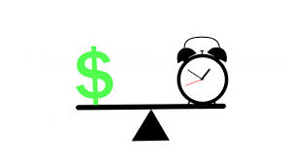
Why project leader need to estimate the Project timeline?
To find a straightforward timeline covering all aspects of the project and the scope of work.
This should show when different parts of the project start and finish, which parts depend on other parts, and when each milestone will be finished.
Dr.Sara Adel

Slide 20

Why project leader need to estimate the Resource overview?
Having a clear scope of work and a timeline will allow you to understand exactly what the project requires when it comes to resources.
A good project estimation will make it clear who will be involved in the project (staff, contractors, vendors, or suppliers), what technical or other resources you will need (manufacturing, printing, shipping, etc.) and how these relate to the overall project.
Dr.Sara Adel

Slide 21

Why project leader need to estimate the Project cost?
Looking at the scope of work, timeline, and resource requirements will allow you to accurately forecast the project cost. With all key elements of the project mapped out, you’ll be able to clearly estimate the overall cost range.
Review all historical data related to past project costs. Dig into previous projects for similar clients to compare and adjust as needed. The more accurate data you have, the closer project estimates will be.
Dr.Sara Adel

Slide 22

Why project leader need to estimate the risk factors?
After gaining a complete overview of the project, it’s time to identify the risk factors and potential roadblocks.
This step should cover all aspects of the project including potential roadblocks with resourcing, scope of work difficulties, and budget constraints.
Dr.Sara Adel

Slide 23
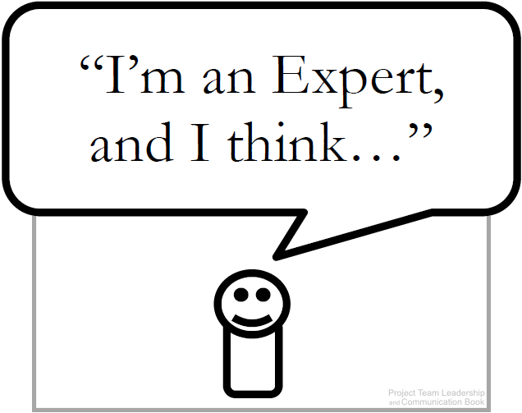
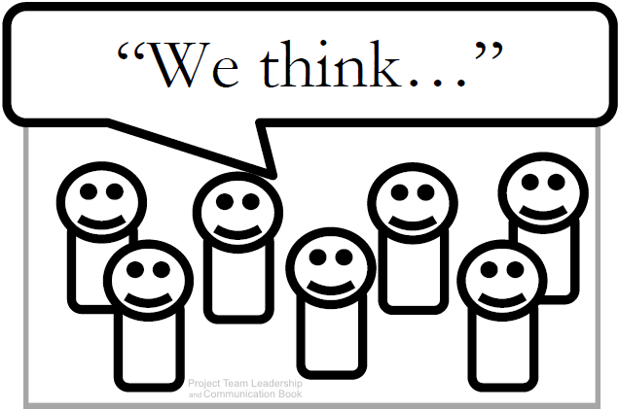
Estimation Techniques (1 of 3)
1- Expert Judgement: experience is used to estimate
The basis for all other techniques.
Strengths: expert lends credibility to estimate.
Weaknesses: one person’s ‘expertise’ may fail.
2- Group Consensus: various techniques are used to poll the group and reach consensus.
Strengths: group participation and ‘buy-in’.
Weaknesses: bias and cultural issues manifest.
Dr.Sara Adel
Diagrams: Malachowsky, Samuel. Project Team Leadership and Communication. Lintwood Press. 2018. p. 80, 82.

Slide 24
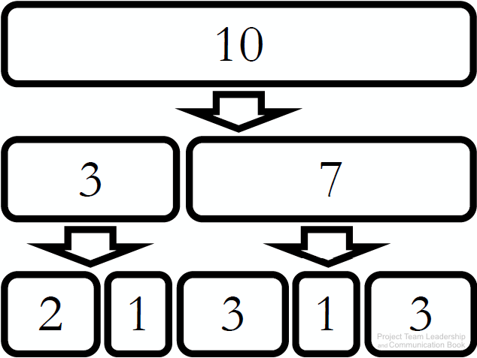
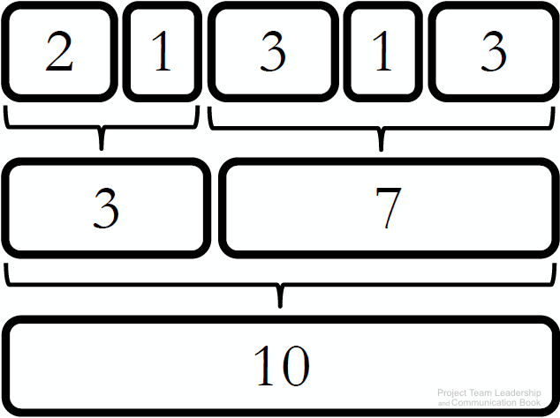
Estimation Techniques (2 of 3)
3- Top-Down: large units estimated then divided up.
Strengths: usable when less detail is known.
Weaknesses: inaccurate if major sections of the project aren’t considered.
4- Bottom-Up: small units estimated then added together.
Strengths: can be quite precise if used properly.
Weaknesses: more time consuming than other techniques, changes to items can impact greatly.
Dr.Sara Adel
Diagrams: Malachowsky, Samuel. Project Team Leadership and Communication. Lintwood Press. 2018. p. 81.

Slide 25

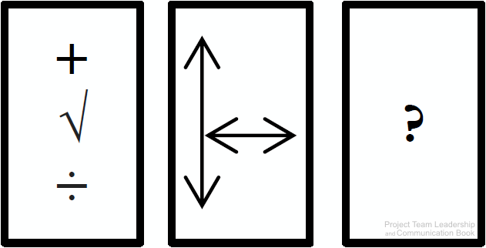
Estimation Techniques (3 of 3)
5- Comparison or Analogy: projects (or components) are compared to previous work.
Strengths: based on actual results, increasing credibility and potentially accuracy.
Weaknesses: all projects are unique, may be difficult to find comparisons, data may not exist.
Other Methods: mathematical/statistical models, focusing on size rather than time, or industry-specific methods.
Dr.Sara Adel
Diagrams: Malachowsky, Samuel. Project Team Leadership and Communication. Lintwood Press. 2018. p. 81, 82.

Slide 26
5.3 Estimates vs. Commitments
Dr.Sara Adel

Slide 27
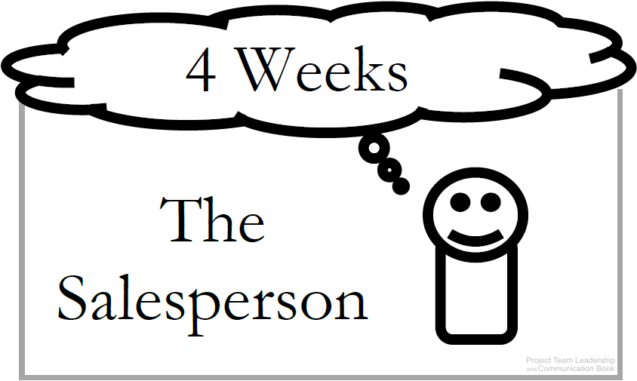
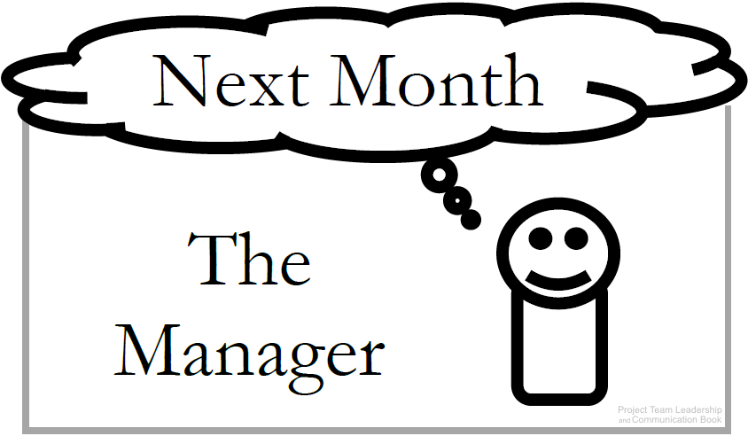
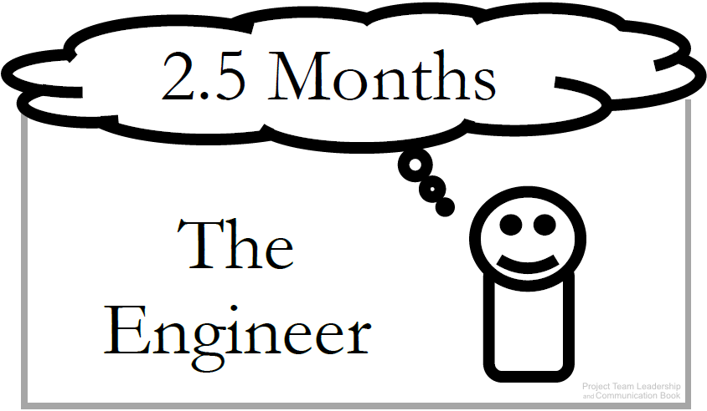
Estimates vs. Commitments
All parties must be careful not to confuse estimates with commitments
Commitments: Are deadlines ‘real’ or arbitrary?
Estimates: Presentation can be important: Ranges (6-8 Months), plus/minus qualifiers (7 Weeks +/– 1 Week), and Confidence factors (4 weeks: 30% chance, 5 weeks: 50% chance) can be helpful.
Don’t confuse estimation with scheduling, which sets actual dates
Dr.Sara Adel
Diagrams: Malachowsky, Samuel. Project Team Leadership and Communication. Lintwood Press. 2018. p. 84.

Slide 28
5.4 Accuracy vs. Precision
Dr.Sara Adel

Slide 29
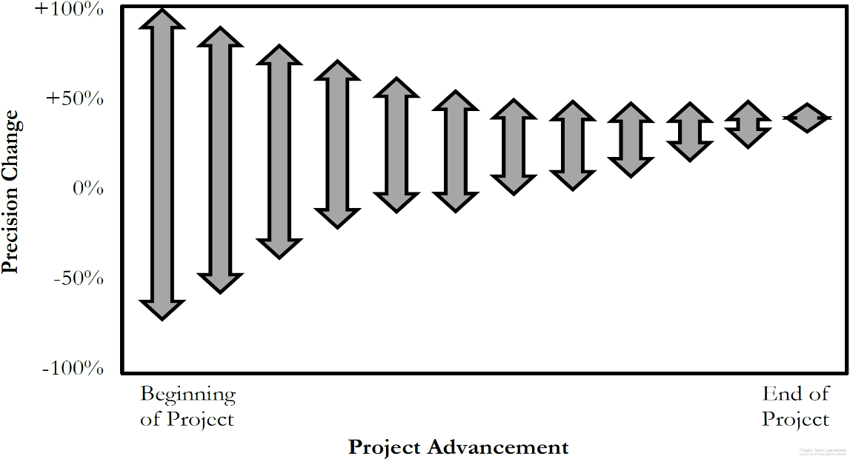
Accuracy vs. Precision
Accuracy is how true a value is
  ‘4-6’ is accurate if the actual # is 5.5
Precision is how exact a value is
  ‘4-6’ is less precise than ‘4.5-5.5’
Within a project communications
should always be as accurate as
possible (especially in estimating)
Because uncertainty is high at the beginning of a project, the only way to be accurate is to be less precise.
As the project progresses, we can be more and more precise while remaining accurate throughout (ranges get smaller and smaller)
Dr.Sara Adel
Diagram: Malachowsky, Samuel. Project Team Leadership and Communication. Lintwood Press. 2018. p. 86.
McConnell, Steve. Software Project Survival Guide: how to be sure your first important project isn’t your last. Redmond, WA: Microsoft Press. p. 31. 1998.

Slide 30
5.5 Project Scheduling
Dr.Sara Adel

Slide 31
Project Scheduling
In project management, a schedule is a listing of a project milestone activities, and deliverables, usually intended start and finish dates.
Dr.Sara Adel

Slide 32
Organizing Tasks:
1- The Work Breakdown Structure (WBS)
A Work Breakdown Structure (WBS) is a deliverable-oriented hierarchical decomposition of the work to be executed by the project team to accomplish the project objectives and create the required deliverables.
A WBS is the cornerstone of effective project planning, execution, controlling, monitoring, and reporting.
Dr.Sara Adel

Slide 33
The Work Breakdown Structure (WBS)
A good WBS should exhibit the following characteristics:
Definable—can be described and easily understood by project participants.
Manageable—a meaningful unit of work where specific responsibility and authority can be assigned to a responsible individual.
Estimateable—duration can be estimated in time required to complete, and cost can be estimated in resources required to complete.
Independent—minimum interface with or dependence on other ongoing elements (i.e., assignable to a single control account, and clearly distinguishable from other work packages).
Integratable—integrates with other project work elements and with higher level cost estimates and schedules to include the entire project.
Measurable—can be used to measure progress; has start and completion dates and measurable interim milestones.
Adaptable—sufficiently flexible so the addition/elimination of work scope can be readily accommodated in the WBS framework.
Dr.Sara Adel

Slide 34
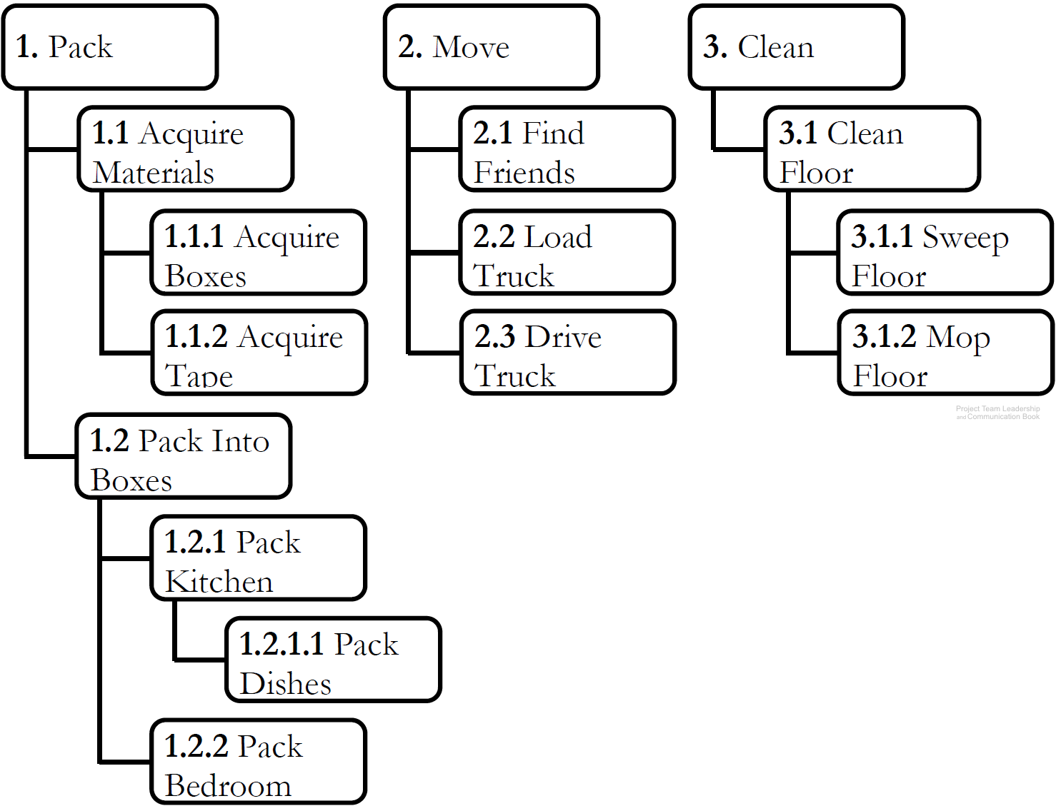
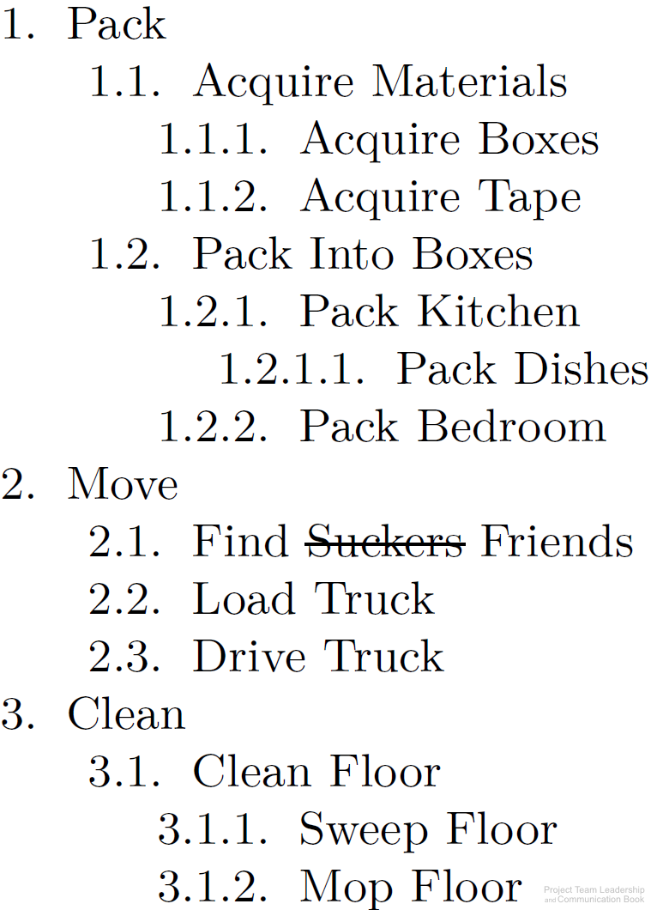
The Work Breakdown Structure (WBS)
Organizes elements with ‘sub-
numbers.’ 1.2.3 is part of 1.2
Two types: product & process
  Product divides by components
  Process divides by activities/tasks
Can be built ‘top down,’
‘bottom-up,’ or ‘rolling-wave’
A good way to organize brain-
storming efforts early in the project
Sequencing of tasks or components
isn’t needed until later in scheduling efforts
Dr.Sara Adel
Diagrams: Malachowsky, Samuel. Project Team Leadership and Communication. Lintwood Press. 2018. p. 88.
Project Management Institute. A Guide to the Project Management Body of Knowledge – Fifth Edition. Project Management Institute Inc. p. 125-132. 2013.

Slide 35
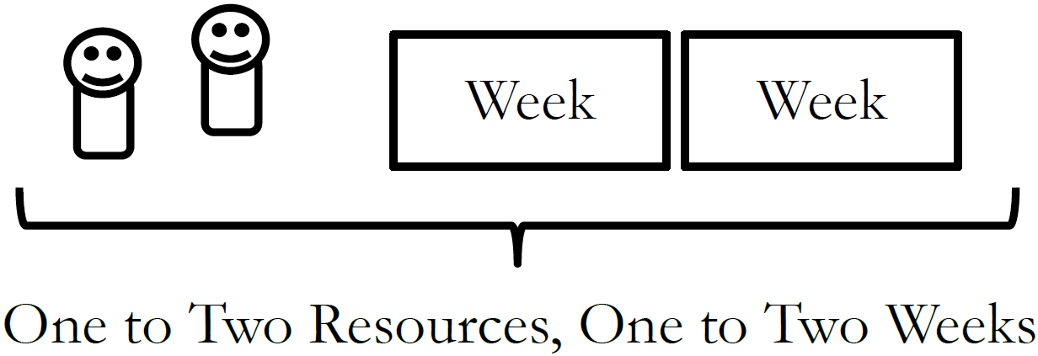
The One-to-Two Rule
How do you know when you’ve divided tasks into small enough ‘chunks’?
If tasks are too large, it becomes difficult to track progress
If tasks are too small, time is wasted micromanaging the project
Optimize with ‘The One-to-Two Rule,’
which states that tasks have been
divided enough when each requires
1-2 resources 1-2 weeks to complete it
Dr.Sara Adel
Diagram: Malachowsky, Samuel. Project Team Leadership and Communication. Lintwood Press. 2018.

Slide 36
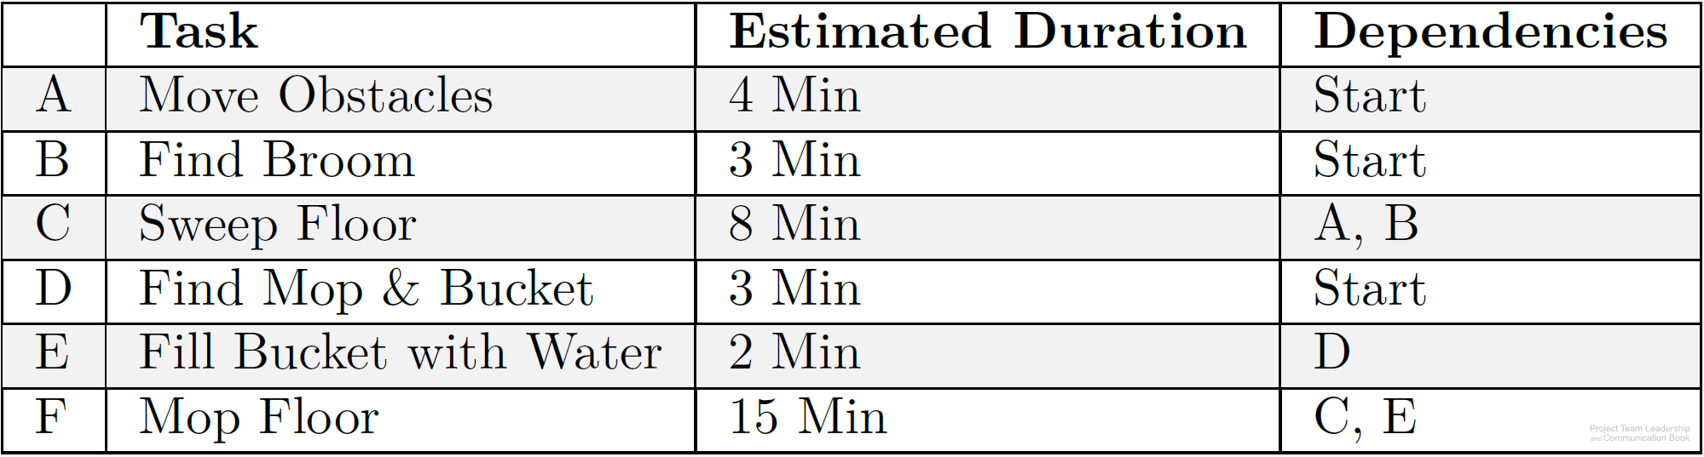
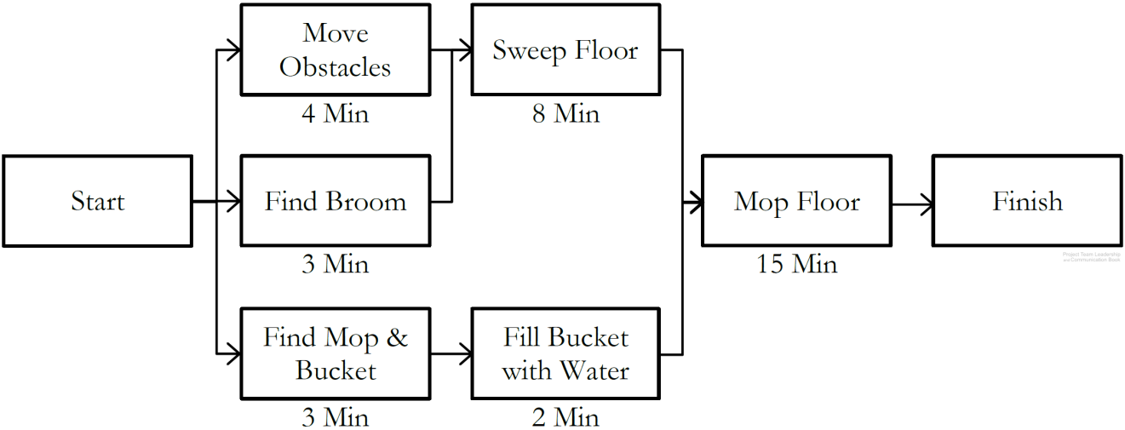
2- Sequencing and Scheduling Tasks
Predecessors or dependencies are determined for all tasks
Using this information, a precedence diagram is created
  The longest path, called the critical path, determines project length.
  Slack time, the ability to delay starting without impacting the schedule, is available to some tasks which are not on the critical path
Tasks are then ‘calendarized,’ with actual dates based on resources available.
Dr.Sara Adel
Diagrams: Malachowsky, Samuel. Project Team Leadership and Communication. Lintwood Press. 2018. p. 89, 90.

Slide 37
Activity – Organizing and Sequencing Tasks
Consider the following scenario:
One of your best friends is graduating from college and you’ve decided to throw her a big party. Her parents have volunteered to let you decorate and hold the event at their house, the food is to be catered, and you would like to invite as many of her friends and family as you can.
Create a basic work breakdown structure, listing 15 planning activities that must take place
After determining which activities must occur before others, create a precedence diagram with the activities and tasks outlined in your work breakdown structure
Dr.Sara Adel

Slide 38
5.6 Project Tracking
Dr.Sara Adel

Slide 39
Project Tracking
A combination of cost and time tracking will let you finish tasks earlier, delay non-critical tasks for the same of keeping to the project baseline, and find ways for reducing costs and the project scope.
Dr.Sara Adel

Slide 40

In order to succeed in delivering your project, you will need to get an understanding of how to track your project and what items need to be monitored.
Track time and cost
Track human resources
Track team progress and efficiency
Track risks, changes, issues
Track project health
Dr.Sara Adel

Slide 41
Tracking Progress
A main concern of project tracking is visibility. Often, the team isn’t aware of how far along they are due to long phases
Project Visibility is often only achieved when phases are started or completed
Dr.Sara Adel
Diagram: Malachowsky, Samuel. Project Team Leadership and Communication. Lintwood Press. 2018. p. 94.
McConnell, Steve. Rapid Development: Taming Wild Software Schedules. Redmond, WA: Microsoft Press. p. 57. 1996.

Slide 42
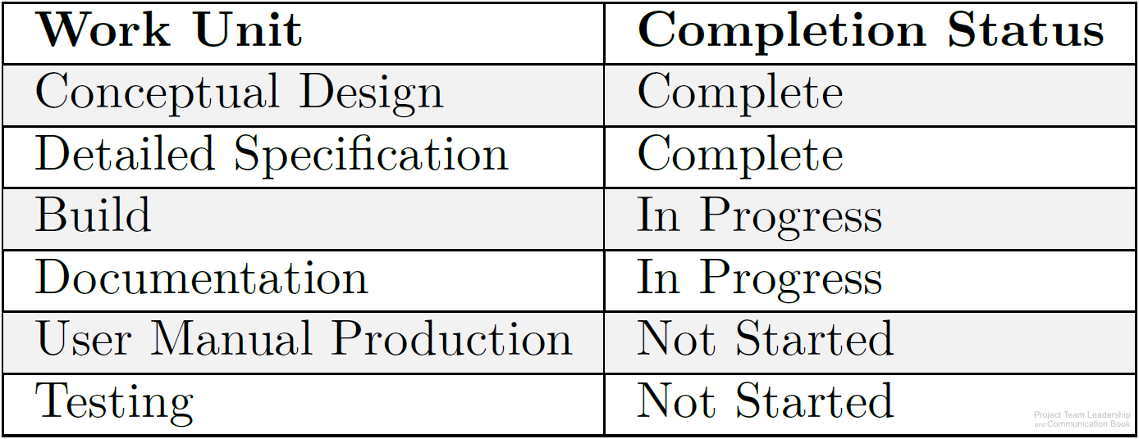
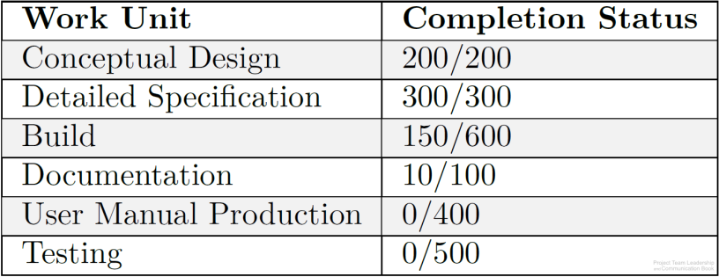
Tracking Earned Value
Tasks or groups of tasks are often tracked with little granularity (large chunks instead of small) and simple not-started / started / complete progress reporting
By giving each task a relative weight and assigning earned value to sub-tasks, the percentage of progress can be calculated (example: 660/2100=31% complete)
Calculated earned value can be compared to the time or resources expended
Dr.Sara Adel
Diagrams: Malachowsky, Samuel. Project Team Leadership and Communication. Lintwood Press. 2018. p. 95.

Slide 43
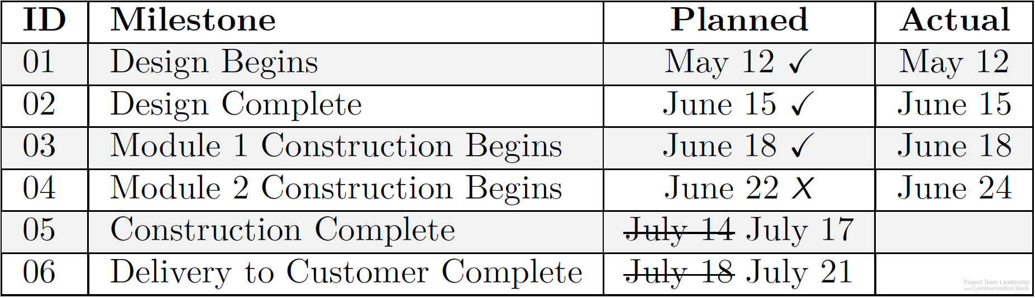
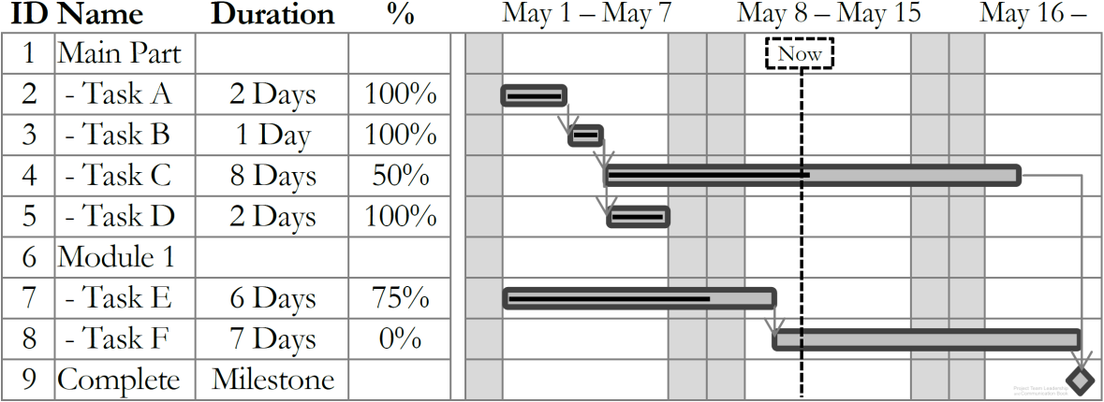
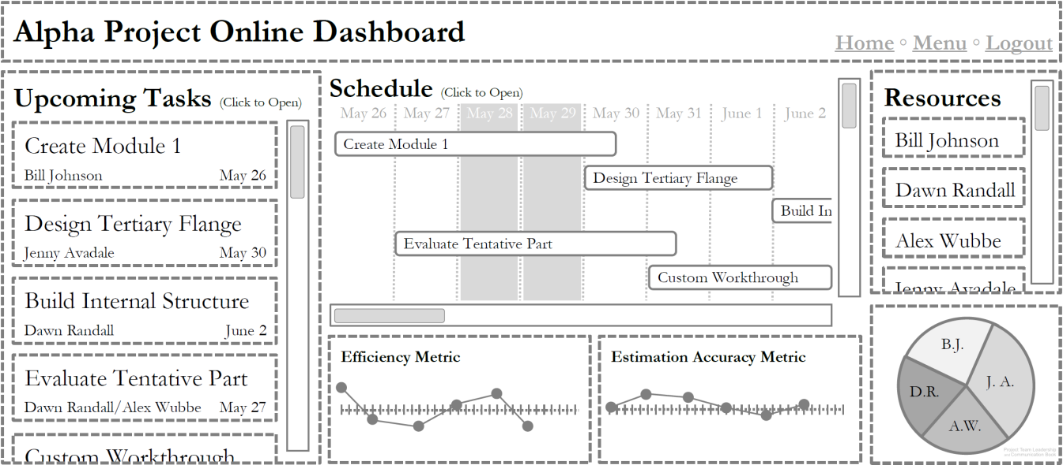
Scheduling/Tracking Tools and Visualizations
Milestone Charts list major points in time, or milestones, such as phases ending
Gantt Charts provide an easy-to-understand visualization of the schedule and progress
Many software packages and online tools are specifically designed for managing projects
Dr.Sara Adel
Diagrams: Malachowsky, Samuel. Project Team Leadership and Communication. Lintwood Press. 2018. p. 92, 96.

Slide 44
Activity – Tracking Project Progress
Examine the following project status information:
Calculate the percentage complete, or earned value
Using a whiteboard or application, create a basic Gantt chart. Estimate the total time elapsed for the project
ID | Task | Units of Work | Units Complete | Days | Start Date
1 | Plow/cultivate soil | 15 | 15 | 5 | April 30
2 | Plant seeds | 25 | 25 | 8 | May 6
3 | Water, weed, and fertilize growing crops | 15 | 5 | 90 | May 15
4 | Initial harvest | 25 | 0 | 7 | August 20
5 | Water, weed, and fertilize growing crops | 5 | 0 | 21 | August 27
6 | Second harvest | 15 | 0 | 5 | September 20
Dr.Sara Adel

Slide 45
5.7 Prioritizing Stakeholders
Dr.Sara Adel

Slide 46
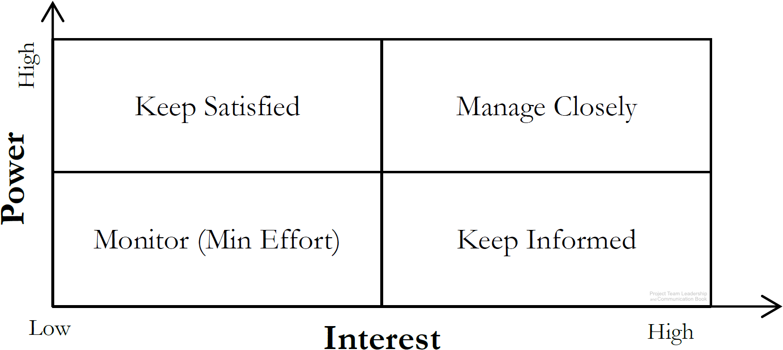
Prioritizing Stakeholders
Stakeholders are people who can affect or are affected by the execution or outcome of a project. Everyone should be involved in identifying them
  Stakeholders can be groups
Once identified, they should be analyzed
  High or low power, or ability to affect the project
  High or low interest, or how they’re affected by
  the projects positive or negative outcome
Dr.Sara Adel
Diagram: Malachowsky, Samuel. Project Team Leadership and Communication. Lintwood Press. 2018. p. 104.
Project Management Institute. A Guide to the Project Management Body of Knowledge – Fifth Edition. Project Management Institute Inc. p. 395-397. 2013.

Slide 47
Prioritizing Stakeholders
All information should be recorded/tracked
in a stakeholder register
ID | Name | Title | Info | Notes | Power | Interest | Strategy
1 | Casey Johnson | Sales Lead | cjohnson@co.com | Initiated the contract | Low | High | Keep Informed
2 | Jordan Baker | Team Specialist | 555-1532 |  | High | High | Manage Closely
Dr.Sara Adel
Diagram: Malachowsky, Samuel. Project Team Leadership and Communication. Lintwood Press. 2018. p. 104.
Project Management Institute. A Guide to the Project Management Body of Knowledge – Fifth Edition. Project Management Institute Inc. p. 395-397. 2013.

Slide 48
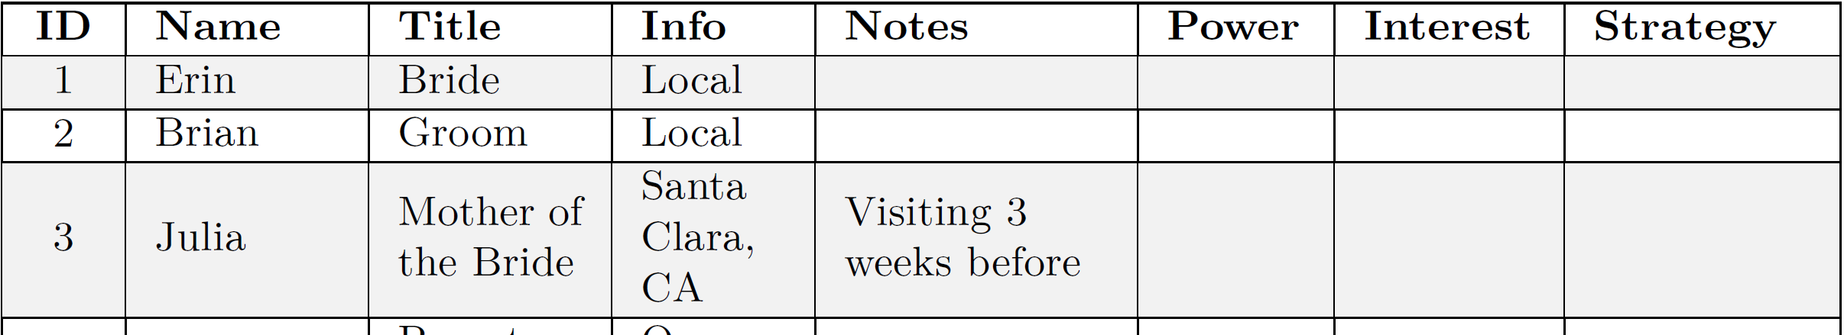
Activity – Finding and Analyzing Stakeholders
Consider the stakeholders in a typical wedding. Remember that stakeholders with a similar stake can be listed as groups.
list 15 stakeholders/stakeholder groups on a whiteboard.
For each, analyze their level of interest and power as it pertains to the wedding planning and execution.
Determine each stakeholder’s management strategy (monitor, keep informed, etc.)
Dr.Sara Adel
Diagram: Malachowsky, Samuel. Project Team Leadership and Communication. Lintwood Press. 2018. p. 104.

Slide 49
5.8 Summary and Conclusions
Dr.Sara Adel

Slide 50
Summary and Conclusions
Project work requires planning, estimating, scheduling, and tracking.
Estimating judges how long project work will take:
  There are several techniques (top-down, bottom-up, analogy, etc.)
  Teams must provide clarity between and estimate and a commitment
  Early estimations should be imprecise (ranges, etc.) to remain accurate
In order to properly schedule tasks, they must first be sequenced
  Work Breakdown Structures assist in dividing work into smaller, estimate-able tasks
  Tasks have dependencies/precedence which must be accounted for in final schedule
  Use visualizations and tools such as milestone charts, Gantt charts, and precedence diagrams
Tracking after the project begins is what makes scheduling efforts ‘worth it’
Stakeholder prioritization starts with identification, then analyzes and formulates strategies
Dr.Sara Adel

Slide 51
5.9 Self Assessment.
Dr.Sara Adel

Slide 52

Self Assessment
1- Determine appropriate estimation, scheduling and tracing techniques?
Dr.Sara Adel

Slide 53
Self Assessment
2- consider the following scenario:
You have been tasked with moving the sales office to a new location 3.6 miles away. There are 43 employees who will be transferred, along with files, computing equipment, and at least one box of personal property per individual. The executive vice president has asked for a pretty exact estimate. You think it will take 11 days to complete the move, but haven't yet shared the estimate with her.
List at least 3 methods you can use to accurately share this estimate.
For each of the three methods chosen, list one advantage and one disadvantage associated with using it.
Dr.Sara Adel

Slide 54

Resources:
Project Team Leadership and Communication by Samuel Malachowsky, 2018.
https://hbr.org/2017/02/a-better-way-to-set-strategic-priorities . Harvard Business Review.
Dr.Sara Adel

Slide 55
THANKS!
Dr.Sara Adel

