Slide 1
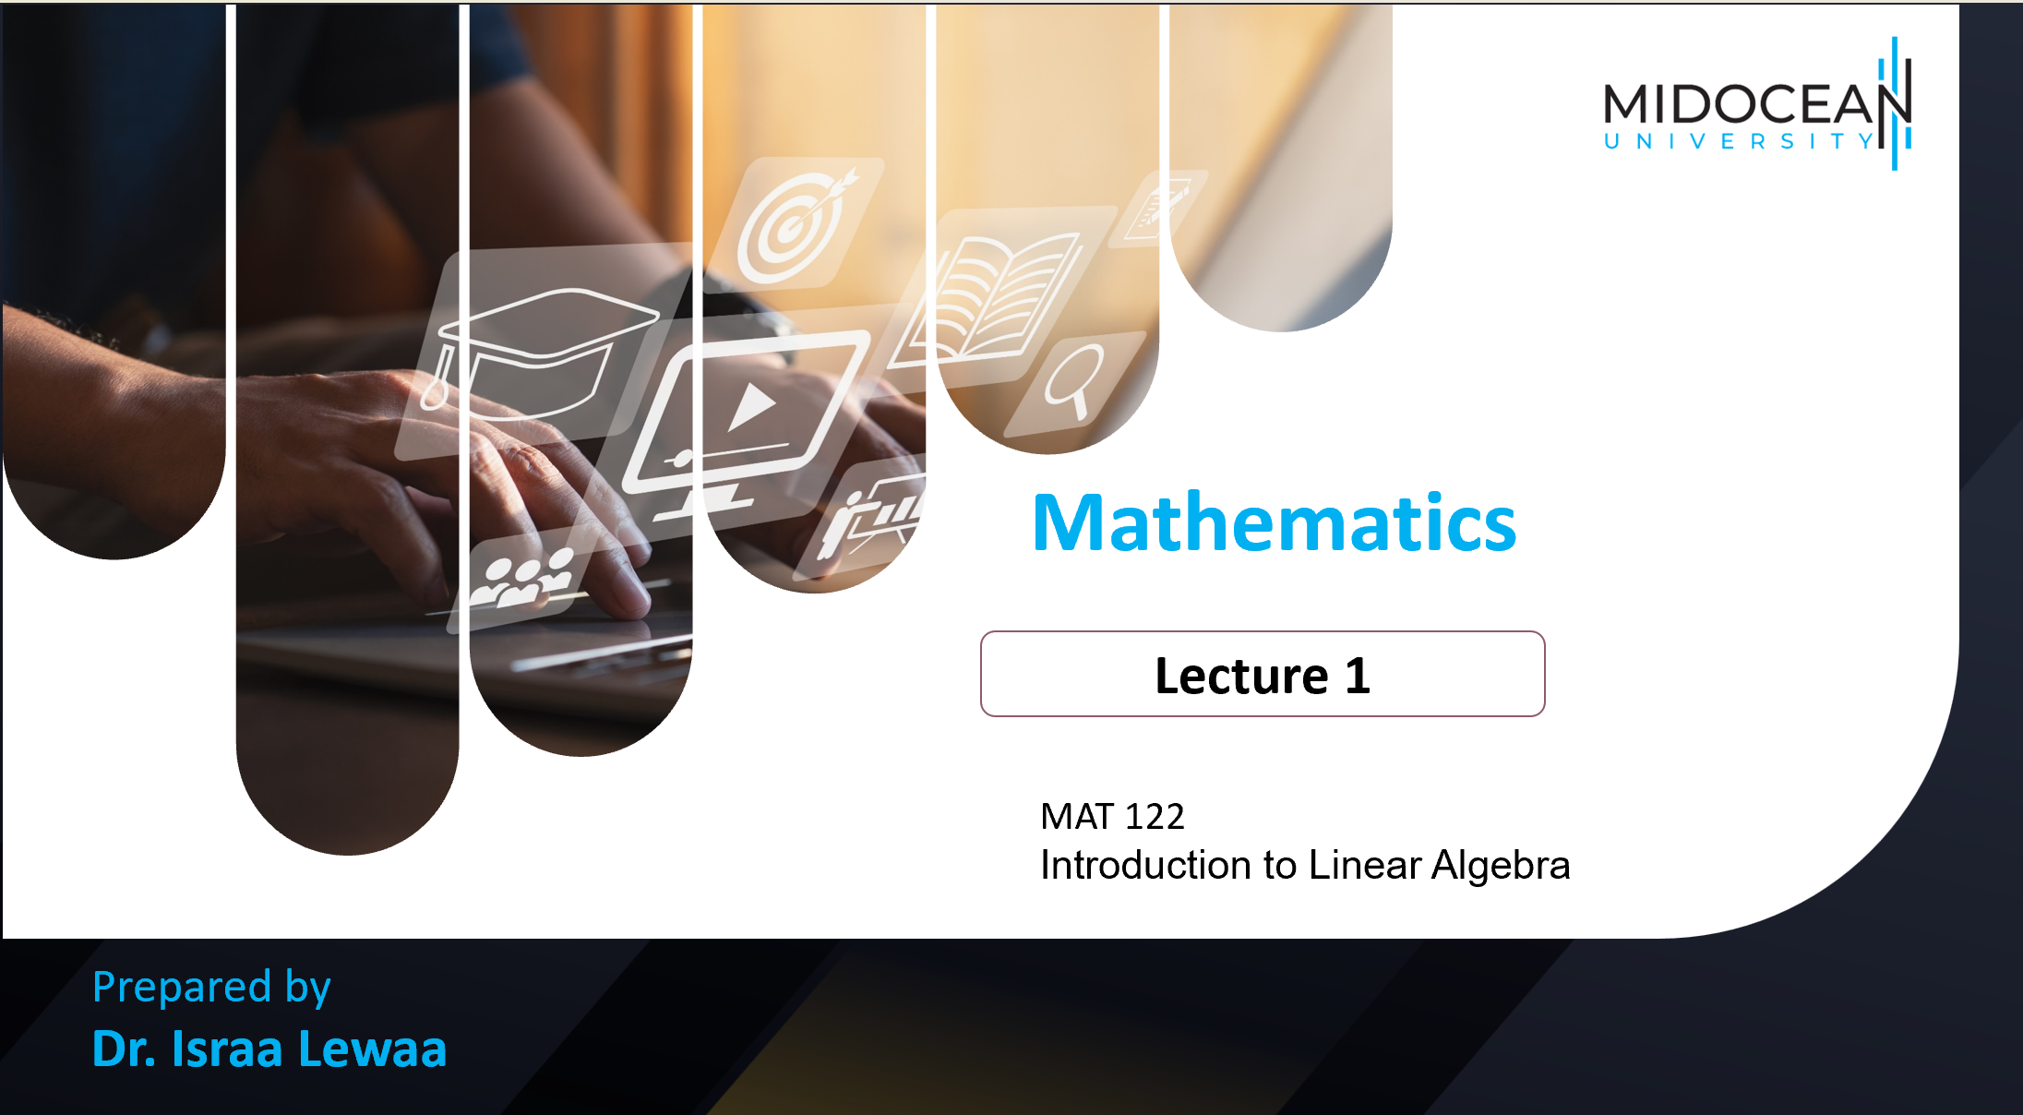
MAT 122
Introduction to Linear Algebra

Slide 2

Lecture
01
Topics
Lecture 1: Introduction to Linear Algebra
Lecture 2: Scalar and Vector
Lecture 3: Introduction to matrix Algebra
Lecture 4: Operations on matrices
Lecture 5: Advanced topics in matrices
Lecture 6: Determinants
Lecture 7: System of Linear Equations
Lecture 8: Vector Space
Lecture 9: Diagonalization
Lecture 10: Linear Algebra by Spreadsheet
Lecture 1 Dr. Israa Lewaa Mathematics 2

Slide 3
Lecture
01
Lecture Outline
Linear Algebra Definition
Linear Algebra Goals
Linear Algebra Application
System of linear equations definition
How to solve system of linear equations Algebraically
Lecture 1 Dr. Israa Lewaa Mathematics 2

Slide 4
Lecture
01
Linear Algebra Definition
What is Linear Algebra?
Lecture 1 Dr. Israa Lewaa Mathematics 2

Slide 5
Lecture
01
Introduction to Linear Algebra
Linear algebra is the branch of Mathematics concerning linear equations. Linear Algebra is the branch of mathematics aimed at solving systems of linear equations with a ﬁnite number of unknowns.
Lecture 1 Dr. Israa Lewaa Mathematics 2

Slide 6
Lecture
01
Linear Algebra Definition
Linear Algebra is one of the most widely used mathematical theories around. Linear Algebra finds applications in virtually every area of mathematics, including Multivariate Calculus, Differential Equations, and Probability Theory.
Lecture 1 Dr. Israa Lewaa Mathematics 2

Slide 7
Lecture
01
Where is Linear Algebra used?
Where is Linear Algebra used?
Lecture 1 Dr. Israa Lewaa Mathematics 2

Slide 8
Lecture
01
Where is Linear Algebra used?
It is also widely applied in fields like physics, chemistry, economics, psychology, and engineering. You are even relying on methods from Linear Algebra every time you use an Internet search like Google, the Global Positioning System (GPS), or a cellphone.
Lecture 1 Dr. Israa Lewaa Mathematics 2

Slide 9
Lecture
01
Where is Linear Algebra used?
Linear algebra is also used in most sciences and fields of engineering, because it allows modeling many natural phenomena, and computing efficiently with such models.
For nonlinear systems, which cannot be modeled with linear algebra, it is often used for dealing with first-order approximations, using the fact that the differential of a multivariate function at a point is the linear map that best approximates the function near that point.
Lecture 1 Dr. Israa Lewaa Mathematics 2

Slide 10
Lecture
01
Linear Algebra Goals
What is the Linear Algebra Goals?
Lecture 1 Dr. Israa Lewaa Mathematics 2

Slide 11
Lecture
01
Linear Algebra Goals
Linear Algebra would like to obtain answers to the following questions:
Characterization of solutions: Are there solutions to a given system of linear equations? How many solutions are there?
Finding solutions: How does the solution set look? What are the solutions?
Lecture 1 Dr. Israa Lewaa Mathematics 2

Slide 12
Lecture
01
Linear Algebra Applications
Applications of Linear Algebra
Lecture 1 Dr. Israa Lewaa Mathematics 2

Slide 13
Lecture
01
Applications of Linear Algebra
Matrices in Engineering, such as a line of springs.
Graphs and Networks, such as analyzing networks.
Markov Matrices, Population, and Economics, such as population growth.
Linear Programming, the simplex optimization method.
Lecture 1 Dr. Israa Lewaa Mathematics 2

Slide 14
Lecture
01
Application of Linear Algebra con’d
Fourier Series: Linear Algebra for functions, used widely in signal processing.
Linear Algebra for statistics and probability, such as least squares for regression.
Computer Graphics, such as the various translation, rescaling and rotation of images.
Lecture 1 Dr. Israa Lewaa Mathematics 2

Slide 15
Lecture
01
Application – System of Linear Equations
Definition:
A system of linear equations is a collection of linear equations in two or more variables.
There are three methods to solve a system of linear equations:
1) By elimination.
2) By substitution.
3) By matrices.
Lecture 1 Dr. Israa Lewaa Mathematics 2

Slide 16
Lecture
01
Let’s Practice
Let’s Practice
Lecture 1 Dr. Israa Lewaa Mathematics 2

Slide 17
Lecture
01
Example 1
Example: (1) Find x and y
x + y = 9 (1)
x – y = 3 (2)
Lecture 1 Dr. Israa Lewaa Mathematics 2

Slide 18
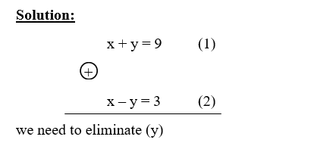
Lecture
01
Solution of Example 1
Lecture 1 Dr. Israa Lewaa Mathematics 2

Slide 19
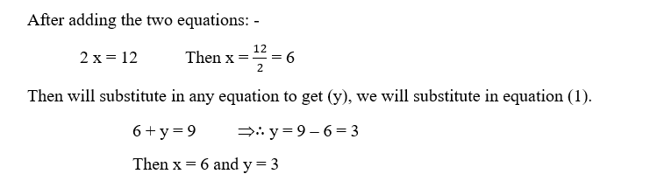
Lecture
01
Solution of Example 1
Lecture 1 Dr. Israa Lewaa Mathematics 2

Slide 20
Lecture
01
Example 2
Find x& y
5 x – y = 13 (1)
2 x + 3 y = 12 (2)
Lecture 1 Dr. Israa Lewaa Mathematics 2

Slide 21
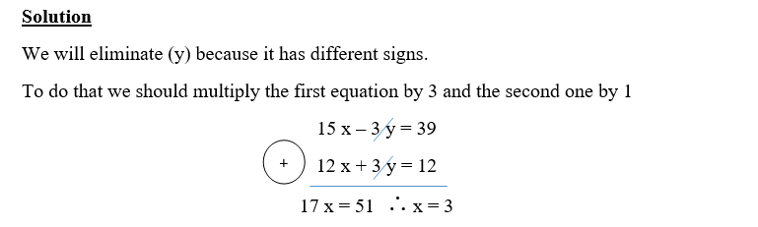
Lecture
01
Solution of Example 2
Lecture 1 Dr. Israa Lewaa Mathematics 2

Slide 22
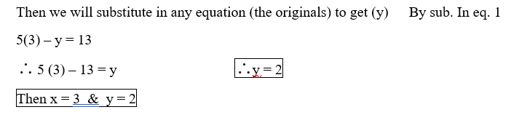
Lecture
01
Solution of Example 2
Lecture 1 Dr. Israa Lewaa Mathematics 2

Slide 23
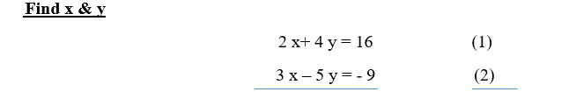
Lecture
01
Example 3
Lecture 1 Dr. Israa Lewaa Mathematics 2

Slide 24
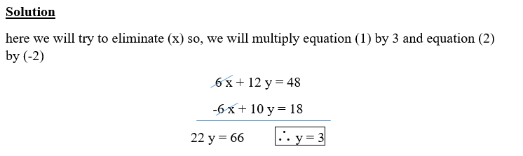
Lecture
01
Solution of Example 3
Lecture 1 Dr. Israa Lewaa Mathematics 2

Slide 25
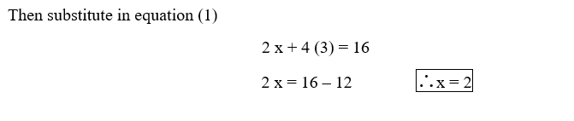
Lecture
01
Solution of Example 3
Lecture 1 Dr. Israa Lewaa Mathematics 2

Slide 26
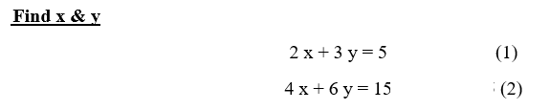
Lecture
01
Example 4
Lecture 1 Dr. Israa Lewaa Mathematics 2

Slide 27
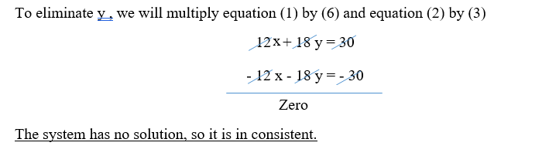
Lecture
01
Solution of Example 4
Lecture 1 Dr. Israa Lewaa Mathematics 2

Slide 28
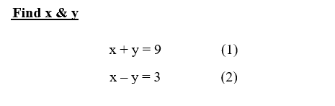
Lecture
01
Example 5
Lecture 1 Dr. Israa Lewaa Mathematics 2

Slide 29
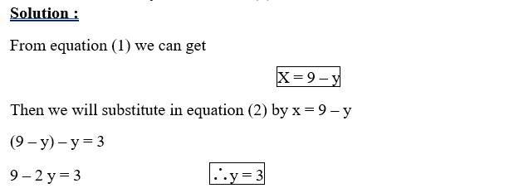
Lecture
01
Solution of Example 5
Lecture 1 Dr. Israa Lewaa Mathematics 2

Slide 30
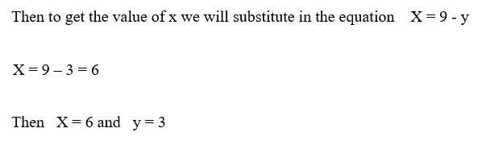
Lecture
01
Solution of Example 5
Lecture 1 Dr. Israa Lewaa Mathematics 2

Slide 31
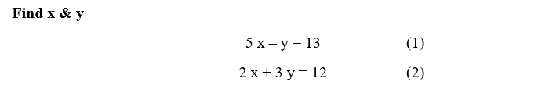
Lecture
01
Example 6
Lecture 1 Dr. Israa Lewaa Mathematics 2

Slide 32
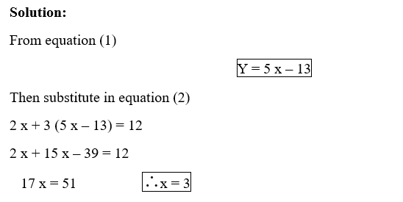
Lecture
01
Solution of Example 6
Lecture 1 Dr. Israa Lewaa Mathematics 2

Slide 33
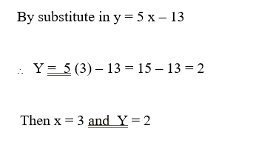
Lecture
01
Solution of Example 6
Lecture 1 Dr. Israa Lewaa Mathematics 2

Slide 34
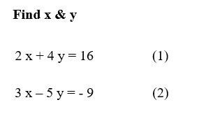
Lecture
01
Example 7
Lecture 1 Dr. Israa Lewaa Mathematics 2

Slide 35
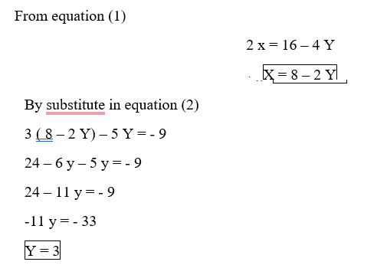
Lecture
01
Solution of Example 7
Lecture 1 Dr. Israa Lewaa Mathematics 2

Slide 36
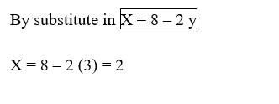
Lecture
01
Solution of Example 7
Lecture 1 Dr. Israa Lewaa Mathematics 2

Slide 37
Lecture
01
Lecture Summary
Linear Algebra Definition
Linear Algebra Goals
Linear Algebra Application
Basic concepts in linear algebra
System of linear equations definition
How to solve a system of linear equations Algebraically
Lecture 1 Dr. Israa Lewaa Mathematics 2

