Slide 1

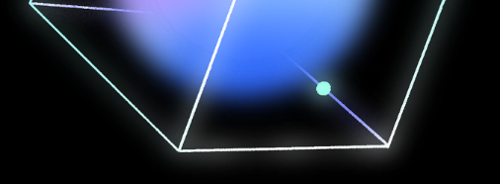
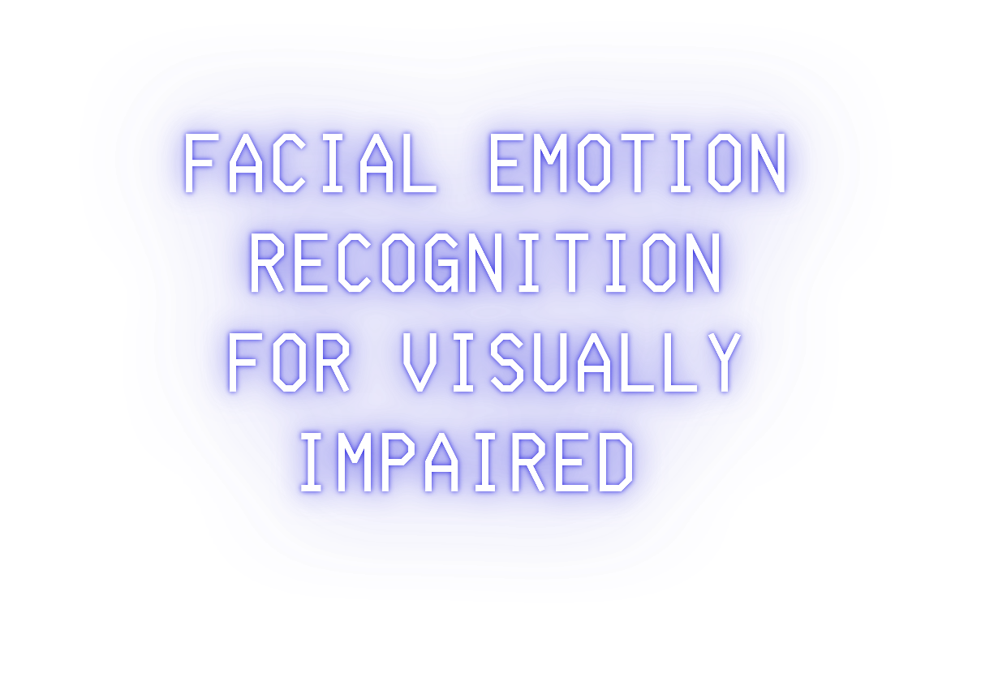




Chadi Omar Elminawi 252001554
Supervisor Name: Dr. Ashraf El-Sayed

Slide 2



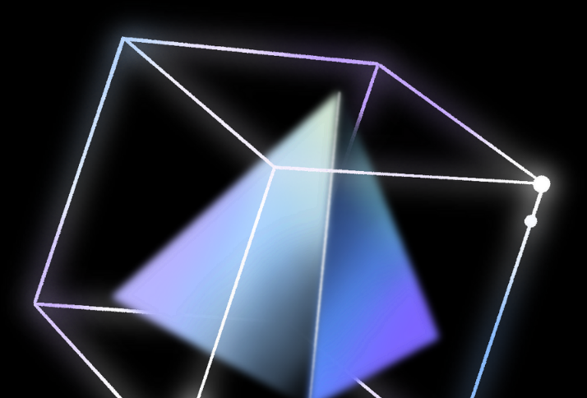
Abstract
01
Conclusion

Slide 3



Our project, Facial Emotion Recognition for Visually Impaired People develops a system that translates facial expressions into audio cues. This solution helps visually impaired individuals understand emotions, enhancing their social interactions and independence. The system is accessible, and aims to improve the quality of life by fostering better social engagement and inclusivity.

Slide 4




01
NEED STATEMENT
Visually impaired individuals struggle with social interactions due to an inability to perceive facial expressions.
This limitation can lead to misunderstandings and increased social isolation.
An estimated 2.2 billion people globally live with some form of vision impairment or blindness, highlighting the widespread prevalence and profound impact of visual impairment.
Recognizing the significance of this issue is essential to mitigate adverse effects on mental health and social interactions among visually impaired individuals.

Slide 5

02
OBJECTIVE STATEMENT
The system will utilize computer vision algorithms to analyze facial expressions.
It will use a device's camera as input to capture facial features and extract emotional cues for classification.
The system will classify facial expressions into distinct emotions.
Audible feedback will be provided to convey recognized emotions to the user, ensuring a non-intrusive and user-friendly interaction.

Slide 6


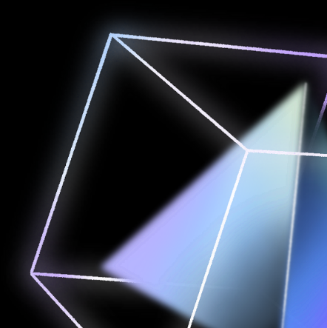

System Overview
1 Deep learning approach
Prepare Dataset
Train the model
Install on hardware platform
Use the device

Slide 7


Deep Learning
Scalability
Accuracy
Deep learning proved to be more accurate on our data than the alternatives
Features
Deep learning can detect the smallest features and extract them
The classifier is able learn and grow with more data

Slide 8

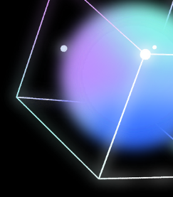

What is CNN ?
Its a deep learning approach performs more efficiently on image processing tasks.
It is built and trained from scratch with convolutional layers for feature extraction and fully connected layers for classification.
Achieves accurate results tailored to facial emotion recognition.

Slide 9

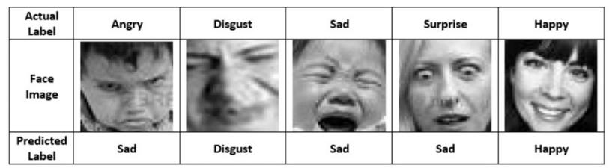
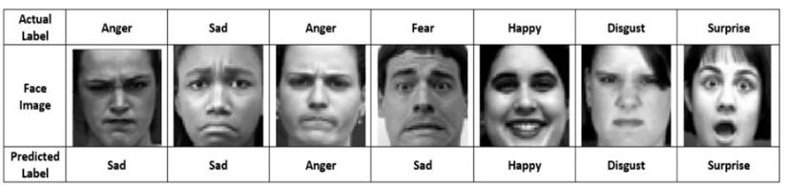

Dataset
Datasets are essential part of any recognition system.
FER2013
Samples from the EFER2013 dataset with the actual and predicted labels
CK+
Samples from the CK+ dataset with the actual and predicted labels

Slide 10
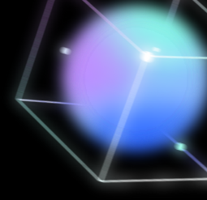
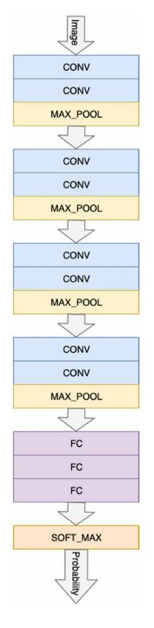

Architecture is inspired by VGGNet
Similarities to VGGNet:
Use of 3x3 Convolutional Kernels
Layer Stacking
Fully Connected Layers

Slide 11
Architecture is inspired by VGGNet
Differences from VGGNet:
Number of Filters
Number of Layers Input Shape

Slide 12

Choosing the model
Criteria:
Accuracy F1-Score
Recall Precision
VGGnet
Densenet 121

Slide 13
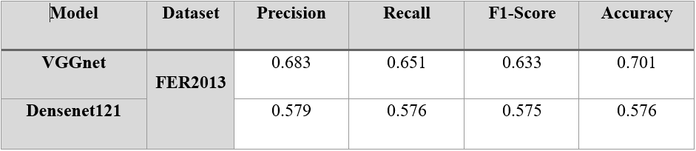
Choosing the model

Slide 14
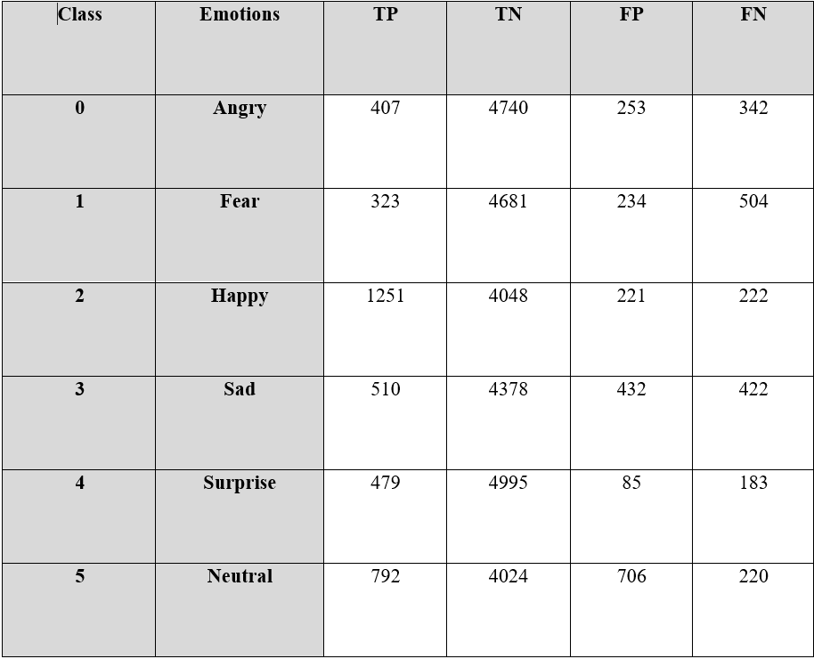
Preliminary results of “vggnet” on the FER2013 dataset

Slide 15
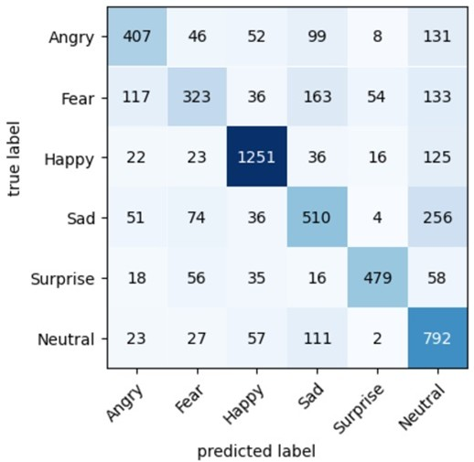
Confusion matrix of “vggnet” on the FER2013 dataset

Slide 16



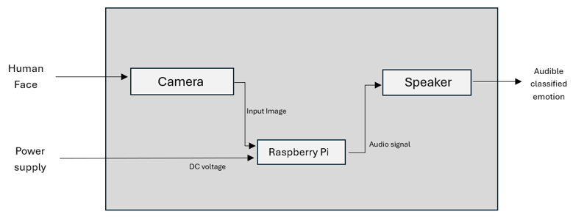

System Design Overview

Slide 17

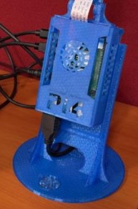
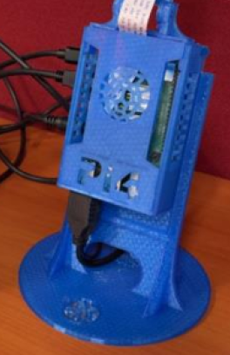
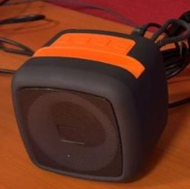
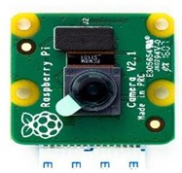
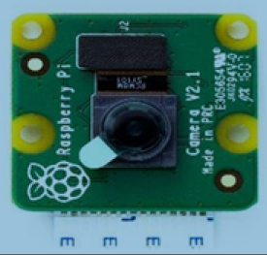
Hardware
Hardware component:
Camera v2
Raspberry pi4
Speaker

Slide 18

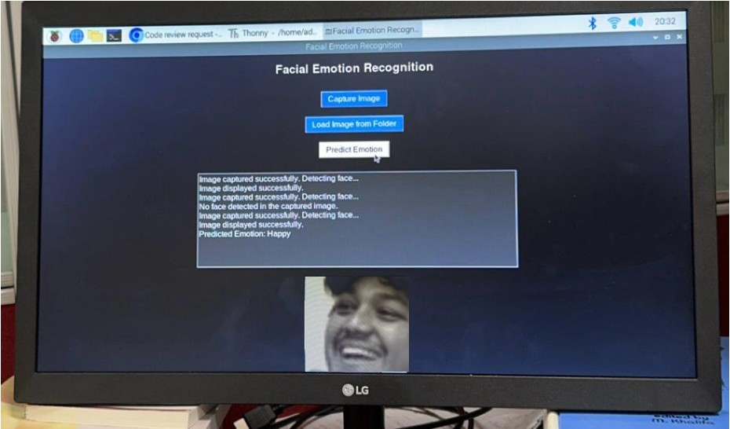
Graphical User Interface
This GUI bridges the gap between complex AI models and everyday users, enhancing the practicality of our facial emotion recognition system

Slide 19
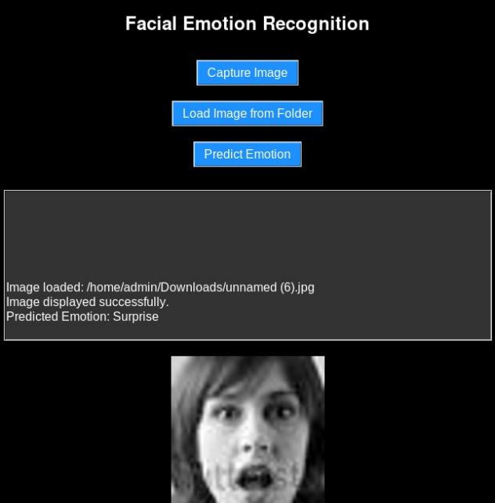
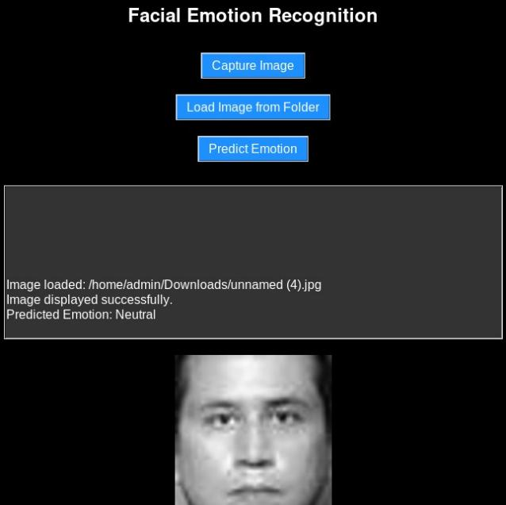
System Output Demonstration

Slide 20
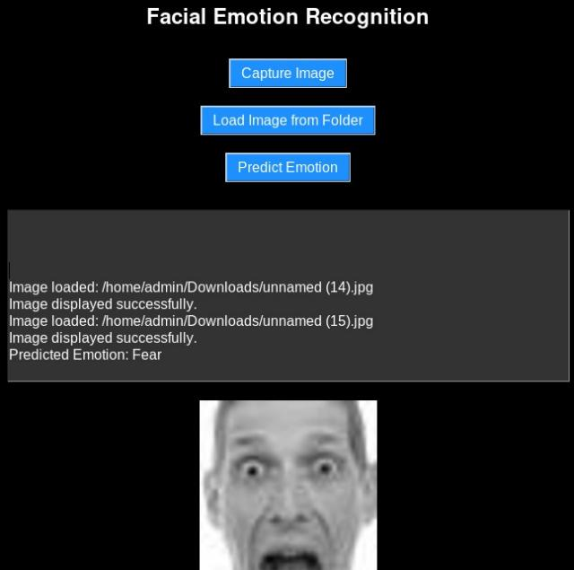
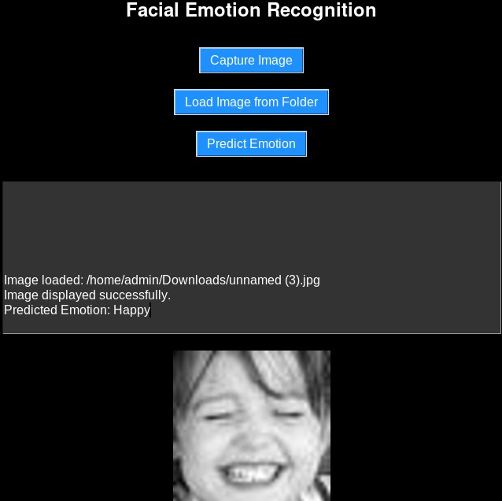
System Output Demonstration

Slide 21
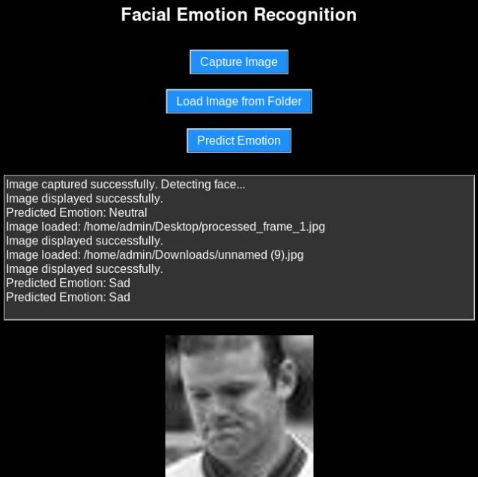
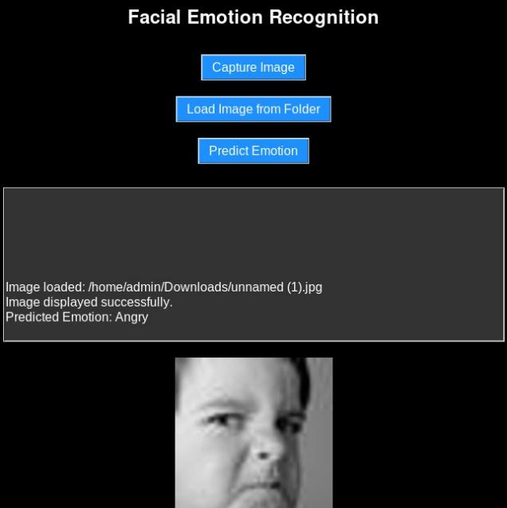
System Output Demonstration

Slide 22



Futurework
Supporting more nuanced emotional classifications.
Integrating multi-language auditory feedback for broader accessibility. Exploring hardware optimization for deployment on portable devices.
Improving model accuracy and reducing latency for real-time applications.

Slide 23
Conclusion
Our facial emotion recognition system is designed to aid visually impaired individuals in understanding emotions through real-time analysis.
Innovative techniques in deep learning and CNN architecture have been implemented to achieve high accuracy.
The system bridges the gap by providing a more inclusive way for visually impaired individuals to interact with their surroundings.

Slide 24







