Slide 1
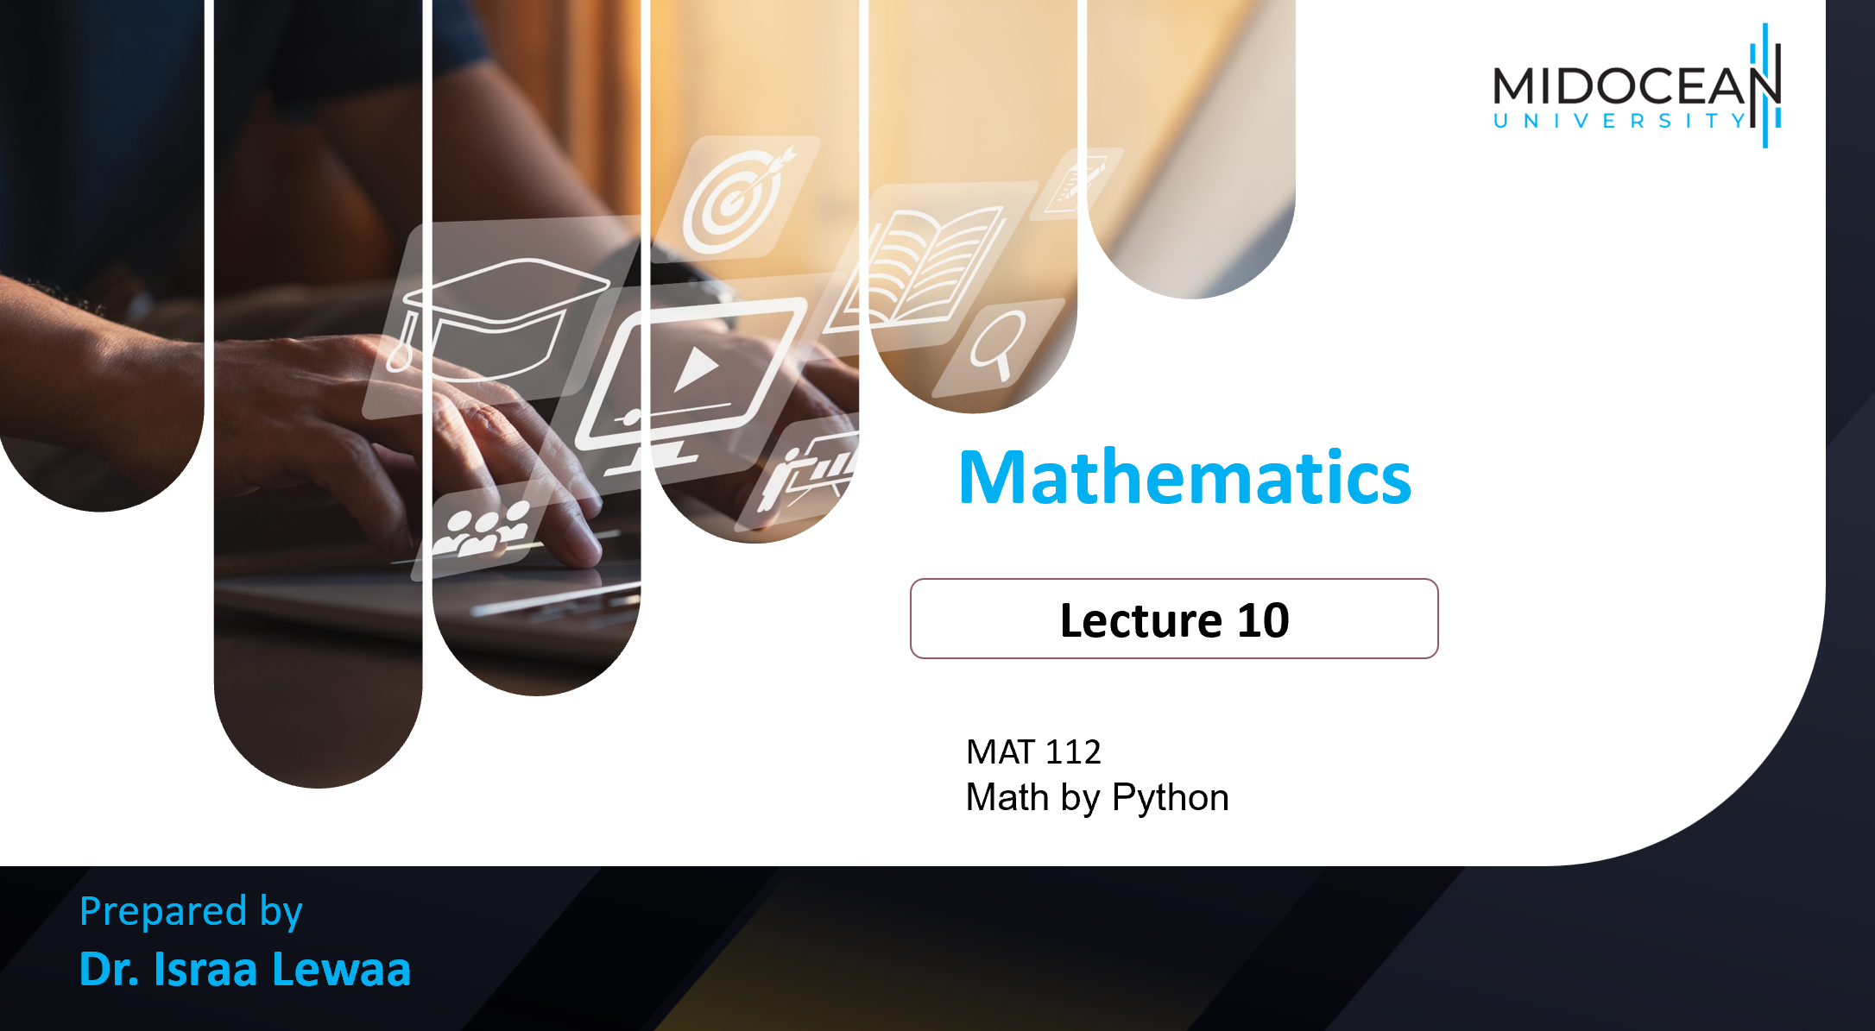
MAT 112
Math by Python

Slide 2
Lecture
10
Lecture Objectives
Study how to download python
Learn how to run different codes with Python for factorization
Learn how to run different codes with Python for graphing functions
Learn how to run different codes with Python for solving limits
Learn how to run different codes with Python for differential
Learn how to run different codes with Python for Integration

Slide 3
Lecture
10
Lecture Objectives
1- Download Python (Anaconda) – Use Jupyter Notebook.
2- Python for factorization
3- Python for graphing functions
4- Python for solving limits
5- Python for differential
6- Python for Integration

Slide 4
Lecture
10
Ways to get the program
1- Go to the technical engineer to set up the program called Anaconda.
2- Use Jupyter ONLINE.
OR
Solve all the problems manually.

Slide 5

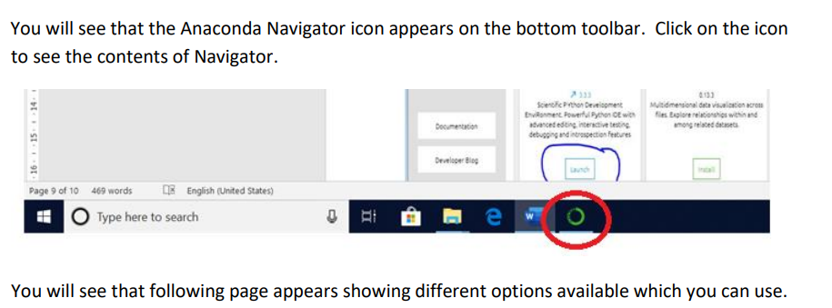
Lecture
10
How to open the program ?

Slide 6
Lecture
10
How to open the program ?

Slide 7
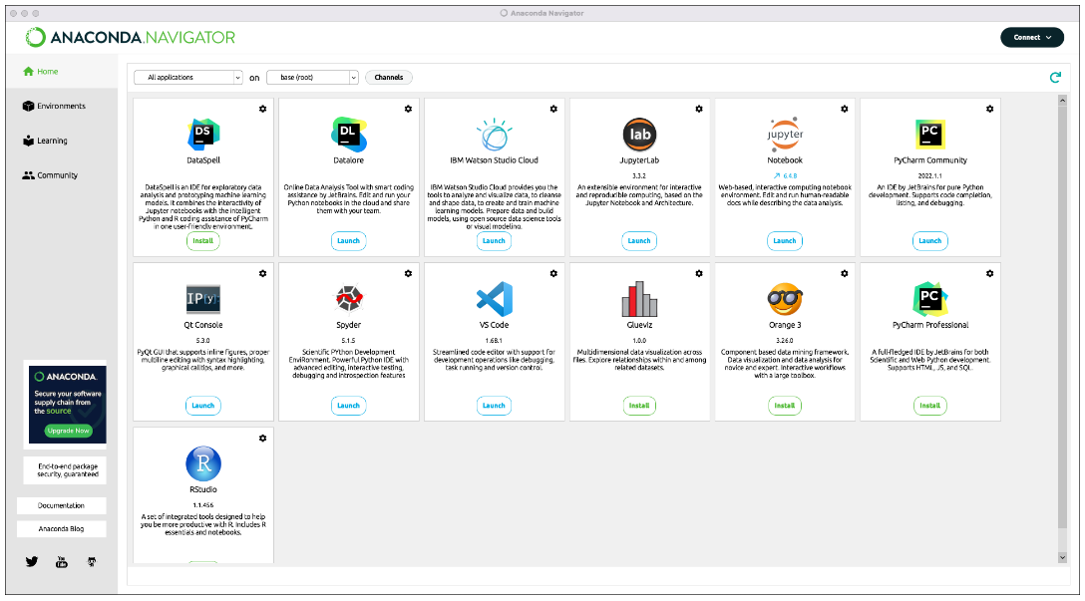
Lecture
10
How to open the program ?

Slide 8
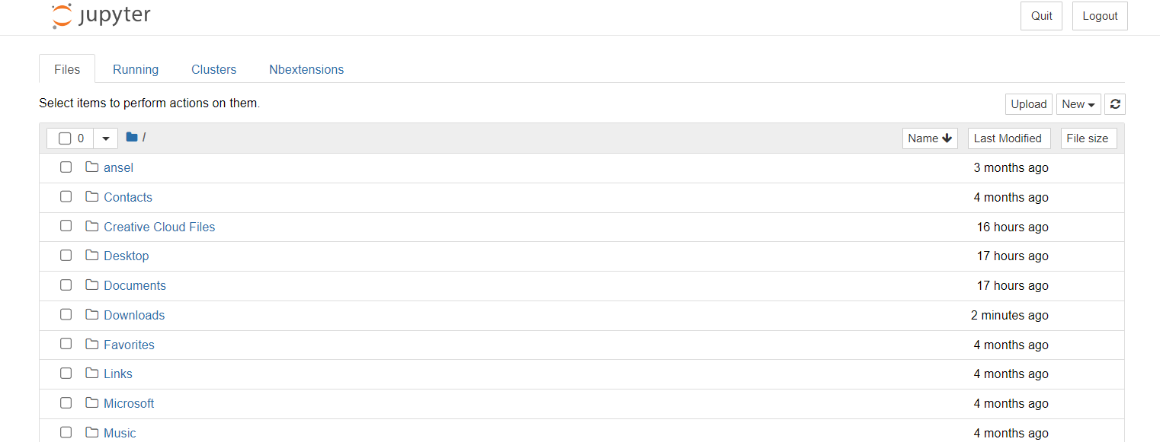
Lecture
10
Jupyter Interface

Slide 9
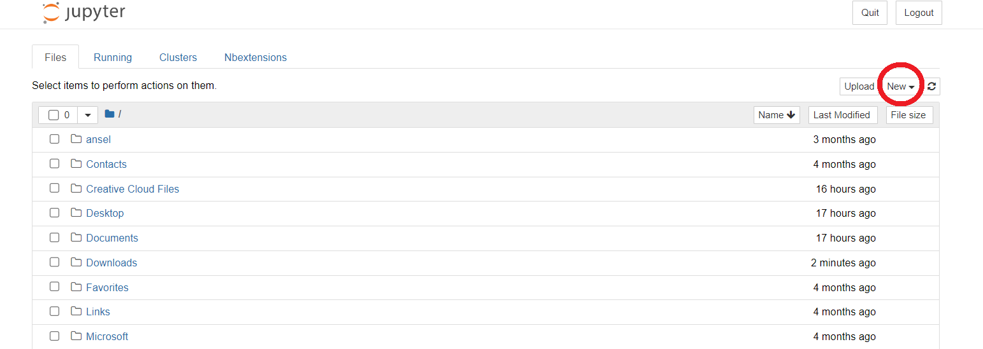
Lecture
10
Open new file in Jupyter

Slide 10
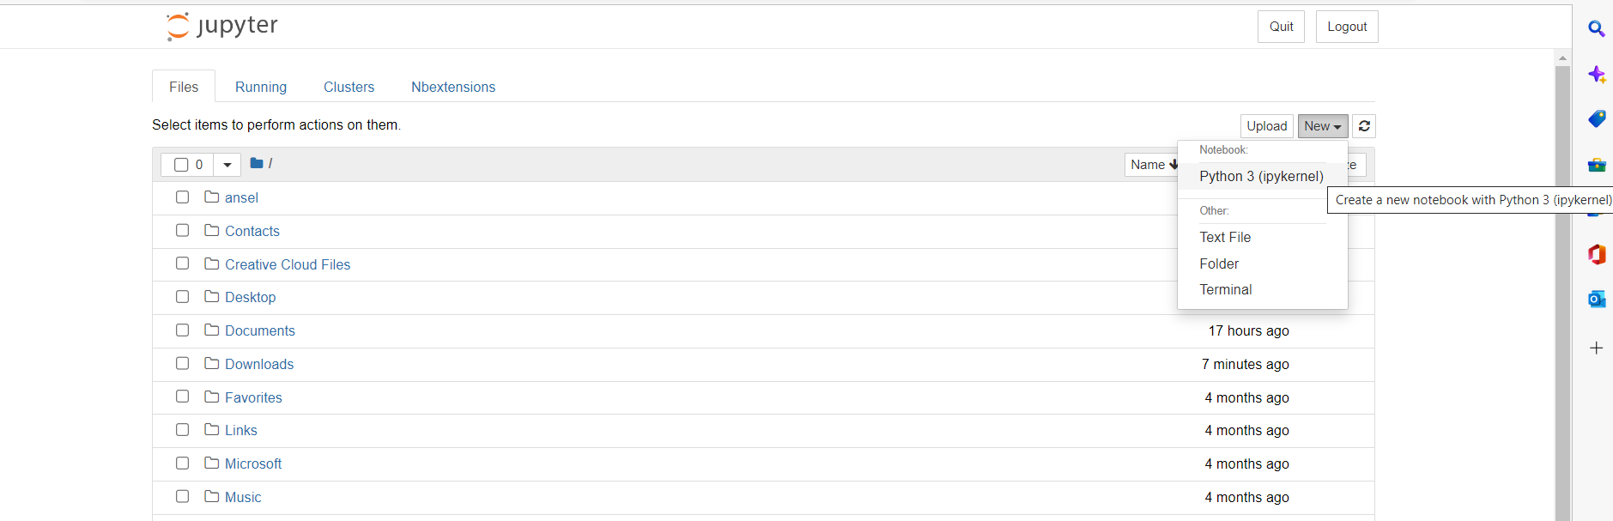
Lecture
10
Open new file in Jupyter

Slide 11
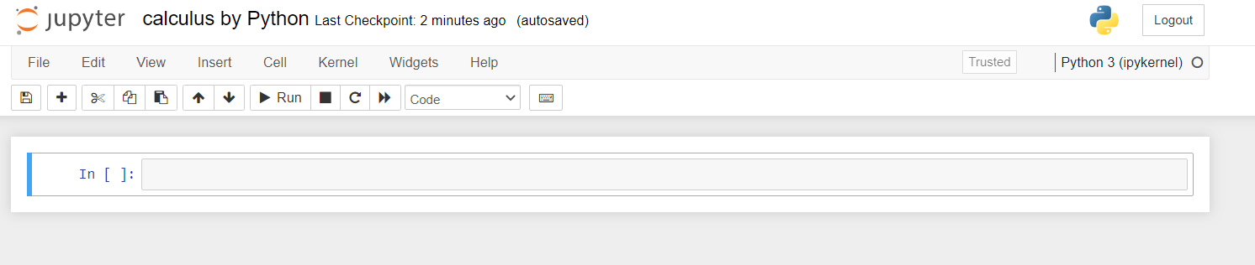
Lecture
10
New Notebook

Slide 12
Lecture
10
New Notebook

Slide 13
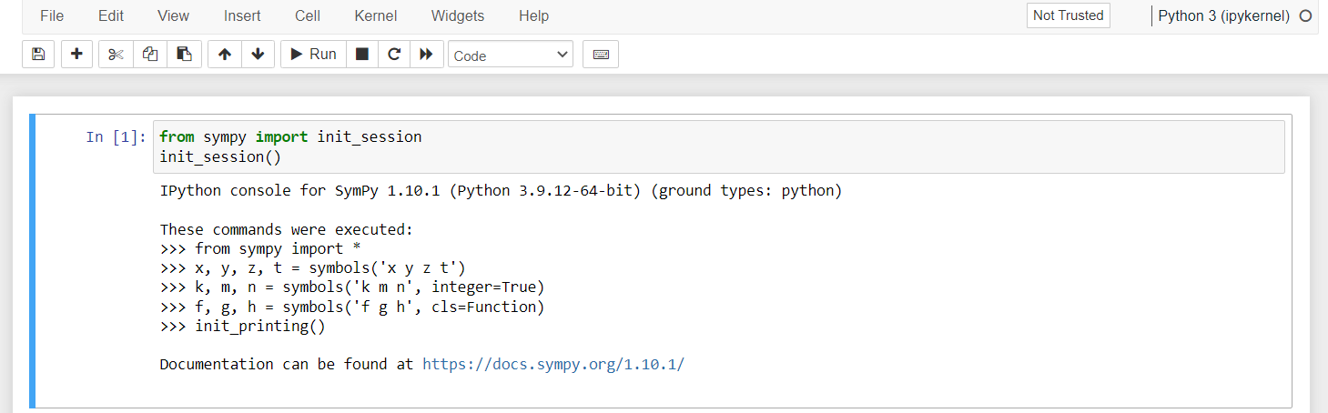
Lecture
10
Sympy Package

Slide 14
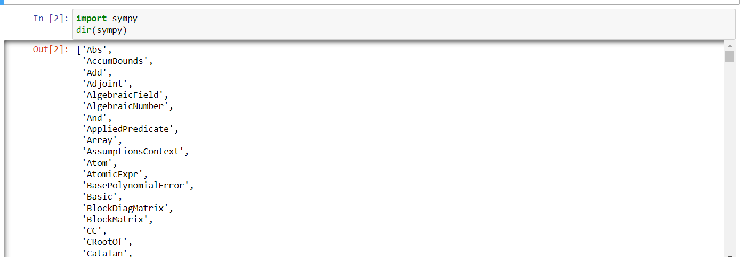
Lecture
10
Sympy Package

Slide 15
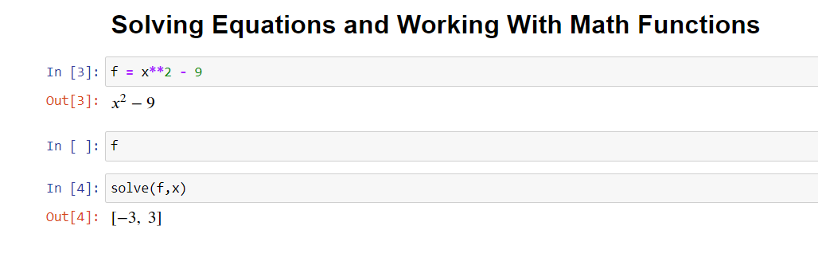
Lecture
10
Solving Equation

Slide 16
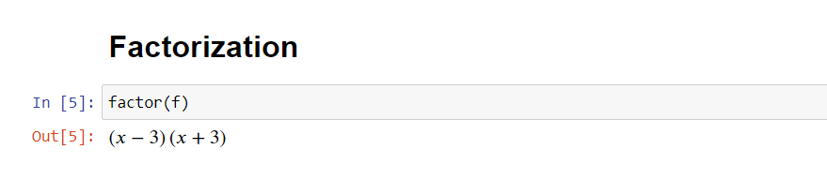
Lecture
10
Factorization by Python

Slide 17

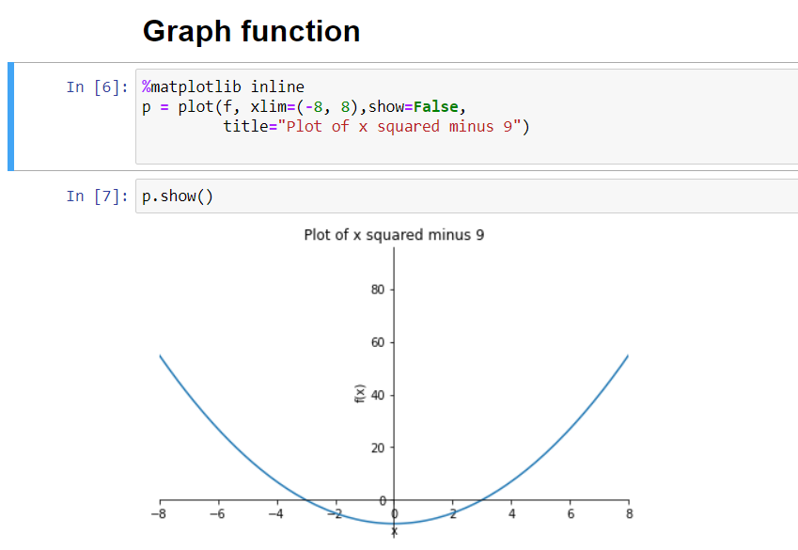
Lecture
10
Graph function

Slide 18
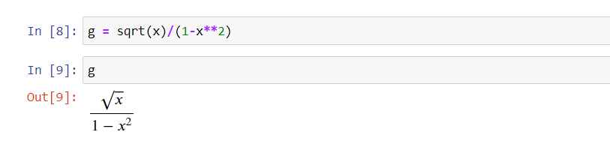
Lecture
10
Writing Root

Slide 19
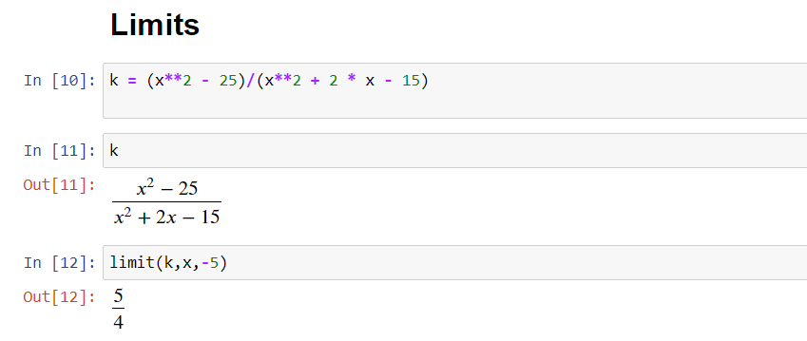
Lecture
10
Limits by Python

Slide 20
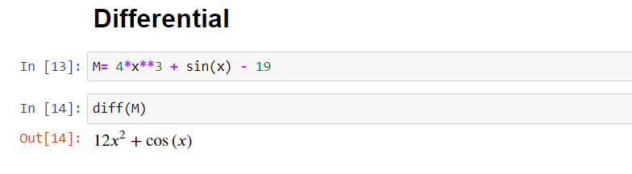
Lecture
10
Python for differential

Slide 21
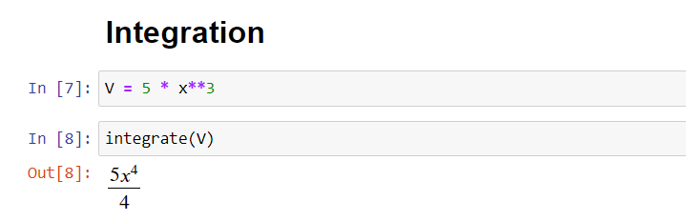
Lecture
10
Integration by Python

Slide 22
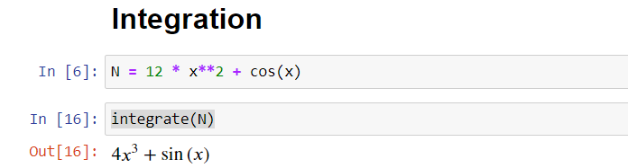
Lecture
10
Integration by Python

Slide 23

Lecture
10
Lecture Summary
1- Download Python
2- Python for factorization factor(f)
3- Python for graphing functions plot(f)
4- Python for solving limits limit(f,x,3)
5- Python for differential diff(f)
6- Python for Integration integrate(f)

Slide 24
Lecture
10
Success Tips for Math 1 Students
1️⃣ Math is not about memorizing … Math is about understanding
Every rule in differentiation or integration has a geometric and practical meaning.
Understand why we differentiate and why we integrate.
Plot the function before solving — you will understand 50% of the problem before you even start.
2️⃣ Solve problems every day, even just one
Consistency matters more than quantity.
One problem a day is better than 30 problems the night before the exam.
Remember:
Math = Practice × Practice

Slide 25
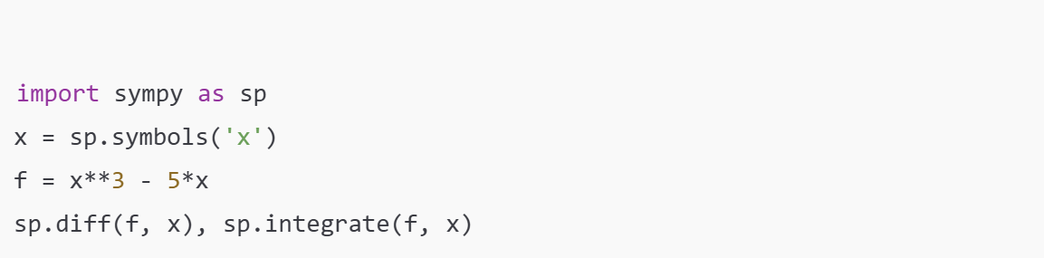
Lecture
10
Success Tips for Math 1 Students
3️⃣ Use Python to Understand, Not Just to Solve
Make Python your learning assistant.
Use simple libraries like:
numpy, matplotlib, sympy.
Visualize functions, derivatives, and integrals — seeing the graph will help you understand much faster than reading the formula.
Example:

Slide 26
Lecture
10
Success Tips for Math 1 Students
4️⃣ Create a One-Page Summary After Each Lecture
Keep it short and useful.
Include:
Key formulas
Important examples
Common mistakes
Two practice questions
Your summary sheet will save you half the study time at the end of the semester.
5️⃣ Never Hesitate to Ask Questions
Most students get stuck in Chapter 2 or 3 simply because they don’t ask.
There is no such thing as a silly question — the real mistake is continuing without understanding.

