Slide 1

Mathematics
Prepared by Dr. Israa Lewaa
Lecture 6
MAT 122
Determinants

Slide 2

Lecture
06
Lecture Outline
Definition of the determinants
Determinant for 2*2 matrix
Determinant for 3*3 matrix – First Way
Determinant for 3*3 matrix – Second Way

Slide 3
Lecture
06
Definition of the determinants
Definition
The determinant of a 2 × 2 matrix A is denoted |A| and is given by
Observe that the determinant of a 2 × 2 matrix is given by the different of the products of the two diagonals of the matrix.
The notation det(A) is also used for the determinant of A.

Slide 4
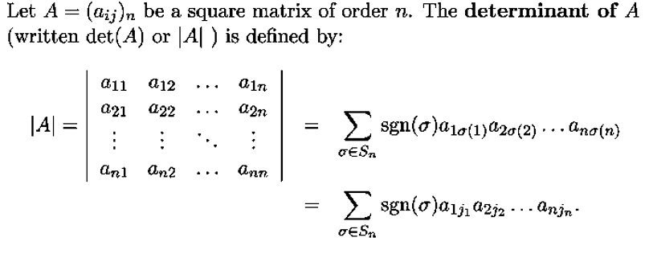
Lecture
06
Determinant

Slide 5
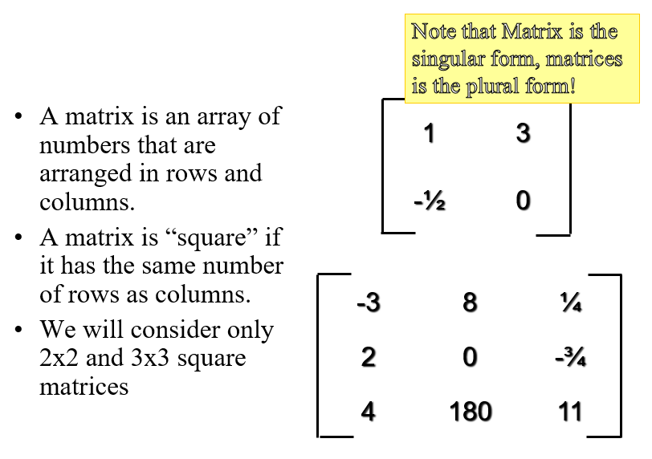
Lecture
06
Matrices

Slide 6
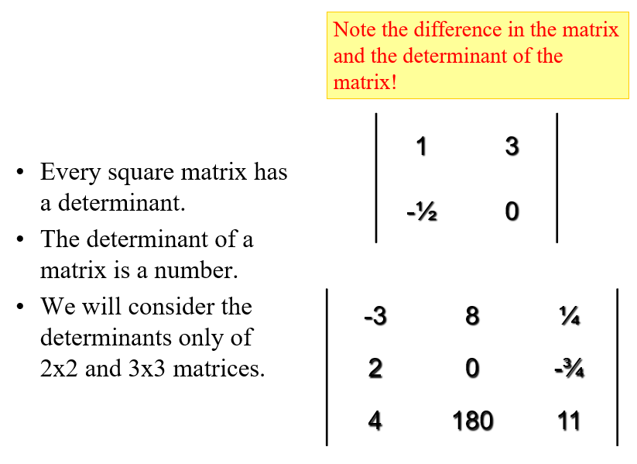
Lecture
06
Determinant

Slide 7
Lecture
06
Determinants of 2*2 Matrix
Determinants of 2*2 Matrix

Slide 8
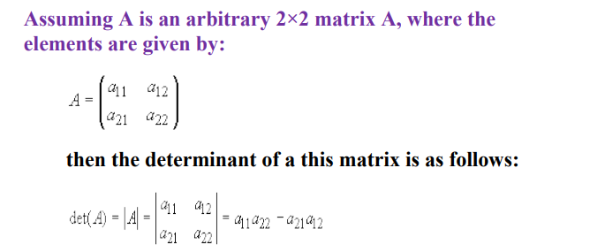
Lecture
06
Determinants of 2*2 Matrix

Slide 9
Lecture
06
Determinants of 2*2 Matrix

Slide 10
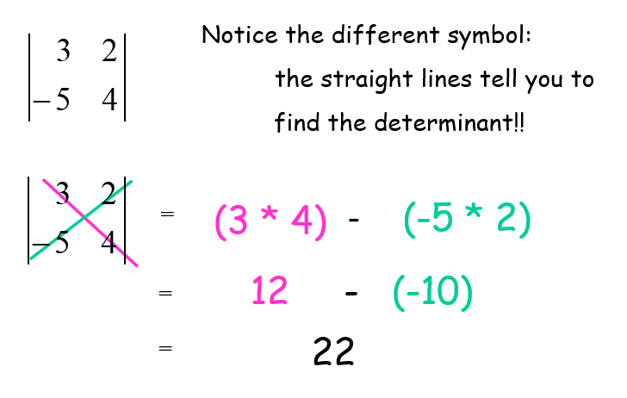
Lecture
06
Determinants of 2*2 Matrix

Slide 11
Lecture
06
Determinants of 3*3 Matrix – First Way
Determinants of 3*3 Matrix – First Way

Slide 12
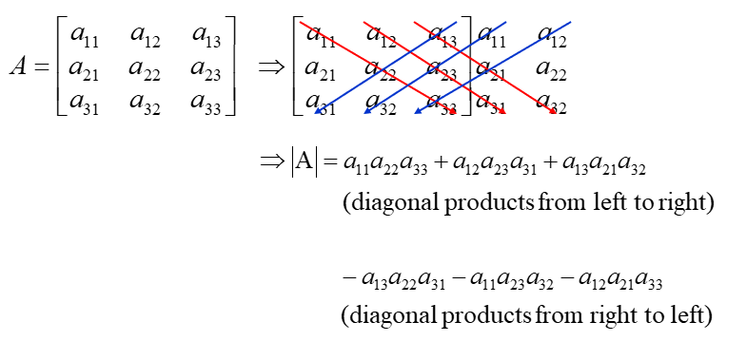
Lecture
06
Determinants of 3*3 Matrix – First Way

Slide 13
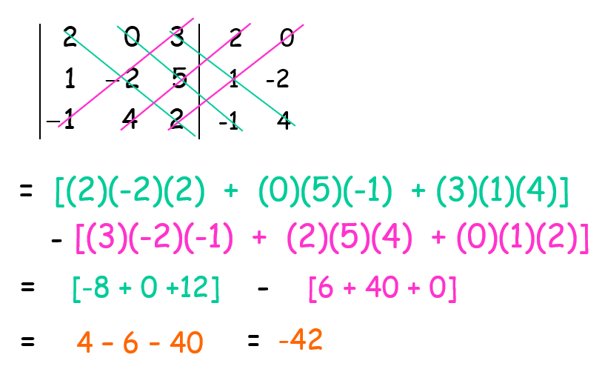
Lecture
06
Determinants of 3*3 Matrix – First way

Slide 14
Lecture
06
Determinants of 3*3 Matrix – Second Way
Determinants of 3*3 Matrix – Second Way

Slide 15
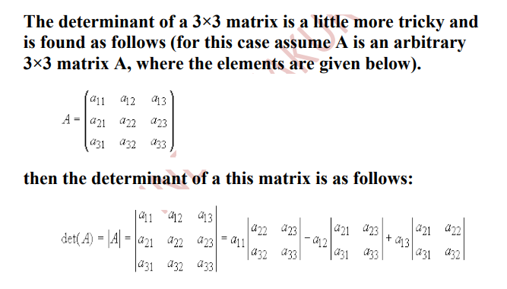
Lecture
06
Determinants of 3*3 Matrix – Second Way

Slide 16
Lecture
06
Determinants of 3*3 Matrix – Second Way

Slide 17
Lecture
06
Determinants of 3*3 Matrix – Second Way

Slide 18
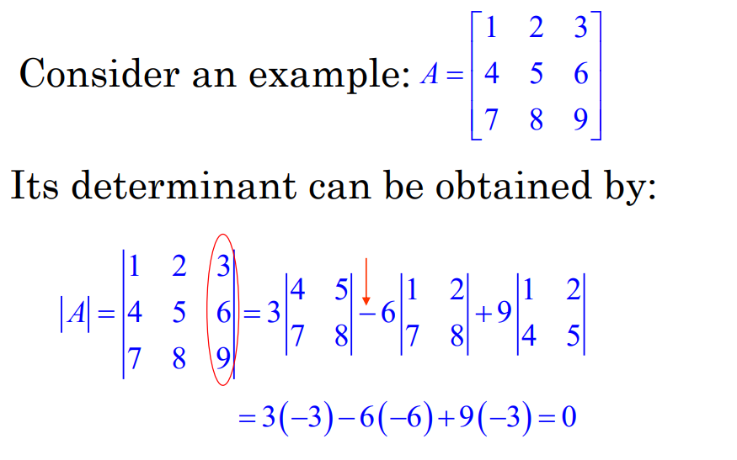
Lecture
06
Determinants of 3*3 Matrix – Second way

Slide 19
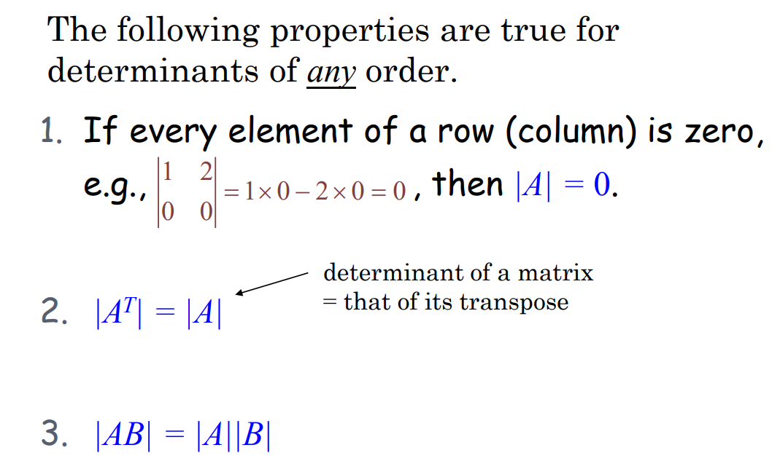
Lecture
06
Properties of Determinants

Slide 20
Lecture
06
Let’s Practice
Let’s Practice

Slide 21

Lecture
06
Example 1
Find the determinants for the following matrix

Slide 22
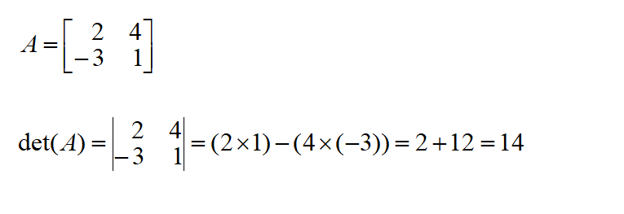
Lecture
06
Solution

Slide 23
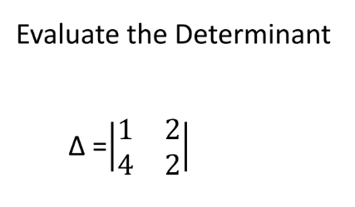
Lecture
06
Example

Slide 24
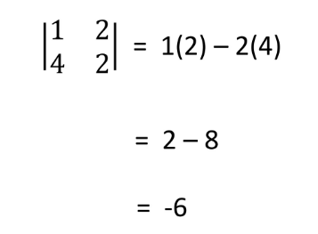
Lecture
06
Solution

Slide 25
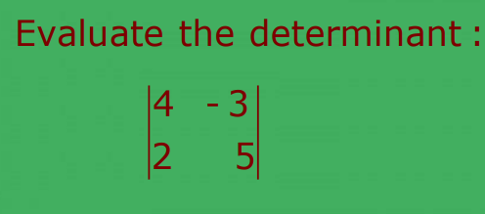
Lecture
06
Example

Slide 26
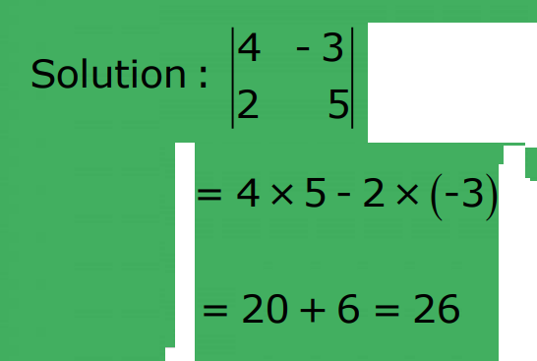
Lecture
06
Example

Slide 27
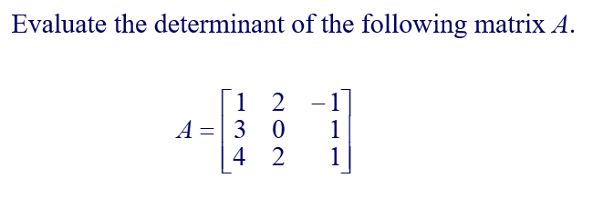
Lecture
06
Example

Slide 28
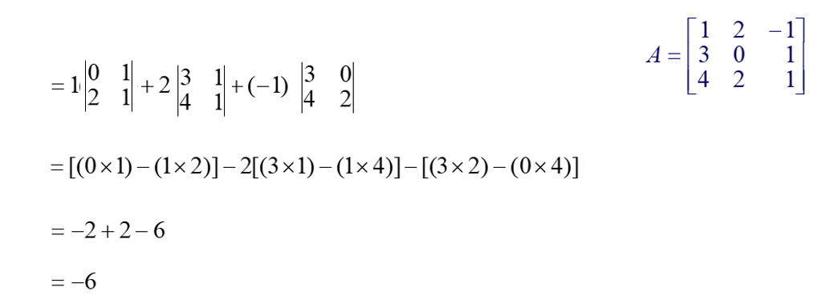
Lecture
06
Extra Practice -- Example

Slide 29
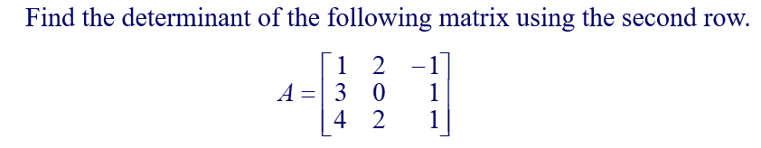
Lecture
06
Extra Practice -- Example

Slide 30
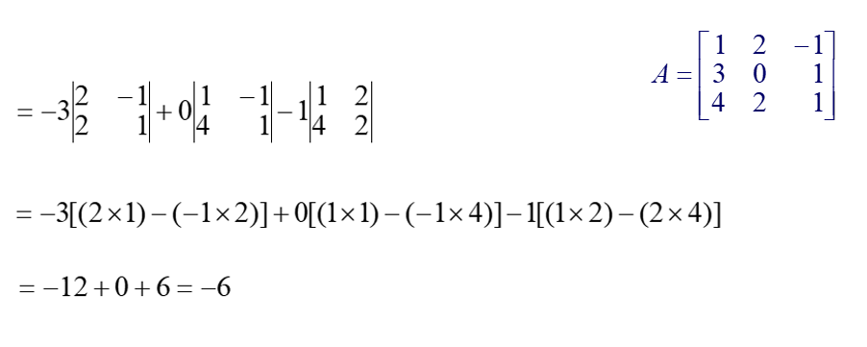
Lecture
06
Example

Slide 31
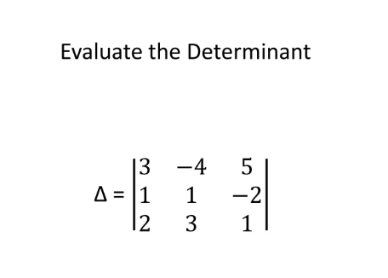
Lecture
06
Example

Slide 32
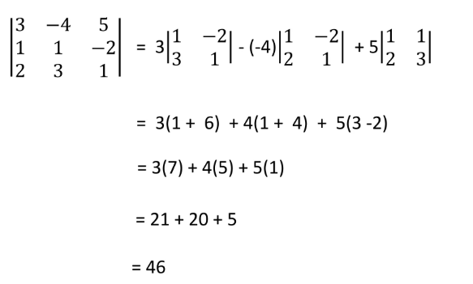
Lecture
06
Example

Slide 33
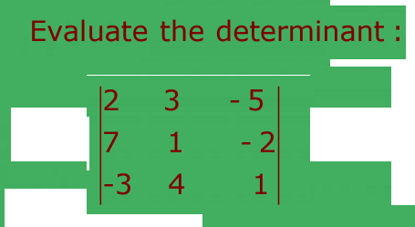
Lecture
06
Example

Slide 34
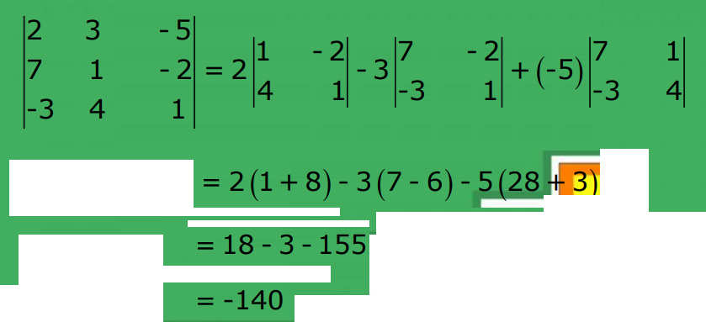
Lecture
06
Solution

Slide 35
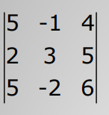
Lecture
06
Example
Evaluate the following determinant

Slide 36
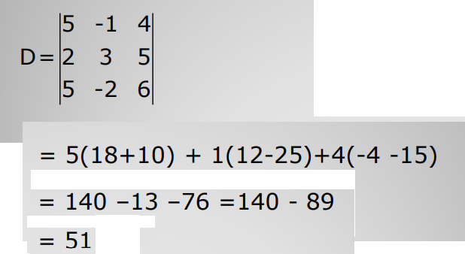
Lecture
06
Solution

Slide 37
Lecture
06
Lecture Summary
Definition of the determinants
Determinant for 2*2 matrix
Determinant for 3*3 matrix – First Way
Determinant for 3*3 matrix – Second Way

