Slide 1


Prepared by Dr. Mahitab ELrafii
Social Media Management (DGM721
Lecture 2

Slide 2



Social Media Management (DGM721
Lecture 2
Prepared by
Dr. Mahitab ELrafii

Slide 3

Chapter
Lecture Content
2
the social media strategies

Slide 4
The Content of lecture 2 Includes the following:
What are the social media strategies?
How To Create A Social Media Strategy.
What are the benefits of having a social media strategy?
Social media marketing strategy vs. social media content strategy
What is a social media engagement strategy?
What makes a good social media post?
Good ROI (Return On Investment)
Improved) SEO(
Using artificial intelligence to develop social media strategies

Slide 5

Chapter
2
What are the social media strategies?
A social media strategy:: is an outline of the content that your business will post, the responsibilities of your social media team, and the social media channels you will use to promote your business. A social media strategy includes social media goals that complement your business' overall digital marketing strategy.

Slide 6
A social media content strategy is like a map and a guidebook rolled into one.
It’s an essential document that tells you how to get from point A to point B to ensure a return on investment (ROI) from social media.
It tells you where to post, what to post, and how often to post to meet your goals. It gives you direction, as well as a way to reach your destination.

Slide 7
Chapter
2
Determining a Social Media Strategy:
Strategy setting is crucial in any organization. This is true for organizations that apply social media as well as those that design social media tools (i.e., either as the core activity in a software development company, e.g., for Facebook™, or as a supporting corporate platform, e.g., for Lego™or Dell™brand communities.

Slide 8
How To Create A Social Media Strategy
Identify Your Audience::
The very first thing you need to do is determine who you are targeting on social media. This will help you create content that will interest and engage them.
Consider not just their wants, needs, and challenges but who they are. find it helpful to create customer personas, which are representations of the major subsets of your audience.

Slide 9
Group your customers into four or fewer clusters and identify general similarities in each. Be sure to include things like:
Interests :: What type of content would interest them?
Demographics :: age, gender, job title, salary, location, etc.
Their goals in relation to your content:: Are they looking for a new job? To improve their fitness? To learn a skill?
The platform of choice :: Facebook, TikTok, LinkedIn, etc.
Preferred format :: Are they more likely to watch videos or read text posts?

Slide 10
2. Set Specific, Measurable Goals::
To track your effectiveness and get the best return on investment, you first need to decide what you want to accomplish through your presence on social media. This can be a single goal, or you can have multiple objectives.
Whatever you choose, it must meet three criteria:
1. Be achievable.
2. Be measurable.
3. Be relevant to your brand.

Slide 11
3. Check Out The Competition ::
There’s a good chance some of your competitors also use social media as a marketing strategy.
Do a deep dive into their profiles and content. This will help you get a feel for the kind of content your audience likes – as well as the ones that don’t interest them.
Look at which platforms get the best results, and which are underserved. Is this because your targets prefer one app to another, or are your rivals missing an opportunity?
But don’t just look once and move on. This should be an ongoing process and part of your social listening process.

Slide 12
4. Decide Which Platforms You’ll Use:
By this point, you should know which social apps your target audience is using. Those are obviously the ones you should focus on.
You don’t have to be on every platform. Did you get that? You do not need to have a social presence on every platform. Some of them will not be used by your target, so if you’re targeting retirees on TikTok, you’re likely wasting your time.
With that said, most brands find it beneficial to have a presence on the “big four” – Facebook, Twitter, Instagram, and LinkedIn.
Understand the strengths and weaknesses of each platform and how they work into your strategy.

Slide 13
5. Optimize Your Profile::
Now that you know where you’ll post content, it’s time to set up or optimize your profile. Because this is the face your show the cyber world, it’s important that you include all the information your audience needs right up front.
Make sure you include your business name, contact details, and anything else visitors could want to know

Slide 14
Using a keyword research tool, determine which words and phrases your customers use in search and include them in your profile.
Next, make sure you’re using consistent branding, with hi-res images that won’t look skewed as thumbnails.
Your goal is to make your brand instantly recognizable across all touchpoints.
This is also a good point at which to look through any content you have previously posted and get rid of those that aren’t on-brand.

Slide 15
6. Plan Your Content::
Your content will depend on many factors, including what you’re promoting and your audience’s preferences.
You also want to ensure everything works towards one of the goals you outlined in step 2.
Depending on the platform(s) you’re using, your content could include memes, educational videos, links to blog posts, or anything else your audience will find useful.
You should include informative and entertaining content, as well as things that are directly promoting your brand. This will usually generate better engagement and sharing than strictly sales pieces.

Slide 16
7. Create A Social Media Content Calendar::
The next thing you should do is make a content calendar that clearly outlines when you’ll be posting and where you’ll be posting it.
Your goal is to catch the attention of the biggest audience and generate maximum engagement. This will vary, depending on several factors, including your business, your audience, and the time of year.

Slide 17
However, you should ensure that you’re regularly posting content. Try to find the sweet spot between posting too much (and annoying your audience) and posting too little (and being unimportant).
Don’t worry if you can’t figure this out exactly right now. It may take some experimentation on your part.
And speaking of things that will require some testing, your content calendar should include not just the date on which you will post things but what time of day you will post them.
Every brand has an optimal post time at which it will be seen by the greatest number of targets. There may be one time per week or several per day – it all depends on your audience.

Slide 18
8. Track Your Performance::
Once you start pushing posts live, you’ll start to gather information about what’s working and start to identify trends
The best and easiest way to monitor this is by looking at your metrics. Most social media platforms offer some form of analytics for commercial users, in which you can view statistics on reach, impressions, and response rates.

Slide 19
The ones that matter to you will depend on your goals.
For example, if you’re tracking the number of web visitors who sign up for your newsletter, you’ll want to measure the click-through rate, conversion rate, and bounce rate. If you’re using paid ads, you’ll want to keep an eye on your cost-per-click. If your goal is to increase engagement, you’ll want to track likes, comments, and reshares.
Look for commonalities among your most successful and least successful posts. This will give you insight into the type of social media content you should post

Slide 20
9. Tweak And Rework Your Strategy::
Social media management isn’t the type of thing that pays instant dividends. It requires some time to understand what works and what your targets are like.
And once you feel confident your content is on-target, on-brand, and generating results, your social media strategy will still require regular adjustments based on changing preferences, trends, and audience needs.

Slide 21
You will need to regularly revisit your plan and rethink it. As your business evolves, your social media presence should evolve with it. You may want to branch out onto new platforms, add paid advertisements to the mix or change how frequently you post.
The goal is to keep looking for new ways to maximize the impact of your presence on social platforms. And while that’s a job that is never done, over time, you’ll gain a feel for what you’re doing that will help you generate more consistent results.

Slide 22
10) Manage and engage your community::
The great thing about social media is that it builds connections, and these connections can become communities. Communities are wonderful things as they build engagement and drive brand awareness.
An active community is an amazing thing as it can create brand advocates and draw in new customers. But a community needs nurturing, so you need to take time to build it and then grow it.

Slide 23
A key element to managing and engaging a social media community is to be responsive. If a customer has a query or comment, get back quickly and be helpful. As social media becomes more popular as a way for customers to reach out, inevitably there will be complaints. Make sure to respond positively and find out how you can make their experience more positive to avoid a social media crisis.
Engage your community by asking questions through polls or surveys. It makes them feel a part of the community, but also may help you find out more about your customer base.

Slide 24
What are the benefits of having a social media strategy?
You may have implemented a successful social media campaign or been heavily involved in posted content. This one-time success is achievable. However, the hard part of managing via social media is consistency. Do you understand why that campaign or post succeeded? Can you repeat it easily?

Slide 25
Thinking of creating a social media strategy can be daunting, but it will provide your company with many tangible benefits, such as::
A direction for all your social media activities
Improve brand awareness
Offer social customer service and support
Enhance targeting across audiences
Direct and increase website traffic
Personalize content

Slide 26
Generate better quality leads.
Create social media influencer opportunities .
Promote your unique content that could go viral (remember the ALS ice bucket challenge?)
Offer social commerce and shoppable posts.
Data you can analyze and measure.
As you can see there are huge benefits to social media, so creating a strategy will serve to achieve your business goals and drive customer engagement.

Slide 27
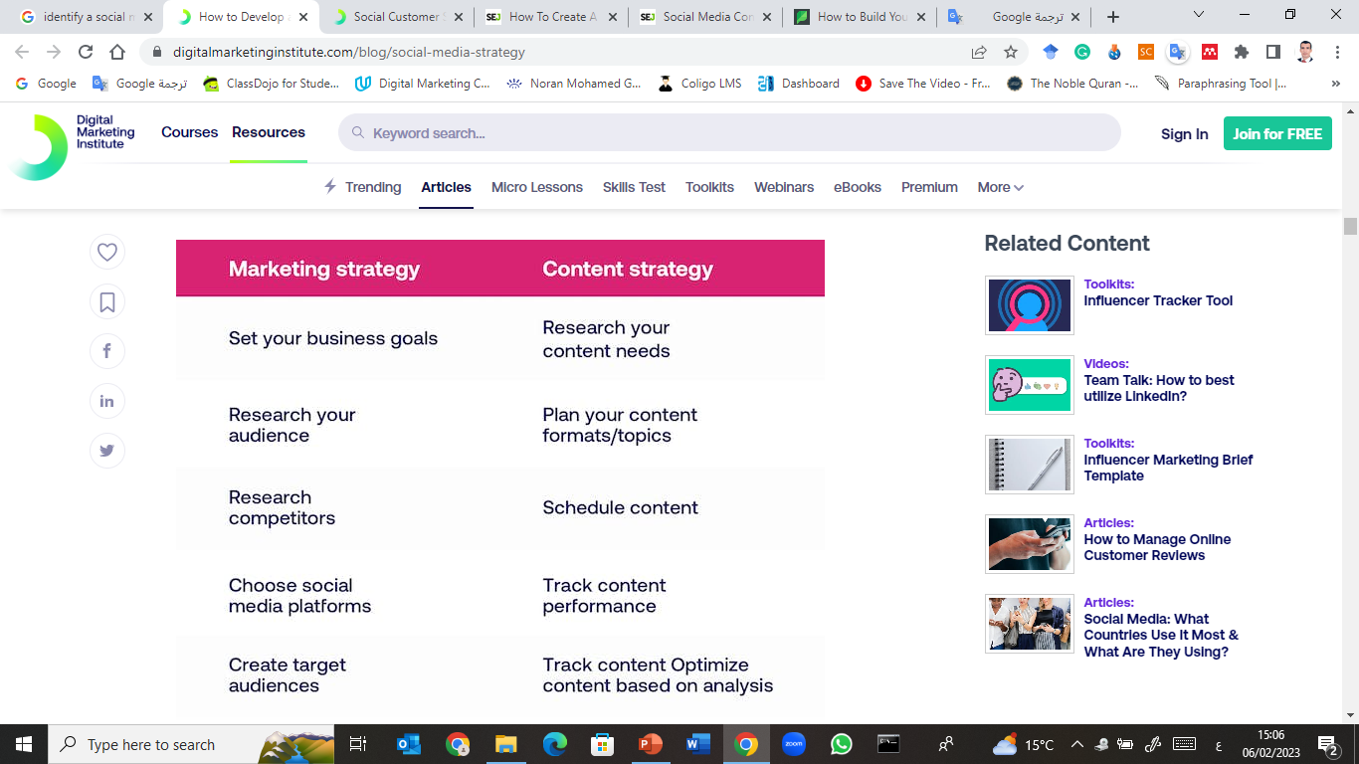
Social media marketing strategy vs. social media content strategy

Slide 28
While content marketing and social media marketing are closely linked, there’s a difference between them.
A marketing strategy is the place to start if you want to direct and enhance your social media activities. It involves some key elements such as audience research, persona building, choosing the social media platform, and much more.
A content strategy focuses on the content formats and outputs. So, it should look at the creation of content, messaging and tone, content scheduling, etc.

Slide 29
What is a social media engagement strategy?
Your social media engagement strategy is important as it creates connections with your audience across networks. It helps you to manage your community through social media channels and build your brand.

Slide 30
The two core purposes of an engagement strategy are to:
Manage your community: this can be done by offering advice through a blog, responding to comments in posts, replying to queries on channels, and reaching out with polls or surveys to find out more about your customer base.

Slide 31
Grow your following: interaction is important here, so offer content that is valuable such as engaging video content, engage prospects with free content or competition offers or simply demonstrate your brand as active and useful by being responsive on your networks to draw people in
User-generated content (UGC) can play a key role here as it’s evidence of the people that support your brand talking about it, rather than it coming from your business or marketing team. Here are four great UGC examples you can take inspiration from

Slide 32
What makes a good social media post?
It’s easy to create posts, but taking the time to create good content will be worth the effort in terms of reach and engagement. So, how do you ensure you create good posts?
Monitor content performance::it’s important to analyze your content to see what does and doesn’t work.
Optimize your content:: Tweak your content to optimize its performance .

Slide 33
Think about new angles for your content:: Would humor work or what about video testimonials from previous customers? Don’t stick to the same message and format all the time, try new things.
A/B test content:: Try different versions of content on platforms to see what works better. Is there a keyword that resonates better, or do different colors get better engagement?
Track your KPIs:: Refer back to your KPIs to make sure you’re on track with your content.

Slide 34
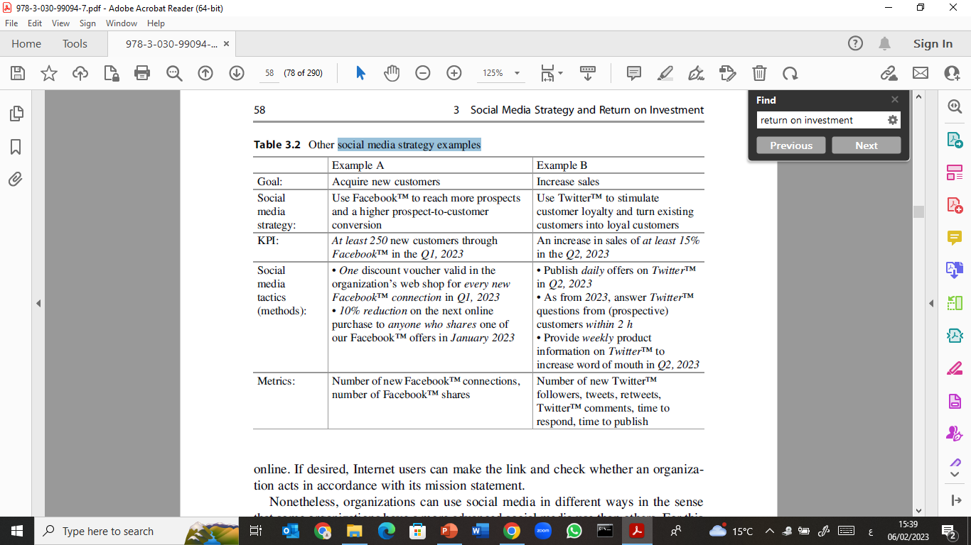
social media strategy examples

Slide 35
Engagement
Engagement:
Unlike traditional forms of marketing, social media allows you to speak with your audience, not at them. You can generate conversations around your brand and what’s important to your customers in a give-and-take format.
It allows you to tell your story while maintaining the narrative in a responsive and authentic manner – something you just won’t find in other types of marketing.

Slide 36
Increased Brand Awareness
There are more than 4 billion social media users worldwide. This means you could theoretically reach more than half of the global population.
Obviously, it’s unlikely that your Dayton, Ohio-based accounting company’s Facebook page will attract new customers from Hyderabad, India, but it is likely to help build your local awareness.

Slide 37
Good ROI (Return On Investment):
One of the biggest advantages of social media marketing is that it allows you to build an audience without a big budget.
Creating a business profile is free on most platforms, and while you can use things like paid advertising, it’s not essential.
Instead, you can build an audience and expand your reach simply by consistently posting content your targets will find valuable.

Slide 38
Improved) SEO(
Social platforms can also help your search engine optimization efforts.
While there’s no direct correlation between your search engine ranking and social media, in that your ranking is not directly affected by what you post on YouTube or Instagram, there is a connection.

Slide 39
For one, social media allows you to boost your content. This leads to more traffic and more engagement, which are positive user signals.
It also gives you more opportunities for generating backlinks, not to mention that your profile could rank in its own right for search terms.

Slide 40
Better Customer Service:
From troubleshooting an issue to providing tips and tricks, social media gives customers an easy way to reach out to you.
It can be an effective way to turn a negative experience into a positive one while allowing you to keep your finger on the pulse of patterns in buying, use and potential issues.

Slide 41
Using artificial intelligence to develop social media strategies:
Artificial intelligence is used to analyze massive databases that include user behavior, interaction patterns, interests, and even the sentiment associated with posts.
With the help of machine learning algorithms, detailed models of audience segments are built.
Applications:
• Hyper-targeting.
• Creating personalized content based on user preferences.

Slide 42
Predicting content trends:
Artificial intelligence systems rely on time-series analysis to predict trending topics on social media platforms.
Using deep learning models such as LSTM, future trends can be predicted based on past patterns.
Applications:
• Pre-planning marketing campaigns.
• Avoiding the production of content that is not appropriate for the timing of publication.

Slide 43
Smart scheduling using algorithmic optimization
AI tools rely on optimization algorithms to determine the best time to post by analyzing past engagement data and linking it to time factors.
Applications:
• Automatic scheduling of content for peak times.
• Improving organic reach.

Slide 44
Automatic performance evaluation
AI uses predictive analytics to directly evaluate strategy outcomes and link them to key performance indicators (KPIs) such as engagement, reach, and click-through rate.
Applications:
• Real-time decision-making.
• Dynamic strategy recalibration.

Slide 45
Campaign management using artificial intelligence
AI enables automated A/B testing, paid advertising management, and budget allocation based on actual campaign performance without direct human intervention.
Applications:
• Cost per acquisition (CPA) optimization.
• Increase advertising effectiveness by personalizing content and audiences in real time.

Slide 46



Thank You

