Slide 1

MGM 112
Introduction to Economics
Prepared by Dr. Maryem ZORGUI
Chapter 6
Business Economics and Quantitative Technique

Slide 2
Syllabus
I- The Production Function in Short and Long Run
III- Law of returns to scale
=
long run production function.
II-Law of variable proportion
=
short run production function.

Slide 3
I- The Production Function in Short and Long Run
I- The Production Function in Short and Long Run
I-1- The Production Function
I-2- PRODUCTION WITH ONE VARIABLE INPUT (LABOUR)
I-3- PRODUCTION WITH 2 VARIABLE INPUTS (LABOUR and CAPITAL)

Slide 4
I- The Production Function in Short and Long Run
I-1- The Production Function
Production functions describe what is technically feasible when the firm operates efficiently.
Production function shows the highest output that a firm can produce for every specified combination of inputs.
The Production Function
q= F (K,L)

Slide 5
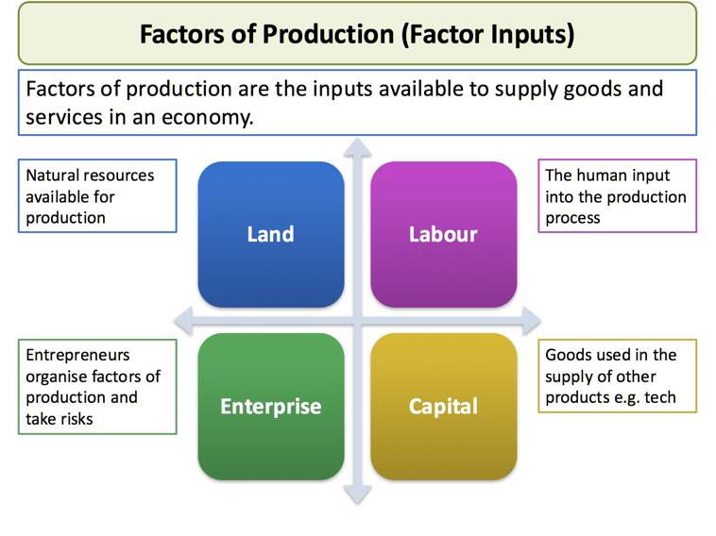
I- The Production Function in Short and Long Run

Slide 6
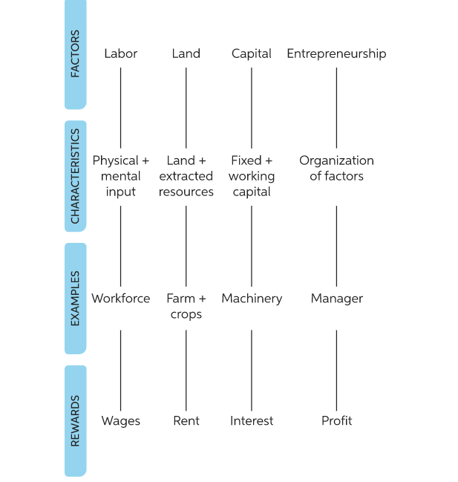
I- The Production Function in Short and Long Run

Slide 7
I- The Production Function in Short and Long Run
(LABOR)
A- The Production Decisions of a Firm
The production decisions of firms are analogous to the purchasing decisions of consumers, and can likewise be understood in three steps:
1. Production Technology
2. Cost Constraints
3. Input Choices

Slide 8
I- PRODUCTION WITH ONE VARIABLE INPUT (LABOUR)
B- The Short Run versus the Long Run
● short run Period of time in which quantities of one or more production factors cannot be changed.
● fixed input Production factor that cannot be varied.
● long run Amount of time needed to make all production inputs variable

Slide 9
I- PRODUCTION WITH ONE VARIABLE INPUT (LABOUR)
I-2- PRODUCTION WITH ONE VARIABLE INPUT (LABOUR)
1- A producer may affect changes in his production by changing only the variable factor, other factors and technology remaining constant.
2- The proportional relationship between production and variable factors of production is termed as return to factor.
Initially, production with one variable input (labour) follows the law of increasing returns.
According to this law, output would increase at an increasing rate as the quantity of labour increases.
The output would increase at a diminishing rate as labour is used more and more.

Slide 10
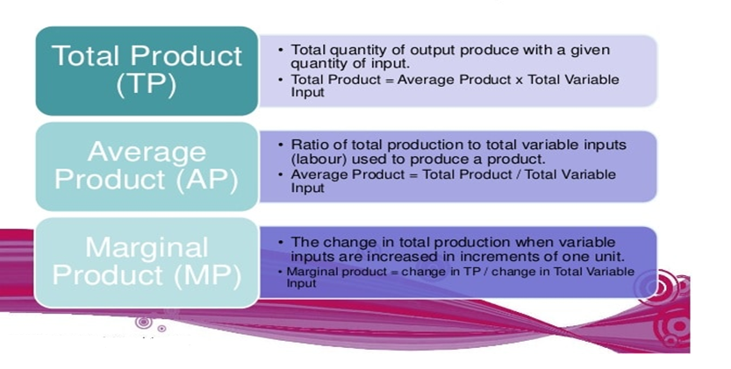
I- PRODUCTION WITH ONE VARIABLE INPUT (LABOUR)
a-Total, Average and Marginal Products

Slide 11
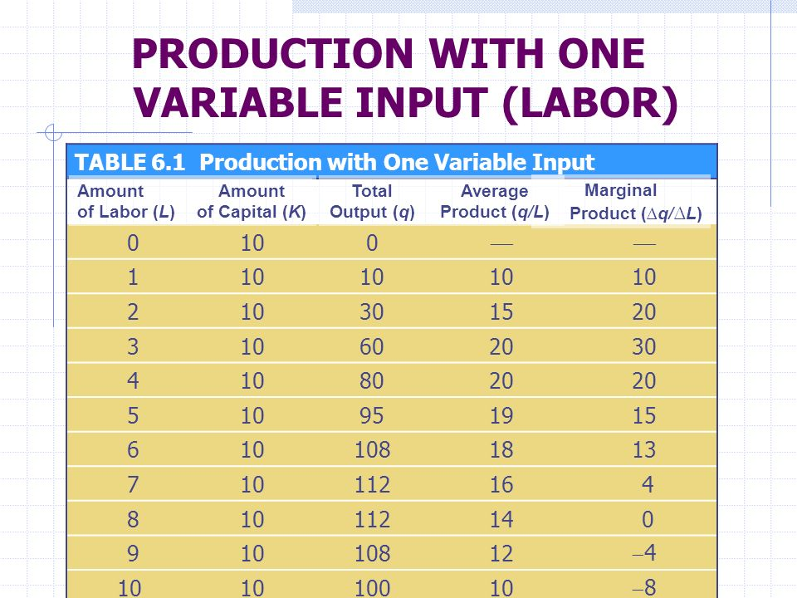
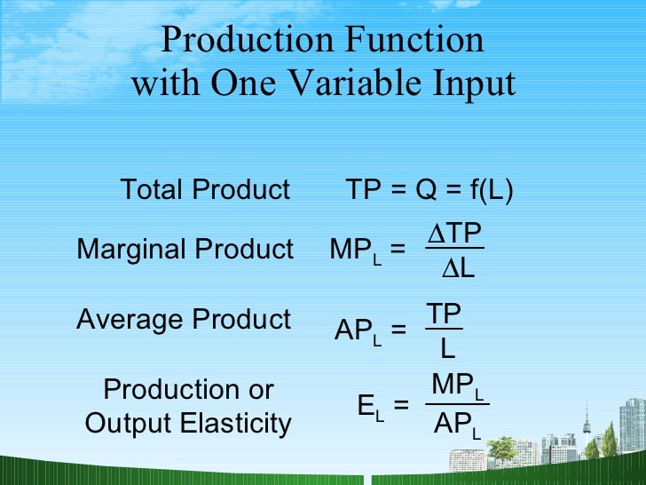
I- PRODUCTION WITH ONE VARIABLE INPUT (LABOUR)

Slide 12
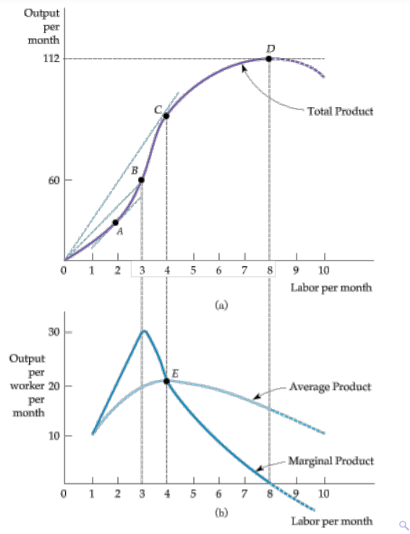
I- PRODUCTION WITH ONE
VARIABLE INPUT (LABOUR)
b-The Slopes of the Product Curve
The total product curve in (a) shows the output produced for different amounts of labor input.
The average and marginal products in (b) can be obtained (using the data in Table 6.1) from the total product curve.
At point A in (a), the marginal product is 20 because the tangent to the total product curve has a slope of 20.
At point B in (a) the average product of labor is 20, which is the slope of the line from the origin to B.
The average product of labor at point C in (a) is given by the slope of the line 0C

Slide 13
I- PRODUCTION WITH ONE
VARIABLE INPUT (LABOUR
To the left of point E in (b), the marginal product is above the average product and the average is increasing; to the right of E, the marginal product is below the average product and the average is decreasing.
As a result, E represents the point at which the average and marginal products are equal, when the average product reaches its maximum. At D, when total output is maximized, the slope of the tangent to the total product curve is 0, as is the marginal product.

Slide 14
I- Production with one variable input (Labour)
C-The Law of Diminishing Marginal Returns
Law of diminishing marginal returns is a principle that as the use of an input increases with other inputs fixed, the resulting additions to output will eventually decrease.

Slide 15
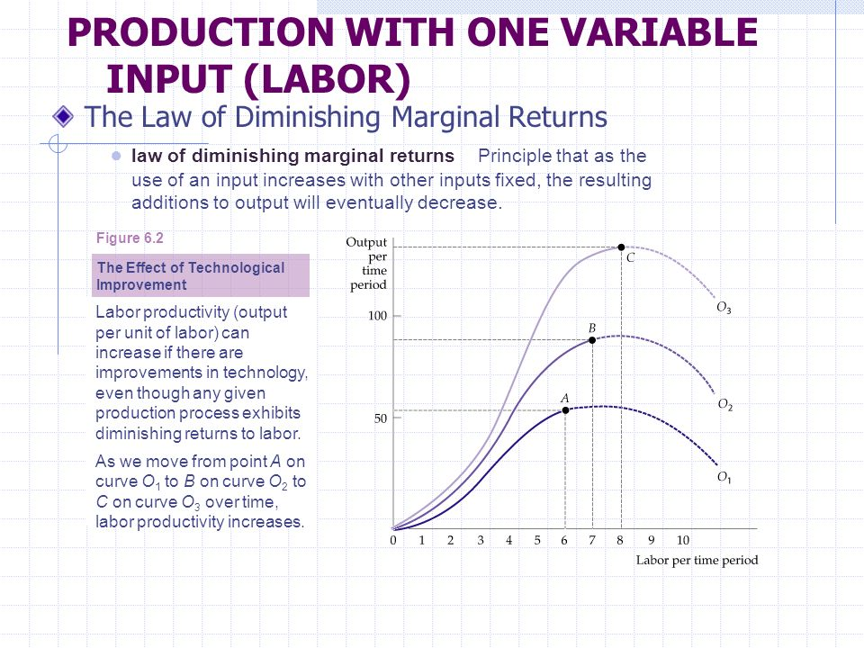

Slide 16
I- Production with one variable input (Labour)
d-Labor Productivity
The Labor Productivity =the Average product of labor for an entire industry or for the economy as a whole.
Productivity and the Standard of Living
● stock of capital Total amount of capital available for use in production.
● technological change Development of new technologies allowing factors of production to be used more effectively.

Slide 17
I- Production with one variable input (Labour)
e- The law of diminishing marginal productivity
The law of diminishing marginal productivity is an economic principle usually considered by managers in productivity management.
Generally, it states that advantages gained from slight improvement on the input side of the production equation will only advance marginally per unit and may level off or even decrease after a specific point.

Slide 18
II- Production Functions with Two Variable Factors and the Isoquants
For the analysis of production function with two variable factors we make use of the concept called isoquants or iso- product curves which are similar to indifference curves of the theory of demand.
Therefore, before we explain the production function with two variable factors and returns to scale, we shall explain the concept of isoquants (that is, equal product curves) and their properties.

Slide 19
II- Production Functions with Two Variable Factors and the Isoquants
I-4- Isoquants:
Isoquants, which are also called equal product curves, are similar to the indifference curves of the theory of consumer’s behaviour. An isoquant represents all those factor combinations which are capable of producing the same level of output.
The isoquants are thus contour lines which trace the loci of equal outputs. Since an isoquant represents those combinations of inputs which will be ca­pable of producing an equal quantity of output, the producer would be indifferent between them. Therefore, isoquants are also often called equal product curves production-indifference curves.

Slide 20
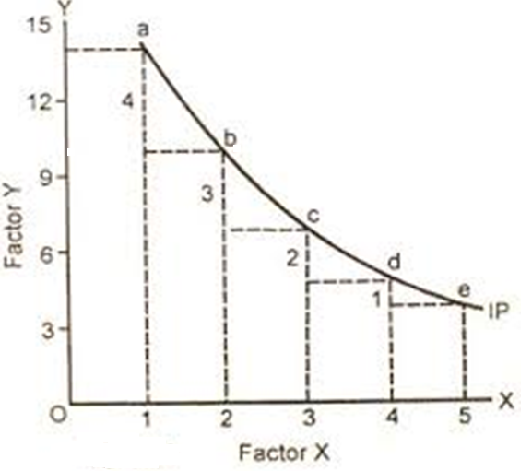
II- Production Functions with Two Variable Factors and the Isoquants
Isoquants
Isoquants shows the different combination of labour and capital to produce the same level of output.

Slide 21
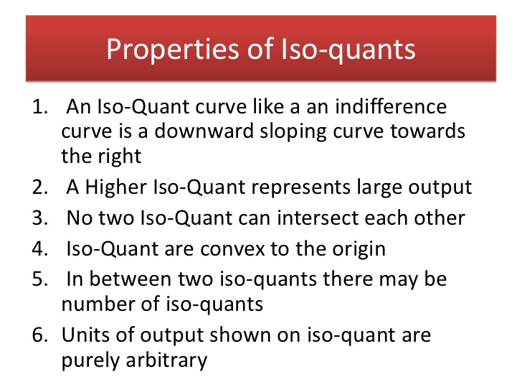

Slide 22
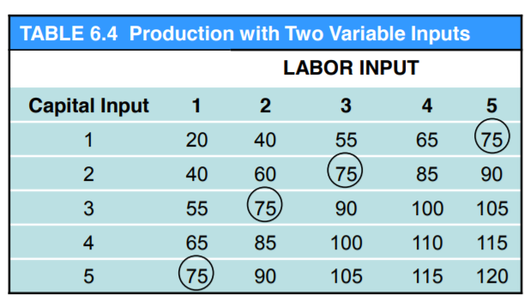
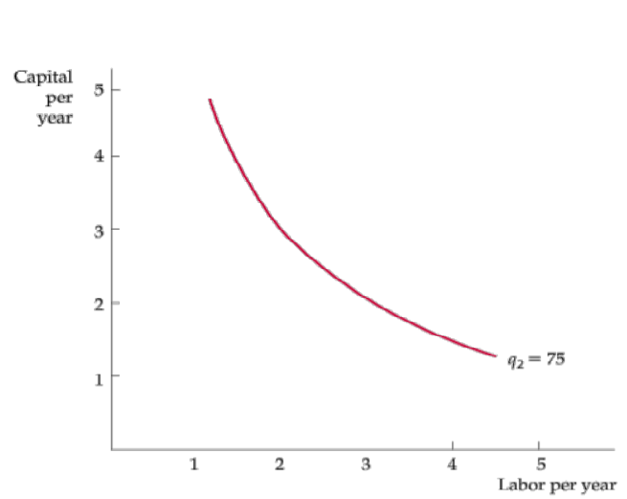
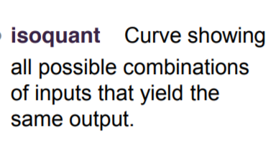

Slide 23
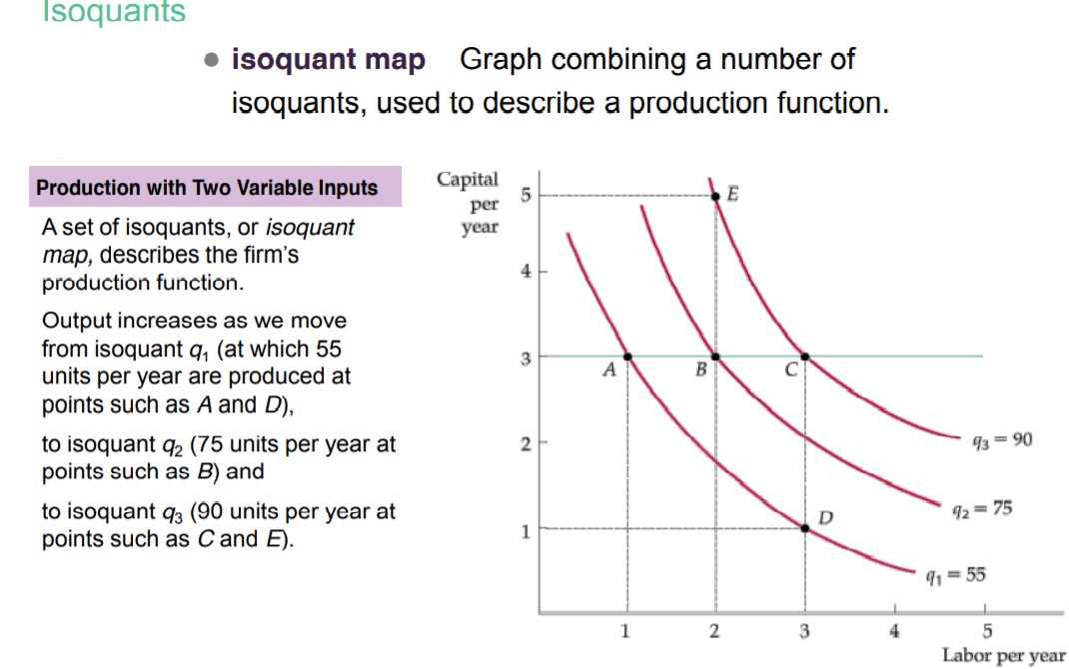

Slide 24
II- Law of Variable Proportion = short run Production Function
II-1- Definition
II-2- Assumptions of the Law of Variable Proportion

Slide 25
II- Law of variable proportion = short run production function
II-1- Definition
This law is also called the law of Proportionality.
The law state that change in output due to the change in any one input by the same rate.
Leftwitch: “the law of variable proportion states that if the inputs of one resource is increased by equal increment per unit of time while the inputs of other resources are held constant, total output will increase, but beyond some point the resulting output increase will become smaller and smaller”.
Notes:
Richard H. Leftwich (born 1946) is Fuji Bank and Heller Professor of Accounting and Finance Emeritus at the University of Chicago

Slide 26
II- Law of variable proportion or short run production function
”The law of variable proportion states that if a variable quantity of one resource is applied to a fixed amount of other inputs, output per unit of variable input will increase but beyond some point the resulting increase will be less and less and with total output reaching a maximum before it finally begins to decline.”

Slide 27
II- Law of variable proportion or short run production function
II-2- Assumptions of the Law of variable proportion
The law is based on no change in the technology.
All units of the variable factor are homogenous.
Only one factor is variable, others remaining constant.
Only applicable under short run.
The products are measured in physical units. Example quintals, tonnes etc.
It is assumed that all variable factors are equally efficient.

Slide 28
II-3- The Three Stages of the Law
The Law of Variable proportions has three stages, which are discussed below.
First Stage or Stage of Increasing returns: In this stage, the total product increases at an increasing rate.
This happens because the efficiency of the fixed factors increases with addition of variable inputs to the product.

Slide 29
2- Second Stage or Stage of Diminishing Returns: In this stage, the total product increases at a diminishing rate until it reaches the maximum point. The marginal and average product are positive but diminishing gradually.
3- Third Stage or Stage of Negative Returns: In this stage, the total product declines and the marginal product becomes negative.

Slide 30
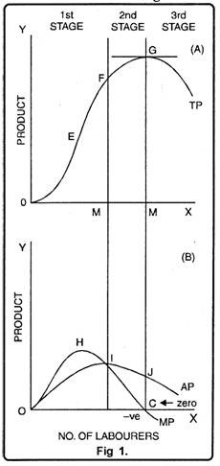
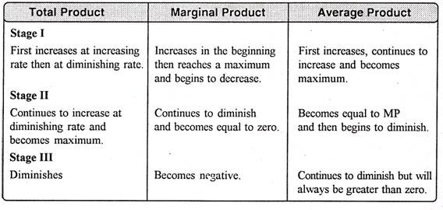
II- Law of variable proportion or short run production function

Slide 31
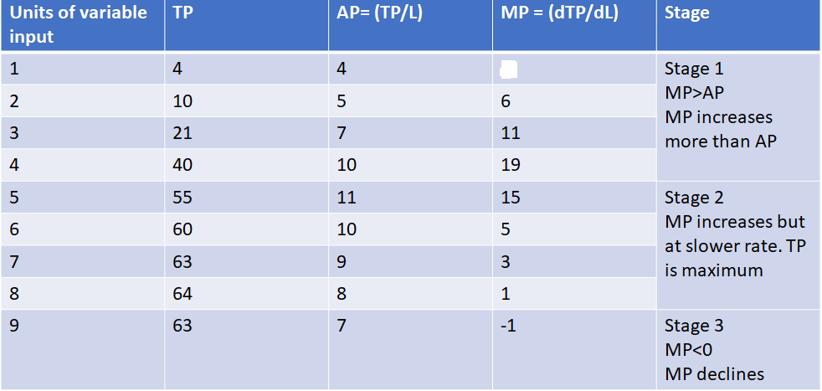
II- Law of variable proportion or short run production function
Example:

Slide 32
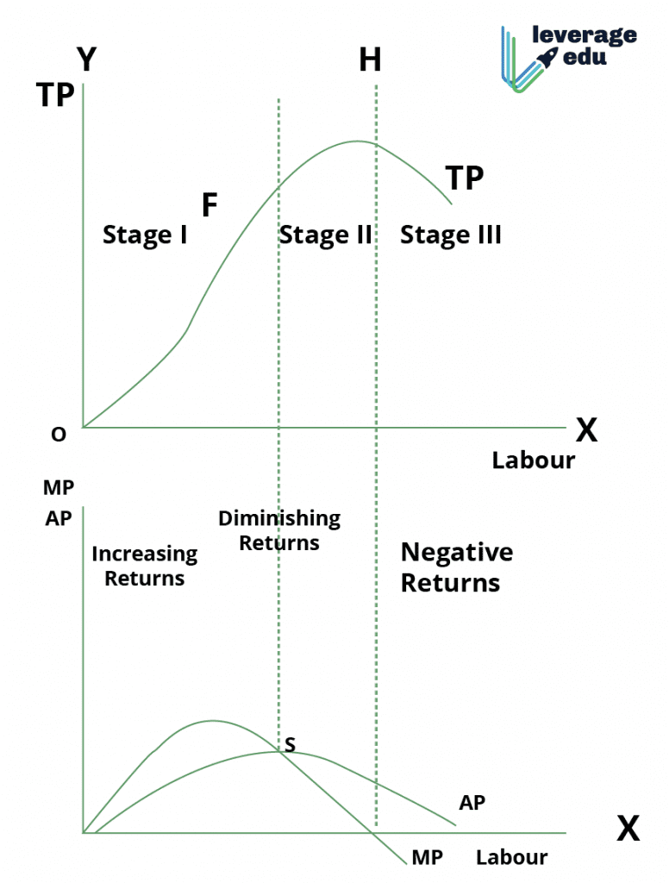
Graph: Diagrammatic representation- Law of variable proportion

Slide 33
II- Law of variable proportion or short run production function
III-4- Applicability of the Law of Variable Proportions:
The law of variable proportions is universal as it applies to all fields of production.
This law applies to any field of production where some factors are fixed and others are variable.
That is why it is called the law of universal application.

Slide 34
II- Law of variable proportion or short run production function
The main cause of application of this law is the fixity of any one factor.
Land, mines, fisheries, and house building etc. are not the only examples of fixed factors.
Machines, raw materials may also become fixed in the short period.
Therefore, this law holds good in all activities of production etc. agriculture, mining, manufacturing industries.

Slide 35
II- Law of variable proportion or short run production function
Application to Agriculture
With a view of raising agricultural production, labour and capital can be increased to any extent but not the land, being fixed factor. Thus when more and more units of variable factors like labour and capital are applied to a fixed factor then their marginal product starts to diminish and this law becomes operative.
Application to Industries
In order to increase production of manufactured goods, factors of production has to be increased. It can be increased as desired for a long period, being variable factors.
Thus, law of increasing returns operates in industries for a long period. But, this situation arises when additional units of labour, capital and enterprise are of inferior quality or are available at higher cost.

Slide 36


Slide 37
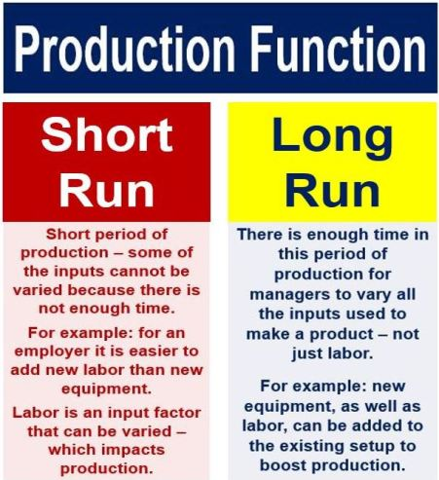
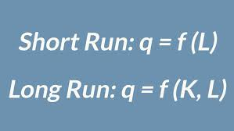

Slide 39
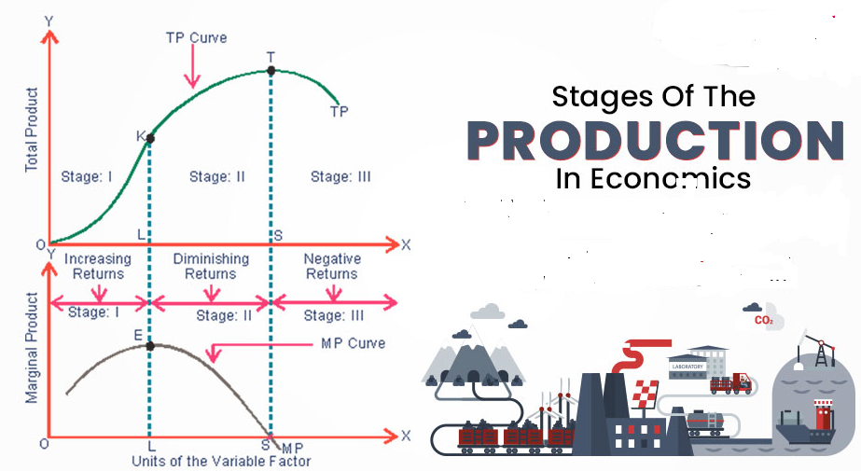

Slide 40


