Slide 1


Change Management
Prepared by Dr. Ranya Mahfouz
MGM323
Lecture 1

Slide 2


Individual change
Chang Management
Lecture 1
Individual change
MGM323
Prepared by
Dr. Ranya mahfouz

Slide 3
Chapter
01
Agenda Individual change
Introduction
Learning and the process of change
The behavioral approach to change
The cognitive approach to change
The psychodynamic approach to change
The humanistic psychology approach to change

Slide 4

Change Management
This subject is about learning how to manage change. The world around us is changing very quickly. Almost every day, there is a new discovery or innovation, especially in science. Globalization also has a big effect on how we think about politics and business. At the same time, the problems that come with globalization are growing just as fast, which is also a big concern.

Slide 5

Change Management
Definition:
Change Management is an organizational process designed to help individuals and organizations adapt to changes in their environment. It involves planning, communication, training, and monitoring outcomes to ensure a smooth transition from the current state to the desired future state.

Slide 6

Chapter
01
-2LEARNING AND THE PROCESS OF CHANGE
Learning plays an important role in the process of change. For people and organizations to deal with change effectively, they must learn new skills, gain new knowledge, and sometimes change their attitudes or behaviors. Change is not just about doing things differently — it's also about thinking differently. Learning helps individuals and teams adapt, grow, and succeed in a constantly changing world.

Slide 7

Chapter
LEARNING AND THE PROCESS OF CHANGE
01
Honey and Mumford (1986) define "Learning is the process by which we make sense of our experiences in the world and apply those learning's to improve ourselves. Learning is not just an acquisition of knowledge, but the application of it through doing something different in the world.

Slide 8

Lecture
LEARNING AND THE PROCESS OF CHANGE
01
Many of the change scenarios that you find yourself in require you to learn something new, or to adjust to a new way of operating: your new boss likes and dislikes, for example.

Slide 9

Chapter
LEARNING AND THE PROCESS OF CHANGE
01
There is another example of driving your new car for the first time. For many people, the joy of a new car is tempered by the nervousness of driving it for the first time.

Slide 10
Chapter
LEARNING AND THE PROCESS OF CHANGE
01
but When you are driving on your usual route to work, you don’t have to think much. Your hands naturally grip the steering wheel, your foot knows exactly when to press the gas pedal, and you automatically take the turns. But when you drive to a new place for the first time, you have to pay extra attention. You may need to check your GPS frequently, look for road signs, and concentrate more on the directions.

Slide 11

Chapter
LEARNING AND THE PROCESS OF CHANGE
01
All these things you would have done automatically but now you need to think about them. Thinking not only requires time, it also requires a ‘psychological space’ which it is not easy to create when driving along at your normal speed

Slide 12

Chapter
Conscious and unconscious competence and incompetence
01

Slide 13
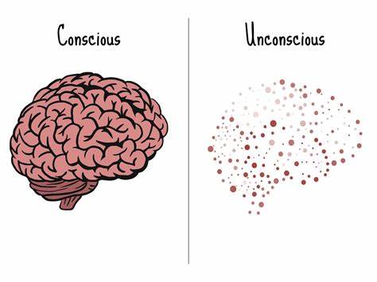
Chapter
Conscious and unconscious competence and incompetence
01
Psychologists suggest that people have a worldview that entails some things being in the foreground and others being in the background of their consciousness.

Slide 14

Chapter
Conscious and unconscious competence and incompetence
01
in the example of driving a new car for the first time, something else is happening. Assuming that I am an experienced driver, many of the aspects of driving, for me, are unconscious. All of these aspects I hopefully carry out competently.

Slide 15
Chapter
01
Kolb’s learning cycle

Slide 16
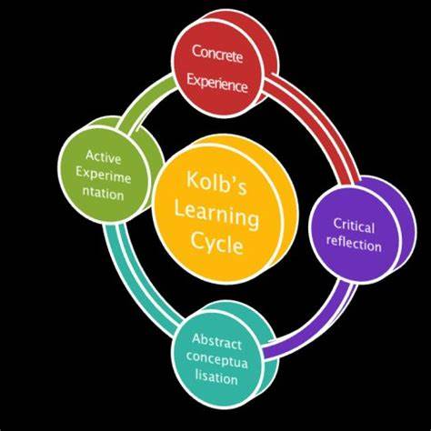
Chapter
Kolb’s learning cycle
01
David Kolb (1984) developed a model of experiential learning, which unpacked how learning occurs, and what stages a typical individual goes through in order to learn. It shows that we learn through a process of doing and thinking. The labels of activist, reflector, theorist and pragmatist.

Slide 17
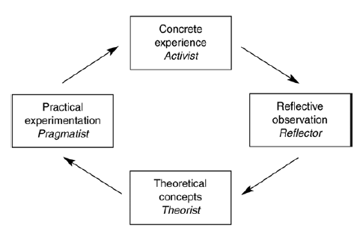
Chapter
Kolb’s learning cycle
01

Slide 18

Chapter
Kolb’s learning cycle
01
You’ve decided to start learning a new language. How do you go about it?
• Do you jump right in, try speaking it immediately, and experiment with new phrases? (Activist)
• Do you prefer to observe others speaking the language or watch videos before trying it yourself? (Reflector)
• Do you research the grammar rules, structure, and compare it to other languages you know? (Theorist)
• Do you wait until you have a practical reason to use the language, such as travel or work? (Pragmatist)

Slide 19
How should I approach learning a new language?
Reflector
Theorist
Observe others and
watch videos before
trying
Research grammar rules
and compare to other
languages
Activist
Pragmatist
Jump in and experiment
with speaking
immediately
Wait for a practical
reason to use the
language

Slide 20
Chapter
01
Approaches to change

Slide 21
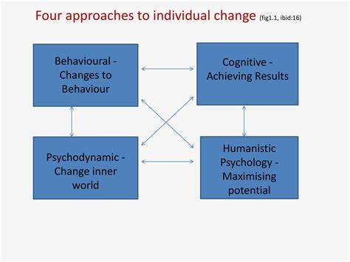

Slide 22

Chapter
-3THE BEHAVIOURAL APPROACH TO CHANGE
01
The behavioral approach to change, as the name implies, very much focuses on how one individual can change another individual’s behavior using reward and punishment, to achieve intended results.

Slide 23

Chapter
THE BEHAVIOURAL APPROACH TO CHANGE
01
If the intended results are not being achieved, an analysis of the individual’s behavior will lead to an understanding of what is contributing to success and what is contributing to non-achievement.

Slide 24

Chapter
THE BEHAVIOURAL APPROACH TO CHANGE
01
For example, an organization is undergoing a planned programme of culture change, moving from being an inwardly focused organization to a more responsive customer-oriented organization.

Slide 25

Chapter
THE BEHAVIOURAL APPROACH TO CHANGE
01
will all need to change the way they behave towards customers and towards each other to achieve this change. The objective will be behaviour change, and there will not necessarily be any attention given to improving processes.

Slide 26

Chapter
THE BEHAVIOURAL APPROACH TO CHANGE
01
What rewards and punishments operate in your organization?
How effective are they in bringing about change?
So in what ways may behaviorism help us with individuals going through change?

Slide 27
Chapter
THE BEHAVIOURAL APPROACH TO CHANGE
01
In any project of planned behavior change a number of steps will be required:
• Step 1: The identification of the behaviors that impact performance.
• Step 2: The measurement of those behaviors. How much are these behaviors currently in use?
• Step 3: A functional analysis of the behaviors – that is, the identification of the component parts that make up each behavior.

Slide 28

Chapter
THE BEHAVIOURAL APPROACH TO CHANGE
01
Reinforcement strategies
When generating reward strategies, the following possibilities should be borne in mind.

Slide 29
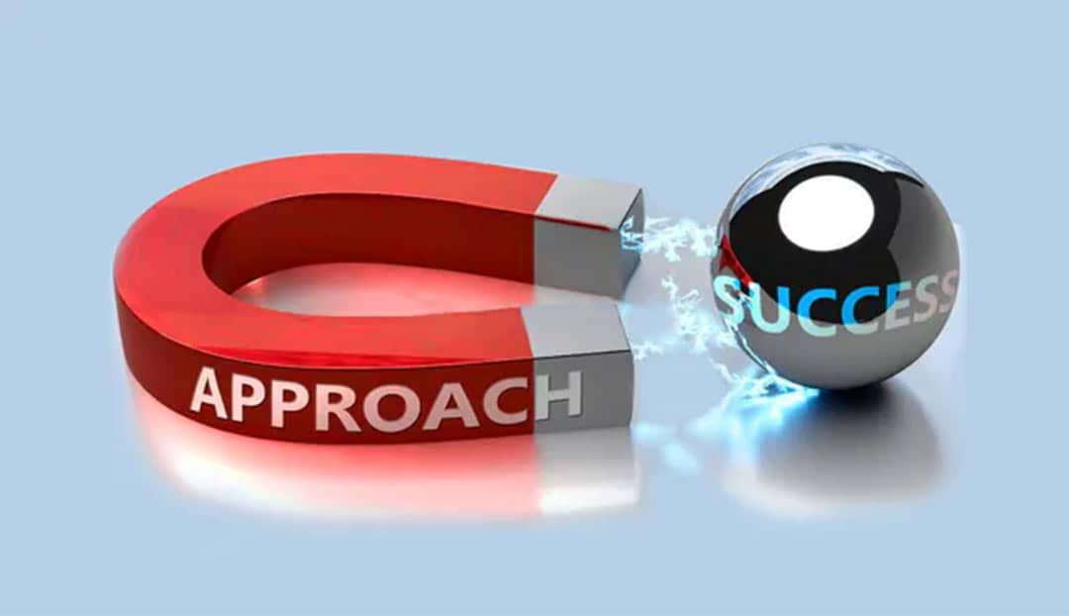
Chapter
THE BEHAVIOURAL APPROACH TO CHANGE
01
Reinforcement strategies
1- Financial reinforcement
Traditionally financial reinforcement is the most explicit of the reinforcement mechanisms used, The use of bonus payments, prizes and other tangible rewards is common. To be effective the financial reinforcement needs to be clearly, closely and visibly linked to the behaviors and performance that the organization requires, the following possibilities should be borne in mind.

Slide 30

Chapter
THE BEHAVIOURAL APPROACH TO CHANGE
01
Reinforcement strategies
2- Non-financial reinforcement - Feedback
Non-financial reinforcement tends to take the form of feedback given to an individual about performance on specific tasks.
This feedback can take both positive and negative forms. This feedback perhaps could take the form of a coaching conversation, where specific effective behaviors are encouraged, specific ineffective behaviors are discouraged and alternatives generated.

Slide 31

Chapter
THE BEHAVIOURAL APPROACH TO CHANGE
01
Reinforcement strategies
2- Non-financial reinforcement - Social reinforcement
Social reinforcement takes the form of interpersonal actions: that is, communications of either a positive or negative nature. Praise, compliments, general recognition, and perhaps greater (or lesser) attention can all act as a positive reinforcement for particular behaviours and outcomes.

Slide 32
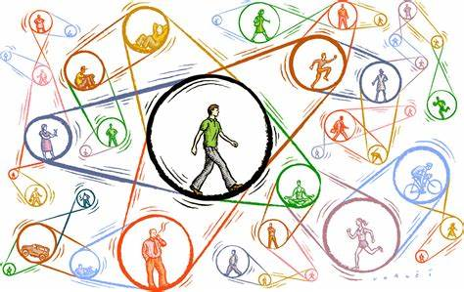
Chapter
THE BEHAVIOURAL APPROACH TO CHANGE
01
Reinforcement strategies
2- Non-financial reinforcement - Social reinforcement
Similarly, social reinforcement could also take the form of ‘naming and shaming’ for ineffective performance.

Slide 33

Chapter
-4THE COGNITIVE APPROACH TO CHANGE
01
The cognitive approach builds on the behaviorist approach by putting behavior into the context of beliefs and focusing more firmly on outcomes. Many cognitive techniques are used in the field of management today, particularly in the coaching arena.

Slide 34
Chapter
THE COGNITIVE APPROACH TO CHANGE
01
People control their own destinies by believing in and acting on the values and beliefs that they hold.
R Quackenbush, Central Michigan University

Slide 35

Chapter
THE COGNITIVE APPROACH TO CHANGE
01

Slide 36
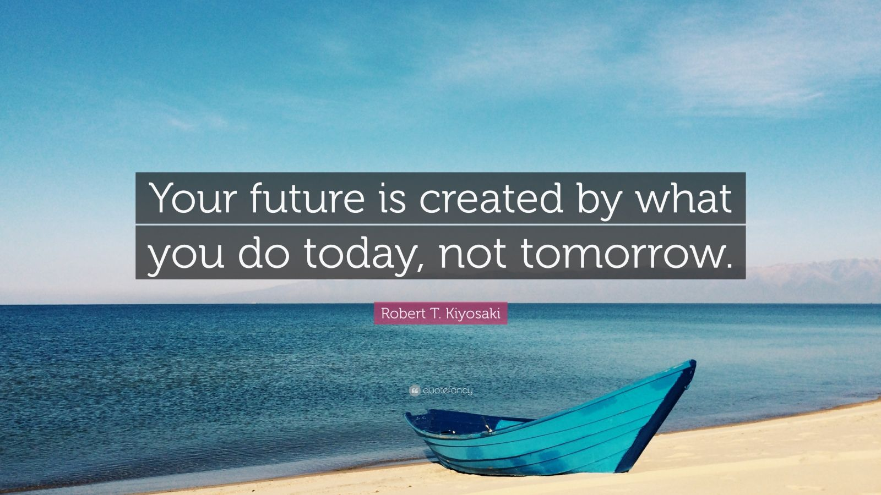
Chapter
THE COGNITIVE APPROACH TO CHANGE
01

Slide 37

Chapter
THE COGNITIVE APPROACH TO CHANGE
01
Techniques for change
The cognitive approach has generated numerous techniques for changing the beliefs of people and there by improving their performance. These include the following.

Slide 38
Chapter
THE COGNITIVE APPROACH TO CHANGE
01
1- Positive listings
Simply list all the positive qualities you have, such as good feelings, good experiences, good results, areas of skills, knowledge and expertise. By accepting that these are all part of you, the individual, you can reinforce all these positive thoughts, feelings and perceptions, which then lead to enhanced beliefs.

Slide 39
Chapter
THE COGNITIVE APPROACH TO CHANGE
01
2- Affirmations
An affirmation is a positive statement describing the way that you want to be. It is important that the statement is:
• Personal/ Present tense : ‘I am always Excited when it comes to work!’ It is you who this is about, and it is as specific as you can make it.
Try writing your own affirmation. Put it on a card and read it out 10 times a day.

Slide 40

Chapter
THE COGNITIVE APPROACH TO CHANGE
01
3 – Visualizations
Visualizations are very similar to affirmations but focus on a positive, present mental image. Effective visualizations require you to enter a relaxed state where you imagine a specific example of the way you want to be. You need to practice this on a regular basis.

Slide 41

Chapter
5-THE PSYCHODYNAMIC APPROACH TO CHANGE
01
The idea that humans go through a psychological process during change became evident due to research published by Elizabeth Kubler-Ross (1969).
The process of change and adjustment
Denial __ Anger _ Bargaining _ Depression _ Acceptance

Slide 42
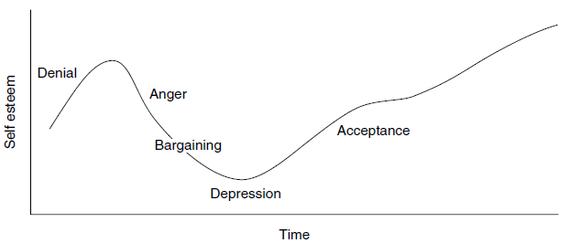
Chapter
THE PSYCHODYNAMIC APPROACH TO CHANGE
01
The process of change and adjustment
Denial __ Anger _ Bargaining _ Depression _ Acceptance

Slide 43
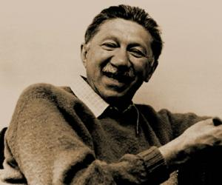
Chapter
6-THE HUMANISTIC PSYCHOLOGY APPROACH TO CHANGE
01
Maslow and the Levels of needs
Maslow developed the Levels of needs, he believed that human beings have an inbuilt desire to grow and develop and move towards something he called self-actualization.

Slide 44
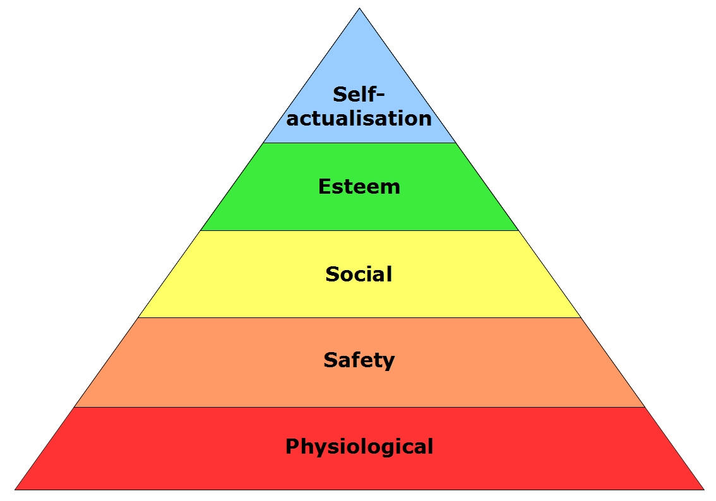
Chapter
THE HUMANISTIC PSYCHOLOGY APPROACH TO CHANGE
01
Maslow’s hierarchy of needs Source: Maslow (1970)

Slide 45

Textbook
Thank You

