Slide 1


English Course- Advanced Level
Prepared by
Ahmed Soliman

Slide 2



Lecture 1
www.midocean.ae

Slide 3
Listening
(Traffic Tickets)
www.midocean.ae

Slide 4
Vocabulary and Sample Sentences
glove compartment (noun): a small space, usually on the dashboard of the car, used for storage
– People usually keep the car’s registration and other small items in the glove compartment.
zone (noun): area
– You cannot park your car in this zone outside the airport.
odometer (noun): a meter that measures speed and distance traveled
– Check your odometer. I think you’re speeding.
malfunction(verb): fail to perform properly
– If any part of your car malfunctions during the warranty period, just take it back to the car dealership.
intersection (noun): the place where two or more roads cross each other
– It looks like the traffic light at the intersection is malfunctioning and is not changing from stop to go.
www.midocean.ae

Slide 5
pal (noun): a close friend
– He went for a drive with some of his high school pals.
impound (verb): to take or seize by legal authority
– The police impounded the man’s car because it was involved in a crime.
infractions (noun): minor crimes or violations against the law
– Because the man had been involved in numerous infractions with the law, his license was suspended for an entire year .
fine (noun): money that is paid as a penalty
– She had to pay a one hundred dollar traffic fine for running a red light.
www.midocean.ae

Slide 6
Listen to the recording and answer the questions.
https://www.esl-lab.com/intermediate/traffic-ticket/
1- The man broke the law when he ____________
exceeded the speed limit
parked illegally near the school
didn't yield to children crossing the road
2- What happened at the intersection?
The driver failed to yield to other drivers.
The driver didn't use his turn signals.
The driver didn't come to a complete stop.
www.midocean.ae

Slide 7
3- What does the police officer tell the man about his driver's license?
The driver is using someone else's license.
The license is only good for 6 more months.
The license is no longer valid.
4- The driver asks about the officer's name because he __________.
plans to report the officer to his superiors
tells the officer that they could have met before
suggests that the officer could let him go
www.midocean.ae

Slide 8
5- What happens at the end of the conversation?
The officer arrests the driver.
The driver is taken to court.
The driver gets a ticket.
www.midocean.ae

Slide 9
Listening Script
Police Officer: Okay. May I see your driver’s license please?
Driver: What? Did I do anything wrong?
Police Officer: License, please. And your car registration.
Driver: Oh, yeah. It’s, uh, somewhere here in the glove compartment. Yeah, here it is.
Police Officer: Sir, did you realize you were speeding in a school zone?
Driver: What? No, I didn’t. That’s probably because my odometer is broken, I . . . I mean, malfunctioning.
Police Officer: Yes, you were going 50 miles per hour in a 20 miles per hour zone. And [What?] AND, you failed to come to a complete stop at the intersection back there.
Driver: Rolling stops don’t count?
www.midocean.ae

Slide 10
Police Officer: And, one of your brake lights is out, [Huh?], and you’re not wearing a seat belt, AND your driver’s license expired six months ag o.
Driver: And your name is . . . . Officer Smith? Hey, are you related to the Smiths in town? [Well . . .] My wife’s cousin’s husband (I think his name is Fred) works for the police department here. Or was that the fire department. Anyway, I thought you might be good pals, and you know . . .
Police Officer: Hey, are you trying to influence an officer? I could have this car impounded right here because of these infractions.
Driver: No, of course not.
Police Officer: Okay, then. Here’s your ticket. You can either appear in court to pay the fine or mail it in. And have a nice day.
Driver: [Do] you take cash?
www.midocean.ae

Slide 11
Grammar
(If Conditionals)
www.midocean.ae

Slide 12
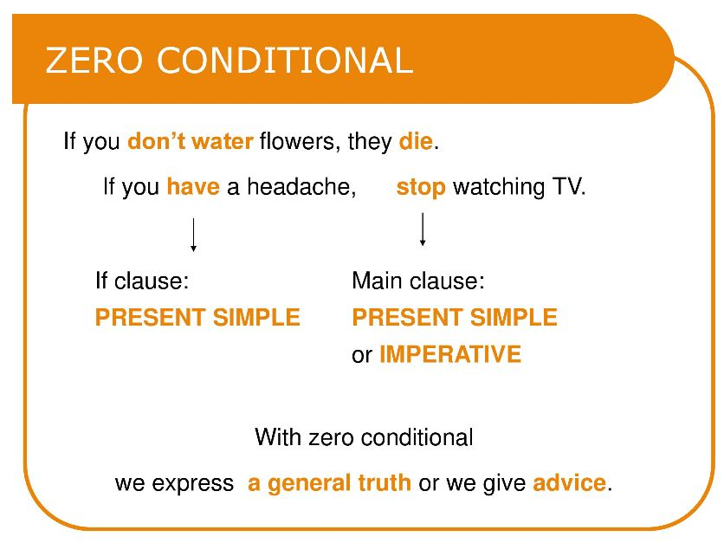
Chapter
02
www.midocean.ae

Slide 13
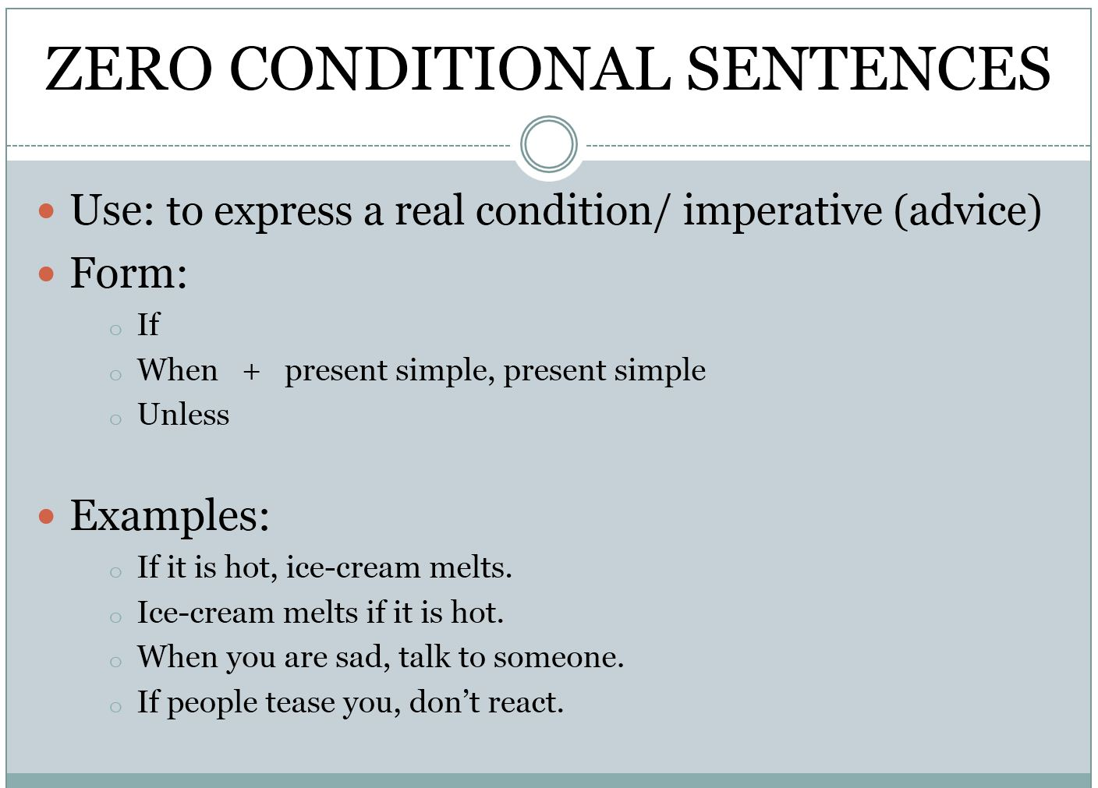
Chapter
02
www.midocean.ae

Slide 14
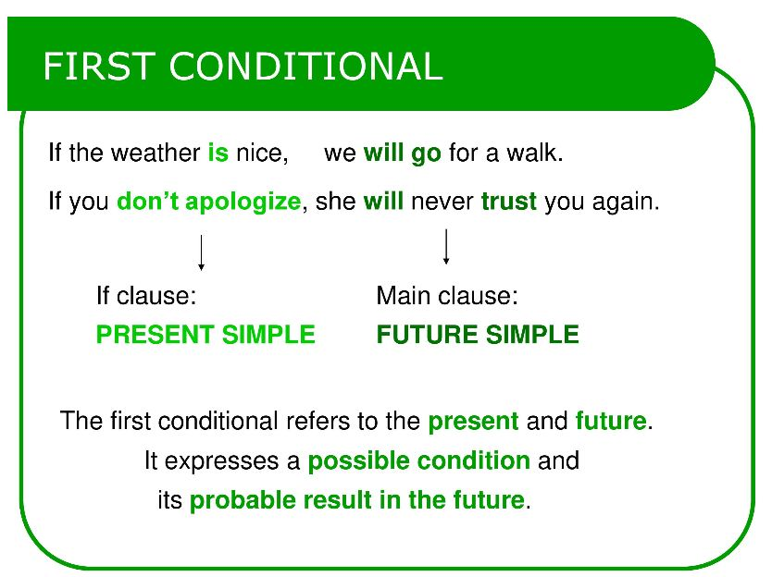
Chapter
02
www.midocean.ae

Slide 15
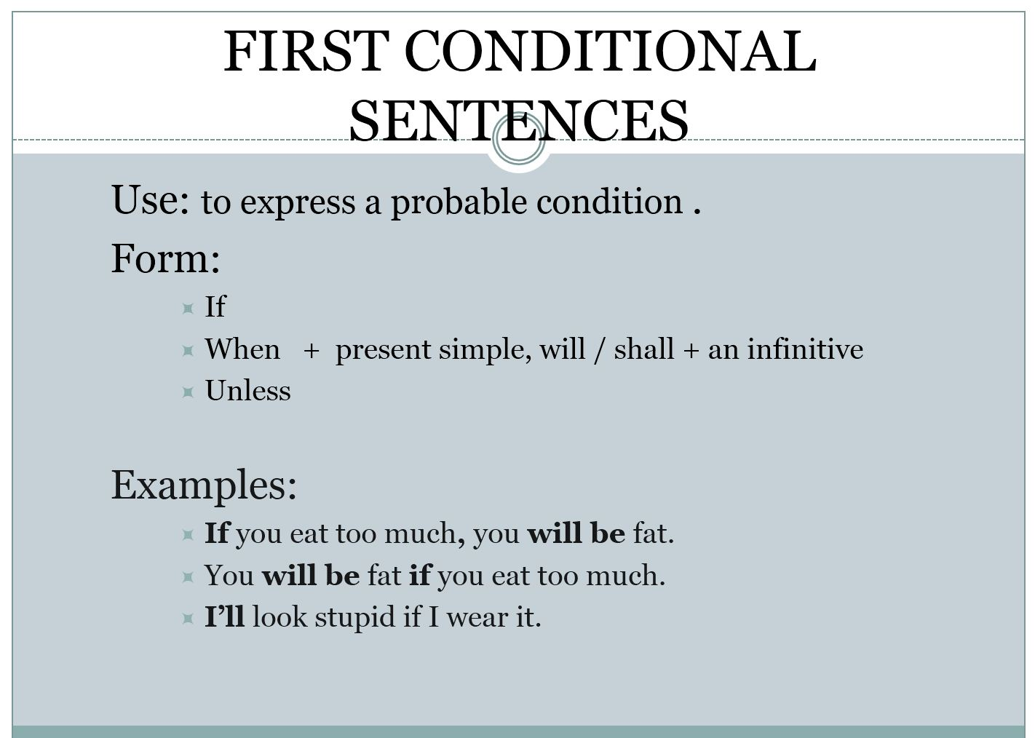
Chapter
02
www.midocean.ae

Slide 16
Reading
(Mars)
www.midocean.ae

Slide 17
Read the following passage, and then choose the best answer
1. The U.S. space program run by NASA began exploring the planet Mars in the 1960. There is a great deal of scientific interest in Mars because it is next to Earth in the solar system. Earth is the third planet from the Sun, while Mars is the fourth planet in the solar system. Mars has two small moons. Mars, commonly, referred to as "the red planet" because it appears a reddish-orange or rust color. Its reddish color comes from the high amounts of iron oxide on its surface
2. Like the Earth, Mars revolves around the Sun in an elliptical orbit. This oval orbit of Mars is more stretched out than the oval orbit of Earth. It takes Mars 687 Earth days to make one revolution around the Sun. One year on Mars is equal to almost two years on Earth. One day on Mars is about 24.5 hours long
www.midocean.ae

Slide 18
3. Mars has a thin atmosphere that contains about half as much oxygen as Earth’s atmosphere and most of its atmosphere is made up of carbon dioxide. Sometimes Mars has thin clouds made of frozen carbon dioxide and can also have fog and haze. The surface of Mars is extremely cold, hundreds of degrees F below zero.
4. There has long been speculation concerning the possibility of life and or liquid water on Mars. However, the planet's thin atmosphere prevents water from accumulating for any time. Strong solar winds and poor heat transfer across its surface would make sustained life virtually impossible.
www.midocean.ae

Slide 19
1. Mars has……………….
a. more moons than the Earth
b. fewer moons than the Earth
c. The same number of moons of the Earth
d. No moon at all
2. Mars is called the "Red Planet" because…………….
a. It is like a reddish-orange
b. It is like the rust color
c. It has high amounts of iron oxide on its surface.
d. All are correct
www.midocean.ae

Slide 20
3. The underlined word "elliptical" in paragraph 2 probably means……
a. Orbit
b. Stretched
c. Oval
d. Revolution
4. Salem who is living on the Earth is 70 years old. How old would he be if he were living on Mars?
a. 70 years
b. 35 years
c. 50 years
d. 140 years
www.midocean.ae

Slide 21
5. How long is the day on Mars?
a. Almost the same as the day on the Earth
b. Much longer than the day on the Earth
c. Much shorter than the day on the Earth
d. 49 hours
6. Paragraph 3 is mainly talking about…………….
a. Fog and haze on mars
b. Oxygen in the Mars atmosphere
c. Carbon dioxide in the Mars atmosphere
d. The atmosphere and climate on Mars
www.midocean.ae

Slide 22




Thank You

