Slide 1
Machine Learning Concept
Input x
Machine Learning
Rule = g(x)
Output Y
Input x
g(x, β)
model
y
Evaluation: How much closer to the final output
β

Slide 2

Supervised Learning, Perceptron
Dr. Mohamed Mostafa
AI 511
Foundations of Artificial Intelligence
Lecture 9

Slide 3


01
  Outline
Machine Learning Concept
What is a Perceptron?
  Types of Perceptron
  Basic Components of Perceptron
  Activation function
  Linear vs non-linear relationship
  Applications of Single layer perceptron
  Multilayer perceptions
  Examples

Slide 4
Resources for this lecture
  Data Mining And Knowledge Discovery Handboook, Published at https://www.researchgate.net/publication/225237661_Decision_Trees.
  Michael Nielsen, Neural Networks and Deep Learning, http://neuralnetworksanddeeplearning.com/chap2.html
  .. AND ..
  Introduction to Artificial Intelligence Course,. Dr. Amr S. Ghoneim
ECE595/STAT598:MachineLearningI Lecture18Multi-LayerPerceptron ,Stanley Chan School of Electrical and Computer Engineering Purdue University

Slide 5
Machine Learning Concept
Input x
Traditional Programming
Output y
Rule = F(x)
Program
f(x)
Output y
Input x
Input x =2;
Rule= x*x;
y=f(x)= 2*2 =4

Slide 6
Machine Learning Concept
Input x
Machine Learning
Rule = g(x)
Output Y
Input x
g(x, β)
model
y
Evaluation: How much closer to the final output
β

Slide 7
Machine Learning Concept
Input x
f(x, β)
model
y
Evaluation: How much closer to the final output
β
Model Learned g(x)=x*4
y= 2*3 =6
eval= 8-6 =2 (difference is 2)
Input x =2;
Output y = 8
y= 2*β =8
y= 2*1 =2
eval= 8-2 =6 (difference is 6)
y= 2*2 =4
eval= 8-4 =4 (difference is 4)
y= 2*4 =8
eval= 8-8 =0 (difference is 0)

Slide 8
Machine Learning Concept
Evaluation: Test Data
g(x)=x*4
Input Testing Data
x1,
x2,
x3,
x4,
Output Testing Data
y1,
y2,
y3,
y4,

Slide 9
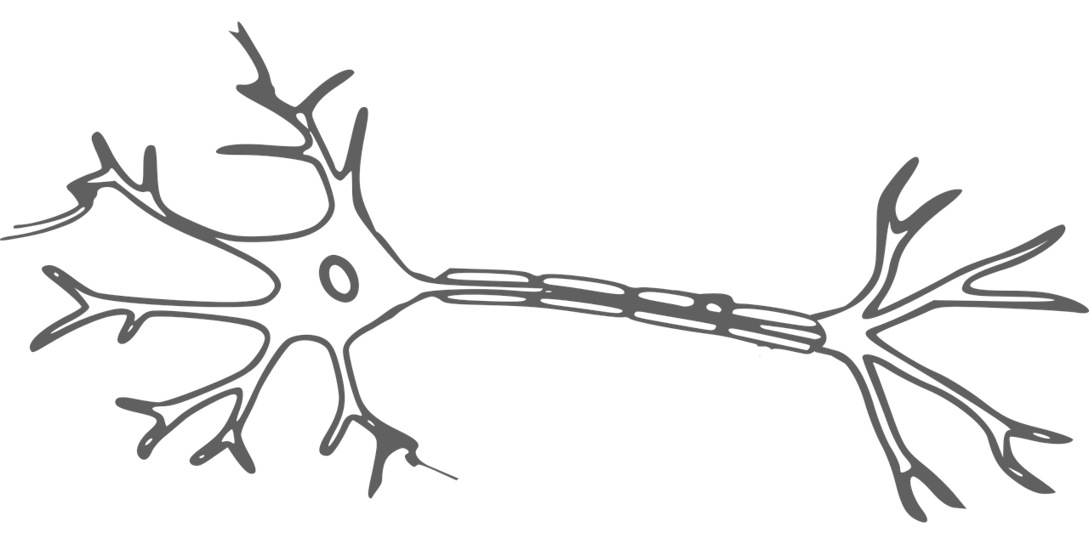
What is a Perceptron?
A Perceptron is an Artificial Neuron
It is the simplest possible Neural Network
Historically:
  Frank Rosenblatt (1928 – 1971) was a prominent American psychologist known for his contributions to the field of Artificial Intelligence.
  In 1957, he initiated a significant development by creating the Perceptron program, which ran on an IBM 704 computer at Cornell Aeronautical Laboratory.
  Researchers had observed that neurons in the brain receive input from sensory organs through electrical signals.
  Subsequently, neurons utilize electrical signals to store information and make decisions based on past input.
  Rosenblatt conceived the idea that Perceptrons could emulate brain functions, possessing the capacity to learn from input data and make decisions autonomously.

Slide 10
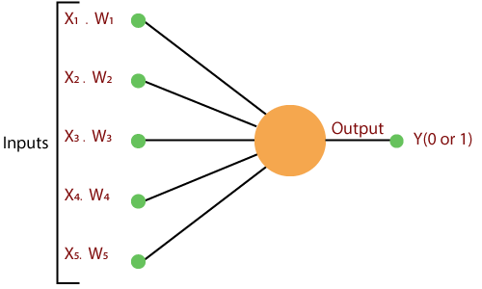
The Artificial Intelligence Perceptron

Slide 11
Types of Perceptron
Single-Layer Perceptron:
This variant of perceptron is restricted to learning linearly separable patterns, making it suitable for tasks where data can be divided into distinct categories using a straight line.
Multilayer Perceptron: Multilayer perceptron exhibit superior processing abilities due to their composition of two or more layers, enabling them to effectively manage more complex patterns and relationships present in the data.

Slide 12
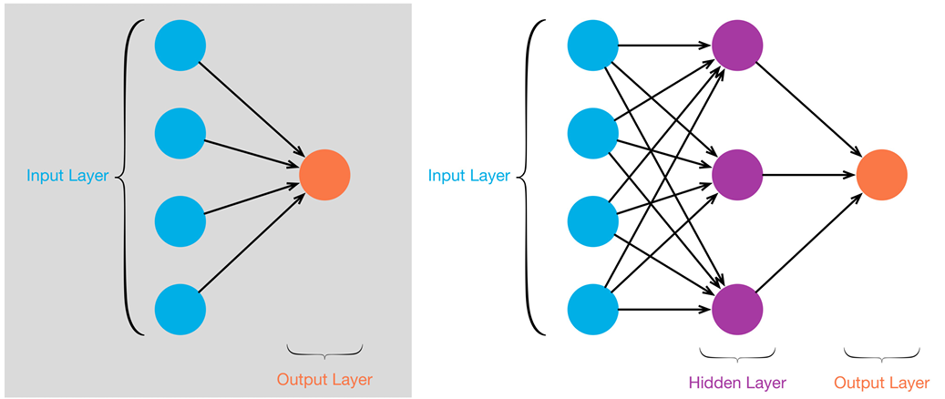
Types of Perceptron

Slide 13
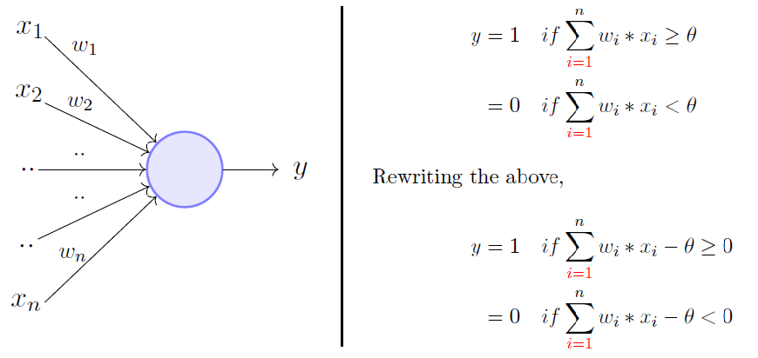
The Artificial Intelligence Perceptron
Source: towardsdatascience

Slide 14
Basic Components of Perceptron
Input Nodes or Input Layer
  input features (characteristics, or attributes)
Wight and Bias:
  Weight parameter represents the importance of the feature.
  These weights are adjusted to learn the optimal values.
  Bias can be considered as the line of intercept in a linear equation.
Summation Function
  The perceptron calculates the weighted sum of its inputs using the summation function.
  The summation function combines the inputs with their respective weights to produce a weighted sum.

Slide 15
Basic Components of Perceptron
Activation Function
  take the summed values as input and compare with the threshold and provide the output as 0 or 1.
Output
  The final output of the perceptron, is determined by the activation function’s result.
Learning Algorithm (Weight Update Rule)
  Throughout the training process, the perceptron undergoes learning by modifying its weights and bias, guided by a designated learning algorithm.
  One prevalent method is the perceptron learning algorithm, which iteratively adjusts the weights in response to the disparity between the predicted output and the actual output.

Slide 16
Activation Function
Role: Activation functions introduce non-linearity to neural networks, allowing them to model complex relationships and learn non-linear patterns in data.
Output Transformation: They transform the weighted sum of inputs of a neuron into its output.
Types: Common activation functions include signum function, step function, and sigmoid function, tanh (hyperbolic tangent), ReLU (Rectified Linear Unit), and softmax.
Selection: The choice of activation function depends on factors such as the nature of the data, the architecture of the neural network, and the task being performed.

Slide 17
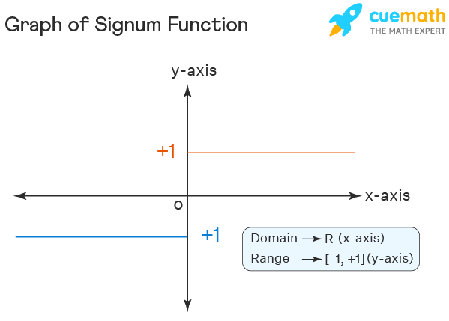
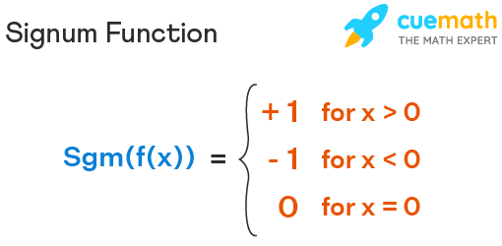
Activation Function
Signum Function

Slide 18
Activation Function
Find the output for the following values of x, using the signum function
x = {4.05, 17.60, 0, -11, 9.2, 3.99, -7.10}
Output = {+1, +1, 0, -1, +1, +1, -1}

Slide 19
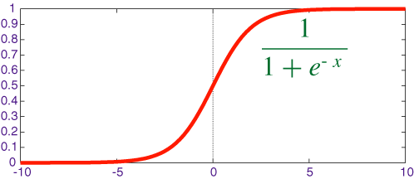
Activation Function
the Sigmoid Function returns a value between 1 and 0, this is too powerful for Binary Classification Problems.
It maps any input value into a range between 0 and 1, providing a way to normalize or ‘squash’ numbers.
e: Is the Number of Euler
x: Can be the output of your perceptron (Neural Network)

Slide 20
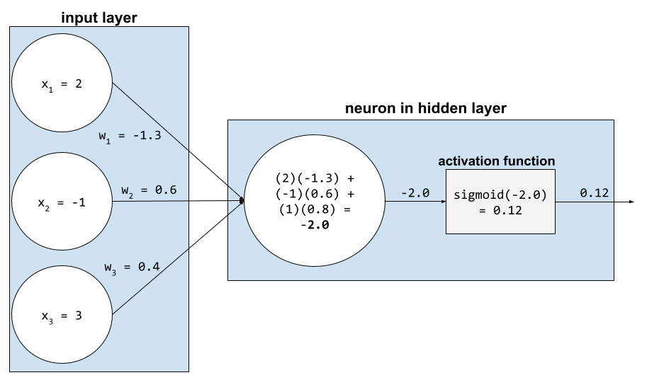
Activation Function
For example, suppose the relevant input to a perceptron (neuron) consists of the following:
input value input weight
2 -1.3
-1 0.6
3 0.4
Source: GoogleDevelopers

Slide 21
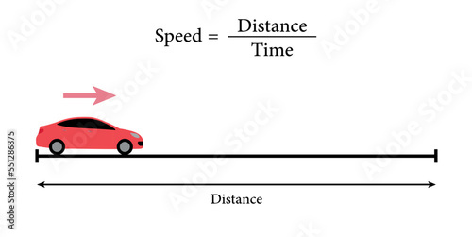
Linear relationship vs Non-linear
In a nonlinear relationship, changes in the output do not change in direct proportion to changes in any of the inputs.
A linear relationship creates a straight line when plotted on a graph.
A nonlinear relationship does not create a straight line but instead creates a curve.
Linear relationship

Slide 22


Linear relationship vs Non-linear
Natural Resources
Non-linear relationship

Slide 23
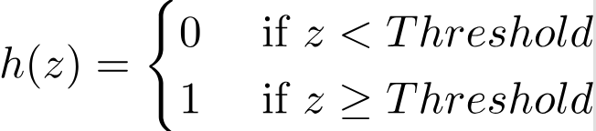
How does Perceptron work?
Randomly initialize the weights and biases (create a random hyperplane)
computes the weighted sum of its inputs as:
The activation function (threshold logic units (TLU)) compares this weighted sum to the threshold, which outputs 1 if the input is larger than a threshold value and 0 otherwise.
z = w₁x₁ + w₁x₂ + ... + w_{n}x_{n} = X^{T}W

Slide 24
How does Perceptron work? (continue)
During training, The perceptron’s weights are adjusted to minimize the difference between the predicted output and the actual output.
the learning rate.
Actual output
Predicted output

Slide 25



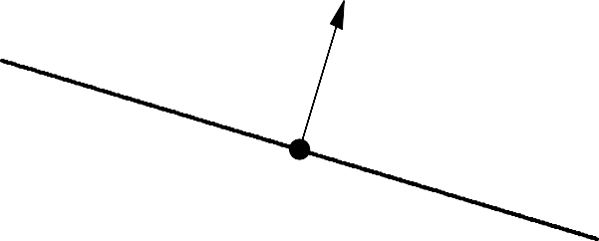
How does Perceptron work? (continue)
Income
Income
Age
Age

Slide 26


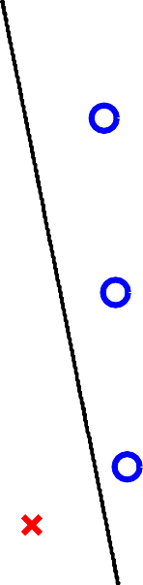



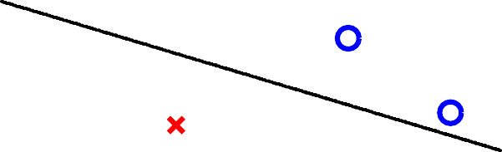


How does Perceptron work? (continue)
Income
Income
Age
Age

Slide 27
How does Perceptron work? (continue)
Income
Income
Age
Age

Slide 28





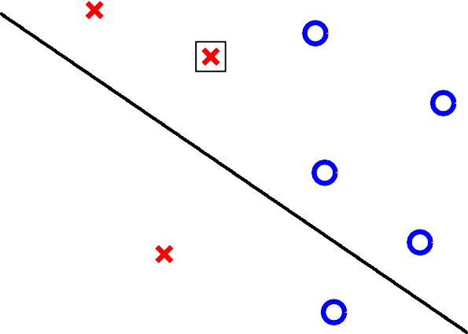








How does Perceptron work? (continue)
Income
Age
Iteration 1
Age
Iteration 2
Age
Iteration 3

Slide 29
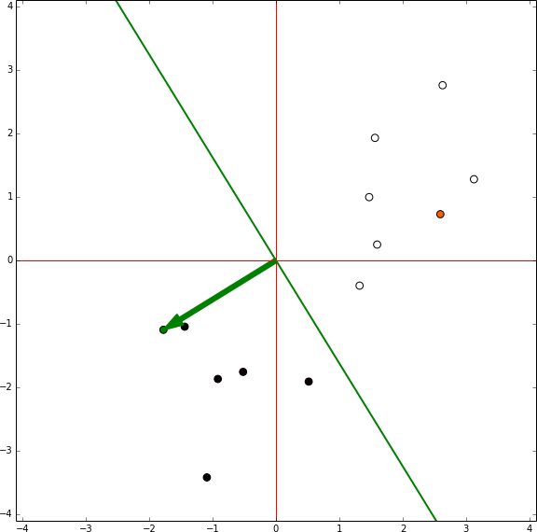
How does Perceptron work? (continue)
source: brilliant — perceptron learning algorithm pg5

Slide 30
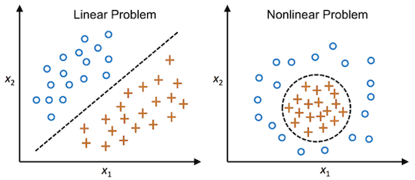
Limitations of Single-Layer Perceptron
There are two major problems:
  Single-Layer Perceptron's cannot classify non-linearly separable data points.
  Complex problems, that involve a lot of features cannot be solved by Single-Layer Perceptron's.

Slide 31
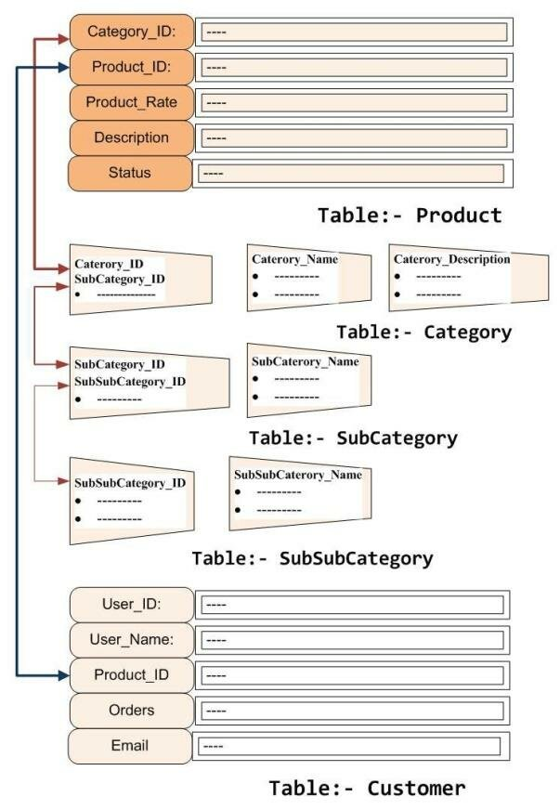

Limitations of Single-Layer Perceptron
  Complex problems, that involve a lot of features cannot be solved by Single-Layer Perceptron's.
so many inputs
Hard to adjust weights for all these parameters
β
Θ
γ
δ
ε

Slide 32
Applications of Single layer Perceptron
Binary classification: One-layer neural networks can effectively classify binary datasets when the classes are linearly separable
Feature extraction: One-layer neural networks can be employed as feature extractors in more complex models. By training a one-layer network on a specific task, the weights learned by the network can be used as features for subsequent machine learning algorithms. This technique is particularly useful when dealing with high-dimensional data, and it helps reduce the dimensionality of the input space.
Simple pattern recognition: One-layer neural networks can recognize simple patterns and make basic decisions based on input features. For example, they can be used in simple image recognition tasks where the patterns to be recognized are linearly separable, such as detecting straight lines in images or distinguishing between basic shapes.
Anomaly detection: One-layer neural networks can be utilized for detecting anomalies or outliers in datasets. If the majority of the data follows a linear pattern, a one-layer network can be trained to recognize that pattern. Any data point that deviates significantly from the learned linear boundary can be considered an anomaly.

Slide 33
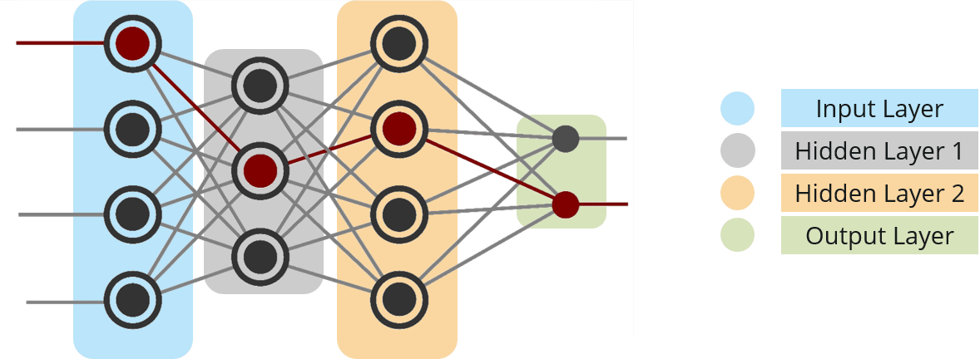
What is Multi-Layer Perceptron?
The brain is made up of millions of neurons, so a Neural Network is really just a composition of Perceptron's, connected in different ways and operating on different activation functions.
Source: edureka

Slide 34
What is Multi-Layer Perceptron?
Input Nodes: These nodes solely relay information to the hidden nodes without performing any computations themselves.
Hidden Nodes: Hidden nodes, appropriately named for their lack of direct interaction with external data, serve as computational units within the network. They process information received from the input nodes and facilitate its transfer towards the output nodes. The collections of hidden nodes forms a "Hidden Layer." While each network includes a single input layer and output layer, it may incorporate zero or multiple hidden layers, with a Multi-Layer Perceptron featuring one or more hidden layers.
Output Nodes: The Output nodes, constituting the "Output Layer," carry out computations and transmit processed information from the network to the external environment. These nodes are responsible for delivering the network's output to the outside world.

Slide 35
Multi-Layer Perceptron Example
Consider a dataset representing student performance in an exam. The dataset consists of three columns: the first column represents the number of hours spent studying, the second column indicates the concentration within the class, and the third column denotes whether the student passed or failed the final exam. For instance, if a student studied for 10 hours, and his concentration an average of 80% in class, and ultimately passed the final exam, the corresponding entry in the dataset would be [10, 80, Passed].
# of hours spent studying | concentration within the class | passed or failed
4 | 60% | pass (1)
10 | 80% | pass (1)
8 | 20% | fail (0)
6 | 10% | pass (1)
4 | 95% | fail (0)
Can you predict whether student will pass the semester or not, if the he studied 2 hrs. and the his concentration is 38%.

Slide 36
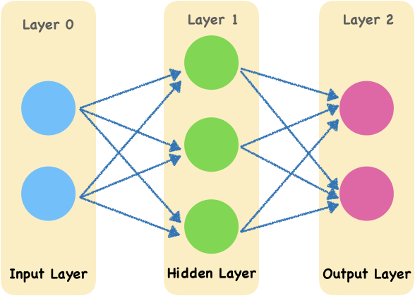
Multi-Layer Perceptron Example
Probability of pass=0.3
Target = 1
10
Error = (1-0.3)= 0.7
80%
Probability of fail=0.7
Target = 0
Error = (0-0.6)= -0.3
Forward Propagation

Slide 37
Multi-Layer Perceptron Example
Gradient of error is calculated w.r.t to each weight
Error is sent back to each neuron
Probability of pass=0.3
Target = 1
10
Error = (1-0.3)= 0.7
80%
Probability of fail=0.7
Target = 0
Error = (0-0.6)= -0.3
backward Propagation

Slide 38
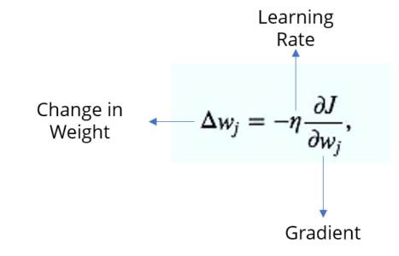
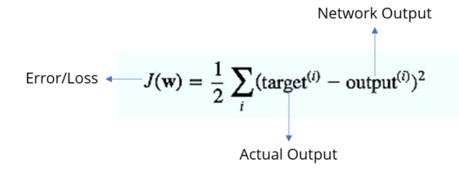
Multi-Layer Perceptron Example
Based on the error we got, it will calculate the rate of change of error w.r.t change in the weights.
First we calculate the error, consider the equation below:

Slide 39
Multi-Layer Perceptron Example
Probability of pass=0.9
Target = 1
10
Error = (1-0.9)= 0.1
80%
Probability of fail=0.1
Target = 0
Error = (0-0.1)= -0.1
Forward Propagation

Slide 40

Example
Suppose you have:
Input x1=0.5, x2​=1.0
Weights w1=0.4, w2​=0.6
Learning rate η=0.1
Target output y=1
Activation function ϕ(z) is the sigmoid function, where

Slide 41




Example
1- Compute the weighted sum:
z=(0.4×0.5)+(0.6×1.0)= 0.2 + 0.6 = 0.8
2- Apply the activation function (sigmoid in this case):
3- Calculate the error:
4- Compute the gradient of the error with respect to w1​:

Slide 42


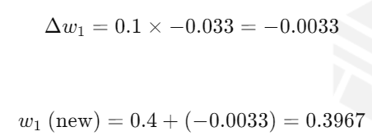
Example
For a sigmoid function, ϕ′(z)=ϕ(z)(1−ϕ(z))
5- Update the weight w1​:

Slide 43
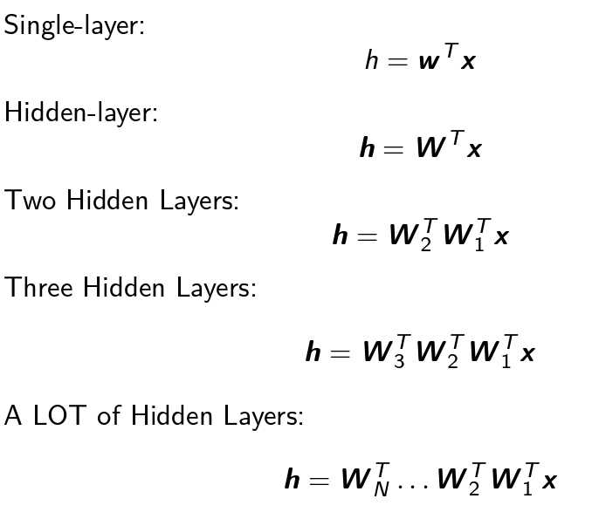
Progression to DEEP (Linear) Neural Networks

Slide 44






Bird Beak? Yes
Bird Head? Yes
Bird Eyes? Yes
Is it Bird? Yes
Bird leg? Yes
Bird Body? Yes
Bird Tail? Yes

Slide 45

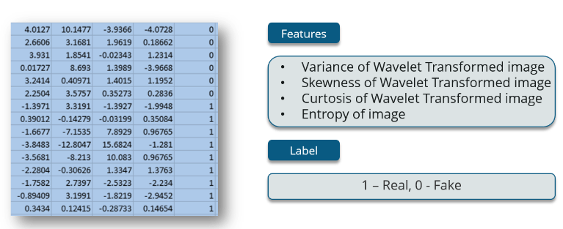
Practice
  Use Multilayer perceptron to predict if the bank note is real or fake, use the following dataset:
Source: edureka

Slide 46
Additional Resources
ECE595ML Lecture 16-1 Perceptron
  https://www.youtube.com/watch?v=amOdxJ6TGWg&list=PL4FSfq6xtSvyqEsz3UUnAizemXJfQyDVD&index=36

Slide 47



Thank You

