Slide 1


Financial Risk Management
Prepared by Dr. Walaa Mohamed
PMG 633
Functions and Forms of Banking
Introductory lecture
Lecture One

Slide 3
Lecture 1
Key Learning Points
Banks provide three core banking services: deposit collection, payment arrangement, and loan underwriting. Banks may also offer financial services such as cash, asset, and risk management.
Banks play a central role in facilitating economic activity through three interrelated processes: financial intermediation, asset transformation, and money creation.
Types of banks.

Slide 4
1. Banks and Banking
To understand banking risk and regulation, it is important to understand the range of services banks provide and the key role that banks play in a modern economy.
1. Core Bank Services:
Banks offer many products and services. While there is variation among banks and across regions, the core services that banks traditionally provide are:

Slide 5
1. Banks and Banking
Deposit collection—the process of accepting cash or money (deposits) from individuals and businesses (depositors) for safekeeping in a bank account, available for future use.
Payment services—the process of accepting and making payments on behalf of the customers using their bank accounts.
Loan underwriting—the process of evaluating and deciding whether a customer (borrower) is eligible to receive credit and then extending a loan or credit to the customer.
Underwriting has many different meanings in finance and banking. This book focuses on lending or credit. Banks underwrite loans in two steps. First, the bank analyzes the borrower’s financial capacity, or the borrower’s ability and willingness to repay. Then, the bank pays out, or funds, the loan (cash or other forms of payment) to the borrower.

Slide 6
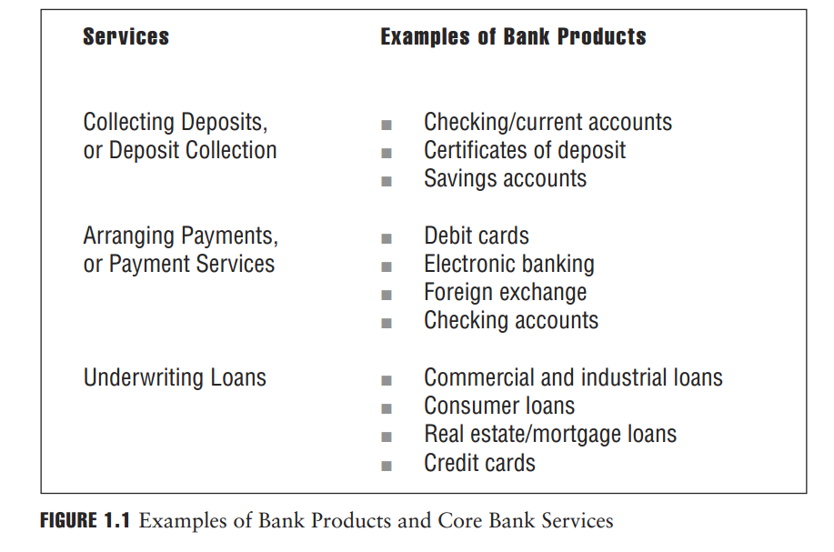

Slide 7
2. Banks in the Economy
Through the core bank services mentioned, banks are critical facilitators of economic activity.
Banks channel savings from depositors to borrowers, an activity known as financial intermediation.
Banks create loans from deposits through asset transformation.
Banks, through financial intermediation and asset transformation, engage in money creation.

Slide 8
2. Banks in the Economy
When a bank accepts deposits, the depositor in effect lends money to the bank. In exchange, the depositor receives interest payments on the deposits. The bank then uses the deposits to finance loans to borrowers and generates income by charging interest on the loans. The difference between the interest that the bank receives from the borrowers and the interest it pays to the depositors is the main source of revenue and profit to the bank.

Slide 9
2. Banks in the Economy
When underwriting a loan, a bank evaluates the credit quality of the borrower—the likelihood that the borrower will repay the loan. However, depositors, who lend money to the bank in the form of deposits, typically do not evaluate the credit quality of the bank or the bank’s ability to repay the deposits on demand. Depositors assume that their deposits with the bank are safe and will be returned in full by the bank “on demand.” This puts depositors at risk because, as we will see in later sections, banks occasionally do fail and are not able to repay deposits in full.
To protect depositors against bank failures, governments have created safety nets such as deposit insurance. These safety nets vary from country to country and generally do not provide unlimited protection, thus leaving a certain percentage of deposits exposed to the risk that a bank will default and the depositors will not be able to receive their deposits in full.

Slide 10
2. Banks in the Economy
Financial intermediation emphasizes the qualitative differences between bank deposits and bank loans. Bank deposits (e.g., savings accounts, checking accounts) are typically relatively small, consisting of money entrusted to the bank by individuals, companies, and other organizations for safekeeping. Deposits are also comparatively safe and can typically be withdrawn at any time or have relatively short maturities.
By contrast, bank loans (e.g., home mortgage loans, car loans, corporate loans) are generally larger and riskier than deposits and have repayment schedules typically extending over several years. The process of creating a new asset (loan) from liabilities (deposits) with different characteristics is called asset transformation (see Figure 1.2).

Slide 11
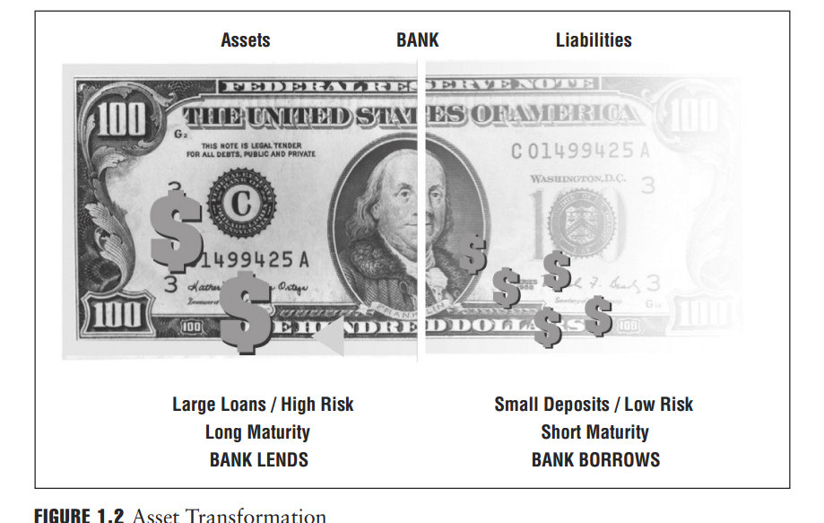

Slide 12
3. Money Creation
Banks earn revenues from the financial intermediation/asset transformation process by converting customer deposits into loans. To be profitable, however, the interest rates that the bank earns on its loans must be greater than the rate it pays on the deposits that finance them. Since the majority of deposits can be withdrawn at any time, banks must balance the goal of higher revenues (investing more of the deposits to finance loans) with the need to have cash on hand to meet the withdrawal requests of depositors.

Slide 13
3. Money Creation
To do this, banks “reserve” a relatively small fraction of their deposit funds to meet depositor demand. Banking regulators determine the reserve requirements, the proportion of deposits a bank must keep as reserves in the vault of the bank. Keeping only a small fraction of the depositors’ funds available for withdrawal is called fractional reserve banking. This system allows banks to create money.
Money creation is the process of generating additional money by repeatedly lending, through the fractional reserve banking system, an original deposit to a bank.

Slide 14
3. Money Creation
EXAMPLE
Suppose Bank A has collected deposits totaling USD 100 and retains 10% of those deposits as reserves to meet withdrawals. Bank A uses the remaining 90%, or USD 90, for lending purposes. Suppose the USD 90 is lent to one person, who then spends all the funds at one store. This USD 90 is effectively “new” money. The store then deposits the USD 90 in Bank B. At that point there are deposits in the two banks of USD 190 (the initial deposit of USD 100 plus the new deposit of USD 90). Bank B now sets aside 10% of the USD 90, or USD 9, in reserves, and loans the remaining USD 81, which is then deposited by the borrower in Bank C. There is now USD 100 + USD 90 + USD 81, or USD 271 of deposits in the three banks. As this process continues, more deposits are loaned out and spent and more money is deposited; at each turn, more and more money is made available through the lending process.

Slide 15
3. Money Creation
EXAMPLE (continued)
Figure 1.3 below shows the amount of money that an initial USD 100 deposit generates, assuming a 10% reserve requirement, transaction by transaction. (The dark shading is the reserve requirement held back from each loan (10%), and the lighter gray shading is each successive loan amount). Over the course of 21 separate transactions, USD 801 of deposits is generated, from an initial deposit of only USD 100. Allowed to continue indefinitely, this process would generate a total of USD 1,000 in deposits—the original USD 100 deposit plus USD 900 created through subsequent loans.

Slide 16
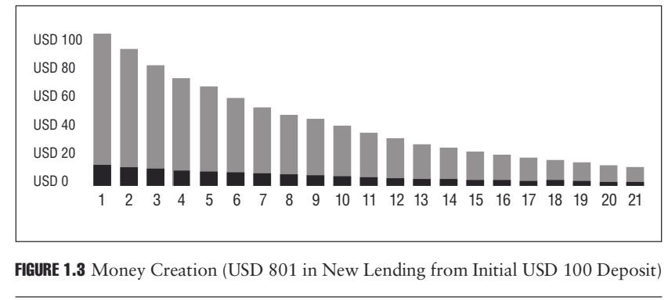
3. Money Creation
EXAMPLE (continued)

Slide 17
3. Money Creation
In the example, the cycle started with an initial deposit of USD 100; no additional money was put into the system. Portions of the original USD 100 repeatedly flowed through the system, increasing both bank deposits and bank loans. The amount of money created at each deposit is 90% of the previous step (100% less the 10% held in reserve).
Reserve requirements limit how much money an initial deposit can create in the fractional reserve banking system. The money multiplier, the inverse of the reserve requirement, is a formula used to determine how much new money each unit of currency can create. As the following example shows, the higher the reserve requirement, the more the bank must keep as regulatory reserves in the vault of the bank and the less money the bank can create.

Slide 18
Money Creation
EXAMPLE
With a reserve requirement of 10%, the money multiplier is 10 (1/10% = 10). Thus, the amount of money that can be created on a USD 100 deposit is USD 1,000. Out of USD 1,000, USD 900 (or 90%) is new money and USD 100 (or 10%) is the original deposit.
With a reserve requirement of 20%, the money multiplier falls to 5 (1/20% = 5). Thus, the amount of money that can be created on a USD 100 deposit would be USD 500. Out of this USD 500, USD 400 (or 80%) is new money and USD 100 (or 20%) is the original deposit.

Slide 19
3. Money Creation
EXAMPLE
The global financial crisis of 2007–2009 vividly showed the interrelationship between bank functions and economic activity. Because banks were unable to collect on loans that were made to low credit quality borrowers called subprime borrowers, banks became unable to recirculate deposits and lend to other parties. This in turn meant there was less credit available for the use of companies and individuals who depend on bank loans to finance their purchases. Consequently, the companies and individuals made fewer deposits, creating less money.
The effects were widely felt around the world and led to a substantial reduction in credit, which first led to a reduction in the demand for goods and services and further reduced the amount of money being deposited at banks. This caused an even further tightening of credit availability, which was one of a number of different causes and consequences related to the financial crisis.

Slide 20
4. Payment Services
Depositors can use their deposit accounts at banks to make and receive payments between depositors and between banks. Payments refer to the settlement of financial transactions between parties and usually involve the transfer of funds between the parties. There are various payment systems that facilitate transfer of funds for transactions, including checks, payment orders, bill payment, and electronic payments in the form of wire services and other electronic settlement systems. Payment systems can also help large corporations and government organizations handle their payments for goods and services.

Slide 21
4. Payment Services
Apart from settlement for payments, banks can also offer payment services by providing their customers with foreign currencies to make international payments. In arranging international payments, banks facilitate international transactions by, on one hand, offering facilities that enable the creation of payment documents that foreign banks accept and, on the other hand, by accepting payment documents that foreign banks have issued. By using international payment networks between banks, banks can also send payments according to their customers’ requests.

Slide 22
5. Other Banking Services
Apart from its core services, a bank usually offers other financial services, sometimes in competition with nonbank financial service providers that typically include finance companies, brokerage firms, risk management consultants, and insurance companies. Banks and the companies offering these services typically receive fees, or “fee income,” for providing these services.
Fee income is the second main source of revenue to banks after the interest the bank receives from its borrowers. Other banking services may include:

Slide 23
5. Other Banking Services
Cash management. As a part of their core deposit collection and arranging payments function, banks provide cash or treasury management services to large corporations. In general, this service means the bank agrees to handle cash collection and payments for a company and invest any temporary cash surplus.
Derivatives trading. Derivatives such as swaps, options, forwards, and futures are financial instruments whose value is “derived” from the intrinsic value and/or change in value of another financial or physical asset, such as bonds, stocks, or commodities such as gold or oil. Derivative transactions help institutions manage various types of risks, such as foreign exchange, interest rate, commodity price, equity price, and credit default risks.

Slide 24
5. Other Banking Services
Investment- and securities-related activities. Many bank customers demand investment products—such as mutual funds, unit trusts, and annuities—that offer higher returns, with higher associated risks, than bank deposits. Historically, customers have turned to nonbanks for these investment products. Today, however, most banks offer them in an effort to maintain customer relationships.
Banks also offer other securities-related activities, including brokerage and investment banking services. Brokerage services involve the buying and selling of securities (e.g., stocks and bonds) on behalf of customers. Investment banking services include advising commercial customers on mergers and acquisitions, as well as offering a broad range of financing options, including direct investment in the companies themselves.

Slide 25
5. Other Banking Services
Loan commitments. Banks receive a flat fee for extending a loan commitment of a certain amount of funds for a period of time, regardless of whether the full amount is drawn down by the borrower. When the borrower uses the loan commitment, either in full or in part, the used portion of the commitment is recorded on the bank’s balance sheet. The unused portion remains off its balance sheet.
Letters of credit. When a bank provides a letter of credit, it guarantees a payment (up to the amount specified in the letter of credit) on behalf of its customer and receives a fee for providing this guarantee.

Slide 26
5. Other Banking Services
Insurance services. Many banks, particularly those outside the United States, offer insurance products to broaden their customer base. Insurance services are a logical progression for banks since insurance products have financial intermediation and asset transformation features similar to traditional bank products. Life insurance policies, for instance, are often similar to many of the long-term deposit products that banks offer: all are savings tools, but they deliver their savings benefits differently.
Trust services. Some bank customers, particularly wealthy individuals, corporate pension plans, and estates, prefer to have professionals manage their assets. Therefore, many banks offer trust services that professionally manage a customer’s assets for a fee. These assets under management do not show up on the balance sheet of the bank.

Slide 27
5. Other Banking Services
Risk management services. As banks have expanded into more complex businesses, they have had to confront more complicated and composite risks such as interest rate, exchange rate, and price risks. Banks have developed sophisticated skills and complicated tools to manage these complex risks. For a fee, banks now offer the same risk management skills and tools to their customers.

Slide 28
6. Different Bank Types
This section illustrates different types of banks by focusing on the types of customers served and the range of services offered. Variations of the types of banks described here exist in different parts of the world.
1. Retail Banks
Retail banks 'primary customers are individuals, or “consumers.” Many retail banks also offer services to small and medium enterprises (SMEs). Retail banks may have different specializations:
Retail and consumer banks, savings and loans companies (thrifts, building societies), cooperatives, and credit unions. These offer loans primarily to individuals to finance house, car, or other purchases (e.g., Woodlands Bank in the United States, TSB Bank in the United Kingdom, or OTP Bank in Hungary). The particular features of cooperatives and credit unions are addressed below.

Slide 29
6. Different Bank Types
Private banking firms. These provide wealth management services, including tax and investment advice, typically to rich individuals (e.g., Coutts & Co. in the United Kingdom and Bank Julius Baer in Switzerland).
Postal banks. These offer banking services to customers in post offices. This structure, where the postal service owns or collaborates with a bank, is widely used throughout the world (e.g., Postbank A.G.in Germany, Japan Post Bank in Japan).

Slide 30
6. Different Bank Types
2. Wholesale Banks
Wholesale banks’ customers are primarily corporate and non corporate businesses. Although the range of business customers varies, it usually includes larger domestic and international companies. Wholesale banks also offer advisory services tailored to the specific needs of large businesses. Types of wholesale banks include:
Commercial banks. These offer a wide range of highly specialized loans to large businesses, act as intermediaries in raising funds, and provide specialized financial services, such as payment and risk management services.
Correspondent banks. These offer banking services to other banks, often in another country, including loans and various investment alternatives.

Slide 31
6. Different Bank Types
Investment (sometimes called “merchant banks”). These offer professional advice to corporations and governments about raising funds in the capital markets such as the stock, bond, or credit markets. In the case of companies, they also provide advice on buying or selling companies as a whole or in part. In the case of governments, they will advise on privatizing public assets. They may also serve as underwriters and investors in these activities.
Many wholesale banks finance international trade and often operate in several countries through representative offices or smaller branches. These banks are known as international, multinational, or global banks. Banks that offer financial services, including insurance, along with the core banking functions are called universal banks. Citibank, Deutsche Bank, HSBC, and BNP Paribas are examples of large universal banks.

Slide 32
6. Different Bank Types
3. Bank Holding Companies
Bank holding companies are companies that own one or more banks but donor conduct banking business themselves. Bank holding companies are primarily a feature of the U.S. banking system where regulators were concerned to limit the ability of banks to engage in nonbanking activity. Bank holding companies could own subsidiaries that, between them, covered the full range of financial service activities, but each individual operating institution engaged in only a limited sector of the financial markets.
When analyzing U.S. banks, it is important to differentiate between the holding company or the operating company. For example, Wells Fargo & Company is a holding company that owns Wells Fargo Bank. It is Wells Fargo Bank that conducts banking business. There are some large non-U.S. banking groups that operate through a holding company structure, such as HSBC Holdings and Royal Bank of Scotland.

Slide 33
6. Different Bank Types
4. Cooperative Banks
Cooperative banks are owned by their customers and usually have a large branch network that covers small towns and villages as well as larger cities. Their core strength is often lending to and taking deposits from individuals and small businesses.
For most banks, there is a distinction between shareholders, who invest in the bank and who therefore own it, and customers, who do business with the bank but have no ownership rights.
In contrast, someone who deposits money with a cooperative bank automatically becomes a shareholder in that cooperative bank. In some cooperative banks, customers who receive loans also become shareholders. Such customers are, in principle, entitled to vote and to control how the local cooperative bank is run.

Slide 34
6. Different Bank Types
5. Credit Unions
Credit unions are similar to cooperative banks in that they are owned by their customers. However, in practice, credit unions tend to be small, closely connected to their local community, and focused on meeting the needs of low-income groups. Frequently, customers may borrow from a credit union only if they also have a savings account there.
Although credit unions are seen all over the world and are an important feature of the financial land-scape, there are no credit unions that have the size of, say, Rabobank or that compete in international markets.
An example of a credit union is the Croydon, Merton, and South Sutton Credit Union that operates in an area of southwest London in the United Kingdom.

Slide 35
6. Different Bank Types
6. Micro-finance Institutions
Micro-finance institutions (MFIs) exist to extend small amounts of money to low-income customers, usually in developing countries. The amounts lent can be as little as USD 20, though they can sometimes reach a few thousand dollars. The purpose of these loans is to enable customers to rise out of poverty and become more economically self-reliant, for example by buying materials with which to manufacture simple goods that can then be sold in a local marketplace. MFIs often try to replace unscrupulous lenders that exploit customers and charge exorbitant rates of interest. Much MFI activity is directed to women.

Slide 36
6. Different Bank Types
7. Central Banks
Central banks are the principal monetary authority of a country (or, occasionally, a group of countries) and are crucial to the functioning of all banks, financial markets, and the economy. Central banks manage the amount of money and credit in an economy—usually in an effort to contain inflation rates and/or to foster economic growth.
They typically accomplish this through their daily activities of buying and selling government debt, determining and maintaining core interest rates, setting reserve requirement levels, and issuing currency. Some central banks are also charged with maintaining certain foreign exchange rate levels for the home currency. Central banks also arrange payments between banks.

Slide 37
6. Different Bank Types
Historically, central banks have usually combined this role as the principal monetary authority with two other roles: oversight of the banking sys-tem as a whole (macro prudential supervision) and the regulation and supervision of individual banks (micro prudential supervision).
Even before the global financial crisis, there were moves to separate these functions (for example, the British government took banking supervision away from the Bank of England in 1997 and gave it to the newly created Financial Services Authority), and in the aftermath of the crisis there has been intense discussion among politicians and bank regulators about how these roles should be as-signed. Views differ on how to divide the responsibilities, and no clear consensus has formed on the right way to do it.

Slide 38
6. Different Bank Types
Even before the global financial crisis, there were moves to separate these functions (for example, the British government took banking supervision away from the Bank of England in 1997 and gave it to the newly created Financial Services Authority), and in the aftermath of the crisis there has been intense discussion among politicians and bank regulators about how these roles should be as- signed. Views differ on how to divide the responsibilities, and no clear consensus has formed on the right way to do it.
The body that is given responsibility for microprudential supervision usually has responsibility not only for bank regulation but also for bank supervision. Regulation refers to the process of writing rules that govern how banks operate and behave (for example, setting minimum levels of capital, or requiring banks to set aside a proportion of their deposits as a reserve) whereas supervision refers to the enforcement of those rules (for example, by examining a bank’s financial statements or sending inspectors to speak to a bank’s management).

Slide 39
6. Different Bank Types
INTEREST RATES AND INFLATION RATES
An interest rate is the price of credit, or the rate a lender charges a borrower for using borrowed funds. The inflation rate is the change in the purchasing value of money.
Bank B lends EUR 1,000,000 to Compagnie Petit, a French corporation, for one year. In exchange for the corporation using these funds, the bank charges 6% interest rate per year. At the end of the year, Compagnie Petit must pay EUR 60,000 in interest to the bank as well as repay the original EUR 1,000,000.
At the beginning of the year, Jean Molineaux paid EUR 100 for various groceries at the store. At the end of the year, the same groceries at the same store cost EUR 105. Since the price of the same groceries increased by 5% during the year, the purchasing power of the money declined by approximately 5%. This decline in purchasing power is the inflation rate.

Slide 40
Main Reference:
Foundations of Financial Risk. An Overview of Financial Risk and Risk-Based Regulation.
Richard Apostolik
Christopher Donohue
Chapter 1

