Slide 1


Slide 2


Slide 3
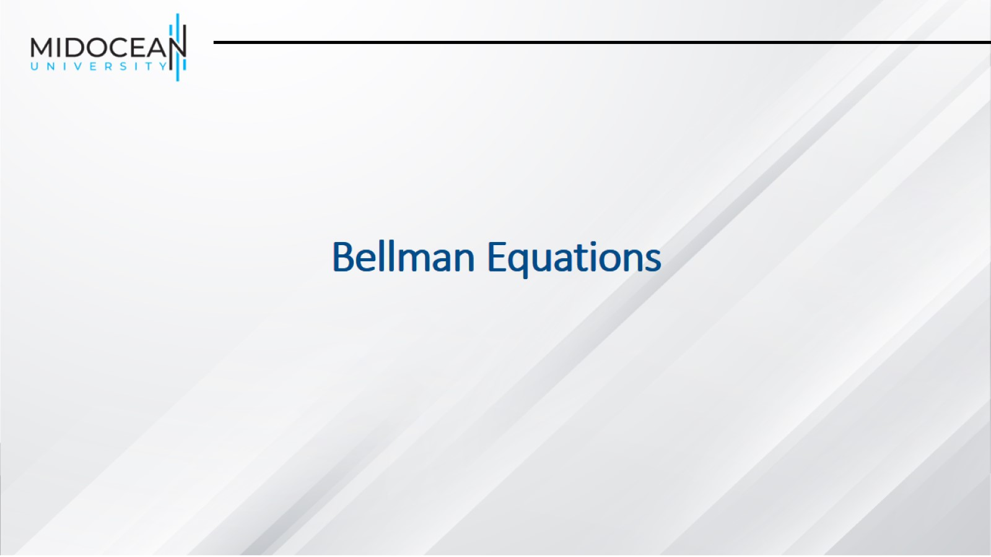
Bellman Equations

Slide 4
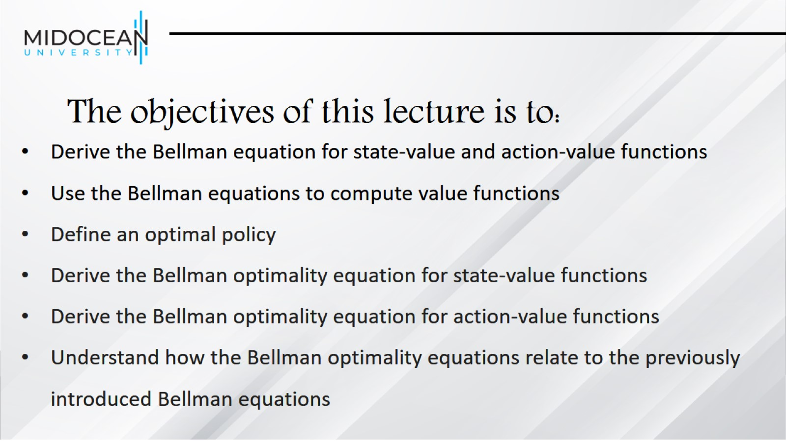
The objectives of this lecture is to:

Slide 5
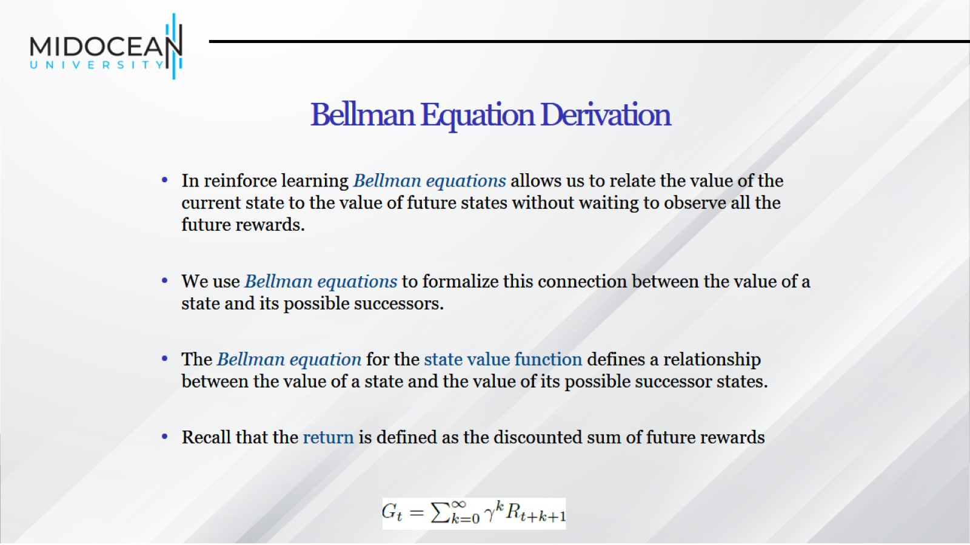
Bellman Equation Derivation

Slide 6
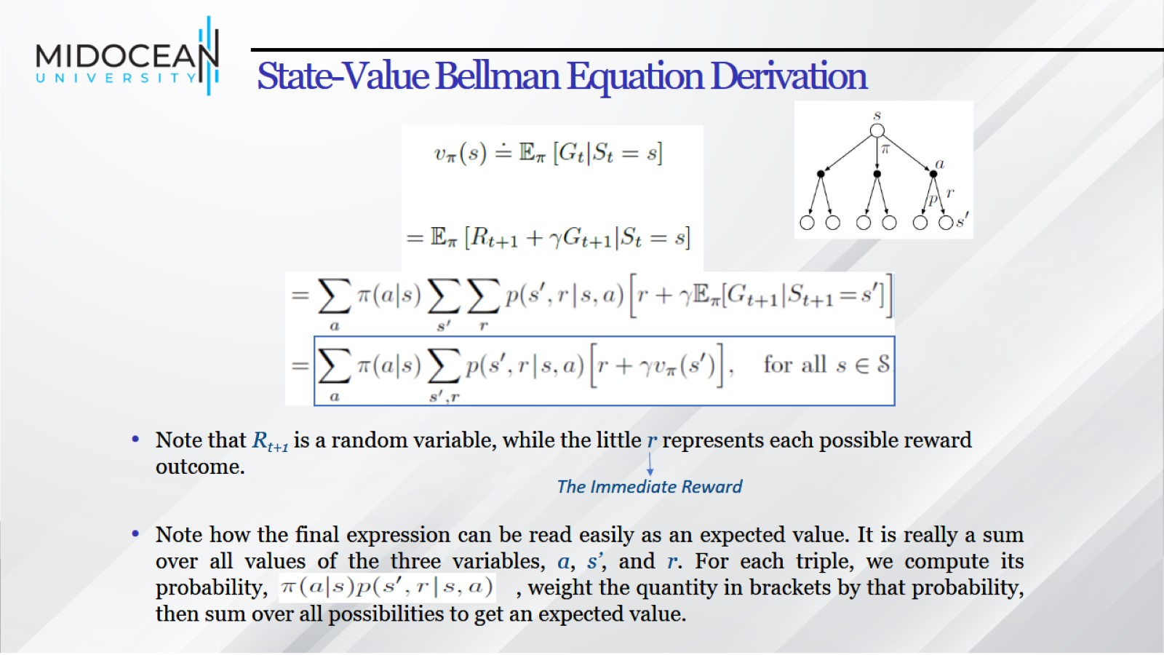
State-Value Bellman Equation Derivation

Slide 7
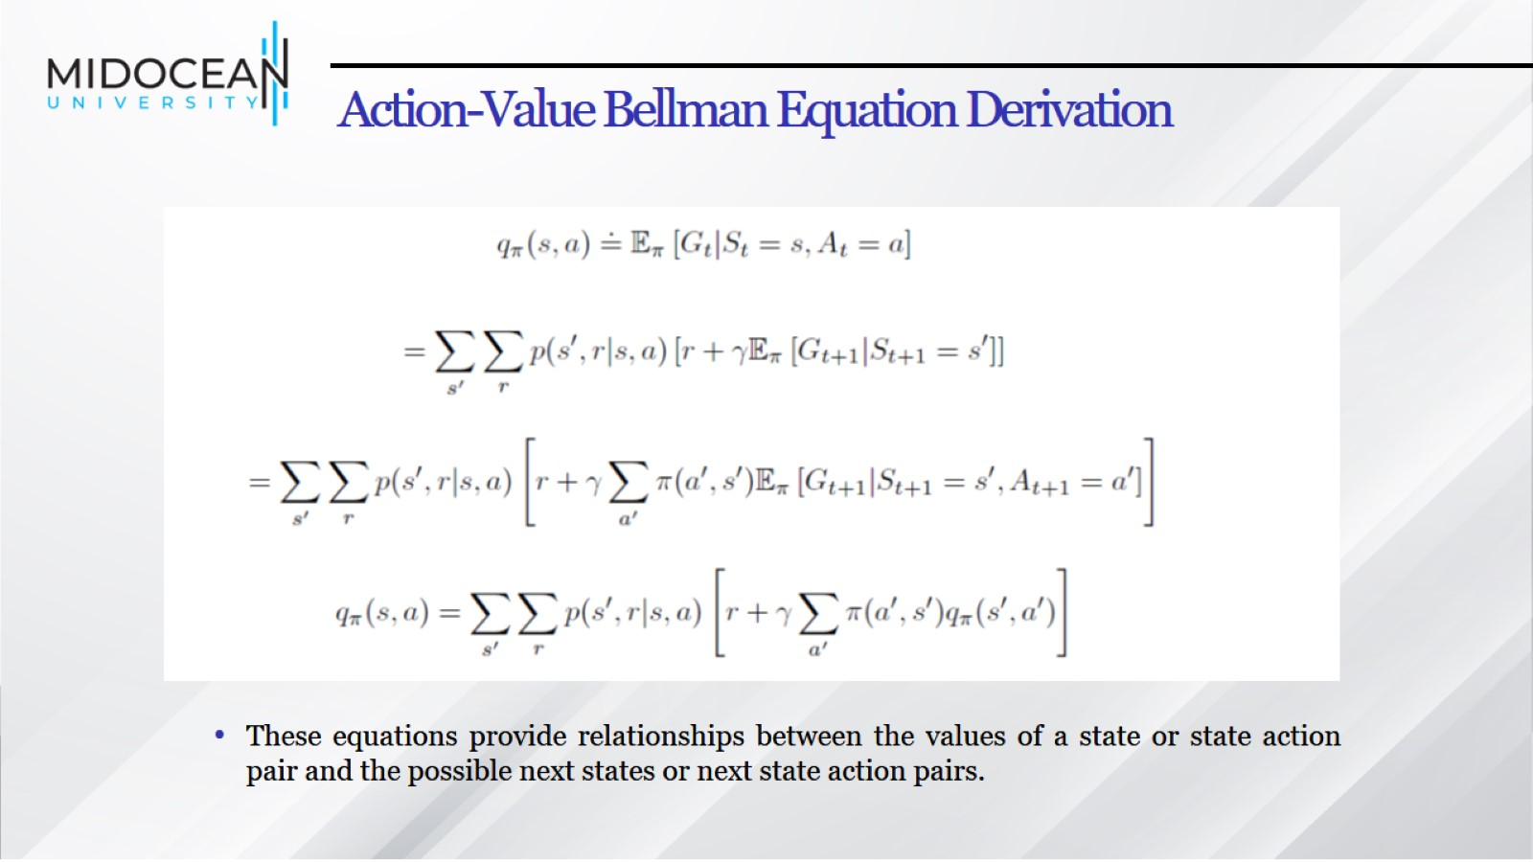
Action-Value Bellman Equation Derivation

Slide 8
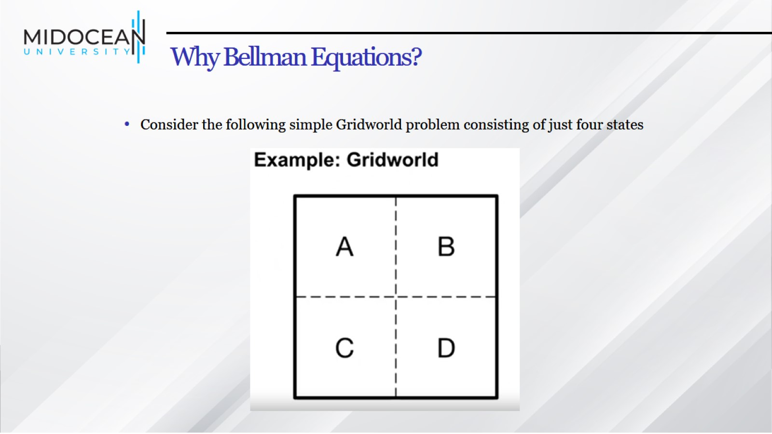
Why Bellman Equations?

Slide 9
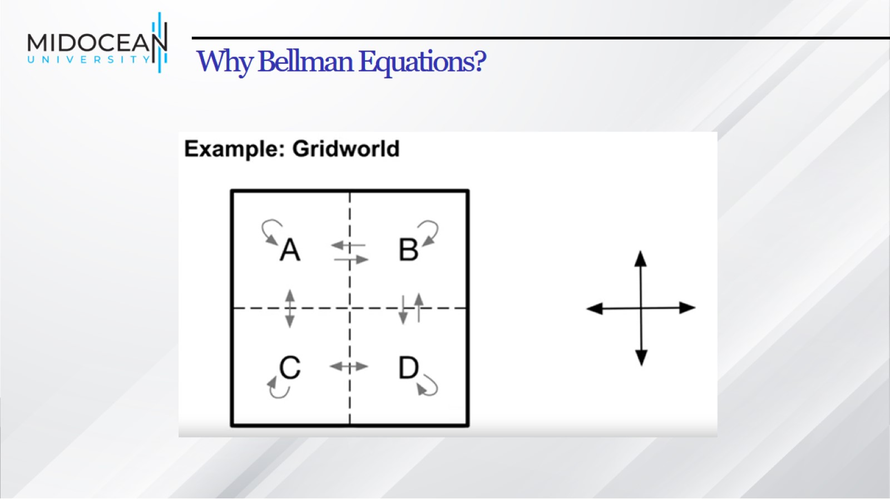
Why Bellman Equations?

Slide 10
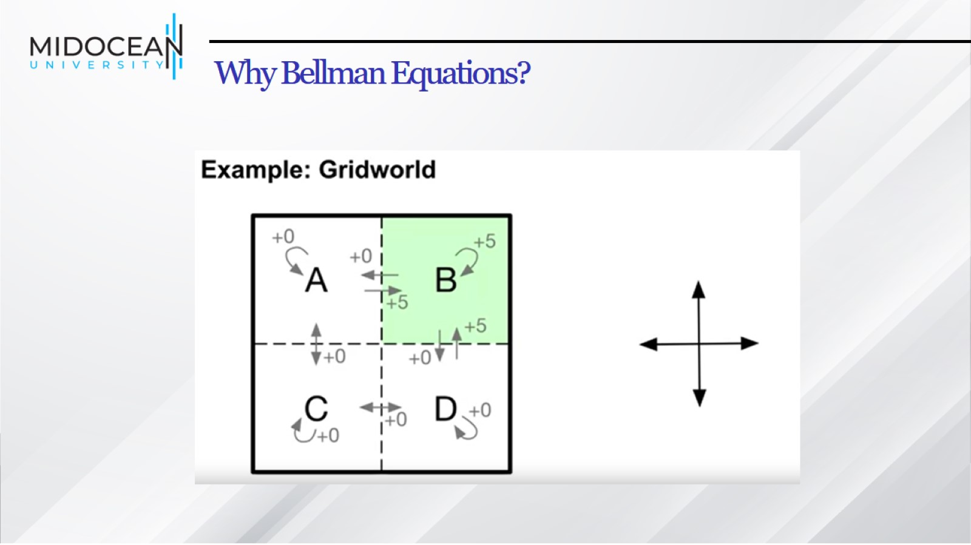
Why Bellman Equations?

Slide 11
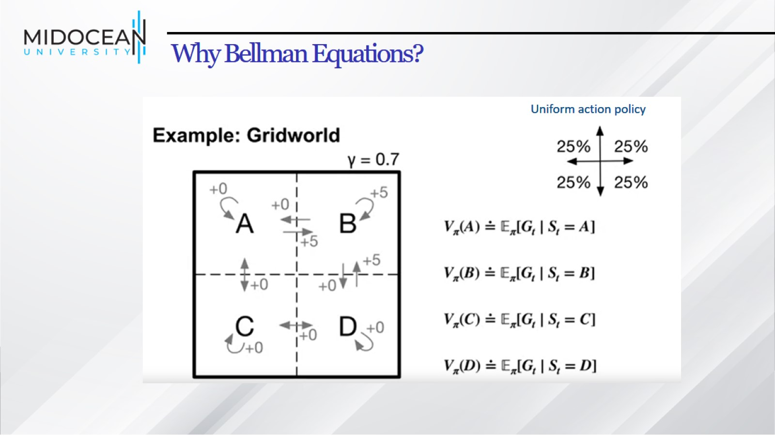
Why Bellman Equations?

Slide 12
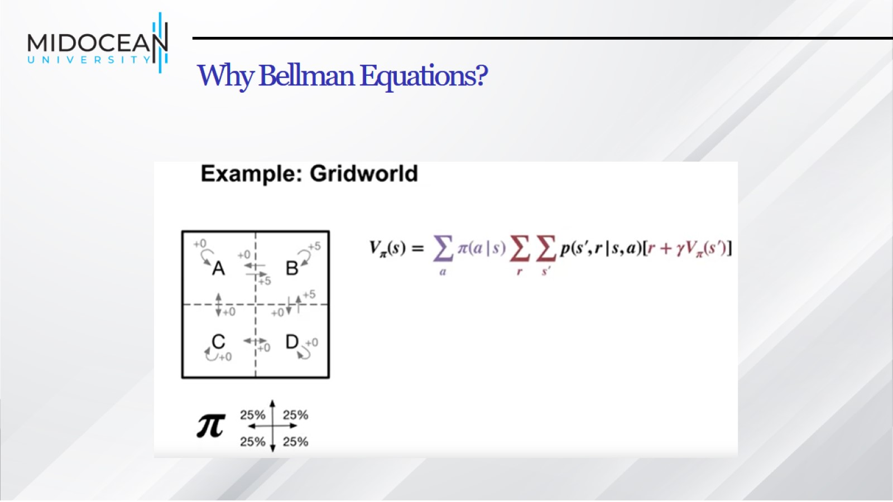
Why Bellman Equations?

Slide 13
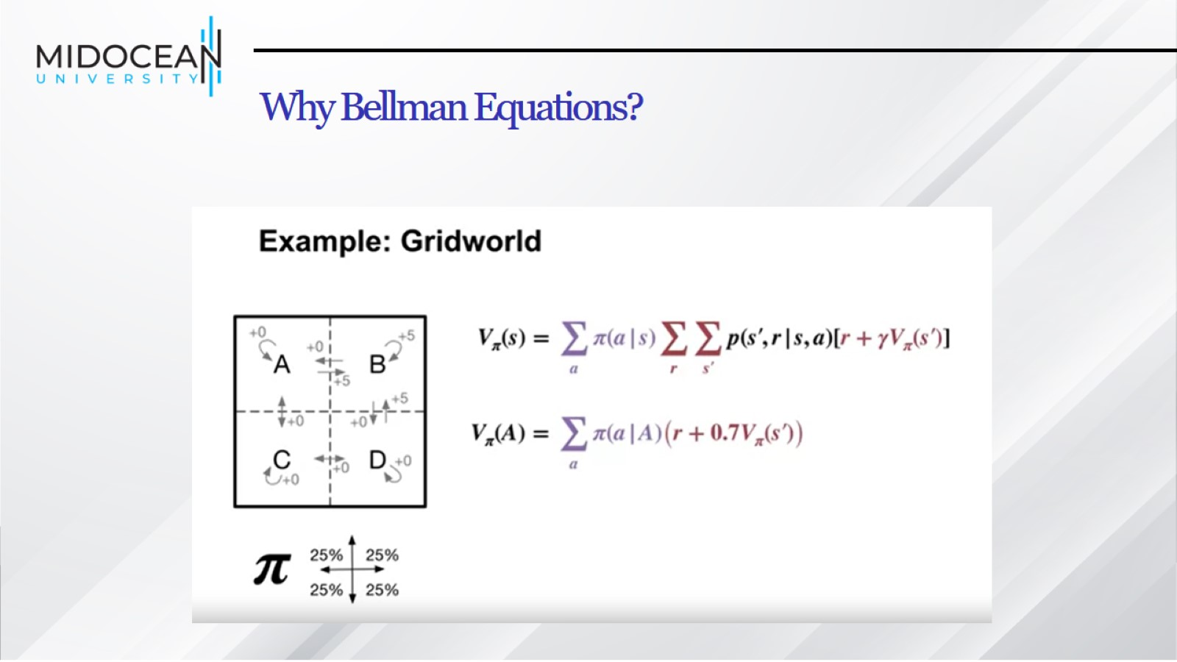
Why Bellman Equations?

Slide 14
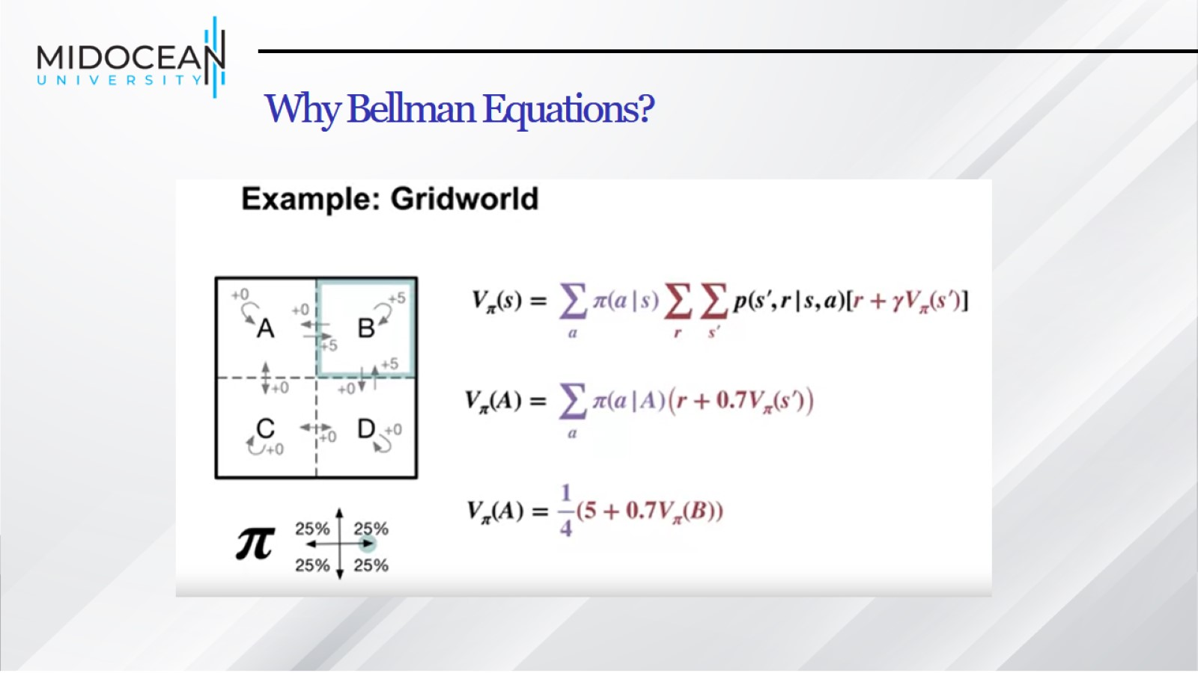
Why Bellman Equations?

Slide 15
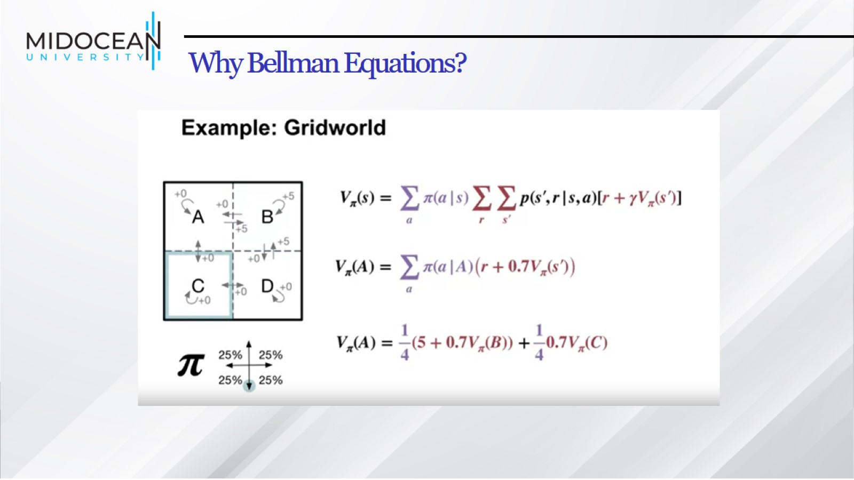
Why Bellman Equations?

Slide 16
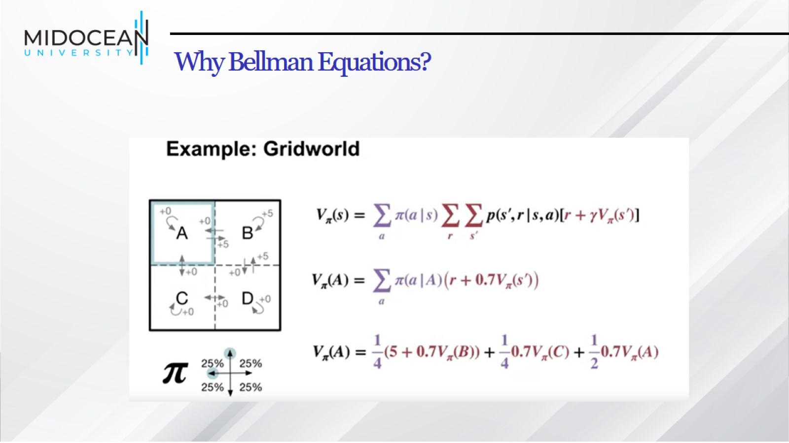
Why Bellman Equations?

Slide 17
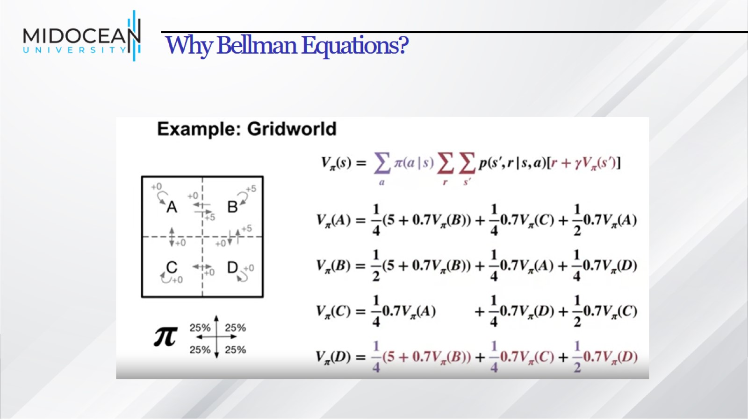
Why Bellman Equations?

Slide 18
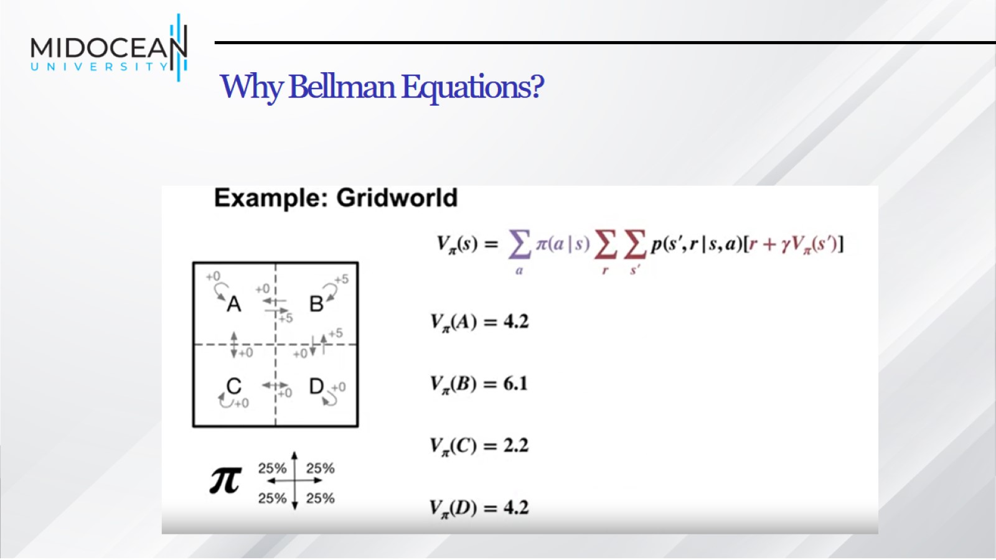
Why Bellman Equations?

Slide 19
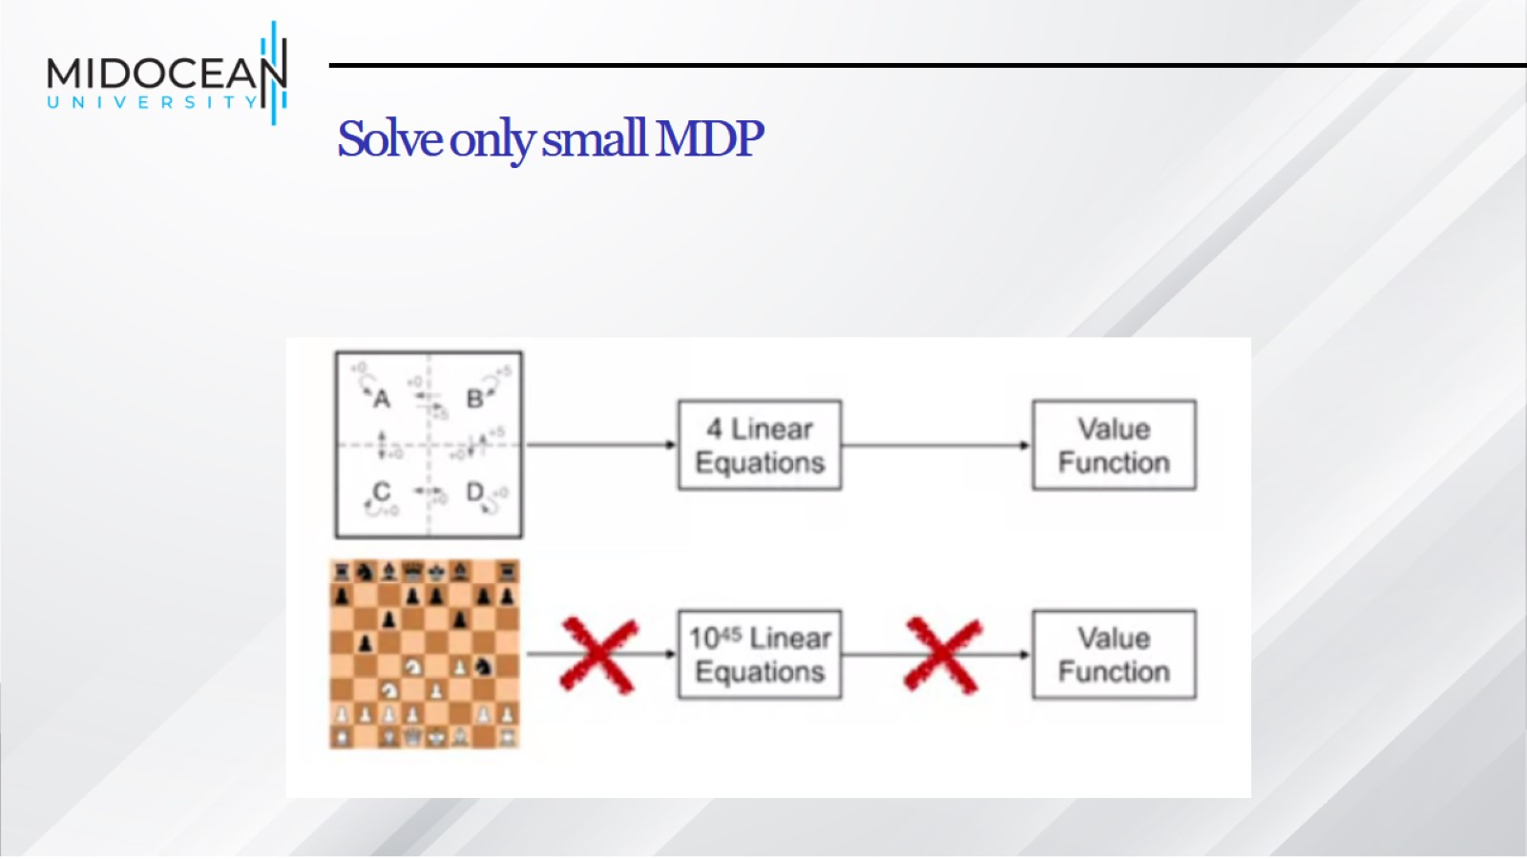
Solve only small MDP

Slide 20
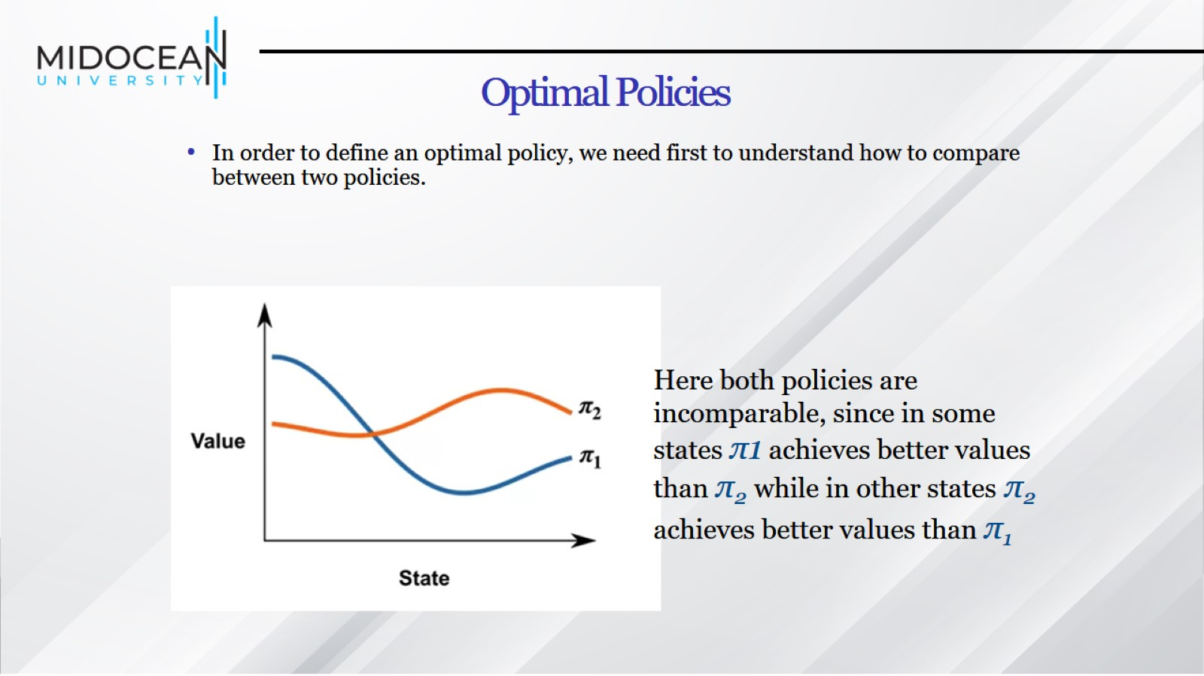
Optimal Policies

Slide 21
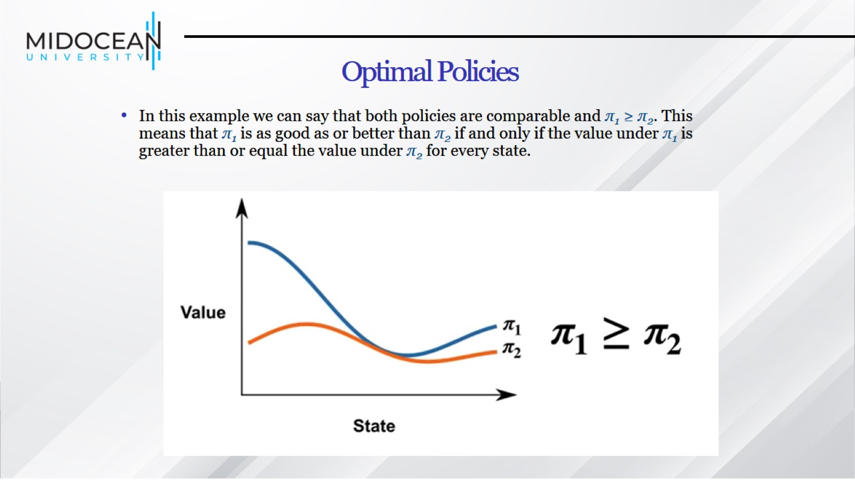
Optimal Policies

Slide 22
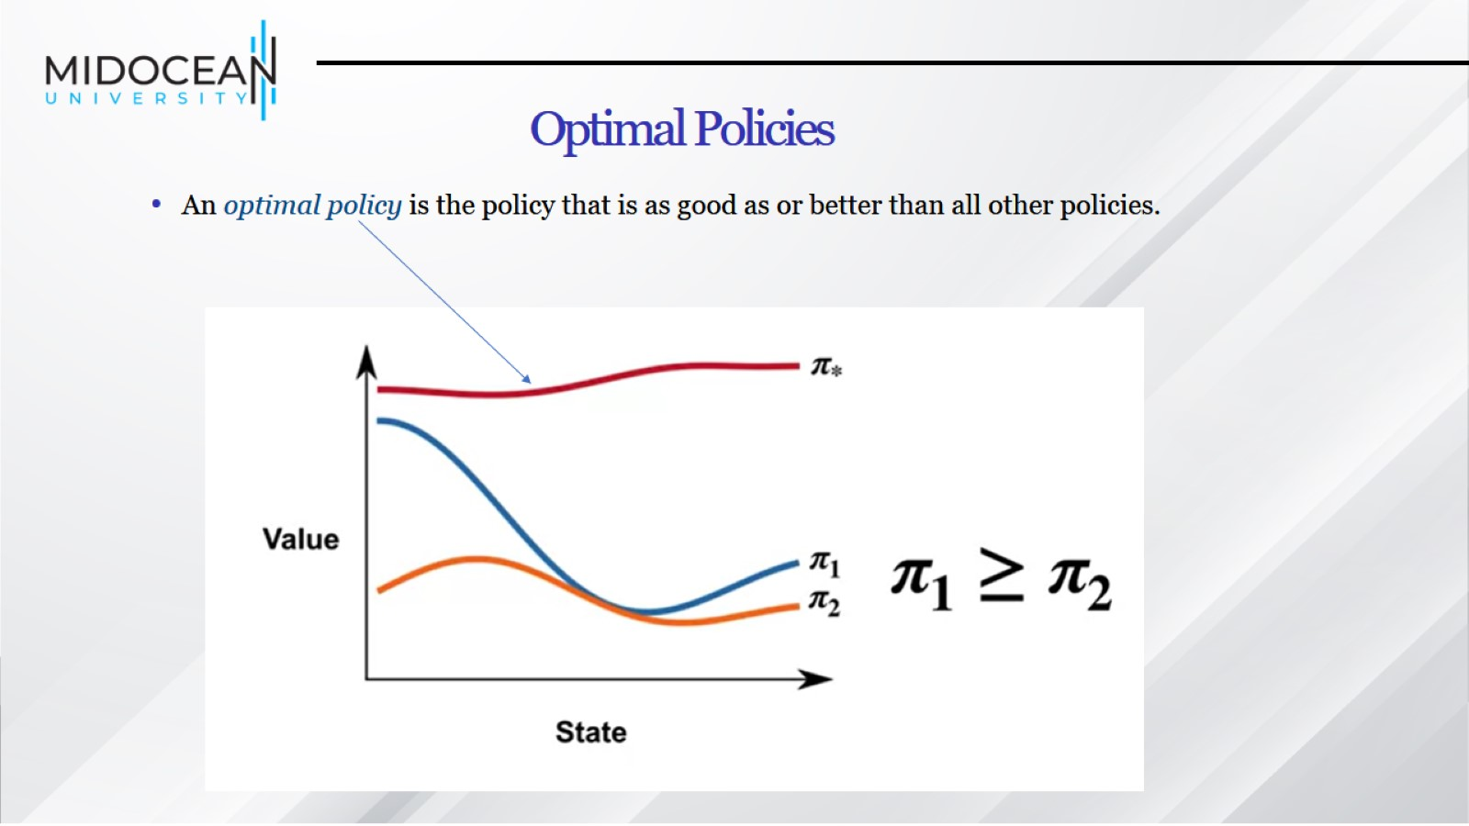
Optimal Policies

Slide 23
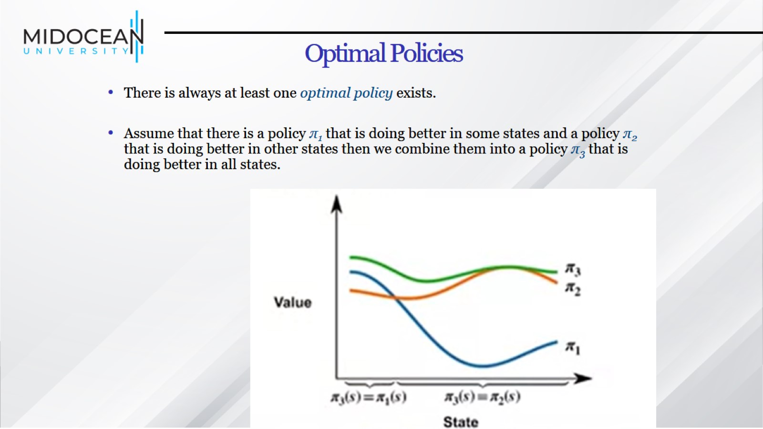
Optimal Policies

Slide 24
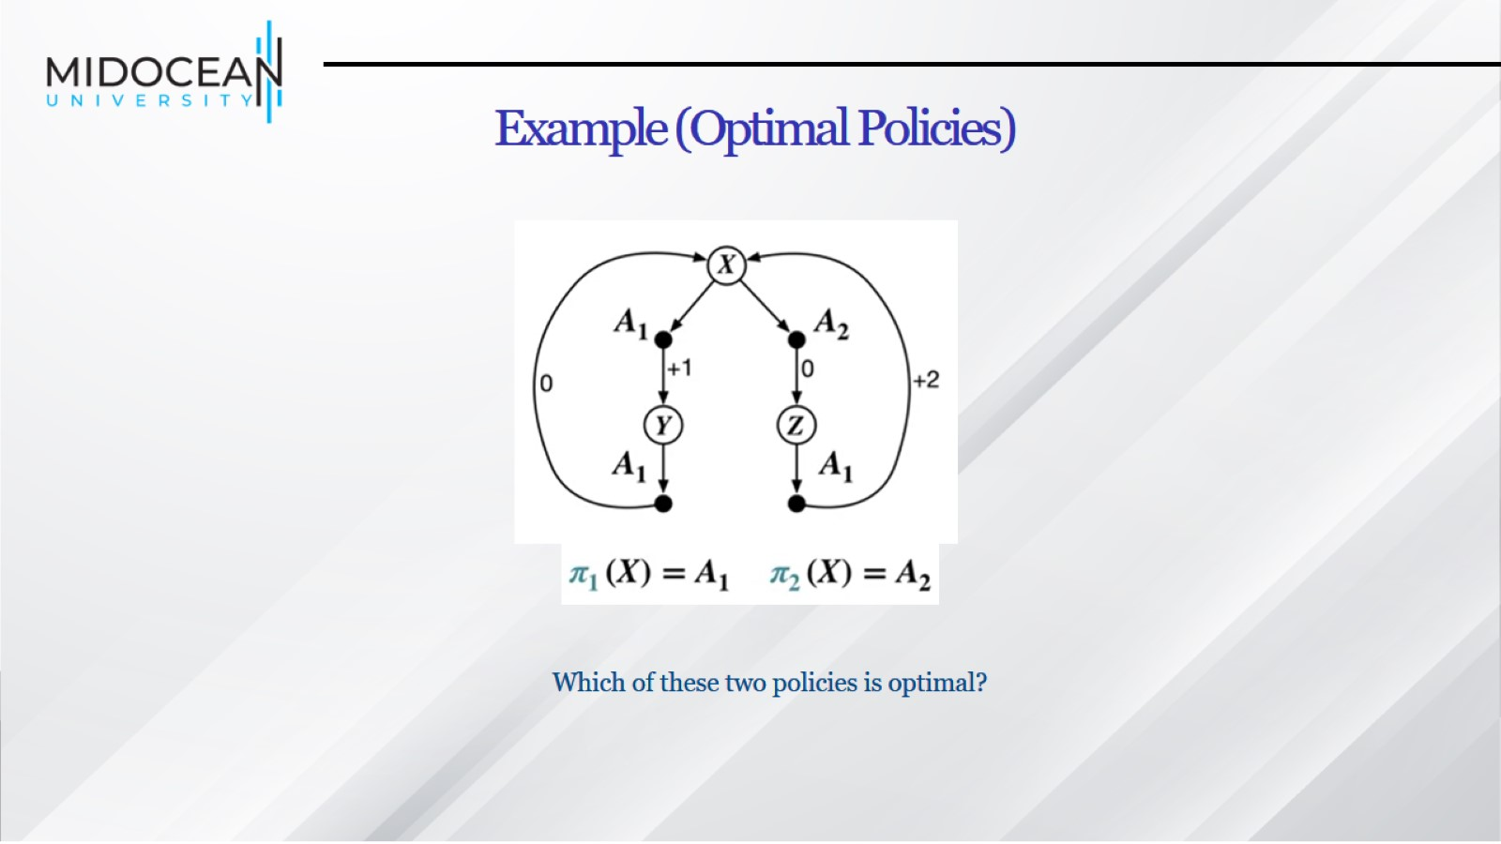
Example (Optimal Policies)

Slide 25
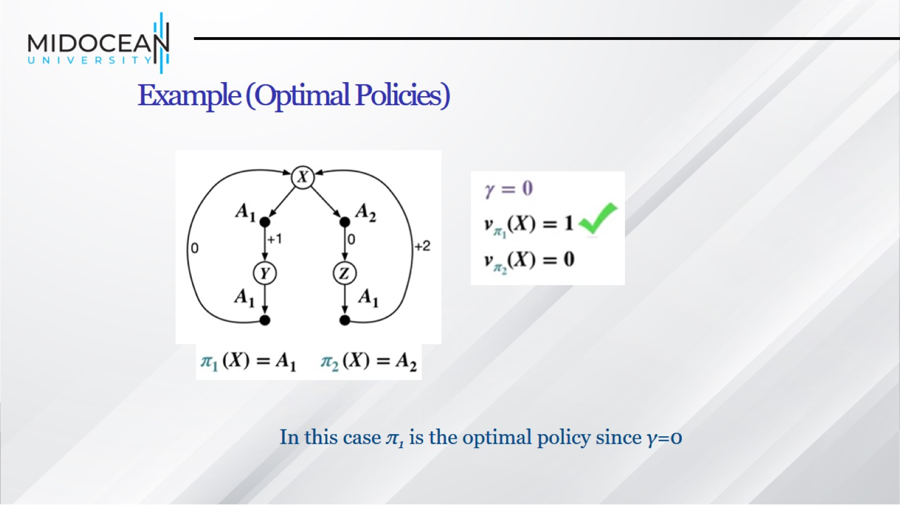
Example (Optimal Policies)

Slide 26
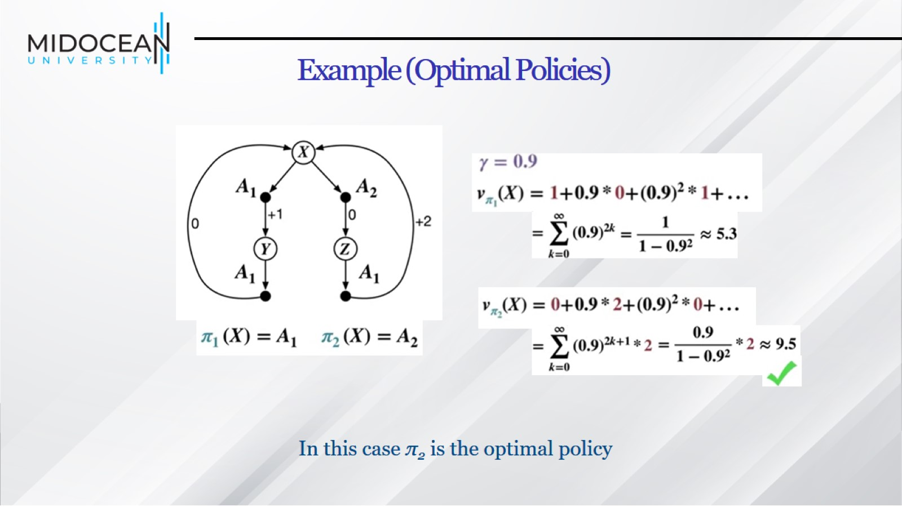
Example (Optimal Policies)

Slide 27
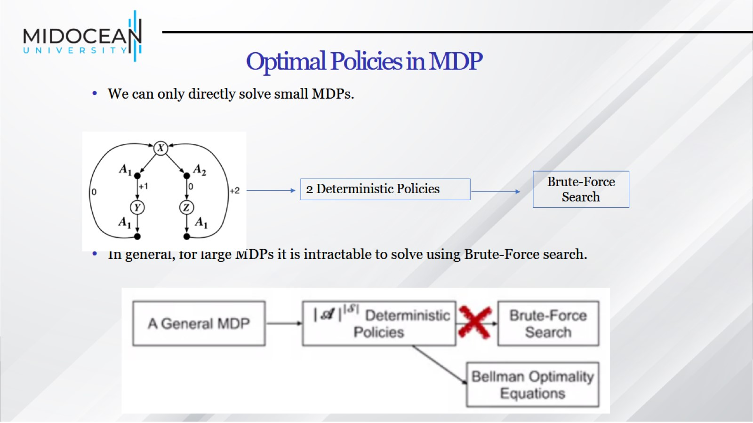
Optimal Policies in MDP

Slide 28
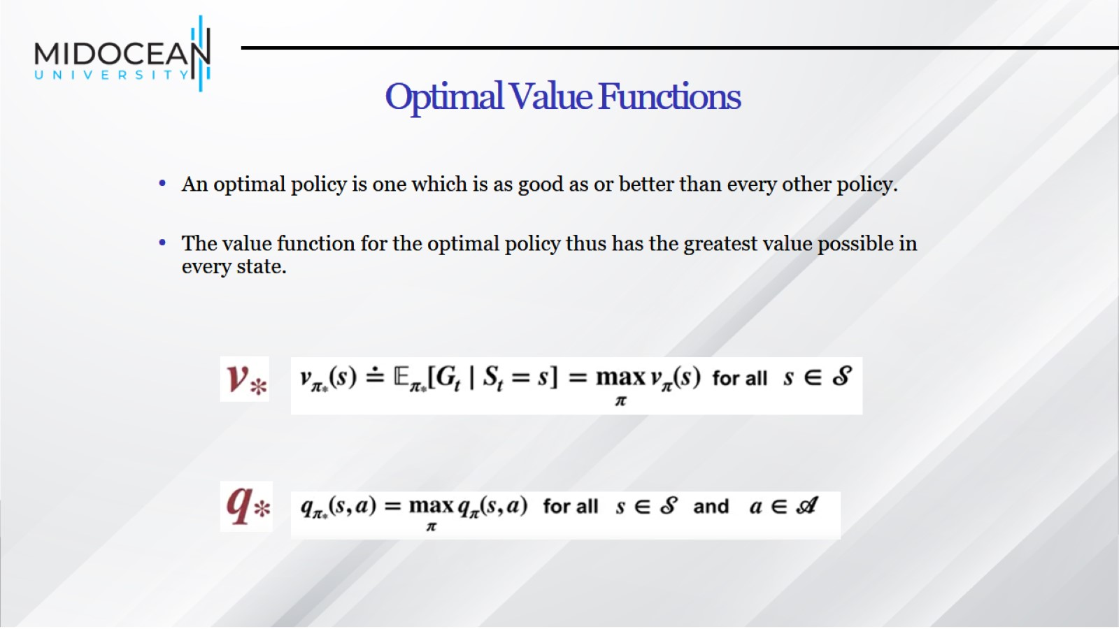
Optimal Value Functions

Slide 29
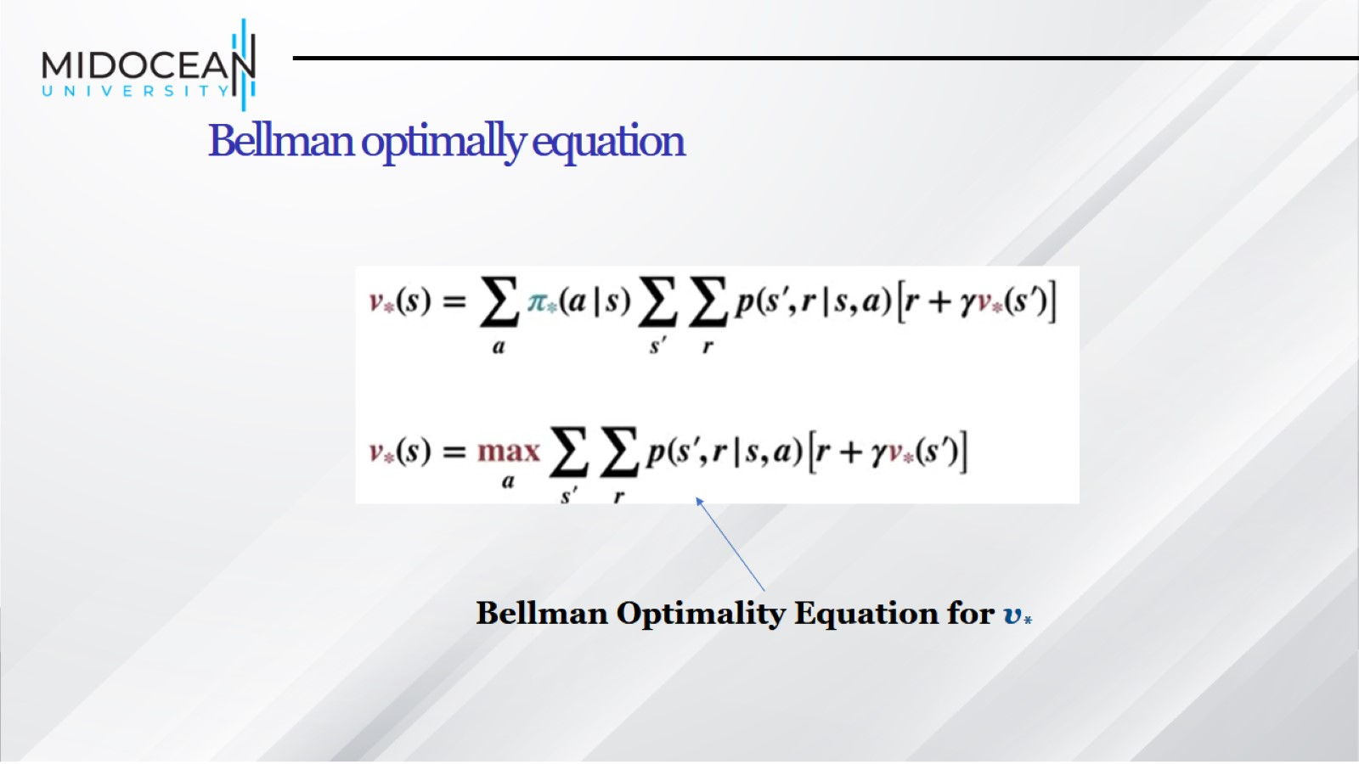
Bellman optimally equation

Slide 30
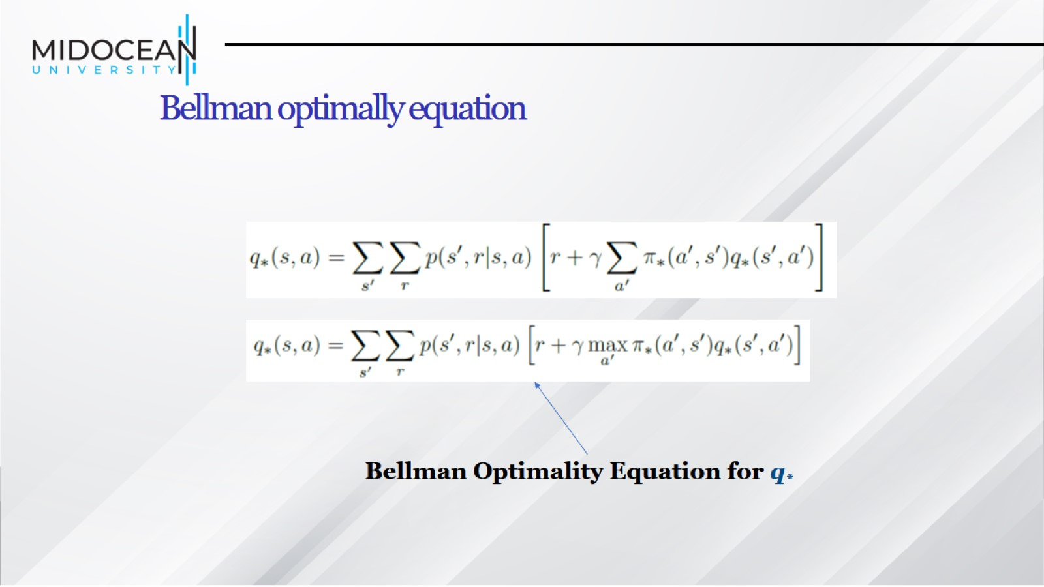
Bellman optimally equation

Slide 31
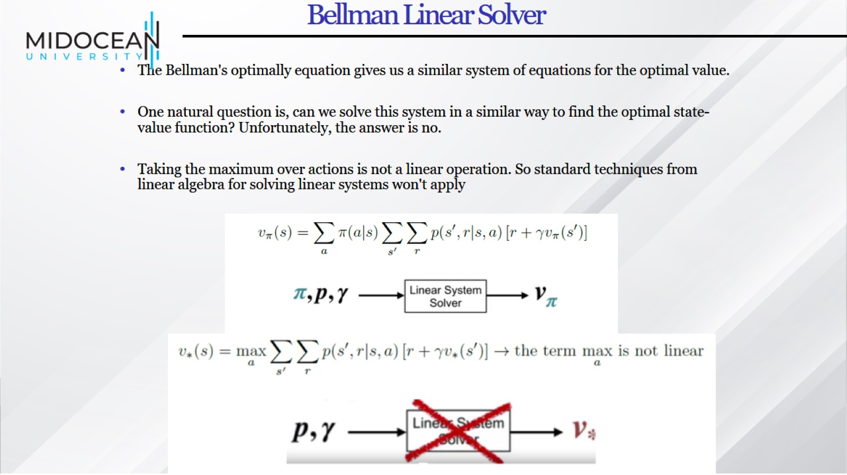
Bellman Linear Solver

Slide 32
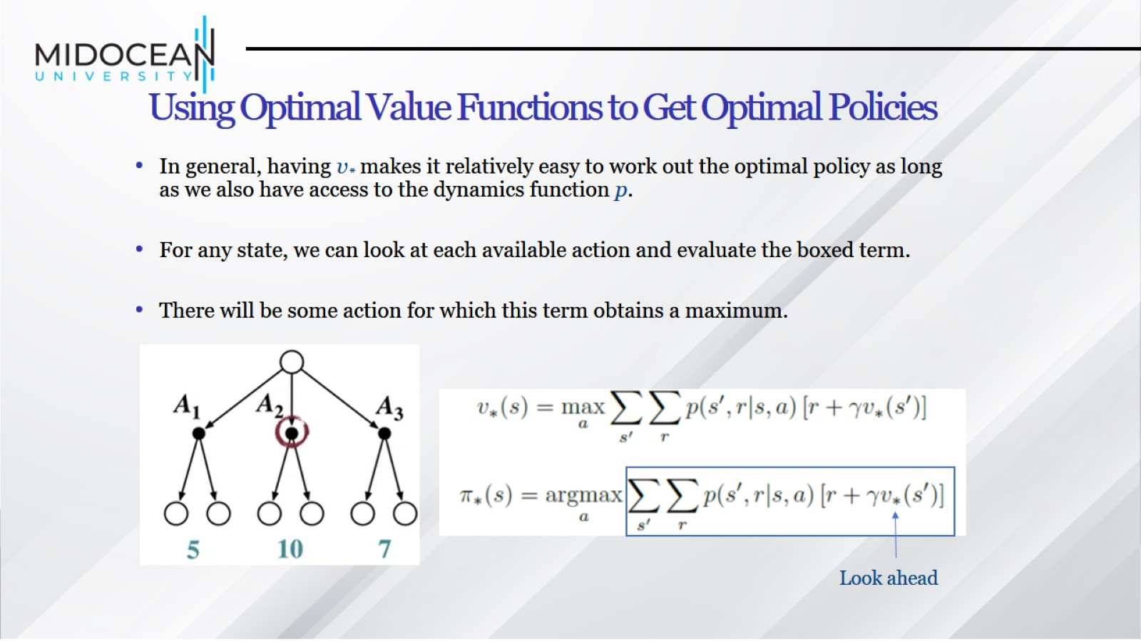
Using Optimal Value Functions to Get Optimal Policies

Slide 33
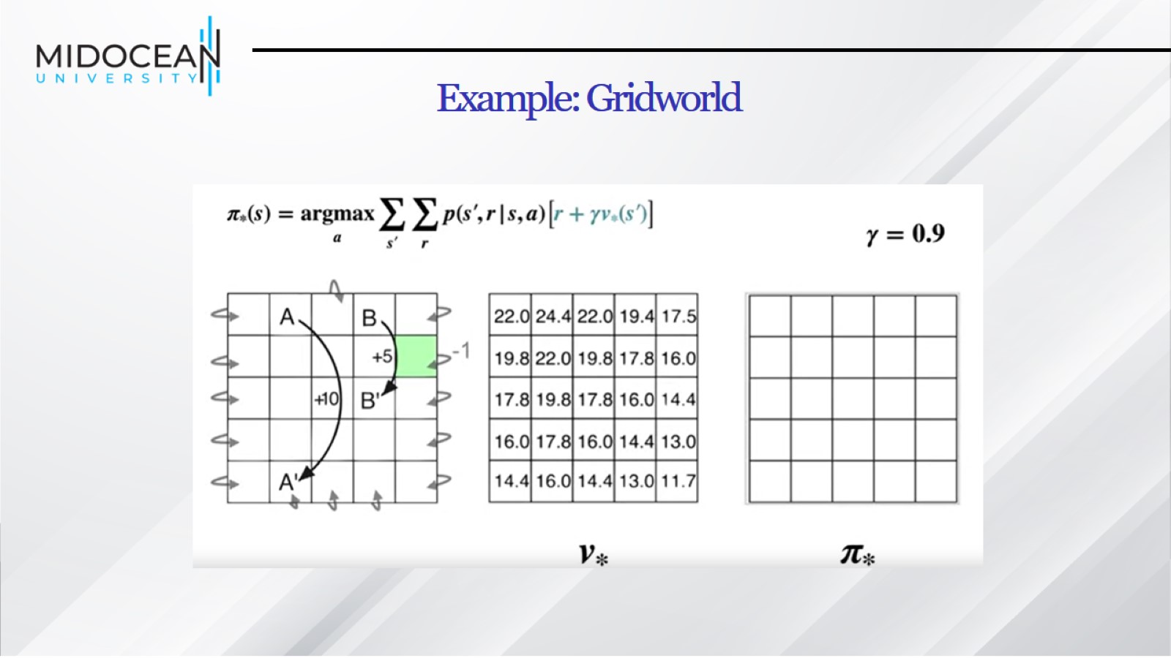
Example: Gridworld

Slide 34
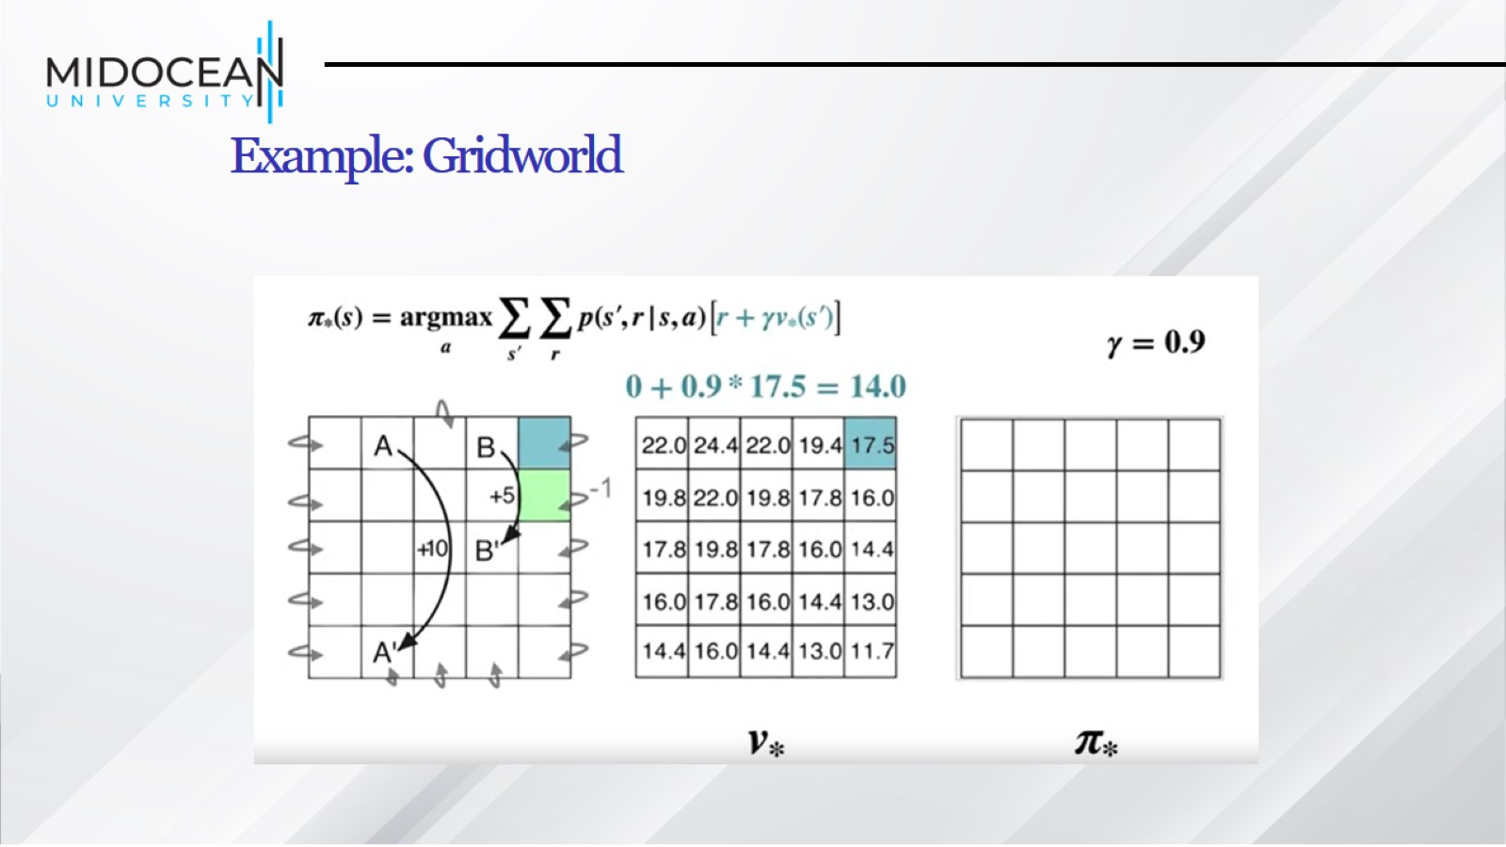
Example: Gridworld

Slide 35
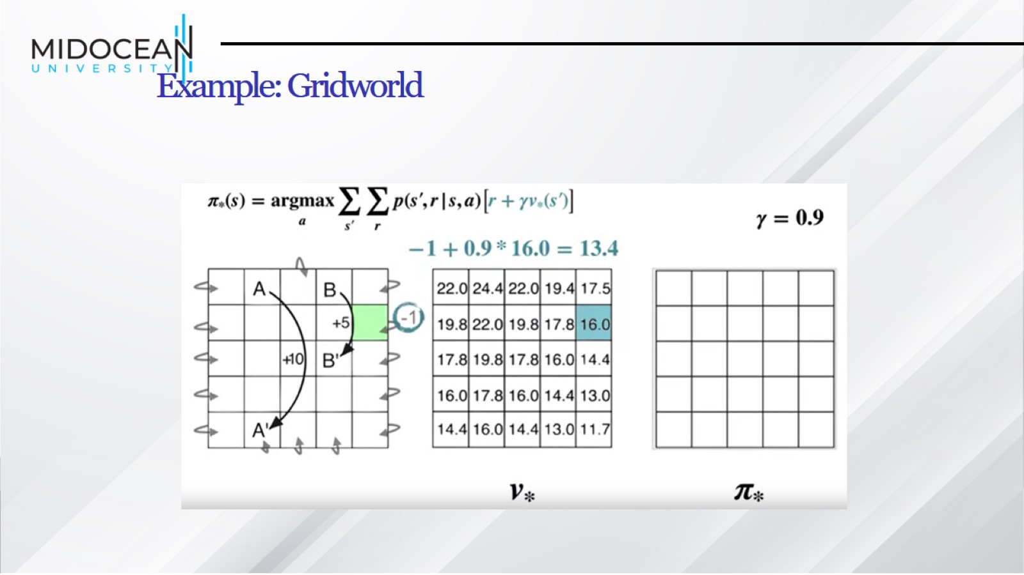
Example: Gridworld

Slide 36
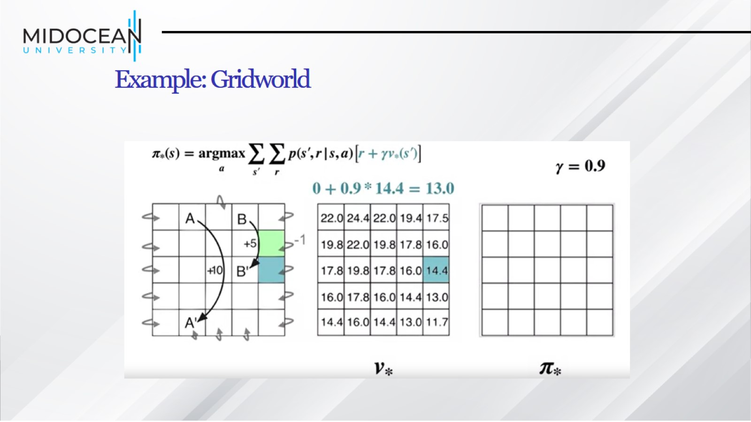
Example: Gridworld

Slide 37
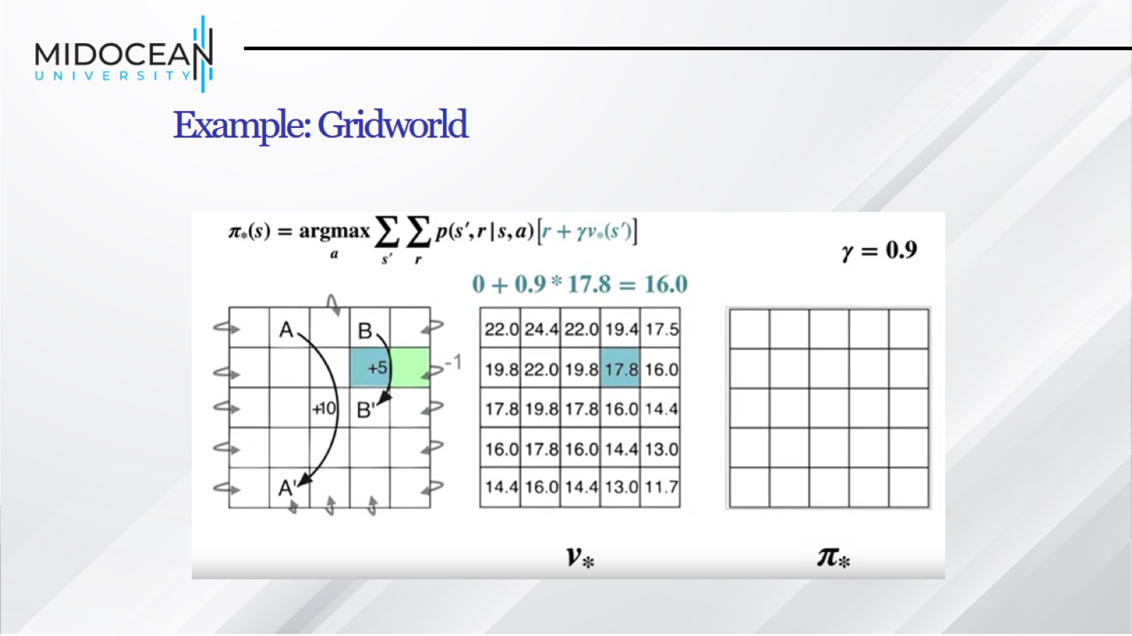
Example: Gridworld

Slide 38
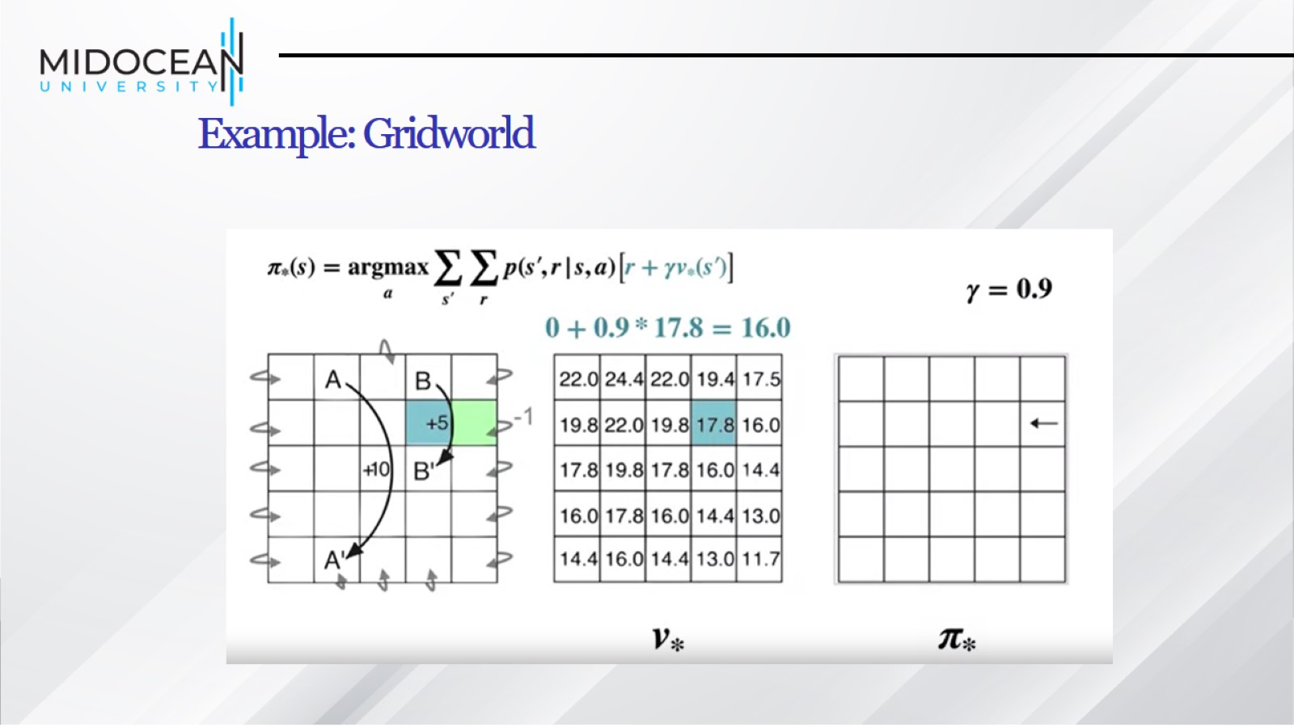
Example: Gridworld

Slide 39
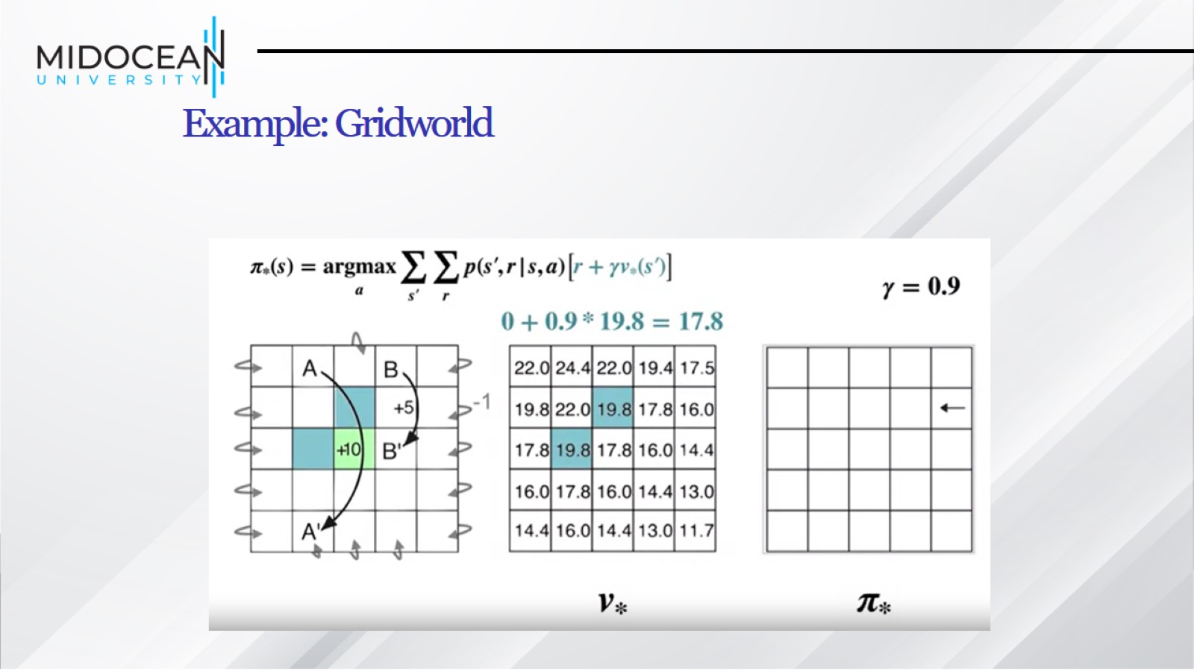
Example: Gridworld

Slide 40
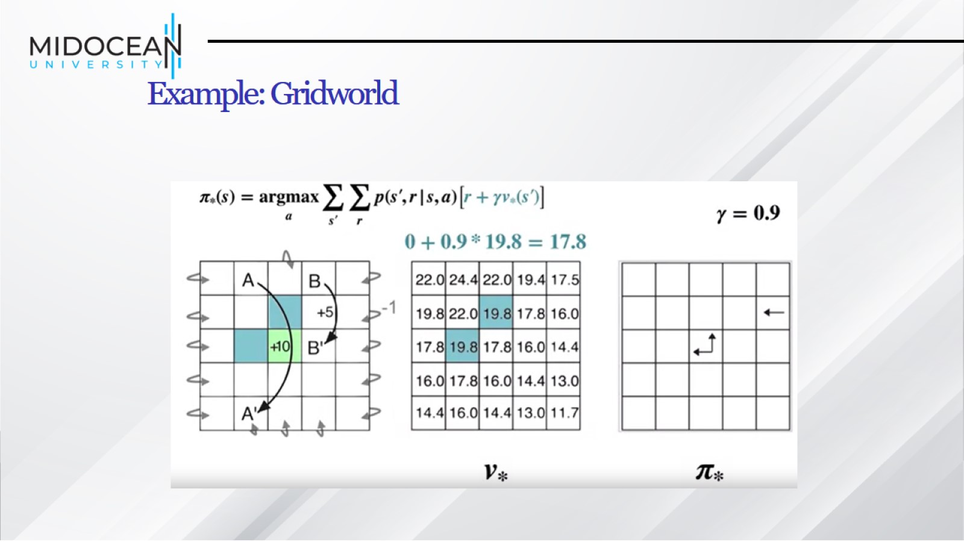
Example: Gridworld

Slide 41
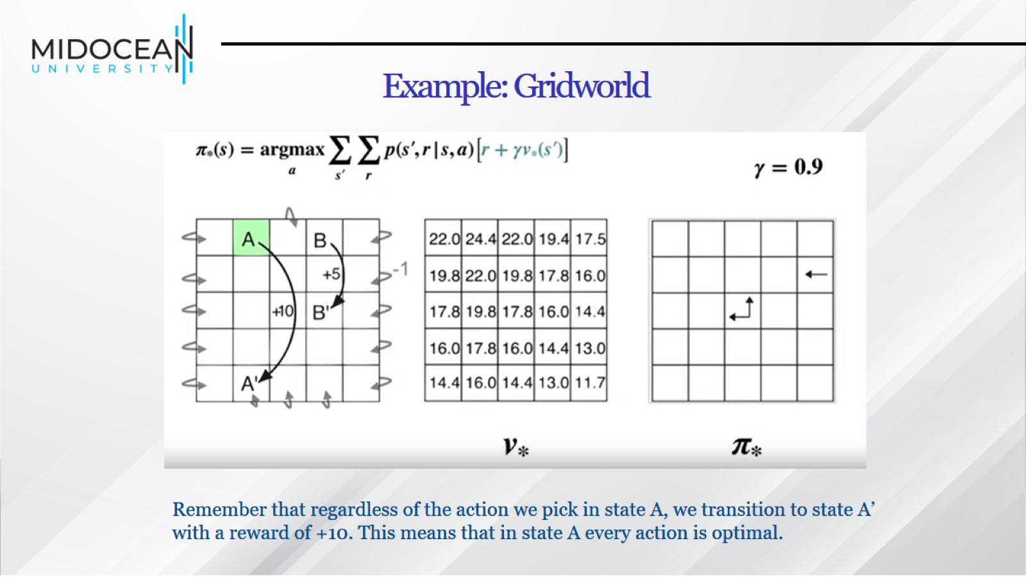
Example: Gridworld

Slide 42
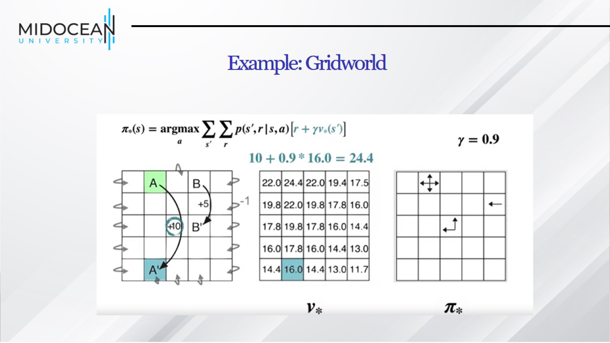
Example: Gridworld

Slide 43
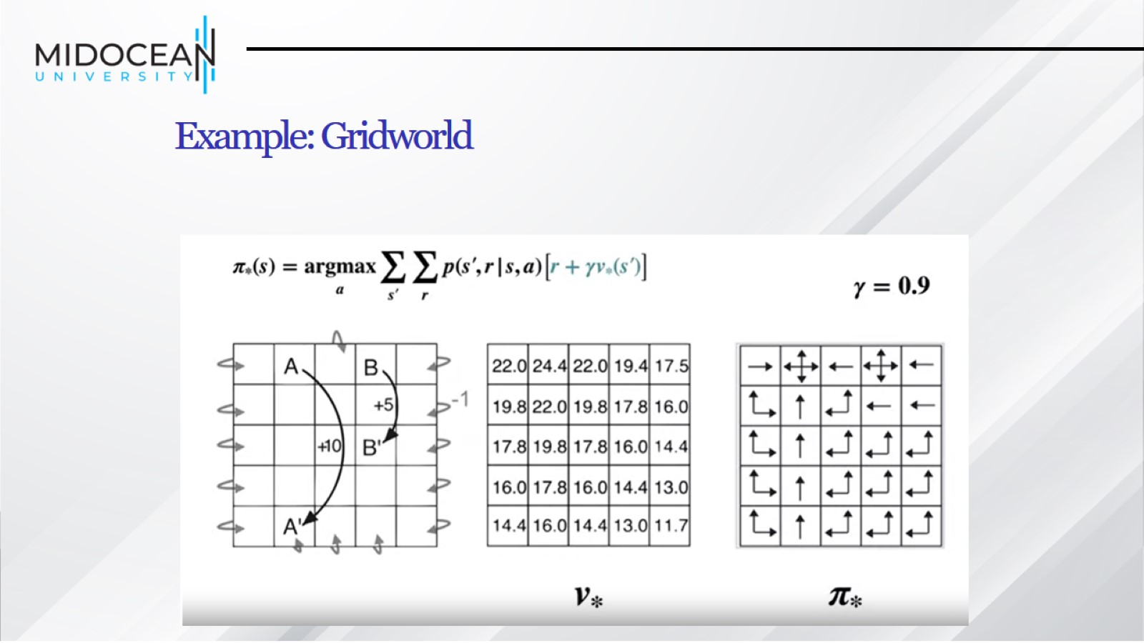
Example: Gridworld

Slide 44
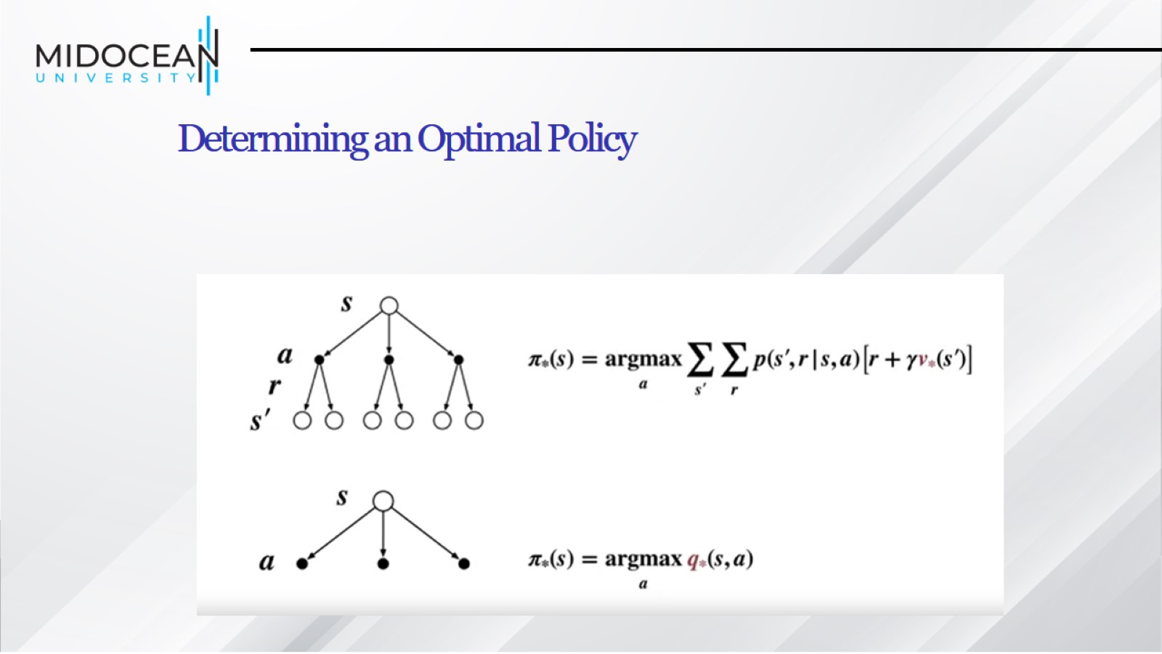
Determining an Optimal Policy

Slide 45
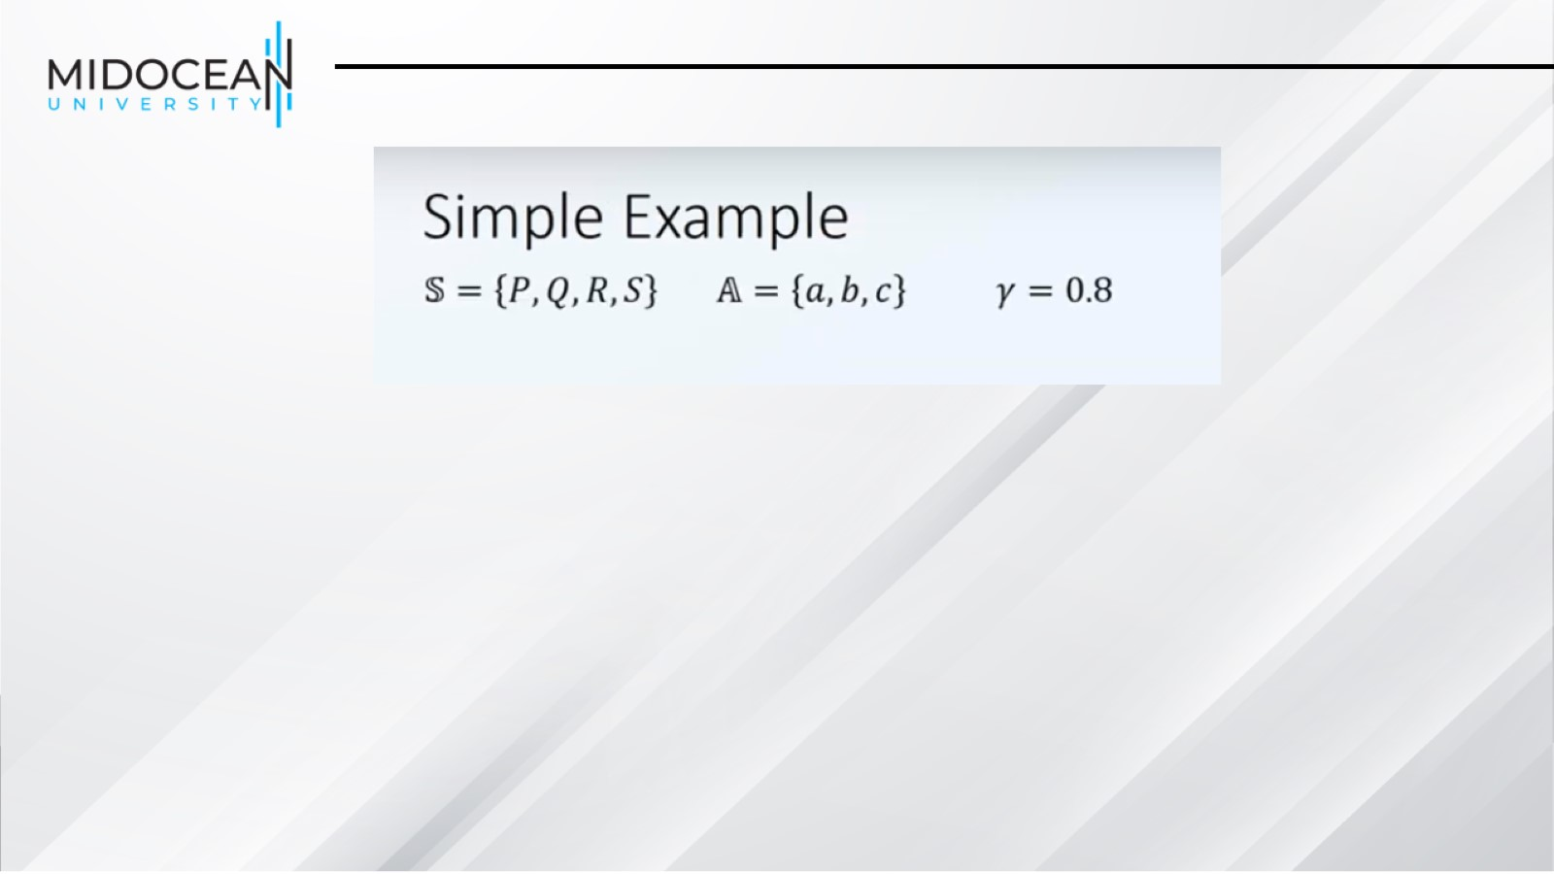

Slide 46
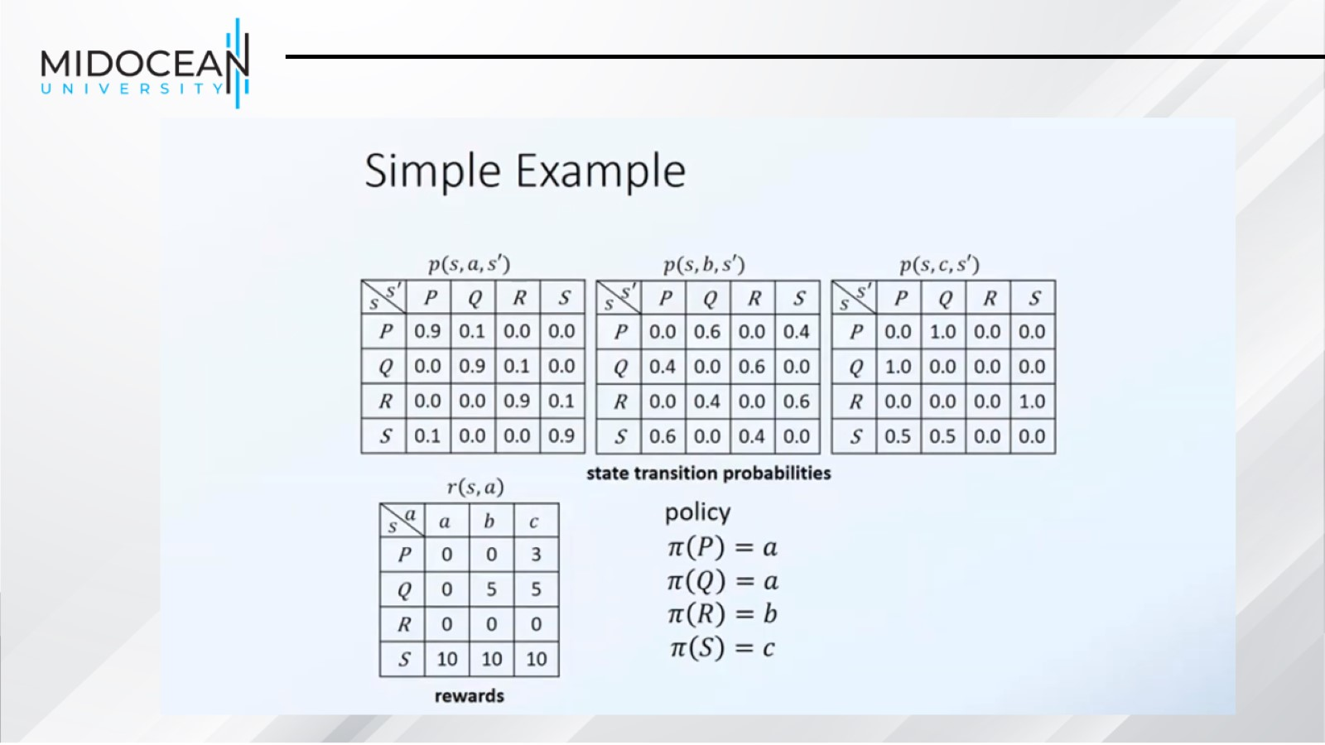

Slide 47
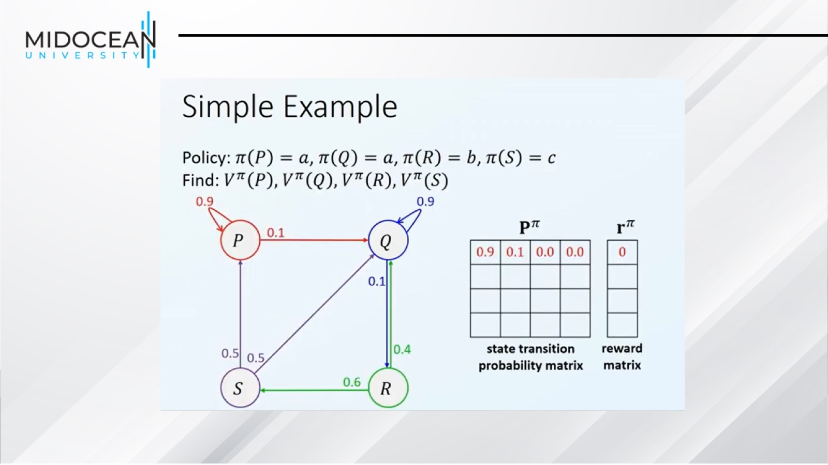

Slide 49
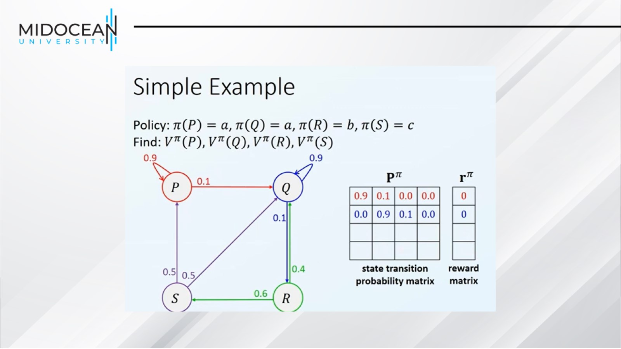

Slide 51
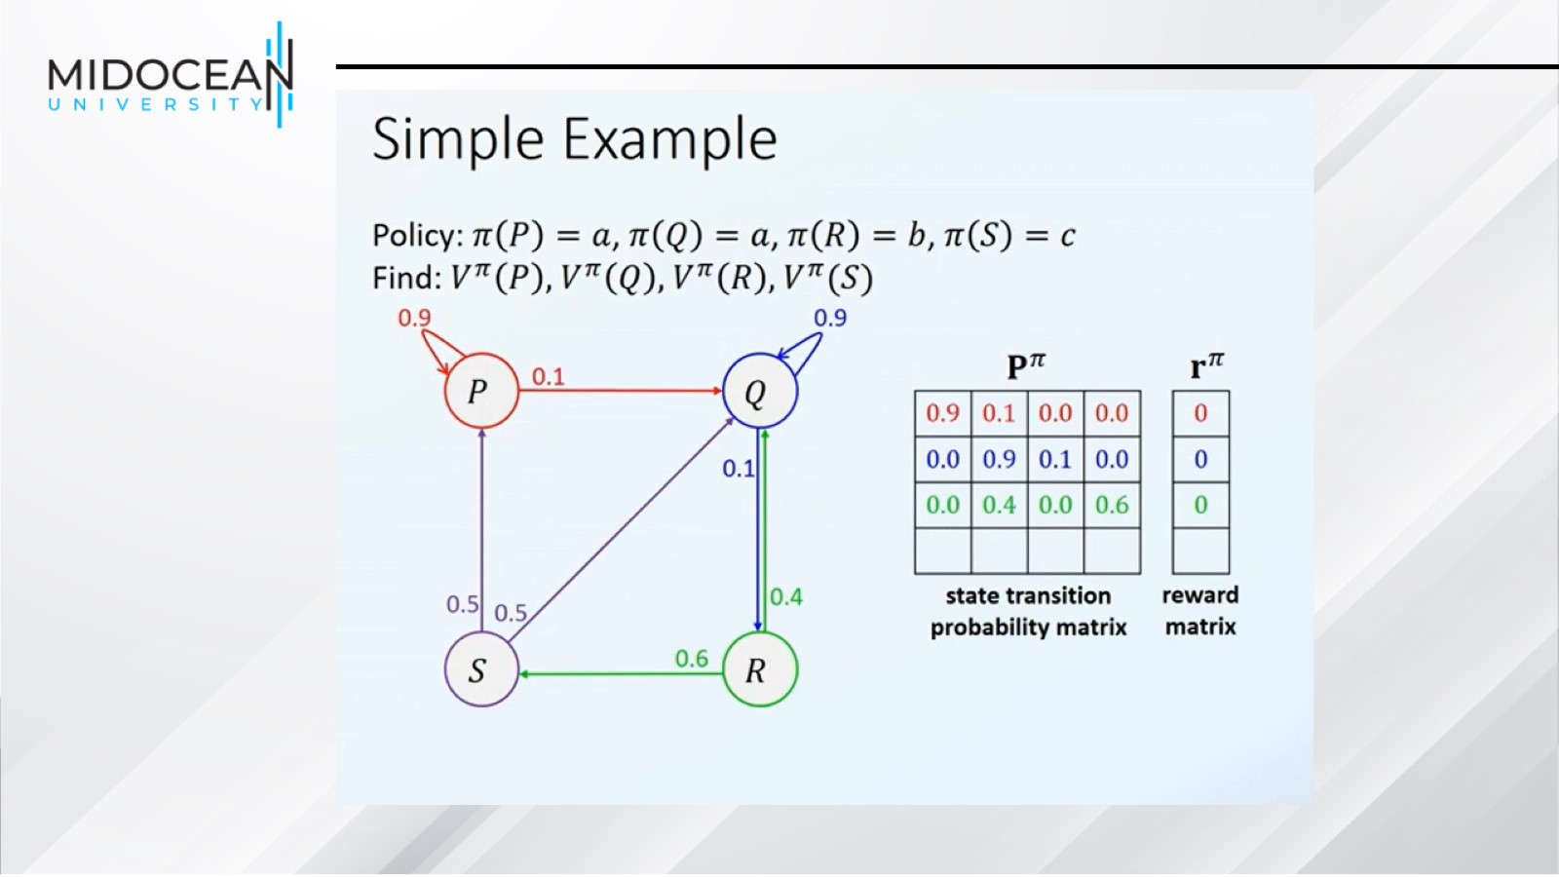

Slide 53
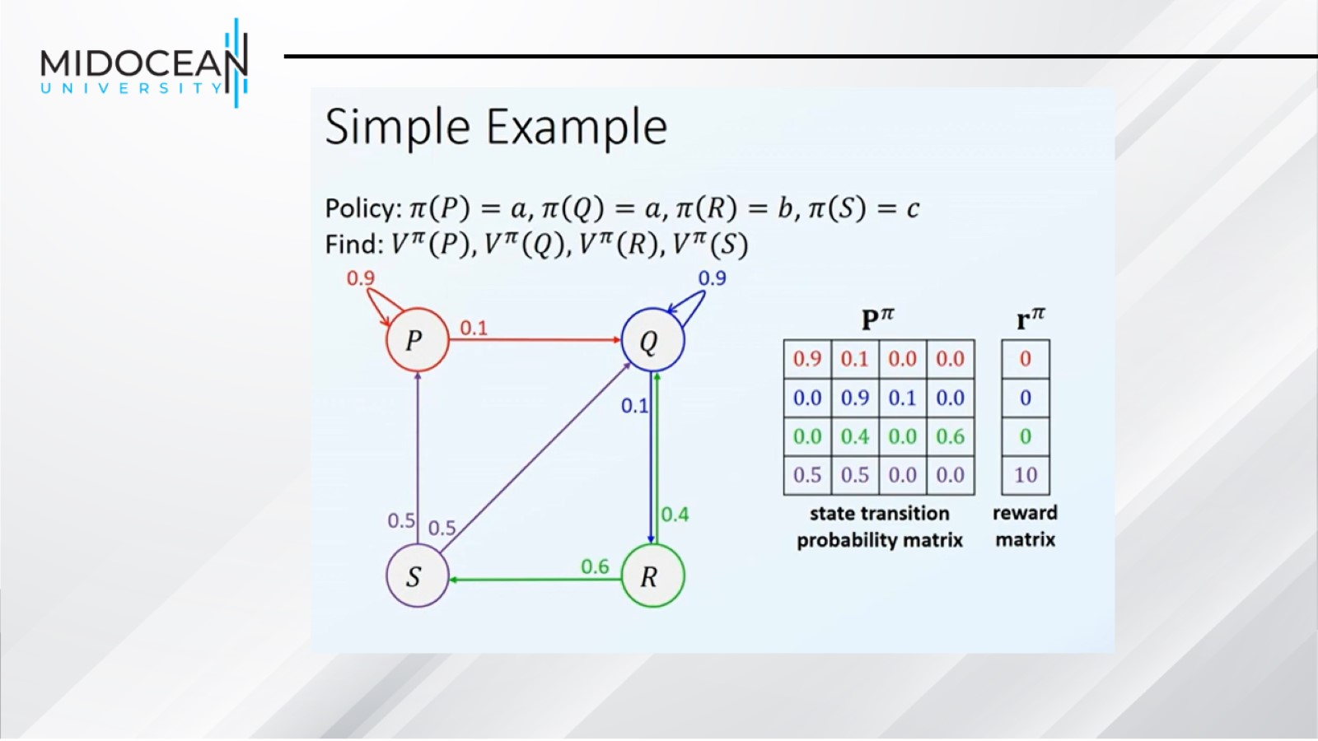

Slide 54
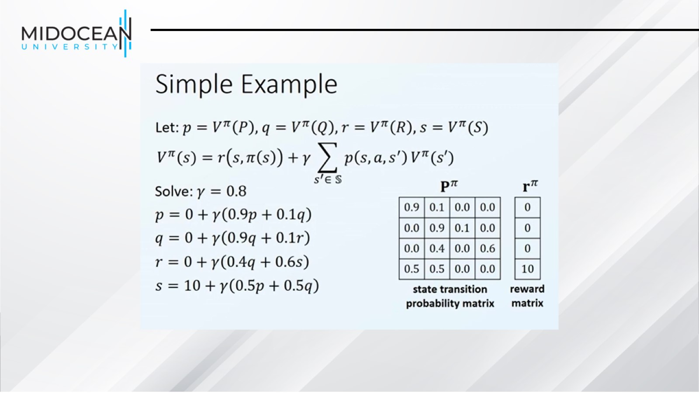

Slide 55


