Slide 1

Lecture 3:
Scheduling
PMG 605
Project Resources and Time Management
Dr. Eng.
Abdullah Jameel Halawany

Slide 2
Session Outline
Scheduling
What is Scheduling?
Planning vs. Scheduling
Project Scheduling Process
Baseline
Summary
Project Scheduling Terms
3–2

Slide 3
Project Management Activities
Planning
  Objectives
  Resources
  Work break-down structure
  Organization
Scheduling
  Project activities
  Start and end times
  Network
Controlling
  Monitor, compare, revise, action
3–3

Slide 4
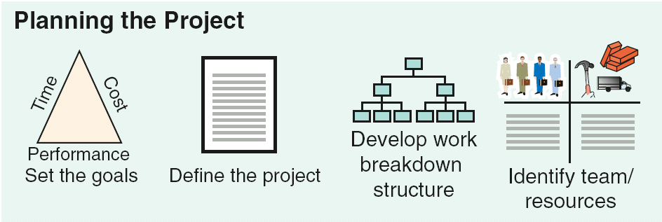
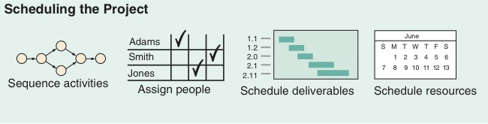
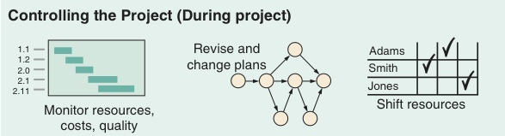
Project Planning, Scheduling, and Controlling
Time/cost estimates
Budgets
Engineering diagrams
Cash flow charts
Material availability details
Budgets
Delayed activities report
Slack activities report
CPM/PERT
Gantt charts
Milestone charts
Cash flow schedules
3–4

Slide 5
Why Estimating Project Times and Costs are Important?
To support good decisions.
To schedule work.
To determine how long the project should take and its cost.
To determine whether the project is worth doing.
To develop cash flow needs.
To determine how well the project is progressing.
To develop time-phased budgets and establish the project baseline.
3–5

Slide 6
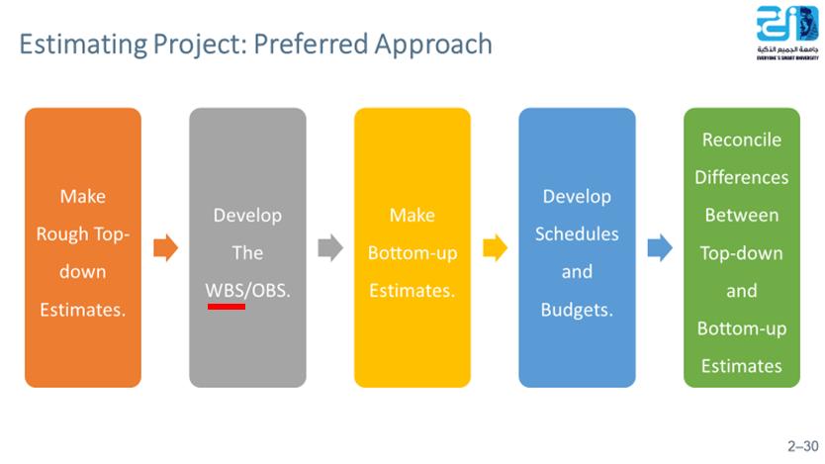
Estimating Process Output
Required Time fore each Task (Work Package / Activity)
Required Resources fore each Task (Work Package / Activity)
Required Cost fore each Task (Work Package / Activity)
Project Scheduling
Project Schedule Baseline
Resources Planning
Project Budget
Project Cost Baseline
3–6

Slide 7
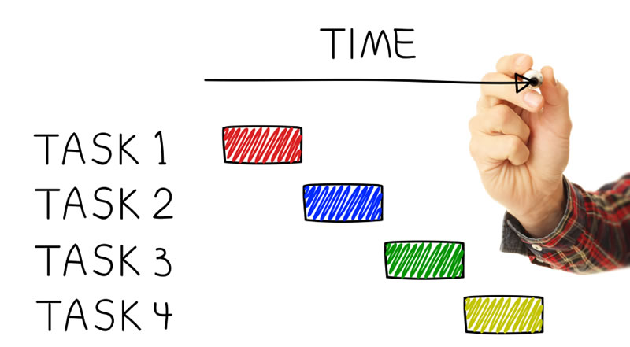
What is Scheduling?
3–7

Slide 8
What is Scheduling?
There are multiple ways of defining scheduling. Scheduling is:
  Planned completion of a project based on the logical arrangement of activities, resources…
  Placing the project and its activities in a workable sequenced timetable…
  A detailed outline of activities/tasks with respect to time…
While scheduling is all of these things, the main thing to remember is that
scheduling is the development of planned dates
for performing project activities and meeting milestones.
By looking at the abovementioned definitions of scheduling, do you see a difference between planning and scheduling?
3–8

Slide 9
Project Scheduling
Project Planning, as it relates to the scheduling process, has been defined by the PMBoK as:
  The identification of the project objectives and the ordered activity necessary to complete the project including the identification of resource types and quantities required to carry out each activity or task.
Project Scheduling requires us to follow some carefully laid-out steps, in order, for the schedule to take shape.
PMBoK states,
“an output of a schedule model that presents linked activities with planned dates, durations, milestones, and resources.”
3–9

Slide 10


Planning vs. Scheduling
3–10

Slide 11
Planning vs. Scheduling
“I keep six honest serving men (they taught me all I knew); their names are What and Why and How and Where and Who and When.” --- Rudyard Kipling
Planning involves making decisions with the objective of influencing the future. Another way to consider planning is as the “thinking” phase. Defining activities, their logical sequence, and their relationship to each other are all planning functions. In planning you answer the following questions:
What will be performed?
  This question is answered by determining the final project product necessary for achieving project success. This is done in the initiation phase before the development of your WBS.
Why it will be performed?
  This question is answered by determining the project objective.
3–11

Slide 12
Planning vs. Scheduling
How will it be performed?
  This question is answered by determining the processes, procedures, and methodologies used to complete the project.
Where will it be performed?
  This answer varies for each type of project. For example, if it’s a construction project, the “where” will be the physical location of the building or road etc. If the project is a software development project, the answer could be the physical location of the project team or the final location of the project software.
Who will perform the work?
  This question is answered by determining if the work will be contracted or will use in-house resources. Then, the question will be examined in even more detail: if a contractor, what type of contractor, and if company resource, what department and who in each department?
3–12

Slide 13
Planning vs. Scheduling
With five main questions answered, only one last question remains: when.
This question involves scheduling.
Scheduling determines the timing of operations in the project. The schedule will determine the specific start and completion dates for the project and all project activities. Another way to look at scheduling is to consider it the “action” or “doing it” phase. In scheduling you answer the question:
When will the work be performed?
  This question involves determining the order in which activities will be performed to complete the project (Sequence).
  Scheduling includes the project start and completion dates, project deliverables and milestones dates, and the start and completion dates for all activities needed to successfully complete the project.
3–13

Slide 14
Project Scheduling
The schedule must:
  Include logical ties for all activities
  Include all key milestones and deliverables
  Reflect the agreed to project baseline
  Integrate with the cost baseline
3–14

Slide 15
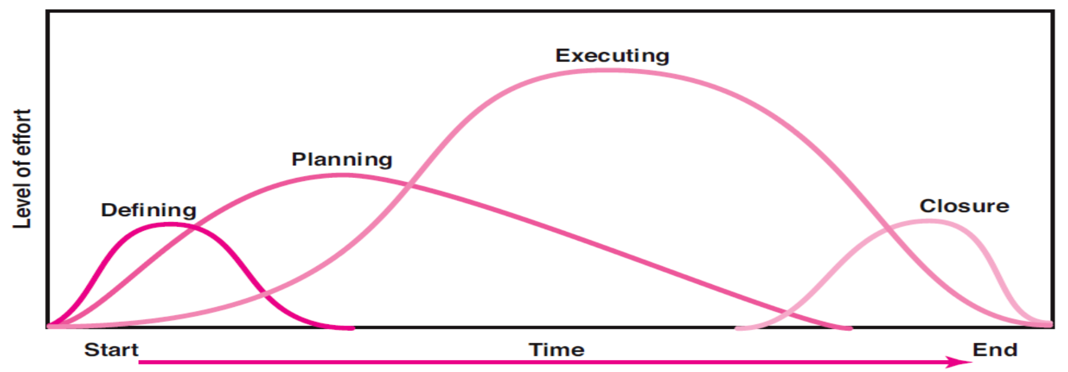
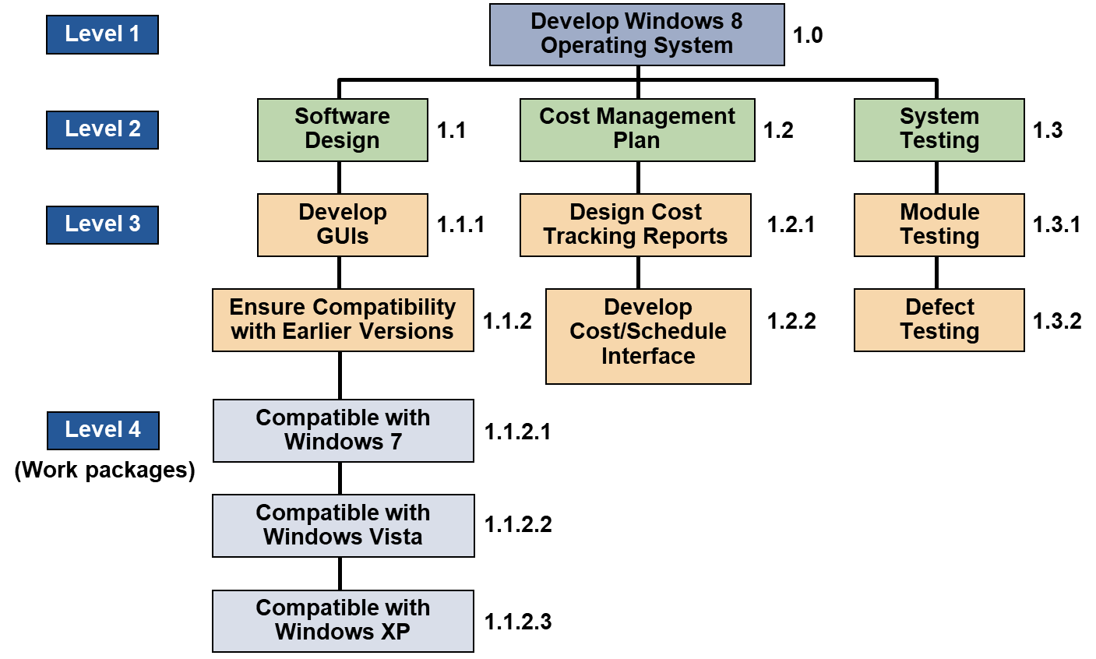
Project Scheduling
Project planning is a prerequisite to Project Scheduling because there is no way to determine the sequence or start and finish dates of activities until they are identified.
Terms of project planning and scheduling are often used synonymously because planning and scheduling are performed interactively.
Planning is more difficult to accomplish than scheduling.
The real test of the project planner/scheduler is his or her ability to identify all the work required to complete the project.
3–15

Slide 16
Some Benefits of Successful Scheduling
Illustrates interdependence of all tasks
Identifies times when resources must be available
Facilitates communication throughout the project
Determines critical activities/critical path
Affects client expectations through establishment of activities, milestones, and completion dates
3–16

Slide 17

Project Scheduling Terms
3–17

Slide 18
Project Scheduling Terms
The Project Network
Activity
Predecessors
Successors
Merge Activity
Burst activity
Path
Critical Path
Duration (D)
Early start (ES) date
Early Finish (EF) date
Late start (LS) date
Late Finish (LF) date
Total Float (TF)
Free Float (FF)
Lags
3–18

Slide 19
Project Scheduling Terms
The Project Network
  Flow chart that graphically depicts the sequence, interdependencies, and start and finish times of the project job plan of activities that is the critical path through the network.
  Provides the basis for scheduling labor and equipment.
  Enhances communication among project participants.
  Provides an estimate of the project’s duration.
  Provides a basis for budgeting cash flow.
  Highlight activities that are “critical” and can not be delayed.
  Help managers get and stay on plan.
3–19

Slide 20
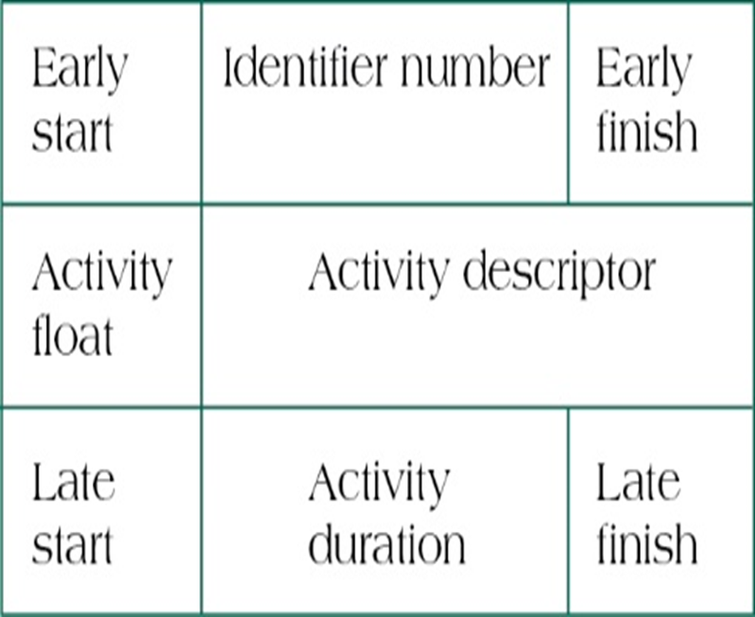
Project Scheduling Terms
Activity: an element of the project that requires time.
Predecessors: Those activities that must be completed prior to initiation of a later activity in the network.
Successors: Activities that cannot be started until previous activities have been completed. These activities follow predecessor tasks.
3–20

Slide 21
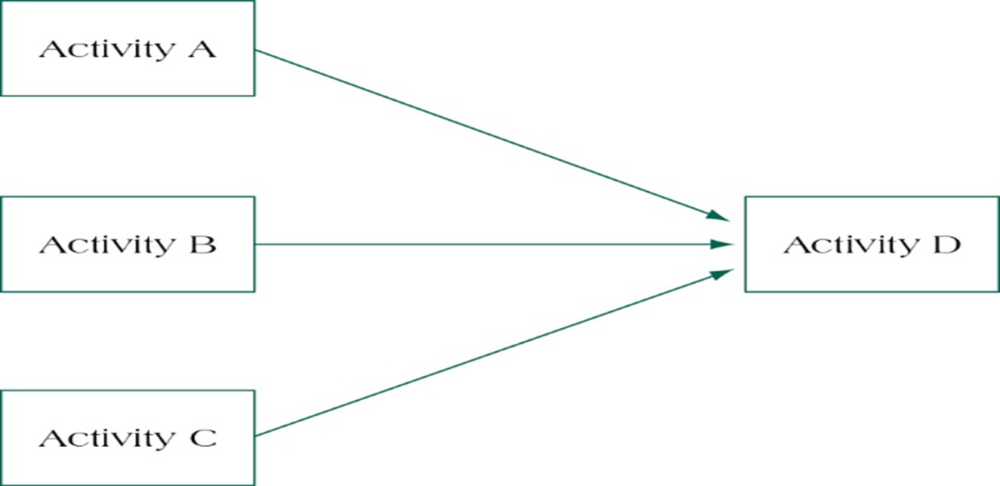
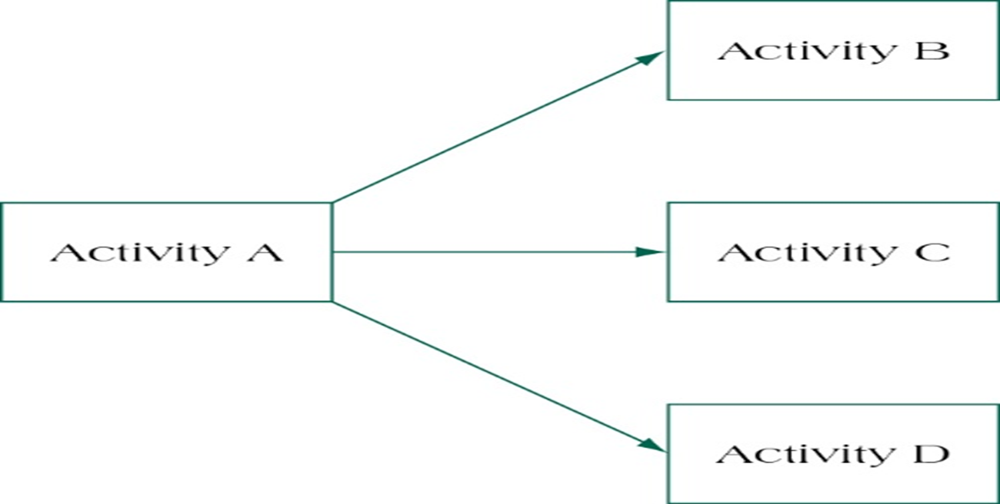
Project Scheduling Terms
Merge Activity: An activity with two or more immediate predecessors.
Burst activity: An activity with two or more immediate successors.
3–21

Slide 22
Project Scheduling Terms
Path: a sequence of connected, dependent activities.
Critical Path: the longest path through the activity network that allows for the completion of all project related activities; the shortest expected time in which the entire project can be completed. Delays on the critical path will delay completion of the entire project.
3–22

Slide 23
Project Scheduling Terms
Duration (D): The estimated time required to perform an activity
Early start (ES) date: The earliest time an activity can be started
Early Finish (EF) date: The earliest time an activity can be finished and is equal to the early start plus the duration
Late start (LS) date: The latest time an activity can be started without delaying the completion date of the project
Late Finish (LF) date: -The latest time an activity can be finished.
3–23

Slide 24
Project Scheduling Terms
Total Float (TF): The amount of time an activity may be delayed without delaying the completion date of the project
Free Float (FF): The amount of time an activity may be delayed without delaying the early start time of the immediately following activity
Lags: The amount of time a dependent activity must be delayed to begin or end
3–24

Slide 25

Project Scheduling Process
3–25

Slide 26
Project Scheduling Process
Project scheduling involves a clear, five step process. This process aids managers in determining the project schedule and, eventually, the project schedule baseline. The process steps are:
Develop the list of project activities
1
Establish the duration for each activities
2
Sequence of project activities
3
Determine the relationships between activities
4
Develop graphic representation of the logical relationships of project activities
5
Determine the project duration (start and completion dates)
6
3–26

Slide 27
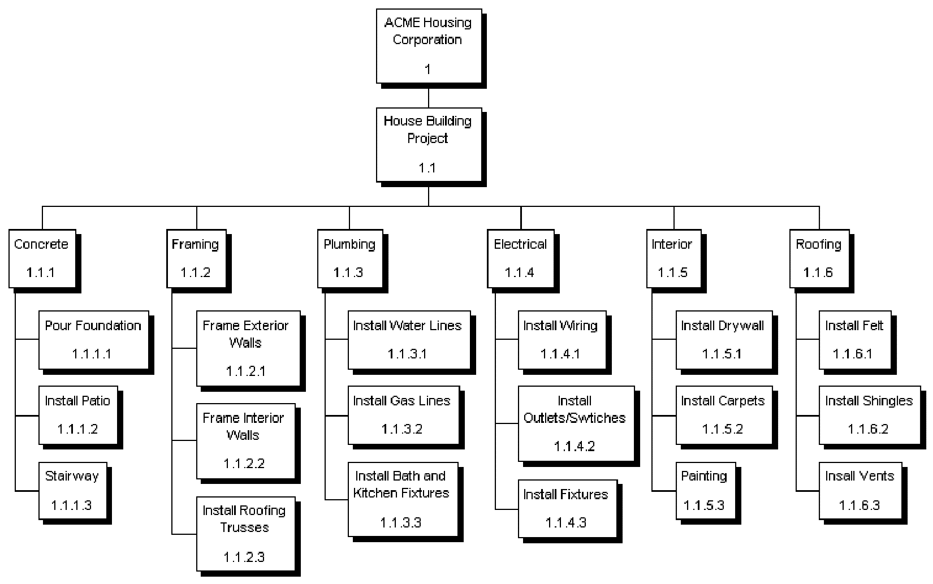
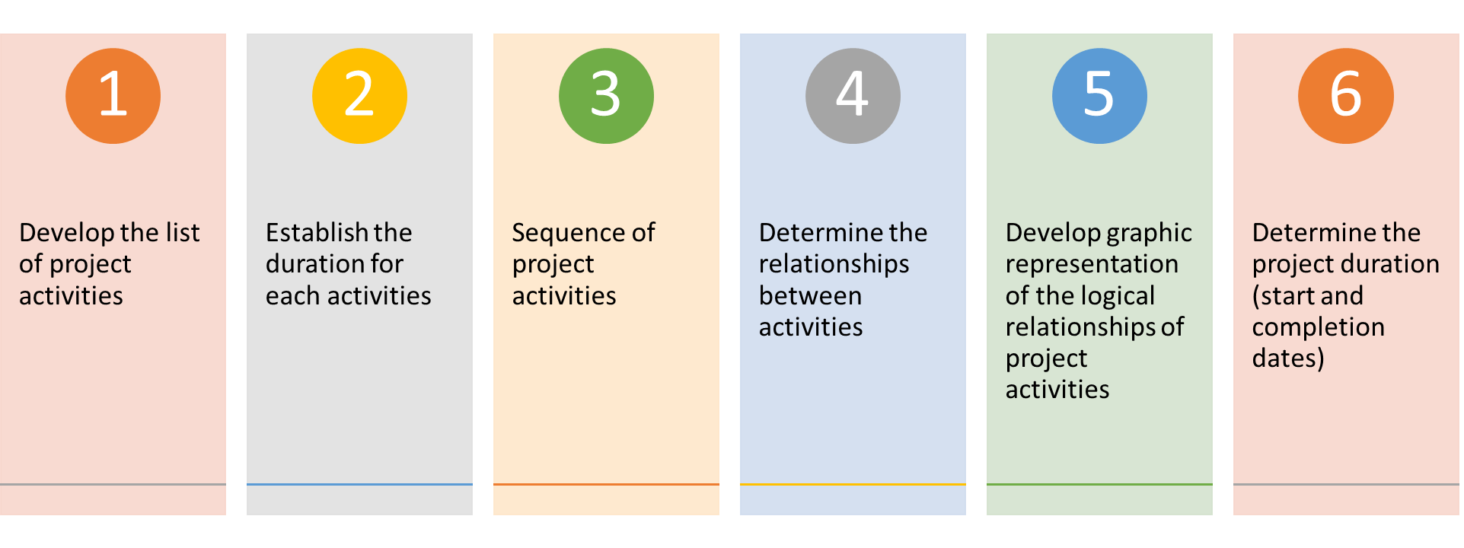
Scheduling – Step 1. Develop a List of Project Activities
  WBS is the best places to start from
  You need to enlist the help of the people or group of people familiar with the nature of the project.
  As you develop your list, you may see the need to update the WBS.
  Remember the WBS is a dynamic tool, revisions may be needed and should be expected as the scheduling of activities progresses.
3–27
Notes:
A chart with two columns, WBS and Activity List. The Activity List column are those activities needed to complete the project. The WBS column is the WBS element for each activity.

Slide 28
Project Scheduling - Step 2. Establish the Duration for Each Activity
Now, it is time to determine the duration for each project activity.
Establishing the duration of each project activity involves determining the work periods needed to complete each identified activity. Work periods can be
    Hours, Days, Weeks, Months, etc..
Remember, the period must be consistent for all activities in the schedule. The project manager and team member(s) must decide which work period is right for the project.
3–28

Slide 29
Scheduling – Step 3. Sequence of Project Activities
With the activity list complete, we need to “sequence” or develop “logic” between activities. To complete this process, we need the WBS activities list and a pencil.
A pencil? Why a pencil?
This process requires the project manager, subject matter experts (SME), and other project team members who are familiar with the nature of the specific activities to meet, discuss and develop the sequencing of the project activities. This process is known as “a pencil to paper” process.
3–29

Slide 30
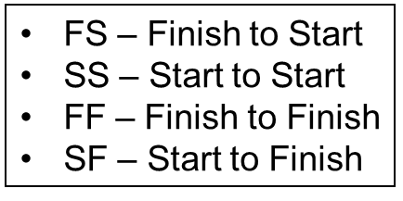
Scheduling – Step 4. Determine the relationships between activities
How does sequencing differ from identifying the relationships of tasks and activities?
Sequencing is the order of how things will happen. First, second, third, etc. . .
Identifying direct relationships provides greater understanding to the project tasks and schedule.
By identifying the relationships between activities in scheduling, you identify the sequence plus dependencies of tasks.
There are 4 types of scheduling dependencies:
3–30

Slide 31
Scheduling – Step 4. Determine the relationships between activities
Finish-To-Start
This means that activity “A” must finish before activity “B” can start.
Most common type of sequencing
0 A 6
Spec Design
6
6 B 11
Design Check
5
11 C 18
Blueprinting
7
3–31

Slide 32
Scheduling – Step 4. Determine the relationships between activities
Start-to-Start
This means that activity “B” can only begin once activity “A” has started.
Both activities must start at the same time.
Common within projects which require their tasks to run parallel to one another.
30 R 36
Wiring
6
30 T 36
HVAC
6
20 S 25
Plumbing
2
3–32

Slide 33
Scheduling – Step 4. Determine the relationships between activities
Finish-To-Finish
This means that activity “B” cannot finish until activity “A” finishes
30 R 36
Wiring
6
30 T 39
HVAC
9
31 U 39
Under construction
8
20 S 25
Plumbing
5
3–33

Slide 34
Scheduling – Step 4. Determine the relationships between activities
Start-To-Finish
This means that activity “B” must start so that activity “A” can finish
Least common type of lag relationship
W: Get new system up and running
Y: Shut down old system
20 W 26
6
10 Y 20
3
20 Z 26
6
3–34

Slide 35
Lags
Lags: The amount of time a dependent activity must be delayed to begin or end
0 A 6
Spec Design
6
6 B 11
Design Check
5
11 C 18
Blueprinting
7
0 A 6
Spec Design
6
6 B 11
Design Check
5
15 C 22
Blueprinting
7
Lag 4
3–35

Slide 36
Lags
30 R 36
Wiring
6
30 T 39
HVAC
9
20 S 25
Plumbing
2
30 R 36
Wiring
6
Lag 3
33 T 42
HVAC
9
20 S 25
Plumbing
2
3–36

Slide 37
Scheduling – Step 5. Develop graphic representation of the logical relationships of project activities
The Checklist
The Linear Schedule
Gant Chart
The Logic Network or Network Diagram
  A diagram showing the relationship, in a logical and time wise fashion, of the identified tasks or activities of the project.
3–37

Slide 38
The Checklist
Not considered a formal type of scheduling
Sometimes called a “to do list,”
used for very short-term planning, rarely more than a few days.
Its main purpose is to ensure that nothing is omitted.
Advantages
  Do not require special skills, equipment, or training to use.
  Easy to maintain
Disadvantages
  There is no way to show the interdependence of activities.
  If one task is delayed, what is its effect on the remaining tasks in the schedule?
3–38

Slide 39
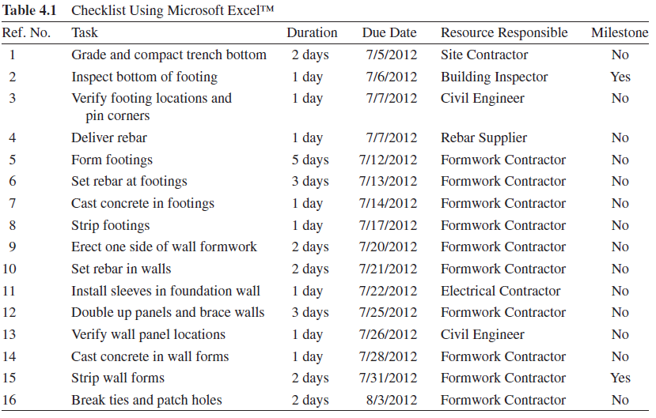
The Checklist
3–39

Slide 40
The Linear Schedule
Line of balance (LOB) is a management control process used in construction where the project contains blocks of repetitive work activities, such as roads, pipelines, tunnels, railways and high-rise buildings.
LOB collects, measures and presents information relating to time, cost and completion, and presents it against a specific plan.
Advantages
  Allowing a clearer understanding of the amount of work taking place at a certain time
  Relatively, It is easy to modify, update and change the schedule.
Disadvantages
  Does not shows critical activities.
3–40

Slide 41
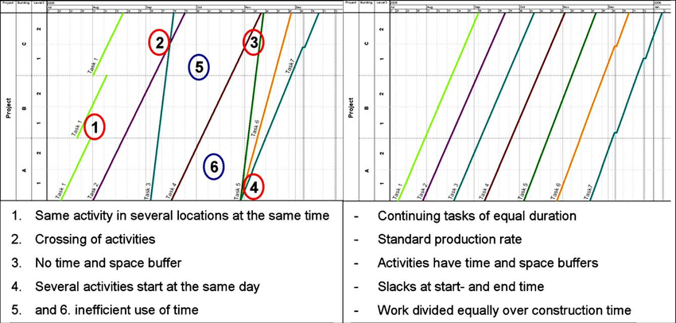
The Linear Schedule
3–41

Slide 42
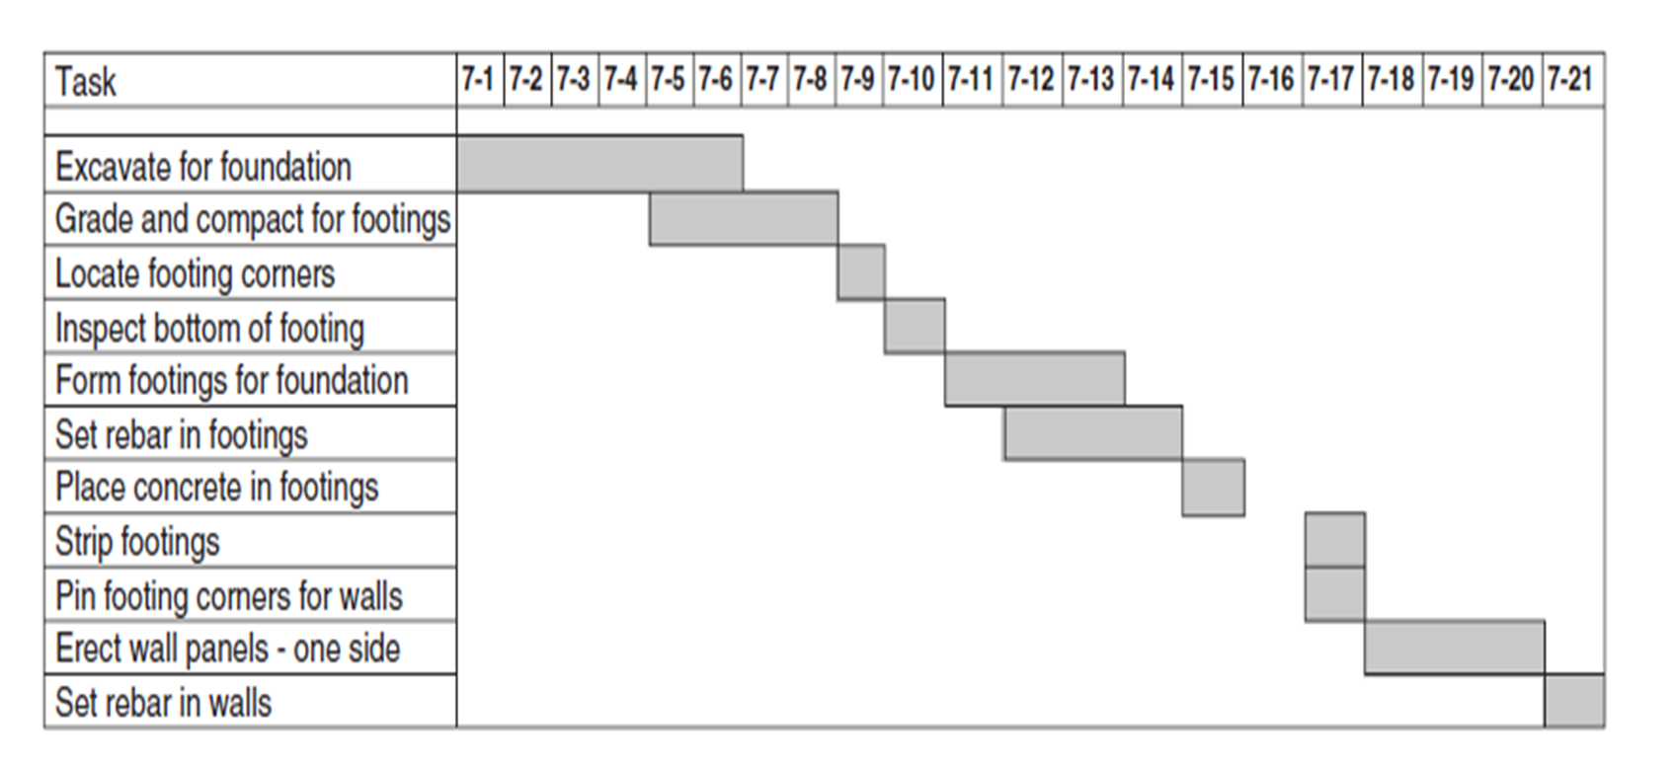
Gantt Charts
Advantages
  Easy to understand
  Easy to show progress and status
  Easy to maintain
  Most popular view to communicate project status to client and/or senior management
Disadvantages
  Can be superficial
  Not always easy to see precedence, relationships
3–42

Slide 43
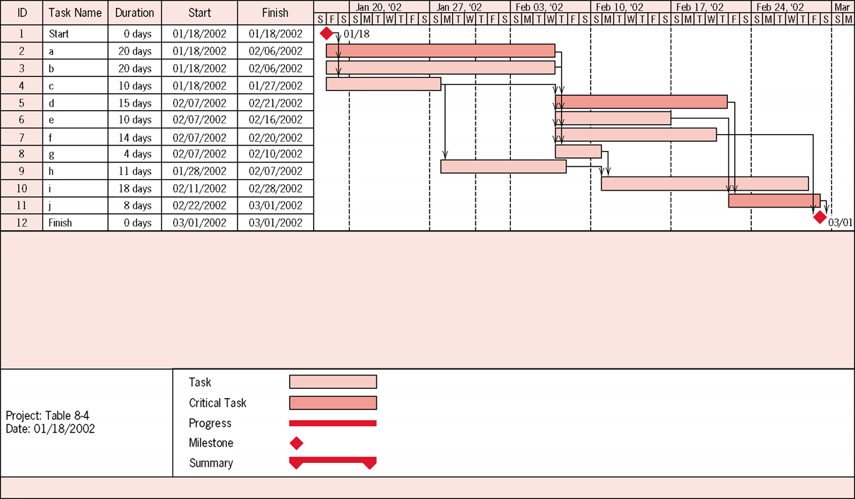
Gantt Chart Example
3–43

Slide 44
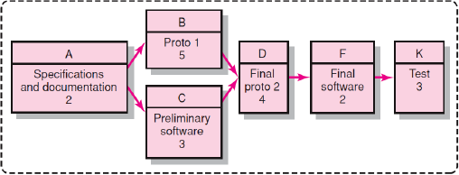
PERT/CPM Network Charts
Advantages
  Allows visualization of task relationships
  Facilitates calculation of critical path
  Clarifies impact of decisions on downstream activities
Disadvantages
  Complex, not easy to comprehend at a glance
  Charts don’t readily show durations, dates, progress
3–44

Slide 45
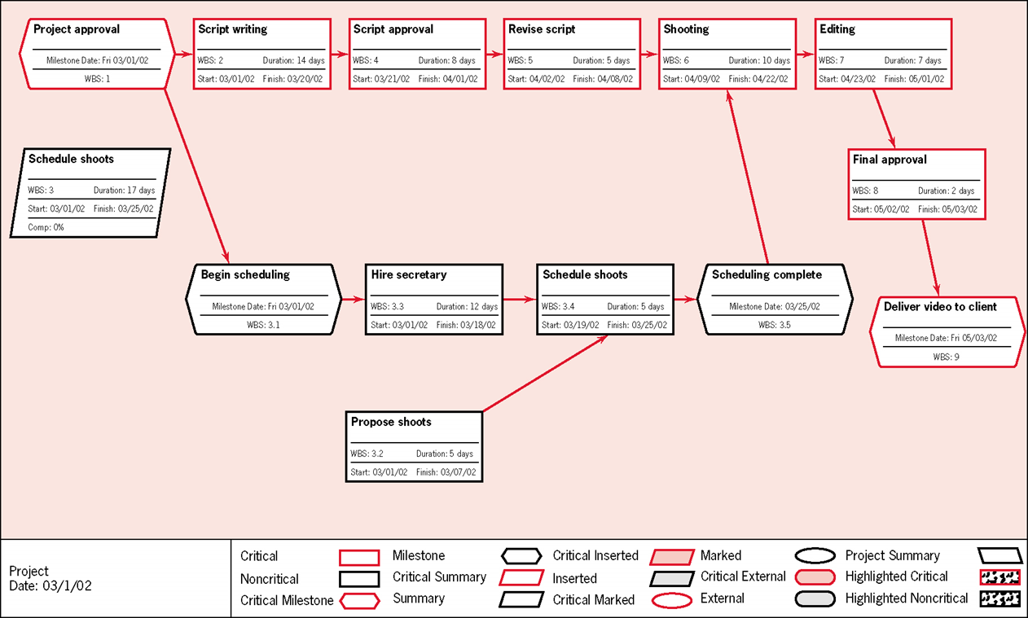
PERT/CPM Network Charts
3–45

Slide 46
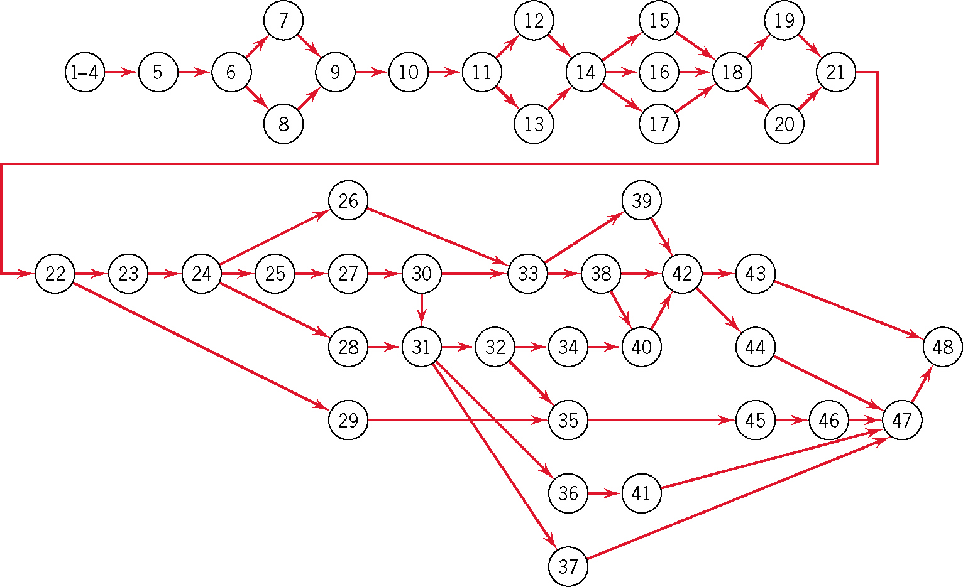
Apartment Complex Network
3–46

Slide 47
Scheduling – Step 6. Determine the project duration (start and completion dates)
Usually the project duration and activity start and completion dates are mapped in a typical scheduling software application. The activities are placed in the software tool, and the relationships are identified. The software calculates the dates.
To better understand how the software calculates the dates, we will take a look at the process known as Forward and Backward Pass.
3–47

Slide 48
Scheduling – Step 6. Determine the project duration (start and completion dates)
Together, these processes give
  The total project duration, including the start and finish dates for each activity.
  Critical path, which tells you the activities that cannot slip without increasing the total duration of the project or moving the project completion date, and
  Float, which tells you how much certain activities can slip without impacting the total project duration.
The Forward Pass determines the early start (ES) and the early finish (EF) of each activity.
The Backward Pass determines the late start (LS) and late finish (LF) of each activity.
3–48

Slide 49
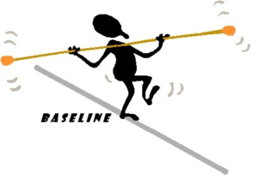
Baseline
3–49

Slide 50
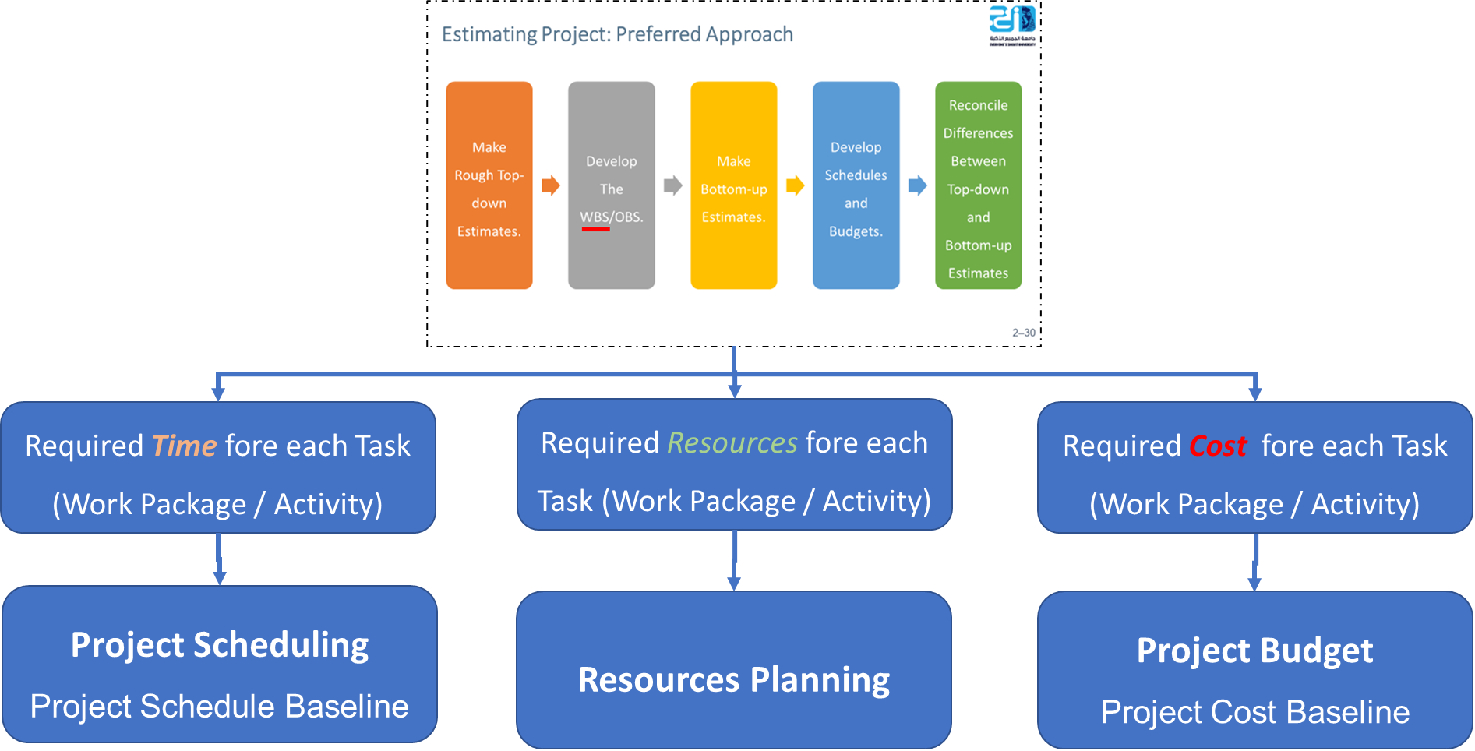
Baseline
Baseline is the original approved plan that consists of both schedule and cost
The schedule and cost baseline are essential.
The Schedule Baseline is the standard that all schedule performance will be measured against.
It should be approved by the project manager and other appropriate individuals.
Once the project manager approved the project start, logic, relationships and project duration, the schedule is then “baselined” to measure schedule performance.
3–50

Slide 51
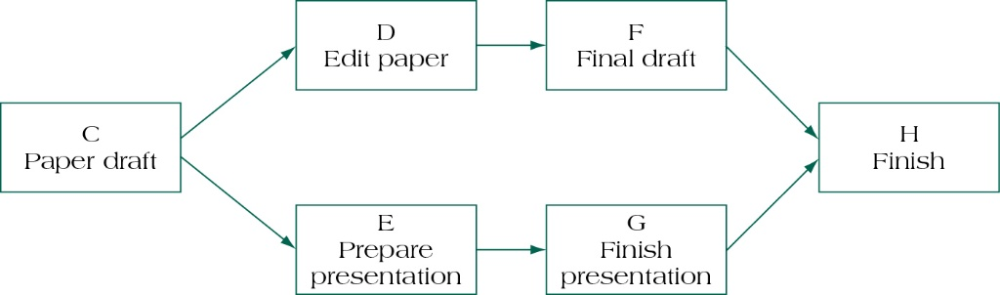
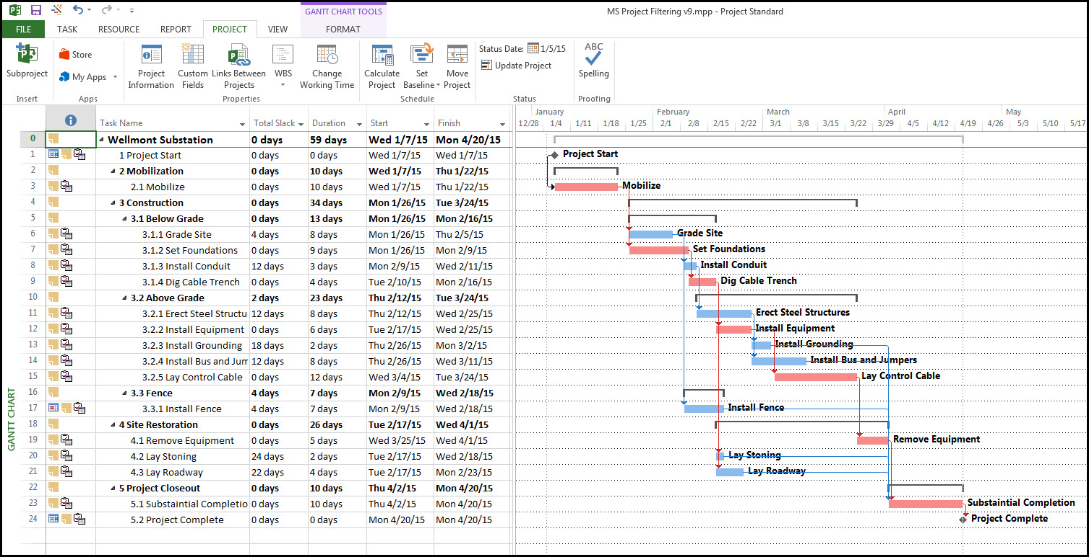
Baseline
3–51

Slide 52
Summary of Today Session
3–52

Slide 53
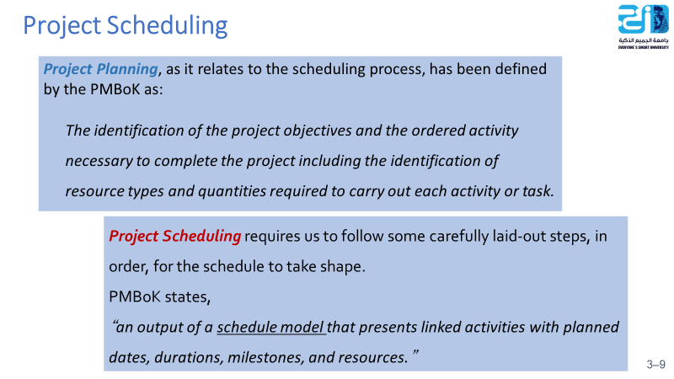
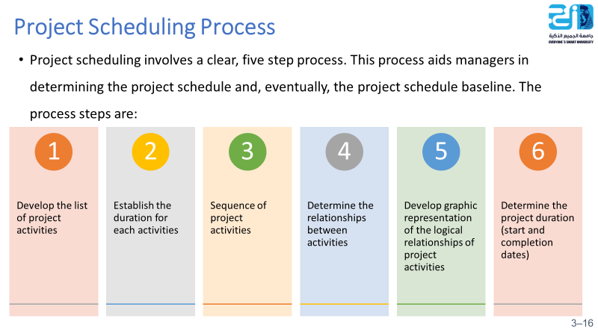
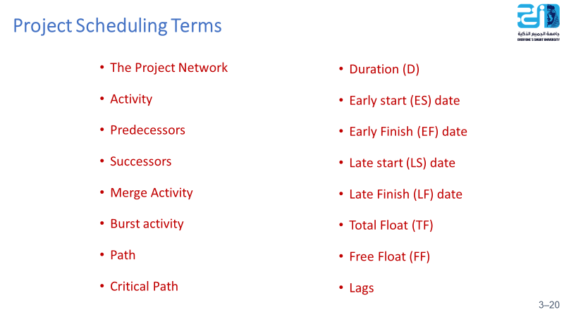
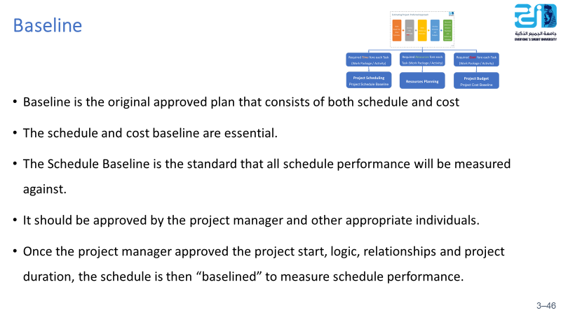

Slide 54
Resources
Project Management
The Managerial Process
Fifth Edition
By: Erik W. Larson
Oregon State University
Clifford F. Gray
Oregon State University
3–54

