Slide 1



Project Leadership
PMG 511
Lecture 4
Ch4 - Theories of Leadership
Prepared by
Dr Hakem Sharari
www.midocean.ae

Slide 2
Learning Outcomes
Understand different leadership theories.
Types of leadership power (Influence).
Motivators.
Culture.
Professional discipline and Ethics.
Summary and conclusions.
Self-assessment

Slide 3

Leadership Theories
The interest in leadership increased during the early part of the 1900’s.

Slide 4

“Great Man” Theory (1900’s)
Great Man theories assume that the capacity for leadership is inherent – that great leaders are born, not made.
These theories often reveals a great leaders as hero, myth, and fated to end by leadership when needed.
The term “Great Man” was used because, at that time, leadership was believed on a male quality, especially in terms of military leadership.

Slide 5
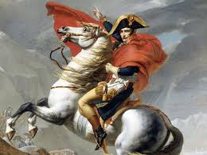

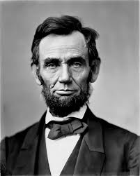
“Great Man” Theory
Great Man approach actually emphasis “charismatic leadership”.
(Gandhi, Lincoln, Napoleon).

Slide 6
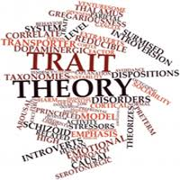
Trait Theory (1940’s – 1950’s)
Similar in some ways to “Great Man” theories, trait theory assumes that people inherit certain qualities and traits that make them better matched to leadership.
Trait theories often identify certain personality or behavioral characteristics shared by leaders.

Slide 7
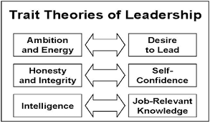
Trait Theories
The Trait Theories Of Leadership is a social, physical traits that differentiate leaders from non leaders
Trait theories of leadership deal with personality, Trait view has little analytical or predictive value, Technical, and human skills.
All leaders would have to possess those unique and consistent characteristics, making it easy to find leaders in organizations.

Slide 8
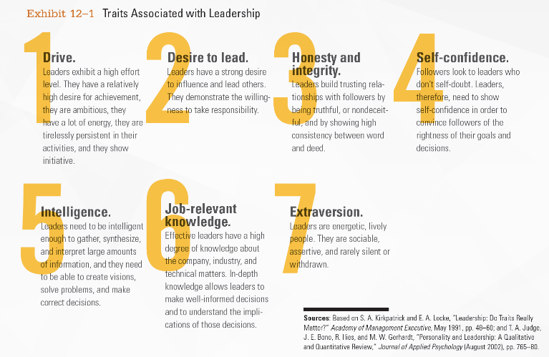
Leadership Traits

Slide 9
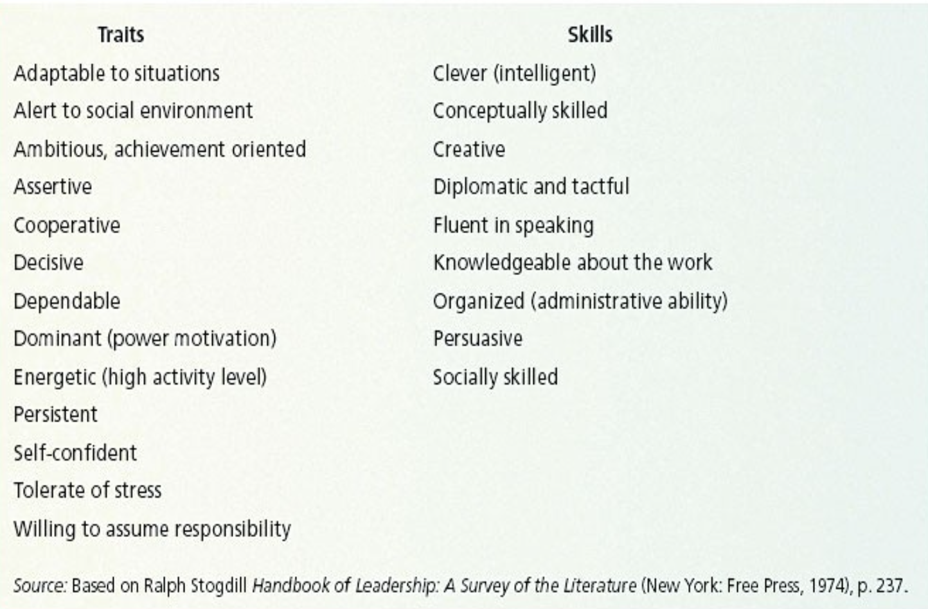
Traits and Skills For Leaders

Slide 10
Behavioral Theories (1950’s – 1960’s)
In behavioral theories Individuals need three primary skills to lead the followers – technical, human, and conceptual skills.

Slide 11
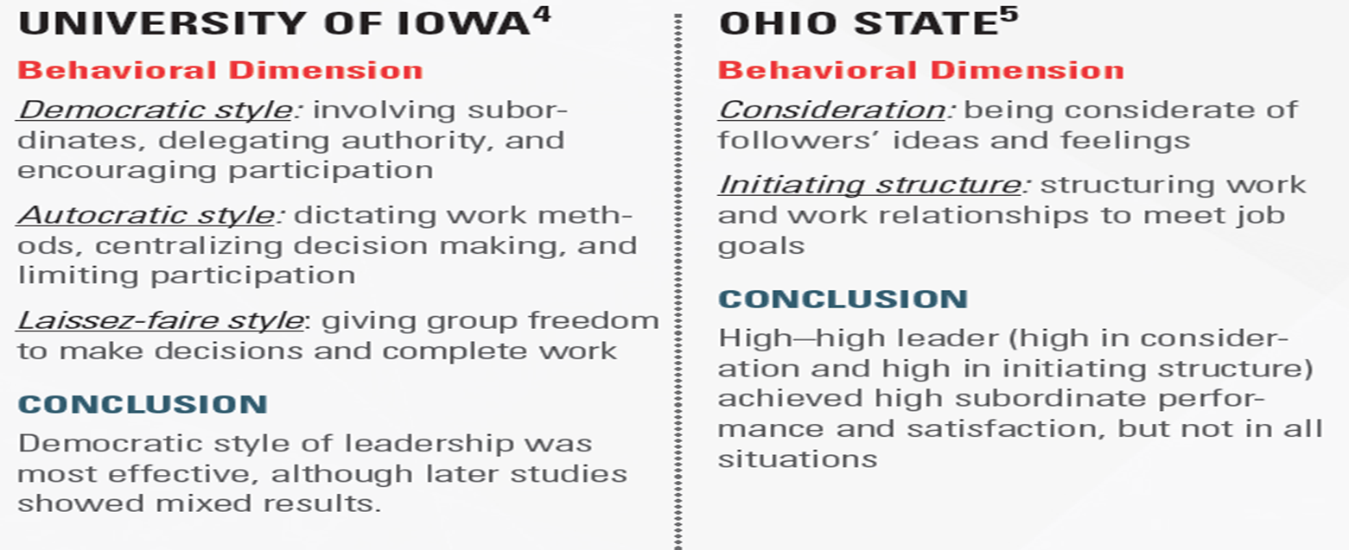
Different Studies on Behavioral Theories

Slide 12
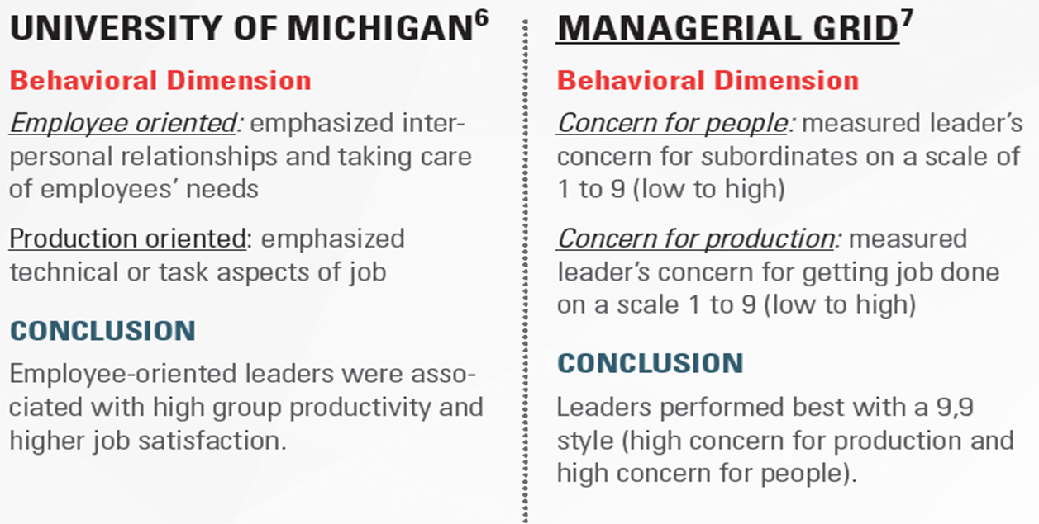
Different Studies on Behavioral Theories

Slide 13
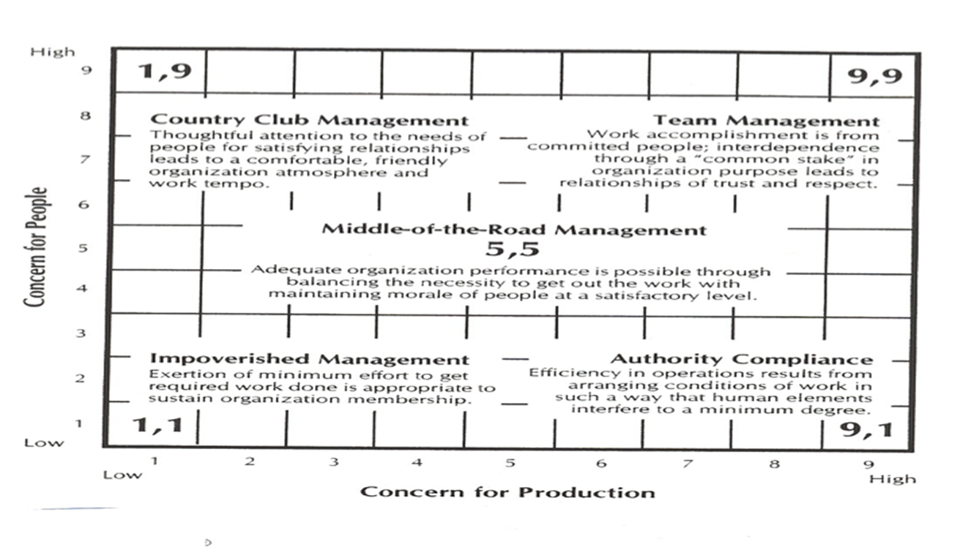
The Managerial Grid

Slide 14
Contingency Theories (1960’s – 1970’s)
There are four major contingency leadership theories:
The Fiedler Model.
Situational Leadership Theory.
Leader-participation Model.
Path-Goal Theory.

Slide 15
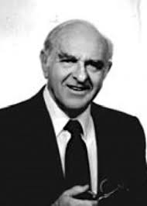
The Fiedler Model
The Fiedler Contingency Model was created in the mid-1960s by Fred Fiedler.
The model states that there is no one best style of leadership. Instead, a leader's effectiveness is based on the situation.
Fiedler believes a key factor in leadership success is the individual’s basic leadership style which could be categorized as either task oriented or relationship oriented.

Slide 16
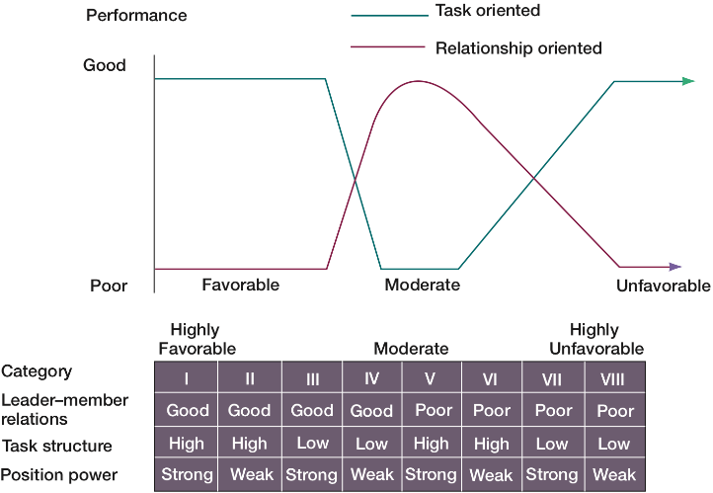
The Fiedler Model
The Fiedler Model - Least-Preferred Coworker Questionnaire.
LPC: An instrument that tells to measure whether a person is task or relationship oriented.

Slide 17
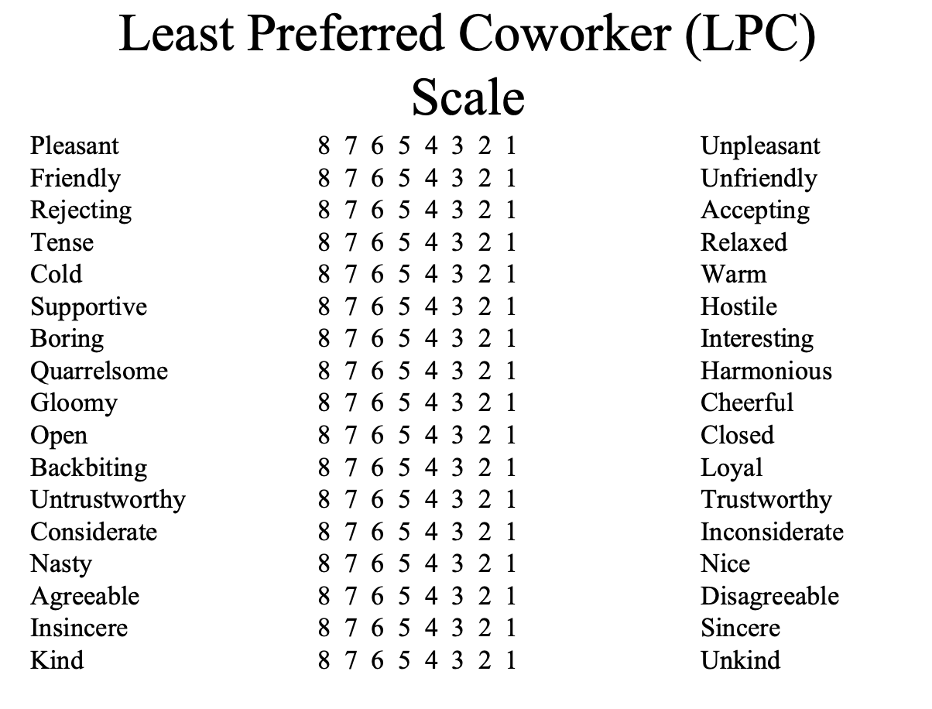
Least-preferred Coworker Questionnaire
If the score of the LPC is low, then the person is task oriented.
If the score of the LPC is high, then the person is relationship oriented.

Slide 18


Situational Leadership Theory (SLT)
Which leadership styles might be suitable in different situations, and what are those different situations?

Slide 19
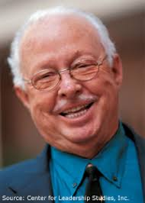
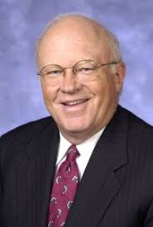
Situational Leadership Theory
It was developed by Paul Hersey and Ken Blanchard.
It is a contingency theory that focuses on followers’ readiness.
It refers to those leaders who adopt different leadership styles according to the situation and the development level of their team members.
It is an effective way of leadership because it adapts to the team’s needs and sets a beneficial balance for the whole organization.

Slide 20



Situational Leadership Theory

Slide 21
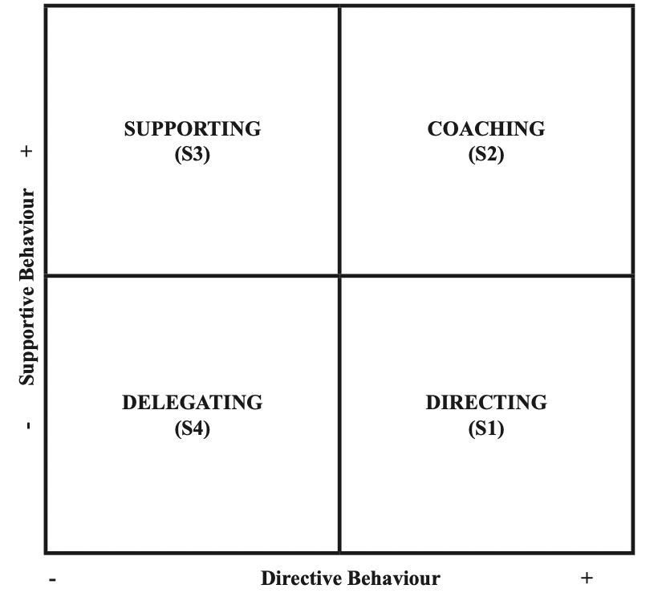
Situational Leadership Theory
Situational theories propose that leaders choose the best course of action based upon situational variable.
Different styles of leadership may be more appropriate for certain types of decision- making.

Slide 22
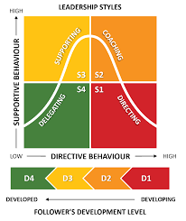
Situational Leadership Theory
Hersey and Blanchard suggested that there are four primary leadership styles:
Telling (S1): In this leadership style, the leader tells people what to do and how to do it.
Selling (S2): This style involves more back-and-forth between leaders and followers. Leaders "sell" their ideas and message to get group members to buy into the process.
Participating (S3): In this approach, the leader offers less direction and allows members of the group to take a more active role in coming up with ideas and making decisions.
Delegating (S4): This style is characterized by a less involved, hands-off approach to leadership. Group members tend to make most of the decisions and take most of the responsibility for what happens.

Slide 23
Participative Theories
Leader-participation Model (Yroom & Yetton’s).
A leadership theory that provides a set of rules to determine the form and amount of participative decision making in different situations.
Participative leadership theories suggest that the ideal leadership style is one that takes the input of others into account.
These leaders encourage participation and contributions from group members and help group members feel more relevant and committed to the decision-making process.

Slide 24
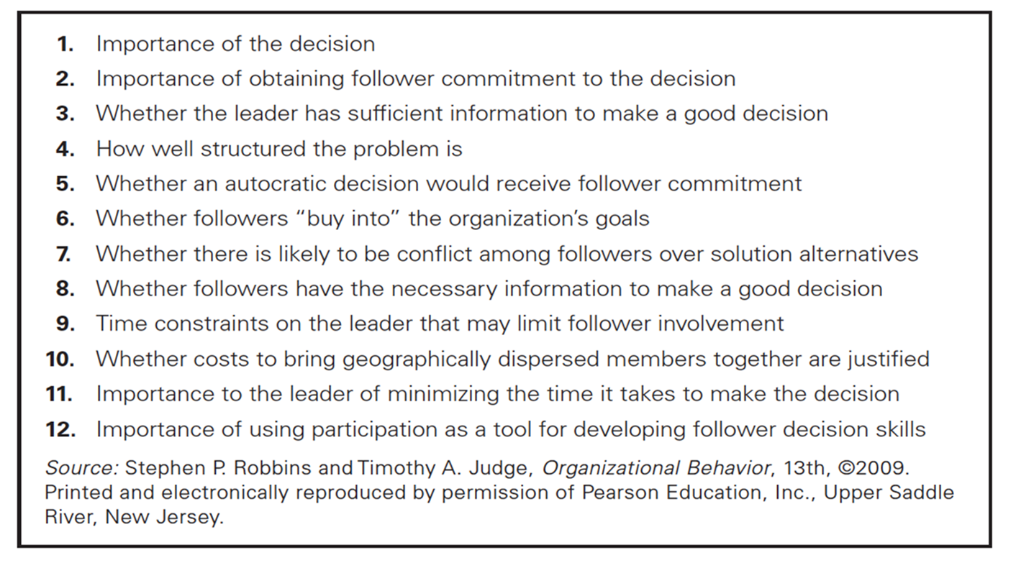
Contingency Variables of Leader-participation Model

Slide 25

Path-Goal Theory
  Four leadership behaviors:
A directive leader lets subordinates know what’s expected of them, schedules work to be done, and gives specific guidance on how to accomplish tasks.
A supportive leader shows concern for the needs of followers and is friendly.
A participative leader consults with group members and uses their suggestions before making a decision.
An achievement-oriented leader sets challenging goals and expects followers to perform at their highest level.

Slide 26
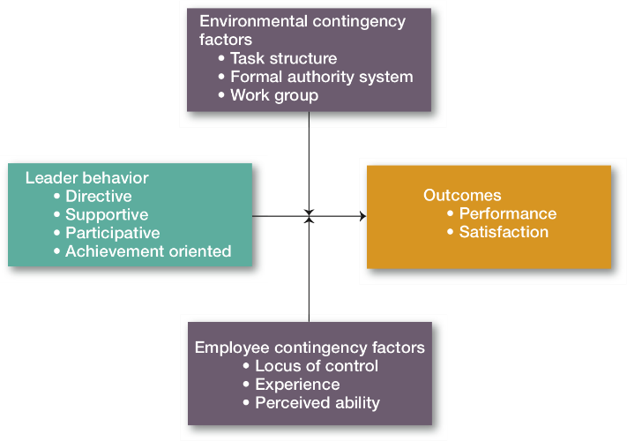
Path-Goal Model

Slide 27
Modern Views Of Leadership
Leader-member exchange (LMX).
Transformational-transactional leadership.
Charismatic-visionary leadership.
Team leadership.

Slide 28
Leader-member Exchange Theory (LMX)
A leadership theory that says leaders create in-groups and out-groups and those in the in-group will have higher performance ratings, less turnover, and greater job satisfaction.

Slide 29
Transactional vs. Transformational Leaders
Transformational Leaders
leaders who stimulate and inspire (transform) followers to achieve extraordinary outcomes.
Transactional Leaders
Leaders who lead primarily by using social exchanges (or transactions).

Slide 30
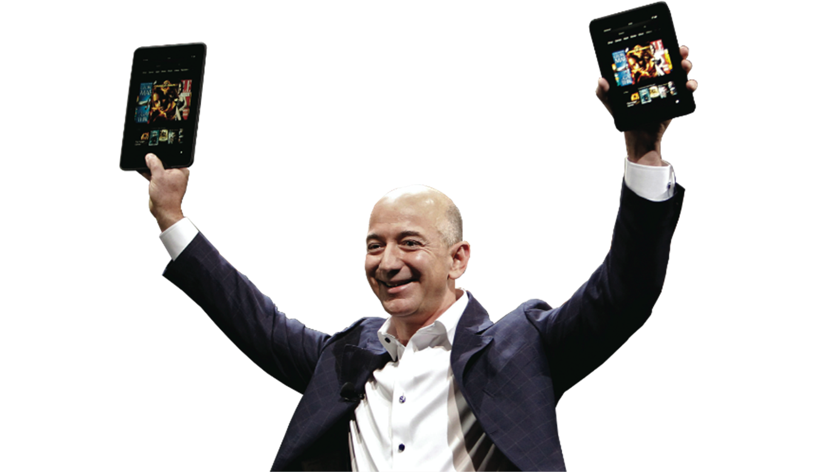
Charismatic vs. Visionary Leaders

Slide 31

Leaders and Teams
The role of a team leader is different from the traditional leadership role and many leaders are not equipped to handle the shift to employee teams.
A good way to describe the team leader’s job is to focus on two priorities:
Managing the team’s external boundary; and
Facilitating the team processes.

Slide 32
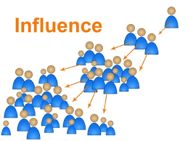
Influence
Not just the leader; All team members have influence on their peers.
Can be positive or negative
Choose appropriate combinations for each peer or team member.
Is being the ‘boss’ isn’t enough?

Slide 33
Influence Types
Formal / Legitimate
  Classic title-based position of authority.
  Ex: CEO.
Penalty/Coercive
  The ability or fear of punishment such as demotion.
  Ex: Sales manager who tells underperforming team members that they will be replaced if goals are not met.
Reward
  The ability to reward.
  Ex: Employee reward and recognition as being the best achiever.
Expert
  A superior level of skill, experience, or knowledge.
  Ex: statistician who helps team interpret data for a project.
Referent
  Based on trust and respect, similar to the influence of trusted family members
  Ex: A coach who is known for preventing team member from bulling one anther.

Slide 34
Influence Types Activity
Leadership Styles
Affiliative
Authoritarian/Commanding/Autocratic
Coaching
Democratic
Laissez-faire
Pacesetting
Transformational / Visionary
- For each leadership style, which types of influence are:
  Most likely or expected to be used
  Most likely to be effective
  Least likely to be effective
Types of Influence
Formal/Legitimate
Penalty/Coercive
Reward
Expert
Referent
- Decide which type of influence is appropriate/inappropriate for multiple leadership styles?

Slide 35

Motivators
It is what makes us want to come to work.
Norms often established by industry, organization, or previous leaders.
What motivates you may or may not motivate others?
Motivators are highly personal; the leader must consider each team member individually.
Divided into Extrinsic and Intrinsic motivators.

Slide 36
Extrinsic Motivators
Money/Power
  Want to ‘move up’ in the organization or earn higher wages.
  Ex: Salespeople, CEO’s, Politicians
Recognition
  Often motivated most by acknowledgement of those in power.
  Ex: Entertainment, Lawyers, Interns
Interpersonal Relationships
  Relationships with co-workers and a cooperative atmosphere are valued.
  Ex: Religious Leaders, Social Workers

Slide 37
Intrinsic Motivators
Autonomy/Interesting Work
  Prefer the excitement of new and innovative endeavors.
  Ex: Architects, Engineers
Purpose
  Need to feel that their work is beneficial to the causes they care about.
  Ex: Doctors, Teachers, Military
Mastery/Exploration
  Personal achievement, problem solving opportunities, and creative endeavors are sought.
  Ex: Artists, Scientists

Slide 38
Your Motivators activity
Rank the following motivators from most important to you to least important to you:
  Autonomy / Interesting Work
  Interpersonal Relationships
  Mastery / Exploration
  Money / Power
  Purpose
  Recognition
Are the majority of your group members intrinsically or extrinsically motivate?

Slide 39
Leaders Professional Ethics
Ethics (self-discipline) are key to professionalism.
Ethics influence and are influenced by organizational culture.
Examples:
  Honesty regarding qualifications
  Protecting proprietary information
  Confronting conflict directly
  Disclosing conflicts of interest
  Focusing on mutual cooperation
  Advocating for team members and stakeholders

Slide 40
National Culture
The set of behaviors or beliefs that determine how an organization or team interacts or carries out work.
Awareness of culture and different circumstances/attitudes is key
Influenced by:
  The industry, environment, customers, organizational practices
  Personalities, values, principles, etc. of the organization, leader, and team
Influences:
  Decision making, risk tolerance, decisiveness, orderliness, competitiveness
  Level of attention to detail, amount of process, emphasis on achievement
  Supportiveness, reward/punishment, team vs. individual contribution

Slide 41

National Culture
Cross-Cultural Leadership
Korean leaders are expected to be paternalistic toward employees.
Arab leaders who show kindness or generosity without being asked to do so are seen by other Arabs as weak.
Japanese leaders are expected to be humble and speak frequently.
Scandinavian and Dutch leaders who single out individuals with public praise are likely to embarrass, not energize, those individuals.

Slide 42
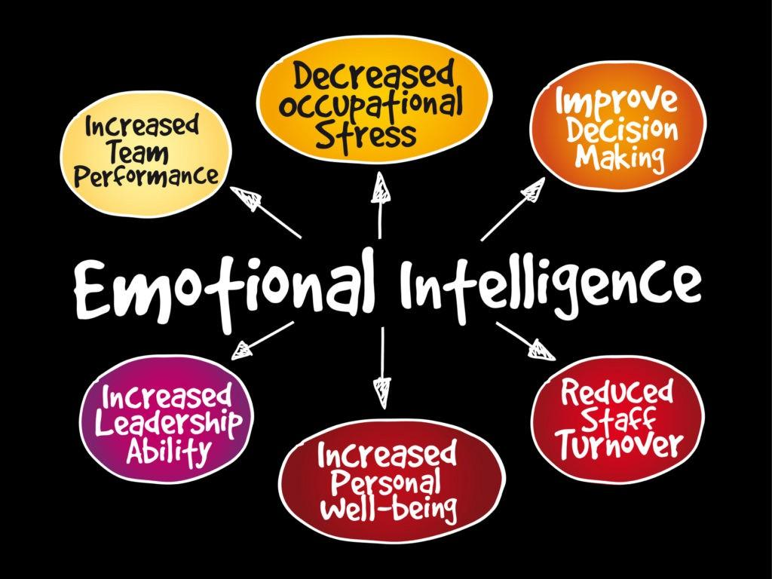
Emotional Intelligence (EI)
EI, more than any other single factor, is the best predictor of who will emerge as a leader.
EI is an essential element in leadership effectiveness.

Slide 43
Summary and Conclusions
There are different leadership theories.
We must be intentional in how we influence and motivate others.
Awareness of various types and techniques is the key.
Project Management is an important discipline which requires diverse skills and a commitment to ethics.
Culture influences every aspect of the organization and team.
EI is an essential element in leadership effectiveness.

Slide 44
Self-assessment
Try to answer the following questions
The answers will be discussed in the upcoming online lecture

Slide 45
Self-assessment
It was a male-centric approach when women have proved to be great leaders too.
Behavioral Theory
The Trait Theory
Contingency Theory
The Great Man Theory
Situational Theory

Slide 46
Self-assessment
An individual must possess the key personality traits and characteristics to be an effective leader and these traits are inherent by birth.
Behavioral Theory
The Trait Theory
Contingency Theory
The Great Man Theory
Situational Theory

Slide 47
Self-assessment
The best leader are born, not made.
Behavioral Theory
The Trait Theory
Contingency Theory
The Great Man Theory
Situational Theory

Slide 48
Self-assessment
The most effective style of leadership changes from situation to situation. To be most effective and successful, a leader must be able to adapt his style and approach to diverse circumstances.
Behavioral Theory
The Trait Theory
Contingency Theory
The Great Man Theory
Situational Theory

Slide 49
Self-assessment
A leader’s effectiveness is contingent on whether or not their leadership style suits a particular situation.
Behavioral Theory
The Trait Theory
Contingency Theory
The Great Man Theory
Situational Theory

Slide 50
Self-assessment
Behavioral Theory Individuals need three primary skils to lead the followers – technical, human, and conceptual skills.
Behavioral Theory
The Trait Theory
Contingency Theory
The Great Man Theory
Situational Theory

Slide 51
Self-assessment
It is founded in the principle that no one leadership style is applicable to all situations
Behavioral Theory
The Trait Theory
Contingency Theory
The Great Man Theory
Situational Theory

Slide 52
Self-assessment
Effective leadership is the result of many learned skills.
Behavioral Theory
The Trait Theory
Contingency Theory
The Great Man Theory
Situational Theory

Slide 53
Resources
Project Team Leadership and Communication by Samuel Malachowsky, 2018.
Leadership: Theory and Practice, 7th Edition.

Slide 54
Thank You For Listening

Slide 55


Reference

