Slide 1



Controlling as a Management Function
Lecture 9
MGM111
Principle of Management
Prepared by
Dr. Bothaina Mahmoud Fouad

Slide 2

Lec. 9
The main points:
Controlling Definition
Importance of Controlling
Types of Control
Scope of Control
Relationship between controlling and other managerial functions

Slide 3
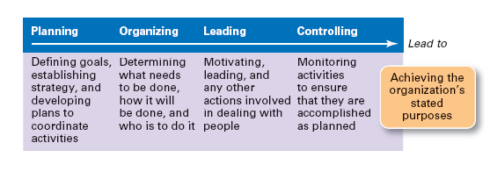

Slide 4
Functions of Management
planning
organizing
leading
controlling
Control is the last function of management

Slide 5
Controlling as a Management Function
A process of monitoring performance and taking action to ensure desired results.
  It sees to it that the right things happen, in the right ways, and at the right time.

Slide 6
Controlling as a Management Function
It helps ensure that objectives and accomplishments are consistent with one another throughout an organization.

Slide 7
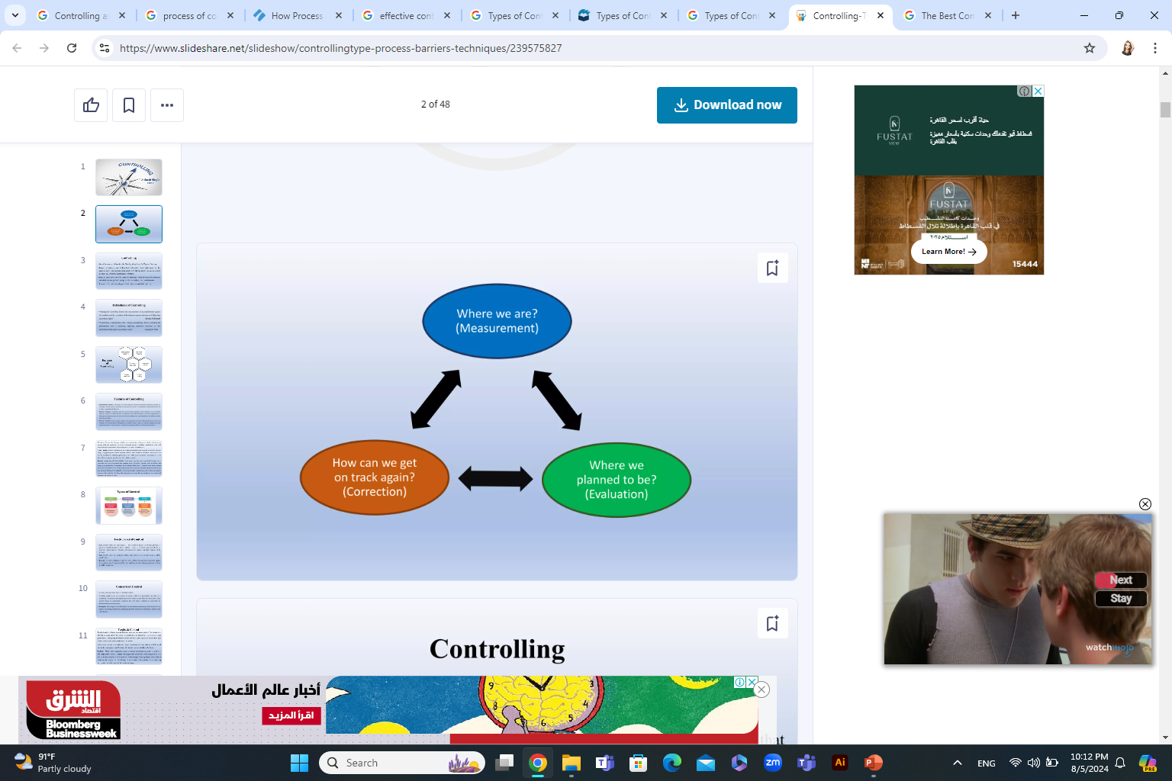
Controlling as a Management Function

Slide 8
Controlling as a Management Function
Managerial control implies the measurement of accomplishment against the standard and the correction of deviations to assure attainment of objectives according to plans

Slide 9
The Importance Of Controlling
Controlling is an important function of management. Its importance becomes apparent when we find that it is needed in all the functions of management.
Controlling checks mistakes and tells us how new challenges can be met or faced.
The success of the organization thus hinges on the effective controlling.

Slide 10
The importance of controlling becomes clear from the following facts:
(1) Accomplishing Organizational Goals
(2) Judging Accuracy of Standards
(3) Making Efficient Use of Resources
(4) Improving Employee Motivation
(5) Ensuring Order and Discipline
(6) Facilitating Coordination in Action

Slide 11
OBJECTIVES OF CONTROL
An effective system of control helps in achieving the following objectives:
Better performance and determining the progress of work.
Minimize dishonest behavior.
Detecting deviations from the planned standards.
Investigating the causes of deviations.
Taking corrective measures to check deviations.
Keeping the loss due to faulty production within the minimum possible limit.

Slide 12
The characteristics of control
It may be described as under:
1. Last Process: Managerial control is the last process of management because the work of control starts after planning, organization, direction, coordination and motivation.
2. Dynamic Process: Control is a dynamic process of management because in this process, necessary changes are made keeping in view the changed circumstances of enterprise.
3. Continuous Process: Control is the continuous process of management, it continues as long as the production continues in the enterprise.

Slide 13
The characteristics of control
It may be described as under:
4. Control on Future Events: In the process of control all the best efforts are made to check the possible losses in future. In fact, managerial control is a process of directing the activities of the enterprise for future on the basis of past experiences.
5. Based on Scientific Principles and Statistical Factors: The process of control is based upon scientific principle and statistical factors.
6. Attainment of Goals: The main object of control is to ensure the proper functioning of enterprise according to pre-determined rules, policies, procedures and programmes. It aims at the attainment of pre decided objectives of the enterprise.

Slide 14
Remember
All meaningful control techniques are, planning techniques
It is worthless to design control plans without taking in account how well the plans are made

Slide 15
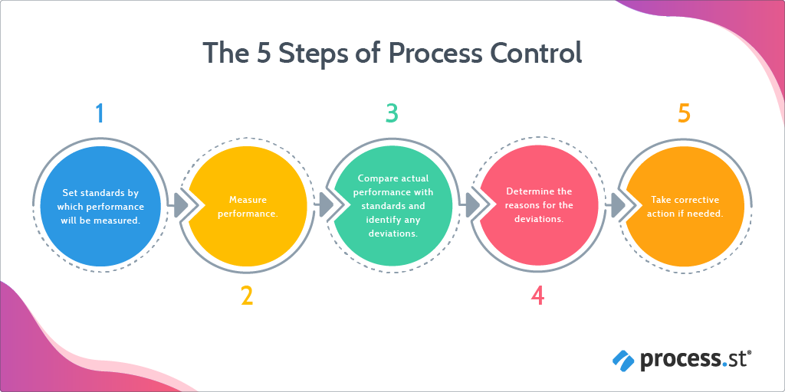
The Control Process

Slide 16
The Control Process
1. Establish Objectives and Standards
The control process begins with planning and the establishment of performance objectives.
Performance objectives are defined and the standards for measuring them are set.

Slide 17
The Control Process
1. Establish Objectives and Standards
Output Standards
measures performance results in terms of quantity, quality, cost, or time.
Input Standards
measures work efforts that go into a performance task.
There are two types of standards

Slide 18
The Control Process
2. Measuring Actual Performance
Measurements must be accurate enough to spot deviations or variances between what really occurs and what is most desired.
Without measurement, effective control is not possible.

Slide 19
The Control Process
3. Comparing Results with Objectives and Standards
The comparison of actual performance with desired performance establishes the need for action.
Ways of making such comparisons include:
  Historical / Relative / Engineering
  Benchmarking

Slide 20
The Control Process
4. Taking Corrective Action
Taking any action necessary to correct or improve things.
Management-by-Exception focuses managerial attention on substantial differences between actual and desired performance.

Slide 21
  Management-by Exception can save the managers time, energy, and other resources, and concentrates efforts on areas showing the greatest need.
  There are two types of exceptions:
    Problems - below standard
    Opportunities - above standard

Slide 22
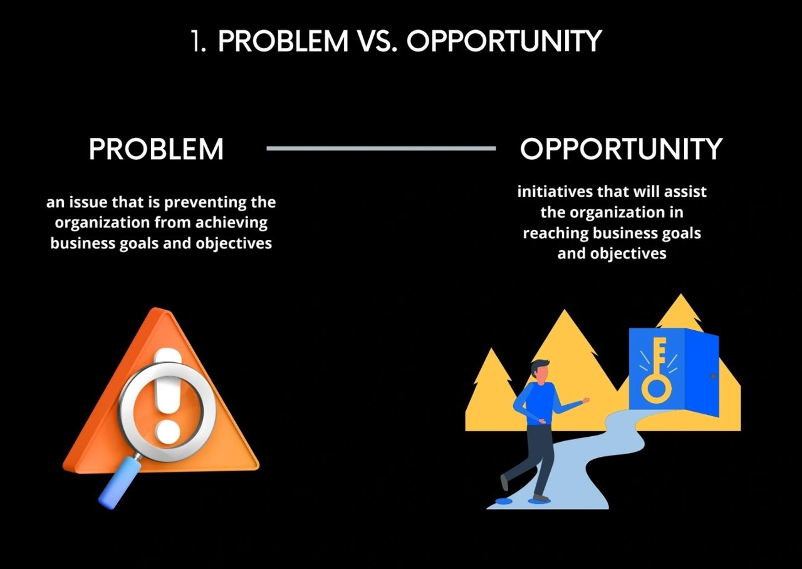

Slide 23
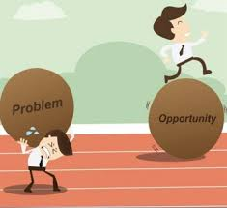
Problem – A situation in which some aspect of organizational performance is less than desirable.
Opportunity – A situation that has the potential to provide additional beneficial outcomes.

Slide 24
Effective Controls
Effective Control is a term that describes the powers that a person or position has within an organization. We are obliged to verify the identity of all persons with Effective Control of an organization.

Slide 25
Effective Controls
The Best Controls in Organizations are
Strategic and results oriented
Understandable
Encourage self-control
Timely and exception oriented
Positive in nature
Fair and objective
Flexible

Slide 26
Effective Controls
Elements of a good and effective Control System
Feedback. Feedback is the backbone of all control systems. ...
Control must be objective. ...
Prompt reporting of deviations. ...
Control should be forward-looking. ...
Flexible controls. ...
Hierarchical suitability. ...
Economical control. ...
Strategic control points.

Slide 27
Types of Control
1.Preliminary
2.Concurrent
3.Post action
4.Internal Controls
5.External Controls

Slide 28
Types of Control
1.Preliminary
Sometimes called the feed forward controls, they are accomplished before a work activity begins.
They make sure that proper directions are set and that the right resources are available to accomplish them.
ضوابط التغذية للأمام

Slide 29
Types of Control
2.Concurrent
Focus on what happens during the work process. Sometimes called steering controls,
they monitor ongoing operations and activities to make sure that things are being done correctly.

Slide 30
Types of Control
3.Post action
Sometimes called feedback controls, they take place after an action is completed.
They focus on end results, as opposed to inputs and activities.

Slide 31
Types of Control
4.Internal Controls
Allows motivated individuals to exercise self-control in fulfilling job expectations.
The potential for self-control is enhanced when capable people have clear performance objectives and proper resource support.

Slide 32
Types of Control
5.External Controls
It occurs through personal supervision and the use of formal administrative systems.
  Performance appraisal systems,
  compensation and benefit systems,
  employee discipline systems,
  and management-by-objectives.

Slide 33
Organizational Control Systems
Management Processes
Compensation and Benefits
Employee Discipline
Information and Financial

Slide 34
Organizational Control Systems
Management Processes
  Strategy and objectives
  Policies and procedures
  Selection and training
  Performance appraisal
  Job design and work structures
  Performance modeling, norms, and organization culture

Slide 35
Organizational Control Systems
Compensation and Benefits
  Attract talented people and retain them.
  Motivate people to exert maximum effort in their work.
  Recognize the value of their performance contributions.

Slide 36
Organizational Control Systems
Employee Discipline
  Discipline is defined as influencing behavior through reprimand.
  Progressive Discipline ties reprimand to the severity and frequency of the employee’s infractions.
  Positive Discipline tries to involve people more positively and directly in making decisions to improve their behavior.

Slide 37
Organizational Control Systems
Information and Financial
  Activity-based costing - the true cost of all products and services.
  Economic value added - examine the value added by all activities.
  Understand the implication of key financial measures of (ratios) organizational performance

Slide 38
Scope of Control
• Policies
• Organization
• Production
• Wages & salary
• Environment

Slide 39
Relationship between controlling and other managerial functions
other managerial functions
Controlling process or (system)
Planning is abase of controlling
Specifying objectives
Organizing a system of controlling
Establishing standards
Staffing is an aid to controlling
Measuring actual performance
Comparing actual performance with standards
Directing is guide to controlling
Correcting divisions

Slide 40
For effective control, it is important to know what are the critical areas where control would exercise.
The identification of these areas of control enhances the management to:
Delegate authority and fixing up of responsibility.
Reduce the burden of supervising each activity in detail.
Have a means of securing satisfactory results.

Slide 41



Thank You

