Slide 1

Principles and aims of risk management
Lecture 5
Everyone’s Smart
University
PMG510
Project Risk Management

Slide 2

Principles of risk management
The main principle of risk management is that it delivers value to the organization. Risk management activities are designed to achieve the best possible outcome and reduce volatility or uncertainty of outcomes.

Slide 3
Principles of risk management
a successful risk management initiative (and framework) will be:
  proportionate to the level of risk within the organization;
  aligned with other business activities;
  comprehensive, systematic and structured;
  embedded within business procedures and protocols;
  dynamic, iterative and responsive to change.

Slide 4
Principles of risk management
A successful risk management initiative (and framework) will be:
  proportionate to the level of risk within the organization;
  aligned with other business activities;
  comprehensive, systematic and structured;
  embedded within business procedures and protocols;
  dynamic, iterative and responsive to change.
  This provides the acronym PACED and provides a very good set of principles that are the foundations of a successful approach to risk management within any organization.

Slide 5
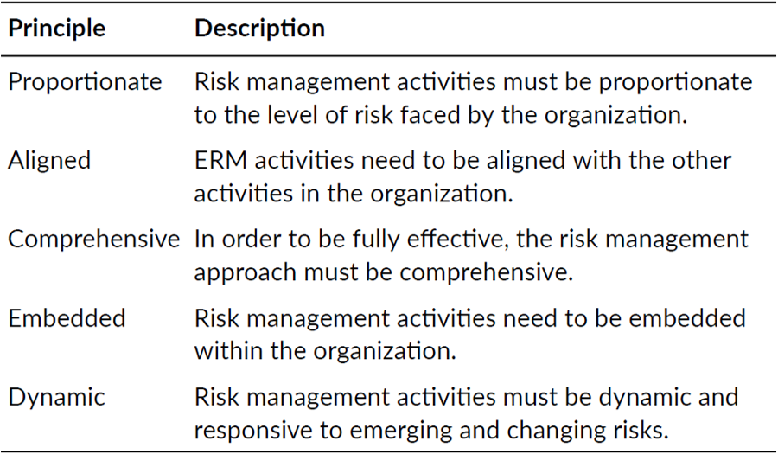
Principles of risk management

Slide 6
Principles of risk management
It is useful to separate the principles of risk management into two distinct lists: what should be the characteristics of risk management, as listed above; and what it should deliver, as listed below:
  mandatory obligations placed on the organization;
  assurance regarding the management of significant risks;
  decisions that pay full regard to risk considerations;
  effective and efficient core processes.

Slide 7
Principles of risk management
The table below sets out the possible purpose or motivation for a risk management initiative as mandatory, assurance, decision making and effective and efficient core processes (MADE2). Core processes represent the activities of the organization and can be strategic, tactical, operational or compliance (STOC) in nature.

Slide 8
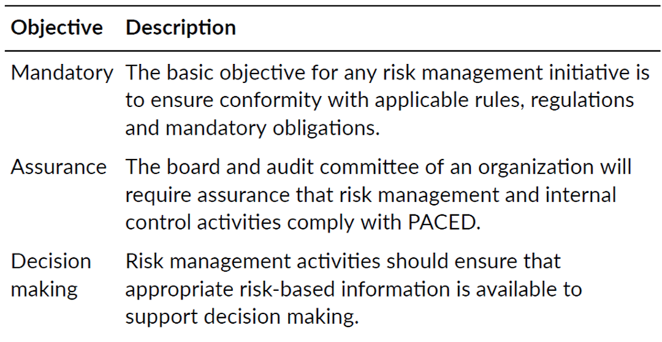
Principles of risk management

Slide 9
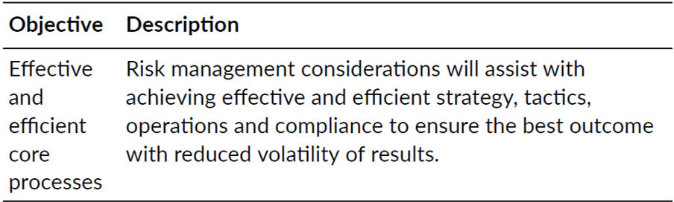
Principles of risk management

Slide 10
Principles of risk management
The objectives for risk management provide the acronym MADE2 and this confirms that outputs from risk management will lead to less disruption to normal efficient operations, a reduction of uncertainty in relation to tactics and improved decisions in relation to evaluation and selection of alternative strategies. In other words, a key part of risk management is improved organizational decision making.

Slide 11
Risk management activities
Risk management is a process that can be divided into several stages.
The process can be represented as the 8Rs and 4Ts of hazard risk management.

Slide 12
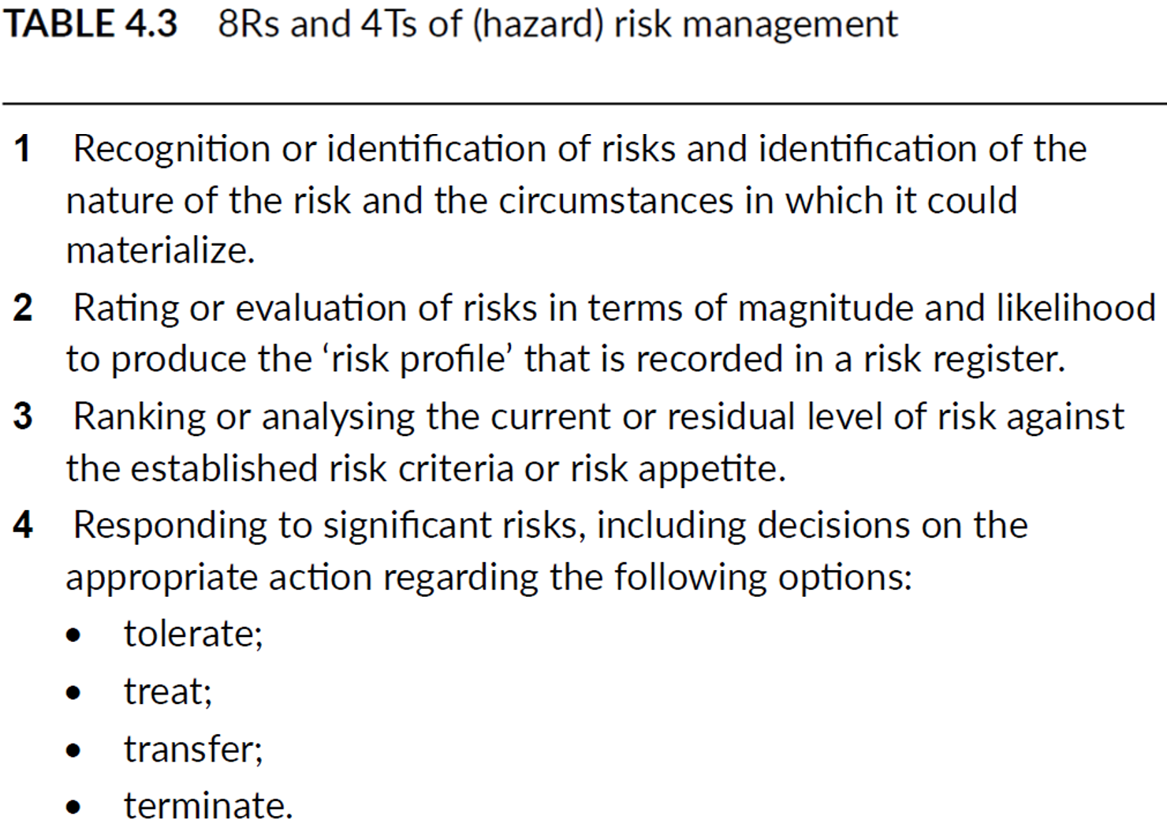
Risk management activities

Slide 13
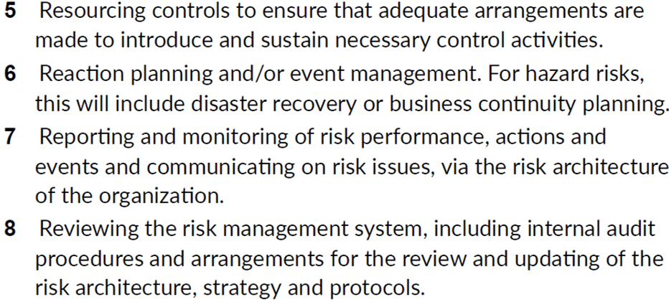
Risk management activities

Slide 14
Risk management activities

Slide 15
Risk management activities
Risk management process is a set of activities, described as identifying, analysing, evaluating, treating, monitoring and reviewing risk.
There has been much discussion about whether a single risk management process and/or diagram can be used to describe the management of compliance risks, hazard risks, control risks and opportunity risks.
The figure and Table above are used to illustrate the stages in the hazard risk management process only.

Slide 16
Risk management activities
Risk management tools and techniques should be used to achieve the following:
  compliance management provides risk governance;
  hazard management makes outcomes less negative;
  control management reduces the range of possible outcomes;
  opportunity management makes outcomes more positive.

Slide 17
Risk management activities
It is important to note that not all activities and functions undertaken by managers should be claimed by the risk manager as being undertaken in the name of risk management. Not all activities in the organization will be driven by risk management, even if all decisions, processes, procedures and activities have risks embedded within them.

Slide 18
Principles of Project
Risk Management
Define the Scope of Work for a Project
A project’s scope of work (SOW) should include:
  Client information
  Contractor information
  Deliverables
  Milestones
  A new SOW should be written for each project. Every client and contract is going to be different

Slide 19
Principles of Project
Risk Management
2. Identify Risks as Early as Possible
Being able to see risk coming down the line requires keeping an open mind and thinking about the future of a project, not just its present state.
Project areas to assess for risk management include:
  Budget
  Client requirements
  Contracts
  Documentation
  People (for example, if a core team member gets sick)
  Schedule
  Technology
  Weather and natural disasters

Slide 20
Principles of Project
Risk Management
3. Identify Opportunities, Too
Preparing for opportunities is an important part of risk management.
organizations who wish to exploit and enhance their opportunities must be intentional:
Objectives should be clearly defined.
Get the appropriate stakeholders together and brainstorm opportunities.
Capture and evaluate the opportunities. Which opportunities have the highest probability and impact scores?
Identify risk/opportunity owners who will develop and execute response plans for the most significant opportunities.
Develop and execute risk response plans.
Monitor the opportunities.

Slide 21
Principles of Project
Risk Management
4. Assign Importance to the Risk
Rate each risk. Using a scale of 1 to 5 is easiest, with 1 being the least impactful and 5 being the most impactful. First, answer the question, “How likely it is that the risk will occur?” and rate it on that scale. Then, rate the impact of the following: time, cost and quality. If it’s a positive risk, you can also rate it in terms of its benefits, as in, “How beneficial will this risk be if it occurs?”

Slide 22
Principles of Project
Risk Management
5. Figure Out How to Respond to the Risk
Now that the root cause of the potential problem is defined, there are four basic ways to deal with it:
Avoidance: Prevent the risk from occurring so that it doesn’t affect the project.
Mitigation: Take action to limit how much damage the risk can cause.
Transference: Hire someone else to take on the risk.
Acceptance: This is what will be chosen if the other three options aren’t available or realistic.

Slide 23
Principles of Project
Risk Management
6. Maintain a Risk Log
Use a spreadsheet to keep track of the expected risks. In addition to the risk assessment scales mentioned above, here are some fields to include:
  The date of when you add the entry and any other dates that will matter.
  Description of the risk
  Likelihood of the risk happening
  The person responsible for managing the risk, determined by who is most suited to that particular risk
  Proper response(s) to the risk
  High and low cost estimates for different risk responses
  Current status

Slide 24
Principles of Project
Risk Management
7. Regularly Review Project Risks
Risk management isn’t a one-time exercise; it has to be monitored and updated throughout the lifespan of a project.

