Slide 1



Overview of Project Management
Lecture 2
PMG 101
Foundations of Project Management
www.midocean.ae

Slide 2
Learning Objectives
Project Life Cycle.
Important concepts.
Understand the process of managing stakeholder engagement and how to use an issue log effectively.
Explain methods for controlling stakeholder engagement.
www.midocean.ae

Slide 3
like organic entities, projects have life cycles. From a slow beginning they progress to a buildup of size, then peak, begin a decline, and finally must be terminated. Some projects end by being phased into the normal, ongoing operations of the parent organization.
A standard project typically has the following four major phases (each with its own agenda of tasks and issues): initiation, planning, implementation, and closure. Taken together, these phases represent the path a project takes from the beginning to its end and are generally referred to as the project “life cycle.”
Project Life Cycle
www.midocean.ae

Slide 4



Slide 5
Important concepts
Overlapping of Activities
Projects often interact with other projects being carried out simultaneously by their parent organization; but projects always interact with the parent organization’s standard, ongoing operations. Although the functional departments of an organization (marketing, finance, manufacturing, and the like) interact with one another in regular, patterned ways, the patterns of interaction between projects and these departments tend to be changeable.
www.midocean.ae

Slide 6
Marketing may be involved at the beginning and end of a project, but not in the middle. Manufacturing may have major involvement throughout. Finance is often involved at the beginning and accounting at the end, as well as at periodic reporting times. The project manager must keep all these interactions clear and maintain the appropriate interrelationships with all external groups.
www.midocean.ae

Slide 7
2. Conflict
More than most managers, the PM lives in a world characterized by conflict. Projects compete with functional departments for resources and personnel. More serious, with the growing proliferation of projects, is the project versus project conflict for resources within multi-project organizations. The members of the project team are in almost constant conflict for the project’s resources and for leadership roles in solving project problems.
www.midocean.ae

Slide 8
3. Delivery and deliverables
There is a word that project managers and people involved regularly in projects use all the time; it is delivery. Delivery in the context of projects simply means getting the things done you set out to do. The role of a project manager is therefore to deliver the project.
Deliverables are what is delivered by a project, deliverables from the respective projects are such as a new house, a new computer system or a new product. In a project the deliverables wanted are defined at the start of the project, and your success as a project manager is in delivering them in the planned time and to the expected cost.
www.midocean.ae

Slide 9
4. Project dependencies
Every project has dependencies, which is defined as the “relationships between products or tasks”, i.e., tasks that require input from other tasks to be completed, or activities that can’t start until a previous activity is done. There are often several sequences to a task, and they’re all dependent on each other.
www.midocean.ae

Slide 10
There are four types of dependencies in project management which define the relationships between tasks:
Finish-to-Start – the first task needs to be completed before the second task can start.
Finish-to-Finish – the second task can’t be completed until the first task has been done.
Start-to-Start – the second task can’t commence until the first task has started.
Start-to-Finish – the first task has to start before the second task can be completed.
www.midocean.ae

Slide 11
5. Stakeholders
A project is successful when it achieves its objectives and meets or exceeds the expectations of the stakeholders. A stakeholder is a party that has an interest in a company and can either affect or be affected by the business. The primary stakeholders in a typical corporation are its investors, employees, customers, and suppliers. However, with the increasing attention on corporate social responsibility, the concept has been extended to include communities, governments, and trade associations.
www.midocean.ae

Slide 12
NOTE: Key stakeholders can make or break success of a project. Even if all the deliverables are met and the objectives are satisfied, if your key stakeholders aren’t happy, nobody’s happy.
Key stakeholders like top management which may include the president of the company, vice-presidents, directors, division managers, the corporate operating committee, and others. These people direct the strategy and development of the organization.
www.midocean.ae

Slide 13
Politics of Projects
Many times, project stakeholders have conflicting interests. It’s the project manager’s responsibility to understand these conflicts and try to resolve them. It’s also the project manger’s responsibility to manage stakeholder expectations. Be certain to identify and meet with all key stakeholders early in the project to understand all their needs and constraints. Project managers are somewhat like politicians. Typically, they are not inherently powerful or capable of imposing their will directly on coworkers, subcontractors, and suppliers. Like politicians, if they are to get their way, they must exercise influence effectively over others. On projects, project managers have direct control over very few things; therefore, their ability to influence others – to be a good politician – may be very important.
www.midocean.ae

Slide 14
Importance of Project Stakeholder Management
Stakeholder management is so important to project success.
The purpose of project stakeholder management is to identify all people or organizations affected by a project, to analyze stakeholder expectations, and to effectively engage stakeholders
www.midocean.ae

Slide 15
Projects Often Cause Change
Projects often cause changes in organizations, and some people may lose their jobs when a project is completed. Project managers might be viewed as enemies if the project resulted in job losses for some stakeholders
By contrast, they could be viewed as allies if they lead a project that helps increase profits, produce new jobs, or increase pay for certain stakeholders
In any case, project managers must learn to identify, understand, and work with a variety of stakeholders.
www.midocean.ae

Slide 16
Project Stakeholder Management Processes
Identifying stakeholders: Identifying everyone involved in the project or affected by it and determining the best ways to manage relationships with them.
Planning stakeholder management: Determining strategies to effectively engage stakeholders.
Managing stakeholder engagement: Communicating and working with project stakeholders to satisfy their needs and expectations, resolving issues, and fostering engagement in project decisions and activities.
Controlling stakeholder engagement: Monitoring stakeholder relationships and adjusting plans and strategies for engaging stakeholders as needed.
www.midocean.ae

Slide 17
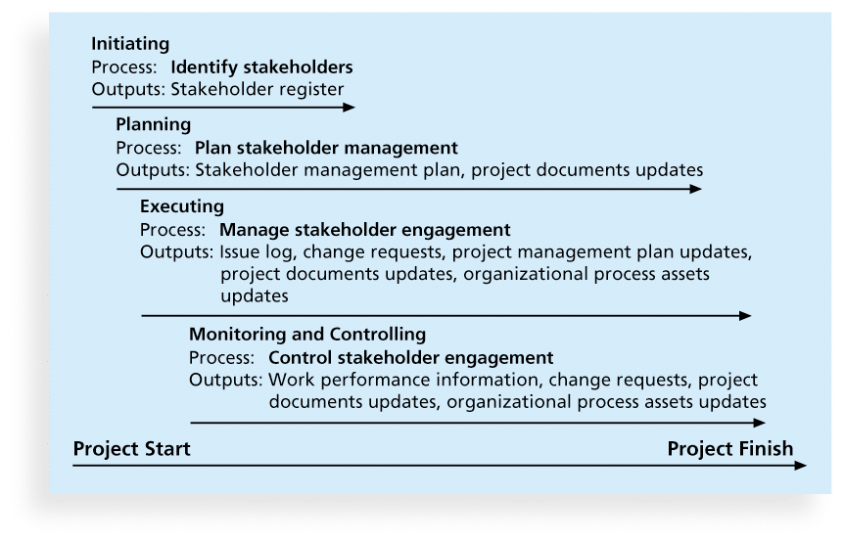
Figure 1. Project Stakeholder Management Summary
www.midocean.ae

Slide 18
Internal project stakeholders generally include the project sponsor, project team, support staff, employees, and internal customers for the project. Other internal stakeholders include top management, other functional managers, and other project managers.
External project stakeholders include the project’s customers (if they are external to the organization), competitors, suppliers, and other external groups that are potentially involved in the project or affected by it, such as government officials and concerned citizens.
1. Identifying Stakeholders
www.midocean.ae

Slide 19
A stakeholder register includes basic information on stakeholders:
  -Identification information: The stakeholders’ names, positions, locations, roles in the project, and contact information.
  -Assessment information: The stakeholders’ major requirements and expectations, potential influences, and phases of the project in which stakeholders have the most interest.
  -Stakeholder classification: Is the stakeholder internal or external to the organization? Is the stakeholder a supporter of the project or resistant to it?
Stakeholder Register
www.midocean.ae

Slide 20
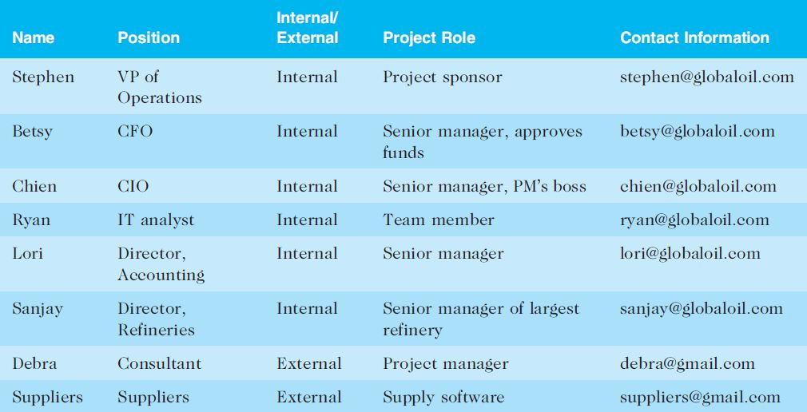
Table 1. Sample Stakeholder Register
www.midocean.ae

Slide 21
After identifying key project stakeholders, you can use different classification models to determine an approach for managing stakeholder relationships.
A power/interest grid can be used to group stakeholders based on their level of authority (power) and their level of concern (interest) for project outcomes.
Classifying Stakeholders
www.midocean.ae

Slide 22
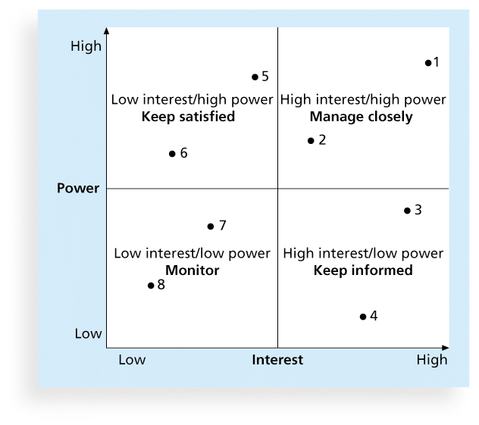
Figure 2. Power/Interest Grid
www.midocean.ae

Slide 23
Unaware: Unaware of the project and its potential impacts on them.
Resistant: Aware of the project yet resistant to change.
Neutral: Aware of the project yet neither supportive nor resistant.
Supportive: Aware of the project and supportive of change.
Leading: Aware of the project and its potential impacts and are actively engaged in ensuring the success of the Project.
Stakeholder Engagement Levels
www.midocean.ae

Slide 24
What Went Right?
Instead of just saying “no” when your project sponsor asks for something unreasonable, it is better to explain what is wrong with the request and then present a realistic way to solve the problem at hand.
For example, Christa Ferguson, a project portfolio manager and independent program manager in San Francisco, described how she handled a request from a project sponsor to deliver a new tablet device in two months when she knew she would need more time. Based on her experience, she knew the request for quotation (RFQ) for the effort alone would take almost a month. Christa quickly researched the facts to propose a realistic delivery schedule.
The project sponsor reset expectations once he learned what it took to produce the tablets.
www.midocean.ae

Slide 25
2. Planning Stakeholder Management
After identifying and analyzing stakeholders, project teams should develop a plan for management them.
The stakeholder management plan can include:
  Current and desired engagement levels.
  Interrelationships between stakeholders.
  Communication requirements.
  Potential management strategies for each stakeholder.
  Methods for updating the stakeholder management plan.
www.midocean.ae

Slide 26
Sensitive Information
Because a stakeholder management plan often includes sensitive information, it should not be part of the official project documents, which are normally available for all stakeholders to review.
In many cases, only project managers and a few other team members should prepare the stakeholder management plan.
Parts of the stakeholder management plan are not written down, and if they are, distribution is strictly limited.
www.midocean.ae

Slide 27
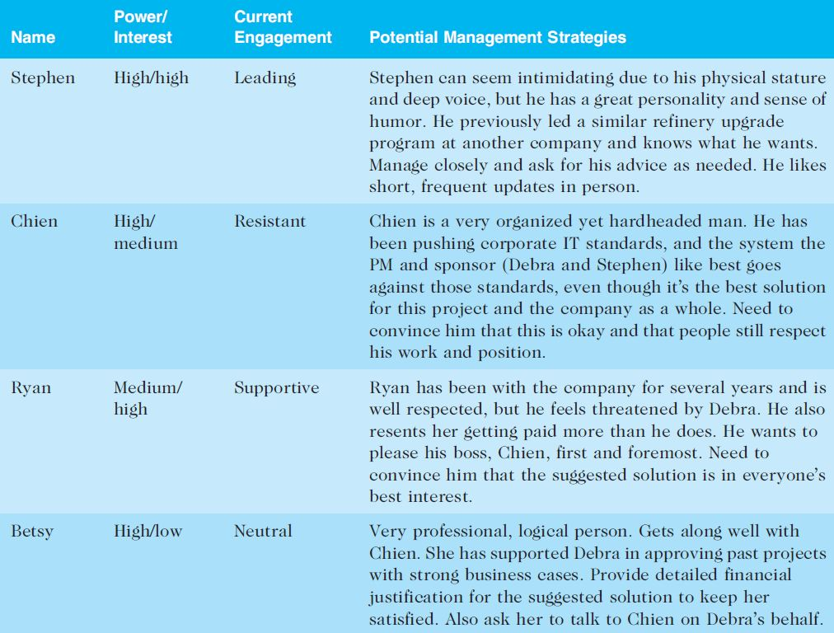
Table 2. Sample Stakeholder Analysis
www.midocean.ae

Slide 28
3. Managing Stakeholder Engagement
Project success is often measured in terms of customer/sponsor satisfaction.
Project sponsors often rank scope, time, and cost goals in order of importance and provide guidelines on how to balance the triple constraint.
This ranking can be shown in an expectations management matrix to help clarify expectations.
www.midocean.ae

Slide 29
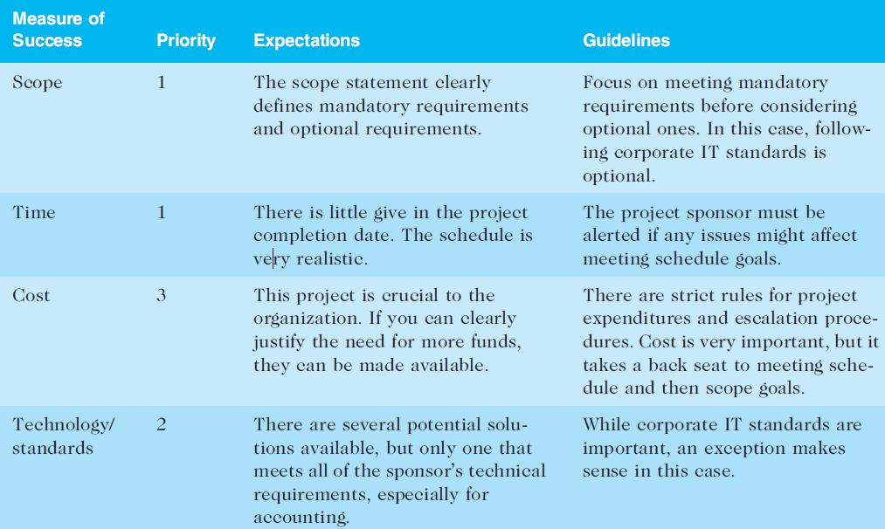
Table 3. Expectations Management Matrix
www.midocean.ae

Slide 30
Issue Logs
Understanding the stakeholders’ expectations can help in managing issues.
Issues should be documented in an issue log, a tool used to document, monitor, and track issues that need resolution.
Unresolved issues can be a major source of conflict and result in stakeholder expectations not being met.
Issue logs can address other knowledge areas as well.
www.midocean.ae

Slide 31
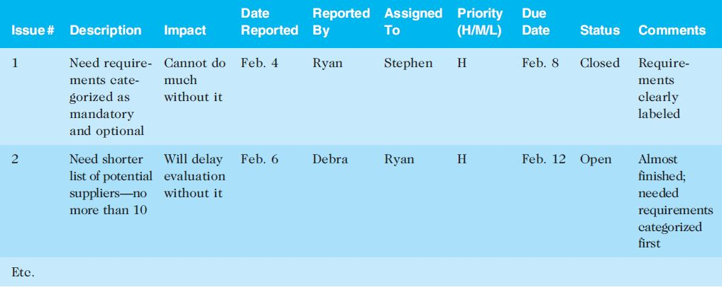
Table 4. Sample Issue Log
www.midocean.ae

Slide 32
Best Practice
Project managers are often faced with challenges, especially in managing stakeholders
Sometimes they simply cannot meet requests from important stakeholders
Suggestions for handling these situations include the following:
  Be clear from the start
  Explain the consequences
  Have a contingency plan خطة طوارئ
  Avoid surprises
  Take a stand أخذ موقف من شيء
www.midocean.ae

Slide 33
4. Controlling Stakeholder Engagement
You cannot control stakeholders, but you can control their level of engagement.
Engagement involves a dialogueحوار in which people seek understanding and solutions to issues of mutual concern.
Many teachers are familiar with various techniques for engaging students.
It is important to set the proper tone at the start of a class or project.
www.midocean.ae

Slide 34
Example of Engaging or Not Engaging Students (or Other Stakeholders)
If a teacher (or manager) does nothing but lecture on the first day of class (or at meetings) or criticizes the first person who offers a comment, students (or workers) will quickly decide that their best strategy is to keep quiet and maybe not even attend the class (or meetings).
On the other hand, if the teacher (or manager) uses a lot of activities to get all participants to speak or use technology to participate, they will expect to be active participants in future classes (or meetings).
www.midocean.ae

Slide 35
Ways to Control Engagement
Key stakeholders should be invited to actively participate in a kick-off meeting rather than merely attending it.
The project manager should emphasize that a dialogue is expected at the meeting, including texts or whatever means of communication the stakeholders prefer. The project manager should also meet with important stakeholders before the kick-off meeting.
The project schedule should include activities and deliverables related to stakeholder engagement, such as surveys, reviews, demonstrations, and sign-offs.
يجب أن يتضمن الجدول الزمني للمشروع الأنشطة والمخرجات المتعلقة بإشراك أصحاب المصلحة ، مثل الاستطلاعات والمراجعات والعروض التوضيحية والتوقيعات.
www.midocean.ae

Slide 36



Thank You

