Slide 1



Program Risk Management
Prepared by Dr. Sami Alzahrani
Lecture 9
Lecture 9
PMG 665
Program and Portfolio Management

Slide 2
Introduction
The origin of the word “risk” hails from risqué and risicare, meaning to dare. Since mankind started to challenge the belief that the world was flat in the 15th century, there has been much advancement in thinking, both in technology and in other fields. One can argue, therefore, that when some risk was taken, when the outcome was positive, not only was risk good, but it drove innovation.

Slide 3
Introduction
Over the course of your career, have you pushed the envelope on a program that advanced your or your company’s knowledge? This is the same principle as the expeditions of the early explorers; when the outcome is positive, taking risks can yield great benefits.

Slide 4
What is risk?
Risk has slightly different definitions, depending the context, on whom you ask, and that person’s experience. In the finance and insurance industries, for example, risk is a calculation of the probability of a loss. However, when applied to program management, this is only half of the equation. Because of the non-infinite nature of programs, one must also be concerned with impact to the program and proximity of time.

Slide 5
What is risk?
If the risk has a high probability of occurring, but the proximity as it relates to the program is in the closing stage, this risk will have a high probability of weighing on the overall impact, strategy, and the action taken for it.

Slide 6
What is risk?
In the context of program management, a risk is any uncertain event which, if it occurs, may positively or negatively impact your program’s success criteria. Risk can be positive! For example, assume it is an election year in the locale of the construction site where you are managing the development of a multi-year, large construction program. The two leading candidates for the top political office differ on the means to raise revenue for the locale. Candidate A’s position is to place new taxes on steel so new buildings will cost more to construct.

Slide 7
Risk categories, triggers, and the risk register
Specific categories for program risks will vary depending on such factors as risk tolerance, industry, maturity of processes, and other issues. What is important to your program is that the categories are both agreed upon and used consistently across the entire program. If certain projects within the program will not have specific categories (such as technology risks—if the project does not have a technology component), the categories should not be used on that project or referenced in that specific project’s risk register.

Slide 8
Risk categories, triggers, and the risk register
Common categories of risk to consider include operational, process, project, environmental, regulatory, resource and technology. The performing organization of the program typically will determine the categories of risks for the program.

Slide 9
Risk categories, triggers, and the risk register
Risk triggers are indications the risk occurred or is about to occur. For example, building on the example previously used concerning the two political candidates, a risk trigger may include one of the candidates gaining more than 50% of the pre-election support within the locale.

Slide 10
The relationship of risk management between projects and programs
Program risks can emerge from a variety of sources and are not solely an aggregate of the project risks from within the program. Certainly, project risks are one area in which program risks are found. However, in addition to risks aggregated to the program from one or more projects, a program can also have a risk specific to the program that is not present at any of the project levels. Figure 16.3 illustrates the relationship of risks between program and projects.

Slide 11
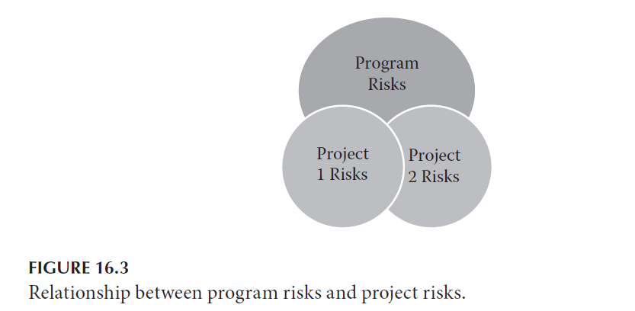
The relationship of risk management between projects and programs

Slide 12
The importance of program risk management
Risk management in the corporate setting has existed for a great number of years. Within the insurance and finance industries, risks and managing risks are the cornerstone of their business models. Without risk management, insurance and finance companies would cease to exist. The same holds true for programs; without risk management, programs will fail. This is why risk management is such a crucial aspect of program management.

Slide 13
Risk communication planning
Foremost, a risk communication plan should be included in the overall program communication plan. This chapter is not intended to cover program communication planning but rather to serve as a guideline for planning the specific communications on risks. However, when planning communications on risks, one must assess the impact across the entire program.

Slide 14
Risk communication planning
Communicating before an adequate impact assessment is performed is risky, and oftentimes leads to rework, and in turn, more issues on the program. A few questions will help guide the team in the impact assessment and plan specific risk communications:

Slide 15
Risk communication planning
• Was the risk efrom the project, or was it identified at the program level?
• What actions have scalated already been taken on the risk?
• Was an adequate stakeholder analysis performed at the project level?
• What are the impacts to the program as well as the projects, how are they impacted, and what is the expected timing of the impact?
• Who are all the stakeholders, and what do they need to know specific to the risk?

Slide 16
Common risk processes, tools, and techniques
While there are several variations of risk models—the one example most common in program management is the five processes of risk management as detailed in the A Guide to the Project Management Body of Knowledge (PMBOK® Guide) 4th edition (PMI® 2008a). These processes are: Risk Planning, Identify Risk, Qualitative Analysis, Quantitative Analysis, Response Planning, and Monitoring and Controlling. Several other processes do exist, but are similar enough, and the aforementioned is a tried and tested process for managing risk.

Slide 17
Common risk processes, tools, and techniques
Risk Planning—Risk planning is the “process of defining how to conduct risk management activities” (PMI® 2008a, p. 276). The planning should be conducted during program initiating and included in the overall program management plan. When planning program risk, be sure to factor in specific environmental factors and organizational process assets unique to your organization.

Slide 18
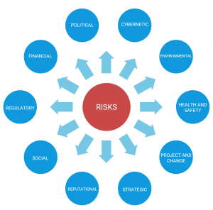
Risk Categories

Slide 19
Common risk processes, tools, and techniques
Identify Risk—Identifying risk involves both the determination of which risks may affect your program as well as documenting their characteristics. Anyone on the program can and should be involved in the risk identification activities. If your organization lacks mature processes, or has limited internal expertise, consider the benefits of hiring external subject matter experts to participate in risk identification.

Slide 20
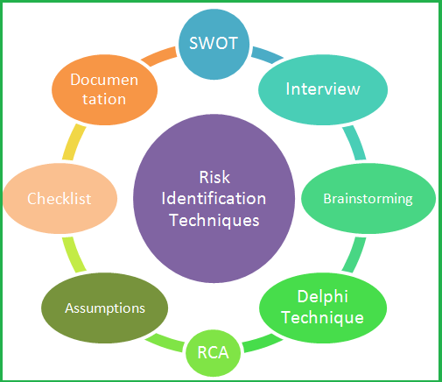
Risk Identification techniques

Slide 21
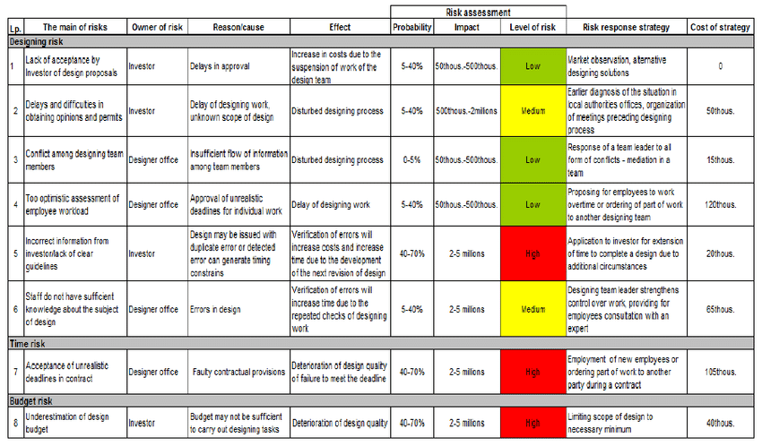
Risk Register

Slide 22
Common risk processes, tools, and techniques
Qualitative Analysis—Qualitative analysis is the “process of prioritizing risks for further analysis”. All risks should be prioritized; therefore, a qualitative analysis should be performed. The identified risks should be captured on the risk register, and the team should perform the qualitative analysis to update the probability and impact of the risks. The qualitative analysis should be performed throughout the program life cycle and not as a one-time activity as events can occur that will impact the probability, impact or both factors of risks.

Slide 23
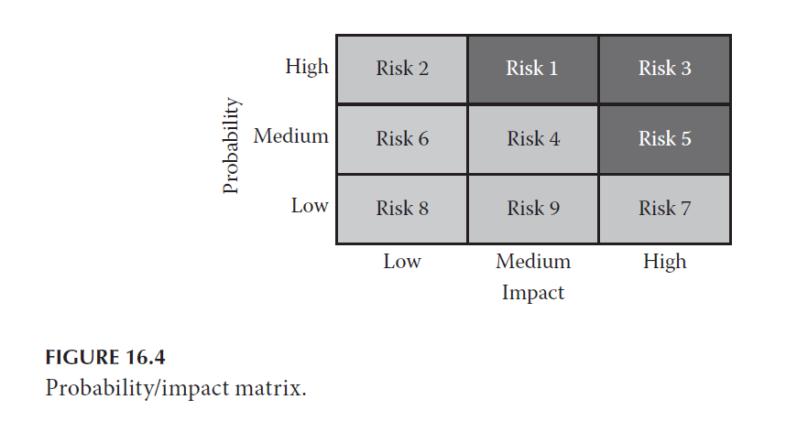
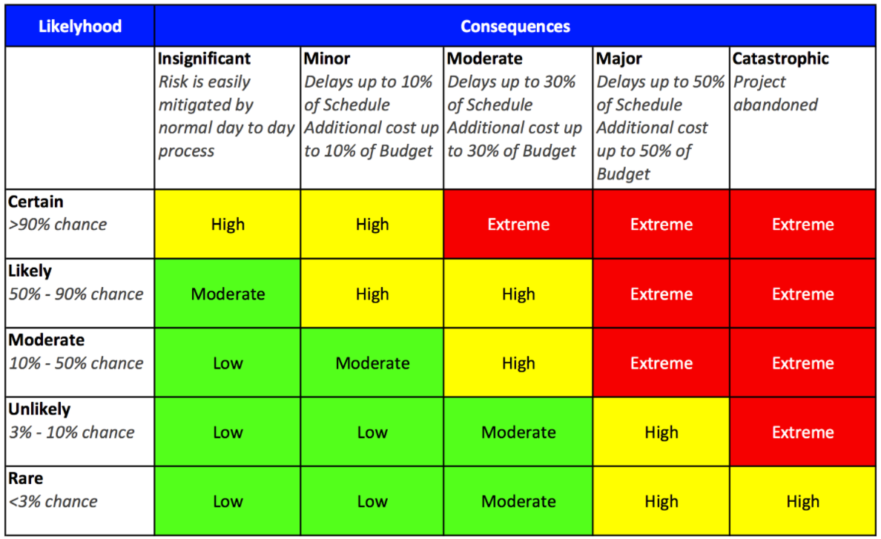
Probability and Impact Matrix

Slide 24
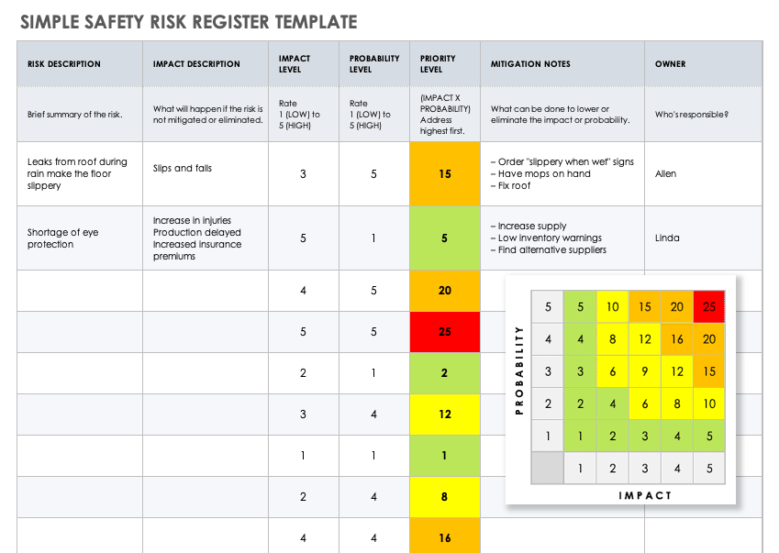
Risk Level

Slide 25
Common risk processes, tools, and techniques
Quantitative Analysis—Quantitative analysis is the process of quantifying the impact of the risk to the program through numeric analysis. Quantitative analysis follows qualitative; however, it is not necessarily performed for all risks. If, for example, identified risks have a low probability of occurrence, and low impact to the program, the resources required to conduct quantitative analysis may be better used elsewhere.

Slide 26
Common risk processes, tools, and techniques
Response Planning—Response planning is developing options and actions for identified risks. The types of responses were highlighted earlier in the chapter. In additional specific responses, response planning should also assign a risk owner to each risk. This risk owner then will be responsible for ensuring the execution of the risk response and for closing it in the register when it is appropriate to do so.

Slide 27
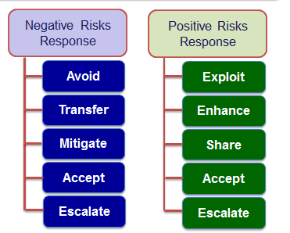
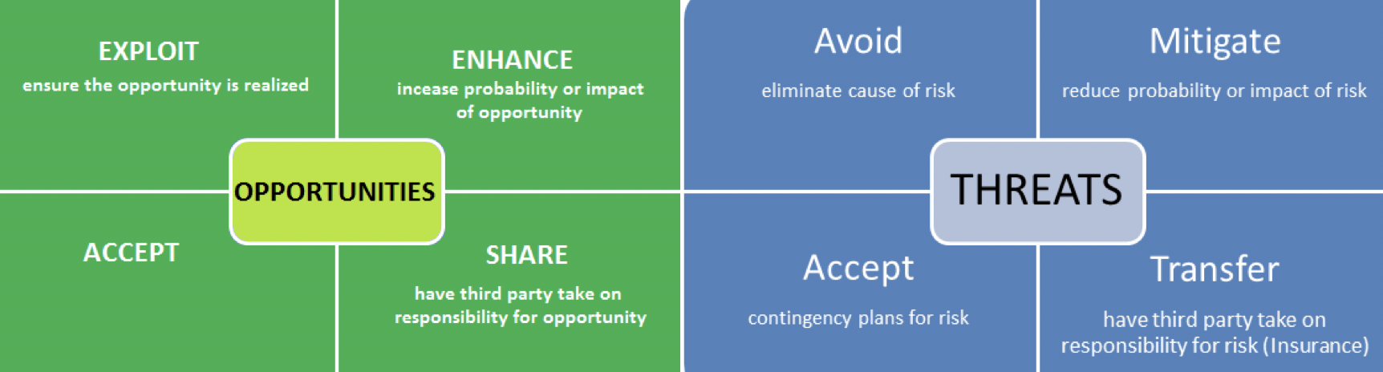
Risk Response Methods

Slide 28
Common risk processes, tools, and techniques
Monitoring and Controlling—Monitoring and controlling risk is an iterative and ongoing process for the program. During monitoring and controlling risk, risks are tracked, responses are implemented, new risks are identified, and residual and secondary risks are monitored. While the following is not a complete list of the tools and techniques used within the PMI® risk process, it does represent some of the more common tools and techniques.

Slide 29
Common risk processes, tools, and techniques
Expert Judgment—Do not discount the use of expert judgment in managing program risk. Not only is this the most subjective tool, it can also be one of the best tools for risk identification and analysis. The program manager should take all reasonable steps to ensure available expert judgment is utilized in the risk processes.

Slide 30
Common risk processes, tools, and techniques
Risk Categories (RBS)—A risk breakdown structure (RBS) is a visual representation of risk categories and sub-categories. Creating a RBS can assist the program team in the identification of risks just as an iterative approach to brainstorming sessions can help identify new risks. The Program level RBS should be an aggregate of the project level RBSs; however, the RBS used on each project within the program may be different.

Slide 31
Common risk processes, tools, and techniques
Brainstorming—According the PMBOK® Guide, (PMI®, 2008a) brainstorming is a general data gathering and creativity technique that can be used to identify risks, ideas, or solutions to issues by using a group of team members or subject-matter experts. This technique can be used effectively to identify risks as long as the program manager sets up the right environment for the brainstorming session.

Slide 32
Common risk processes, tools, and techniques
FMEA (Failure Mode and Effects Analysis)—A FMEA is a common Six Sigma tool, but it is not generally listed in most program management literature as a risk tool. A FMEA is a tool used to analyze the potential failure modes by the severity and likelihood of the failures. In other words, it is an expanded probability impact table. It is due to this expansion that it warrants being called out on its own.

Slide 33
Common risk processes, tools, and techniques
Monte Carlo—is a software simulation technique used to simulate project characteristics, such as cost and schedule. The outcome generates a probability distribution for the entire program. It is a key quantitative risk analysis approach.

Slide 34
Common risk processes, tools, and techniques
Probability Tables—are generated from the Monte Carlo technique. These tools will allow you to take some level of subjectivity out of the event. The probability table will have the confidence level of the event and its resulting impact (time or costs). Probability tables can be effective, not only in the analysis of risks, but also in communicating risks.

Slide 35
Common risk processes, tools, and techniques
Probability/Impact Matrix—is a two-dimensional graph of the probability of the event and the resulting impact should it occur. This tool allows the program resources to focus on the events with the highest potential probability of occurrence or greatest impact on the program. Program resources should focus on the risks that fall into the upper right quadrant, which have the potential greatest impact on the program. An example of the probability impact matrix is shown in Figure 16.4.

Slide 36
Common risk processes, tools, and techniques

Slide 37
Common risk processes, tools, and techniques
Decision Tree and Expected Monetary Value (EVM)—Decision-tree analysis is focused on evaluating the probability and impact of all decisions, and calculating the expected monetary value of the whole. The sum of all the probabilities within the decision tree must equal 1.0 (or 100%).

Slide 38
Common risk processes, tools, and techniques
Variance and Trend Analysis—Variance and trend analysis are effective tools to identify areas of concern on a program. The variance analysis is a comparison of the planned to the actual, while trend analysis will show the variances over time. These tools can quantify the risk for your program. If the variances continue trending in a negative way, the tools will quantify this risk and assist in communicating the issue to your stakeholders.

Slide 39
Common risk processes, tools, and techniques
Risk Audits—Risk audits are reviews of the risk processes in place across the program to ensure the risk processes are performing the intended goal (identification, analysis, etc.). The auditor must be objective and, often times, is the project manager for the assigned project or is the program manager overseeing the projects. They also can be conducted by a member of a Program or Project Management Office, if one exists in the organization.

Slide 40
What is effective risk management?
As mentioned previously, effective program management cannot exist without effective risk management. This leads one to ask, what is effective risk management? Is effective risk management following the risks procedures established within your organization? See Figure 16.6. If only it were all that easy; there would be far fewer troubled projects and programs! To begin, effective risk management should be proactive.

Slide 41
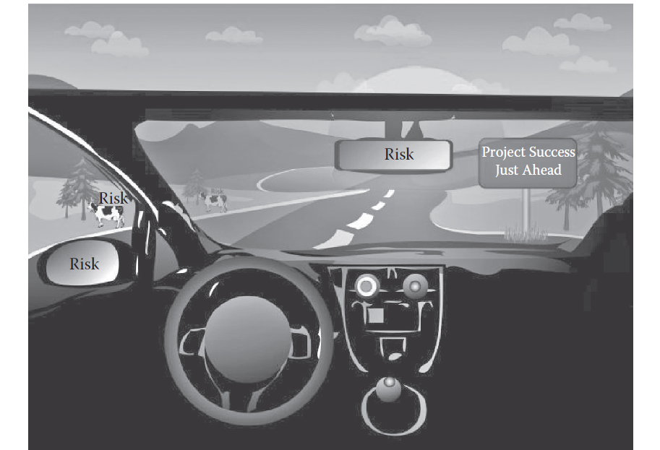
What is effective risk management?

Slide 42
Reference
Program Management: A Life Cycle Approach
by Ginger Levin, PMP, PgMP
Chapter 16

