Slide 1





Lecture: #10
Network Security Tools
Dr. Hesham Abou Elfetouh
Cybersecurity Department
Faculty of Informatics
Midocean University
Secure Operating Systems (CYB610)
www.midocean.ae

Slide 2
Chapter
Outline
10
    This chapter covers the following topics and concepts:
    Network Security Tools
    Firewalls
2
www.midocean.ae
Secure Operating Systems

Slide 3
Chapter
Introduction
10
In Previous Lectures you learned:
The Web Security
Browser Attack Types
Email Spam
Denial of Service Attacks
Classes of Attacks
Detection Methods
3
www.midocean.ae
Secure Operating Systems

Slide 4
Chapter
CHAPTER 10 GOALS
10
When you complete this chapter, you will be able to:
Describe what is the fire wall
Illustrate Types of firewalls
Compare between firewall types
Explain the firewall configurations
Define What firewalls can—and can’t—block
4
www.midocean.ae
Secure Operating Systems

Slide 5
Chapter
Firewalls
10
Outline
  Introduction
  What is a firewall
  Firewall design
  Types of firewalls
    Packet filters
    (i-1) Simple packet filters
    (i-2) Stateful packet filters
    Application proxies
      (ii-1) Guards
    iii. Personal firewalls
  Comparison of firewall types
  Example firewall configurations
  What firewalls can—and can’t—block
5
www.midocean.ae
Secure Operating Systems

Slide 6
Chapter
What is a Firewall?
10
It is a device (h/w), or software, or combination of both designed as a:
Wall between protected local (sub)net & outside global net
Choke point of control and monitoring
It Interconnects networks with differing trust
It Imposes restrictions on network services
  only authorized traffic is allowed prevent unauthorized outside users from accessing network and/or single workstation
Auditing and controlling access
  can implement alarms for abnormal behavior prevent inside users from omitting sensitive information or accessing insecure resources
Itself immune to penetration
Provides perimeter defence
6
www.midocean.ae
Secure Operating Systems

Slide 7
Chapter
What is a Firewall?
10
Most firewalls run as dedicated devices
Easier to design correctly and inspect each individual inbound or outbound packet of data sent to / from protected system
Easier to optimize for performance
Firewalls implement security policies, or set of rules that determine what traffic can or cannot pass through
A firewall is an example of a reference monitor, which means it should have three characteristics:
Always invoked (cannot be circumvented)
Tamperproof
Small and simple enough for rigorous analysis
7
www.midocean.ae
Secure Operating Systems

Slide 8
Chapter
What is a Firewall?
10
Examples of security policy requirements w.r.t. firewalls:
Block any access from the outside, allow all accesses to the outside
Allow” from” accesses only for certain activities OR only to/from certain subnets/hosts/apps/users
E.g., prevent outside access to subnet hosts except for mail server accesses
Choice of default firewall behavior
1) Default permit
“That which is not expressly forbidden is allowed”
2) Default deny
“That which is not expressly allowed is forbidden”
Users prefer default permit, security experts prefer default deny
Sysadmin must make the choice
8
www.midocean.ae
Secure Operating Systems

Slide 9
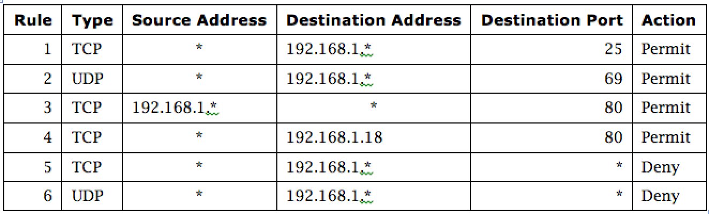
Chapter
Firewall Security Policy
10
  In this example firewall configuration,
  External traffic can reach the entire internal network on TCP/25 and UDP/69 (1 &2).
  Internal traffic can go out to port 80 on the external network.
  External traffic can reach TCP/80 on one internal server.
  All other traffic from external to internal is disallowed.
9
www.midocean.ae
Secure Operating Systems

Slide 10
Chapter
Types of Firewalls
10
  Packet filtering gateways or screening routers
  Stateful inspection firewalls
  Application-level gateways, also known as proxies
  Circuit-level gateways
  Guards
  Personal or host-based firewalls
  Combination of above is dynamic packet filter
10
www.midocean.ae
Secure Operating Systems

Slide 11
Chapter
Packet-Filtering Gateways
10
  A packet-filtering gateway controls access on the basis of packet address and specific transport protocol type (e.g., HTTP traffic).
  The example firewall configuration table on a previous slide was in relation to a packet-filtering gateway. In the image on this slide, the firewall is filtering out Telnet traffic but allowing HTTP traffic in.
11
www.midocean.ae
Secure Operating Systems

Slide 12
Chapter
Firewalls – Packet Filters
10
Simplest of components
Uses transport-layer information only
  IP Source Address, Destination Address
  Protocol/Next Header (TCP, UDP, ICMP, etc)
  TCP or UDP source & destination ports
  TCP Flags (SYN, ACK, FIN, RST, PSH, etc)
  ICMP message type
Examples
  DNS uses port 53
    No incoming port 53 packets except known trusted servers
12
www.midocean.ae
Secure Operating Systems

Slide 13
Chapter
Usage of Packet Filters
10
    Filtering with incoming or outgoing interfaces
    E.g., Ingress filtering of spoofed IP addresses
    Egress filtering
    Permits or denies certain services
    Requires intimate knowledge of TCP and UDP port utilization on several of operating systems
13
www.midocean.ae
Secure Operating Systems

Slide 14
Chapter
How to Configure a Packet Filter
10
Start with a security policy
Specify allowable packets in terms of logical expressions on packet fields
Rewrite expressions in syntax supported by your vendor
General rules - least privilege
All that is not expressly permitted is prohibited
If you do not need it, eliminate it
14
www.midocean.ae
Secure Operating Systems

Slide 15

Chapter
How to Configure a Packet Filter
10
Every ruleset is followed by an implicit rule reading like this.
Example 1:
Suppose we want to allow inbound mail (SMTP, port 25) but only to our gateway machine. Also suppose that mail from particular site SPIGOT is to be blocked.
15
www.midocean.ae
Secure Operating Systems

Slide 16

Chapter
How to Configure a Packet Filter
10
Solution 1:
Example 2:
Now suppose that we want to implement the policy “any inside host can send mail to the outside”.
16
www.midocean.ae
Secure Operating Systems

Slide 17

Chapter
How to Configure a Packet Filter
10
Solution 2:
This solution allows calls to come from any port on an inside machine, and will direct them to port 25 on the outside. Simple enough…
So why is it wrong?
17
www.midocean.ae
Secure Operating Systems

Slide 18
Chapter
How to Configure a Packet Filter
10
Our defined restriction is based solely on the outside host’s port number, which we have no way of controlling.
Now an enemy can access any internal machines and port by originating his call from port 25 on the outside machine.
What can be a better solution ?
18
www.midocean.ae
Secure Operating Systems

Slide 19

Chapter
How to Configure a Packet Filter
10
The ACK signifies that the packet is part of an ongoing conversation
Packets without the ACK are connection establishment messages, which we are only permitting from internal hosts
19
www.midocean.ae
Secure Operating Systems

Slide 20
Chapter
Security & Performance of Packet Filters
10
IP address spoofing
  Fake source address to be trusted
  Add filters on router to block
Tiny fragment attacks
  Split TCP header info over several tiny packets
  Either discard or reassemble before check
Degradation depends on the number of rules applied at any point
Order rules so that most common traffic is dealt with first
Correctness is more important than speed
20
www.midocean.ae
Secure Operating Systems

Slide 21
Chapter
Port Numbering
10
TCP connection
  Server port is number less than 1024
  Client port is number between 1024 and 16383
Permanent assignment
  Ports <1024 assigned permanently
    20,21 for FTP 23 for Telnet
    25 for server SMTP 80 for HTTP
Variable use
  Ports >1024 must be available for client to make any connection
  This presents a limitation for stateless packet filtering
    If client wants to use port 2048, firewall must allow incoming traffic on this port
  Better: stateful filtering knows outgoing requests
21
www.midocean.ae
Secure Operating Systems

Slide 22
Chapter
Firewalls – Stateful Packet Filters
10
Traditional packet filters do not examine higher layer context
  i.e. matching return packets with outgoing flow
Stateful packet filters address this need
They examine each IP packet in context
  Keep track of client-server sessions
  Check each packet validly belongs to one
Hence are better able to detect bogus packets out of context
22
www.midocean.ae
Secure Operating Systems
Notes:
Ordinary عادي

Slide 23
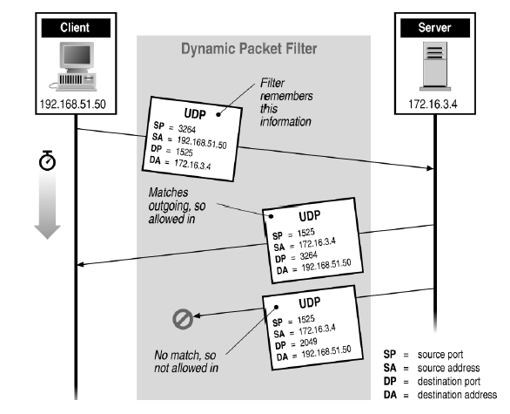
Chapter
Stateful Filtering
10
23
www.midocean.ae
Secure Operating Systems
Notes:
Ordinary عادي

Slide 24
Chapter
Stateful Inspection Firewall
10
Packet-filtering gateways maintain no state from one packet to the next. They simply look at each packet’s IP addresses and ports and compare them to the configured policies.
Stateful inspection firewalls, on the other hand, maintain state information from one packet to the next. In the example in the image, the firewall is counting the number of systems coming from external IP 10.1.3.1; after the external system reaches out to a fourth computer, the firewall hits a configured threshold and begins filtering packets from that address. In real life, it can be difficult to define rules that require state/context and that attackers cannot circumvent.
24
www.midocean.ae
Secure Operating Systems

Slide 25
Chapter
Firewall Outlines
10
Packet filtering
Application gateways
Circuit gateways
Combination of above is dynamic packet filter
25
www.midocean.ae
Secure Operating Systems

Slide 26
Chapter
Application Proxy
10
An application proxy simulates the behavior of an application at OSI layer 7 , so that the real application receives only requests to act properly. Application proxies can serve a number of purposes:
Filtering potentially dangerous application-layer requests
Log requests/accesses
Cache results to save bandwidth
Perhaps the most common form of application proxies in the real world is a web proxy, which companies often use to monitor and filter employee Internet use.
26
www.midocean.ae
Secure Operating Systems

Slide 27
Chapter
Firewall Gateways
10
Firewall runs set of proxy programs
  Proxies filter incoming, outgoing packets
  All incoming traffic directed to firewall
  All outgoing traffic appears to come from firewall
Policy embedded in proxy programs
Two kinds of proxies
  Application-level gateways/proxies
    Tailored to http, ftp, smtp, etc.
  Circuit-level gateways/proxies
    Working on TCP level
    Gateway is like a home router.
27
www.midocean.ae
Secure Operating Systems

Slide 28
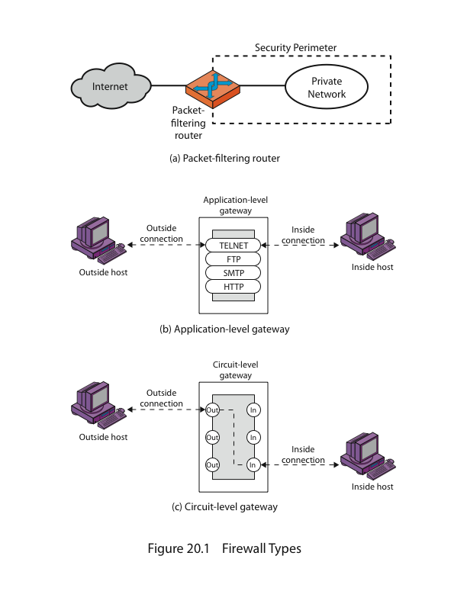
Chapter
Firewalls - Application Level Gateway (or Proxy)
10
28
www.midocean.ae
Secure Operating Systems

Slide 29
Chapter
Application-Level Filtering
10
Has full access to protocol
  user requests service from proxy
  proxy validates request as legal
  then actions request and returns result to user
Need separate proxies for each service
  E.g., SMTP (E-Mail)
  NNTP (Net news)
  DNS (Domain Name System)
  NTP (Network Time Protocol)
  custom services generally not supported
29
www.midocean.ae
Secure Operating Systems

Slide 30
Chapter
Firewall Outlines
10
Packet filtering
Application gateways
Circuit gateways
Combination of above is dynamic packet filter
30
www.midocean.ae
Secure Operating Systems

Slide 31
Chapter
Circuit-Level Gateway
10
  A circuit-level gateway is a firewall that essentially allows one network to be an extension of another. It operates at OSI layer 5, the session layer, and it functions as a virtual gateway between two networks. One use of a circuit-level gateway is to implement a VPN.
31
www.midocean.ae
Secure Operating Systems

Slide 32
Chapter
Firewalls - Circuit Level Gateway
10
Relays two TCP connections
Imposes security by limiting which such connections are allowed
Once created usually relays traffic without examining contents
Typically used when trust internal users by allowing general outbound connections
SOCKS (Socket Secure protocol) commonly used for this.
32
www.midocean.ae
Secure Operating Systems
Notes:
The trinoo or trin00 is a set of computer programs to conduct a DDoS attack. It is believed that trinoo networks have been set up on thousands of systems on the Internet that have been compromised by remote buffer overrun exploits.

Slide 33
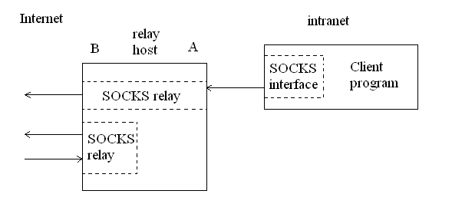
Chapter
Firewalls - Circuit Level Gateway
10
A typical SOCKS connection through interface A, and rogue connection through the external interface, B.
33
www.midocean.ae
Secure Operating Systems
Notes:
The trinoo or trin00 is a set of computer programs to conduct a DDoS attack. It is believed that trinoo networks have been set up on thousands of systems on the Internet that have been compromised by remote buffer overrun exploits.

Slide 34
Chapter
Bastion Host
10
A highly secure host system
Potentially exposed to "hostile" elements
Hence is secured to withstand this
Disable all non-required services; keep it simple
Trusted to enforce trusted separation between network connections
Runs circuit / application level gateways
Install/modify services you want
Or provides externally accessible services
34
www.midocean.ae
Secure Operating Systems

Slide 35
Chapter
Guard
10
A sophisticated firewall that, like an application proxy, can interpret data at the protocol level and respond
The distinction between a guard and an application proxy can be fuzzy; the more protection features an application proxy implements, the more it becomes like a guard
Guards may implement any programmable set of rules; for example:
  Limit the number of email messages a user can receive
  Limit users’ web bandwidth
  Filter documents containing the word “Secret”
  Pass downloaded files through a virus scanner
35
www.midocean.ae
Secure Operating Systems

Slide 36
Chapter
Personal Firewalls
10
  A personal firewall runs on a workstation or server and can enforce security policy like other firewalls. In addition to restricting traffic by source IP and destination port, personal firewalls can restrict which applications are allowed to use the network. In this example Windows firewall configuration dialog, an administrator can select which protocols and applications should be allowed to communicate to and from the host.
36
www.midocean.ae
Secure Operating Systems

Slide 37
Chapter
Firewall Outlines
10
  Packet filtering
  Application gateways
  Circuit gateways
  Combination of above is dynamic packet filter
37
www.midocean.ae
Secure Operating Systems

Slide 38
Chapter
Dynamic Packet Filters
10
  Most common
  Provide good administrators protection and full transparency
  Network given full control over traffic
  Captures semantics of a connection
38
www.midocean.ae
Secure Operating Systems

Slide 39
Chapter
Dynamic Packet Filters
10
5.6.7.8
1.2.3.4
5.6.7.8
1.2.3.4
Firewall
Intended connection from 1.2.3.4 to 5.6.7.8
Redialing on a dynamic packet filter. The dashed arrow shows the intended connection; the solid arrows show the actual connections, to and from the relay in the firewall box. The Firewall impersonates each endpoint to the other.
39
www.midocean.ae
Secure Operating Systems

Slide 40
Chapter
Dynamic Packet Filters
10
Application
Proxy
5.6.7.8
10.11.12.13
5.6.7.8
Firewall
Intended connection from 1.2.3.4 to 5.6.7.8
A dynamic packet filter with an application proxy. Note the change in source address
40
www.midocean.ae
Secure Operating Systems

Slide 41
Chapter
Firewalls Aren’t Perfect?
10
Useless against attacks from the inside
Evildoer exists inside
Malicious code is executed on an internal machine
Organizations with greater insider threat
Banks and Military
Protection must exist at each layer
Assess risks of threats at every layer
Cannot protect against the transfer of all virus infected programs or files
because of a huge range of O/S & file types
41
www.midocean.ae
Secure Operating Systems

Slide 42
Chapter
Are Dynamic Packet Filters Safe?
10
Comparable to that of circuit gateways, as long as the implementation strategy is simple
If administrative interfaces use physical network ports as the highest-level construct
Not if evildoers exist on the inside
Circuit or application gateways demand user authentication for outbound traffic and are therefore more resistant to this threat
42
www.midocean.ae
Secure Operating Systems

Slide 43
Chapter
Distributed Firewalls
10
A central management node sets the security policy enforced by individual hosts
Combination of high-level policy specification a with file distribution mechanism
Advantages:
Lack of central point of failure
Ability to protect machines outside topologically isolated space
Great for laptops
Disadvantage:
Harder to allow in certain services, whereas it’s easy to block
43
www.midocean.ae
Secure Operating Systems

Slide 44
Chapter
Distributed Firewalls Drawback
10
Allowing in certain services works if and only if you’re sure the address can’t be spoofed
Requires anti-spoofing protection
Must maintain the ability to roam safely
Solution: IPsec
A machine is trusted if and only if it can perform proper cryptographic authentication
44
www.midocean.ae
Secure Operating Systems

Slide 45
Chapter
Where to Filter?
10
Balance between risk and costs
Always a higher layer that is hard to filter
Humans
45
www.midocean.ae
Secure Operating Systems

Slide 46
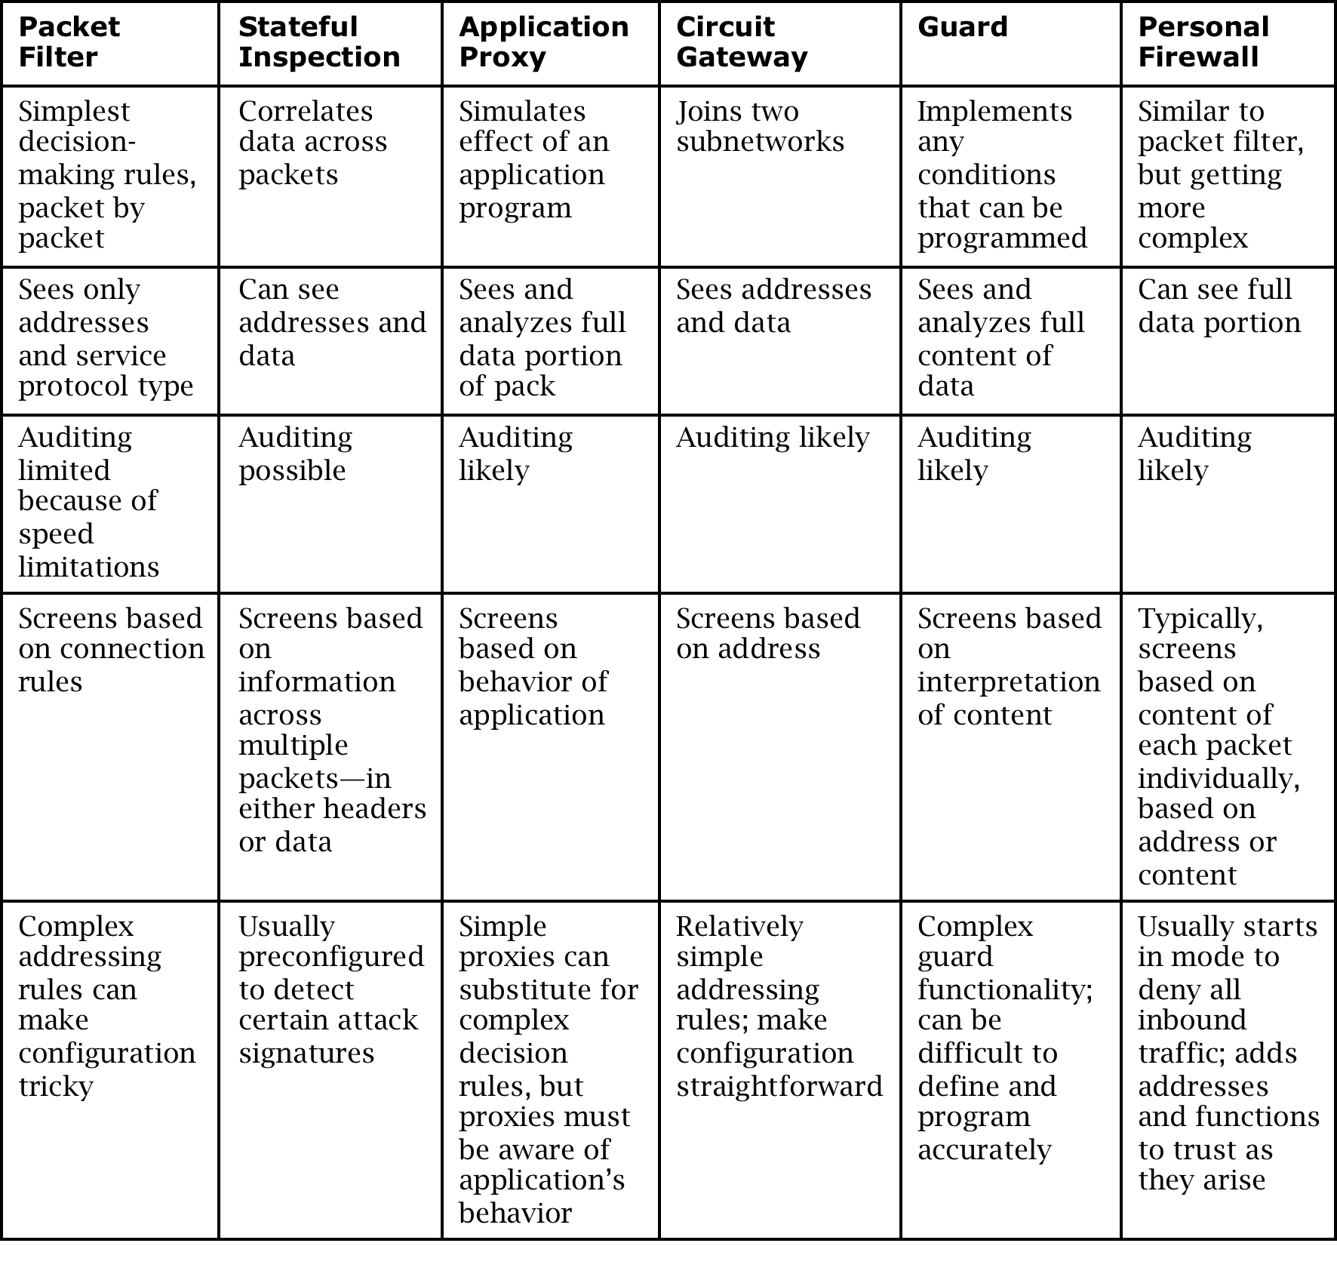
Chapter
Comparison of Firewall Types
10
46
www.midocean.ae
Secure Operating Systems

Slide 47
Chapter
Demilitarized Zone (DMZ)
10
47
www.midocean.ae
Secure Operating Systems

Slide 48
Chapter
What Firewalls Can and Cannot Do
10
  Firewalls can protect an environment only if they control the entire perimeter
  Firewalls do not protect data outside the perimeter
  Firewalls are the most visible part of an installation to the outside, so they are an attractive target for attack
  Firewalls must be correctly configured, that configuration must be updated as the environment changes, and firewall activity reports must be reviewed periodically for evidence of attempted or successful intrusion
  Firewalls exercise only minor control over the content admitted to the inside, meaning that inaccurate or malicious code must be controlled by means inside the perimeter
48
www.midocean.ae
Secure Operating Systems

Slide 49
Chapter
Summary
10
This chapter explained :
What is a firewall
Firewall design
Types of firewalls
Comparison of firewall types
Example firewall configurations
What firewalls can—and can’t—block
49
www.midocean.ae
Secure Operating Systems

Slide 50



Thank You

