Slide 1


Decentralized Applications – DApps
Prepared by Dr. Omar Al-kasasbeh
FNT628
Blockchain and Cryptocurrencies
Lecture 3

Slide 2



Blockchain and Cryptocurrencies
FNT 628
Blockchain and Cryptocurrencies
Prepared by
Dr. Omar Al-kasasbeh

Slide 3
Lecture
Table of Contents
3
Historical Evolution of Decentralized Applications
- Smart Contracts as the Operational Backbone of DApps
- Consensus Mechanisms and their Role in DApps
- Tokenomics and Economic Incentives in Decentralized Applications DApps
- Decentralized Finance (DeFi) as a DApp Ecosystem
- Real-World Use Cases Beyond Finance
- Supply Chain and Logistics DApps
- Healthcare and Data Sharing Applications
- Programming Languages and Development Frameworks
- Economic Sustainability of DApp Ecosystems

Slide 4
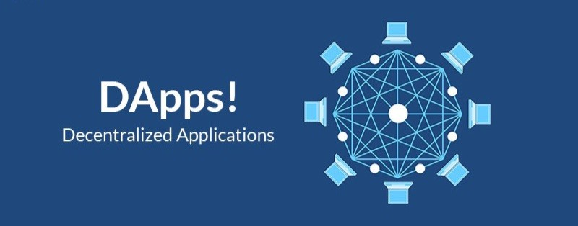
Lecture
3

Slide 5
Lecture
3
Introduction to Decentralized Applications (DApps)
Decentralized Applications, commonly referred to as DApps, represent a transformative evolution in software architecture enabled by blockchain technology. Unlike traditional applications that rely on centralized servers controlled by a single organization, DApps operate on decentralized peer-to-peer networks where no single entity has complete authority over the system.
The emergence of DApps is closely linked to the development of blockchain platforms such as Ethereum, which introduced programmable smart contracts. These smart contracts allow developers to build applications whose backend logic runs on a distributed ledger rather than a centralized database. This structural shift fundamentally changes how trust, security, and control are managed in digital systems.

Slide 6
Lecture
3
However, DApps eliminate or significantly reduce this dependency by embedding trust directly into cryptographic protocols and consensus mechanisms. Transactions are validated collectively by network participants rather than approved by a central authority.
DApps are considered a foundational component of Web3, the next generation of the internet characterized by decentralization, user ownership, transparency, and token-based economies. They enable new economic models, governance systems, and digital ownership structures that were not possible under centralized infrastructures.

Slide 7
Lecture
3
Historical Evolution of Decentralized Applications
The concept of decentralized applications did not emerge in isolation; rather, it evolved gradually alongside advancements in distributed systems, cryptography, and peer-to-peer networking. The intellectual roots of DApps can be traced back to early distributed computing models, where multiple nodes shared computational responsibilities without relying on a single controlling authority. Systems such as BitTorrent demonstrated that decentralized coordination was both feasible and scalable long before blockchain technology became mainstream.

Slide 8
Lecture
3
The next major milestone came in 2015 with the launch of Ethereum. Ethereum expanded blockchain capabilities by introducing a Turing-complete programming environment, enabling developers to write complex smart contracts. This innovation allowed for the creation of fully programmable decentralized applications rather than simple peer-to-peer transaction systems.
In recent years, the DApp ecosystem has expanded significantly, incorporating decentralized finance (DeFi), non-fungible tokens (NFTs), decentralized autonomous organizations (DAOs), and cross-chain interoperability solutions. This rapid evolution highlights the dynamic and experimental nature of decentralized technologies and their growing impact on digital economies.

Slide 9
Lecture
3
Core Architectural Principles of DApps
The architecture of Decentralized Applications (DApps) is fundamentally different from that of traditional centralized systems. At its core, a DApp is built upon distributed network infrastructure, cryptographic validation mechanisms, and autonomous execution logic.
The first architectural principle is decentralization. In a DApp, data and computational processes are distributed across multiple nodes within a blockchain network.
The second principle is deterministic smart contract execution. Smart contracts serve as the backend logic of DApps and are deployed onto the blockchain.

Slide 10
Lecture
3
The third principle is consensus-driven validation. Unlike centralized systems where a server validates transactions, DApps rely on consensus algorithms such as Proof of Work (PoW) or Proof of Stake (PoS). These mechanisms allow distributed participants to agree on the state of the ledger without requiring mutual trust.
Finally, DApps often incorporate token-based economic models. Tokens incentivize network participants, compensate validators, and enable governance mechanisms. This economic layer is deeply embedded in the architecture and distinguishes DApps from traditional applications.

Slide 11
Lecture
3

Slide 12
Lecture
3
Smart Contracts as the Operational Backbone of DApps
Smart contracts constitute the operational core of decentralized applications. They are self-executing programs deployed on a blockchain that automatically enforce predefined rules and conditions without requiring human intervention. Conceptually, a smart contract functions as a deterministic state machine: it receives inputs (transactions), processes them according to encoded logic, and updates the blockchain’s state accordingly.
Unlike traditional backend systems hosted on centralized servers, smart contracts operate within a decentralized virtual machine environment, such as the Ethereum Virtual Machine (EVM).

Slide 13
Lecture
3
From a computational perspective, smart contracts execute in a sandboxed environment to ensure network security. Each computational step requires a fee commonly referred to as “gas” which prevents infinite loops and resource abuse. This economic constraint introduces a cost model into program execution, distinguishing blockchain computing from traditional server-based computing.
Smart contracts also eliminate intermediaries by automating processes traditionally managed by third parties. For example, in financial applications, contracts can autonomously manage lending, borrowing, trading, and settlement processes. In governance systems, they can facilitate transparent voting and decision-making procedures.

Slide 14
Lecture
3
Blockchain Infrastructure Supporting DApps
Imagine you are building a financial application that allows people around the world to lend and borrow money without banks. In a traditional system, you would need servers, databases, security teams, compliance departments, and a trusted authority to verify every transaction. Now imagine removing all of that and replacing it with a global network that maintains itself.
This global network is the blockchain infrastructure that powers DApps.
At its core, blockchain acts as a distributed ledger maintained by thousands of independent nodes. Each node stores a synchronized copy of the transaction history. When a user interacts with a Dapp whether sending funds, voting in a DAO, or minting an NFT the request is broadcast to the network.

Slide 15
Lecture
3
For example, suppose a user named Ahmed wants to lend 5 ETH using a decentralized finance (DeFi) DApp. he connects his digital wallet and confirms the transaction. Instead of a bank approving it, the blockchain network validates that Ahmed owns the funds, checks the smart contract conditions, deducts gas fees, and records the transaction on-chain. Within seconds or minutes, the loan is executed without any centralized institution.
This infrastructure relies on three critical layers:
Consensus Layer – Ensures agreement on the state of the ledger.
Execution Layer – Runs smart contracts and processes transactions.
Data Layer – Stores the immutable transaction history.

Slide 16

Lecture
3

Slide 17
Lecture
3
The User Experience in Decentralized Applications (DApps)
Let us shift perspective for a moment. Instead of focusing on infrastructure, imagine you are an ordinary user interacting with a DApp for the first time.
You open a decentralized exchange (DEX) website. Unlike traditional platforms, there is no “Sign up with email” button. Instead, you see an option: Connect Wallet.
This simple difference represents a fundamental transformation in digital identity.
In traditional applications, users create accounts stored on centralized databases. Passwords, personal information, and transaction histories are managed by the platform provider. In contrast, DApps rely on cryptographic wallets such as MetaMask as identity mechanisms.

Slide 18
Lecture
3
You connect your wallet, approve the smart contract interaction, and confirm the transaction. Instead of submitting personal information or trusting a company to execute the trade, you directly authorize a blockchain transaction. The smart contract performs the swap algorithmically, and the blockchain records it permanently.
However, this model introduces new usability challenges. Users must understand private keys, gas fees, transaction confirmations, and blockchain delays. If a user loses their private key, access to funds may be permanently lost there is no “Forgot Password” option in decentralized systems.

Slide 19
Lecture
3
Consensus Mechanisms and Their Role in DApps
Imagine a global network where thousands of computers owned by strangers across different countries must agree on a single version of truth. No central authority exists. No administrator resolves disputes. Yet, the system must decide: Is this transaction valid or not?
This is where consensus mechanisms become the invisible engine behind DApps.
A consensus mechanism is a protocol that enables distributed network participants to agree on the current state of the blockchain. Without consensus, decentralization would collapse into chaos. It ensures that every node maintains the same transaction history and prevents fraudulent activities such as double spending.

Slide 20
Lecture
3
- In Proof of Work (PoW) systems like early Bitcoin and Ethereum, miners compete to solve complex cryptographic puzzles. The first to solve it earns the right to add the next block of transactions. This process requires computational effort, making fraud economically expensive.
- In Proof of Stake (PoS) systems, validators are selected based on the amount of cryptocurrency they stake as collateral. If they act dishonestly, they risk losing their stake.

Slide 21
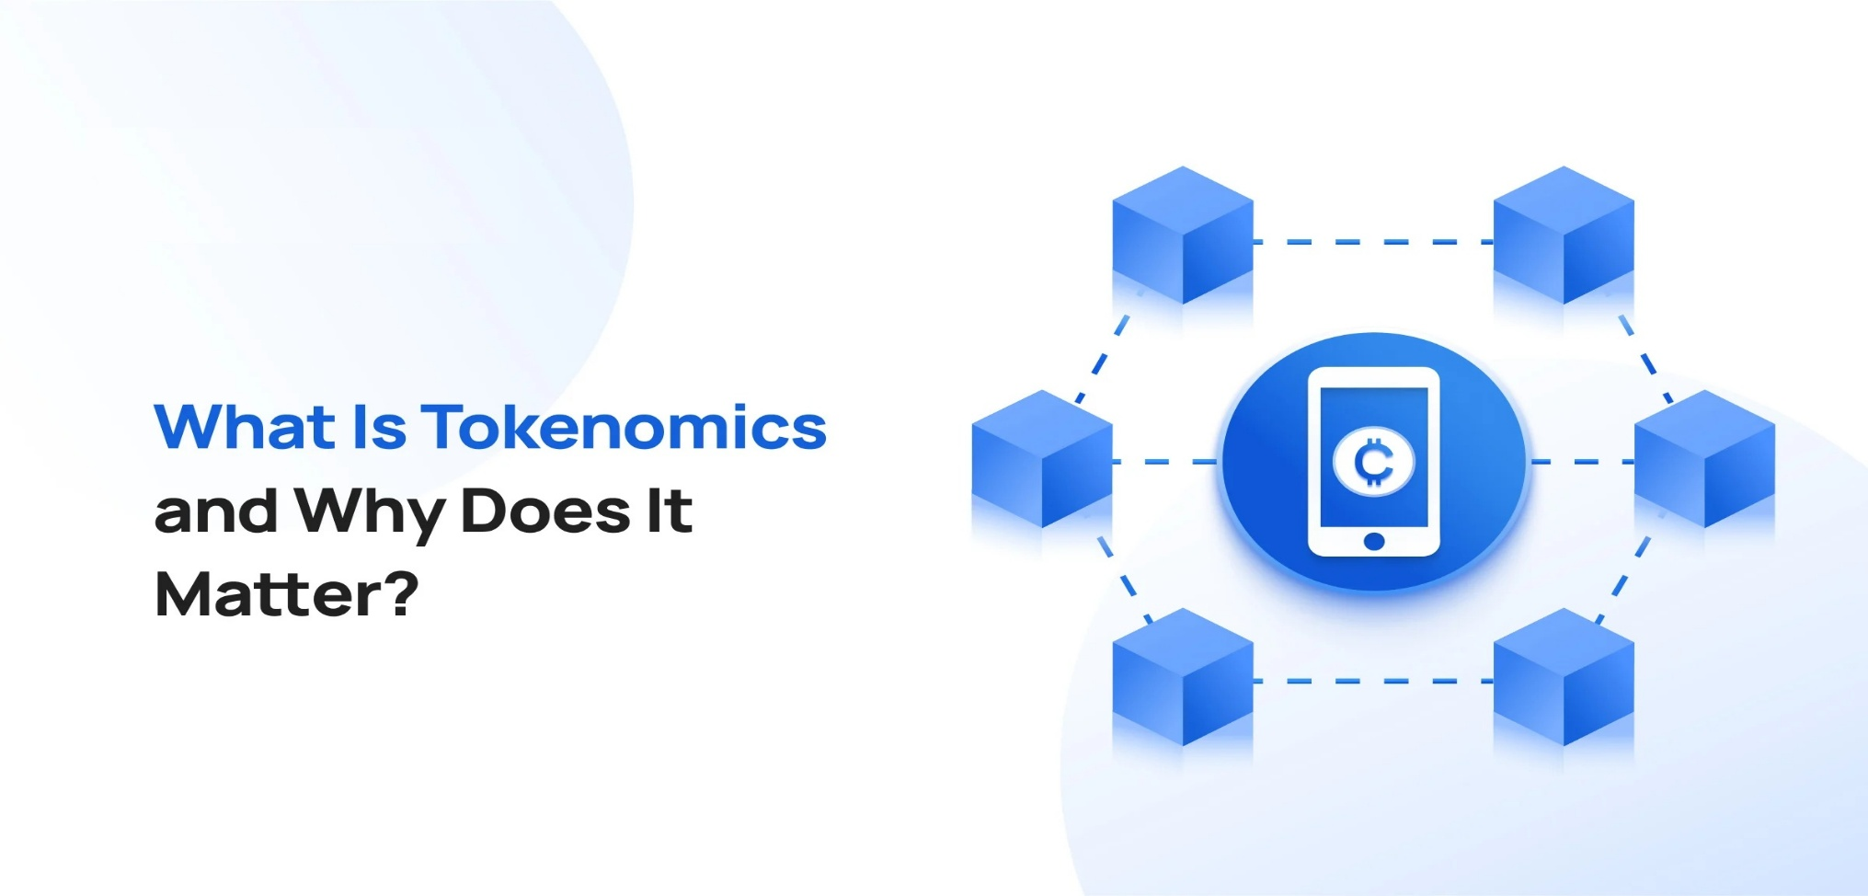
Lecture
3

Slide 22
Lecture
3
Tokenomics and Economic Incentives in Decentralized Applications DApps
Tokenomics refers to the economic framework that governs the creation, distribution, utility, and value dynamics of tokens within a decentralized application (DApp). Tokenomics can be understood as a mechanism design problem in which economic incentives are structured to align the behavior of participants with the long-term objectives of the protocol. Unlike traditional centralized platforms, DApps rely on cryptographic protocols and distributed consensus rather than institutional authority; therefore, well-designed token economies are essential to ensure participation, security, and sustainability.
In decentralized systems, tokens serve multiple economic and functional roles. Utility tokens facilitate access to services, enable transaction processing, or represent digital rights within the application.

Slide 23
Lecture
3
Economic incentives in DApps are commonly structured around participation and security. For example, staking mechanisms require users to lock tokens as collateral, thereby contributing to network validation or governance processes. In return, participants receive rewards, which may originate from inflationary token issuance or transaction fees.
From a theoretical perspective, tokenomics integrates principles from game theory, behavioral economics, and monetary economics. The system must carefully balance token supply, reward distribution, and demand drivers to prevent issues such as hyperinflation, speculative bubbles, or governance centralization.

Slide 24
Lecture
3
Decentralized Finance (DeFi) as a DApp Ecosystem
To understand the real impact of decentralized applications (DApps), one must examine Decentralized Finance (DeFi)the most mature and economically significant DApp ecosystem to date.
Imagine rebuilding the entire global financial system banks, stock exchanges, lending institutions, insurance companies but without physical branches, centralized control, or traditional intermediaries. Instead, everything operates through smart contracts on blockchain networks. This vision defines DeFi.
Decentralized Finance refers to a network of financial applications built primarily on programmable blockchains such as Ethereum.

Slide 25
Lecture
3
Unlike traditional finance (TradFi), where institutions act as custodians and intermediaries, DeFi replaces institutional trust with algorithmic trust. Smart contracts automatically execute financial logic according to transparent, pre-defined rules. Users maintain custody of their assets through cryptographic wallets rather than depositing funds into centralized entities.

Slide 26
Lecture
3
Real-World Use Cases Beyond Finance
While blockchain technology and decentralized applications (DApps) initially gained prominence through financial use cases particularly cryptocurrencies and decentralized finance (DeFi) their transformative potential extends far beyond the financial sector. The underlying properties of decentralization, immutability, transparency, and trust minimization enable applications across multiple industries, reshaping traditional governance, data management, and coordination mechanisms.
One significant domain of application is supply chain management. Blockchain-based systems can provide end-to-end traceability of goods by recording every transaction and transfer of ownership on a distributed ledger. This enhances transparency, reduces fraud, and improves accountability among stakeholders.

Slide 27
Lecture
3
Another critical application lies in digital identity management. Traditional identity systems are centralized, often fragmented, and vulnerable to data breaches.
In the public sector, blockchain technologies offer new paradigms for governance and public administration. Smart contracts can automate bureaucratic processes, such as land registration, licensing, and voting systems.
Healthcare represents another promising area. Blockchain can facilitate secure sharing of medical records among authorized providers while preserving patient privacy.

Slide 28
Lecture
3
In the creative and intellectual property sectors, blockchain enables new models of ownership and monetization. Through non-fungible tokens (NFTs) and decentralized platforms, artists and content creators can tokenize digital assets, establish provenance, and receive automated royalty payments via smart contracts. This reduces dependency on centralized intermediaries and enhances transparency in revenue distribution.
From a theoretical perspective, these non-financial applications demonstrate that blockchain is not merely a financial innovation but a broader institutional technology. It introduces alternative trust architectures, where cryptographic verification and distributed consensus replace centralized authority. Consequently, blockchain systems have the potential to reconfigure organizational structures, redefine property rights, and reshape governance models across various socio-economic domains.

Slide 29
Lecture
3
Supply Chain and Logistics DApps
Supply chain systems today are largely fragmented and centralized. Data is stored in isolated databases controlled by manufacturers, logistics providers, customs authorities, and retailers. This fragmentation creates information asymmetry, inefficiencies, fraud risks, and limited transparency.
Supply Chain and Logistics DApps aim to transform this model by introducing blockchain-based traceability and decentralized data verification.

Slide 30
Lecture
3
from an academic perspective, blockchain in supply chains enhances:
Transparency – All authorized participants can access a shared version of truth.
Traceability – Products can be tracked from origin to final consumer.
Accountability – Responsibility is clearly documented at each stage.
Efficiency – Reduced paperwork and automated verification processes.

Slide 31
Lecture
3
Healthcare and Data Sharing Applications
Healthcare systems around the world face a persistent challenge: fragmented data. A patient’s medical history is often scattered across hospitals, laboratories, insurance companies, and private clinics. These institutions maintain separate databases that rarely communicate seamlessly.
By leveraging blockchain technology, healthcare data can be managed through a distributed ledger system where patients, providers, and authorized entities share access to a secure and unified source of truth. Instead of storing sensitive medical records directly on-chain which would raise privacy and scalability concerns most systems store encrypted references (hashes) of medical records on the blockchain while keeping actual data in secure off-chain storage.

Slide 32
Lecture
3
blockchain in healthcare promotes:
Data Integrity – Medical records cannot be altered retroactively.
Interoperability – Multiple institutions access standardized data securely.
Patient-Centered Control – Individuals manage consent and data sharing.
Security and Privacy – Cryptographic mechanisms reduce unauthorized access risks.

Slide 33

Lecture
3

Slide 34
Lecture
3
Programming Languages and Development Frameworks
The development of decentralized applications (DApps) and blockchain-based systems relies on a specialized ecosystem of programming languages and development frameworks designed to support distributed, trust-minimized architectures. Unlike traditional software development, blockchain programming requires attention to immutability, consensus mechanisms, cryptographic security, and economic logic embedded within smart contracts.
At the core of many blockchain platforms particularly Ethereum is the concept of smart contracts, which are self-executing programs deployed on a blockchain. These contracts automatically enforce predefined rules and agreements without the need for intermediaries.

Slide 35
Lecture
3
Beyond programming languages, development frameworks and toolchains are essential for streamlining the blockchain development lifecycle. Frameworks such as Truffle and Hardhat provide comprehensive environments for compiling, testing, debugging, and deploying smart contracts.
The selection of programming languages and frameworks in blockchain development reflects broader considerations in software engineering, including security assurance, performance optimization, maintainability, and ecosystem maturity. Given the financial and institutional implications of smart contract execution, developers must adopt secure coding standards, conduct formal audits, and implement robust testing methodologies.

Slide 36
Lecture
3
Economic Sustainability of DApp Ecosystems
The economic sustainability of decentralized application (DApp) ecosystems represents one of the most critical and complex dimensions of blockchain-based innovation. While technological decentralization has been widely discussed, long-term viability ultimately depends on the robustness of the underlying economic architecture. For DApps to endure beyond speculative cycles, they must establish self-reinforcing incentive systems, stable value mechanisms, and adaptive governance frameworks capable of responding to market fluctuations and systemic shocks.

Slide 37
Lecture
3
Network effects also play a decisive role. The more users, developers, and applications integrate with a DApp ecosystem, the greater its utility and economic resilience. However, rapid growth can produce fragility if it is not accompanied by risk management mechanisms.
Governance further determines sustainability. Decentralized Autonomous Organizations (DAOs) must balance decentralization with efficiency in decision-making. If governance participation is too concentrated, the system risks oligarchic control; if too fragmented, it may suffer from coordination paralysis.

Slide 38
Lecture
3
DApp ecosystems do not operate in isolation from global financial systems. Regulatory uncertainty can affect liquidity, user participation, and institutional adoption. Sustainable ecosystems must therefore design compliance-aware architectures that remain decentralized while adapting to evolving legal environments.
From a theoretical perspective, the sustainability of DApp ecosystems can be analyzed through the lens of mechanism design and game theory. Protocol architects must anticipate strategic behavior by rational agents who respond to incentives. If incentives are misaligned, participants may exploit loopholes, engage in short-term extraction, or abandon the system during downturns.

Slide 39
Lecture
2
References
Saleh, F. (2021). Blockchain without waste: Proof-of-stake. The Review of financial studies, 34(3), 1156-1190.
Schär, F. (2021). Decentralized Finance: On Blockchain- and Smart Contract-Based Financial Markets. Federal Reserve Bank of St. Louis Review.
Cong, L. W., Li, Y., & Wang, N. (2021). Tokenomics: Dynamic adoption and valuation. The Review of Financial Studies, 34(3), 1105-1155.
Dowling, M. (2022). Is non-fungible token pricing driven by cryptocurrencies?. Finance Research Letters, 44, 102097.
Casino et al. (2019). Systematic Literature Review of Blockchain Applications

Slide 40


Thank You

