Slide 1




Project Leadership
Lecture 7
PMG 511
Ch7 - Leadership and Resolving Conflict
Prepared by
Dr Hakem Sharari
www.midocean.ae

Slide 2
Chapter
Learning Outcomes
07
Definition of Conflicts.
Organizational Conflict Is Beneficial Or Not?
Definition of Conflict resolution.
How Leaders Effectively Manage Conflict.
Sources Of Project Conflict.
What Causes Team Conflict?
Conflicts Arise from Differing Needs.
Symptoms of Team Conflict.
Conflict-resolution Techniques.
Thomas-Kilmann Conflict Mode Instrument.
Leaders’ Keys To Resolving Conflict.
Summary and Conclusions.
www.midocean.ae

Slide 3
Chapter
Definition of Conflict
07
www.midocean.ae

Slide 4
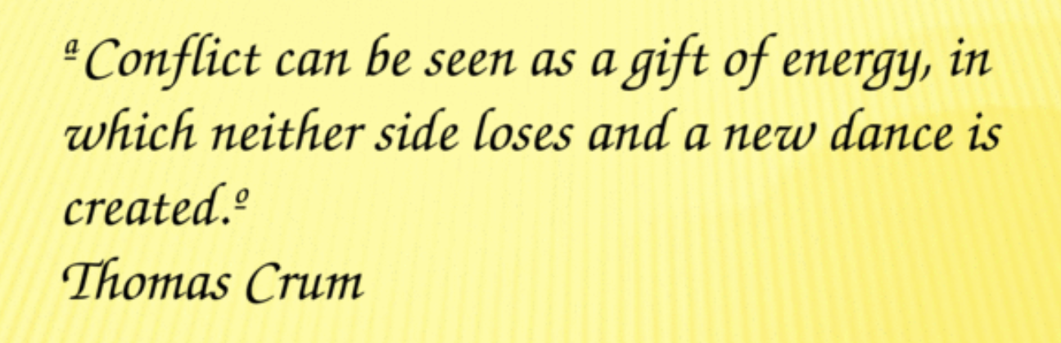
Chapter
Definition of Conflict
07
www.midocean.ae

Slide 5
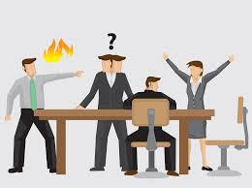
Chapter
What is Conflict?
07
Conflict is a natural ingredient in every organization.
The ability to manage conflict is considered to be a core leadership competence and can help project teams to grow and advance. However, conflict management is one of the most difficult soft skills that someone can master and develop.
www.midocean.ae

Slide 6
Chapter
Is Organizational Conflict Beneficial?
07
www.midocean.ae

Slide 7
Chapter
Understanding Conflict
07
Conflict is normal and healthy (if managed appropriately).
Conflict arises from differences.
Conflict can either stimulate or hinder progress, growth, and productivity.
Conflict that is mismanaged can derail leaders and limit their efficacy.
Conflict can not and should not be avoided forever.
Leaders have ways in which they prefer to handle or resolve conflict.
www.midocean.ae

Slide 8
Chapter
07
BAD conflict:
Lowers team energy or morale.
Reduces productivity.
Prevents job accomplishment.
Creates destructive behavior, and
Fosters poor performance.
GOOD conflict:
Produces new ideas.
Solves continuous problems.
Gives opportunity for people to expand skills
Allows creativity, and
Improves performance.
www.midocean.ae

Slide 9
Chapter
Definition of Conflict Resolution
07
www.midocean.ae

Slide 10
Chapter
What is Conflict Resolution?
07
Conflict resolution is a daily occurrence at work that can either propel or disrupt the momentum for a leader, a team or the entire organization.
- The workplace can become a toxic environment when leaders allow conflict to fester rather than confront it head-on. Managing conflict can be a tricky thing – especially when you are not familiar with the larger ecosystem in which the particular individual or department creating the conflict, and how efforts to resolve conflict will reverberate throughout that ecosystem.
www.midocean.ae

Slide 11
Chapter
How Leaders Effectively Manage Conflict
07
www.midocean.ae

Slide 12

Leaders Effectively Can Manage Employee Conflict
Chapter
07
An effective leader builds teams that work well together.
As a leader, he facilitate the resolution of conflicts that distract the team members, decrease productivity, destroy motivation and lead frustration and anger.
www.midocean.ae

Slide 13
Chapter
07
To understand team members’, leaders need to differentiate between a motivational/situation model and a behavioral model of each member.
The behavioral model focuses on patterns of behavior and characteristic traits that define a specific type of personality—this model is recognizing what someone does based on his or her personality.
The motivational / situation model looks behind behavior to understand what are the factors that drive behavior (situation)—this model is recognizing why someone is likely to do something based on his motivational value.
www.midocean.ae

Slide 14
Chapter
Sources of Project Conflict
07
www.midocean.ae

Slide 15
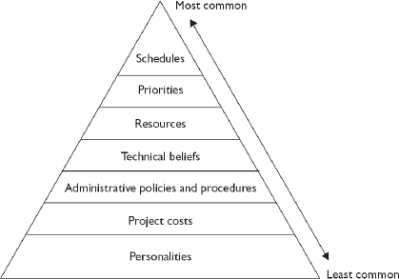
According to Thamhain and Wilemon (1975), the seven major sources of project conflict and team disagreements are (sorted by significance are)
www.midocean.ae

Slide 16
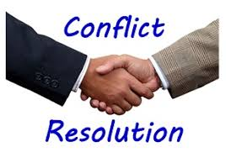
Chapter
07
Based on research by Thamhain and Wilemon (1975), there are seven major sources of project conflict and team disagreements are:
Personalities.
Project costs.
Administrative policies and procedures.
Technical beliefs and performance trade-offs.
Manpower resources.
Project Priorities.
Schedules.
www.midocean.ae

Slide 17
Chapter
07
In the organizational set up, there seems to be conflict among the managers, subordinates, team members and others also.
Sources of interpersonal conflict:
  Personal differences: Everyone is unique. Family background, culture, values and so many indicators vary from one person to another. So, conflict may arise. There exists individual difference where intelligence, ability, attitude, motivation vary from one person to others.
  Information deficiency: There seems to be indication of communication gap and also there seems to be indication of misinformation.
  Role incompatibility: This type of interpersonal conflict mainly draws from both intra-individual role conflict and inter-group conflict.
www.midocean.ae

Slide 18
Chapter
07
  Environmental stress: This is mainly due to stressful environmental condition. Here downsizing, competition, uncertainty.
  Besides this there exists inter-group conflict in any organizational set up. The reasons are mainly as follows:
  Competition for resources
  Task interdependence
  Status struggle
www.midocean.ae

Slide 19
Chapter
What Causes Team Conflict?
07
www.midocean.ae

Slide 20
Chapter
What Causes Team Conflict?
07
Team conflict can be cause by various factors. Some of these factors include:
Poor communication or no communication;
Lack of problem-solving skills or getting to “root cause”;
Lack of clarity in purpose, goals, objectives, team & individual roles;
Uncertainty/lack of resources and sources for help and support;
Poor time management;
Lack of leadership and management;
Team members bored, not challenged, not really interested;
Lack of skills and abilities in team members;
Personality conflicts;
Personal problems; and
High turnover rates.
www.midocean.ae

Slide 21
Chapter
Conflicts Arise From Differing Needs
07
www.midocean.ae

Slide 22
Chapter
07
Everyone needs to feel understood, and supported, but the ways in which these needs are met vary widely.
Differing needs for feeling comfortable and safe create some of the most severe challenges in our personal and professional relationships.
It is important to acknowledge that both parties’ needs to play important roles in the long-term success of team members relationships, a lack of understanding about differing needs can result in distance, arguments, and conflicts.
Build a trust, To feel secure.
www.midocean.ae

Slide 23
Chapter
Symptoms of Team Conflict
07
www.midocean.ae

Slide 24
Chapter
Symptoms of Team Conflict
07
The typical symptoms of team conflict are the following:
Absenteeism
Complaining
Filing lawsuits
Finger pointing
Gossiping
Hiding information that should be shared
www.midocean.ae

Slide 25
Chapter
Symptoms of Team Conflict
07
Not attending required meetings
Not completing work on-time or to quality goals
Not responding to requests for information
Not returning phone calls or e-mails
Passive/aggressive behavior
Physical violence
Verbal abuse
www.midocean.ae

Slide 26
Chapter
Conflict-resolution Techniques/Approaches
07
www.midocean.ae

Slide 27
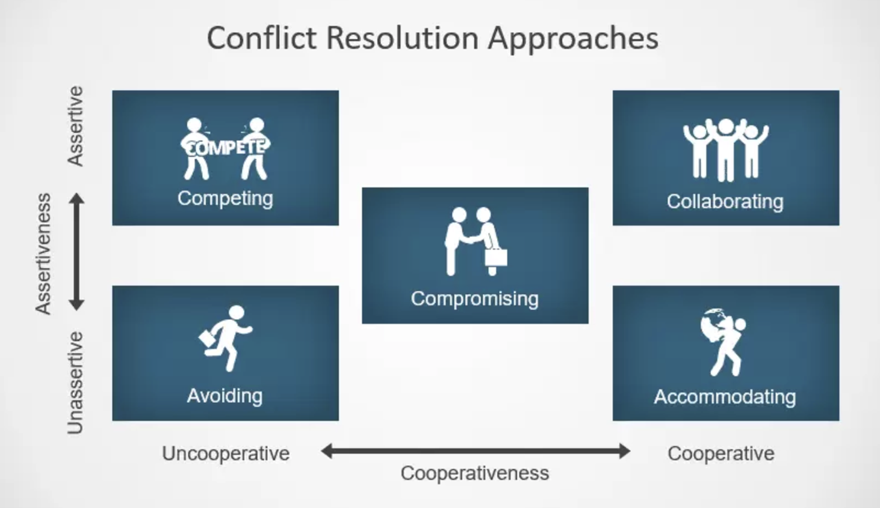

Chapter
07
www.midocean.ae

Slide 28
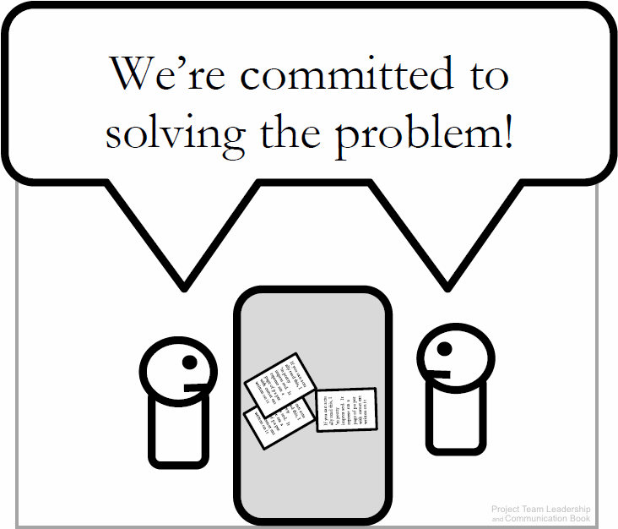
Chapter
1- Confronting/Problem-solving
07
The optimal solution, following a standard problem-solving process:
  Define the real/root problem
  Analyze the problem
  Identify solutions
  Choose a solution (this can be difficult)
  Implement a solution
  Review the solution, and confirm that it solved the problem and repeat if necessary
Often takes the longest – not appropriate if deadlines are tight.
www.midocean.ae

Slide 29
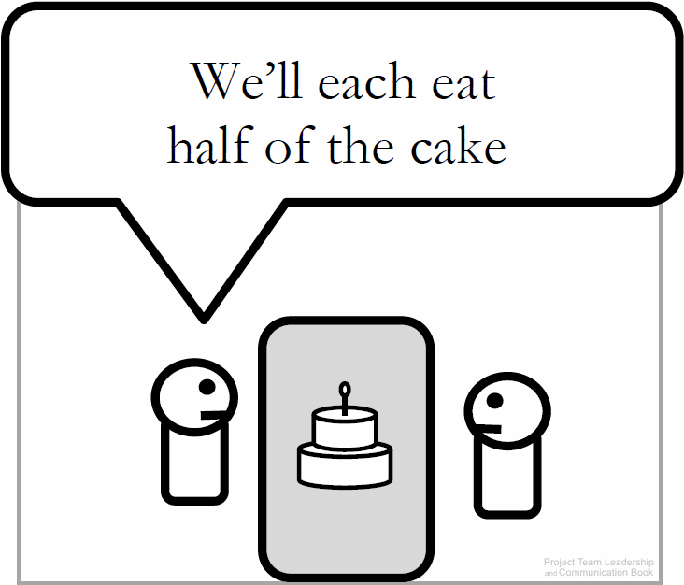
Chapter
2- Compromising
07
Each party makes concessions to the other, and a mutually-accepted conclusion is reached.
Works best with issues that can be divided.
Is often the quickest solution.
May result in a ‘lose-lose’ situation because everyone gets only a subset of what they want.
www.midocean.ae

Slide 30
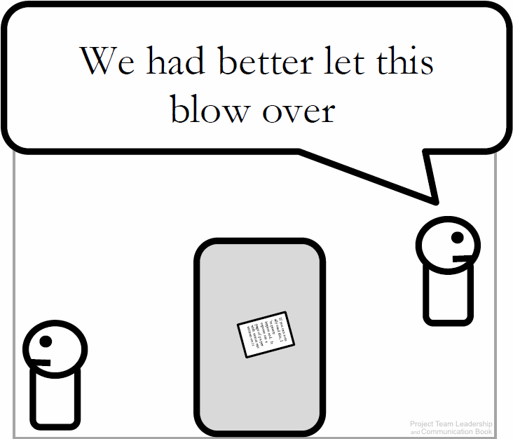
Chapter
3- Withdrawal/Avoidance
07
One or more parties choose to withdraw from or avoid the other to end or delay the conflict.
Useful when debate is trivial or emotions are high.
May be needed until an authority can intervene.
Often doesn’t directly solve the conflict.
www.midocean.ae

Slide 31
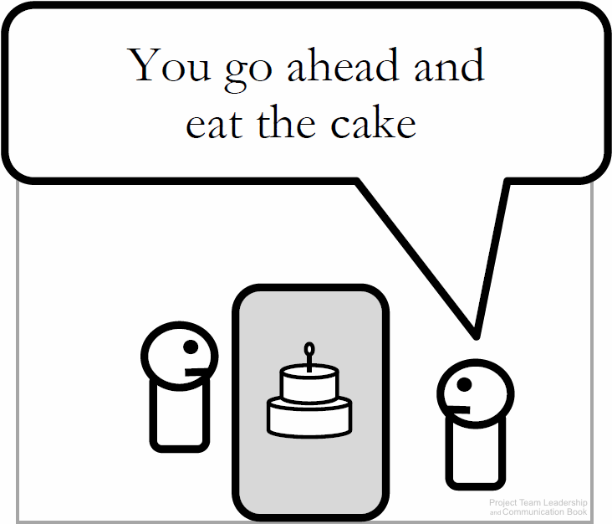
Chapter
4- Smoothing/Accommodating
07
One party concedes, giving the other the ‘win’.
Useful when the issue is clearly more important to one party or satisfying one party is important to the overall success of the project.
Can delay conflict, as the accommodating party may change their mind and the disagreement still is in place.
Potential for abuse of the situation is present.
www.midocean.ae

Slide 32
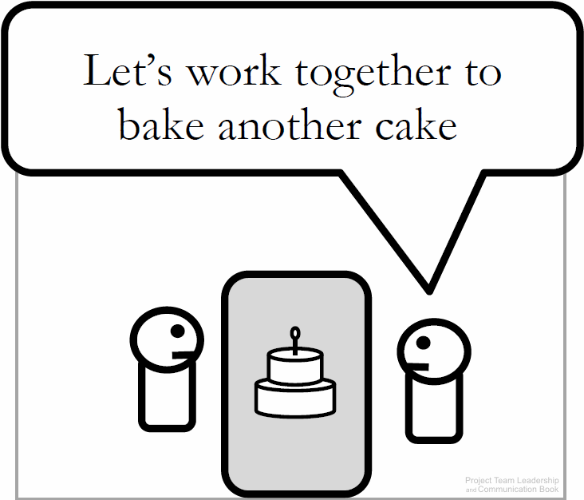
Chapter
5- Collaborating
07
Parties work together to find a mutually-acceptable solution, often a previously-unconsidered third option.
Considered to be an optimal solution to most conflicts.
Takes longer than most techniques.
If parties don’t trust each other, collaborating is nearly impossible.
www.midocean.ae

Slide 33
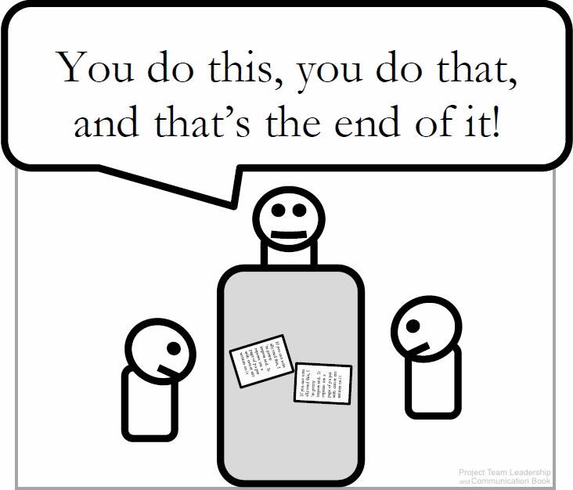
Chapter
6- Forcing
07
Authority figure resolves the conflict/makes the decision, forcing all parties to end their conflict.
Effective when the conflict is petty, unimportant, or one party’s opinion is unethical.
Often used as a last-resort.
May not resolve the conflict, which can reappear at another time in the future.
www.midocean.ae

Slide 34
Chapter
Thomas-Kilmann Conflict Mode Instrument
07
www.midocean.ae

Slide 35
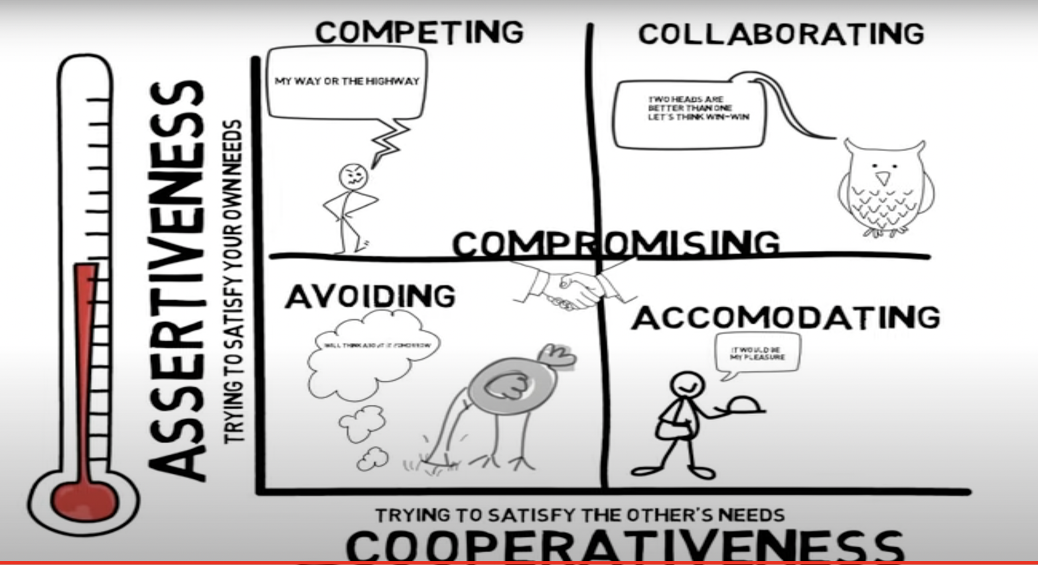
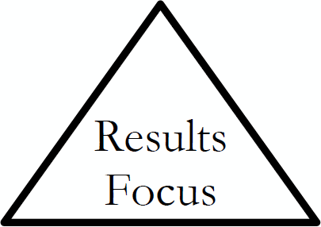
Chapter
07
www.midocean.ae

Slide 36
Chapter
07
The Thomas-Kilmann conflict mode instrument was developed by K. W. Thomas and R. H. Kilmann (1974, 2000).
According to Thomas-Kilmann conflict mode instrument:
Competing/ Forcing is a win-lose resolution technique.
Collaborating is a win-win resolution technique.
Compromising is a lose-lose resolution technique.
Avoiding is a lose-lose resolution technique.
Accommodating is a lose-win resolution technique.
www.midocean.ae

Slide 37
Chapter
Types of Conflict Resolutions
07
Whatever conflict we have, there are only three types of conflict resolutions:
Win-Win: | To reach a solution acceptable to anyone
Lose-Lose: | Everyone gets something that does not accomplish the goals
Win-Lose: | Power struggle where one party wins
www.midocean.ae

Slide 38
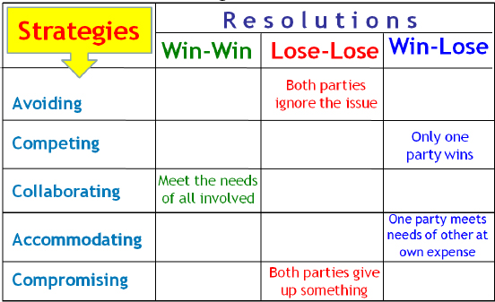
Comparing the conflict strategies from the one side and the conflict resolutions from the other side, we have the following two-dimensions table:
www.midocean.ae

Slide 39
Chapter
Leaders’ Keys To Resolving Conflict
07
www.midocean.ae

Slide 40
Chapter
Leaders Effectively Can Manage Any Conflict
07
Leaders must ensure they continuously communicate with their team as well as articulate a vision.
Leaders must act responsibly to be respected.
Leadership is not a popularity contest; it is a serious responsibility that primarily involves developing and guiding the full potential in people, teams and the organization at-large.
An important part in the process of developing potential is knowing how to see conflict and when to seize the opportunity within the conflict before healthy tension turns into overly disruptive matter.
www.midocean.ae

Slide 41
Chapter
Keys To Resolving Conflict by Leaders
07
Act Responsibly.
A leader must act responsibly when handling conflict. If the leader is not responsible, respect for the leader may be affected.
Good self-control:
This is an important prerequisite in resolving conflicts. Though one may be highly tensed up and unwilling to listen to anybody other than having their own way during a conflict.
www.midocean.ae

Slide 42
Chapter
Keys To Resolving Conflict by Leaders
07
Patient listener:
Another good qualification is to be a patient listener and assess the problem realistically without getting emotional or biased.
To have a give and take attitude:
If you are really interested in resolving a conflict and having lasting peace, as happens a good conflict resolution strategies.
www.midocean.ae

Slide 43
Chapter
Keys To Resolving Conflict by Leaders
07
Right Timing
Leaders who avoid conflict at all cost will find themselves regretting it later. Timing is everything when it comes to managing conflict, and the best time to take action is when there is hard evidence/proof that an employee has a track record of wrongdoing that is negatively impacting the performance of others.
Know Your Boundaries
Conflict can become something much more complicated and unmanageable if you don’t know the limitations and boundaries of your employees.
www.midocean.ae

Slide 44
Chapter
Keys To Resolving Conflict by Leaders
07
Respect Differences
Rather than impose your influence, hierarchy or rank – respect the unique differences in people and learn to see things from differing points of view Conflict resolution is rarely black and white. In fact, there are more and more grey areas.
Confront the Tension
Leadership is often about doing the things that most other people don’t like doing. Conflict resolution is one of those things – but as leaders we must confront the tension head-on. Don’t wait, but rather activate your leadership to address the conflict before circumstances force your hand.
www.midocean.ae

Slide 45
Chapter
Keys To Resolving Conflict by Leaders
07
Identify a Goal
The leader must be careful when addressing only one person’s point of view. The leader must gather information, develop their own self-awareness, and be ready for the unexpected.
www.midocean.ae

Slide 46
Chapter
Keys To Resolving Conflict by Leaders
07
Make Conflict Resolution the Priority Rather Than Winning Or “Being Right”
Maintaining and strengthening the relationship, rather than “winning” the argument, should always be your first priority.
Focus on the present, focus on what you can do in the here and how to solve the problem.
www.midocean.ae

Slide 47
Chapter
Summary and Conclusions
07
www.midocean.ae

Slide 48
Chapter
Summary and Conclusions
07
Conflict is a natural ingredient in every organization.
The ability to manage conflict is considered to be a core leadership competence and can help project teams to grow and advance.
The workplace can become a toxic environment when leaders allow conflict to fester rather than confront it head-on.
Based on research by Thamhain and Wilemon (1975), there are seven major sources of project conflict and team disagreements.
conflict-resolution techniques.
Leaders’ Keys To Resolving Conflict.
www.midocean.ae

Slide 49

Chapter
Reference
07
www.midocean.ae

Slide 50


Thank You

