Slide 1



Corporate Entrepreneurship and Innovation
Prepared by Dr. Ibrahim Siam
ENT628
Entrepreneurship
Lecture 6

Slide 2



Chapter
Generating business ideas
10
CONTENTS
Commercial opportunity
New technology and market spaces
Creative synthesis
Creating blue-water opportunity
Value-chain analysis
Spotting opportunity
Tools for exploring change
Techniques for exploring product inadequacies
Systematic inventive thinking
ENT628
Entrepreneurship

Slide 3
Critically evaluate the structure of on organization.
Managing risk in the entrepreneurial organization
Chapter
10
LEARNING OUTCOMES
Understand and explain how 'creative synthesis' applied to technology is vital in bringing a new technology to the market
Understand and explain the importance of 'blue-water opportunities' and how to create them by challenging market conventions
Understand how exploring the value chain con highlight business opportunities
Use a range of techniques to scan the environment for changes that might highlight business opportunities
Use a range of techniques to explore product inadequacies that might highlight business opportunities.
ENT628
Entrepreneurship

Slide 4
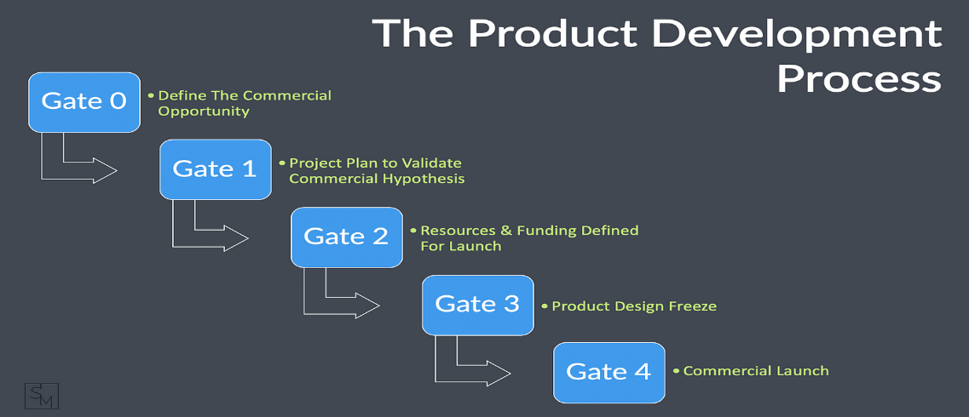
Chapter
Commercial Opportunity
10
Finding a new commercial business opportunity is about being able to find a solution to a problem - a solution that sufficient people are willing to pay for and one that competitors have not (yet) come up with.
Successful entrepreneurs are able to match opportunities in the marketplace with innovative ways of meeting those opportunities. They link opportunity with creativity and innovation.
ENT628
Entrepreneurship

Slide 5
Chapter
10
Commercial Opportunity
But which comes first: seeing the commercial opportunity or the innovation?
Successful entrepreneurial firms such as Google or Samsung also go about seeking out ways of developing innovations that match commercial opportunities in a systematic way. Their success is not just down to good luck. They systematically and actively stimulate indi­vidual creativity - connectivity and discovery skills - whilst integrating information and knowledge into organizational learning. They go about finding and developing business ideas in a similar systematic fashion.
ENT628
Entrepreneurship

Slide 6
Chapter
New Technology And Market Spaces
10
Not all innovation takes the same form. Companies following a marketing strategy of low price and low differentiation are likely to encourage innovations that reduce costs and encourage efficiency, but this may necessitate capital investment. These are likely to be incre­mental, process innovations.
Companies following a strategy of high differentiation are likely to encourage innovation stimulated by information on user needs and technical inputs . They are likely to implement major innovations frequently, although these will usually be well short of invention or paradigm shift.
ENT628
Entrepreneurship

Slide 7
Chapter
New Technology And Market Spaces
10
Encouraging large-scale innovation is not the same as encouraging incremental changes in products, processes, and marketing. The risks faced in launching these different types of innovation are also very other.
However, the reality in most multi-product businesses is that they will have to cope with both incremental and large­ scale innovations - often on a continuous basis. And then there is the issue of invention and paradigm shift, which we call 'disruptive' or 'discontinuous' innovation, and which requires quite a different mindset.
ENT628
Entrepreneurship

Slide 8


Chapter
New Technology And Market Spaces
10
Generally, the more radical the innovative ideas the more difficult they are to generate and validate commercially. The idea may have originated from scientific research, but to be of interest to a business it must have a commercial application - hopefully, one that has not been spotted by rivals and ideally one that can offer some sort of safeguard far the intellectual property
ENT628
Entrepreneurship

Slide 9
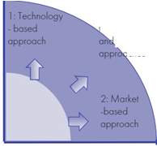
Chapter
New Technology And Market Spaces
10
shows three generic approaches to generating business ideas
The first approach is a technology -based approach
is the market-based approach
linking technological innovation with a market-based approach
technological
ENT628
Entrepreneurship

Slide 10
Chapter
New Technology And Market Spaces
10
The first approach is a technology-based approach relying on a good knowledge of new develop­ments in technology and technology mapping :
This may include analyzing product/ service inadequacies to understand and isolate commercial opportunities. It requires a deep understanding of the technology and can involve providing the product/service with greater or improved functionality and/or applying the technology to other applications. It can result in either incremental or radical innovation. However, unless it is linked to market needs it may prove to be commercially unsuccessful.
ENT628
Entrepreneurship

Slide 11
Chapter
New Technology And Market Spaces
10
The second approach is the market-based approach relying on analyzing market needs and trends .
This involves spotting unmet needs and gaps in the market as well as analys­ing product /service inadequacies. Again the innovations in this instance may be either incremental or radical in their scope. The approach can be based on:
Market research | This provides insights into existing customer behaviours and views. Generally, it provides a volume of broad data, rather than any depth. It is particularly useful in highlighting existing product inadequacies. It is less useful in providing insights about the future.
Focus groups and key user analysis | These provide a deeper insight into how custom­ers feel. They can be combined with market research. . They are also of limited use in providing insights about the future.
ENT628
Entrepreneurship

Slide 12
Chapter
New Technology And Market Spaces
10
The third approach involves a synthesis of these two approaches - linking technological ­ innovation with a market-based approach.
This often involves linking new, often­ emergent technologies with business model innovation to create new market spaces. This is disruptive innovation and is when new industries can be born. Whilst this may offer the greatest commercial opportunity, it is also the most difficult to achieve. (blending an understanding of technology with an understanding of the market to create this new market space)
ENT628
Entrepreneurship

Slide 13
Chapter
New Technology And Market Spaces
10
three levels of synthesis, consistent with increasing levels of market complexity and impact:
Outcome-driven innovation | his is based on the premise that customer-valued performance can be identified and improved
Design thinking | A loose set of holistic concepts that approach design from the perspective of solving complex problems for people, rather than just creating distinc­tive objects or shape
Creative synthesis | -This builds on design thinking but integrates business model development with the technology perspective. Creative synthesis applied to radical
ENT628
Entrepreneurship

Slide 14
Chapter
New Technology And Market Spaces
10
While other cosmetic companies depend on department store sales, Sephora is revolutionizing retail by offering customers new in-store and on-line experiences such as trying on make-up virtually using augmented reality, matching their skin tone to a foundation using artificial intelligence {AI), and sampling a fragrance via a touchscreen and scented air. Founded in 1970, and acquired by the luxury goods conglomerate LVMH {Moet Hennessy - Louis Vuitton) in 1997, Sephora is a French retail cosmetics chain with some 2,300 stores operating in 33 countries and revenues of over $4 billion in 2013. It sells its own and other brands of cosmetics over-the-counter and online in a highly competitive and changing industry where brands like Glossier and Huda Beauty are rapidly building market share, almost entirely through the new channels of social media and user-generated content. To help it counter this competition and bridge the gap between its online and in-store experiences, Sephora set up an Innovation Lab in 2015 to help it develop, test and launch new offerings for shopping both in-store and online, using AI technologies such as natural language processing, machine learning and computer vision .
ENT628
Entrepreneurship

Slide 15


Chapter
Creative Synthesis
10
Radical innovation is riskier than spotting an existing market opportunity because there is no guarantee that the market need will materialize. It requires vision and self­ belief aplenty, and is also likely to absorb both time and resources. It requires a high degree of creativity and innovation. However, the returns for success are also likely to be high
Disruptive innovation is a step change in products, processes, or the framing of markets. Generated by major inventions, they can have large-scale disruptive effects on markets, industries, and even economies. But many inventors fail to realize the commercial viability of their inventions.
Leading -This scale gauges the degree of respect and deference shown to authority figures (power distance}. (China, Russia)
Deciding -This scale measures how group decision-making is consensually compared to relying on one person (the boss). (Japanese)
Trusting -This scale balances task-based trust (from the head} with relationship ­based trust (from the heart). In task-based cultures (e.g., the USA, the UK, Germany) trust is built through work. In relationship -based societies (e.g., Brazil, China, India} trust is built by personal networks
ENT628
Entrepreneurship

Slide 16


Chapter
Creative Synthesis
08
Disruptive innovation is an idea that improves upon an existing market by exceeding the needs of a customer base, eventually displacing the old market.
Radical innovation destroys the current market and value network, creating an entirely new one.
ENT628
Entrepreneurship

Slide 17
Chapter
Value-chain Analysis
10
One way to discover inadequacies in underlying processes or question market paradigms is by analyzing the value chain of an industry. Behind this is the idea that real advantages in cost or product/service differentiation can be found in the chain of activities that a firm performs to deliver value to its customers.
The value chain comprises five primary activities :
Inbound logistics (receiving, storing, and disseminating inputs).
Operations (transforming inputs into a final product).
Outbound logistics (collecting, storing, and distributing products to customers).
Marketing and sales.
After-sales service.
ENT628
Entrepreneurship

Slide 18
Chapter
Value-chain Analysis
10
It might be possible to reduce costs through new technologies, different sourcing, or work efficiencies.
The internet has given businesses the opportunity to look at disintermediation - reducing the use of intermediaries - in order to reduce costs.
Equally, however, if customers value certain stages of the chain more highly than indicated by the resources allocated to them, it may be profitable to offer an improved product /service by increasing the resources allocated to these stages.
There may also be opportunities for complementary products or services to be developed either on your own or in partnership with other companies.
ENT628
Entrepreneurship

Slide 19
Chapter
Spotting Opportunity
10
That Entrepreneurs need to search purposefully for the sources of innovation, the changes, and their symptoms that indicate opportunities for successful innovation: The search for innova­tive opportunities can be practiced systematically through a creative analysis of change in the environment and the opportunities this generates.
seven sources of opportunity for firms in search of creative innovation. These are:
ENT628
Entrepreneurship

Slide 20
Chapter
Spotting Opportunity
10
The unexpected - be it the unexpected success or failure or the unexpected event
Nobody can predict the future but an ability to react quickly to changes is a real com­mercial advantage, particularly in a rapidly changing environment. Information and knowledge are invaluable.
The incongruity - between what actually happened and what was supposed to happen.
Plans go wrong and unexpected outcomes produce opportunities for firms that are able to spot them.
ENT628
Entrepreneurship

Slide 21
Chapter
Spotting Opportunity
10
The inadequacy in underlying processes -that are taken for granted but can be improved or changed.
This is essentially improving process engineering -especially important if the product is competing primarily on price.
The changes in industry or market structure - take everyone by surprise
unexpected change, perhaps arising from technology, legislation or other outside events creates an opportunity to strategize about how the firm might cope, and, as usual, first­ mover advantage is usually worth striving for.
ENT628
Entrepreneurship

Slide 22
Chapter
Spotting Opportunity
10
The causes of the changes give clues about how innovation can be used to increase value added to the customer and economic return to the firm. An entrepreneurial firm should be adept at this.
The other three factors come from scanning for change in the outside world:
Demographic changes - population changes caused by changes in birth rates, wars, medical improvements and so on.
Changes in perception, mood and meaning -that can be brought about by the ups and downs of the economy, culture, fashion etc. In-depth interviews or focus groups can also often give an insight into these changes.
New knowledge - both scientific and non-scientific.
ENT628
Entrepreneurship

Slide 23

Chapter
Spotting Opportunity
10
And trying to analyze existing products and markets is probably easier than trying to invent new ones. It is certainly less risky. There may well already be existing commercial opportunities arising from:
Unmet needs or the unsolved problems consumers face now (and in the future).
Inadequate products /services where the product /service itself or the process undertaken to produce it can be improved.
Products/services that can be reimagined and re-engineered to produce alternatives that also have value in the market
ENT628
Entrepreneurship

Slide 24
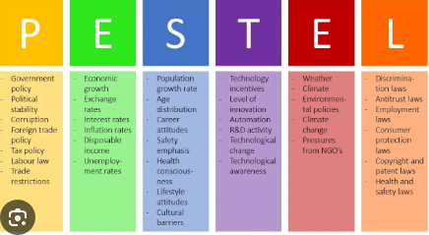
Chapter
TOOLS FOR EXPLORING CHANGE
10
PESTEL analysis
This is a widely used tool to aid thinking about changes in the wider environment. PESTEL is an acronym that stands for:
Political changes | local or central government elections, political initiatives
Economic changes | changes in interest rates, inflation, employment, currency fluctuations
Social changes | an aging population, increasing inequality, increasing work participation often from home
Technological developments | increasing use of computers and chip technology, increasing use of smartphones,
Environmental developments | climate change, waste and pollution reduction,
Legal changes | health and safety legislation, changes in employment laws,
ENT628
Entrepreneurship

Slide 25
Chapter
Tools For Exploring Change
10
Futures thinking
Once PESTEL has identified the broad environmental trends, future thinking can be used to help paint a comprehensive picture of the future state of the competitive environment.
It helps develop further insight into the changes that have been identified, ahead of defining the commercial opportunity. It tries to take a holistic perspective, developing a vision of the future state after the change has taken place. From this, the commercial oppor­tunities can be identified, again using brainstorming. Current constraints to action are ignored and in this way, the barriers to change are identified.
ENT628
Entrepreneurship

Slide 26
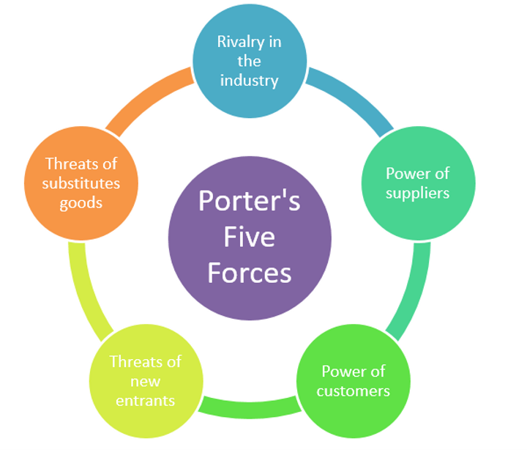
Chapter
Tools For Exploring Change
10
Scenario planning
This is another technique that tries to assess how possible future situations might impact on a firm. It allows you to take Porter's static Five Forces analysis and add to it the extra dimen­sion of competitive reaction.
Ifan innovation causes radical changes to markets it is particularly useful to 'game plan' how competitors might react. Trends and drivers of change identified from the PESTEL analysis can be built into the scenarios. These scenarios must be logically consistent possible futures, based around the strengths and weaknesses and other key factors influencing the firm and its competitors.
ENT628
Entrepreneurship

Slide 27
Chapter
Tools For Exploring Change
10
Brainstorming
Generating ideas is a numbers game. So it is worth distinguishing between those tech­niques designed to generate volume and those designed to improve the quality of the idea.
Brainstorming is one of the most widely-used, basic techniques for facilitating the generation of a volume of ideas around a topic. It is practiced in a group, thereby encouraging con­nectivity. In the session participants do not question or criticize ideas. the aim is to encourage the free flow of ideas -divergent thinking -and to come up with as many ideas as possible.
ENT628
Entrepreneurship

Slide 28
Chapter
Tools For Exploring Change
10
These are simple maps that link one idea to another. They can help develop and refine a business opportunity.
They can be used by individuals or in a group. As with brainstorming, you have to suspend disbelief and simply generate related ideas that might nat have been encapsulated in the original. It can help you 'think outside the box' and generate relation­ ships that might nat initially have been apparent. Creativity is about making connections between apparently unconnected things, and this technique can be particularly helpful.
ENT628
Entrepreneurship

Slide 29
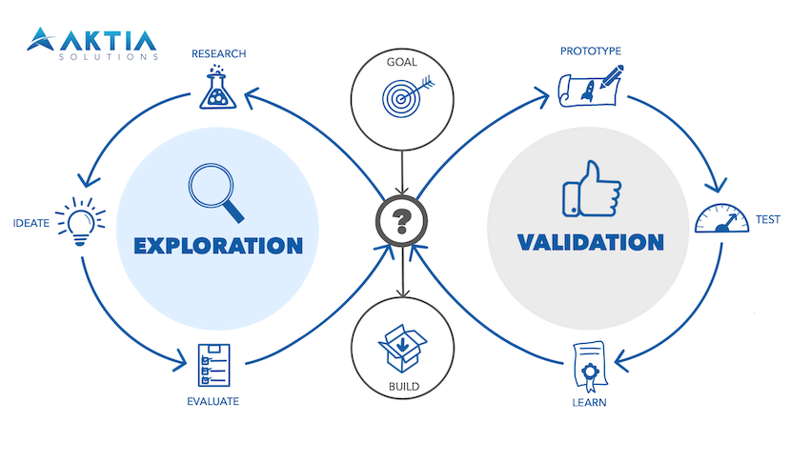
Chapter
Techniques For Exploring Product Inadequacies
10
Sometimes there may be problems for which no solutions - or rather no commercially viable solutions - have been found.
Mare often perhaps existing products or services can be improved, providing better solutions to existing problems. There are a number of tech­niques that can be used to explore inadequacies in existing products or services.
ENT628
Entrepreneurship

Slide 30
Chapter
Techniques For Exploring Product Inadequacies
10
Analogy
This is a product-centered technique that attempts to join together apparently unconnected or unrelated combinations of features of a product or service and benefits the customer to come up with innovative solutions to problems. It is designed, therefore, to provide more focused ideas that create opportunities out of unsolved problems for customers. Analogies are proposed once the initial problem is stated. The analogies are then related to opportuni­ties in the marketplace. They work in a similar way to brainstorming
ENT628
Entrepreneurship

Slide 31
Chapter
Techniques For Exploring Product Inadequacies
10
Attribute analysis
Sometimes a product can be inadequate and simply not work properly, presenting a fairly obvious opportunity for a new, better product.
Attribute analysis is another more focused product-centered technique designed to evolve product improvements and line extensions - used as the product reaches the mature phase of its life cycle. It can be useful, therefore, to spot opportunities arising from inadequate existing products or services. It uses the basic marketing technique of looking at the features of a product or service which, in turn, performs a series of functions but, most importantly, delivers benefits to the customers. An existing product or service is stripped down to its component parts and then you explore how these features might be altered, using brainstorming. The focus needs to be on whether those changes might bring valuable benefits to the customer
ENT628
Entrepreneurship

Slide 32
Chapter
Techniques For Exploring Product Inadequacies
10
Gap analysis
This is a market-based approach that attempts to produce a 'map' of product/market attri­butes based on dimensions that are perceived as important to customers, analyzing where competing products might lie and then spotting gaps where there is little or no competi­tion. Depending on the scale, this can be used to spot or create opportunity, particularly in the form of redefining market paradigms.
There are a number of approaches to this task:
ENT628
Entrepreneurship

Slide 33
Chapter
Techniques For Exploring Product Inadequacies
(Gap analysis)
10
Perceptual mapping
places the attributes of a product within specific categories. So, for example, the dessert market might be characterized as hot vs cold and sophisti­cated vs unsophisticated. Various desserts would then be mapped onto these two dimensions. The issue is whether the 'gap' identified is one that customers would value being filled - and means under­ standing whether they value the dimensions being measured. That is a question for market research to attempt to answer.
ENT628
Entrepreneurship

Slide 34
Chapter
Techniques For Exploring Product Inadequacies
(Gap analysis)
10
Non-metric mapping
places products in generic groups that customers find similar and then tries to explain why these groupings exist. One classic example would be its application to the soft drinks market where products might be clustered and then described simply in terms of the widely-used generic groups, 'still' vs 'carbonated' and 'flavored' vs 'non-flavoured: The key here is also finding the appropriate dimensions that create opportunities for differentiating the product. The mapping of soft drinks on the two dimensions of a perceptual map is unlikely to reveal any gaps in the market.
ENT628
Entrepreneurship

Slide 35
Chapter
Techniques For Exploring Product Inadequacies
(Gap analysis)
10
Repertory grid
is a more systematic extension of this technique using market research.
Customers are asked to group similar and dissimilar products within a market, normally in pairs. They are then asked to explain the similarities and dissimilarities. The sequence is repeated for all groups of similar and dissimilar products. The explanations are then used to derive 'constructs' which describe the way in which people relate to and evaluate the products. These constructs form a grid that can be used to map the products, using the words used by the customers themselves.
ENT628
Entrepreneurship

Slide 36
Chapter
Techniques For Exploring Product Inadequacies
10
Delphi method
First, relevant experts need to be identified. These might include experts in non­ technological fields so that the economic, social, and environmental impacts of the changes are not overlooked. Then experts are then asked to complete a carefully constructed questionnaire survey of their opinion on what the key future issues might be and their likelihood of occurrence. Having been analyzed, the questionnaire is then refined into a second more focused version and the experts resurveyed. The process is repeated until there is some convergence of opinion that yields a Delphi forecast of the probability and time scale of certain events. The process can be costly and time-consuming and depends upon the quality and appropriateness of experts and the questionnaires used.
ENT628
Entrepreneurship

Slide 37
Chapter
Systematic Inventive Thinking
10
That there are many opportunities for innovation based upon existing products or services that do not adequately meet customer needs or where customer value can be enhanced through changes: 'The traditional view of creativity is that it is unstructured and doesn't follow rules or patterns. That you need to think "outside the box" to be truly original and innovative.
Their templates, which they called 'Systematic Inventive Thinking; involved five approaches to changing the attributes or features of a product or service:
ENT628
Entrepreneurship

Slide 38

Chapter
Systematic Inventive Thinking
10
1. Attribute dependency
Bringing together or correlating two or more apparently unrelated attributes of the product can add value for customers. Examples include smartphones that provide information that depends on geographic location and in cars windscreen wiper speed or radio volume that varies with the speed of the car and headlights that dim automati­cally for oncoming cars.
ENT628
Entrepreneurship

Slide 39

Chapter
Systematic Inventive Thinking
10
2. Task unification
Similarly, bringing together multiple tasks into one product or service can add value for customers. For example, sunscreen products are added to facial moisturizers and make-up (and vice versa) to unify a task. Samsonite used this principle to redesign the shape of straps on backpacks so as to press softly at 'shiatsu points' on the back and provide a soothing massage sensation rather than causing back and neck strain from the weight of their contents. The heavier the contents, the deeper the sensation and the more stress­ relieving for the wearer, thus using the heavy load carried as a comfort advantage.
ENT628
Entrepreneurship

Slide 40

Chapter
Accelerators And Incubators
10
3. Multiplication
By way of contrast, duplicating some product features or characteristics may enhance customer value. For example, 'picture-within-picture' TVs allow people to watch more than one program at a time. Pearson Education has used this principle to create a new course designed specifically for students who failed algebra exams and needed a different approach to studying the subject.
4. Division
Alternatively, dividing out the functions of a product might add value for some custom­ ers. For example, dividing the control features into many electronic products and placing them into a remote control provided more convenience and allowed the products to become smaller, cheaper, and easier to use.
ENT628
Entrepreneurship

Slide 41
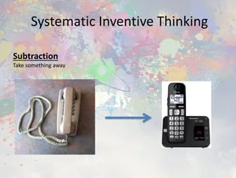
Chapter
Creative Environments
09
5. Subtraction
Finally, subtracting product features not valued by some market segments. This was the approach taken by low-cost airlines.
ENT628
Entrepreneurship

Slide 42



Thank You

