Slide 1



Risk Management
MGM 510
Lecture 10
Prepared by
Dr. Nael Zabel
www.midocean.ae

Slide 2
Topics to Cover in Week 10
Tolerate, treat, transfer and terminate
The 4ts of hazard response
Description of the 4Ts of hazard response
Risk matrix and the 4Ts of hazard management
Key dependencies and significant risks
Strategic Risk Response
Opportunity evaluation and response

Slide 3
Tolerate, treat, transfer and terminate
Priority significant risks facing an organization are those that have:
●● high or very high impact in relation to the benchmark test for significance;
●● high or very high likelihood of materializing at or above the benchmark level;
●● high or very high scope for cost-effective improvement in control.

Slide 4
The 4ts of hazard response
Generally speaking, it is only priority significant risks that require attention at the most senior level of the organization.
However, it is appropriate that compliance risks also receive boardroom attention.

Slide 5
The 4ts of hazard response
In practice, the board will expect these compliance risks to be properly managed and the board will only receive routine/annual reports describing risk performance, or a special report if a specific issue has arisen.
The organization will seek to introduce effective and efficient controls to minimize compliance risks.

Slide 6
The 4ts of hazard response
Having identified the priority significant risks, the organization then needs to review the controls in place and decide whether further actions are required.
For hazard risks, the range of responses available is often described as the 4Ts.

Slide 7
Description of the 4Ts of hazard response
Tolerate Accept/retain: The exposure may be tolerable مقبوله without any further action being taken.
Even if it is not tolerable, the ability to do anything about some risks may be limited, or the cost of taking any action may be disproportionate to the potential benefit gained.

Slide 8
Description of the 4Ts of hazard response
Treat Control/reduce: By far the greater number of risks will be addressed in this way.
The purpose of treatment is that, whilst continuing within the organization with the activity giving rise to the risk, action (control) is taken to constrain the risk to an acceptable level.

Slide 9
Description of the 4Ts of hazard response
Transfer Insurance/contract: For some risks the best response may be to transfer them.
This might be done by conventional insurance,
or it might be done by paying a third party to take the
risk in another way.
This option is particularly good for mitigating financial risks or risks to assets.

Slide 10
Description of the 4Ts of hazard response
Terminate Avoid/eliminate: Some risks will only be treatable, or containable to acceptable levels, by terminating the activity.
It should be noted that the option of termination of activities may be severely limited in government when compared to the private sector.

Slide 11
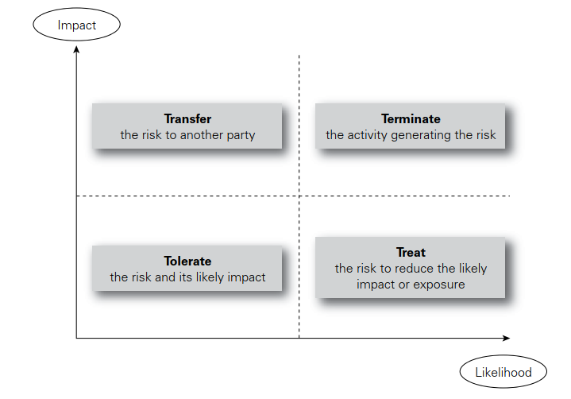
Risk matrix and the 4Ts of hazard management

Slide 12
Tolerate risk
Risk tolerance is defined in Guide 73 as the organization’s or stakeholder’s readiness to bear the risk after risk treatment in order to achieve its objectives.

Slide 13
Key dependencies and significant risks
FirM risk scorecard | example dependencies | example of a significant risk
Financial | Availability of funds Correct allocation of Funds Internal control Liabilities under control | Insufficient funds available from parent company. Inadequate profit because of incorrect capital expenditure decisions. Fraud occurs because of inadequate internal controls. Higher than expected liabilities arise in the pension fund.

Slide 14
Key dependencies and significant risks
FirM risk scorecard | example dependencies | example of a significant risk
Infrastructure | People Premises Processes Products | Failure to achieve/maintain health and safety standards. Damage to key location caused by insured peril. IT control systems not available because of virus or hacker activity. Disruption because of failure of supplier.

Slide 15
Key dependencies and significant risks
FirM risk scorecard | example dependencies | example of a significant risk
Reputational | Brand Public opinion Regulators | Product recall causes damage to product image and brand. Lost sales or revenue because of change in public tastes. Regulator enforcement action causes loss of public confidence. Allegations of unethical product-sourcing causes loss of sales

Slide 16
Key dependencies and significant risks
FirM risk scorecard | example dependencies | example of a significant risk
Marketplace | Regulatory environment Economic health Product development Competitor behaviour | Change in tax regime results in unbudgeted tax demands. Decline in world or national economy reduces consumer spending. Changes in technology reduce product appeal and sales. Competitor substantially reduces prices to win market share

Slide 17
Treat Risk
When the level of risk exposure (likelihood) associated with a particular hazard is high but the potential loss (impact) associated with it is low, the organization will
wish to treat the risk.
Risk treatment will often be undertaken with the risk at the inherent and/or current level, so that when the risk has been treated, the new current level or target level may become tolerable.

Slide 18
Treat Risk
Actions to improve the standard of risk control will always be under constant review in an organization.
On a personal level, wearing a seat belt when driving a car or fitting an intruder alarm in a house are examples of risk reduction actions.

Slide 19
Treat Risk
Fitting sprinklers to buildings, providing enhanced building security arrangements and employee security vetting are all examples of risk improvement actions designed to better manage hazard risks.

Slide 20
Treat Risk
Cost-effective risk treatments will need to be selected and the effect of different control measures can
be shown on a risk matrix.
There is an issue of terminology associated with treat risk.
ISO 31000 considers that ‘treat risk’ is the main heading under which various options exist, such as:

Slide 21
Treat Risk
●● avoiding the risk by deciding not to start or continue with the activity;
●● taking or increasing the risk in order to pursue an opportunity;
●● removing the risk source;
●● changing the likelihood or the consequences;
●● sharing the risk with another party or parties;
●● retaining the risk by informed decision.

Slide 22
Transfer Risk
When the likelihood of a risk materializing is low but the potential is high, the organization will wish to transfer that risk.
Insurance is a well-established mechanism for transferring the financial impact of losses arising from hazard risks and (to a lesser extent) control risks.

Slide 23
Transfer Risk
Risk transfer can be achieved by conventional insurance and also by contractual agreement.
It may also be possible to find a joint-venture partner, or some other means of sharing the risk.
Risk hedging or neutralization may therefore be considered to be a risk transfer option, as well as a risk treatment option.

Slide 24
Transfer Risk
Such arrangements are usually provided by insurance, and insurance is, therefore, finance that is contingent upon certain insured events taking place.

Slide 25
Transfer Risk
There is another issue of terminology with the use of the phrase ‘risk transfer’.
ISO 31000 recommends that risk sharing should be used in preference to risk transfer.
The argument is that a risk can never be fully transferred and whatever the intention of the parties, the risk will always be, to some extent, shared.

Slide 26
Terminate Risk
When a risk is both of high likelihood and high potential impact, the organization will wish to terminate or eliminate the risk.
It may be that the risks of trading in a
certain part of the world or the environmental risks associated with continuing to use certain chemicals are unacceptable to the organization and/or its stakeholders.

Slide 27
Terminate Risk
In these circumstances, appropriate responses would be elimination of the risk by stopping the process or activity, substituting an alternative activity or outsourcing the activity that is associated with the risk.

Slide 28
Terminate Risk
An organization may wish to terminate a risk, but it could be the case that the activity that gives rise to it is fundamental to the ongoing operation of the organization.
In such circumstances, the organization may not be able to terminate or eliminate the risk entirely and thus will need to implement alternative control measures.

Slide 29
Strategic Risk Response
The overall approach to the management of control and opportunity risks is similar to the approach adopted for the management of hazard risks.
However, there are sufficient differences in the range of options available for these to be presented separately.
It is worth remembering that projects normally reflect and implement the tactics that are being employed to implement strategy.

Slide 30
Strategic Risk Response
Figure 15.2 suggests that there are a range of responses available for the management of opportunity risks. Developing and implementing effective and efficient strategy will require the evaluation of the level of risk associated with each available strategy and the level of reward that the strategy will deliver.

Slide 31
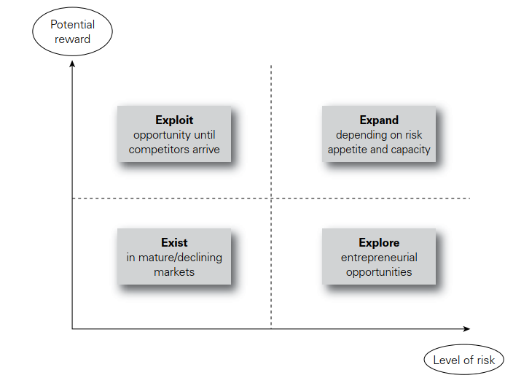
Risk versus reward in strategy

Slide 32
Strategic Risk Response
Figure 15.3 shows a refinement to Figure 15.2 in that the area of high risk and potentially high reward is evaluated in a little more detail by taking account of risk appetite.
An organization may find that it has a viable business opportunity but does not have the resources to exploit it on its own. In these circumstances, the organization has three main choices.

Slide 33
Strategic Risk Response
It may exit the opportunity because it does not have the
risk appetite or risk capacity to pursue that opportunity.
It may sell the opportunity on to an organization that does have the appetite, capacity and resources to exploit
the opportunity or it may seek to share that opportunity.

Slide 34
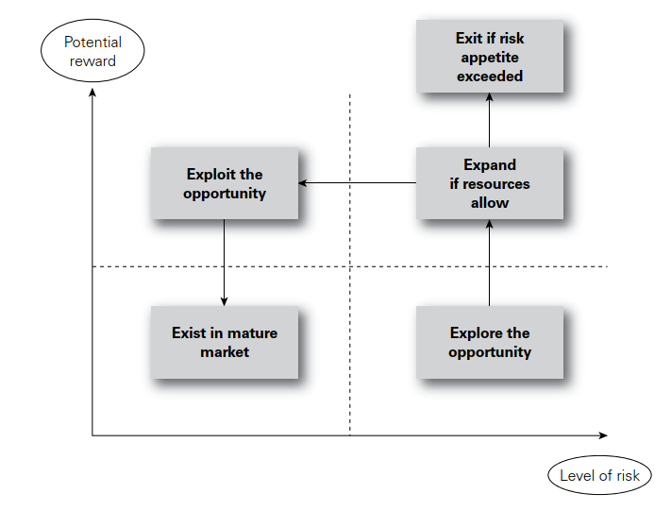
Opportunity risks and risk appetite

Slide 35
Opportunity evaluation and response
The purpose of the evaluation and response is to decide which opportunities require a response and what the recommended response will be.
The following are the key terms and concepts when deciding how to respond to an opportunity and they can be used in combination:

Slide 36
Opportunity evaluation and response
●● Enhance: the opportunity equivalent of ‘mitigating’ a risk is to enhance the opportunity by increasing the probability and/or the impact.
●● Exploit: equivalent to the ‘avoid’ response, but the ‘exploit’ strategy seeks to make the opportunity definitely happen.

Slide 37
Opportunity evaluation and response
●● Ignore: the ‘acceptance’ strategy takes no measures to deal with a hazard risk, and opportunities can be ignored, with a reactive approach but no explicit actions.
●● Sharing (transfer) opportunity: ‘share’ strategy for opportunities seeks a partner able to manage the opportunity who can maximize the chance of it happening.

Slide 38
Thank You

