Slide 1

PRESENTATION AND WRITING SKILLS lecture No. 10
BY
Dr. Manal El-Sayed
MGM223

Slide 2

lecture No. 10
Applying and Interviewing for Employment
الرجاء الاستماع الى المحاضرة أو قراءة ال notes أسفل السلايدز قبل حل الامتحان الأسبوعي

Slide 3

Test your knowledge for the previous
lecture
Finding the ideal opportunity
Define your personal strategy.
Know the Employer’s perspective
How to conduct your internet research.
How to build your network
Planning your résumé
Notes:
LEARNING OBJECTIVES
After studying this chapter, you will be able to:
Describe the three-step writing process and explain why it will help you create better messages in less time
Explain what it means to analyze the situation when planning a message
Describe the techniques for gathering information for simple messages and identify three attributes of quality information
Compare the four major classes of media and list the factors to consider when choosing the most appropriate medium for a message
Explain why good organization is important to both you and your audience and explain how to organize any business message

Slide 4
Learning Objectives
Submitting your résumé
Understanding the interview process
Preparing for a job interview
Interviewing for success
Following up after an interview
تقديم سيرتك الذاتية
فهم عملية المقابلة
التحضير لمقابلة عمل
إجراء المقابلات من أجل النجاح
المتابعة بعد المقابلة
Notes:
LEARNING OBJECTIVES
After studying this chapter, you will be able to do the following:
Explain the purposes of application letters and how to apply the AIDA organizational approach to them
Describe the typical sequence of job interviews, the major types of interviews, and what employers look for during an interview
List six tasks you need to complete to prepare for a successful job interview
Explain how to succeed in all three stages of an interview
Identify the most common employment messages that follow an interview and explain when you would use each one

Slide 5
Submitting Your Résumé
تقديم سيرتك الذاتية

Slide 6

Application Letters
خطابات التقديم
Unsolicited
غير المرغوب فيها
Solicited
المعلن عنها أو المطلوبة
What You Are Sending
ما الذي ترسله؟
Why You Are Sending It
لماذا ترسلها؟
Benefits of Reading It
فوائد قراءته
Notes:
Whenever you mail, e-mail, upload, or hand-deliver your résumé, you should include an application letter, also known as a cover letter,
to let readers know what you’re sending,
why you’re sending it, and how they can benefit from reading it.
Even though these documents are referred to as letters, they can be e-mail messages as well.
Take the same care with your application letter that you took with your résumé. A poorly written application letter can prompt employers to skip over your résumé, even if you are a good fit for a job.
If you’re sending a solicited application letterخطاب تقدم مرغوب فيه أو مطلوب (in response to an identified job opening)
you’ll know what qualifications the organization is seeking.
You’ll also have more competition because hundreds of other job seekers will have seen the listing and may be sending applications too.
If you are sending an unsolicited letter (a prospecting letter to an organization that has not announced an opening),
you will have to do some research to identify the requirements the position is likely to have.
In addition, search for information about the company,
its customers, the profession, or the manager to whom you are writing.
Using such information in your letter will help you establish common ground with your reader and show that you are tuned into what is going on in the industry.

Slide 7
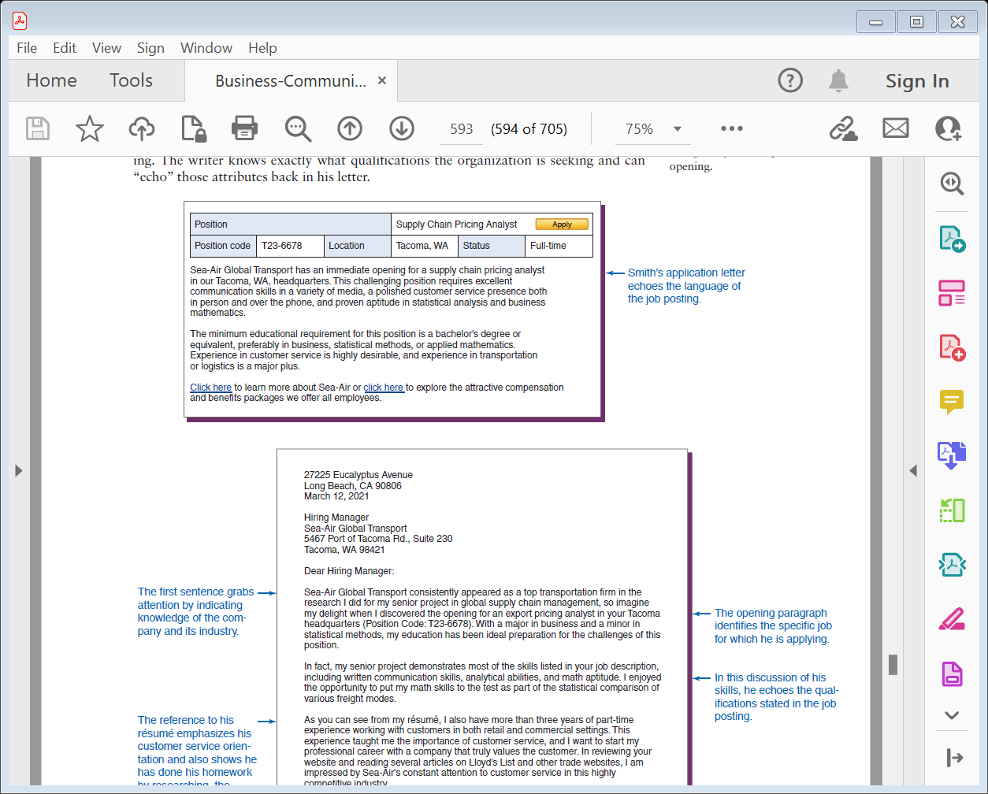
Application Letters
خطابات التقديم
Notes:
Whenever you mail, e-mail, upload, or hand-deliver your résumé, you should include an application letter, also known as a cover letter, to let readers know what you’re sending, why you’re sending it, and how they can benefit from reading it. Even though these documents are referred to as letters, they can be e-mail messages as well.
Take the same care with your application letter that you took with your résumé. A poorly written application letter can prompt employers to skip over your résumé, even if you are a good fit for a job.
If you’re sending a solicited application letter (in response to an identified job opening) you’ll know what qualifications the organization is seeking. You’ll also have more competition because hundreds of other job seekers will have seen the listing and may be sending applications too. If you are sending an unsolicited letter (a prospecting letter to an organization that has not announced an opening), you will have to do some research to identify the requirements the position is likely to have. In addition, search for information about the company, its customers, the profession, or the manager to whom you are writing. Using such information in your letter will help you establish common ground with your reader and show that you are tuned into what is going on in the industry.

Slide 8
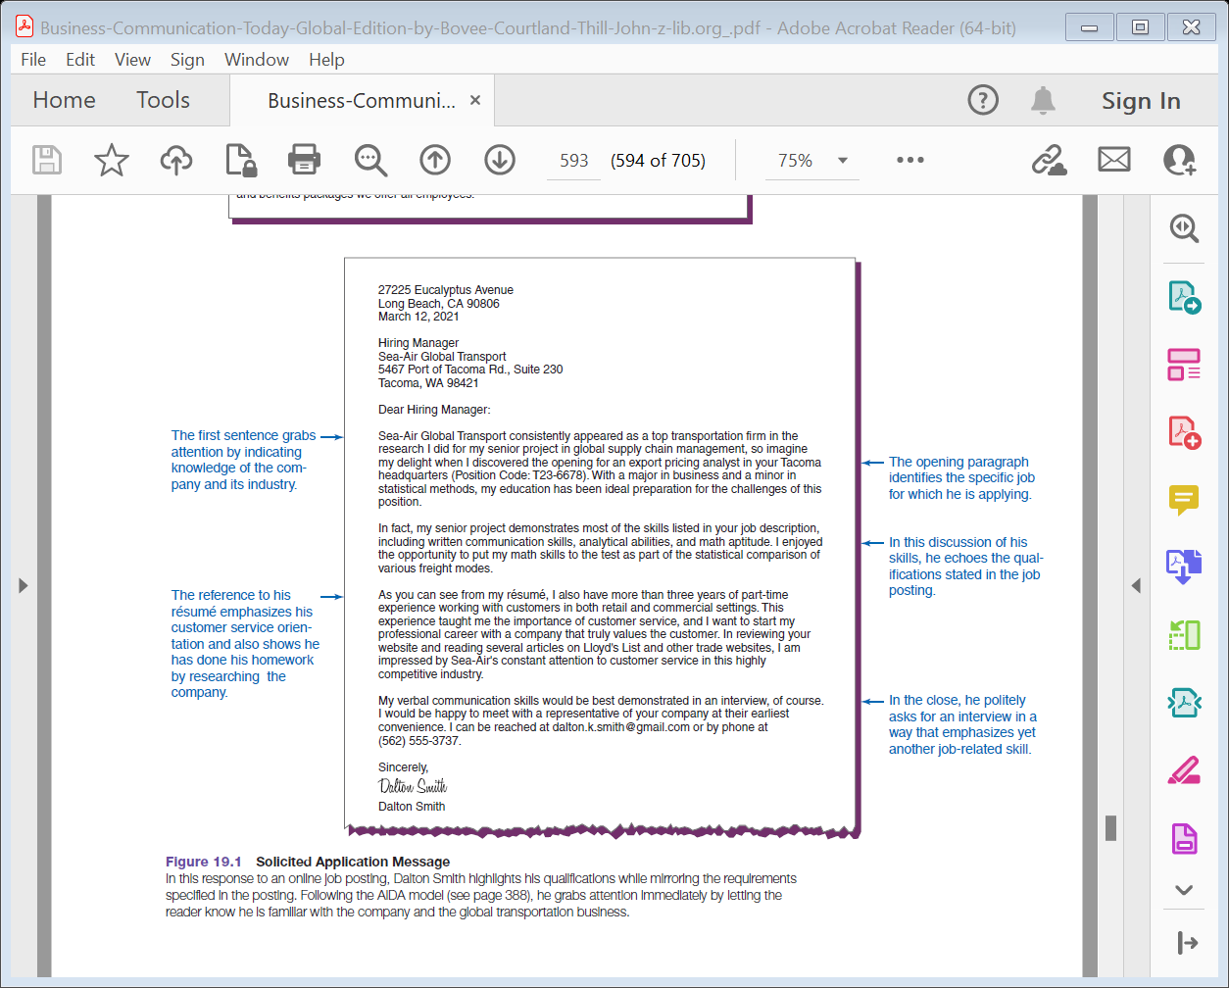
Application Letters
Notes:
Whenever you mail, e-mail, upload, or hand-deliver your résumé, you should include an application letter, also known as a cover letter, to let readers know what you’re sending, why you’re sending it, and how they can benefit from reading it. Even though these documents are referred to as letters, they can be e-mail messages as well.
Take the same care with your application letter that you took with your résumé. A poorly written application letter can prompt employers to skip over your résumé, even if you are a good fit for a job.
If you’re sending a solicited application letter (in response to an identified job opening) you’ll know what qualifications the organization is seeking. You’ll also have more competition because hundreds of other job seekers will have seen the listing and may be sending applications too. If you are sending an unsolicited letter (a prospecting letter to an organization that has not announced an opening), you will have to do some research to identify the requirements the position is likely to have. In addition, search for information about the company, its customers, the profession, or the manager to whom you are writing. Using such information in your letter will help you establish common ground with your reader and show that you are tuned into what is going on in the industry.

Slide 9
Application Letters
Solicited application letter
خطاب التقدم لوظيفة معلن عنها
(in response to an identified job opening) you’ll know what qualifications the organization is seeking. You’ll also have more competition because hundreds of other job seekers will have seen the listing and may be sending applications too
(ردا على وظيفة شاغرة محددة) ستعرف المؤهلات التي تبحث عنها المنظمة. سيكون لديك أيضا المزيد من المنافسة لأن المئات من الباحثين عن عمل الآخرين سيشاهدون القائمة وقد يرسلون الطلبات أيضا
Notes:
Whenever you mail, e-mail, upload, or hand-deliver your résumé, you should include an application letter, also known as a cover letter, to let readers know what you’re sending, why you’re sending it, and how they can benefit from reading it. Even though these documents are referred to as letters, they can be e-mail messages as well.
Take the same care with your application letter that you took with your résumé. A poorly written application letter can prompt employers to skip over your résumé, even if you are a good fit for a job.
If you’re sending a solicited application letter (in response to an identified job opening) you’ll know what qualifications the organization is seeking. You’ll also have more competition because hundreds of other job seekers will have seen the listing and may be sending applications too. If you are sending an unsolicited letter (a prospecting letter to an organization that has not announced an opening), you will have to do some research to identify the requirements the position is likely to have. In addition, search for information about the company, its customers, the profession, or the manager to whom you are writing. Using such information in your letter will help you establish common ground with your reader and show that you are tuned into what is going on in the industry.

Slide 10
Application Letters
unsolicited application letter
(خطاب تنقيب إلى منظمة لم تعلن عن افتتاح) ، سيتعين عليك إجراء بعض الأبحاث لتحديد المتطلبات التي من المحتمل أن يمتلكها المنصب. بالإضافة إلى ذلك ، ابحث عن معلومات حول الشركة أو عملائها أو المهنة أو المدير الذي تكتب إليه. سيساعدك استخدام هذه المعلومات في رسالتك على إنشاء أرضية مشتركة مع القارئ وإظهار أنك على دراية بما يجري في الصناعة.
(a prospecting letter to an organization that has not announced an opening), you will have to do some research to identify the requirements the position is likely to have. In addition, search for information about the company, its customers, the profession, or the manager to whom you are writing. Using such information in your letter will help you establish common ground with your reader and show that you are tuned into what is going on in the industry.
Notes:
Whenever you mail, e-mail, upload, or hand-deliver your résumé, you should include an application letter, also known as a cover letter, to let readers know what you’re sending, why you’re sending it, and how they can benefit from reading it. Even though these documents are referred to as letters, they can be e-mail messages as well.
Take the same care with your application letter that you took with your résumé. A poorly written application letter can prompt employers to skip over your résumé, even if you are a good fit for a job.
If you’re sending a solicited application letter (in response to an identified job opening) you’ll know what qualifications the organization is seeking. You’ll also have more competition because hundreds of other job seekers will have seen the listing and may be sending applications too. If you are sending an unsolicited letter (a prospecting letter to an organization that has not announced an opening), you will have to do some research to identify the requirements the position is likely to have. In addition, search for information about the company, its customers, the profession, or the manager to whom you are writing. Using such information in your letter will help you establish common ground with your reader and show that you are tuned into what is going on in the industry.

Slide 11
Application Letter Tips
نصائح خطاب التطبيق
حدد الفرصة بوضوح
أظهر فهمك للشركة
لا تتطوع بسجل الرواتب
اجعلها قصيرة - حوالي ثلاث فقرات
أظهر شخصيتك ولكن ابق عمليا
عرض الثقة وليس الغطرسة
identify the opportunity
Show you understand the company
Don’t volunteer salary history
Keep it short—about three paragraphs
Show personality but stay businesslike
Project confidence, not arrogance
Notes:
No matter whether your letter will be solicited or unsolicited, do everything you can to address your letter to a specific person who can hire you. Search LinkedIn, the company’s website, and Twitter.
If another applicant finds a name and you don’t, you will be at a disadvantage.
In addition, the following tips can improve the effectiveness of your letter:
Be as clear as possible about the kind of opportunity you seek.
Show that you understand the company and the position.
Never volunteer salary information unless an employer asks for it.
Keep it short—and keep e-mail cover letters even shorter; in just two or three paragraphs, convey how your strengths and character would fit the position.
Show some personality; this will help balance the choppy, shorthand style of your résumé.
Project confidence without being arrogant.

Slide 12

Using the AIDA Plan
Attention
Interest
Desire
Action
انتباه
اهتمام
الرغبة
فعل
Notes:
Because application letters are persuasive messages,
the AIDA approach you learned in Chapter 9 is ideal.
Getting attention. The opening paragraph of your application letter has two important tasks to accomplish:
clearly stating your reason for writing
and (2) giving the recipient a reason to keep reading by demonstrating that you have some immediate potential for meeting the company’s needs.
Building interest and increasing desire. The middle section of your letter presents your strongest selling points in terms of their potential benefit to the organization, thereby building interest in you and creating a desire to interview you.
Be specific and back up your assertions with convincing evidence.
Motivating action. The final paragraph of your application letter has two important functions:
to ask the reader for a specific action (usually an interview) and to facilitate a reply.
Include your e-mail address and phone number, as well as the best time to reach you.
Alternatively, you can take the initiative and say that you will follow up with a phone call.

Slide 13

Résumé Follow-Up
Communication
Professionalism
Employer Instructions
Closing Date
التواصل
الاحترافية
تعليمات أصحاب الأعمال
تاريخ الإغلاق
Notes:
Deciding if, when, and how to follow up after submitting your résumé and application letter is one of the trickiest parts of a job search.
First, keep in mind that employers continue to evaluate your communication efforts and professionalism during this phase,
so don’t say or do anything to leave a negative impression.
Second, adhere to whatever instructions the employer has provided.
If a job posting says “no calls,” for example, don’t call.
Third, if the job posting lists a close date, don’t call or write before then, because the company is still collecting applications and will not have decided about inviting people for interviews.
Wait a week or so after the close date. If no close date is given and you have no other information to suggest a timeline, you can generally contact the company starting a week or two after submitting your résumé.

Slide 14
Follow-Up Questions
أسئلة المتابعة
Has a decision been made?
Can you tell me what will happen next?
What is the company’s time frame?
Could I follow up in another week?
Can I provide additional information?
هل تم اتخاذ قرار؟
هل يمكن أن تخبرني ماذا سيحدث بعد ذلك؟
ما هو الإطار الزمني للشركة؟
هل يمكنني المتابعة في غضون أسبوع آخر؟
هل يمكنني تقديم معلومات إضافية؟
Notes:
When you follow up by e-mail or telephone, you can share an additional piece of information that links your qualifications to the position (keep an eye out for late-breaking news about the company, too)
and ask a question about the hiring process to gather some information about your status. Good questions to ask include:
Has a hiring decision been made yet?
Can you tell me what to expect next in terms of the hiring process?
What is the company’s timeframe for filling this position?
Could I follow up in another week if you haven’t had the chance to contact me yet?
Can I provide any additional information regarding my qualifications for the position?
Whatever the circumstances, a follow-up message can demonstrate that you’re sincerely interested in working for the organization, persistent in pursuing your goals, and committed to upgrading your skills.

Slide 15
Understanding the Interview Process
فهم عملية المقابلة
Notes:
When you follow up by e-mail or telephone, you can share an additional piece of information that links your qualifications to the position (keep an eye out for late-breaking news about the company, too) and ask a question about the hiring process as a way to gather some information about your status. Good questions to ask include:
Has a hiring decision been made yet?
Can you tell me what to expect next in terms of the hiring process?
What is the company’s timeframe for filling this position?
Could I follow up in another week if you haven’t had the chance to contact me yet?
Can I provide any additional information regarding my qualifications for the position?
Whatever the circumstances, a follow-up message can demonstrate that you’re sincerely interested in working for the organization, persistent in pursuing your goals, and committed to upgrading your skills.

Slide 16
Interview Sequence
تسلسل المقابلة
Selection
اختيار
Final Stage
المرحلة النهائية
Screening
فحص

Slide 17
Structured
مهيكلة
Open-Ended
مفتوحة
Panelمجموعة
Types of
Interviews
أنواع المقابلات
Group
جماعية
Behavioral
Situational
موقفية
Working
Stress
ضغط
الرجاء الاستماع الى المحاضرة أو قراءة ال notes أسفل السلايدز
Notes:
Organizations use various types of interviews to discover as much as possible about applicants.
A structured interview follows a set sequence of questions, allowing the interview team to compare answers from all candidates.
In an open-ended interview, the interviewer adapts the line of questioning based on your responses and questions.
In a panel interview, you meet with several interviewers at once; in a
group interview you and several other candidates meet with one or more interviewers at once.
In a behavioral interview, you are asked to describe how you handled situations from your past.
A situational interview focuses on how you would handle various hypothetical situations on the job.
In a working interview, you actually perform work-related tasks.
Perhaps the most unnerving type of interview is the stress interview, which is set up to see how well a candidate handles stressful situations, such as long periods of silence, criticisms of your appearance, deliberate interruptions, and abrupt or even hostile reactions by the interviewer.
المقاطعات المتعمدة ، وردود الفعل المفاجئة أو حتى العدائية من قبل القائم بإجراء المقابلة.

Slide 18

Interview Mediaوسائل المقابلة
Telephone مقابلة عبر التليفون
Email and IMالبريد الإلكتروني والمراسلة الفورية
Video Technologyتقنية الفيديو
Online Options الخيارات عبر الإنترنت
Notes:
In addition to encountering a variety of interview formats, expect to be interviewed through a variety of media.
To succeed at
a telephone interview, make sure you treat it as seriously as an in-person interview. Be prepared with a copy of all the materials you have sent the employer, including your résumé and any correspondence.
If possible, arrange to speak on a landline so you don’t have to worry about cell phone reception problems.
Remember that you won’t be able to use nonverbal signals to create a good impression, so a positive, alert tone of voice is vital.
E-mail and IM are also sometimes used in the screening stage. While you have almost no opportunity to send and receive nonverbal signals with these formats, you do have the major advantage of being able to review and edit each response before you send it.
Maintain a professional style in your responses and be sure to ask questions that demonstrate your knowledge of the company and the position.
Many employers use video technology for both live and recorded interviews.
Prepare for a video interview as you would for an in-person interview and take the extra steps needed to become familiar with the equipment and the process. During any video interview, remember to sit up straight and focus on the camera.
Online interviews can range from simple structured questionnaires and tests to sophisticated job simulationمحاكاة الوظائف المتطورة that are similar to working interviews. Job simulations not only identify good candidates but also reduce the risk of employment discrimination lawsuits because they closely mimic actual job skills.
تقليد مهارات العمل الفعلية.

Slide 19
What Employers Seekما الذي يسعى إليه أصحاب العمل
Suitabilityملاءمه
Organization Fitملاءمة المنظمة
Education
تعليم
Background
خلفية
Experience
تجربة
Attitudes
المواقف
Job-Related Traits
السمات المتعلقة بالوظيفة
Personal Style
النمط الشخصي
Notes:
Interviews give employers the chance to go beyond the basic data of your résumé to get to know you and to answer two essential questions.
The first is whether you can handle the responsibilities of the position.
Naturally, the more you know about the demands of the position, and the more you’ve thought about how your skills match those demands, the better you’ll be able to respond.
Suitability for a specific job is judged based on such factors as
academic preparation,
work experience,
and job-related personality traits.
The second essential question concerns organization fit;
that is, whether your overall personality and approach to work will be appropriate,
not only for the target position but also for the organization.
This determination will be made based on your personal background, attitudes, and style.

Slide 20
Preemployment Testsاختبارات ما قبل التوظيف
Integrity
التكامل
Knowledge
and Skills
المعلومات والمهارات
Personality
الشخصية
Substance Abuse
ادمان المخدرات
Cognition
الإدارك
Background
الخلفية
Notes:
Many companies rely on pre-employment testing to determine whether applicants are suited to the job and whether they’ll be worth the expense of hiring and training.
Integrity tests. You might not think that a test could identify job candidates who are more likely to steal from their employers or commit other ethical or legal infractions, but employers have had some success in using integrity tests.
الذين هم أكثر عرضة للسرقة من أصحاب العمل أو ارتكاب مخالفات أخلاقية أو قانونية أخرى ، لكن أصحاب العمل حققوا بعض النجاح في استخدام اختبارات النزاهة.
Personality tests. Personality tests can try to assess either general character or suitability for the demands of specific profession. General tests attempt to profile overall intellectual ability, attitudes toward work, interests, and managerial potential, as well as such characteristics as dependability, commitment, honesty, and motivation.
الاعتمادية والالتزام والصدق والتحفيز.
Cognitive tests. These tests measure a variety of attributes involved in acquiring, processing, analyzing, using, and remembering information. Typical tests involve reading comprehension, mathematics, problem solving, and decision making.
تتضمن الاختبارات النموذجية فهم القراءة والرياضيات وحل المشكلات واتخاذ القرار.
Job knowledge and job skills tests. These are the most common type, designed to assess competency or specific abilities needed to perform a job.
Substance tests. To avoid the increased costs and reduced productivity associated with drug abuse in the workplace, many employers require applicants to be tested for drug use.
Companies with mandatory testing have found real advantages, including lower accident rates, fewer disability claims, and decreased violence and absenteeism.
Background checks. Although not a test in the usual sense, a background check also helps employers learn more about you. A background check might be used to verify the credentials on your résumé, to see how well you manage credit, or to learn if you have a criminal record.

Slide 21
Preparing for a Job Interview
التحضير لمقابلة عمل

Slide 22
Employer’s Questions أسئلة صاحب العمل
The hardest decision you ever made
Your greatest weaknesses
Goals over the next five years
What you didn’t like about prior jobs
Relate something about yourself
أصعب قرار اتخذته على الإطلاق
أعظم نقاط ضعفك
الأهداف على مدى السنوات الخمس المقبلة
ما لم يعجبك في الوظائف السابقة
اربط شيئا عن نفسك
Notes:
Throughout the interview process, you can expect to get a mix of questions that are specific to you and the job opening, as well as questions that are of a more general nature, such as the following:
What is the hardest decision you’ve ever had to make? Be prepared with a good example, explaining why the decision was difficult and how you made the choice you made.
What are your greatest weaknesses? Describe a weakness so that it sounds like a virtue (such as working too hard) or describe a relatively minor shortcoming and explain how you’re working to improve.
Where do you want to be five years from now? Your answer should reflect your desire to contribute to the employer’s long-term goals, not just your own goals. Whether this question yields useful information is a matter of debate,
but prepared to answer it.
What didn’t you like about previous jobs you’ve held? Describe something that you didn’t like in a way that puts you in a positive light, such as having limited opportunities to apply your skills or education. Avoid making negative comments about former employers or colleagues.
Tell me something about yourself. Ask if the interviewer would like to know about your specific skills or attributes. If this point is clarified, then respond accordingly. If it isn’t, explain how your skills can contribute to the job and the organization.

Slide 23

Build Your Confidence
بناء ثقتك بنفسك
Weaknesses الضعف
Strengthsنقاط القوه
التوجس أو الخوف
Apprehension
Notes:
Interviewing is stressful for everyone, so some nervousness is natural.
However, you can take steps to feel more confident.
Start by reminding yourself that you have value to offer the employer,
and the employer already thinks highly enough of you to invite you to an interview.
If some aspect of your appearance or background makes you uneasy,
correct it if possible or offset it by emphasizing positive traits such as warmth, wit, intelligence, or charm.
Instead of dwelling on your weaknesses, focus on your strengths.
Instead of worrying about how you will perform in the interview, focus on how you can help the organization succeed.
The more prepared you are, the more confident you’ll be.

Slide 24

Professional Imageصورة احترافية
Clothingاللبس
Grooming
Behavior السلوك
Notes:
Physical appearance is important because clothing and grooming reveal something about a candidate's personality, professionalism, and ability to sense the unspoken “rules” of a situation.
When it comes to clothing, the best policy is to dress conservatively.
Wear the best-quality clothing you can but remember that “clean and appropriate” clothes are far more important than “expensive and flashy” clothing.
Good grooming makes any style of clothing look better. Make sure your clothes are clean and unwrinkled, your shoes un-scuffed and well shined, your hair neatly styled and combed, your fingernails clean, and your breath fresh.
نظيفة وغير مجعدة ، حذائك غير مجروش ولامع جيدا ، شعرك مصفف ومشط بدقة ، أظافرك نظيفة ، وأنفاسك منعشة.
Remember that an interview is not the place to express your individuality or to let your inner rebel run wild.
Send a clear signal that you understand the business world and know how to adapt to it. You will not be taken seriously otherwise.

Slide 25
Interviewing for Success
إجراء المقابلات من أجل النجاح
Notes:
Physical appearance is important because clothing and grooming reveal something about a candidate's personality, professionalism, and ability to sense the unspoken “rules” of a situation. When it comes to clothing, the best policy is to dress conservatively. Wear the best-quality clothing you can, but remember that “clean and appropriate” clothes are far more important than “expensive and flashy” clothing.
Good grooming makes any style of clothing look better. Make sure your clothes are clean and unwrinkled, your shoes un-scuffed and well shined, your hair neatly styled and combed, your fingernails clean, and your breath fresh.
Remember that an interview is not the place to express your individuality or to let your inner rebel run wild. Send a clear signal that you understand the business world and know how to adapt to it. You will not be taken seriously otherwise.

Slide 26

The Warm-Up Stageمرحلة الترحيب أو بداية المقابلة
First Impressionالانطباع الأول
Body Languageلغة الجسد
Social Skills مهارات اجتماعية
Notes:
Of the three stages, the warm-up is the most important, even though it may account for only a small fraction of the time you spend in the interview.
Studies suggest that many interviewers, particularly those who are poorly trained in interviewing techniques, make up their minds within the first 20 seconds of contact with a candidate.
Don’t let your guard down if it appears that the interviewer wants to engage in what feels like small talk; these exchanges are every bit as important as structured questions.
Body language is crucial at this point. Stand or sit up straight, maintain regular but natural eye contact,
تشير الدراسات إلى أن العديد من المحاورين ، وخاصة أولئك الذين لم يتم تدريبهم بشكل جيد على تقنيات إجراء المقابلات ، يتخذون قرارهم خلال أول 20 ثانية من الاتصال بالمرشح.
لا تخذل حذرك إذا بدا أن القائم بإجراء المقابلة يريد الانخراط في ما يبدو وكأنه حديث صغير. هذه التبادلات لا تقل أهمية عن الأسئلة المنظمة.
لغة الجسد أمر بالغ الأهمية في هذه المرحلة. الوقوف أو الجلوس بشكل مستقيم ، والحفاظ على اتصال العين العادية ولكن الطبيعية ،
and don’t fidget.
When the interviewer extends a hand, respond with a firm but not overpowering handshake.
Repeat the interviewer’s name when you’re introduced (“It’s a pleasure to meet you, Ms. Litton”).
Wait until you’re asked to be seated or the interviewer has taken a seat. Let the interviewer start the discussion. Then, be ready to answer one or two substantial questions right away: for example, “Why do you want to work here?” or “What do you know about us?”
ولا تتململ.
عندما يمد القائم بإجراء المقابلة يده ، أجب بمصافحة حازمة ولكن ليس طاغية.
كرر اسم القائم بإجراء المقابلة عند تقديمك ("إنه لمن دواعي سروري مقابلتك ، السيدة ليتون").
انتظر حتى يطلب منك الجلوس أو أن يأخذ القائم بإجراء المقابلة مقعدا. دع القائم بإجراء المقابلة يبدأ المناقشة. بعد ذلك ، كن مستعدا للإجابة على سؤال أو سؤالين جوهريين على الفور: على سبيل المثال ، "لماذا تريد العمل هنا؟" أو "ماذا تعرف عنا؟"

Slide 27

Questions-and-Answers
Asking and Respondingالسؤال و
الاستجابه
Careful Listening الاستماع الدقيق
Personal Questions أسئلة شخصية
Notes:
Questions and answers will consume the greatest part of the interview.
The interviewer will ask you about your qualifications and discuss many of the points mentioned in your résumé.
You'll also be asking questions of your own.
Let the interviewer lead the conversation, and never answer a question before he or she has finished asking it.
Tailor your answers to make a favorable impression. Don't limit yourself to yes or no answers.
If you're asked a difficult question, be sure you pause to think before responding.
If you periodically ask a question or two from the list you've prepared, you'll not only learn something but also demonstrate your interest.
Paying attention when the interviewer speaks can be as important as giving good answers or asking good questions.
The interviewer's facial expressions, eye movements, gestures, and posture may tell you the real meaning of what is being said. Be especially aware of how your comments are received.
Employers cannot legally discriminate against a job candidate on the basis of race, color, gender, age (from 40 to 70), marital status, religion, national origin, or disability. If you are asked questions that are personal or potentially unlawful, how you respond depends on how badly you want the job, how you feel about revealing the information asked for, what you think the interviewer will do with the information, and whether you want to work for a company that asks such questions.

Slide 28

Close the Interview
Courtesy and Interest المجاملة والاهتمام
Salary Optionsخيارات الراتب
Interview Notesملاحظات المقابلة
Notes:
Like the warm-up stage, the end of the interview is more important than its duration would indicate.
In the last few minutes, emphasize your value to the organization and correct any misconceptions the interviewer might have.
You can generally tell when the interviewer is trying to conclude the session.
When you get the signal, respond promptly, but don't rush.
Thank the interviewer for the opportunity and express an interest in the organization.
If you can do so comfortably, try to pin down what will happen next, but don't press for an immediate decision.
If you do receive an offer during the interview, you'll naturally want to discuss salary.
However, let the interviewer raise the subject. If asked your salary requirements, say that you would expect to receive the standard salary for the job in question. If you don't like the offer, you might try to negotiate, provided you're in a good bargaining position and the organization has the flexibility to accommodate you.
Maintain a notebook or simple database with information about each company, interviewers’ answers to your questions, contact information for each interviewer, the status of thank-you notes and other follow-up communication, and upcoming interview appointments. Carefully organized notes will help you decide which company is the right fit for you when it comes time to choose from the job offeR

Slide 29
Following Up After an Interview
ملاحظات المقابلة
Notes:
Staying in contact with a prospective employer after an interview shows that you really want the job and are determined to get it.
Doing so also gives you another chance to demonstrate your communication skills and sense of business etiquette.
Following up brings your name to the interviewer’s attention once again and reminds him or her that you’re actively looking and waiting for the decision.
Any time you hear from a company during the application or interview process, be sure to respond quickly. Companies flooded with résumés may move on to another candidate if you they don’t hear back from you within 24 hours.

Slide 30

Follow-Up Messages متابعة الرسائل
Thank-You Message
Message of Inquiry
Request Time Extension
رسالة شكر
رسالة استفسار
طلب تمديد الوقت

Slide 31
Follow-Up Messages
Letter of Acceptance
Letter Declining Job Offer
Letter of Resignation
خطاب القبول
خطاب رفض عرض العمل
خطاب الاستقالة
الرجاء الاستماع الى المحاضرة أو قراءة ال notes أسفل السلايدز قبل الامتحان
Notes:
When you receive a job offer that you want to accept, reply within five days. Begin by accepting the position and expressing thanks.
Identify the job that you're accepting.
In the next paragraph, cover any necessary details. Conclude by saying that you look forward to reporting for work.
After all your interviews, you may find that you need to write a letter declining a job offer.
The bad-news plan is ideally suited to this type of letter. Open warmly, state the reasons for refusing the offer, decline the offer explicitly, and close on a pleasant note, expressing gratitude.
If you get a job offer and are currently employed, you can maintain good relations with your current employer by writing a letter of resignation to your immediate supervisor. Follow the bad-news plan, and make the letter sound positive, regardless of how you feel.

Slide 32


