Slide 1


Comparing Paired (dependent) group’s quantitative data
Paired samples t-test &
Wilcoxon-signed rank
Prepared by Dr. Hesham Mousli
MHA 613
Statistics in Healthcare
Lecture 8

Slide 2

Chapter
Intended Objectives
08
Grasp the importance of comparing paired quantitative data in healthcare.
Identify suitable tests for paired data, like paired t-test and Wilcoxon rank test.
Interpret test results, focusing on p-values and significance.
Recognize the assumptions and limitations of each test.

Slide 3
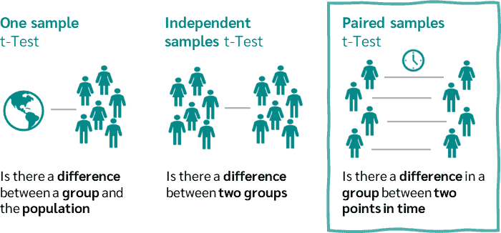

Slide 4
Chapter
Indication of Use
08
We have two samples that are related to each other and one Quantitative continuous variable of interest.
The variable may be measured on each individual in two circumstances.

Slide 5
Chapter
Explaining Example
08
For example, in a cross-over trial, each patient has two measurements on the variable, one while taking active treatment and one while taking a placebo.
Such data are known as paired (Dependent) data.

Slide 6
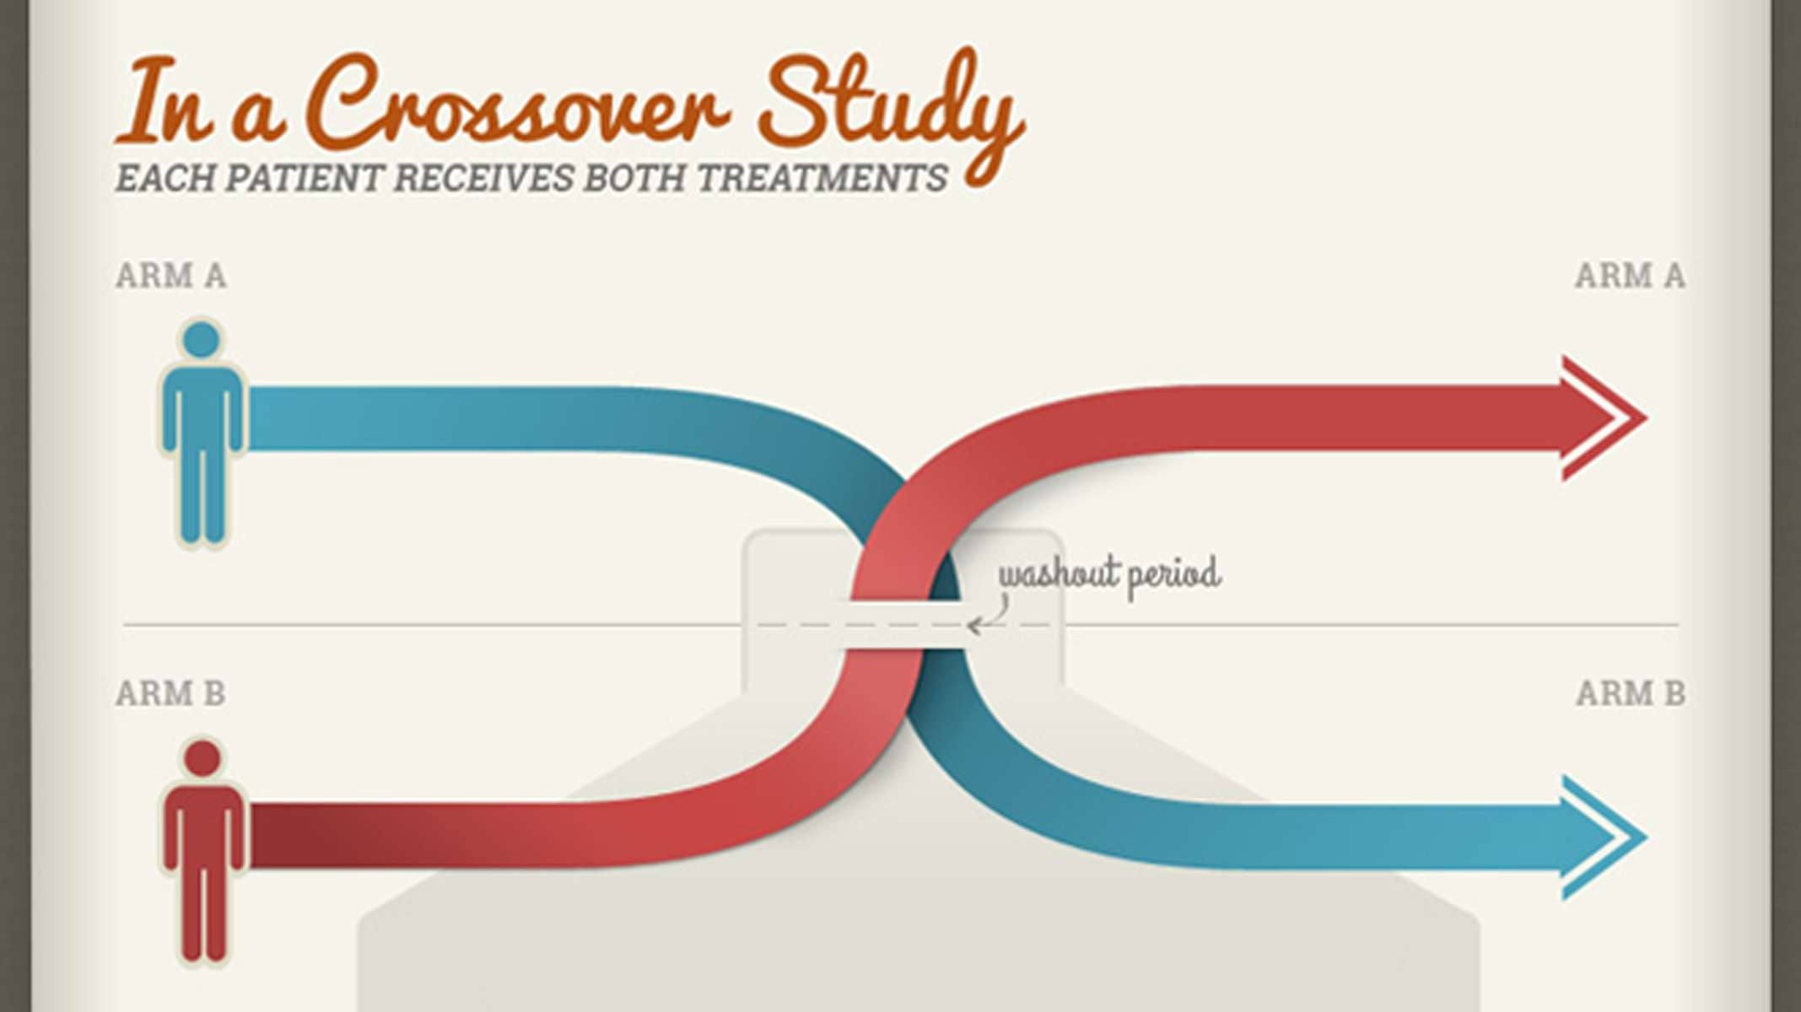

Slide 7

Chapter
Explaining Example
08
Example 2: a researcher is interested in testing the difference in Blood Glucose Level (BGL) for the same group of people after one month and then after two months.

Slide 8

The Hypothesis test that can solve this problem is either (Paired samples) t-test OR Wilcoxon-signed rank test.

Slide 9

I can select either of them based on the Normality status of differences between the repeated measurements.

Slide 10
So, I must first check the Normality of differences between the repeated measurements.

Slide 11
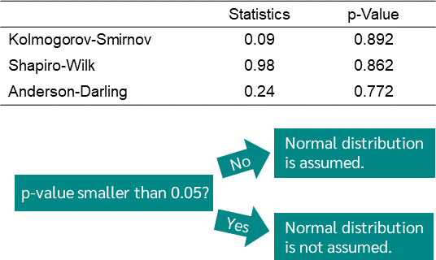

Slide 12
Chapter
The (Paired samples) t-test
08
Assumptions:
Paired Data: Observations in each group are paired in a meaningful way (e.g., measurements before and after a treatment on the same subjects).

Slide 13
Chapter
The (Paired samples) t-test
08
Assumptions:
Continuous Data: The differences between pairs should be continuous.
Normality of Differences: The differences between paired observations are approximately normally distributed.

Slide 14
Chapter
The (Paired samples) t-test
08
Rationale:
The paired samples t-test is designed to test whether the mean difference between paired observations is significantly different from zero.

Slide 15
Chapter
The (Paired samples) t-test
08
Rationale:
Under the alternate hypothesis, the mean difference between the paired observations is significantly different from zero.
This implies that there is a statistically significant difference between the population means of the two paired (related) groups.

Slide 16
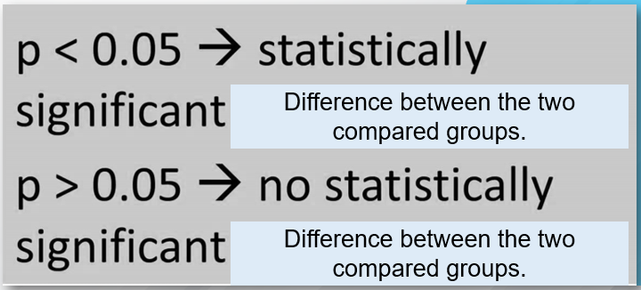
Difference between the compared paired samples data
Difference between the compared paired samples data

Slide 17
Chapter
Conclusion
08
It will be in terms of Mean & SD reporting for each time point measurement.
If P-value < 0.05 so, there is a statistically significant difference between the BGL of patients after one month (Mean= ……., SD= ……..) and their BGL after 3 months (Mean= ……., SD= ……..), (P-value = ……….).

Slide 18
Chapter
Conclusion
08
If P-value > 0.05 so, there is No statistically significant difference between the BGL of patients after one month (Mean= ……., SD= ……..) and their BGL after three months (Mean= ……., SD= ……..), (P-value = ……….).

Slide 19
Chapter
The Wilcoxon-signed rank t-test
08
Rationale:
The Wilcoxon signed-rank test is a non-parametric alternative to the paired samples t-test, used when the data does not meet the normality assumption.

Slide 20
Difference between the compared paired samples data
Difference between the compared paired samples data

Slide 21
Chapter
Conclusion
08
It will be in terms of Median & Range/IQR reporting for each time point measurement.
If P-value < 0.05 so, there is a statistically significant difference between the BGL of patients after one month (Median= ……., Range= ……..) and their BGL after 3 months (Median= ……., Range= ……..), (P-value = ……….).

Slide 22
Chapter
Conclusion
08
If P-value > 0.05 so, there is No statistically significant difference between the BGL of patients after one month (Median= ……., Range= ……..) and their BGL after 3 months (Median= ……., Range= ……..), (P-value = ……….).

Slide 23

Please don’t forget: Before dealing with any Quantitative data, first, test for its normality.

Slide 24
Chapter
Case Scenario (1)
08
Comparing Costs of Medication Management Before and After Centralizing Pharmacy Services:
Scenario: A hospital centralizes its pharmacy services to reduce costs associated with medication management. Monthly medication costs for the same patients are compared for periods before and after centralization.

Slide 25
Chapter
Case Scenario (1)
08
Null Hypothesis (H₀): There is no difference in monthly medication costs before and after centralizing pharmacy services.
Alternative Hypothesis (H₁): There is a difference in monthly medication costs before and after centralizing pharmacy services.

Slide 26
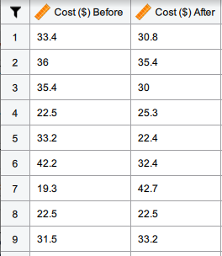

Slide 27


Slide 28
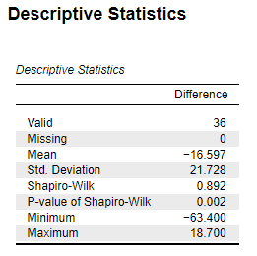

Slide 29
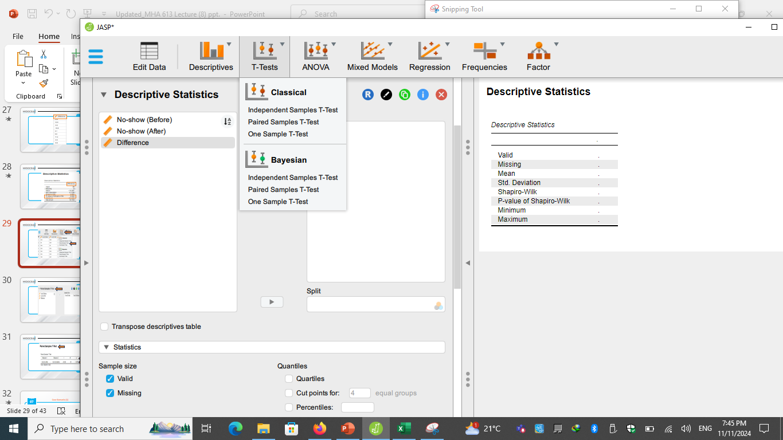

Slide 30
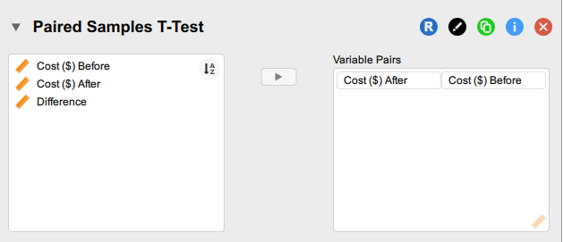

Slide 31
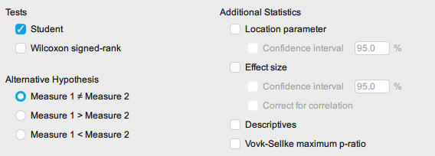

Slide 32
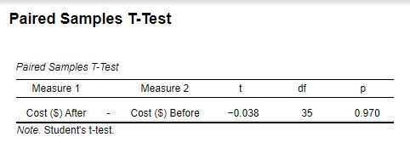

Slide 33
Chapter
Case Scenario (1)
08
With a p-value of 0.970, which is much higher than the typical significance level (0.05), Since the test showed no significant cost reduction, the hospital may re-evaluate centralizing pharmacy services, consider alternative cost-saving strategies, or conduct further analysis to improve the system.

Slide 34
Now, let’s go to the 2nd Case Scenario

Slide 35
Chapter
Case Scenario (2)
08
Evaluating the Impact of a New Digital Appointment Scheduling System on Patient No-Show Rates:
A clinic implements a digital appointment scheduling system designed to reduce patient no-show rates. The no-show rates are measured for the same set of patients before and after the implementation.

Slide 36
Chapter
Case Scenario (2)
08
Null Hypothesis (H₀): There is no difference in patient no-show rates before and after implementing the digital scheduling system.
Alternative Hypothesis (H₁): There is a difference in patient no-show rates before and after implementing the digital scheduling system.

Slide 37
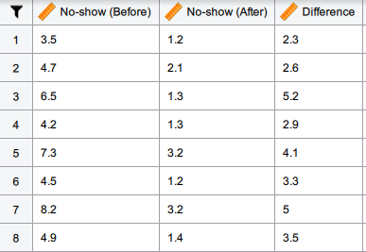

Slide 38
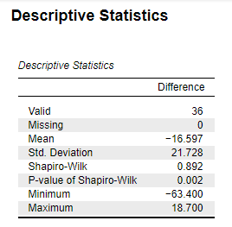

Slide 39
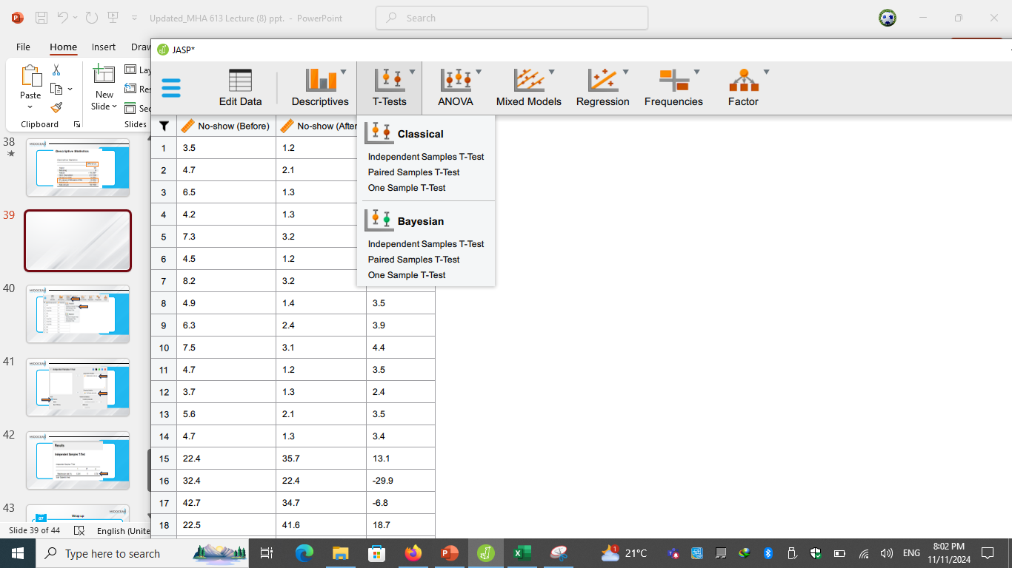

Slide 40
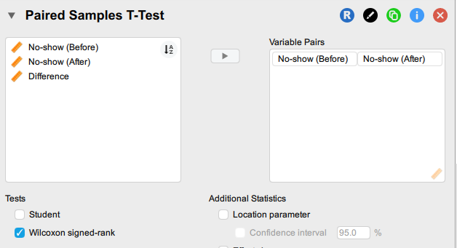

Slide 41
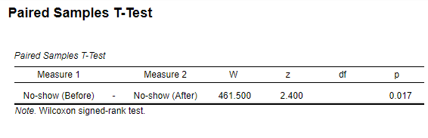

Slide 42
Chapter
Case Scenario (2)
08
With a p-value of 0.017, we reject the null hypothesis, indicating a significant reduction in no-show rates.
The clinic should consider fully adopting the digital scheduling system, as the evidence suggests it effectively reduces patient no-show rates.

Slide 43
Chapter
Wrap up
08
Paired tests like the paired samples t-test or Wilcoxon-signed rank test are essential for comparing dependent data, such as pre- and post-treatment measurements.
Correct test selection (parametric vs. non-parametric) depends on the normality of the data.
Practical applications include scenarios like assessing changes in patient health metrics over time or evaluating healthcare interventions.
Interpreting results with a focus on p-values allows healthcare managers to make data-informed decisions about treatment effectiveness and operational improvements.

Slide 44



Thank You

