Slide 1

MGM603
Managing People and Organizations
Prepared by Dr. Ayman El-Moesrawy
Lecture 6
Motivating Behavior
Part 2

Slide 2

CHAPTER 5
Motivating Behavior (Perspectives on Motivation)
2- Process-Based Perspectives on Motivation
1- The Equity Theory of Motivation
Equity theory | Equity theory: Focuses on people’s desire to be treated with what they perceive as equity and to avoid perceived inequity The equity theory of motivation is based on the relatively simple premise that people in organizations want to be treated fairly The theory defines equity as the belief that we are being treated fairly in relation to others and inequity as the belief that we are being treated unfairly compared with others.

Slide 3
CHAPTER 5
Motivating Behavior (Perspectives on Motivation)
2- Process-Based Perspectives on Motivation
1- The Equity Theory of Motivation
Forming Equity Perceptions | People in organizations form perceptions of the equity of their treatment through a four-step process: First, they evaluate how they are being treated by the firm. Second, they form a perception of how a “comparison-other” is being treated. The comparison-other might be a person in the same workgroup, someone in another part of the organization, or even a composite of several people scattered throughout the organization Third, they compare their own circumstances with those of the comparison-other and then use this comparison as the basis for forming an impression of either equity or inequity. Fourth, depending on the strength of this feeling, the person may choose to pursue one or more of the alternatives

Slide 4

CHAPTER 5
Motivating Behavior (Perspectives on Motivation)
2- Process-Based Perspectives on Motivation
1- The Equity Theory of Motivation
Forming Equity Perceptions | Equity theory describes the equity comparison process in terms of an input-to-outcome ratio. Inputs are an individual’s contributions to the organization—such factors as education, experience, effort, and loyalty. Outcomes are what the person receives in return—pay, recognition, social relationships, intrinsic rewards, and similar things. The equity comparison thus takes the following form:

Slide 5
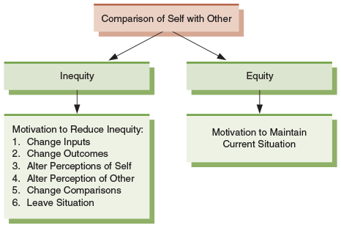
CHAPTER 5
Motivating Behavior (Perspectives on Motivation)
2- Process-Based Perspectives on Motivation
1- The Equity Theory of Motivation
Figure 5.4.
Responses to Perceptions of Equity and Inequity
People form equity perceptions by comparing their situation with that of someone else’s. If they perceive equity, they are motivated to maintain the current situation. If they perceive inequity, they are motivated to use one or more of the strategies shown here to reduce the inequity. ALTER

Slide 6

CHAPTER 5
Motivating Behavior (Perspectives on Motivation)
2- Process-Based Perspectives on Motivation
1- The Equity Theory of Motivation
A key element of equity theory is that people in organizations compare their situations with that of other people. Take these two people, for instance. Each one has an education and experience, and contributes his time, talent, and effort to the company. In return, each gets pay, benefits, others rewards, and various forms of recognition. But if the man standing feels that the man sitting and reviewing his email is being treated better than he is, then he may decide to reduce his contributions to the organization or look for a new job somewhere else.

Slide 7
Motivating Behavior
CHAPTER 5
Motivating Behavior (Perspectives on Motivation)
2- Process-Based Perspectives on Motivation
2- The Expectancy Theory of Motivation
The Basic Expectancy Model | The Expectancy Theory of Motivation: Suggests that people are motivated by how much they want something and the likelihood they perceive of getting it Expectancy theory is a more encompassing model of motivation than equity theory (expectancy theory is also known as VIE theory, for valence–instrumentality–expectancy). Over the years since its original formulation, the theory’s scope and complexity have continued to grow.

Slide 8
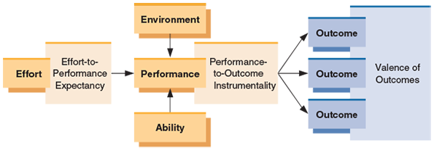
CHAPTER 5
Motivating Behavior (Perspectives on Motivation)
2- Process-Based Perspectives on Motivation
2- The Expectancy Theory of Motivation
Figure 5.5.
The Expectancy Theory of Motivation
The expectancy theory is the most complex model of employee motivation in organizations. As shown here, the key components of expectancy theory are effort-to-performance expectancy, performance-to-outcome instrumentality, and outcomes, each of which has an associated valence. These components interact with effort, the environment, and the ability to determine an individual’s performance.

Slide 9
CHAPTER 5
Motivating Behavior (Perspectives on Motivation)
2- Process-Based Perspectives on Motivation
2- The Expectancy Theory of Motivation
1- Effort-to-Performance Expectancy | Effort-to-performance expectancy is a person’s perception of the probability that effort will lead to successful performance. If we believe our effort will lead to higher performance, this expectancy is very strong, perhaps approaching a probability of 1.0, where 1.0 equals absolute certainty that the outcome will occur. If we believe our performance will be the same no matter how much effort we make, our expectancy is very low—perhaps as low as 0, meaning that there is no probability that the outcome will occur. Ex. Alex Morgan, a star soccer player who believes that when she puts maximum effort, she has a great chance of scoring higher than any opponent, clearly sees a link between her effort and performance.

Slide 10
CHAPTER 5
Motivating Behavior (Perspectives on Motivation)
2- Process-Based Perspectives on Motivation
2- The Expectancy Theory of Motivation
2- Performance-to-Outcome Expectancy | Performance-to-Outcome Expectancy the individual’s perception of the probability that performance will lead to certain outcomes. If a person thinks a high performer is certain to get a pay raise, this expectancy is close to 1.0. At the other extreme, a person who believes raises are entirely independent of performance has an expectancy close to 0. Finally, if a person thinks performance has some bearing on the prospects for a pay raise, his or her expectancy is somewhere between 1.0 and 0. Ex Green Bay Packers quarterback Aaron Rodgers may believe that if he plays aggressively all the time (performance), he has a great chance of leading his team to the playoffs. Playing aggressively may win him individual honors like the Most Valuable Player award, but he may also experience more physical trauma and throw more interceptions.

Slide 11
CHAPTER 5
Motivating Behavior (Perspectives on Motivation)
2- Process-Based Perspectives on Motivation
2- The Expectancy Theory of Motivation
3- Outcomes and Valences | An outcome is anything that might potentially result from performance. High-level performance conceivably might produce such outcomes as a pay raise, a promotion, recognition from the boss, stress, fatigue, or less time to rest, among others.. The valence of an outcome is the relative attractiveness or unattractiveness—the value—of that outcome to the person. Pay raises, promotions, and recognition might all have positive valences, whereas, stress, and less time to rest might all have negative valences.

Slide 12
CHAPTER 5
Motivating Behavior (Perspectives on Motivation)
2- Process-Based Perspectives on Motivation
2- The Expectancy Theory of Motivation
The basic expectancy framework suggests that three conditions must be met before motivated behavior occurs:
First, the effort-to-performance expectancy must be well above zero. That is, the worker must reasonably expect that exerting effort will produce high levels of performance.
Second, the performance-to-outcome expectancies must be well above zero. In other words, the person must believe that performance will realistically result in valued outcomes.
Third, the sum of all the valences must be well above zero as long as the positives outweigh the negatives.
For example, stress and fatigue may have moderately negative valences, but if pay, promotion, and recognition have very high positive valences, the overall valence of the set of outcomes associated with performance will still be positive.

Slide 13
CHAPTER 5
Motivating Behavior (Perspectives on Motivation)
2- Process-Based Perspectives on Motivation
2- The Expectancy Theory of Motivation
2- The Porter–Lawler Model | The Porter–Lawler model appears in Figure 5.6. Some of its features are quite different from the original version of expectancy theory. For example, the extended model includes abilities, traits, and role perceptions. At the beginning of the motivational cycle, effort is a function of the value of the potential reward for the employee (its valence) and the perceived effort-reward probability (an expectancy). Effort then combines with abilities, traits, and role perceptions to determine actual performance.

Slide 14
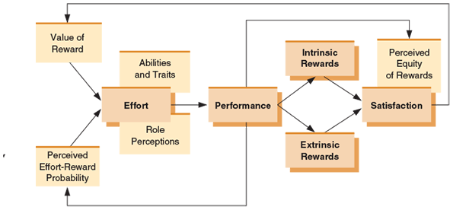
CHAPTER 5
Motivating Behavior (Perspectives on Motivation)
2- Process-Based Perspectives on Motivation
2- The Expectancy Theory of Motivation
Figure 5.6. The Porter-Lawler Model
The Porter and Lawler expectancy model provides interesting insights into the relationships between satisfaction and performance. As illustrated here, this model predicts that satisfaction is determined by the perceived equity of intrinsic and extrinsic rewards for performance. That is, rather than satisfaction causing performance, which many people might predict, this model argues that it is actually performance that eventually leads to satisfaction.

Slide 15
Thanks

