Slide 2
Contents
Why study Boolean Algebra?
Binary Logic and Gates
Boolean Algebra
Canonical and Standard Forms

Slide 3
Explanatory Example
It is required to design a simple system to control a lamp at a room. The lamp should go on when there is someone in the room and we are at night. Else, if we are in the morning or no one in the room the lamp should go off.
Solution\Steps:
  Truth tables are used to represent the requirements for the system to be designed. It clarifies what is the desired output for the different states of the inputs.
  From the truth table we can define the Boolean equation, simplify it (using Boolean algebra) then describe the logic diagram (implementation)

Slide 4
Explanatory Example
Solution:
We have two inputs and one output to control the lamp:
X = 1 when someone in the room
0 otherwise
Y = 1 in the morning
0 at night
Truth table
X
Y
Z
0
0
0
0
1
0
1
0
1
1
1
0

Slide 5
Canonical Forms
There are Two methods to form Boolean functions from truth table:
  1) Sum of minterms
  2) Product of maxterms
  which called canonical forms.

Slide 6
Explanatory Example
It is required to design a simple system to control a lamp at a room. The lamp should go on when there is someone in the room and we are at night. Else, if we are in the morning or no one in the room the lamp should go off.
Solution\Steps:
  Truth tables are used to represent the requirements for the system to be designed. It clarifies what is the desired output for the different states of the inputs.
  From the truth table we can define the Boolean equation, simplify it (using Boolean algebra) then describe the logic diagram (implementation)

Slide 7
Explanatory Example
Solution:
We have two inputs and one output to control the lamp:
X = 1 when someone in the room
0 otherwise
Y = 1 in the morning
0 at night
Truth table
X
Y
Z
0
0
0
0
1
0
1
0
1
1
1
0

Slide 8
What is Minterm?
Minterms are AND terms with every variable present in either true or complemented form (standard product term)
Given that each binary variable may appear normal (e.g., x) or complemented (e.g., x’ ), there are 2^{n} minterms for n variables.
Example: Two variables (X and Y)produce
2 ² = 4 combinations:
  (both normal)
  (X normal, Y complemented)
  (X complemented, Y normal)
  (both complemented)
Thus there are four minterms of two variables.

Slide 9
What is Maxterm?
Maxterms are OR terms with every variable in true or complemented form. (standard sum term)
Given that each binary variable may appear normal (e.g., x) or complemented (e.g., x’), there are 2^{n} maxterms for n variables.
Example: Two variables (X and Y) produce
2 ² = 4 combinations:
  (both normal)
  (x normal, y complemented)
  (x complemented, y normal)
  (both complemented)

Slide 10
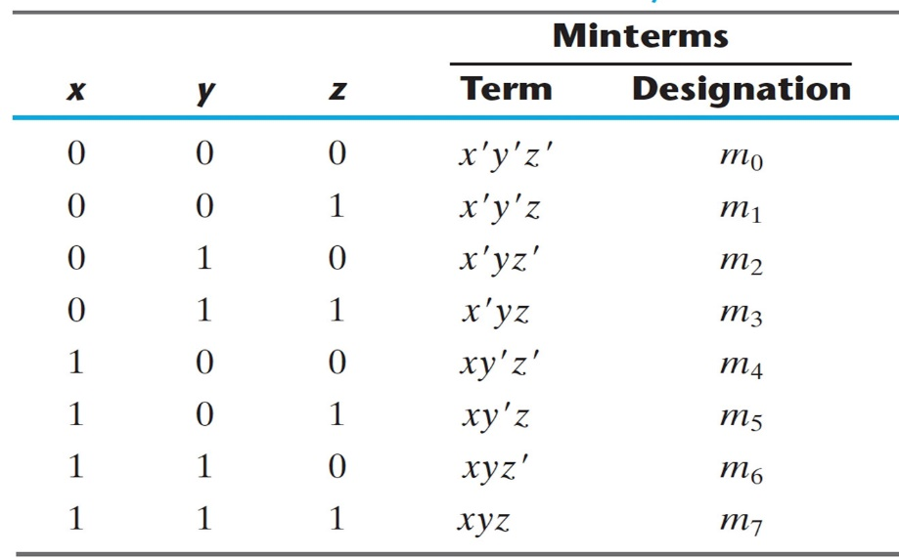
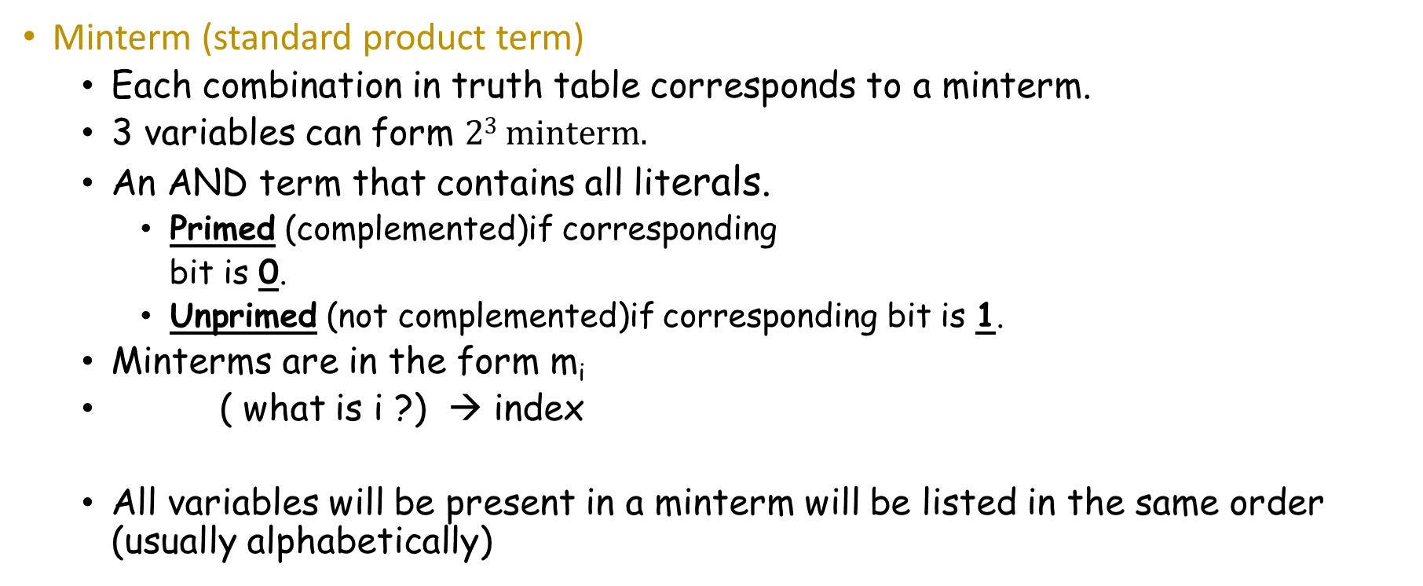
3 variables Minterm?
Minterm (standard product term)
  Each combination in truth table corresponds to a minterm.
  3 variables can form $23 minterm.$
  An AND term that contains all literals.
    Primed (complemented)if corresponding
    bit is 0.
    Unprimed (not complemented)if corresponding bit is 1.
  Minterms are in the form m_{i}
  ( what is i ?) → index
  All variables will be present in a minterm will be listed in the same order (usually alphabetically)

Slide 11
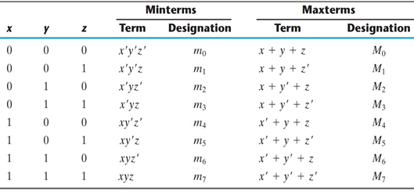
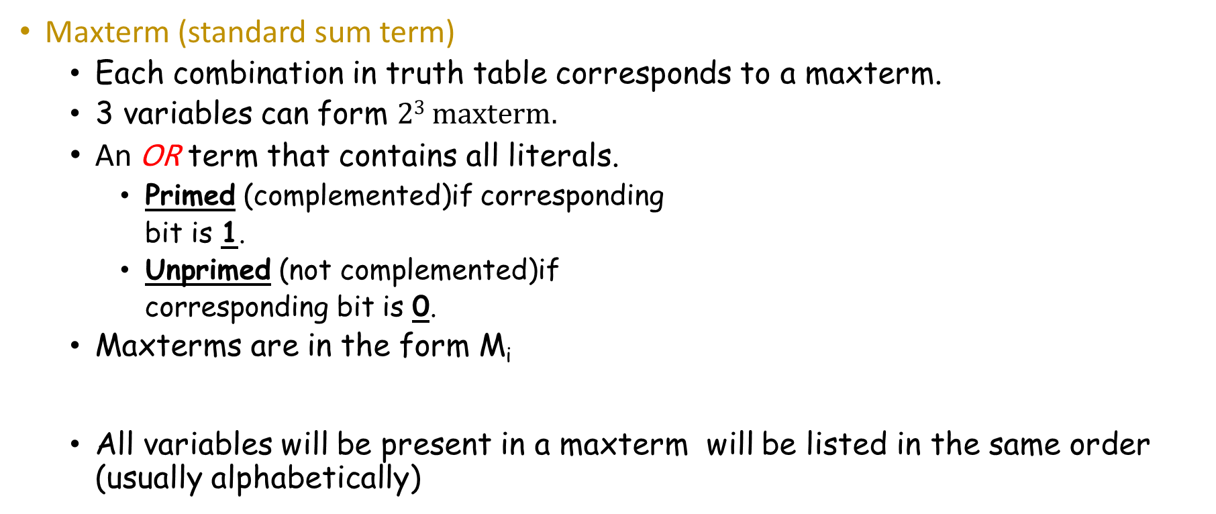
3 variables Maxterm
Maxterm (standard sum term)
  Each combination in truth table corresponds to a maxterm.
  3 variables can form $23 maxterm.$
  An OR term that contains all literals.
    Primed (complemented)if corresponding
    bit is 1.
    Unprimed (not complemented)if
    corresponding bit is 0.
  Maxterms are in the form M_{i}
  All variables will be present in a maxterm will be listed in the same order (usually alphabetically)

Slide 12
M and m Relationship
Each maxterm is the complement of its corresponding minterm, and vice versa
m_{n} ‘ = M_{n} and Vice Versa
For example:
  000 = X’ Y’ Z’ -→ m₀ → m₀’ = (X’ Y’ Z’)’ = X + Y + Z =M₀
  001 = X’ Y’ Z -→ m₁ → m₁’ = (X’ Y’ Z)’ = X + Y + Z’ =M₁
  010 = X’ Y Z’ -→ m₂ → m₂’ = (X’ Y Z’)’ = X + Y’ + Z =M₂
  011 = X’ Y Z -→ m₃ → m₃’ = (X’ Y Z)’ = X + Y’ + Z’ = M₃
  100= X Y’ Z’ -→ m₄ → m₄’ = (X Y’ Z’)’ = X’ + Y + Z = M₄
  101 = X Y’ Z -→ m₅ → m₅’ = (X Y’ Z)’ = X’ + Y + Z’ = M₅
  110 = X Y Z’ -→ m₆ → m₆’ = (X Y Z’)’ = X’ + Y’ + Z = M₆
  111 = X Y Z -→ m₇ → m₇’ = (X Y Z)’ = X’ + Y’ + Z’= M₇

Slide 13
Minterm/Maxterm– Four Variables
Index Binary Minterm Maxterm
i abcd m_{i} M_{i}
0 0000 a’ b’ c’ d’ a+b+c+d
1 0001 a’ b’ c’ d a+b+c+d’
3 0011
5 0101
7 0111
10 1010
13 1101
15 1111
Notes:
M1 = a + b + c + d’
m3 = a’ b’ c d
m7 = a’ b c d
M 13 = a’ + b’ + c + d’

Slide 14
Canonical Forms
A Boolean function expressed algebraically can be written in two ways canonical form.
Canonical forms express all binary variables in every product (AND) or sum (OR) term of the Boolean function. There are two types of canonical form: Sum of Minterms and Product of Maxterms

Slide 15
Canonical Forms - SoM
Sum of Minterms (SoM)
  Given a truth table, a Boolean function can be expressed as sum of minterms by:
    Forming a minterm for each combination of the variables that produces a 1 in the function and then taking the OR of all terms.

Slide 16
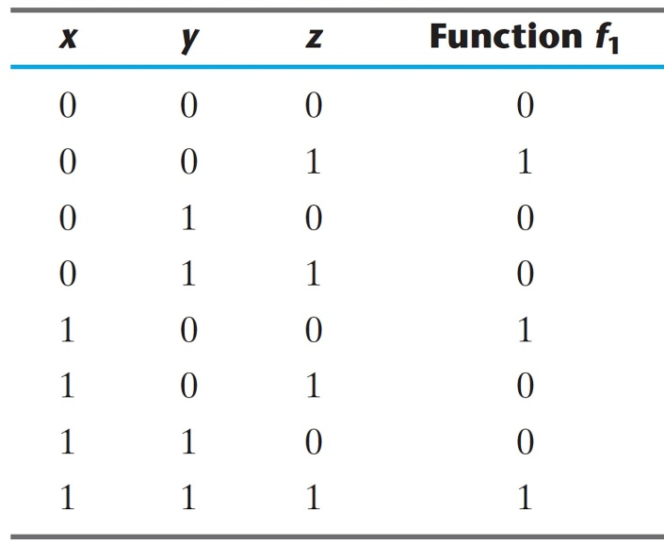
Canonical Forms - SoM
  Example:
  Given the truth table, express f₁ as SoM
  f1 = x'y'z + xy'z' + xyz ← SoM Form
  = m1 + m4 + m7
  f1(x,y,z)=Σ(m1,m4,m7) ← Shorthand SoM Form
x'y'z
xy'z'
xyz

Slide 17
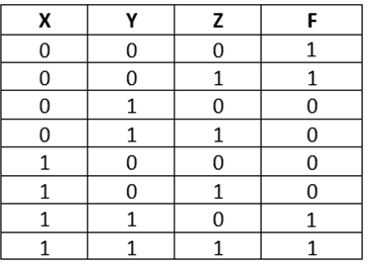
Exercise1:
Example: Find F₁ = m₀ + m₁ + m₆+ m₇
F = x’ y’ z’+ x’ y’ z + x y z’ + x y z
Exercise 2:
F(A, B, C, D) = m₂ + m₉ + m₁₁ + m₁₄
F(A, B, C, D) = A’B’CD’ + AB’C’D + AB’CD + ABCD’

Slide 18
Canonical Forms - PoM
Product of Maxterms (PoM)
  Given a truth table, a Boolean function can be expressed as product of maxterms by:
  Forming a maxterm for each combination of the variables that produces a 0 in the function and then taking the AND of all those terms.
  Forming minterms of the complement of the function and then take the complement.

Slide 19
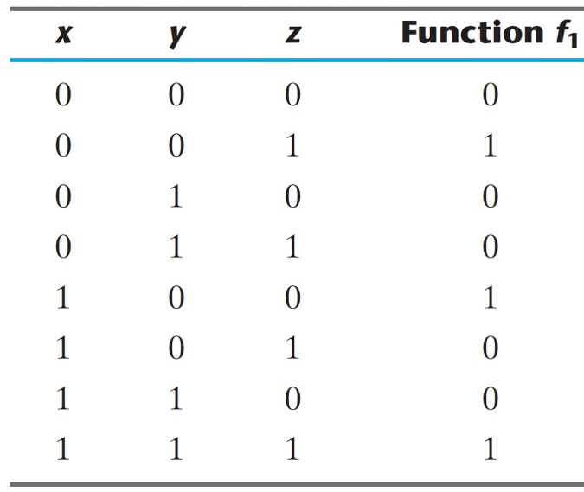
Canonical Forms - PoM
  Example
Given the truth table, express F1 as PoM
  f1 = (x+y+z)(x+y'+z) (x+y'+z') (x'+y+z')(x'+y'+z)
  = M0. M2. M3 .M5. M6 ← PoM Form
  f1(x,y,z)=∏(M0,M2,M3,M5,M6) ← Shorthand SoM Form
M₀
M₁
M₂
M₃
M₄
M₅
M₆
M₇

Slide 20
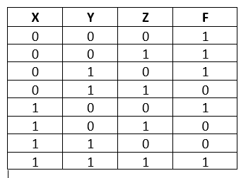
Exercise1:
Example: Find F₁ = M₃ . M₅ . M₆
F1 = (X+Y’+Z’).(X’+Y+Z’).(X’+Y’+Z)
Exercise 2:
F(A, B, C, D) = M₃ . M₈ . M₁₁ . M₁₄
F(A, B, C, D) = (A+B+C’+D’).( A’+B+C+D).(A’+B+C’+D’).(A’+B’+C’+D)

Slide 21
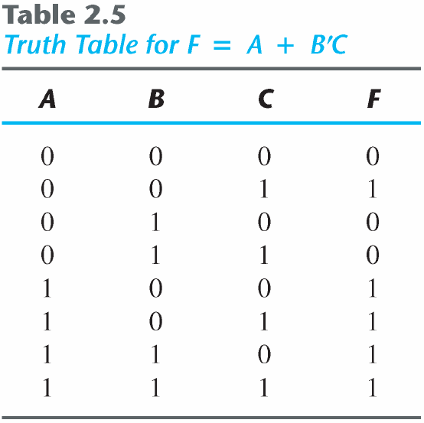
Canonical Forms-SoM
Example
Express F = A+B'C as a sum of minterms.
1) Algebraically
  F = A+B’C
  = A (B+B') + B'C = AB +AB' + B' C
  = AB(C+C') + AB'(C+C') + (A+A')B’C
  = ABC+ABC'+AB'C+AB'C'+A'B'C
  2) Using TT
Build the truth table
  Choose the minterms where F equals to 1.
  Sum them together.
  = m₁+m₄+m₅+m₆+ m₇
  F= Ʃ(1, 4, 5, 6, 7)
A'B'C
AB'C'
AB'C
AB'C
ABC

Slide 22
Example
Express F = A+B'C as a sum of minterms.
1) Algebraically
  F = A+B’C
  = A (B+B') + B'C = AB +AB' + B' C
  = AB(C+C') + AB'(C+C') + (A+A')B’C
  = ABC+ABC'+AB'C+AB'C'+A'B'C
  2) Using TT
Build the truth table
  Choose the minterms where F equals to 1.
  Sum them together.
  = m₁+m₄+m₅+m₆+ m₇
  F= Ʃ(m1, m4, m5, m6, m7)
A'B'C
AB'C'
AB'C
AB'C
ABC

Slide 23
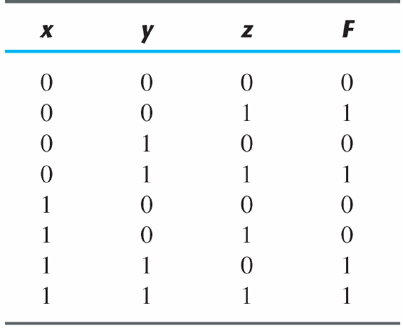
Conversion Between Canonical Forms
To convert from one canonical form to another, interchange the Symbols Ʃ and ∏ and list missing numbers from the original form.
Example: Consider the function F = xy + x′z
  F(x, y, z) = Ʃ(1, 3, 6, 7) → SoM
  F(x, y, z) = ∏ (0, 2, 4, 5) →PoM

Slide 24
Function Complements … cont..
The complement of a function expressed as a sum of minterms is constructed by selecting the minterms missing in the sum-of-minterms canonical forms.
Alternatively, the complement of a function expressed by a Sum of Minterms form is simply the Product of Maxterms with the same indices.
Example: Given F(X,Y,Z) = Σ 1,3, 5,7
F’ (X,Y,Z) = Σ 0,2,4,6
F’ (X,Y,Z) = ∏ 1,3,5,7

Slide 25
Function Complements
The complement of a function expressed as a product of Maxterms is constructed by selecting the Maxtrems missing in the maxterm canonical forms.
Alternatively, the complement of a function expressed by a product of Maxterms form is simply the sum of Minterms with the same indices.
Example: Given F(X,Y,Z) = ∏ 1,3, 5,7
F’ (X,Y,Z) = ∏ 0,2,4,6
F’ (X,Y,Z) = ∑ 1,3,5,7

Slide 26
Standard Forms
In both canonical forms, each minterm or maxterm must contain, by definition, all the variables, either complemented or uncomplemented.
Another way to express Boolean functions is in standard form. Where the terms that form the function may contain any number of literals.
There are two types of standard forms:
  Sum of Products (SoP):
    a Boolean expression containing AND terms, called product terms.
    The sum denotes the Oring of these terms. Example: F₁ = y' + xy+ x'yz'
    Represented by a group of AND gates followed by a single OR gate

Slide 27
Standard Forms
  Product of Sums (PoS):
    A Boolean expression containing OR terms, called sum terms.
    The product denotes the Anding of these terms.
    Example: F₂ = x(y'+z)(x'+y+z’)
    Represented by a group of OR gates followed by a single AND gate

Slide 28
Standard Forms
Standard Sum-of-Products (SoP) form: equations are written as an OR of AND terms
Standard Product-of-Sums (PoS) form: equations are written as an AND of OR terms
Examples:
  SOP: ABC+A’B’C+B
  POS: (A+B).(A+B+C).C
These “mixed” forms are neither SOP nor POS
  (AB+C)(A+C)
  ABC’+AC(A+B)
Notes:
Product of Sums
Another standard form of expressing Boolean functions algebraically is the product of sums. This form is obtained by forming a logical product of sum terms. Each logical sum term may have any number of distinct literals.

Slide 29
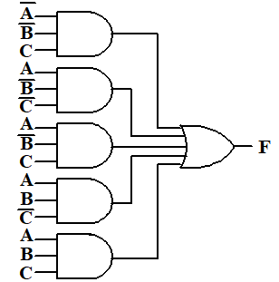
Canonical(SoM) Vs. Standard (SoP)
What is the difference between SoM and SoP?
F(A,B,C)= Ʃ (1,4,5,6,7)
Writing the minterm expression (SoM):
F= A’B’C+AB’C’+AB’C+ABC’+ABC
Simplifying to (SoP):
F=B’C+A
SoM
The two implementations for F are shown here – it is quite apparent which is simpler!
SoP
Notes:
F = A’ B’ C + A (B’ C’ + B C’ + B’ C + B C)
= A’ B’ C + A (B’ + B) (C’ + C)
= A’ B’ C + A.1.1
= A’ B’ C + A
=(A+A’)*(B’C + A) --? By applying rule 15 where A is x, y is A’, and z=B’c
= B’C + A
---------------
What is the difference between SOM and SOP?
The sum-of-minterms form is a standard algebraic expression that is obtained directly from a truth table.
Once the sum of minterms is obtained from the truth table, the next step is to try to simplify the expression to see whether it is possible to reduce the number of product terms and the number of literals in the terms. The result is a simplifed expression in sum-of-products form.

Slide 30
SoM and SoP Observations
The previous examples show that:
  Simplified F (SoP) contains 3 literals compared to contains 15 in minterm F (SoM)
  Canonical Forms (Sum-of-minterms), or other standard forms (SoP, PoS) differ in complexity
  Boolean algebra can be used to manipulate equations into simpler forms.
  Simpler equations lead to simpler two-level implementations

Slide 31
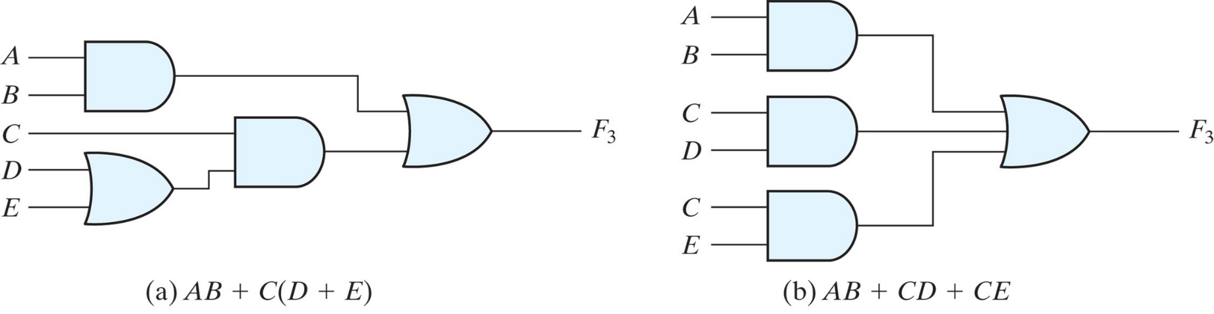
Non standard form
Example:
F=AB +C (D+E)
  It can be changed to a standard form by using distributive law.
  F = AB + CD + CE

Slide 32
Exercises
Convert each of the following to the other canonical form:
  F(x,y,z ) = Σ (2,5,6)
  F(A.B.C,D) = Π(0,1,2,4, 7, 9,12)
Solution:
1. F(x,y,z ) = Π (0,1,3,4,7)
2. F(A.B.C,D) = Σ(3,5, 6, 8, 10,11,13,14,15)

Slide 33
Exercises
Express the following function as a sum of minterms and as a product of maxterms:
F(A ,B,C) = B’.C + A’.C
Solution:
Using Boolean Algebra;
  F = (A + A’). B’.C + (B + B’). A’.C
  F = A.B’.C + A’.B’.C + A’.B.C + A’.B’.C
  F= A’.B’.C + A’.B.C + A.B’.C = ∑m₁, m₃, m₅ (Sum of Minterms)
  F = ∏M₀,M₂,M₄,M₆,M₇ (Product of Maxterms)

Slide 34
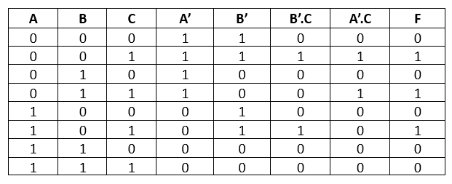
F(A ,B,C) = B’.C + A’.C
Solution:
Using Truth Table (TT) :
F= ∑m₁, m₃, m₅
F= ∏M0,M2,M4,M6,M7

Slide 35
Exercises
Express the following function as a Product of maxterms and as a sum of minterms:
F(X ,Y,Z) = (X’+ Y)(X + Z)
Solution:
Using Boolean algebra
F = (x’ + y + z.z’). (x + z + y.y’)
= (x’ + y + z)(x’ + y + z’) (x + y + z)(x + y’ + z)
=(x + y + z)(x + y’ + z) (x’ + y + z)(x’ + y + z’)
= M₀.M_{2.}M₄.M₅ ₌ ∏M0,M2,M4,M5 (PRODUCT OF Maxterms)
= ∑m1, m3, m6, m7 (Sum of Minterms)

Slide 36
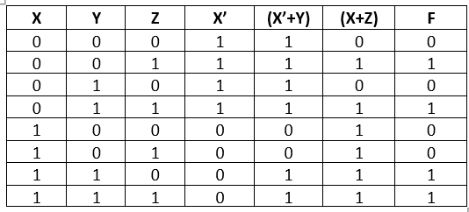
Exercises
Express the following function as a Product of maxterms and as a sum of minterms:
F(X ,Y,Z) = (X’+ Y)(X + Z)
Solution:
Using Truth Tables (TT)
F= ∏M0,M2,M4,M5
F = ∑m1, m3, m6, m7

Slide 37
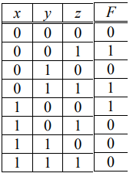
Exercises:
Given the function as defined in the truth table, express F using sum of minterms and product of maxterms, and express F ' using sum of minterms and product of maxterms.
Solution
F = m1 + m3 + m4
= Σ(1, 3, 4)
= x' y' z + x' y z + x y' z’
F = M0 • M2 • M5 • M6 • M7
= Π(0, 2, 5, 6, 7)
= (x + y + z) (x + y' + z) (x' + y + z') (x' + y' + z) (x' + y' + z')

Slide 38

Exercises:
Given the function as defined in the truth table, express F using sum of minterms and product of maxterms, and express F ' using sum of minterms and product of maxterms.
Solution
F ' as sum of 0-minterms:
F ' = m0 + m2 + m5 + m6 + m7
= Σ(0, 2, 5, 6, 7)= x' y' z' + x' y z' + x y' z + x y z' + x y z
F ' as product of 1-maxterms:
F ' = M1 • M3 • M4 = Π(1, 3, 4) = (x + y + z') (x + y' + z') (x' + y + z)

Slide 39
Exercises
Express the following Boolean function in a nonstandard form:
F(x,y,z) = x.y + x.z + y.z
Solution:
F = x y + (x + y) z
or = x (y + z) + y z =
or = x z + y (x + z)

Slide 40
End of Chapter 4

