Slide 1





Financial Management
Prepared by Dr. Mohamed Hamouda
Lecture 1
Introduction to financial Management

Slide 2


Introduction to the course

Slide 3
Learning Platform
IT MUST be checked frequently
Include All course material and information
  Lectures’ Videos and PDF/PPT files
  Course grades distribution
  Quizzes/Assignments/Exams Dates
  Regulations for accepted excuses
  Zoom weekly meeting link (same link is used for all meetings)

Slide 4

References

Slide 5

Brief Description of The Course
The focus of this course is in the area of financial management. We will show managers how to interface with accounting and finance departments, help them to understand how firms meet their financial objectives utilizing financial decision-making. This course will also explain financial tools and techniques, which can be used to help firms maximize value by improving decisions relating to capital budgeting, capital structure, and working capital management. This course will deal with a number of related topics, including multinational financial management, risk management, mergers and acquisitions.

Slide 6

Topics
▪ Financial Statements
▪ Investing and Financing Decisions
▪ Operating Decisions and the Income Statement
▪ Communicating and Interpreting Accounting Information
▪ Cost of Goods Sold and Inventory
▪ Property, Plant, and Equipment Natural Resources
▪ Reporting and Interpreting Liabilities
▪ Reporting and Interpretation

Slide 7

Course Learning Outcomes
▪ This course will enable the students to combine practice and theoretical knowledge
of financial accounting.
▪ The students of this course will be active learners and develop awareness of emerging
trends in financial accounting.
▪ The course will provide decision making skills to the students in the financial analysis
context.
▪ The students of this course will have the ability to identify and analyze financial
accounting problems and opportunities in real life situations.

Slide 8

Lecture one agenda
Describe the primary forms of business organization.
Identify the users and uses of accounting information.
Explain the three principal types of business activity.
Describe the content and purpose of each of the financial statements.
Explain the meaning of assets, liabilities, and stockholders’ equity, and state the basic accounting equation.
Describe the components that supplement the financial statements in an annual report.

Slide 9
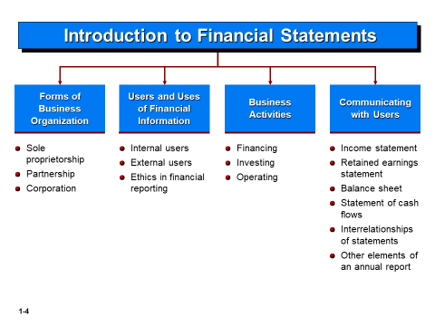

Introduction to Financial Statements

Slide 10
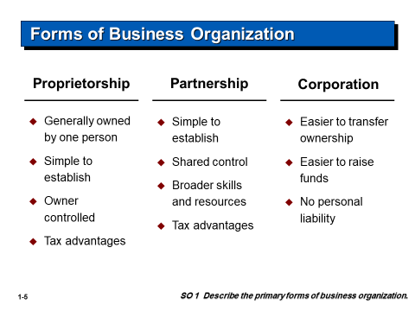
Forms of Business Organization

Slide 11
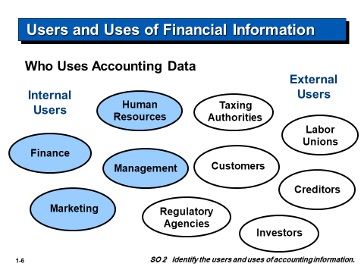
Users and Uses of Financial Information

Slide 12
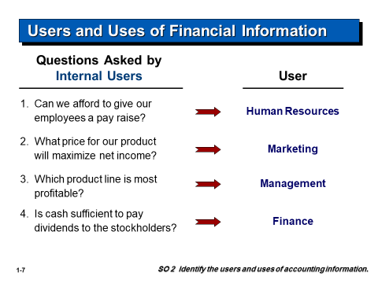
Users and Uses of Financial Information

Slide 13
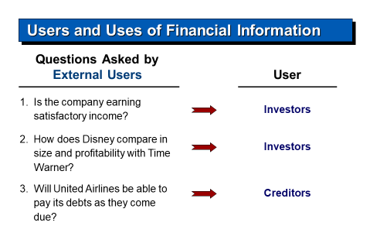
Users and Uses of Financial Information

Slide 14
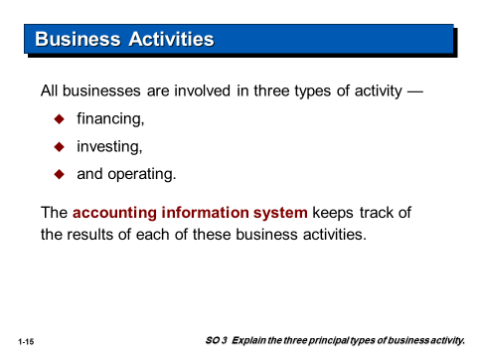
Business Activities

Slide 15
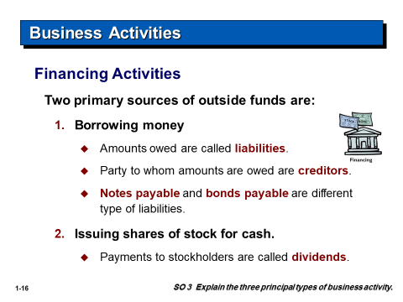
Business Activities

Slide 16
Business Activities

Slide 17
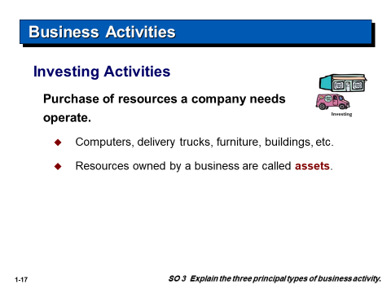
Business Activities

Slide 18
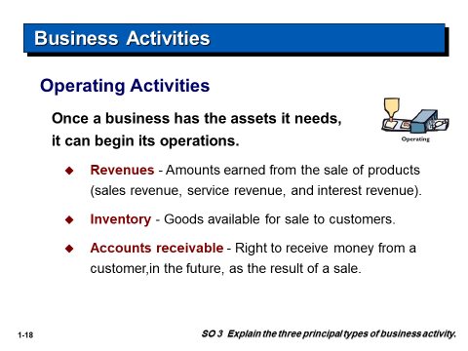
Business Activities

Slide 19
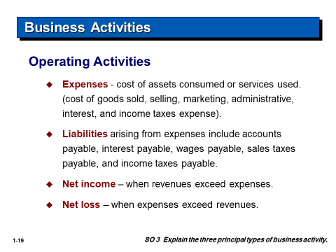
Business Activities

Slide 20
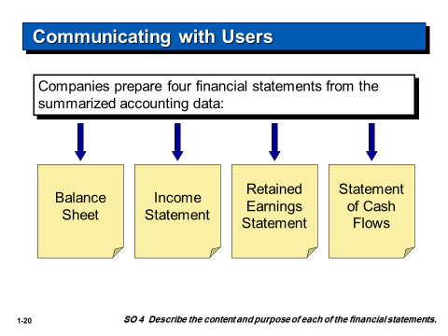
Communicating with Users

Slide 21
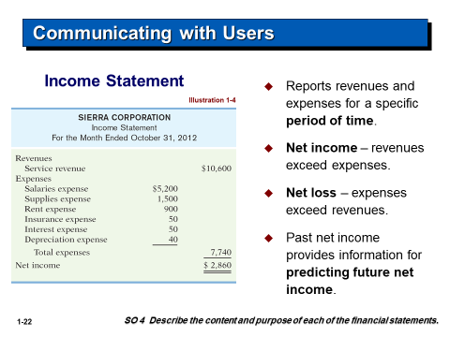
Communicating with Users

Slide 22
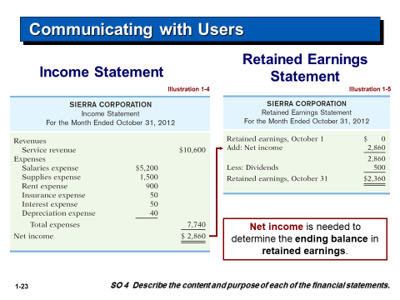
Communicating with Users

Slide 23
Communicating with Users

Slide 24
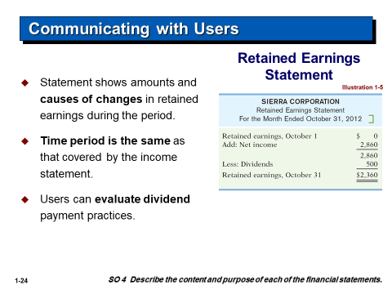
Communicating with Users

Slide 25
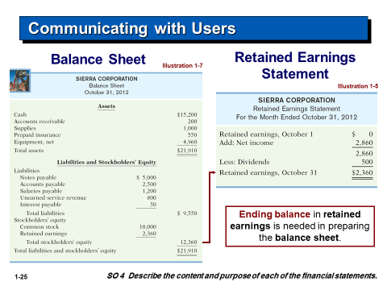
Communicating with Users

Slide 26
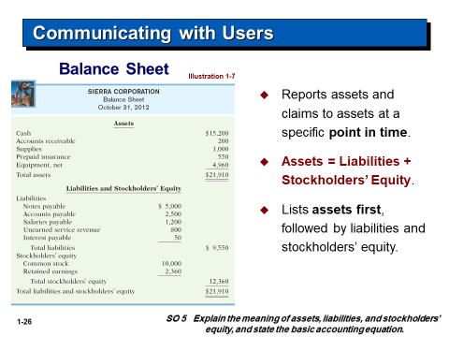
Communicating with Users

Slide 27
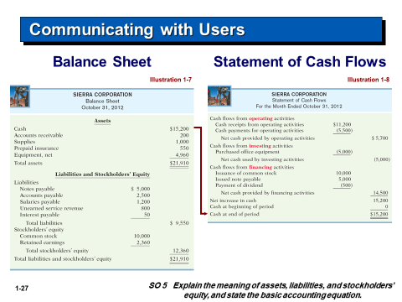
Communicating with Users

Slide 28
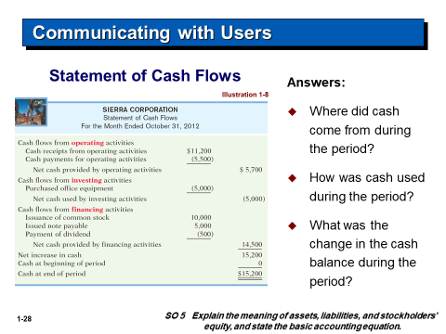
Communicating with Users

Slide 29
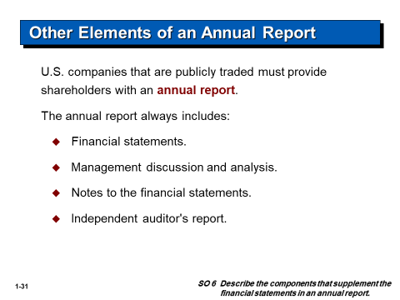
Other Elements of an Annual Report

Slide 30
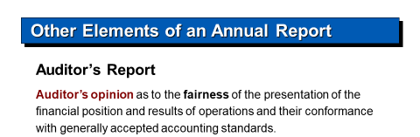
Other Elements of an Annual Report

